Slide 1
Low-Fi Prototyping

Slide 2
An important story
As we grow older and move out of our homes, our parents grow older too.
At home. Alone.
Watching our loved ones age from afar is difficult, especially when they live by themselves. Will someone be there to call 9-1-1 for your mother in a medical emergency? How will you know when an intruder breaks into their home?
The truth is, you won’t know.

Slide 3
Our Mission
Simple
A Usense watch tracks the user’s health and location, and a family member monitors the user through the smartphone application.
Intuitive
Usense users can contact emergency services with the push of a button, and loved ones are instantly alerted when a medical or safety emergency arises.
Safe
Usense empowers personal care between distant family members.
Notes:
monitoring to families. to help connect everyday people with their loved ones and bridge the distance barrier. Usense gives users and their family members a sense of security with an intuitive and easy to use interface, connecting younger generations
Location support/Phone Call Support
Ideas I want to get across:
All it takes is a phone and usense watch
Tells you the things you want to know, cuts out the crap
Simple

Slide 4
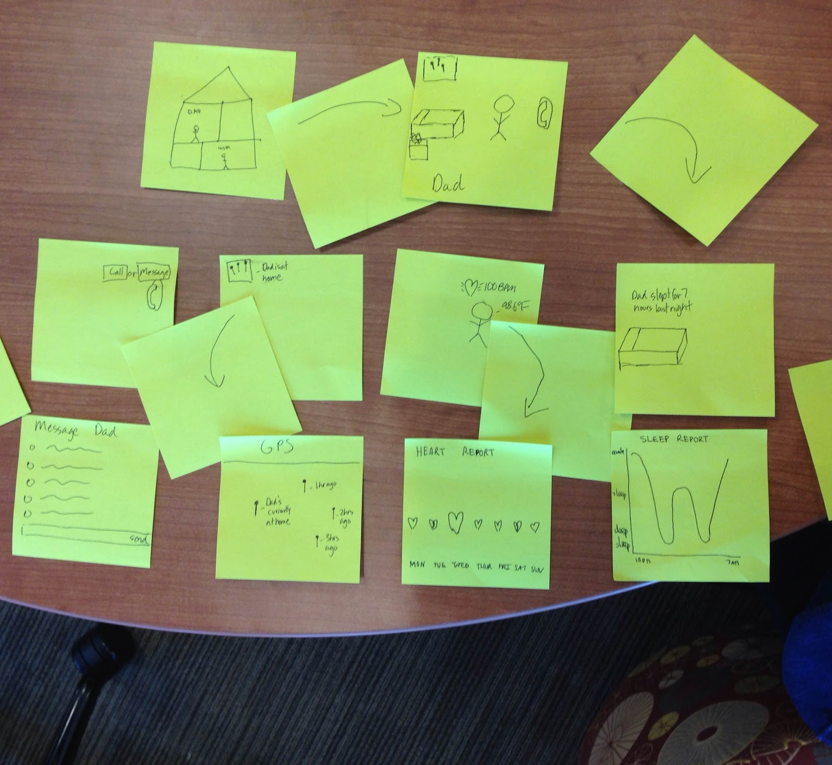
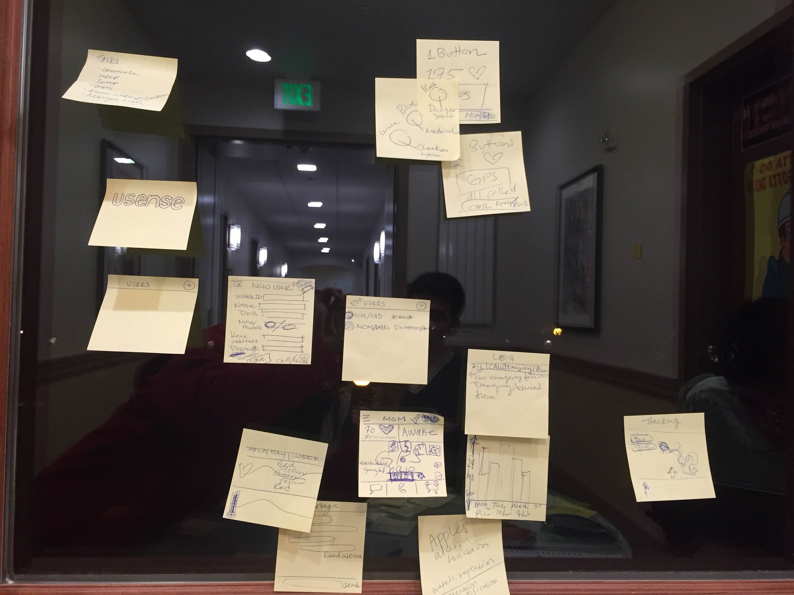
Two different UIs

Slide 5
Selected Interface
Displays all monitored health information on landing screen.
Implements familiar UI from Apple’s messaging, phone, and alarm functions.
Familiarity is key in the UI of a safety app.
The other Tamagotchi UI denoted a misleading owner-to-pet relationship, while this UI enables a loved-one-to-loved-one relationship.

Slide 6
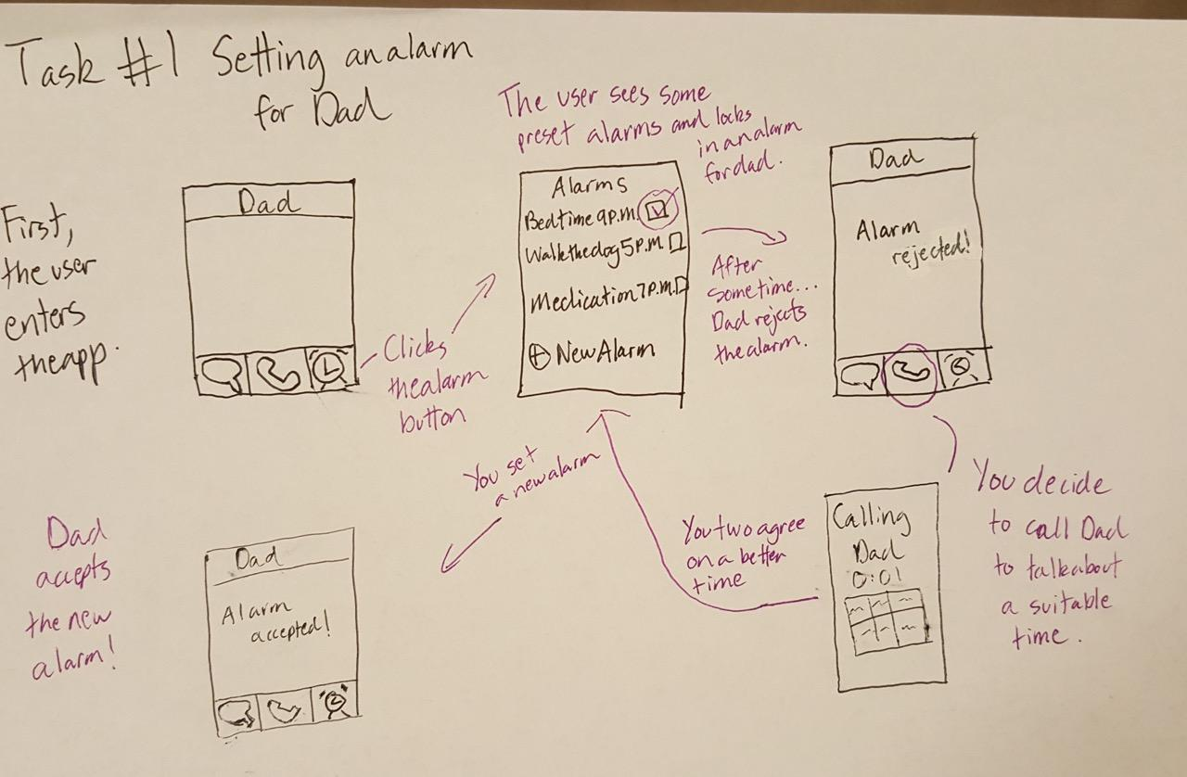

Slide 7
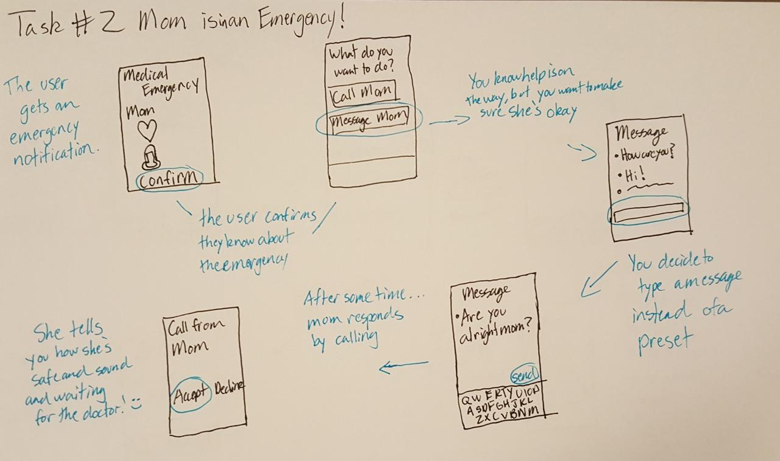
Task 2

Slide 9
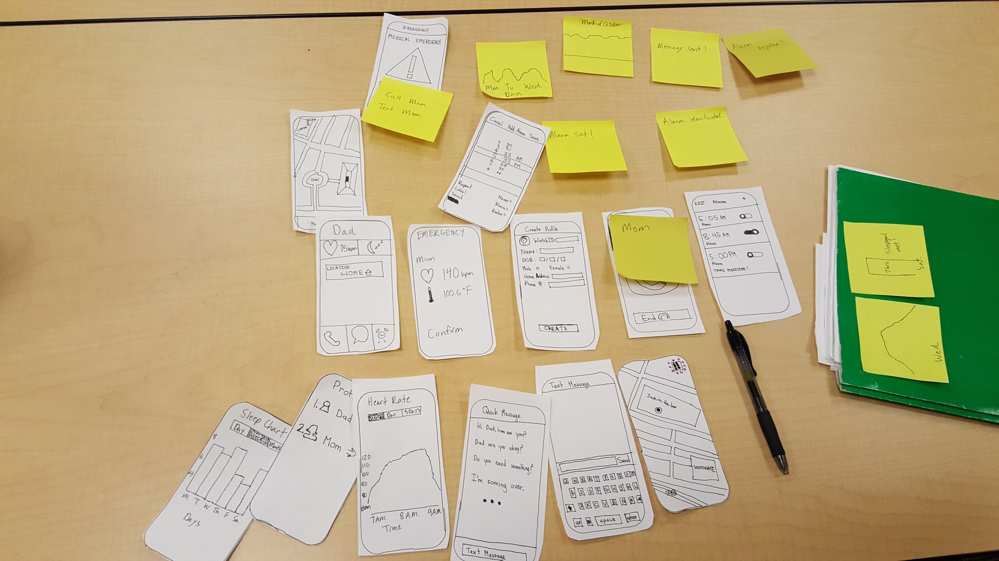
Low-fi Prototype Structure

Slide 10
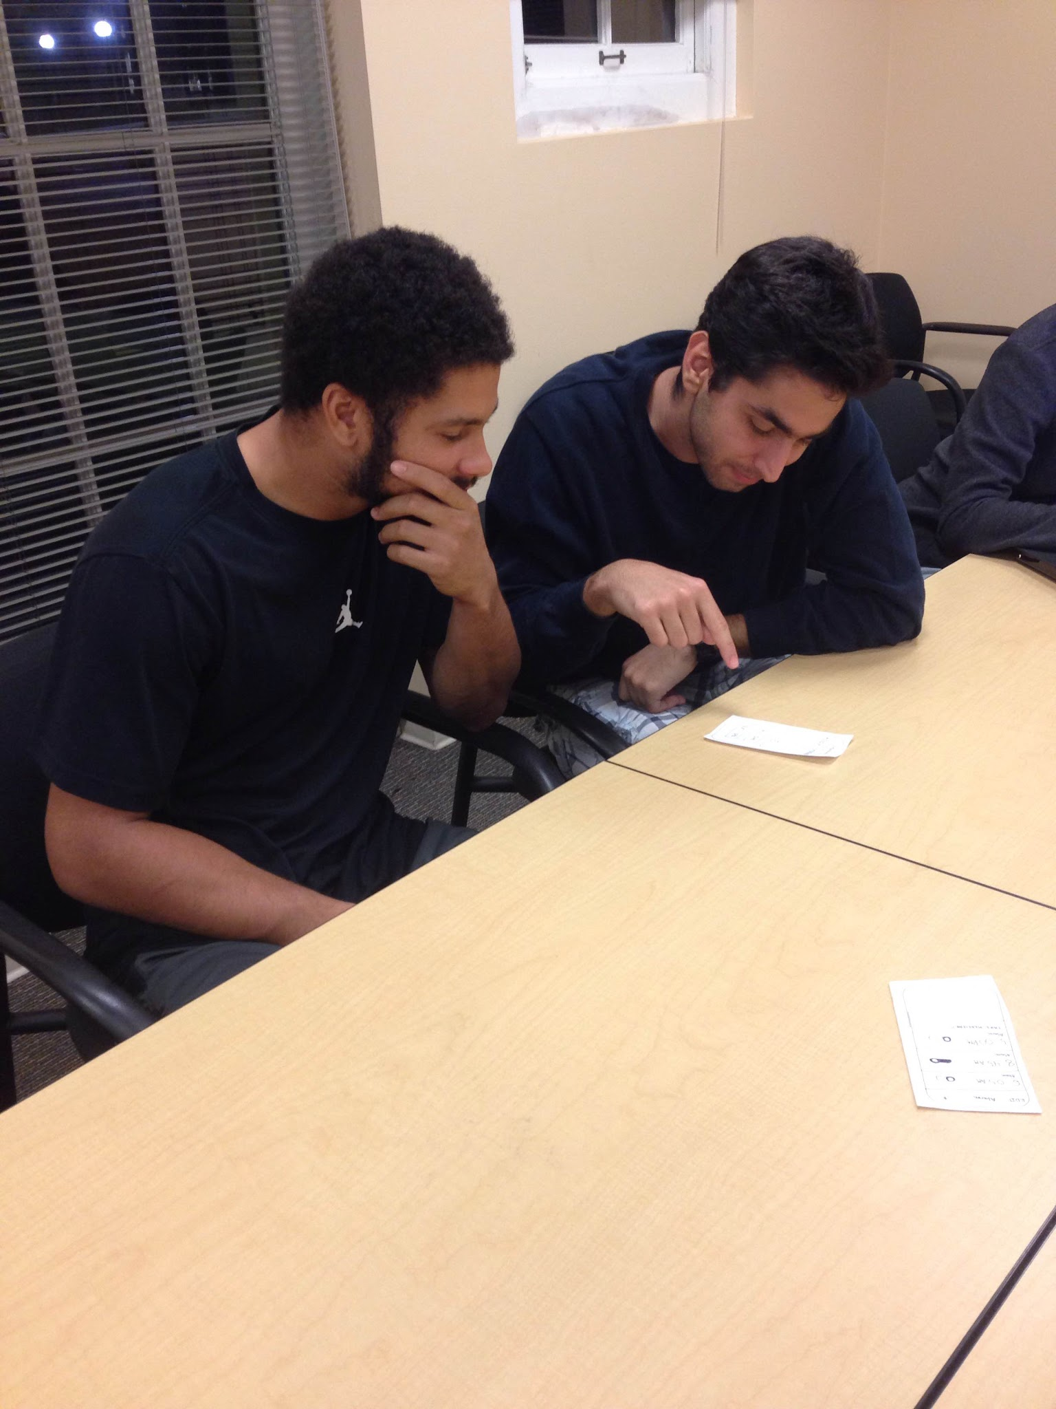
Participant 1
International student from Brazil
First task - Did not like preset text messages that appeared before the keyboard. Described them as “overwhelming.”
Second task - Wants to see details on the heart rate in emergency situation. Example: What is the normal bpm? Does 140bpm mean death?
Second task - Appreciates having health info show onscreen in an emergency notification, before showing options for user to take action.
Second task - Wants heart rate graph to be color coded, and important numbers noted. Possibly implement situational instructions if a specific vital is found to be irregular.

Slide 11
Participant 2
Student with parents traveling separately
Second task - Raises the question, what are his option
if he received an emergency notification from Mom,
but Mom does not pick up his call?
Third task - Unclear what the timestamp on location tracking shows. “Is this a random sampling of where Dad is throughout the day?”
Third task - Wants a clearer interface in location tracking that shows useful, organized information.
General - Likes the clear UI. Asked to have explicit instructions (instead of a label) in a text field.
Example: “Type a message” instead of “Text message”

Slide 12
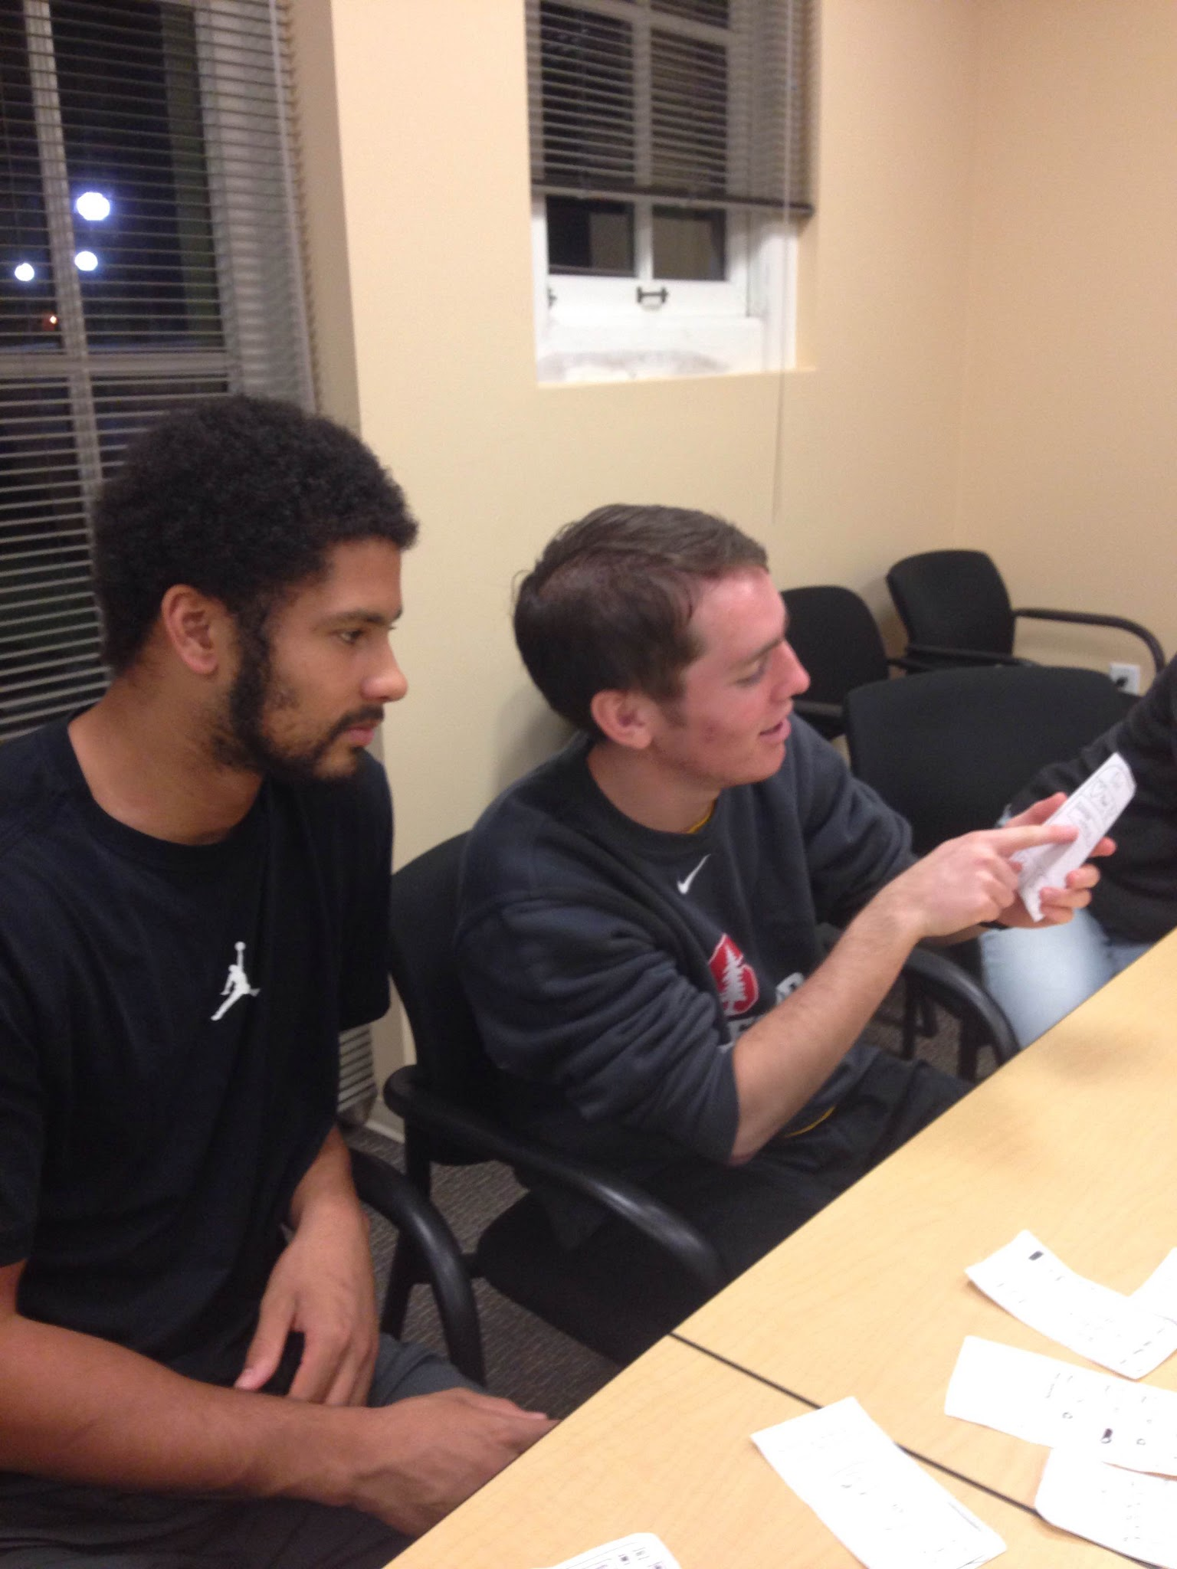
Participant 3
Guatemalan smart-watch user
First task - Wants to edit and customize preset messages. Likes preset messages.
First task - Did not realize Dad would be notified when an alarm is set and that Dad had option to Reject alarm.
Third task - Asks for a way to denote asleep/awake on the heart rate graph. Should have some way to compare sleep with heart rate, without having to toggle back and forth.
Third task - Wants location tracking timestamps to show previous and next timestamps.

Slide 13
Changes to UI
Explicit instructions where needed. Example: “Type a message”
*This may not be needed in a high fidelity prototype where we can denote text field labels with grey text.
Color code graphs to deliver safe/dangerous levels.
Improve the location tracking icon.
Add path to location tracking timestamps, connect to Log.

Slide 14
Summary
Usense users experienced high satisfaction with the product.
They felt great knowing 9-1-1 is called first, and then they are notified next.
They appreciated the range of options given for them to respond to situations.
Simple. Intuitive. Safe.

