Slide 1
Usense Concept Video
Team IBA

Slide 2
Value Proposition and Problem Solution
usense: “Care from anywhere”
usense puts people at ease knowing their loved ones are safe and sound. All it takes is one tap.

Slide 3
Three Tasks
Emergency Scenario, Reporting the need for help
Task Difficulty: Very Simple
App User: After being notified by the application, they would be directed to get in contact with them. Timestamps, gps.
Family Member: The family member would press both of the two buttons on the watch at the same time.
Passive Tracking - GPS, tracking vitals, notifications when they sleep/wake up
Task Difficulty: Automatic/Simple
App User: The family member gets push notifications and can track family member whenever.
Family Member: The person would just have to wear the watch.
Receiving and Sending Vitals
Task Difficulty: Automatic/Simple
App User: Opens the app, the application would present a list of vitals.
Family Member: The person would just have to wear the watch.

Slide 4
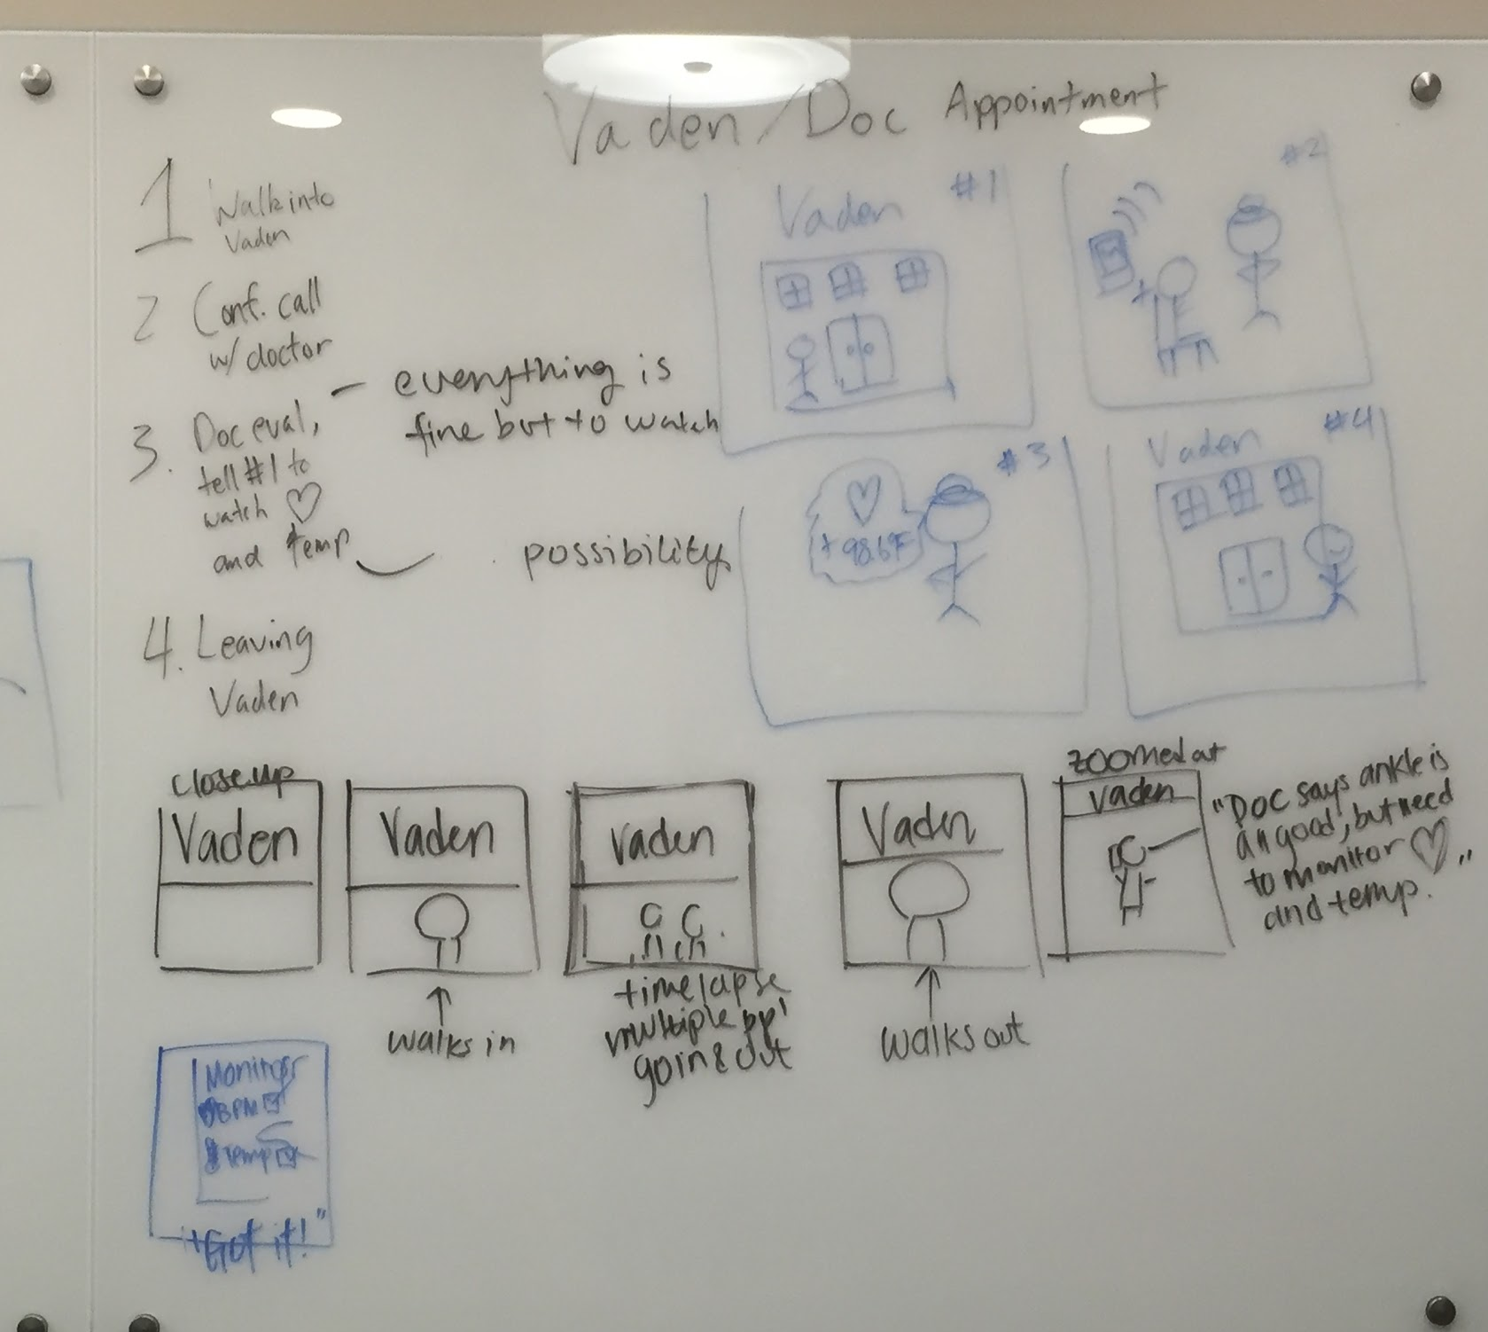
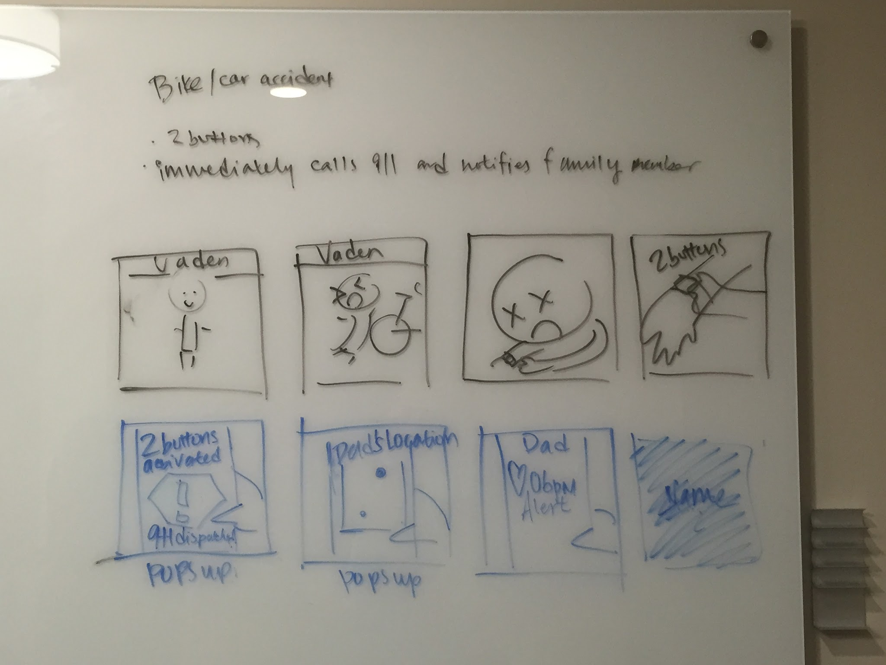

Slide 5
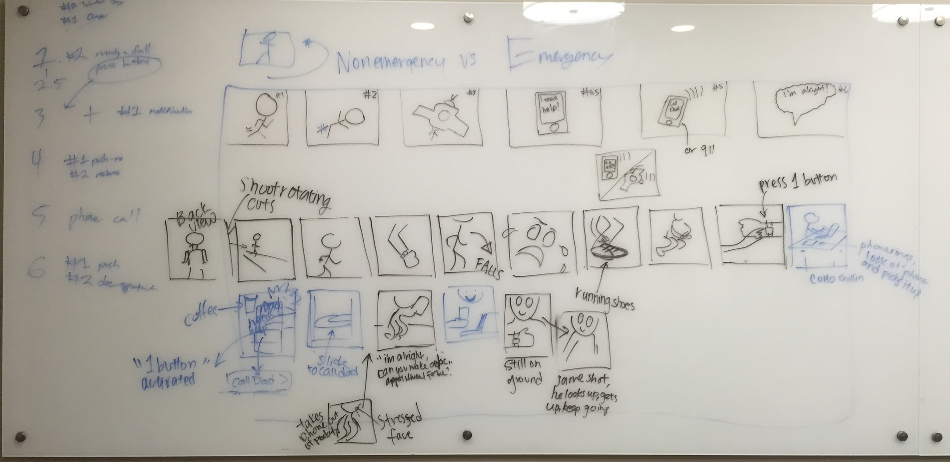

Slide 7
Video Link
https://vimeo.com/142595296

