Slide 1
Prototypes
Manuel Torres, Jacqueline Lin,
Isaiah Brandt-Sims, Larry Lam

Slide 2
Problem Domain
Our problem domain in particular is the theme of missing home.
In particular, we were interested in discovering how people of different demographics felt about home.
In terms of how this relates to sharing, we feel that people can help each other by sharing their knowledge about food with members of their culture.

Slide 3
Previous POVs
We met Cindy, we were amazed to find out how often she contacted her parents, it would be game changing to bring her parents with her on every trip.
We met Jacob, we were amazed to find out how much he checked on his family, it would be game changing to help him monitor relatives back home.
We met Bryon, we were amazed to find out how alienated he felt in his new home, it would be game changing to bring his sense of home to every new place he moves to.

Slide 4
New Interviews
William - Comfortable being away from home, regularly talks to parents and childhood friends.
Felipe - Expressed little sentiment about missing home aside from the typical responses and was surprised to hear that about his disdain for his community, his nationality is a big part of his identity.
Jake - He moved places constantly, misses his family, people create his home environment.

Slide 5
Revised POVs
We met a college student named William, and we we were surprised to find that he doesn’t miss home yet enjoys telling stories about home. It would be game changing to help students become as comfortable as William being away.
We met an international student named Felipe, and we were surprised to find that he calls his family every day to make sure they are safe. It would be game changing to help family members monitor each other’s safety remotely.
We met Jake, who has moved around a lot before college, and we were surprised to find that he often misses sleep due to homesickness. It would be game changing to comfort him when he is homesick.

Slide 6
3 HMW Statements
How might we preserve and build family history and traditions?
How might we inject smiles and laughter into people’s lives?
How might we recreate the physical embrace of someone for comfort?

Slide 7
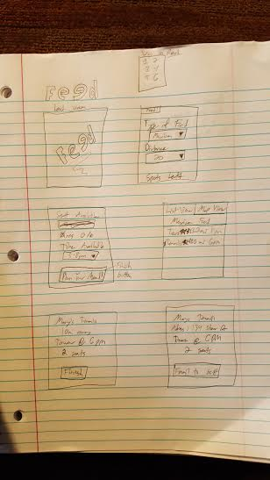
Prototype #1
Profile: Alexander, male student living in FloMo
Profile: Jasdeep, male student living in FloMo, used to live in India
Assumptions: iPhone app, free to download, it’s legal, commercial/residential sales (blurred lines), meals for $10~15
How did we make it: We drew it in a notebook and discussed what features we wanted
What worked: Familiar with other food apps, easy to pick up/start using,
What didn’t work: Confusion on what was being sold (fast food vs homecooked)
What did we learn: Idea is interesting, wouldn’t be ignored, price range of $15 is solid for the product,
Assumptions about our user base: We thought they would want food to be around $10, but they were a bit more flexible on the idea, so our assumption was true.
New Assumptions that emerged: We could see people using the app on a weekly basis.
Tasks that we may also want to implement:
sharing a photo of the meal to other users of the app
a review section, so that users can get an opinion on where to get the best meals
a voting mechanism to influence what is served by the sellers on a meal to meal basis

Slide 8
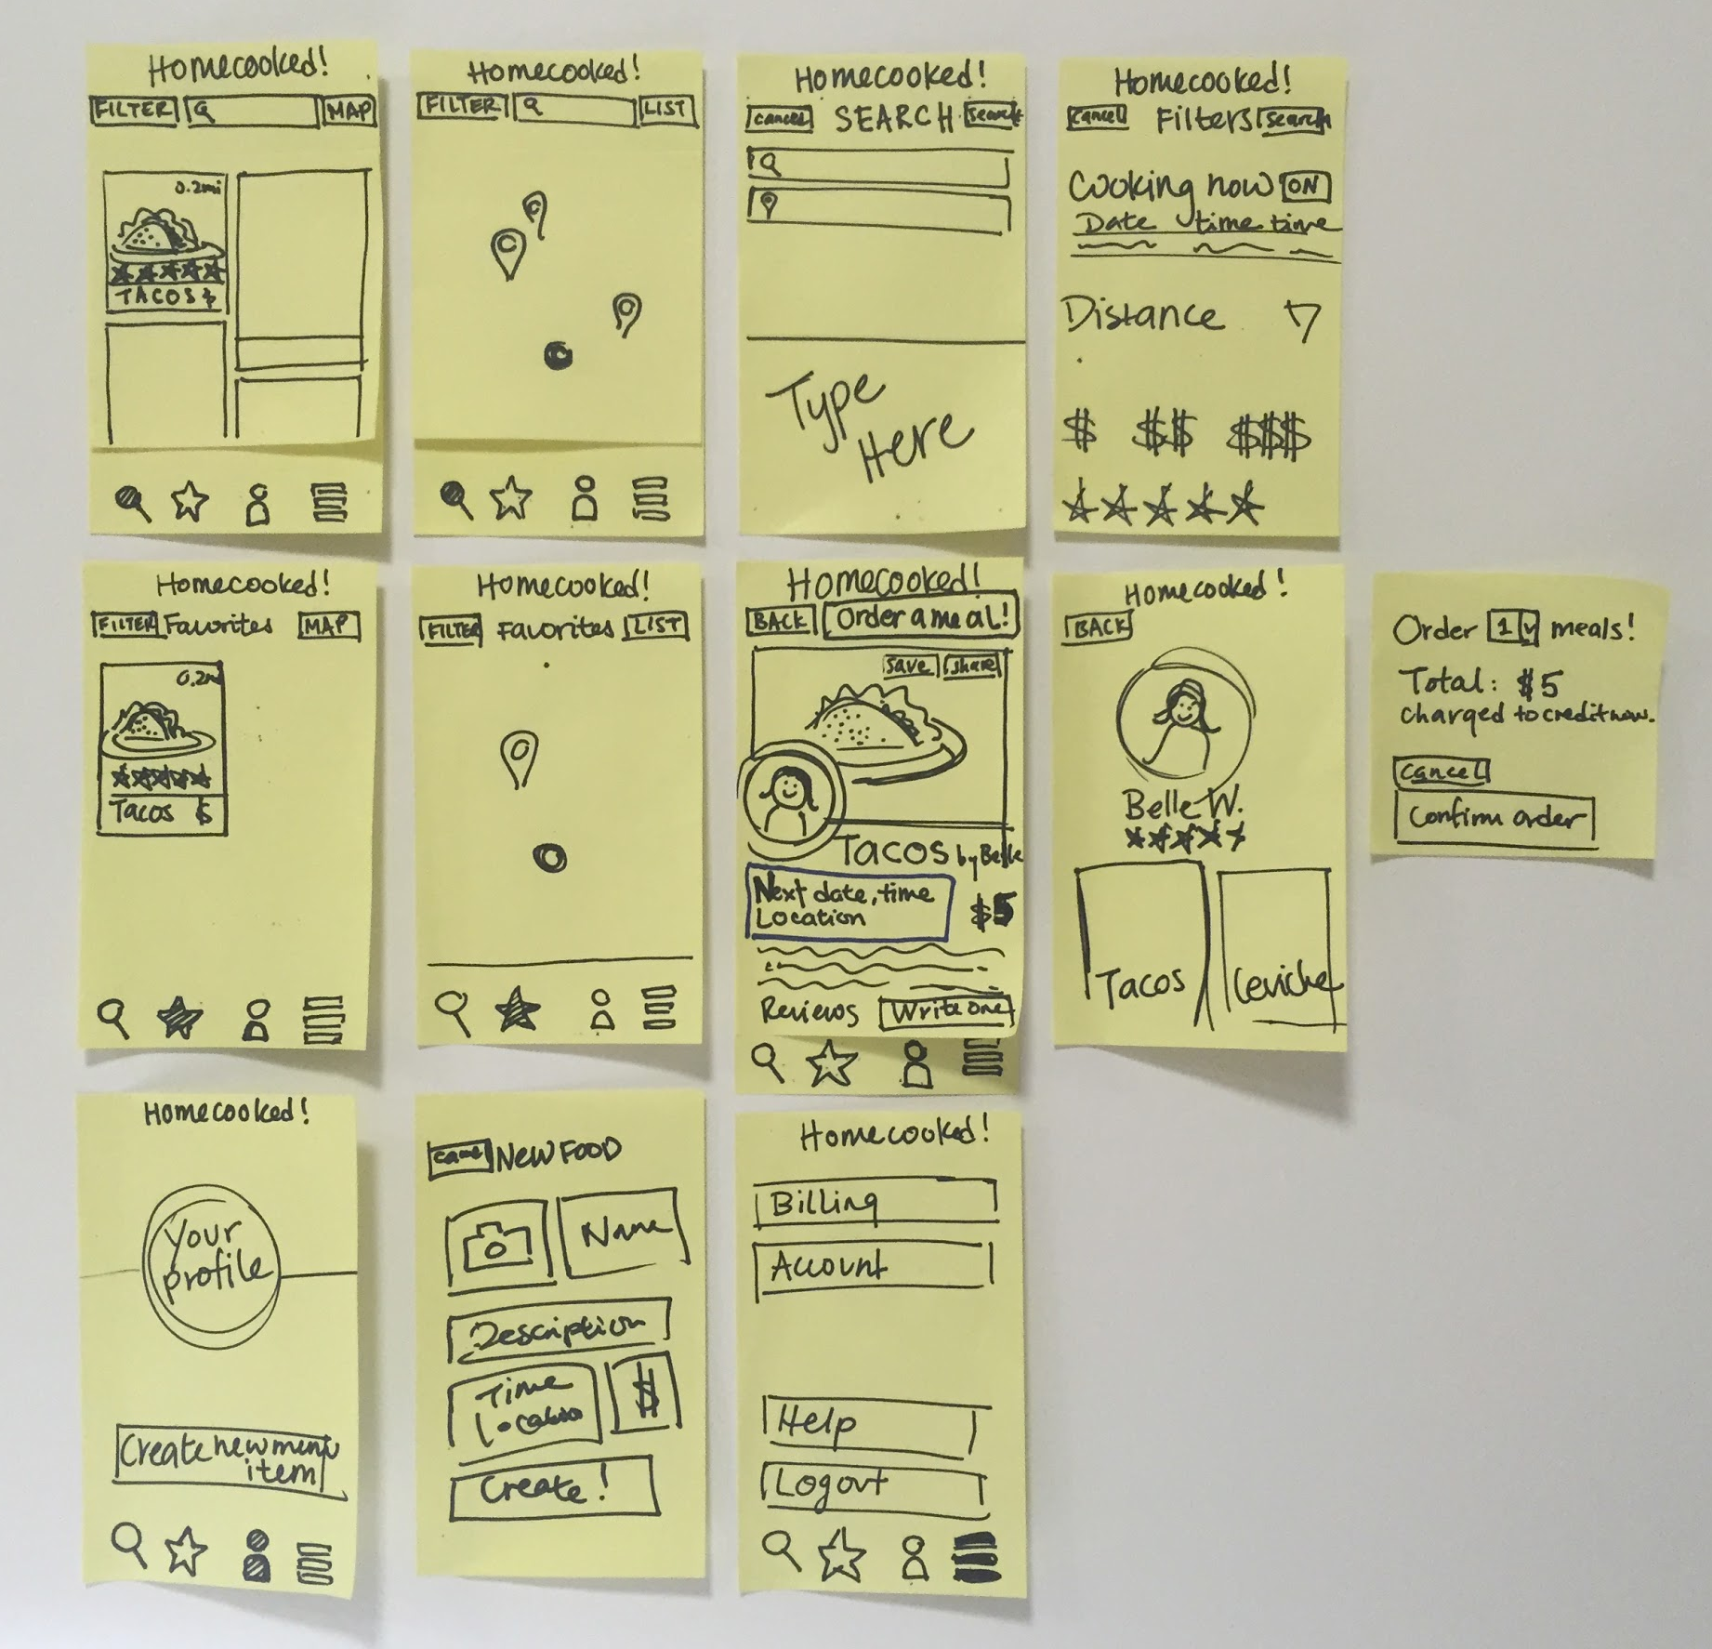
Prototype #2
Profile: Nadia, female student from Wisconsin
Tasks the prototype offered
filter choices, search by food, cuisine, date/time, and proximity/location
browse Pinterest style and also view all on a map
book a meal for multiple people
share link to meal event (user did not touch this)
connect to billing (this was unclear/hidden, billing did not come up in this experiment)
start your own seller menu (seller profile same as user profile)
Tasks the user wanted
ability to view meals coming up and cancel meals
communication btwn user and seller - updates on cooking status, allergies
Tasks that we may also want to implement + other feedback
“If I’m getting dinner someplace it’s because I’m already going out. Otherwise I would want it delivered.” - Nadia
How do we differentiate ourselves from Yelp and DoorDash? How do we provide an experience that emulates the comfort of home, and not simply a transaction?
target stay at home moms as the seller demographic

Slide 9
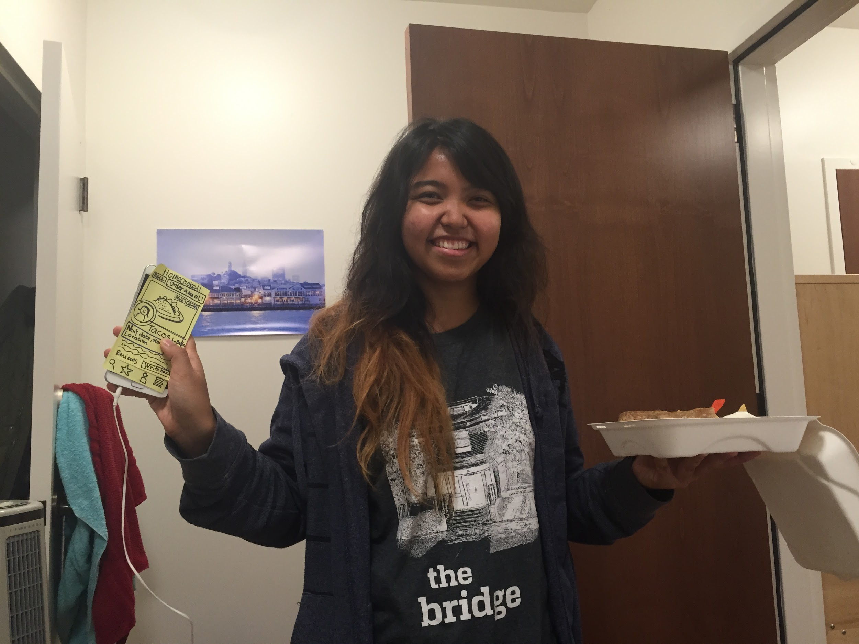

Slide 10
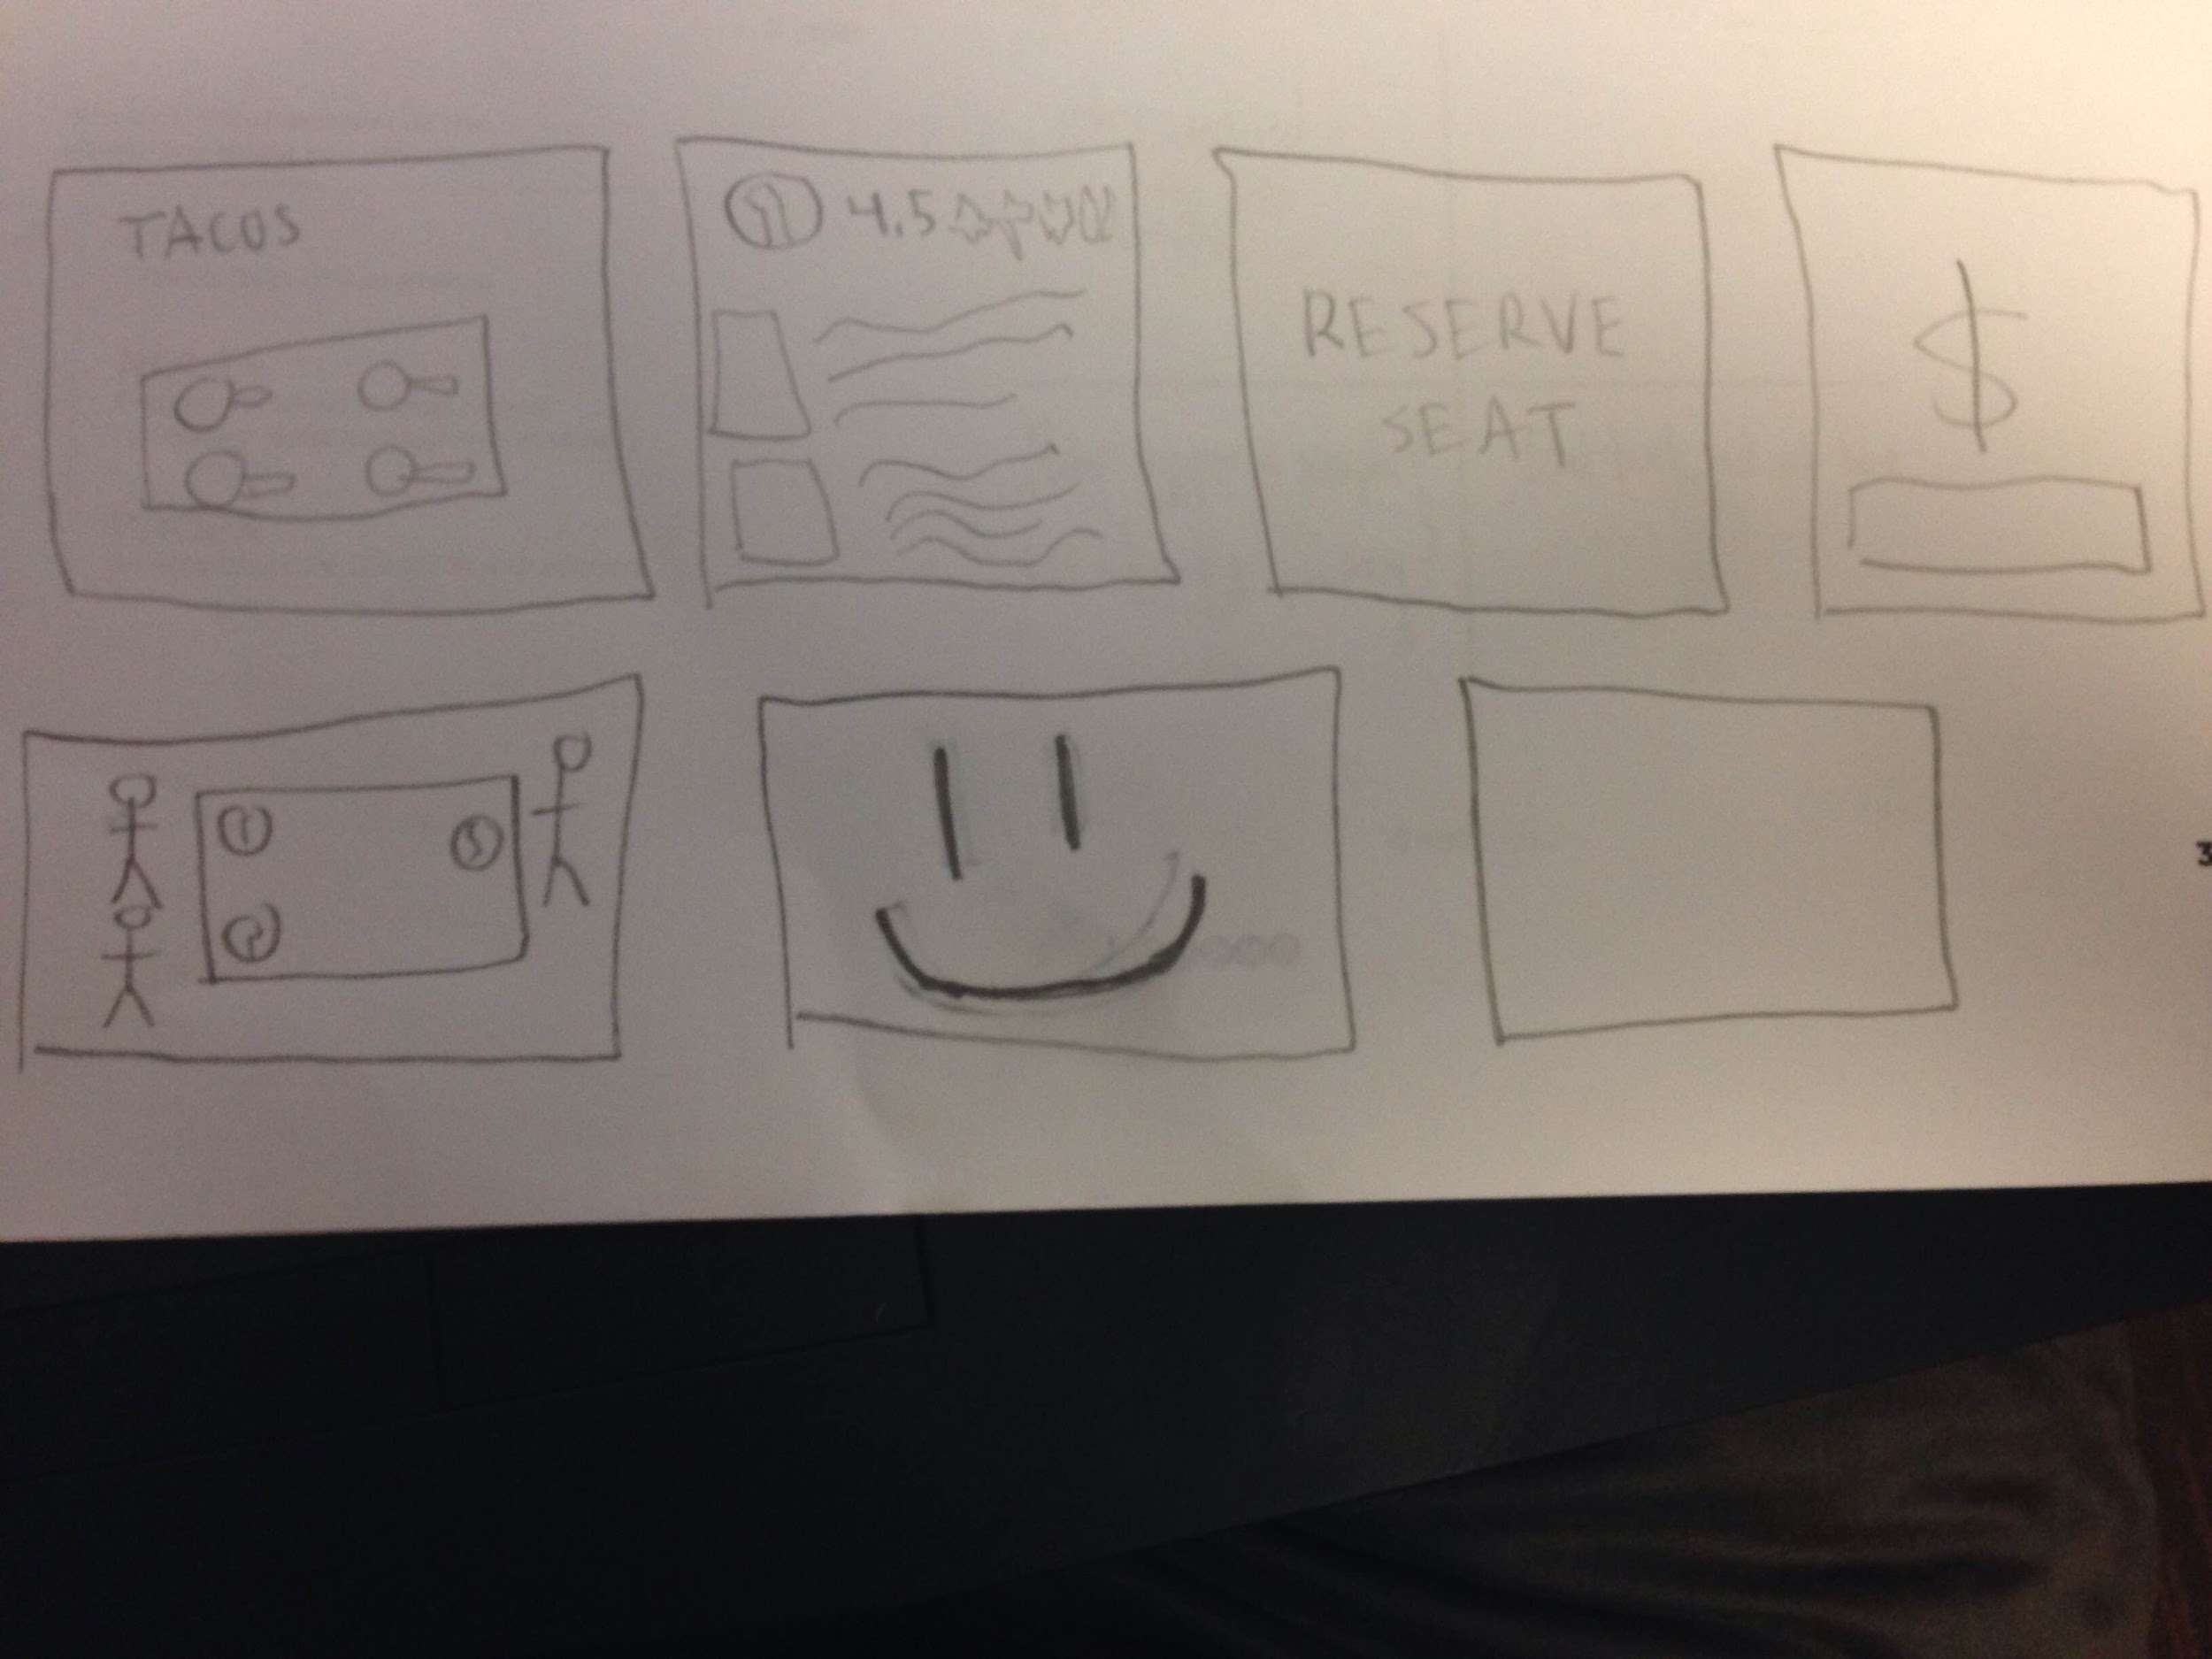
Prototype #3
Assumptions: That the user knows this is a food-based app and that it is meant to primarily obtain a certain type of ethnic food.
How did you make the prototype? A: Made it on a piece of paper.
How did you test the prototype? A: The user would go through the paper with post it notes covering each upcoming screen until they said they wanted to move on from what they were seeing (current screen).
What worked? A: Having the user think of what the screen was showing and observing what their initial reactions. Making it very simple and minimalist allow to observe the really rough interpretation of the product, the user had a very streamed presentation of the product it.
What didn’t? A: Having not as much interactional guidelines, led to the user having trouble thinking what was supposed to happen next or navigate the service.
What did you learn? A: That the idea of the product was passed on well, that this is some type of service where you get food and reserve it, and pay a fee for it and generally should obtain happiness from it.
That the idea that this is supposed to be a comfort food type service or that it is supposed to help you remember home isn't that intuitive, there needs to be more focus on that aspect..
Was the assumption valid? A: The assumption that this is a food based app yes because that was very easy to understand from the prototype, the idea that is about obtaining a specific type of ethnic food relating to home-cooked meals no because it is hard to show that without actually telling the user.
Any new assumptions that emerged? A: That people are interested in this kind of service and that they would be willing to pay for it.

Slide 11
Best Prototype
Prototype #2 was most developed, both aesthetically speaking and in quantity of choices tested.
We are still more open towards development, we just know what features we really want but still exploring the UI/UX interface.
All prototypes gathered great feedbacks though!

