Slide 1
The Family
CS 147, TA Sarah Nader

Slide 2
Introduction
Team Members
Isaiah Brandt-Sims, Jacqueline Lin, Manuel Torres Rojo, and Larry Lam
The Problem
Missing Home

Slide 3
Methodology
Young adults to middle-age adults
Living away from home, both domestic and international
Traveling, recently moved out, moved out for years

Slide 4
The Participants
A Chinese woman in her mid 20’s showing her relatives around campus.
A 31 year old mexican janitor who moved to the US on his own.
A 60 year old Filipino man who has been in the US for 20 plus years.
A 40 year old Mexican who has created a family in the US.

Slide 5
The Questions
Tell me about the last time you thought about home.
When was the last time you were home?
What things did you not miss about home?
What places do you consider your home?
How do you make your current living situation feel like home?
What is something on you that reminds you of home?

Slide 6
Interview Results
Participant 1 - Asian Woman in her mid 20’s
This interviewee was showing her relatives around campus. She works and lives around Stanford, so her sense of home has changed over the years.
Hometown-Zhejiang, China
Notes:
Mention how she feels like multiple places are her home, US versus home in China

Slide 7
Interview Results (cont.)
Participant 2 - Chelsea, an asian woman in her late 20’s vacationing in California
Our second interviewee was on campus as part of her vacation to the states. When asked about what she missed about home, she expressed a strong connection of her missing her parents and missing home.
Notes:
Likes to share images and videos with parents so they know she’s doing well.

Slide 8
Interview Results (cont.)
Participant 3 - Everardo, a male Janitor of the Humanities House in his late 40’s
Our third interviewee emphasized a strong connection with his mother when asked about feelings of home. For him, Mexico and his family there are what tie him back to home.
Notes:
Misses the culture and community at home in Mexico (not available in the United States)
Feels like a foreigner despite being in the States for 20~ years.

Slide 9
Interview Results (cont.)
Participant 4 - Mel, a male Janitor working at Soto in his early 60’s
Despite having lived in the United States for 26 years, Mel still associated the Philippines as his home. With a lot of family still in the Philippines, Mel plans to split his time between here and the Philippines.
Notes:
His home was in the Philippines, he’s made the US his new home. Multiple families/sense of home. Connected to both places.
Best of both worlds

Slide 10
Interview Results (cont.)
Participant 5- Artemio, a male janitor working at Trancos in his mid 30’s
Unlike the other participants, Artemio expressed a sense of security in the United States. While he’s been able to cultivate a new home in the States, he still misses not being able to care for his elderly parents.
Notes:
Moved for better life/opportunity. Emphasized his sense of independence and hard work to earn his living.

Slide 11
Surprises
“I miss my parents most when I am in someplace nice like here, I wish they are here with me to share the memory.”
“I was feeling excited and very sad because I got to see my family but my mother was dead.”

Slide 12
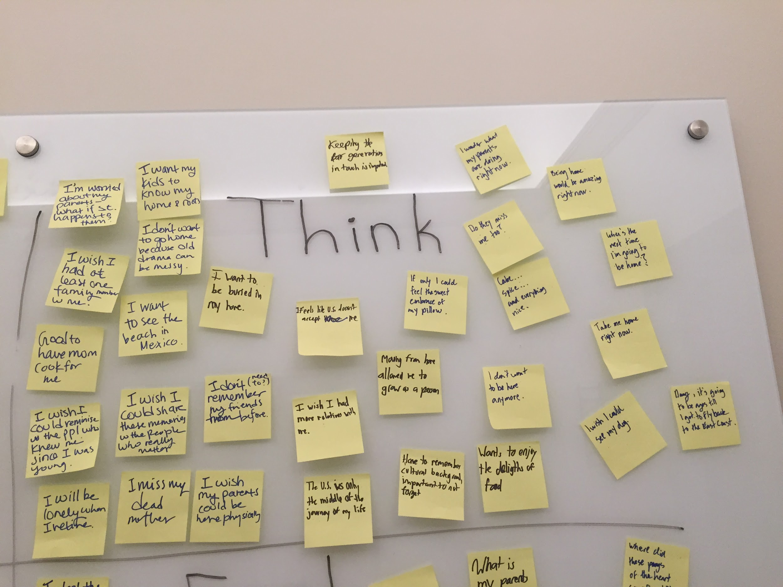
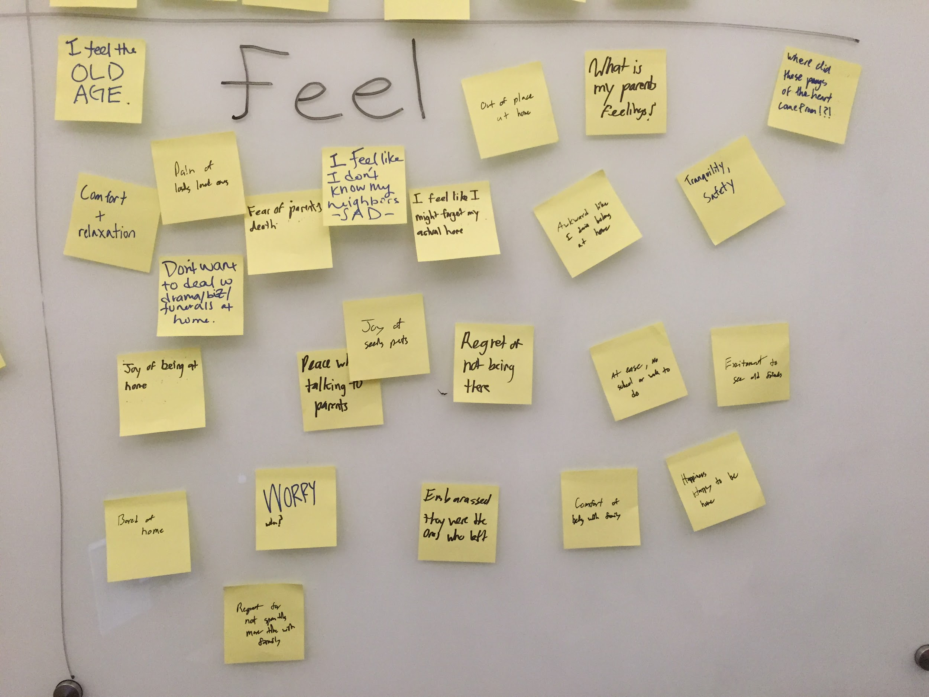
Inferences
Notes:
So here basically pick on of the most interesting inferences we made and make a comment about it

Slide 13
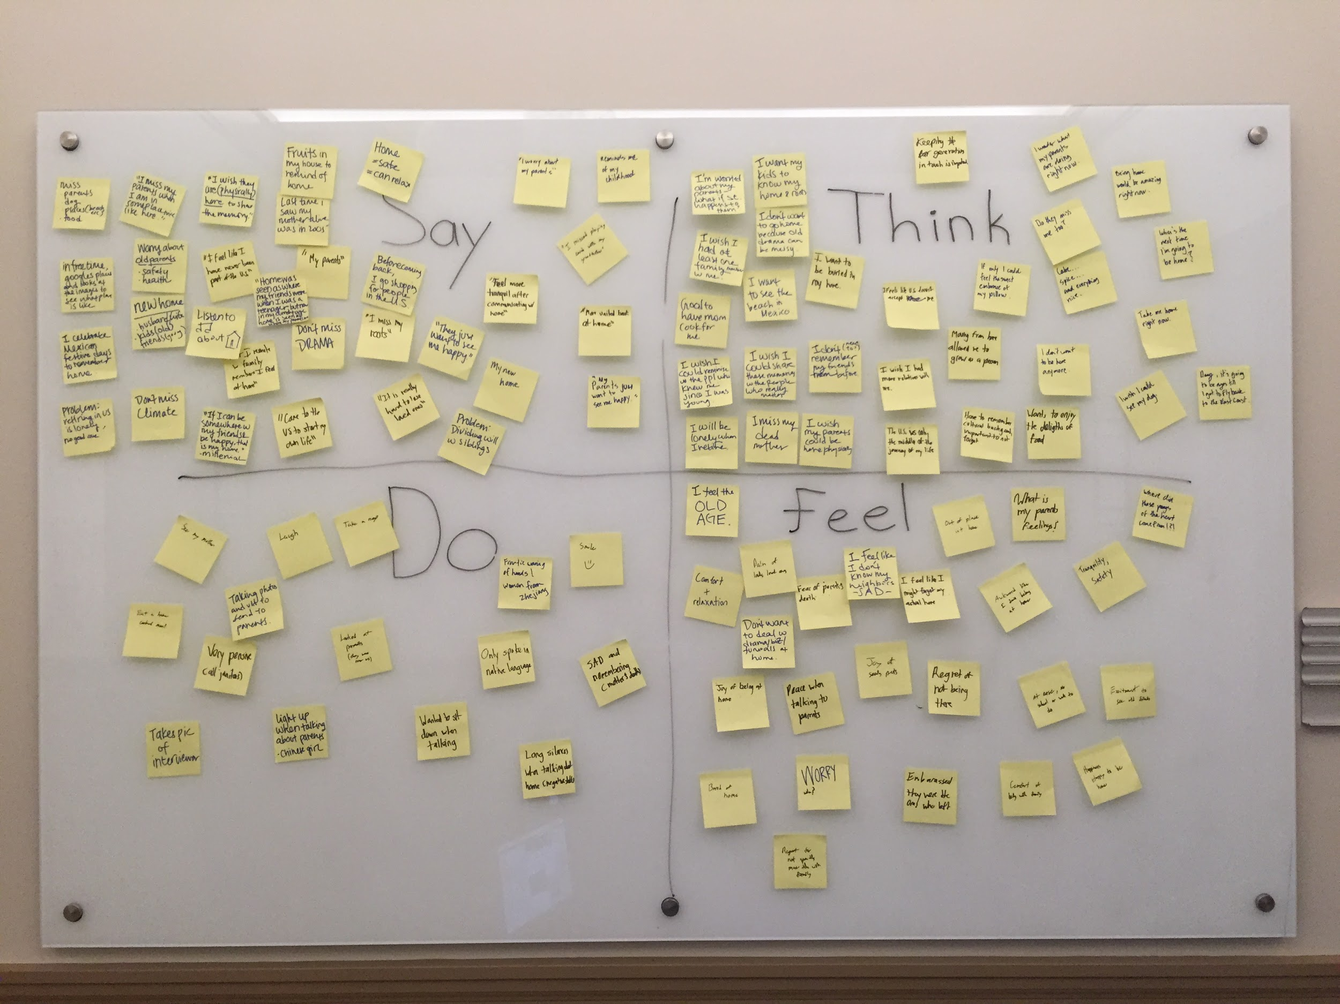
Empathy Map
Notes:
Say that this is what our map looked after we finish it, maybe make a comment about how we did it and what was easy and what was hard to do

Slide 14
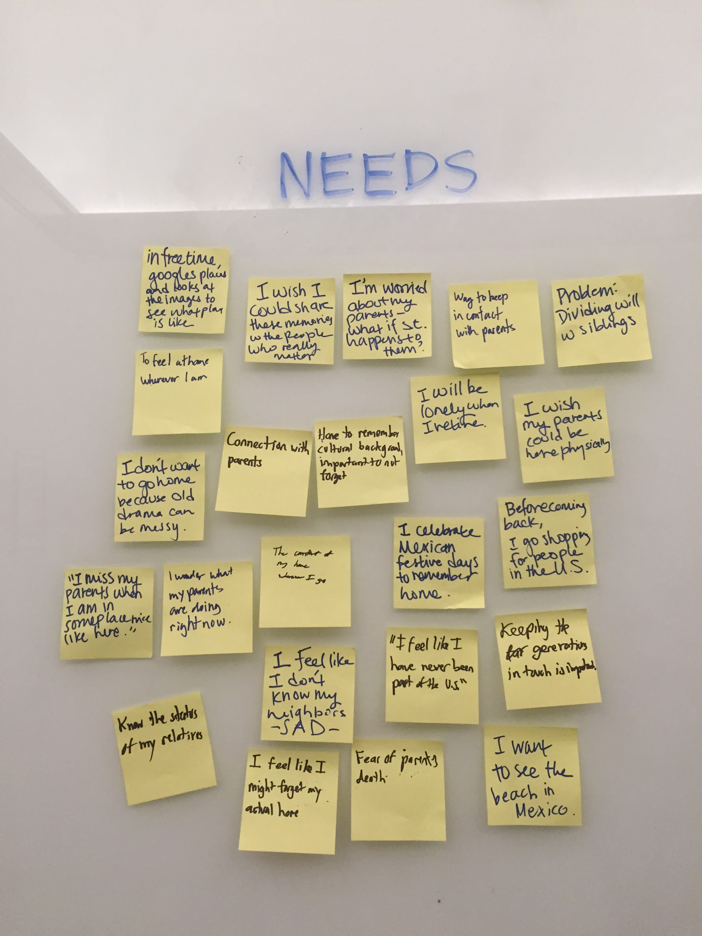
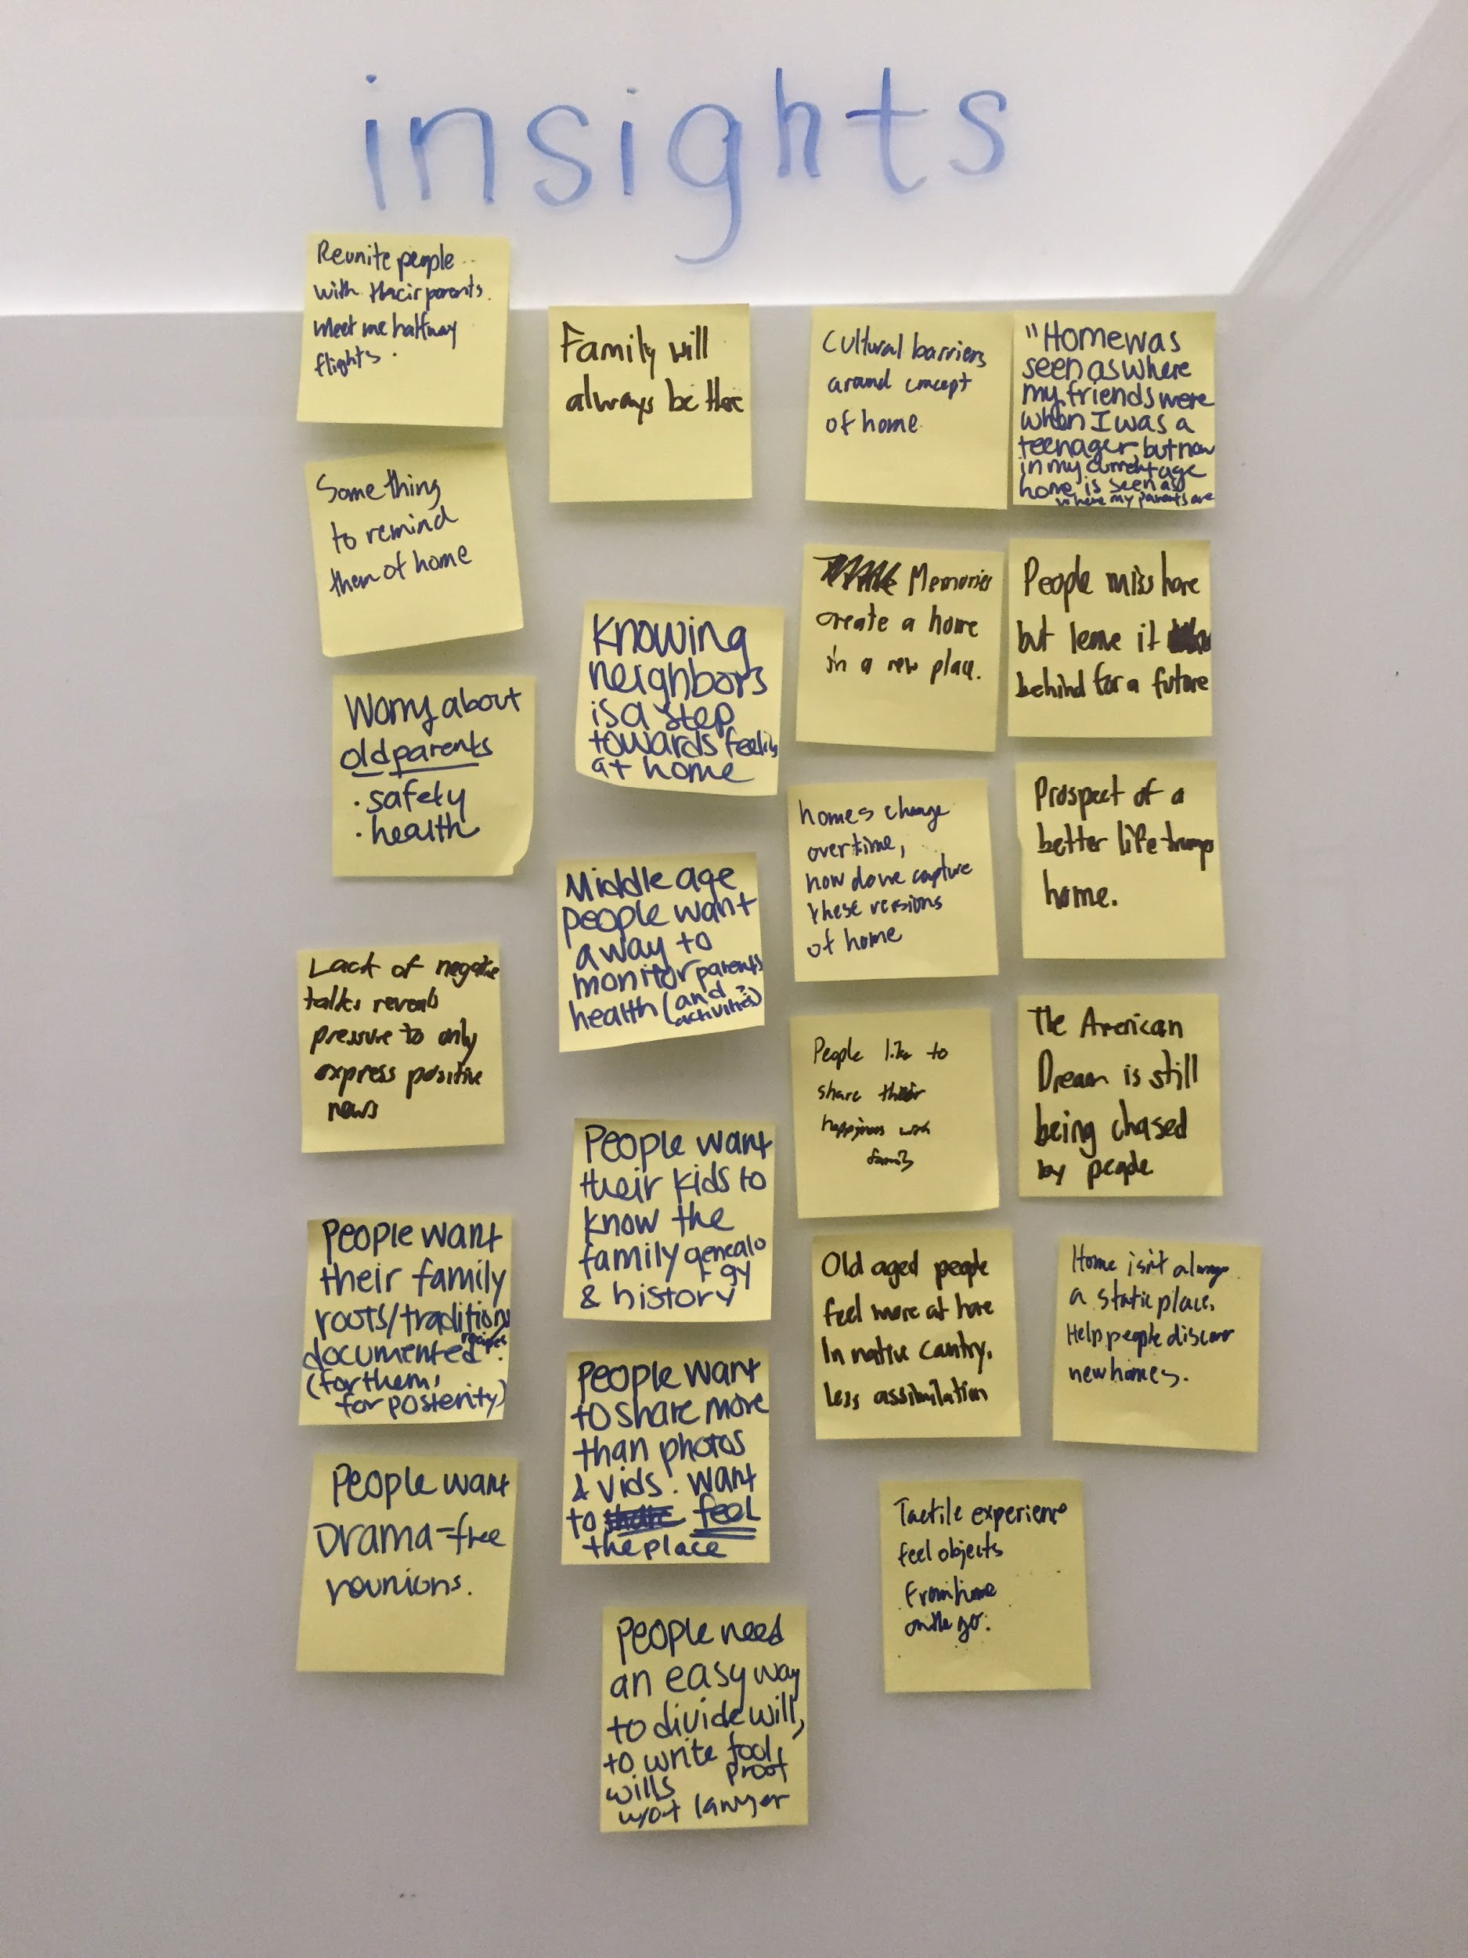
Needs and Insights
*Upload image*
Notes:
And here say some of the needs and insights we came up with and comment on them

Slide 15
Wrap Up
We found a couple main points.
Common themes: missing family, where they are now is their new home, but still maintain ties to their own home.
Home away from home - stay connected to their family
Home is where the stomach is - missing home-cooked meals

