Slide 1
High-Fi Prototyping

Slide 2
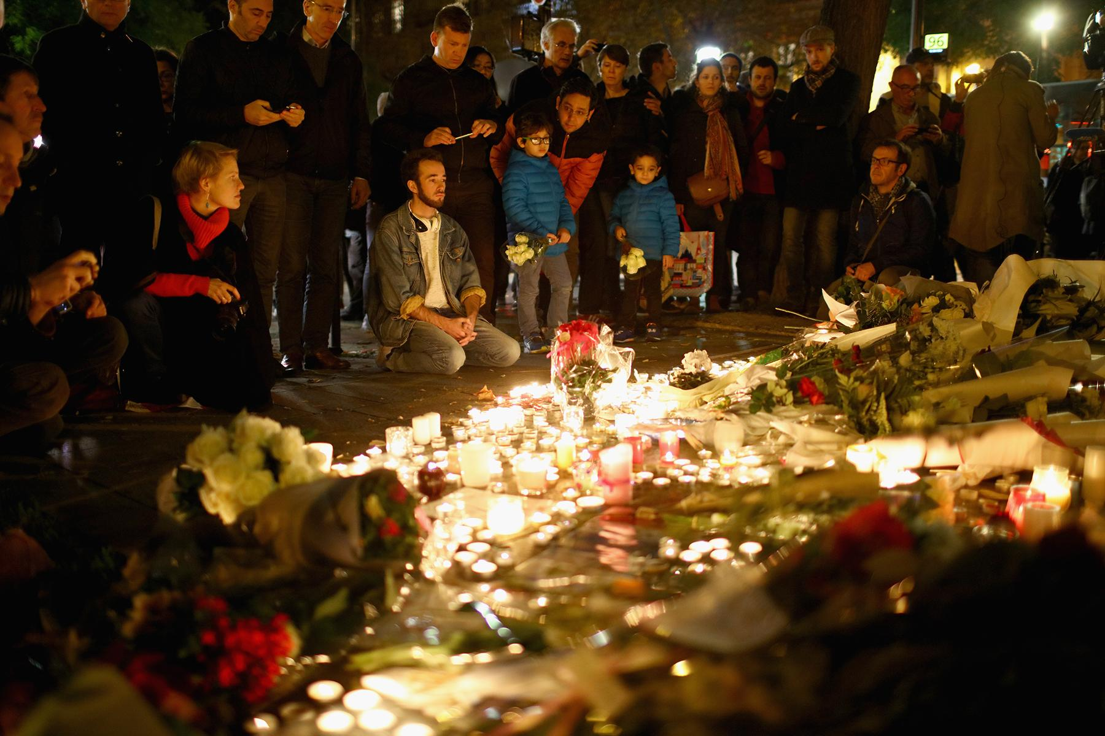
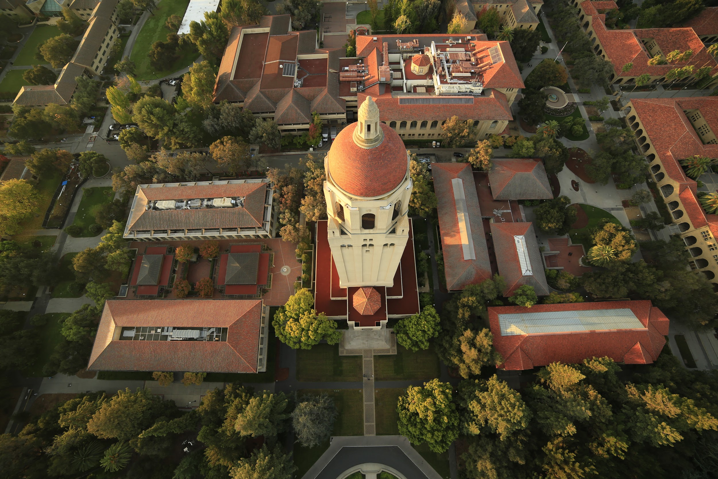
A Growing Problem
Ari Segal
Christopher Furlong/Getty Images

Slide 3
Our Mission
Intuitive
A Usense watch tracks
your loved one’s health and location, and you can monitor both
with your smartphone.
Safe
Your loved ones can
contact emergency services with the push of a button,
and we alert you instantly
when they do.
Simple
Usense empowers
personal care between distant family members.

Slide 4
Hi-Fi Prototype
Heuristic Evaluation + Fixes

Slide 5
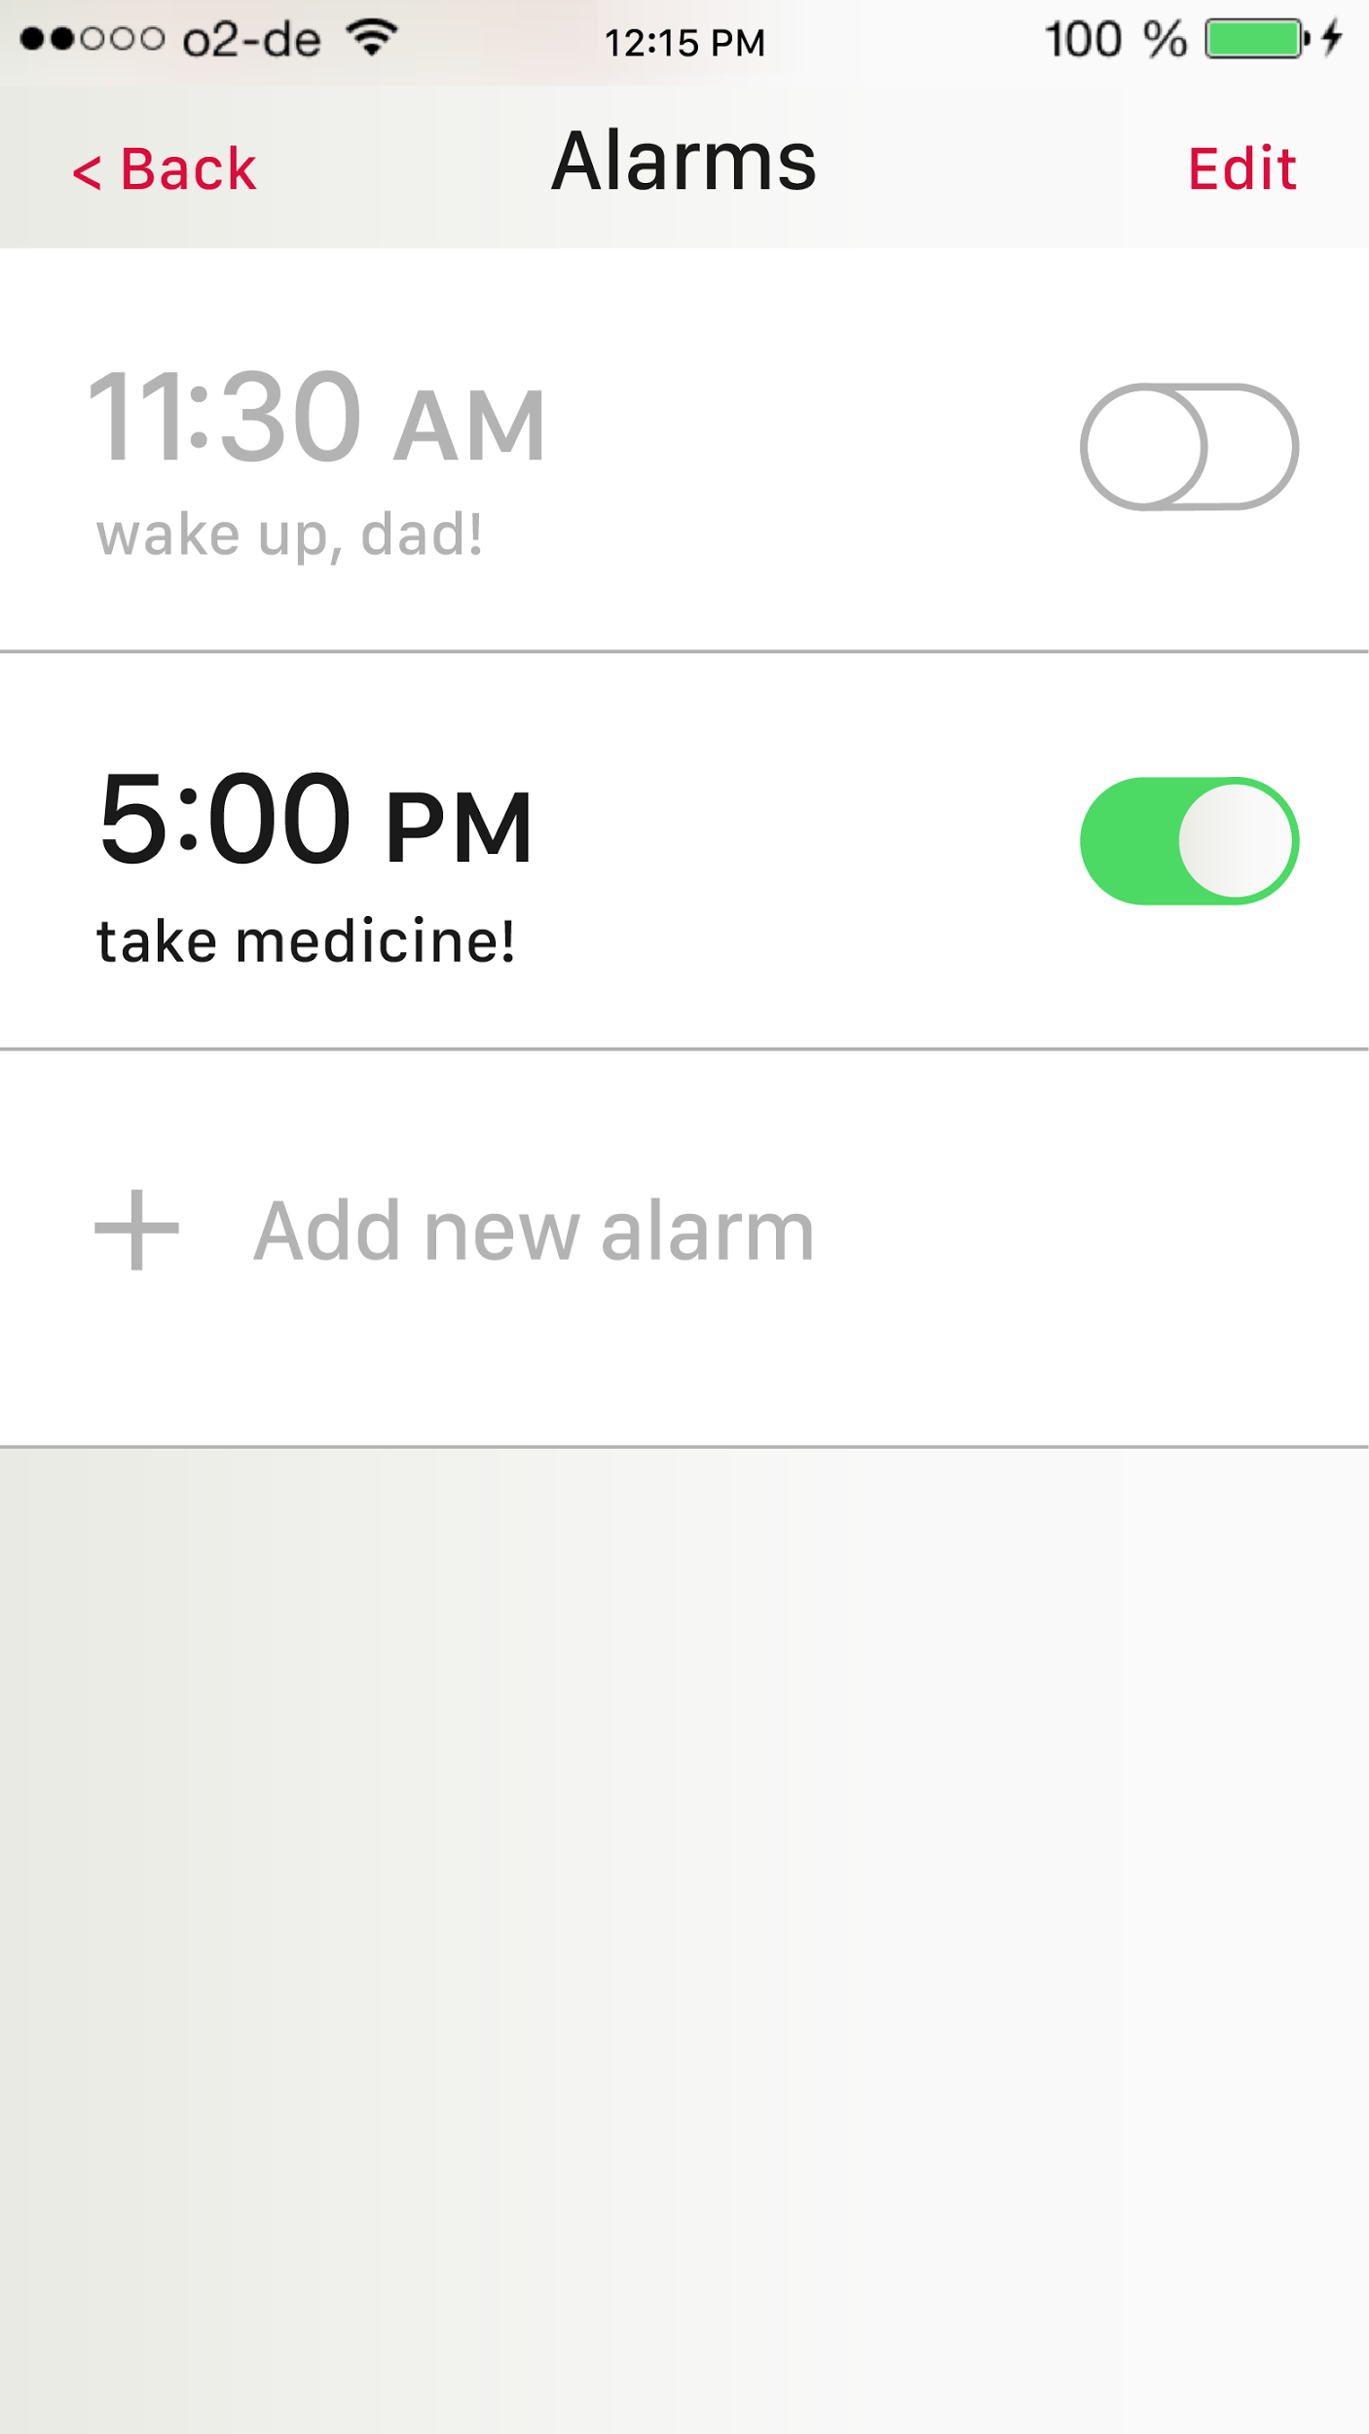
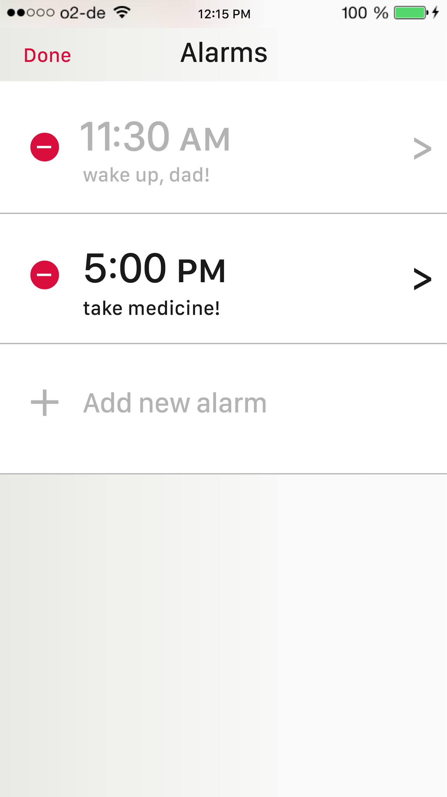
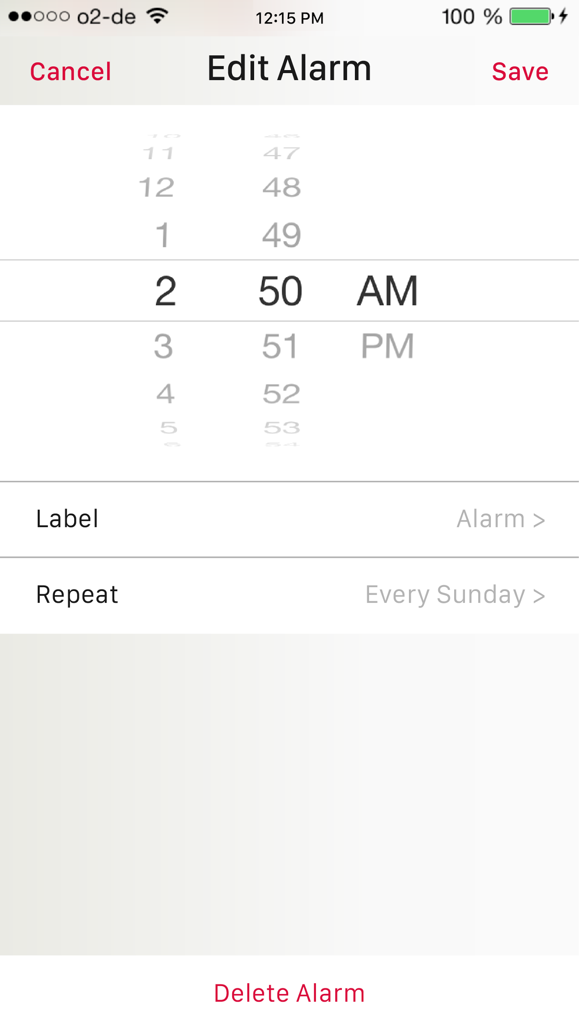
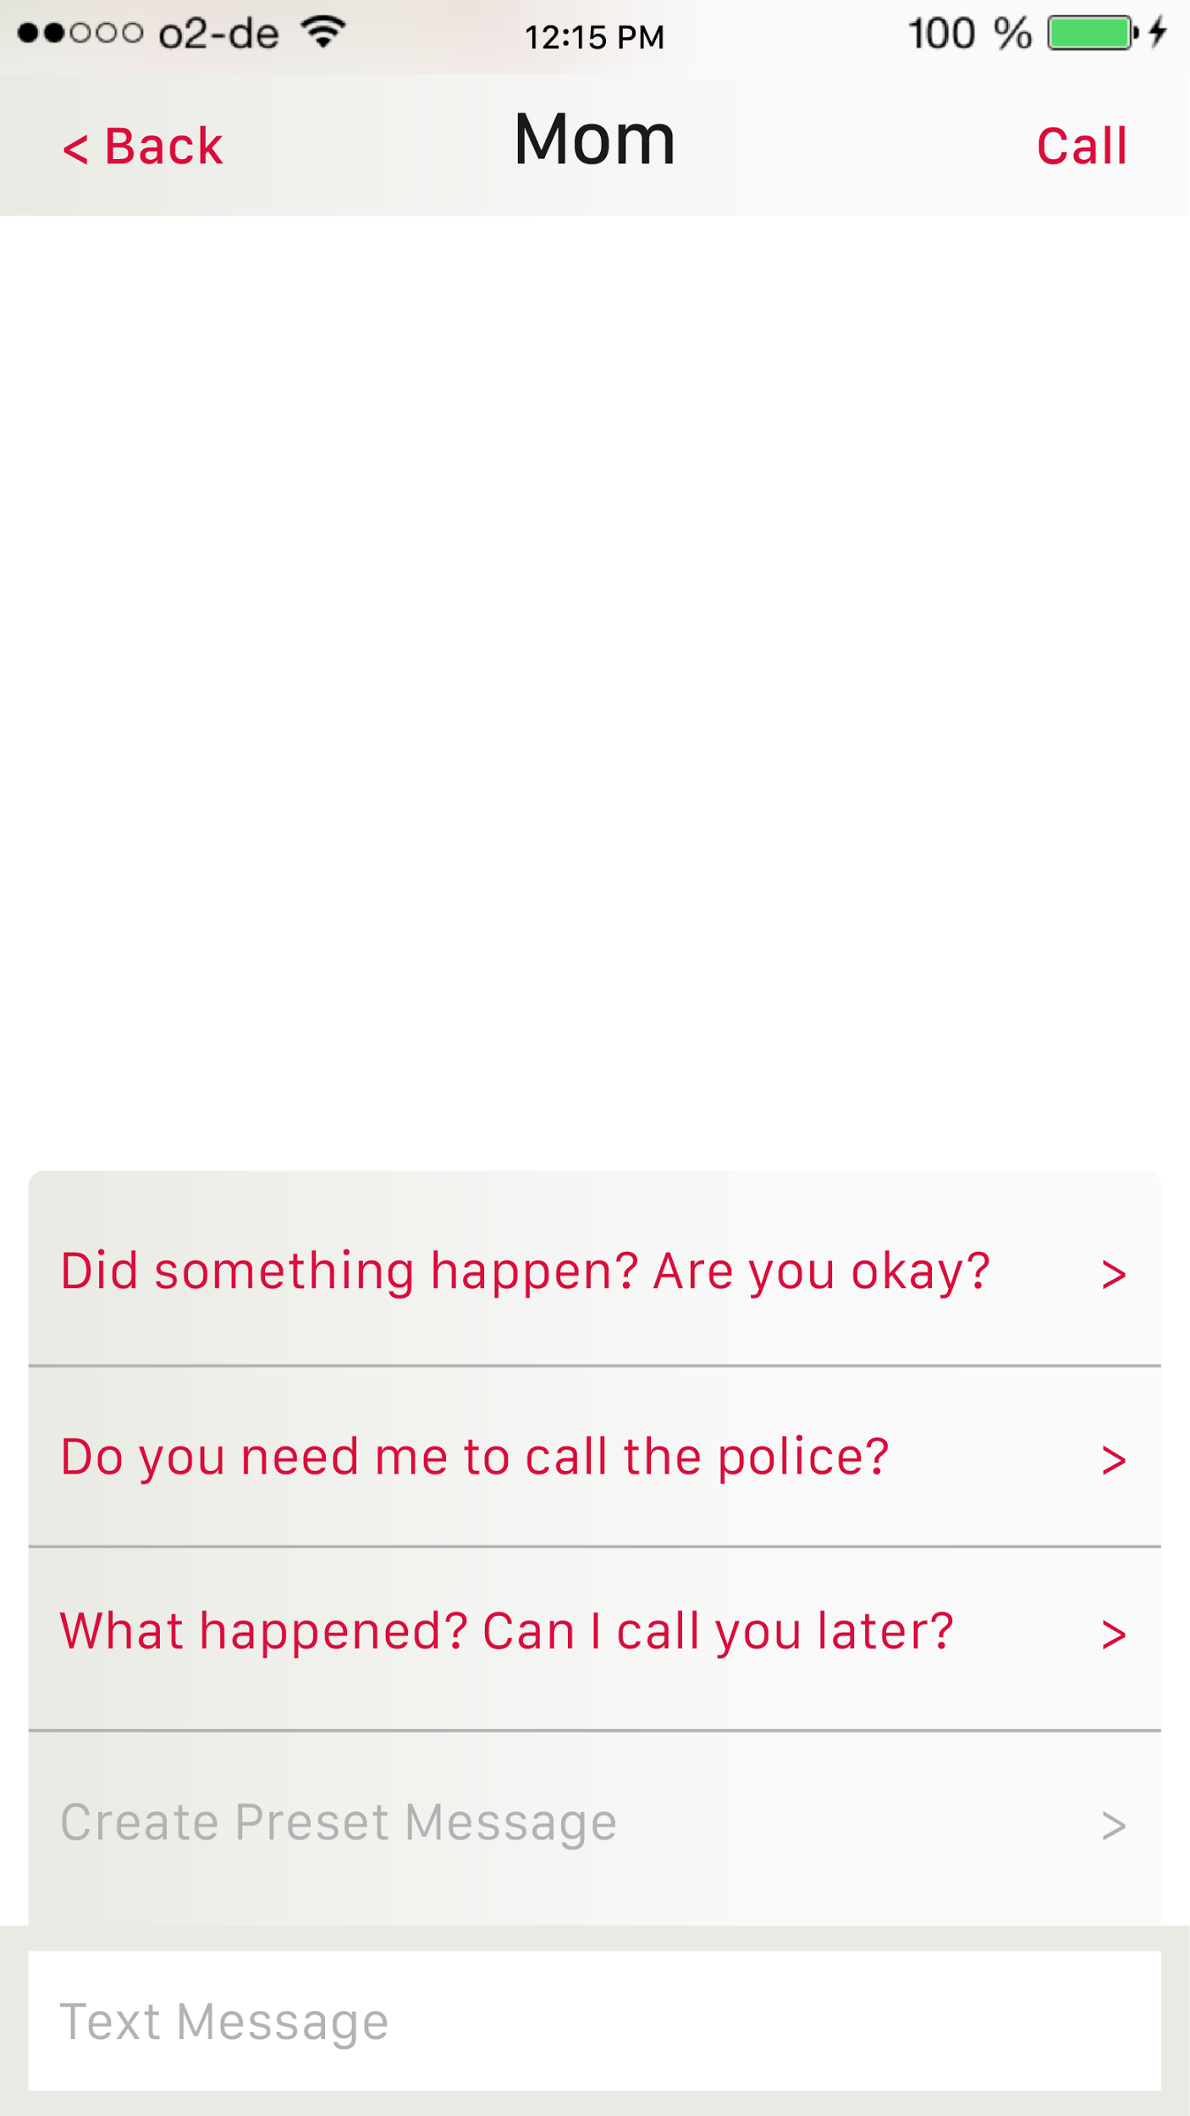
Functionalities implemented!
Edit and Add Alarms
Preset Messages

Slide 6
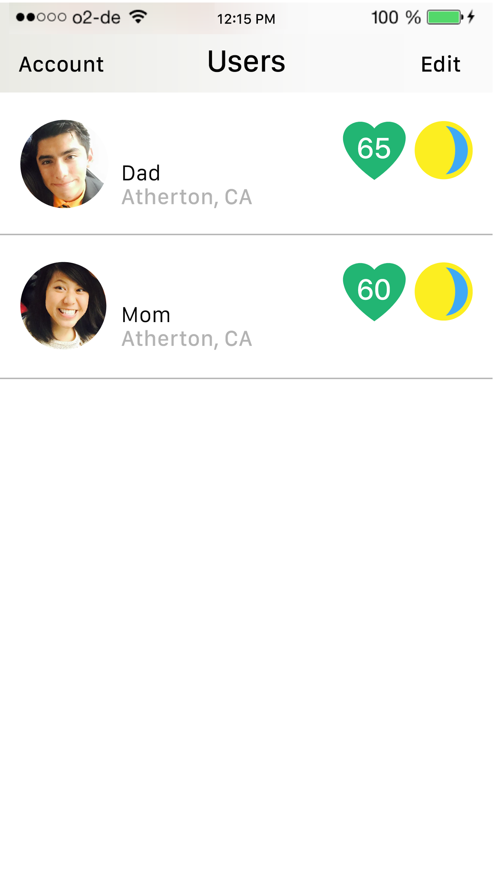
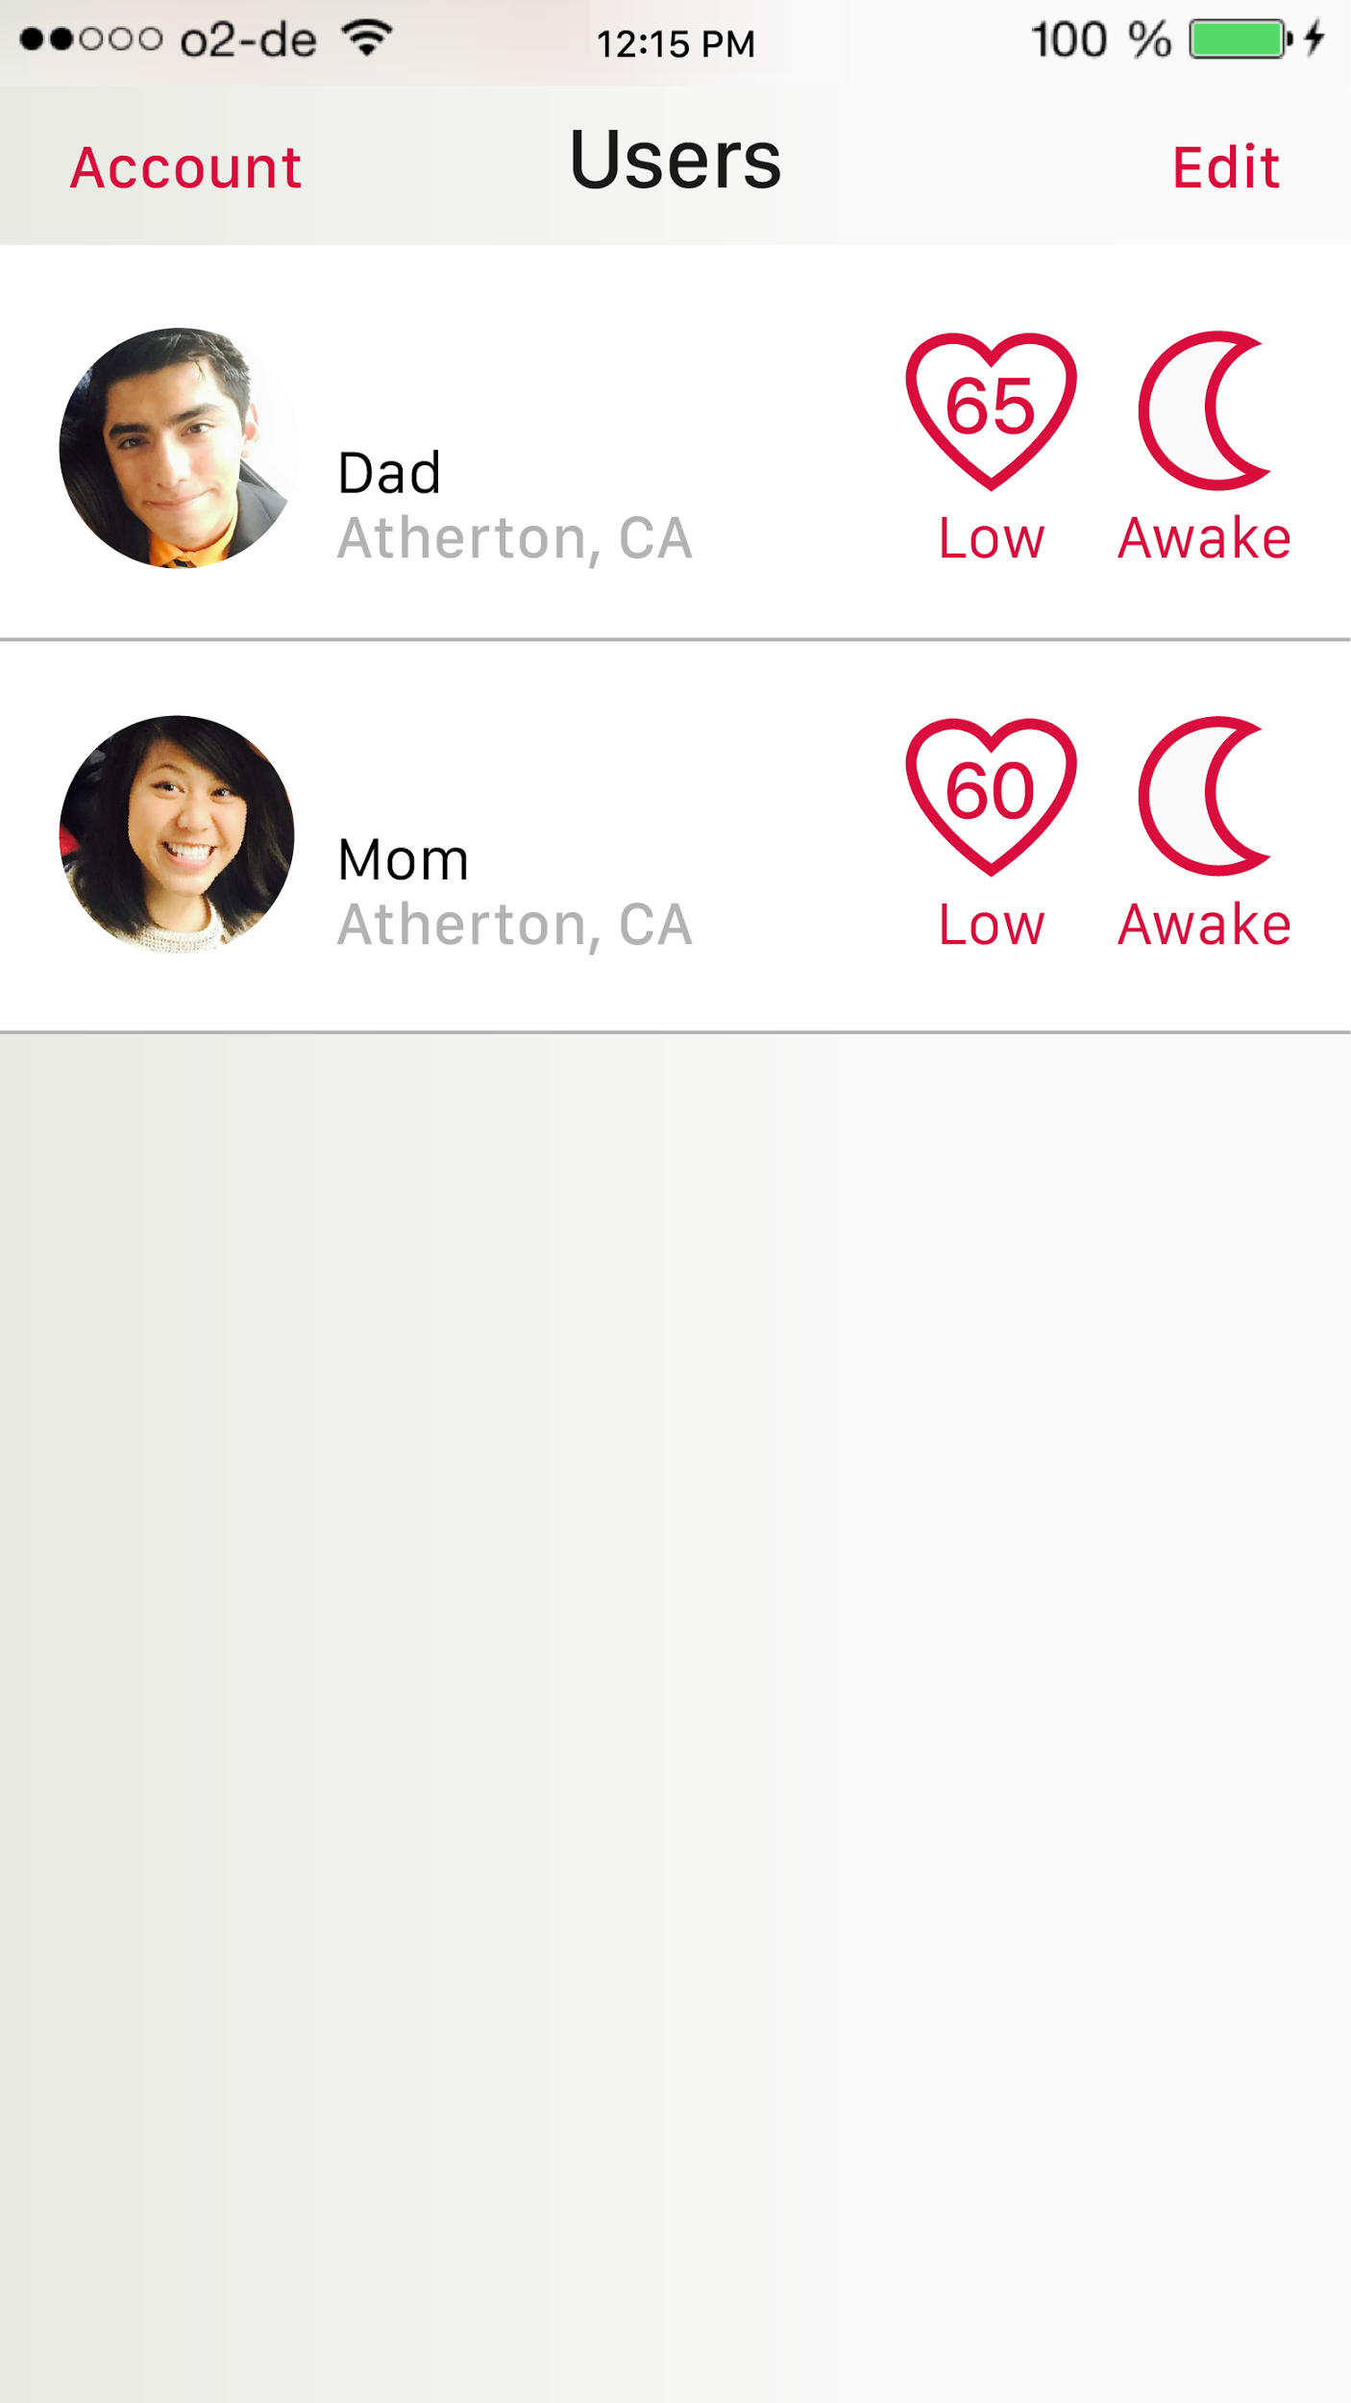
Style Redesigns
Problem: Clashing Colors
Solution: Established Brand Colors

Slide 7
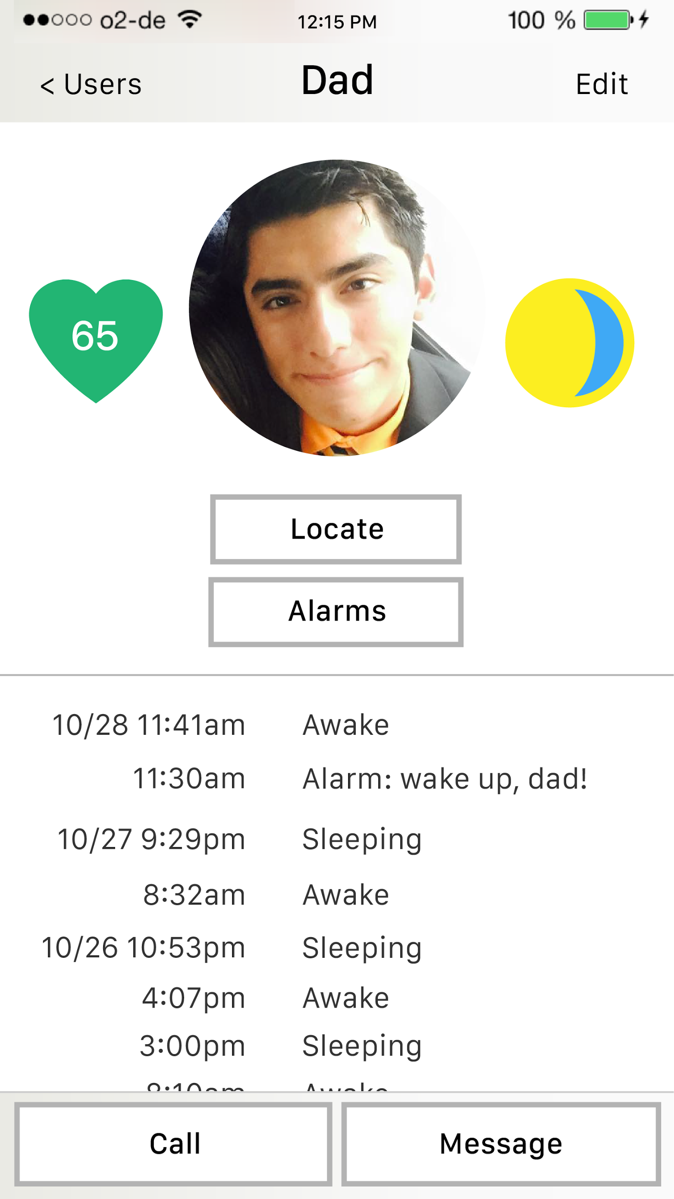
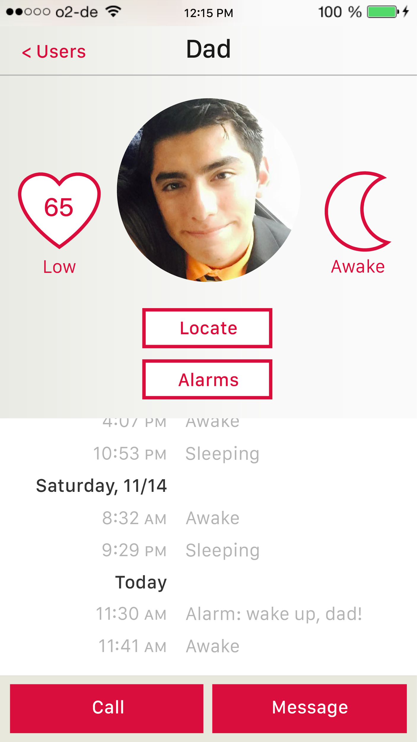
Style Redesigns
Problem: Button Hierarchy Conflict
Solution: Redesigned Buttons
Health-checking buttons
Action buttons

Slide 8
Icon Redesigns
Problem: Look like toggles
Solution: Switch to labels

Slide 9
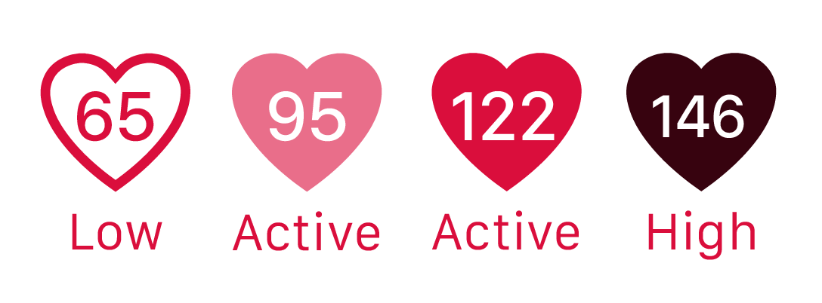
Icon Redesigns
Problem: Arbitrary color key
Solution: Values denote healthy bpm

Slide 10
Readability Redesigns
Problem: Confusing read
Solution:
rearranged chronological order
added “Today”

Slide 11
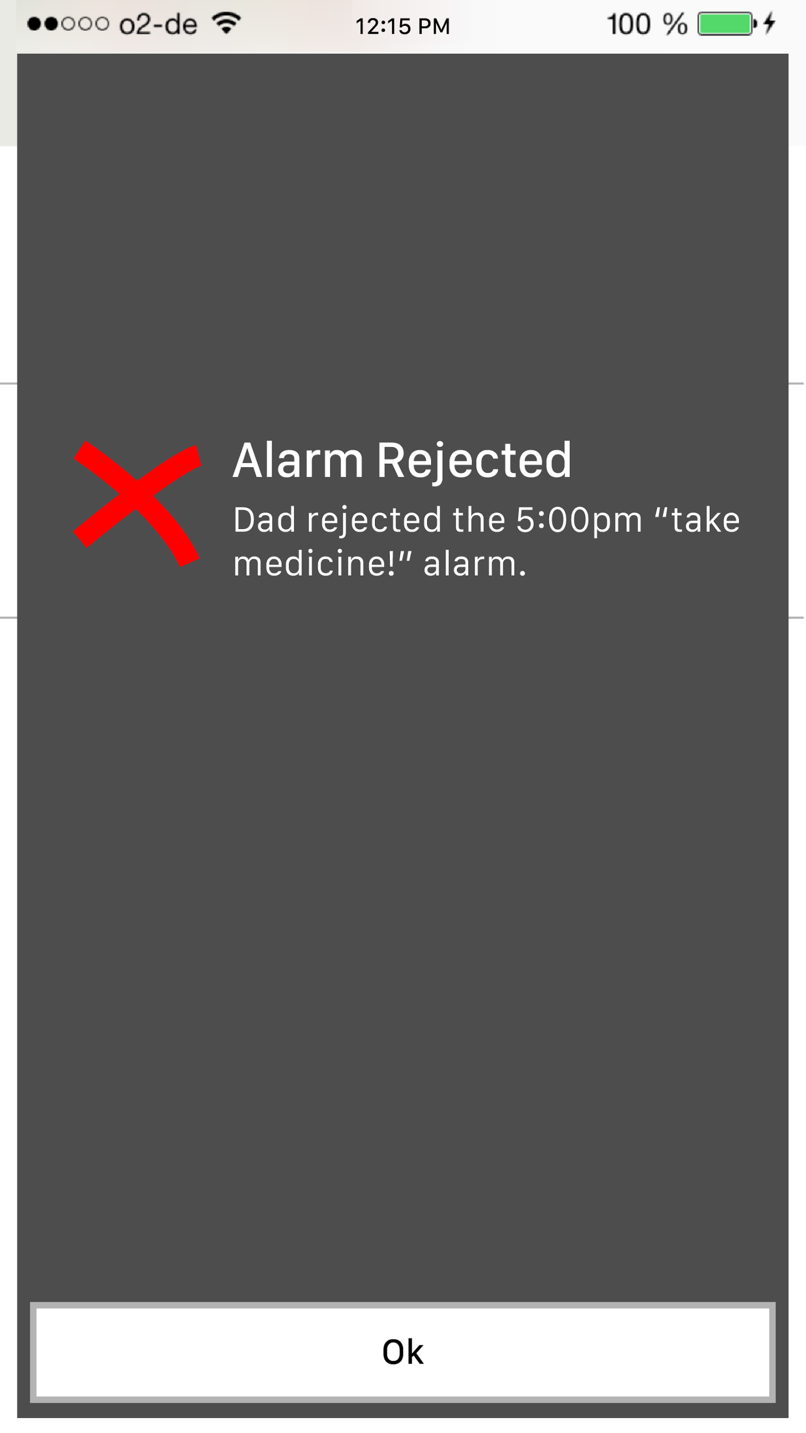
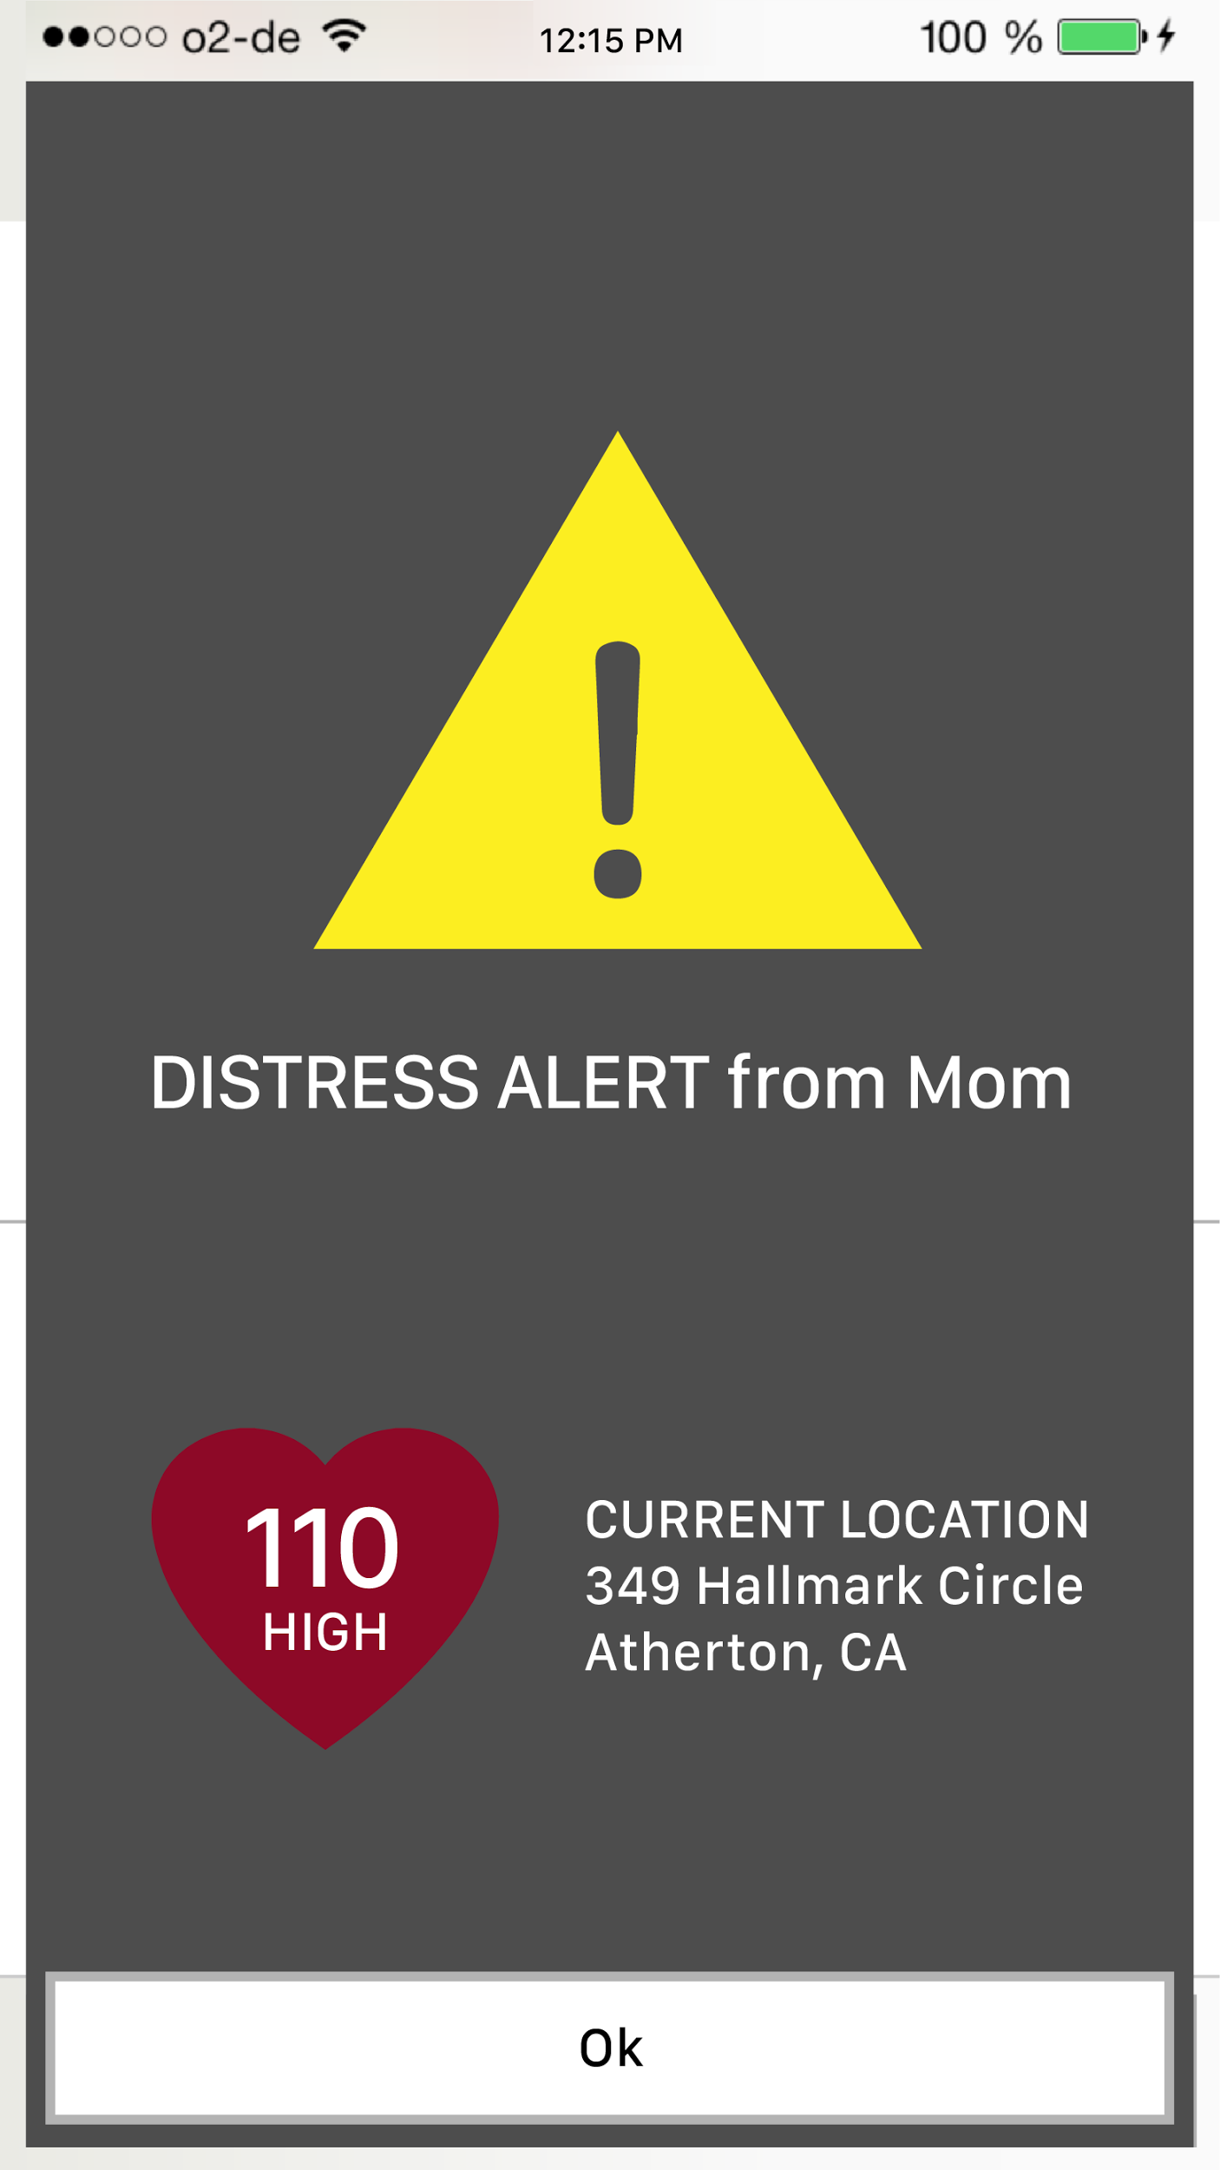
Notifications Redesign
Problem:
Inconsistent Formatting

Slide 12
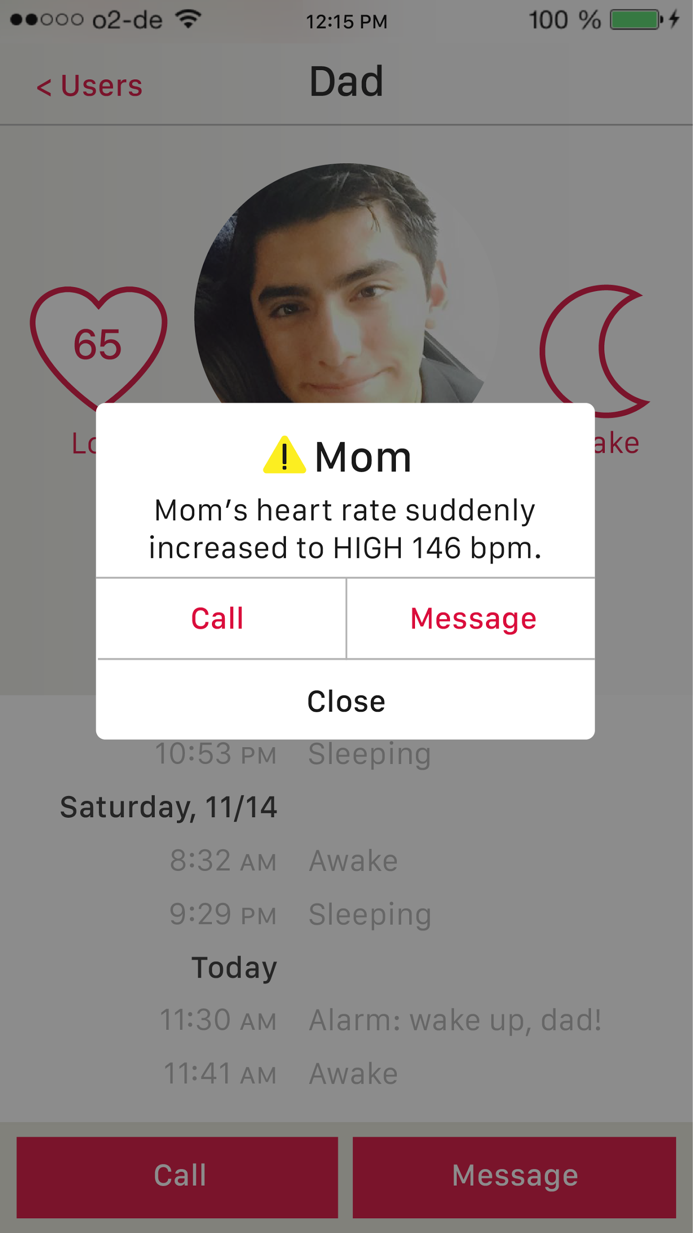
Notifications Redesign
Problem:
Inconsistent Formatting
Solution:
Standardized iOS style with
mini icon, title, and text

Slide 13
Notifications Redesign
Problem: 1 option
Tapping the “Ok” led to where the user left off, instead of to Mom’s profile

Slide 14
Notifications Redesign
Problem: 1 option
Tapping the “Ok” led to where the user left off, instead of to Mom’s profile
Solution: 3 options
call
message
close

Slide 15
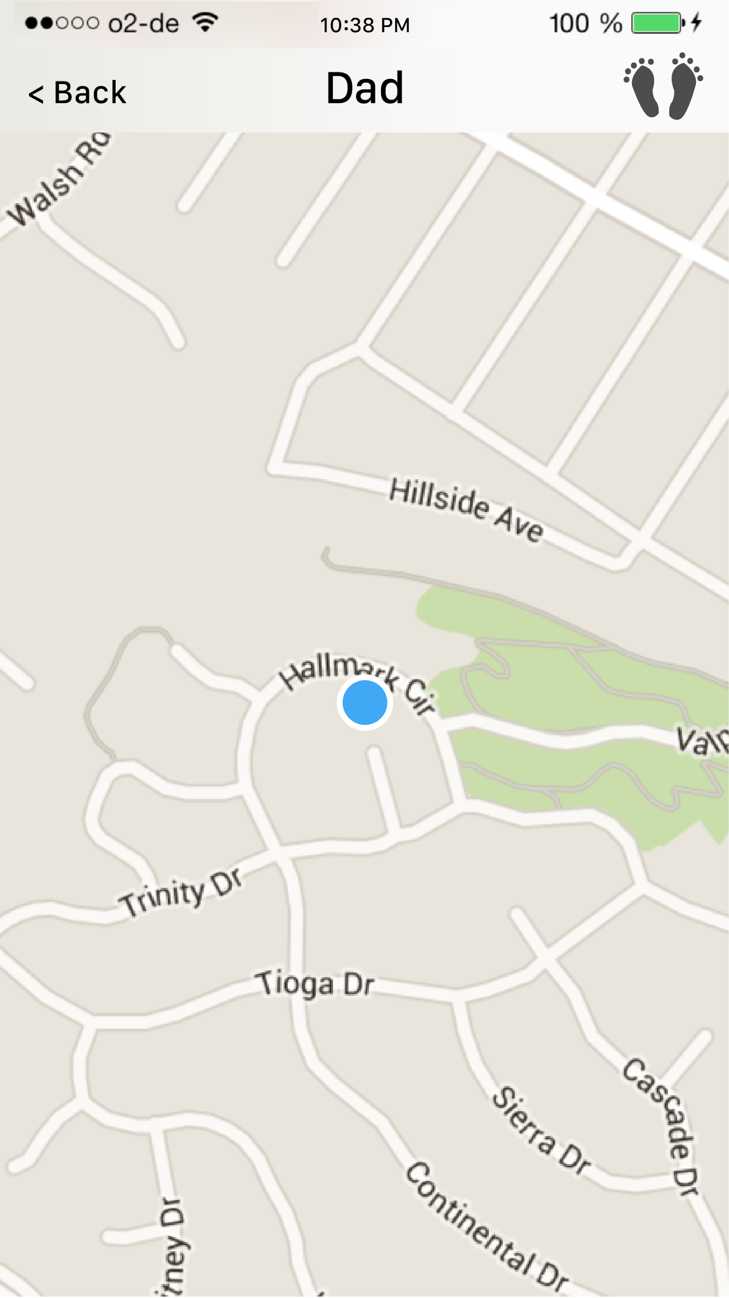
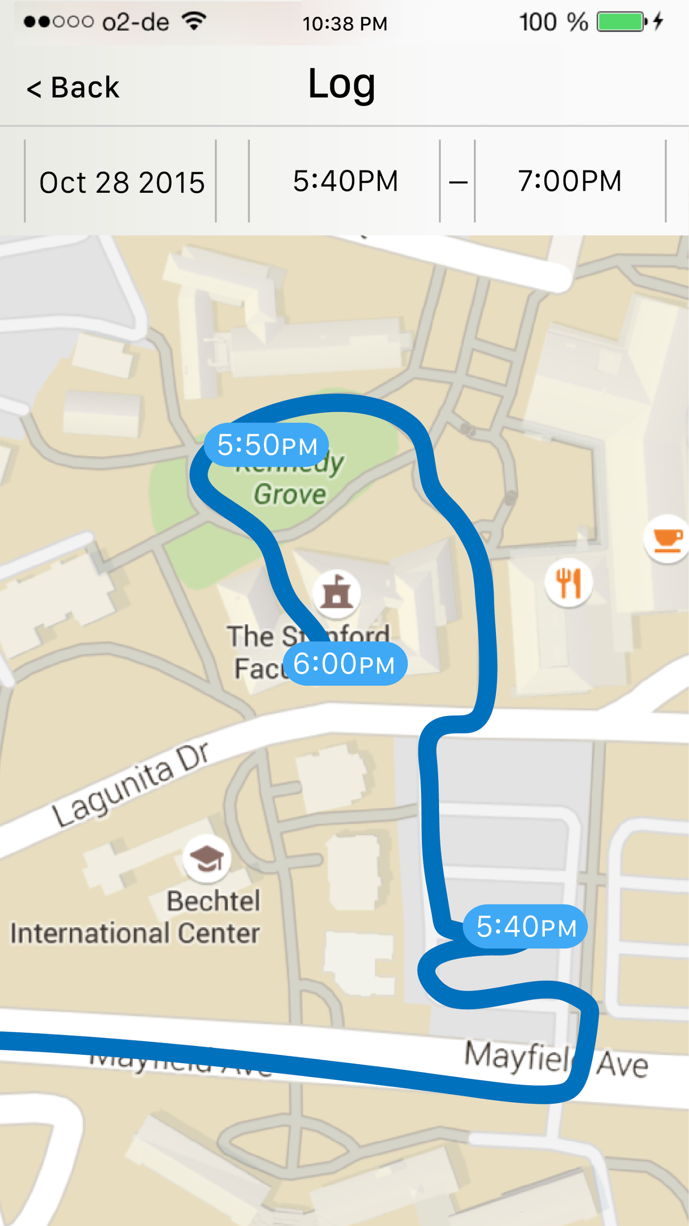
Maps *Complete* Redesign

Slide 16
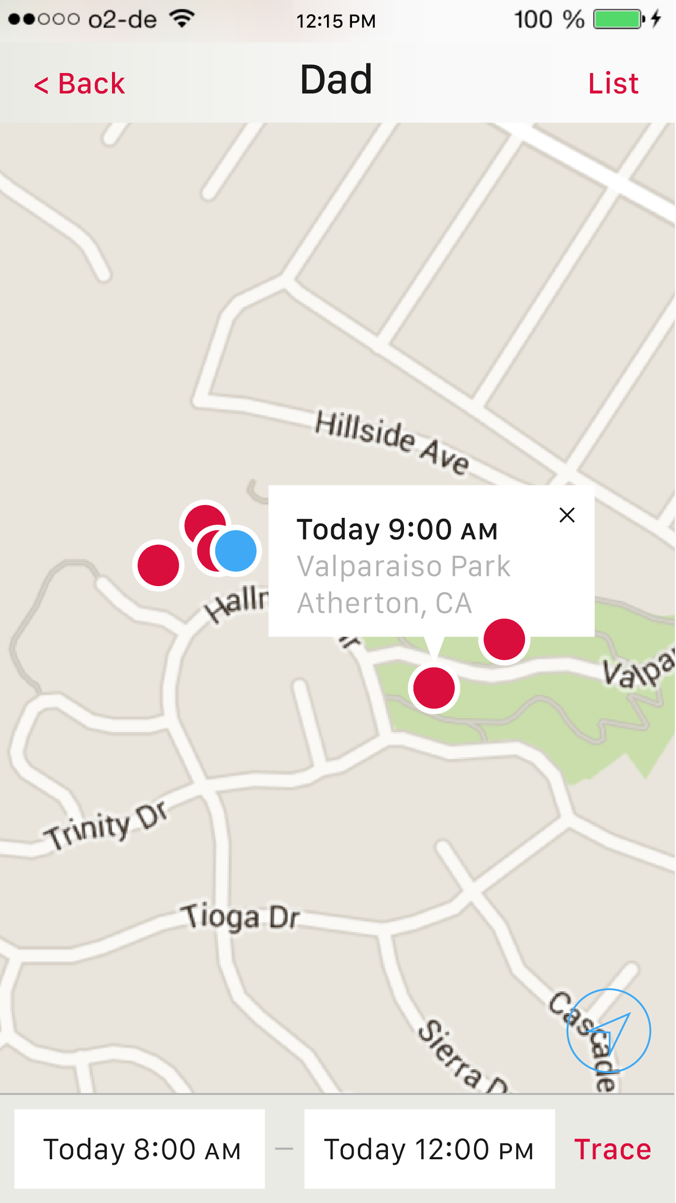
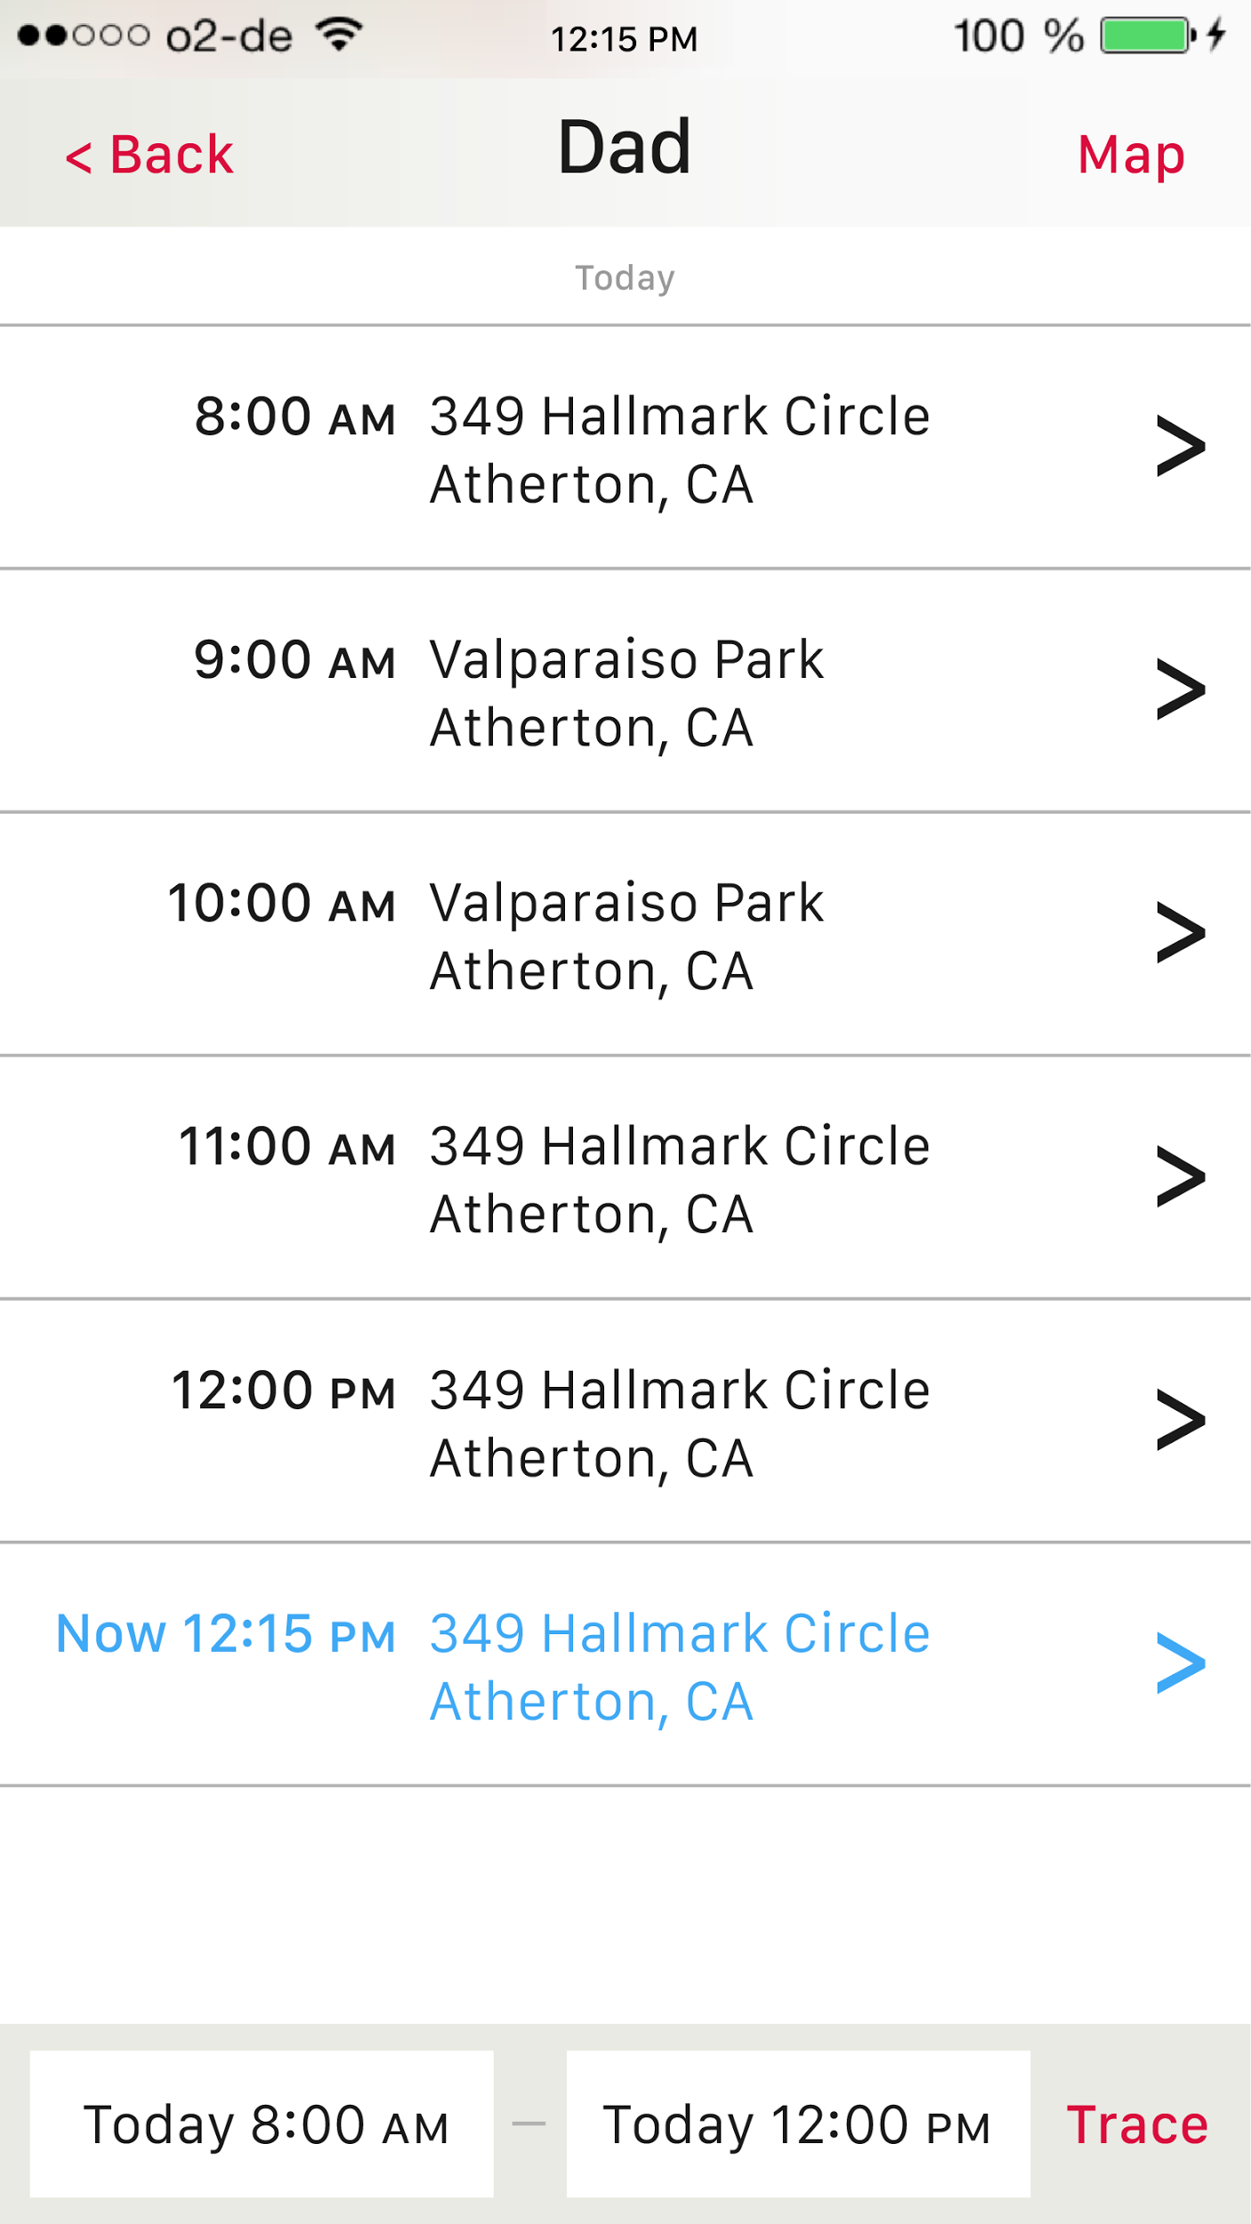
Maps *Complete* Redesign
Combined current location and history into a single screen
Tap points to find exact address
Toggle between map and list view

Slide 17
Hi-Fi Prototype
Midway Report

Slide 18
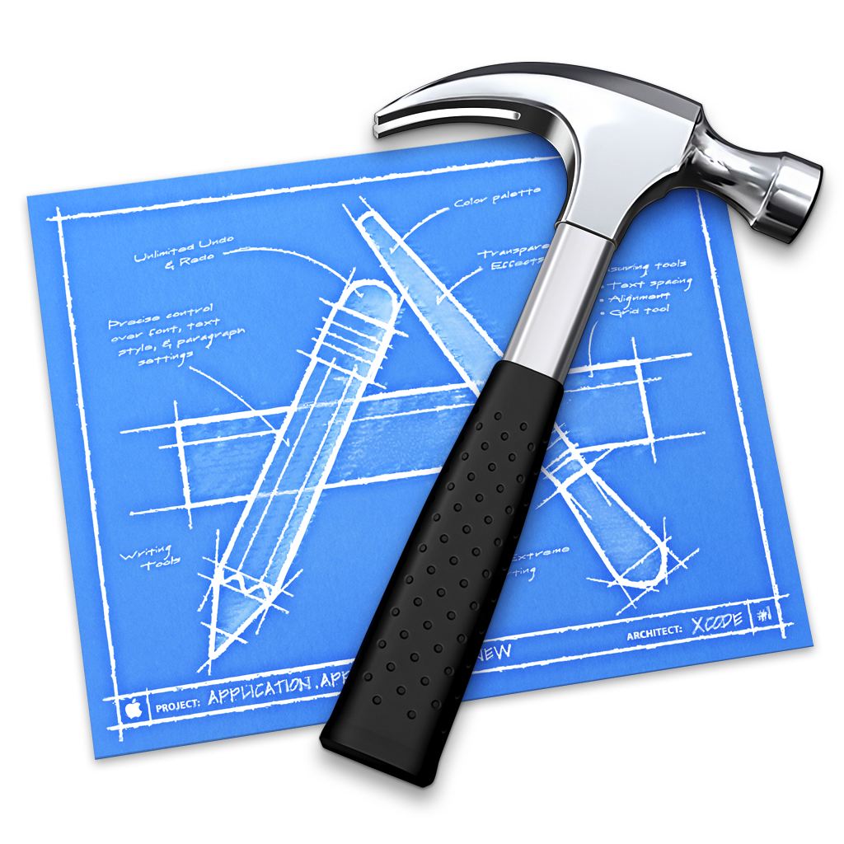
iPhone Application Tools
Xcode
ionic

Slide 19
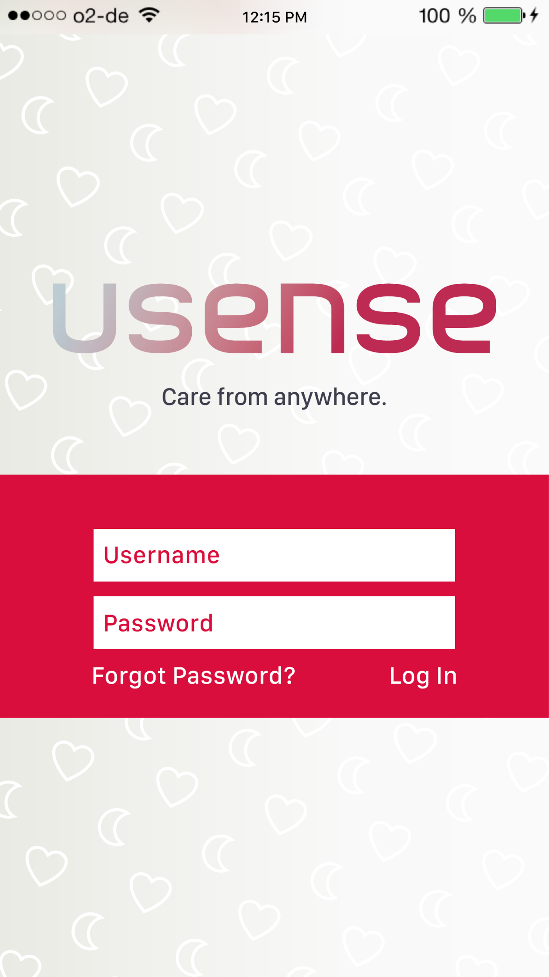
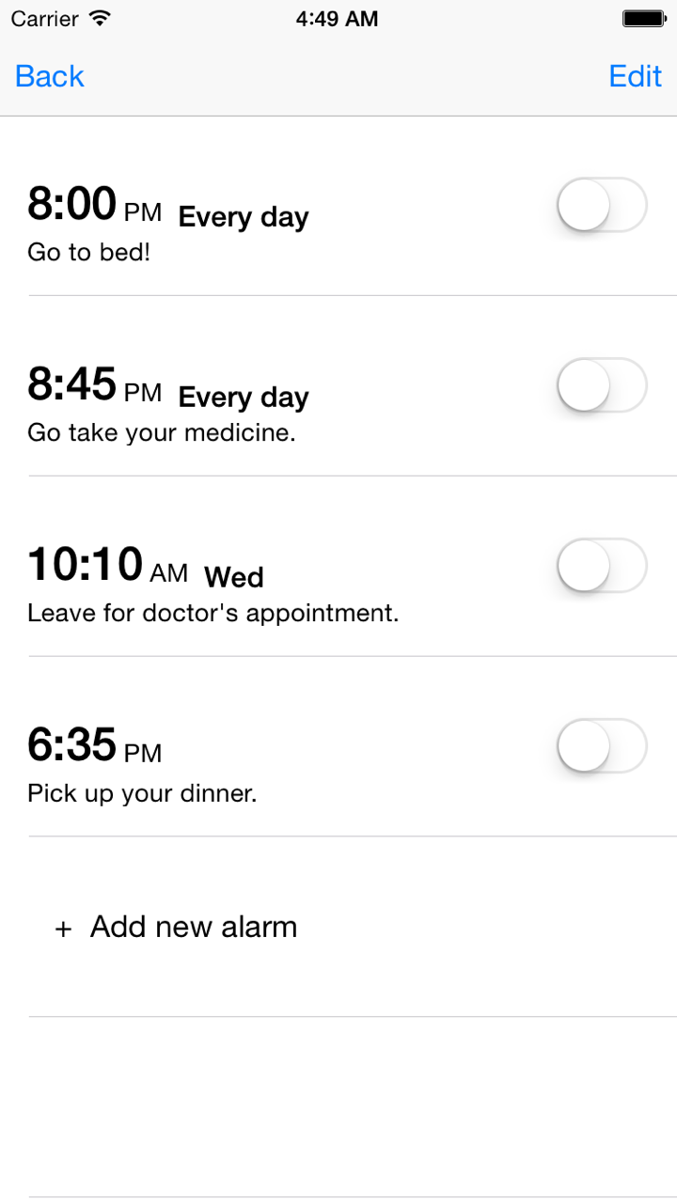
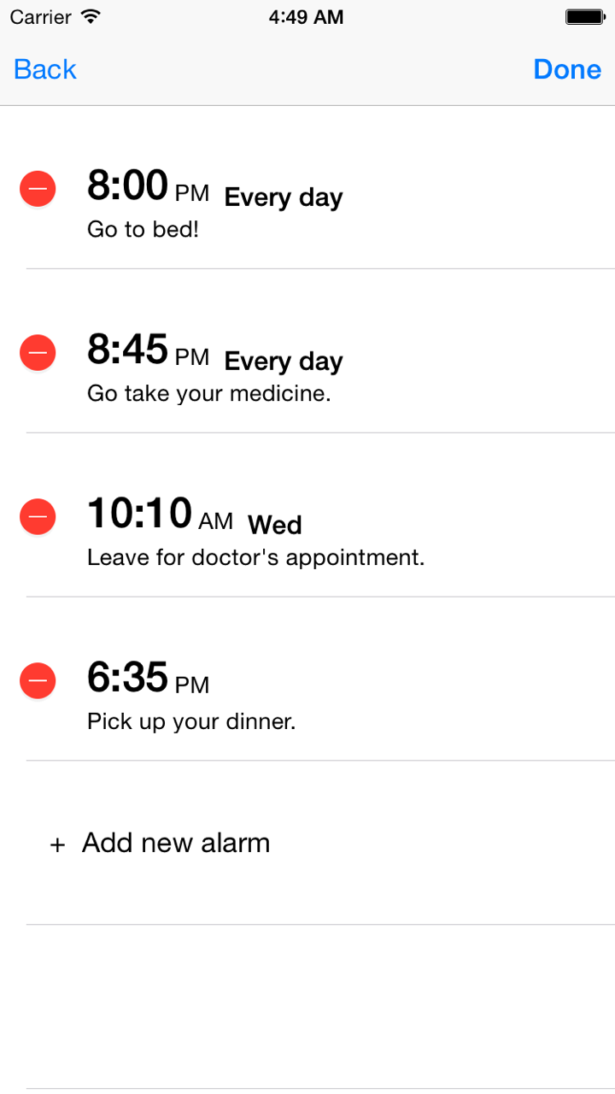
Current Implementation: Log in, Profiles, Alarms

Slide 20
Plan for Finishing
Isaiah - Xcode
Larry - ionic
Larry, Manuel - Report
Jackie - Poster
Wizard of Oz
health alerts
emergency alerts
Hard-coded
Dad’s profile, Mom’s profile
their alarms, health logs, and maps

Slide 21
Hi-Fi Prototype
Demonstration

