Slide 1
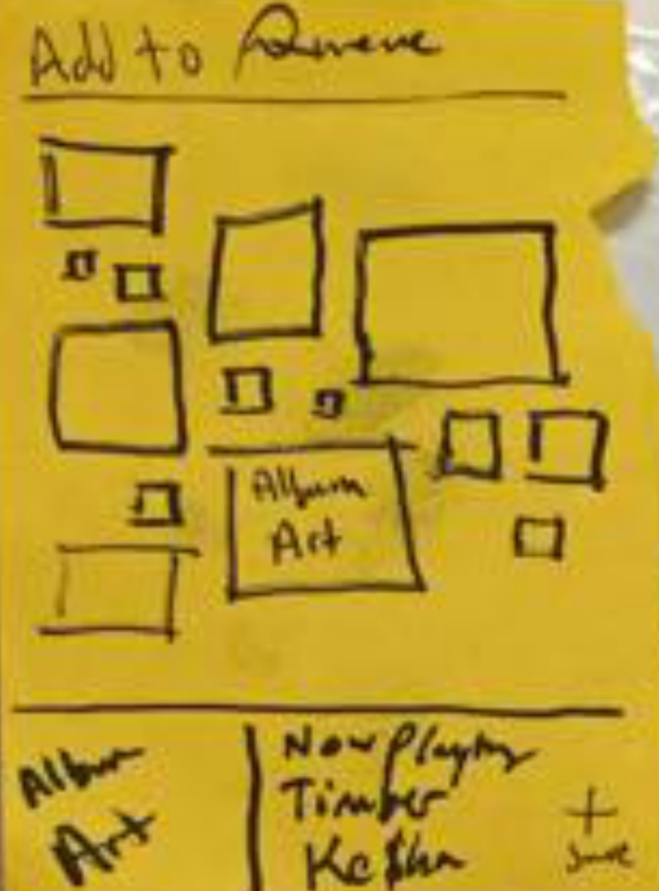
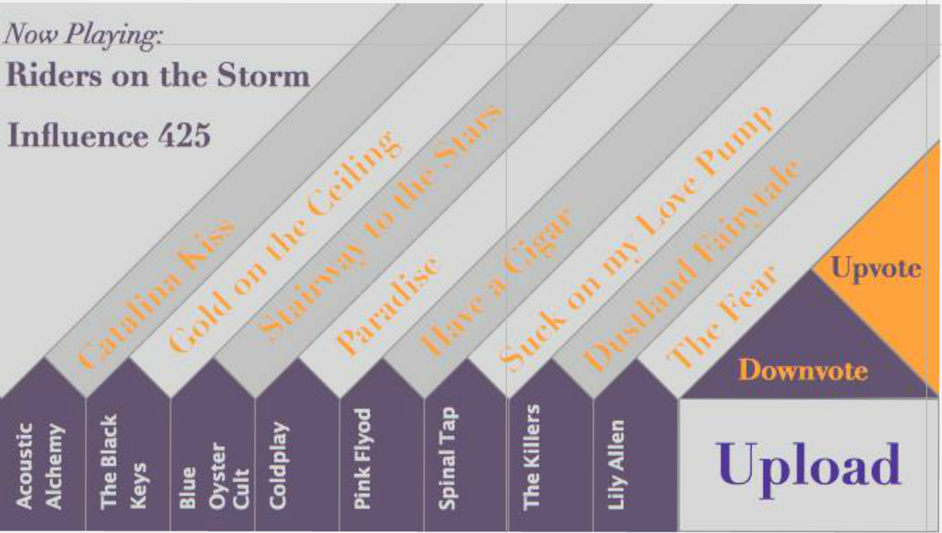
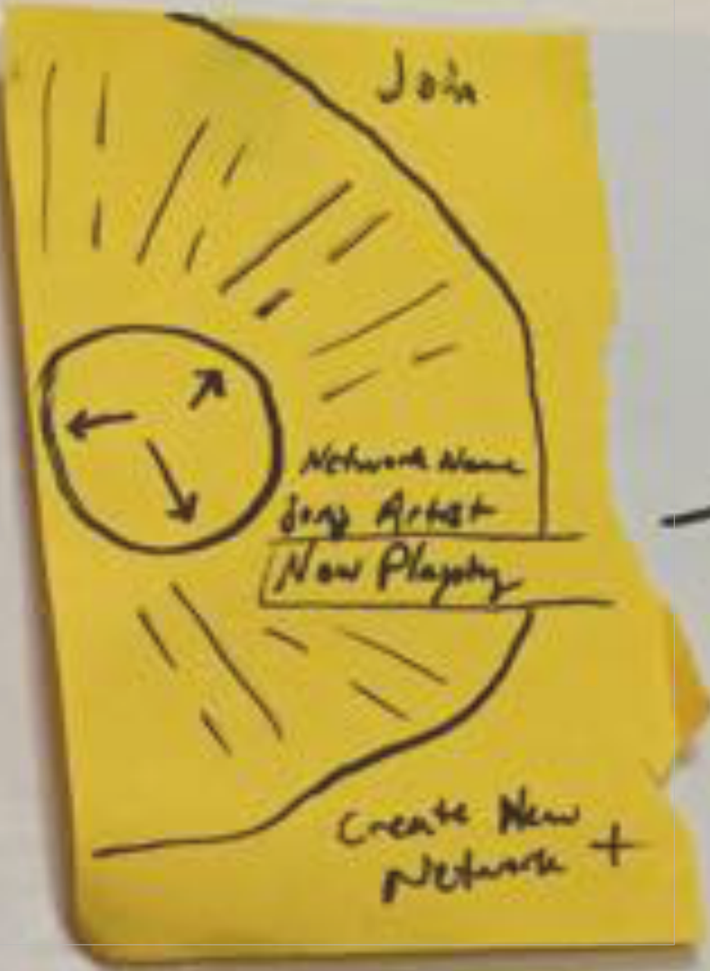
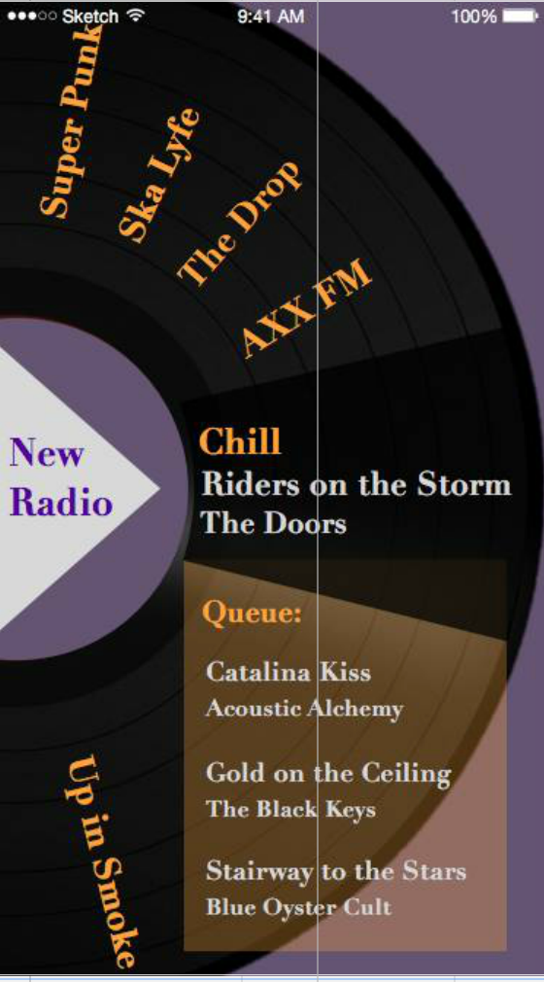
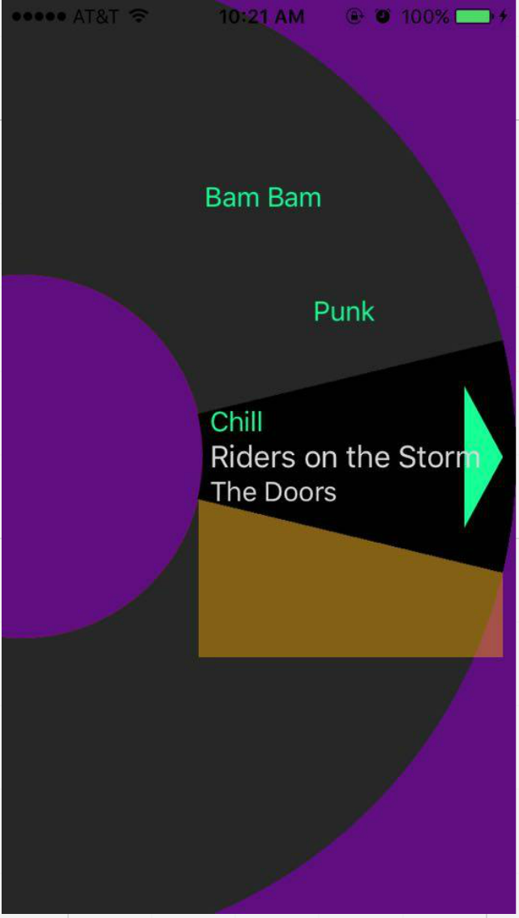
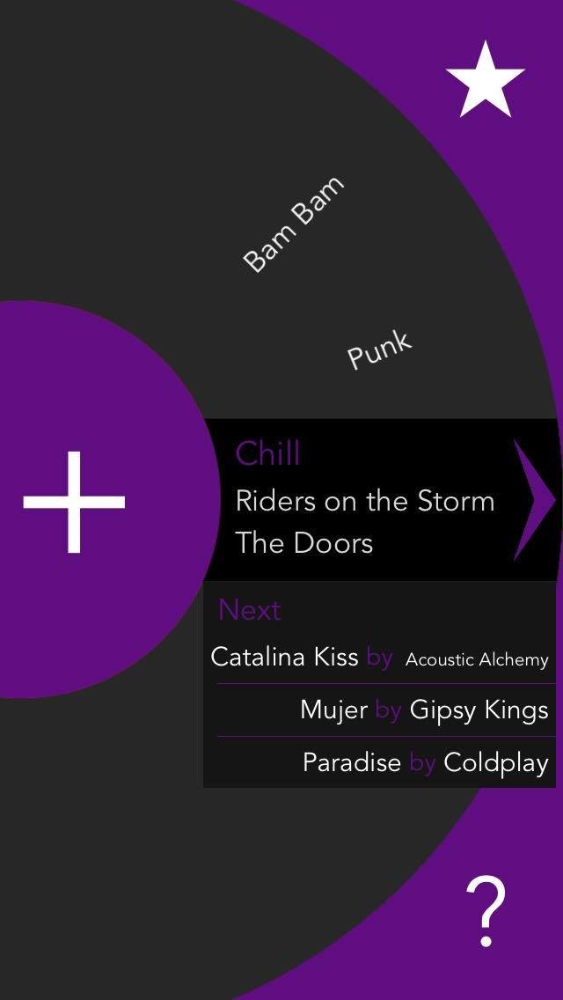
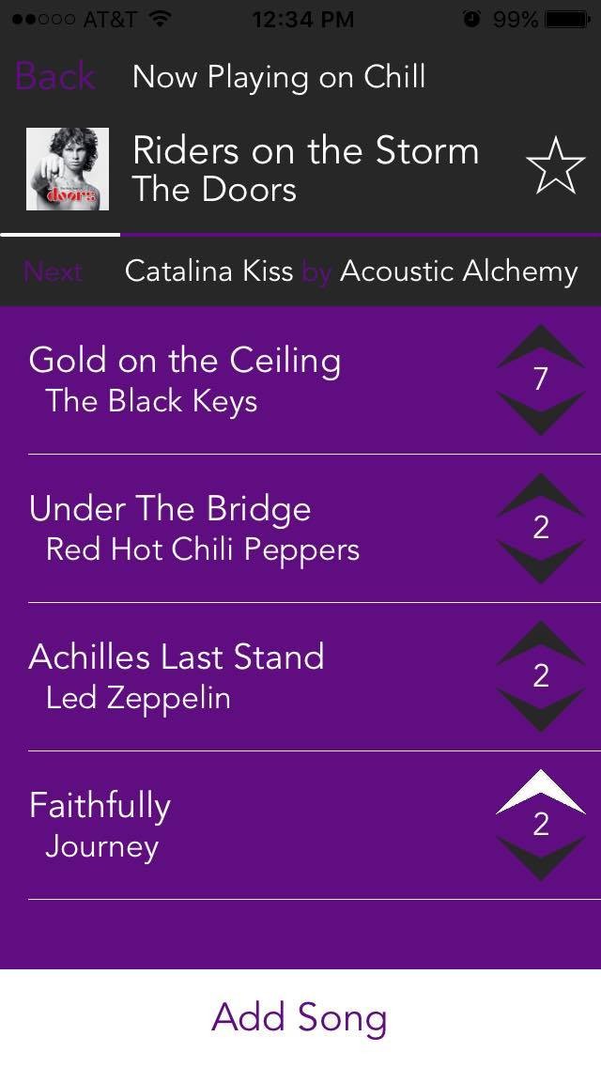
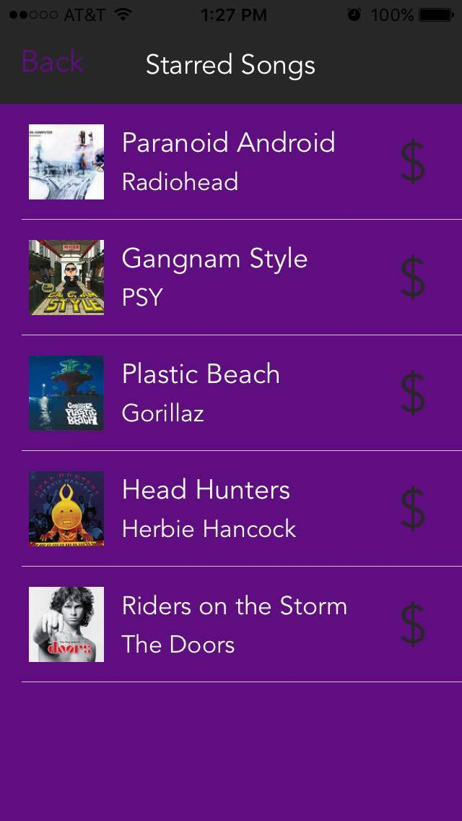
Q
Locally Synchronized Social Radio
Needfinding: People want a way to effortlessly discover and keep track of music recommendations from friends
Countless Ideas
is a crowd-powered radio queue which synchronizes a shared musical experience across many neighboring speakers.
Constant Refinement
‣
‹›
Designing Q
+
Key Features
★
Tune in
Share old
favorites
Star new
ones
Alec A. Sam T. Yvan Q.
hci.stanford.edu/courses/cs147/2015/au/projects/sharing/q/
CS147 Autumn 2015

