Slide 1
Joynus
Medium-Fi Prototyping
Bernardo V. Bronwyn E. Clark P. Hilary S.

Slide 2
Intro
Value Proposition
Connect through spontaneous events
Problem
People long to connect with strangers but find it hard to take the first step
Solution
Provide a service that connects nearby strangers through shared experiences and events

Slide 3
Tasks
Simple
Add “sports” to your interests to be notified about sport events in your area
Medium
Find and join a soccer event
Complex
Create a “Netflix & Chill” event

Slide 4
Major Design Changes

Slide 5
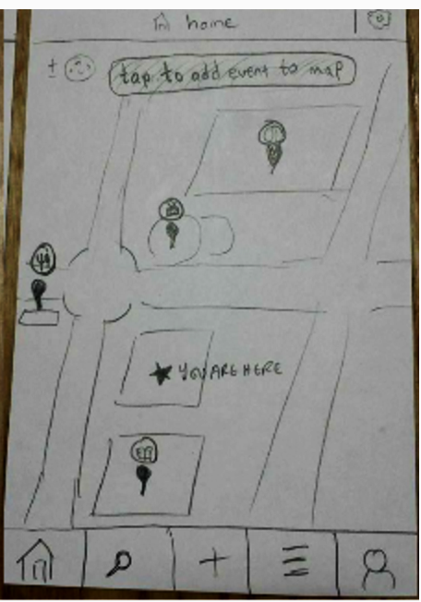
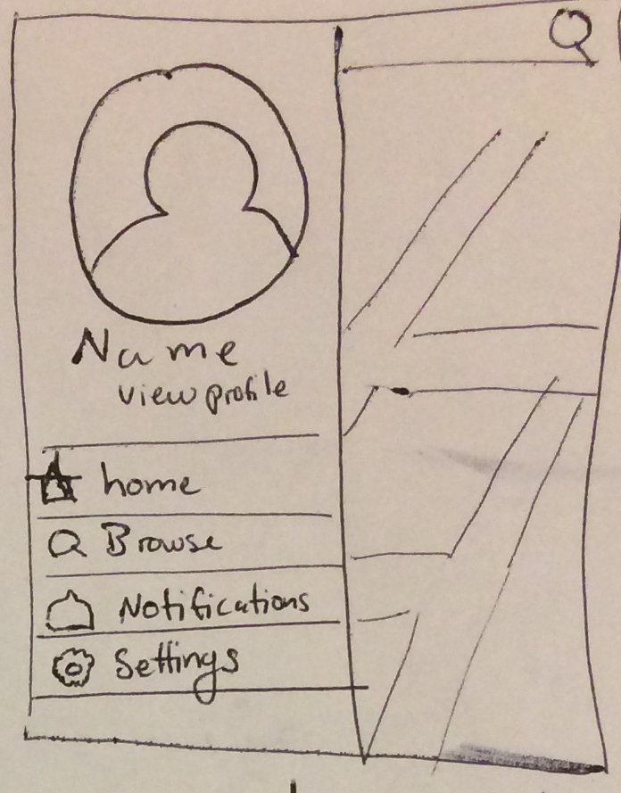
Change 1: Navigation
Navigation bar Navigation drawer (with search on top)
Rationale: Less clutter, only keep most frequently used and most relevant buttons on screen at all times

Slide 6
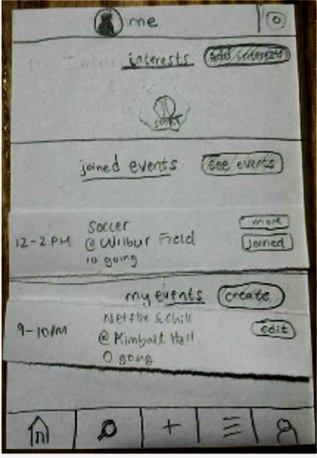
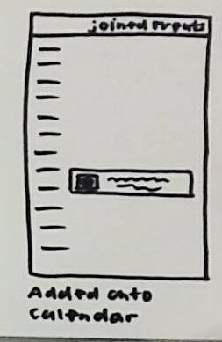
Change 2: Listing
List on profile Separate Calendar List
Rationale: Allows user to form an intuitive itinerary of events rather than a scattered assortment

Slide 7
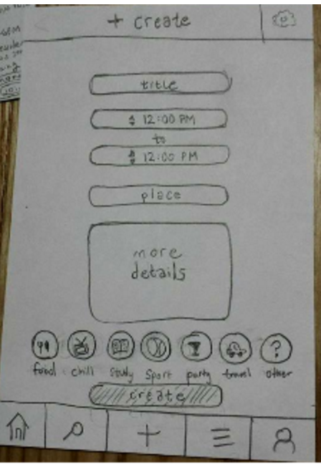
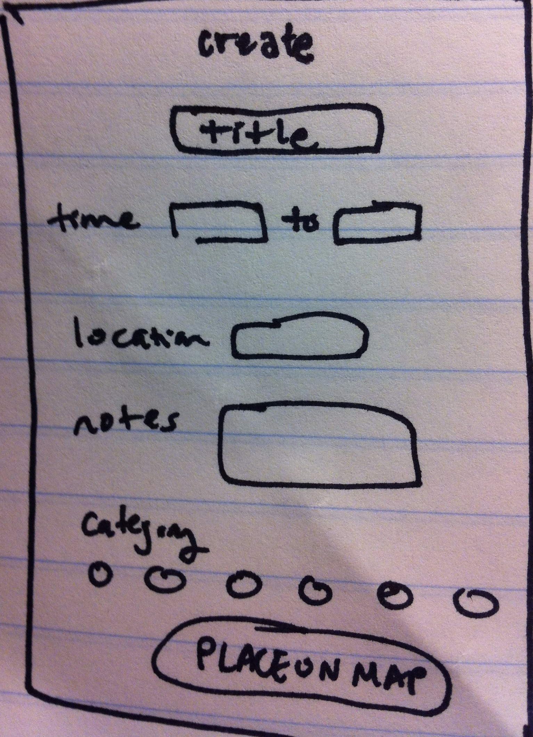
Change 3: Creating
“Create” “Place on Map”
Rationale: Explicitly indicate what the user should do on the next screen to reduce confusion. Place “create” icon directly on map

Slide 8
Medium-Fi Task Flows

Slide 9
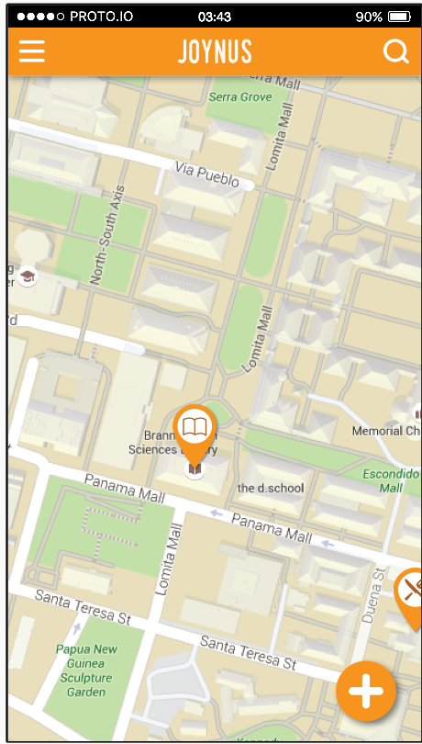
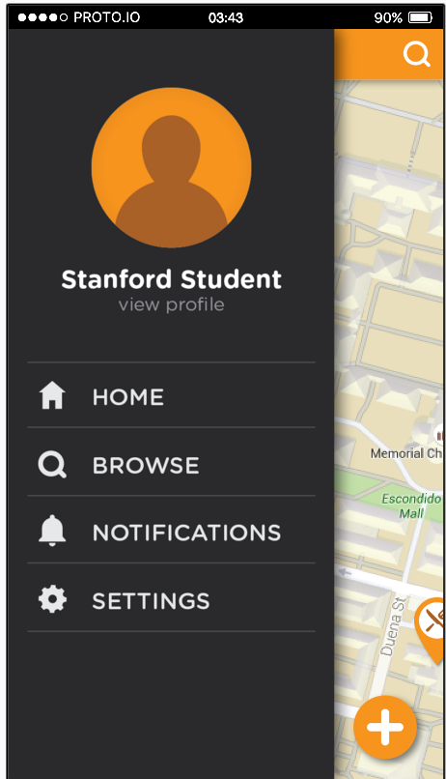
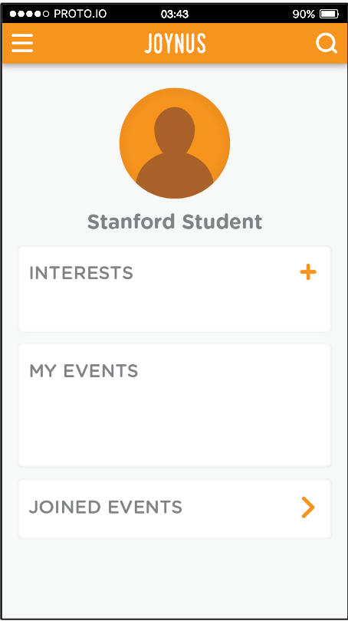
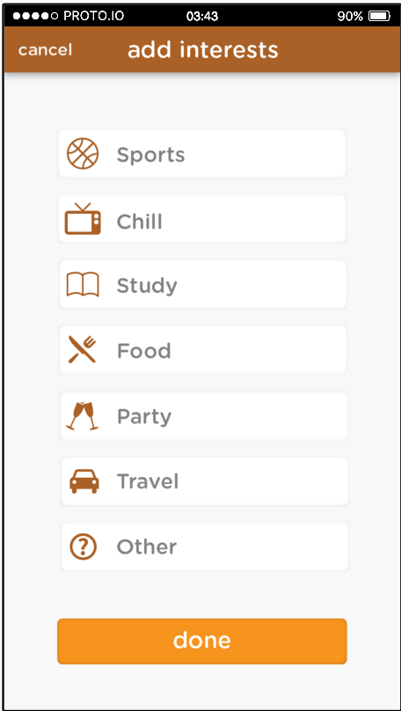
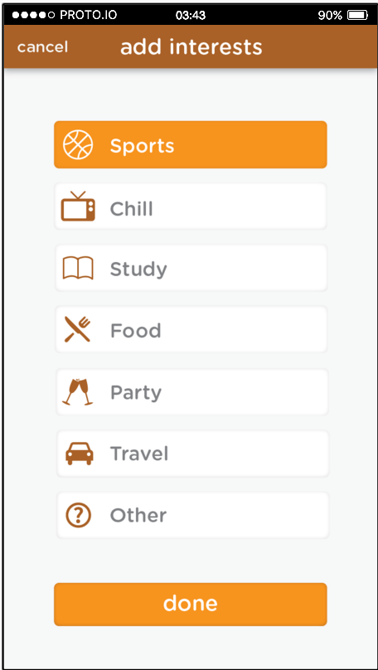
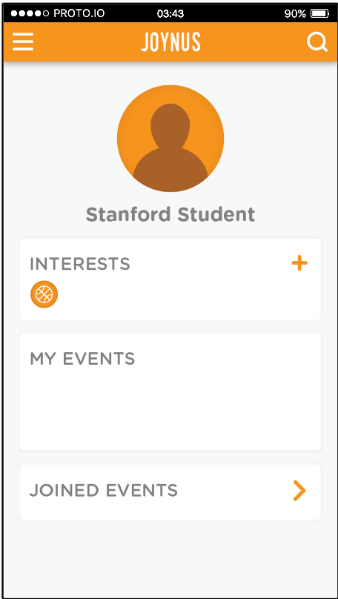
Add Sports to Interests

Slide 10
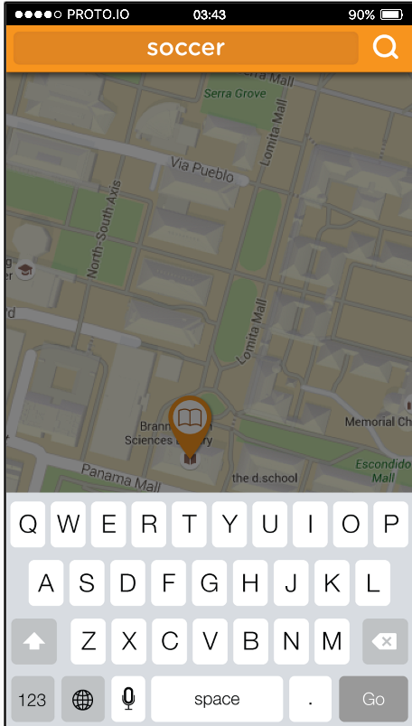
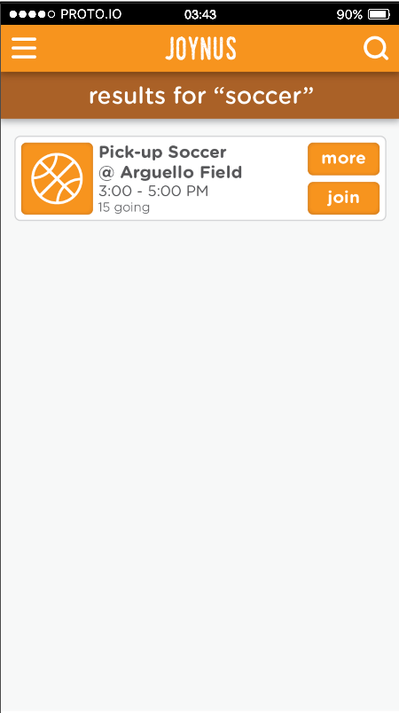
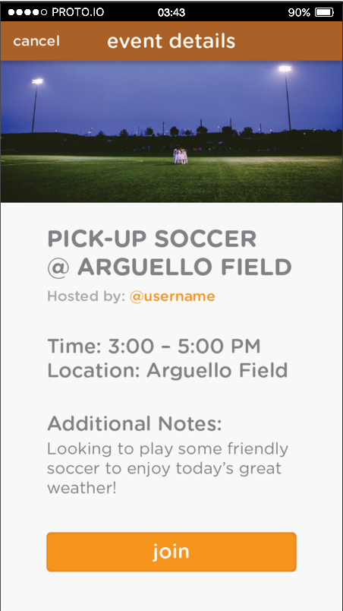
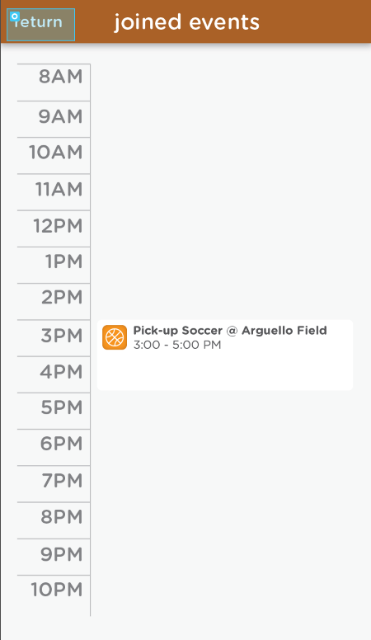
Find and Join Soccer Event

Slide 11
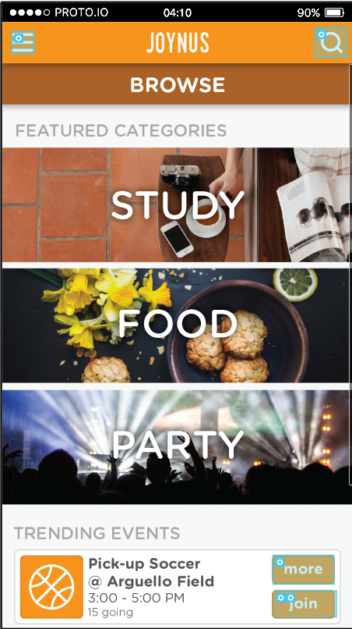
Find and Join Soccer Event (2)

Slide 12
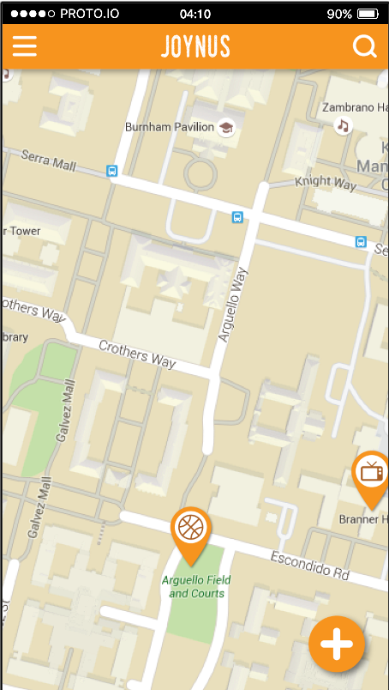
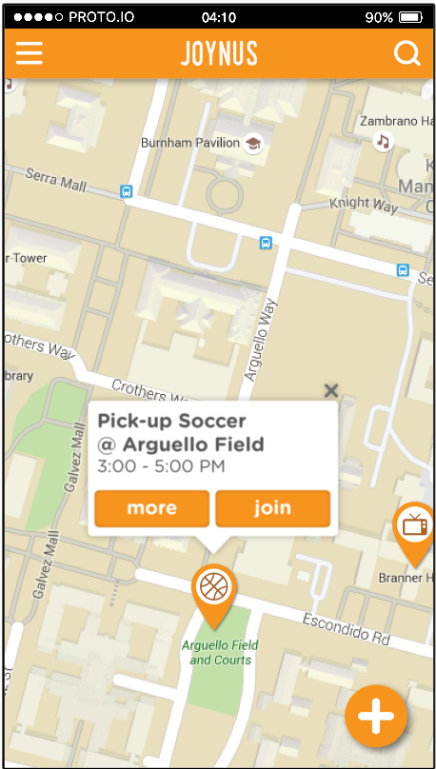
Find and Join Soccer Event (3)

Slide 13
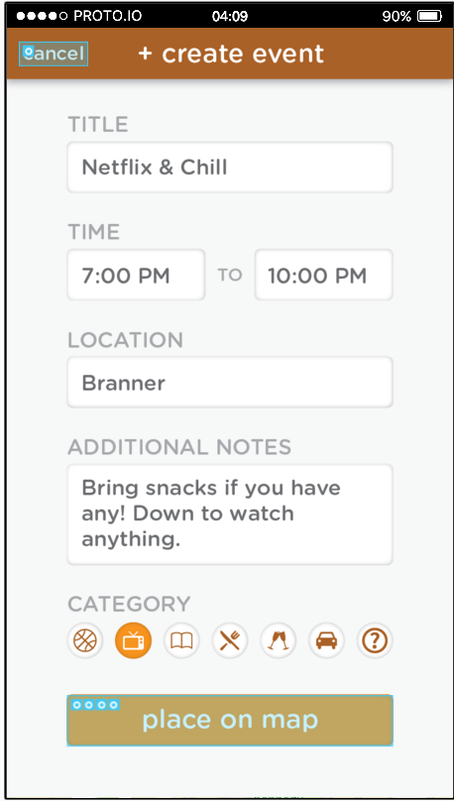
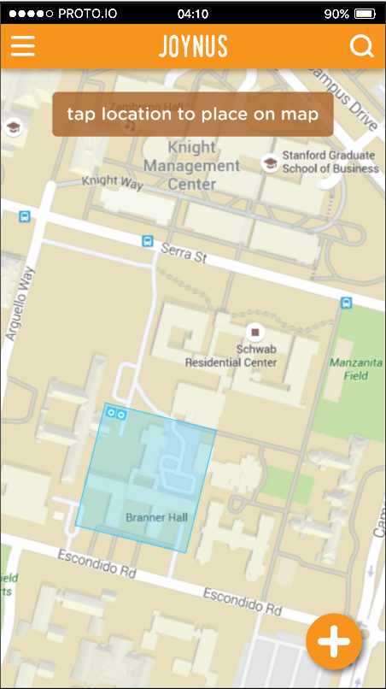
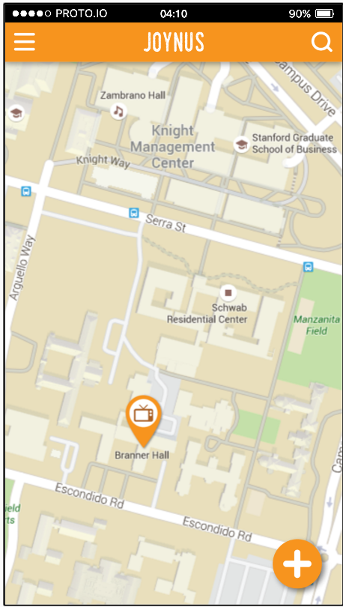
Create Netflix & chill event

Slide 14
Overview

Slide 15
Tool Use
Helpful
Adobe Illustrator integration
Scrollable container for map
Side menu & pages with multiple states
Not helpful
Information storage
Simulating notifications
Typing

Slide 16
Limitations / Trade offs
Map = screenshot
No use of API
Login, settings, & notifications unimplemented
Irrelevant to UI experience for now
No viewing others’ profiles
One event creatable (location predetermined)
One interest selectable
Not necessary for our task flows
Limit on number events to join and categories to select
Limitations on data storage

Slide 17
Oz Techniques & Hard coded
Oz-like touch response
User believes they select where to place their marker, but it is predefined
Why: Inability to track where user taps
Hard coded
Search and create are auto filled to streamline task flow
Map with preset events
Category selected in interests
Why: No typing and minimal data storage

Slide 18
That’s All!

