Slide 1
Needfinding Results
Bronwyn Early, Bernardo Velez, Clark Pang, Hilary Sun

Slide 2
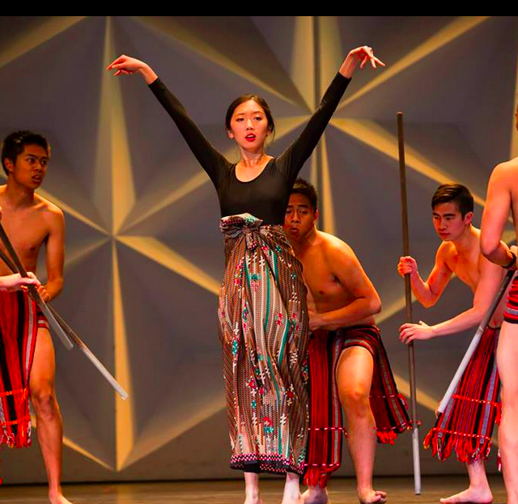
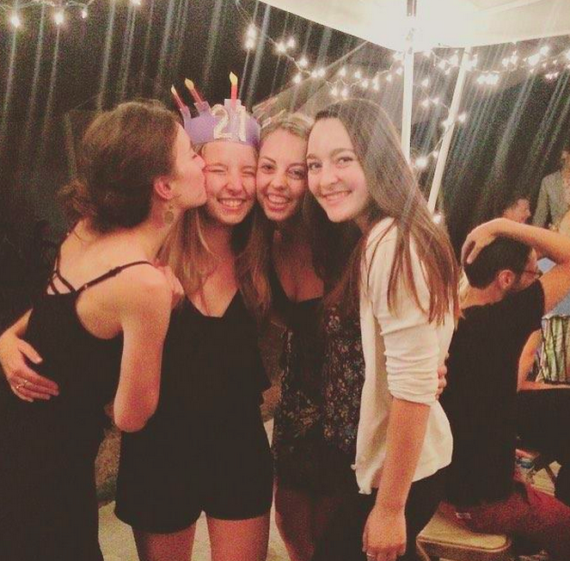
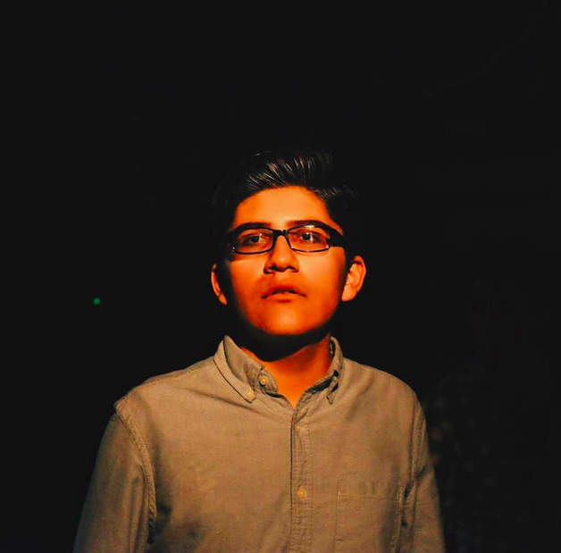
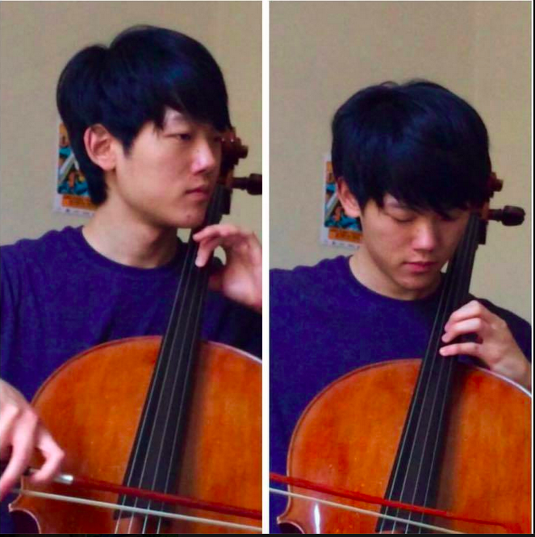
Who we are / What we’re about
Focusing on meals, travel, getting to know strangers, and ways for meals to bring people together

Slide 3
Needfinding Methodology: Visitors at Main Quad
Travelers most often visit main quad - sought immediate tourists’ perspective
Notes:
Susan seemed friendly

Slide 4
Needfinding Methodology: Restaurant Employee
Watches meals take place far more than the average user
Extreme example
Justin of Jazen Tea
Have interacted with a lot as customer
Notes:
In what situations do you share meals with people
Best meal had recently and why
How to find food when traveling (and why)
When he shares food
Interactions with customers
Willing to open up home?
Meet others in a new place?

Slide 5
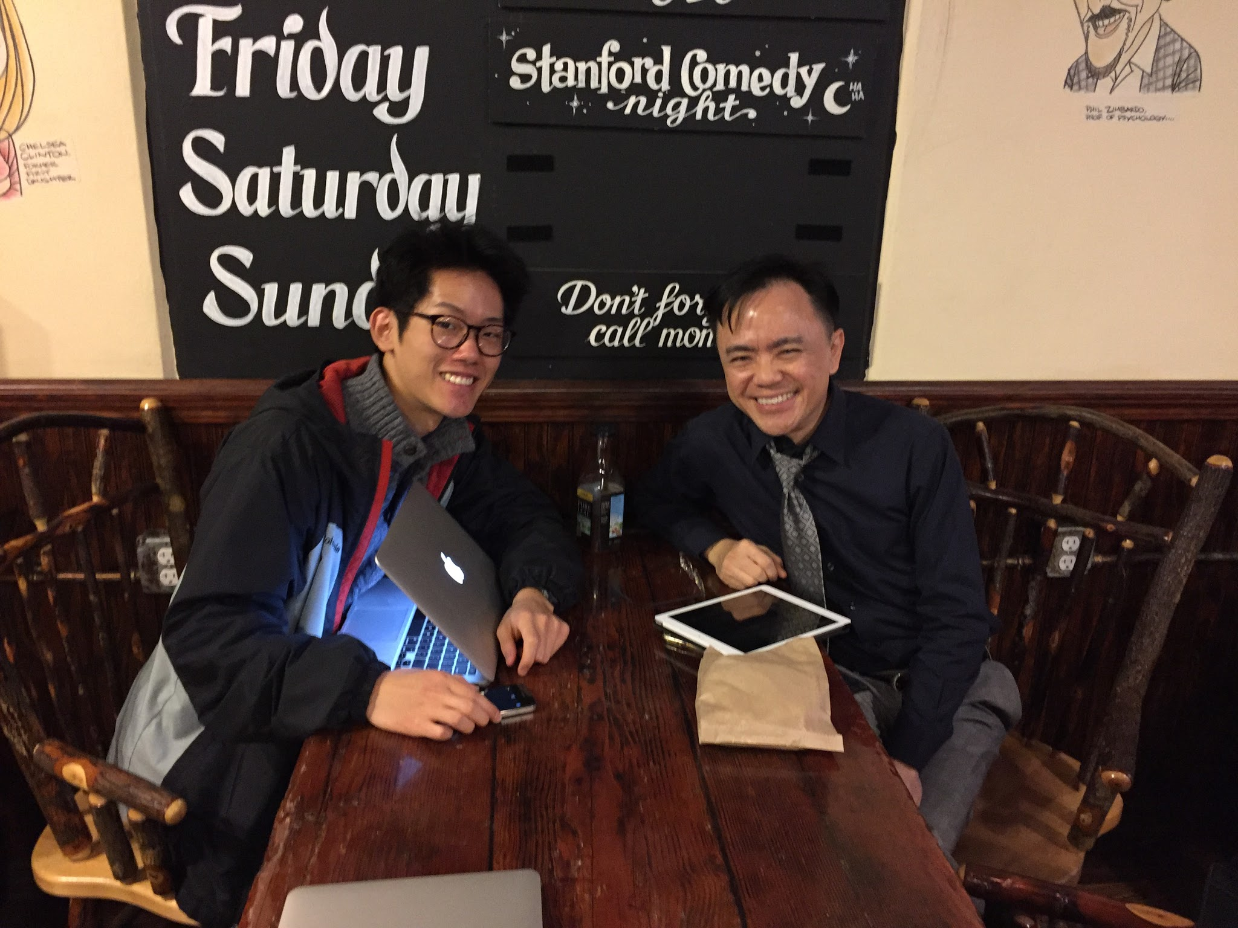
Needfinding Methodology: Locals at a restaurant
those already eating in a restaurant will be thinking about meals
Coho unique place for interaction with strangers
Busyness a factor
University worker atypical worker
Notes:
relatively un busy
girls very different from david
When do you share meals? --- DAVID, MICA & DANIELA
Shared meals with strangers?
Process of searching for new food places?
Adding locals to your party?
Current favorite restaurant

Slide 6
Interview Results: Susan
Middle aged, white woman, short
Former peace corps member, journalist, works with Stanford students now (not sure what capacity)
Meeting people very important when traveling
Frequently eats street food while traveling
Loves the idea of sharing meals with others at home
  Life as a single woman presents unique challenges
Unafraid of interactions with strangers;, but is also atypical user
Surprises: saw the value of interacting with strangers abroad but wouldn’t extend same hospitality
Notes:
only to less privleedged

Slide 7
Interview Results: Justin
Worker at Jazen Tea, chain Vietnamese cafe
Vietnamese, mid-20’s, from Hawaii
In work environment: relaxed, joking,
When traveling, asks locals whenever possible
  Hasn’t been out of country
Prizes interacting with customers, forming relationships
Surprises: mom’s birthday was “family oriented” but mostly described food
Notes:
Shares food w/family, friends,
occasionally gives to homeless

Slide 8
Interview Results: David
From Singapore, started working in Public Affairs Office at Stanford last week
Shares meals as much as possible
Remember a meal because of who you were with, not what you ate
Would be happy to add strangers to party
Good for stomach & soul
Notes:
with strangers, meal sharing starts with communal tables
Technology limiting
Coho is current favorite restaurant - good people watching, variety of people
traveling with local perferred
Relies on referrals from friends/locals when going to new cities
Loves showing off his family’s food
Has experienced hospitatlity in foreign places, would love to give back
Surprised that he was so easy tot alk to

Slide 9
Interview Results: Students
Mica & Danielle
Filipino, freshmen and junior. Humbio & undecided
Always happy to share food with friends, found stranger idea “weird”
  someone who “looks normal” would be acceptable
Have always traveled with others
If meeting a local in new place, safety of top concern
Jenny
Indonesian, eating at Thai cafe
Ultimately preferrs dining hall to eating out
Would be happy to interact with more locals when traveling
Misses home and meals associated
Notes:
noted that dining hall has more people
Misses home cooked food
Indonesian food hard to find
Has had conversation with strangers while traveling
Surprised that thai cafe girl sporadically had meal with man but wasn’t a date
Surprised that girls were hesitant and introverted
Other contradictions

Slide 10
Analysis
Say:
Students relied on apps for finding food, but all preferred local
Meeting people is a great part of traveling
Do
Generally gregarious
Willing to engage
Think
Meals create connection
People and experiences are more meaningful than the food
Feel
Food can feel like home
Feels like best meal experiences involve connection

Slide 11
Analysis II
Questions:
Why are people so distrusting of strangers?
What could make an app more personal?
Why is sharing a meal so valued?
What value does genuine spontaenous interaction with strangers have over a “filtered” sense of reality (through an app)?

Slide 12
Needs and Insights
Needs:
way to find the best local food when traveling
Smaller groups to eat with
familiarity in order to take the first step
find traveling people in their area
to eat!
We all are craving human connection
Insights
People gravitate towards food they gew up with
Initial conversations erase the strangeness
Restaurants with smaller staff grow more relationships
System of trust might be important

Slide 13
Summary
Universal value in sharing meals with others
People seem most receptive to meeting new people when traveling
Element of distrust when interacting with strangers
Most people have a set routine, but if prompted, are receptive to alternatives
Most find it unsettling to make the first leap, but agree the leap would be a positive experience

