Slide 1
Jamalot - Low-Fi Prototyping
By: Matt H.
Yunha H. Mohammed R.

Slide 3
Overview
Mission Statement
Selected Interface
Low-fi prototype structure
Tasks
Method
Results
Recommended Changes
Recap

Slide 4
Jamalot Mission Statement
Problem: Practicing instrument can be lonely task
Solution: Get people together in an official setting (smart practice room) to jam
Value Proposition: Smarter Practice Room

Slide 5
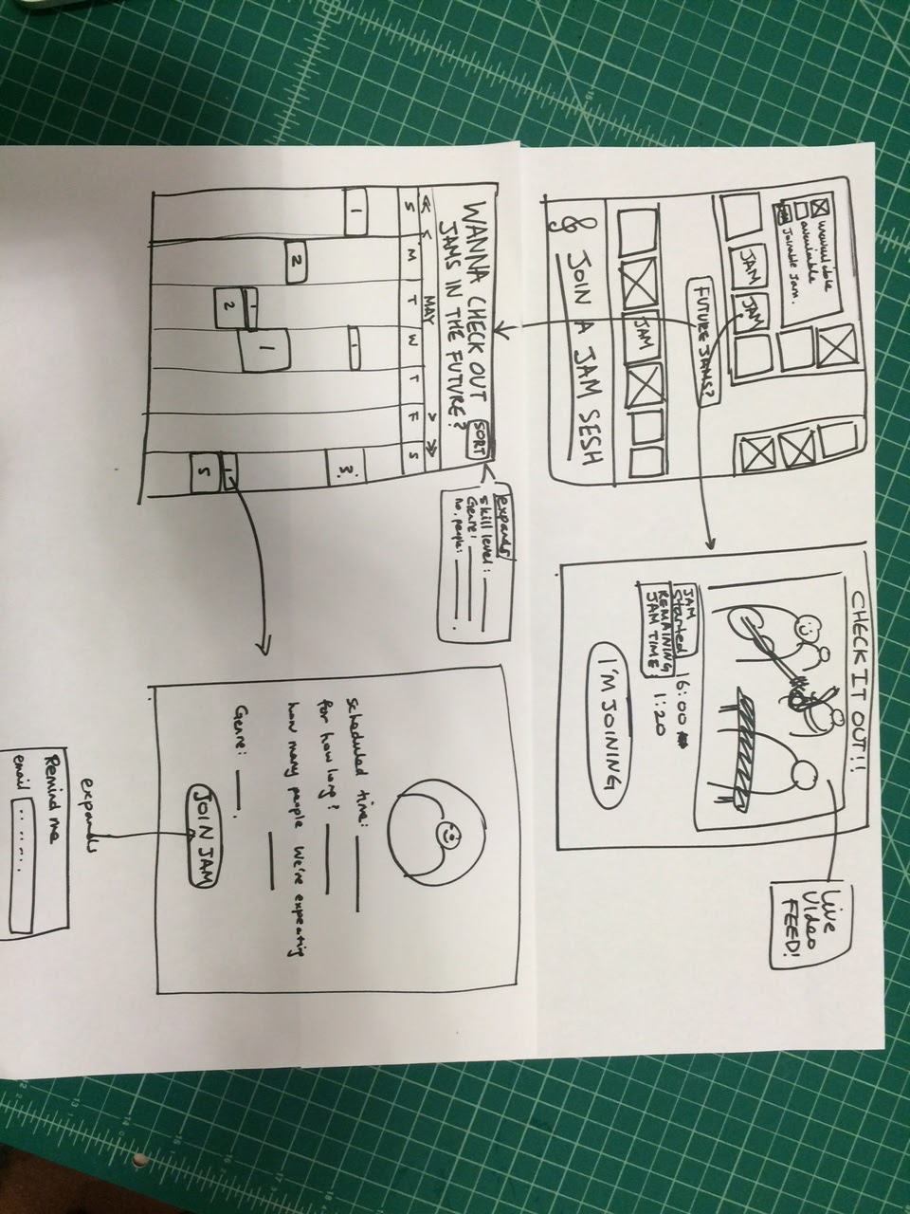
Selected Interface
Considered 4 different design ideas:
IPhone app
Kiosk
Web app
Smart watch
Top 2 : Iphone app, Kiosk
Ultimately, decided upon Kiosk

Slide 6
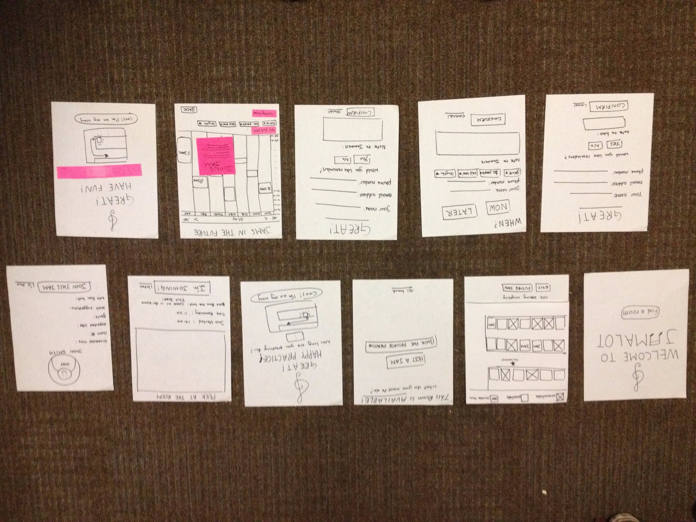
Low-fi Prototype Structure

Slide 7
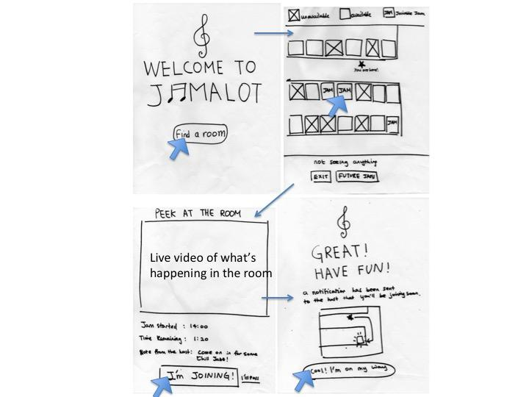
Task 1 - Private Practice

Slide 8
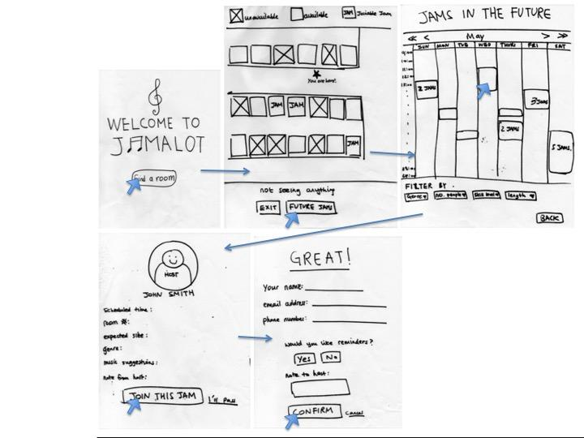
Task 2 - Find a jam in the future

Slide 9
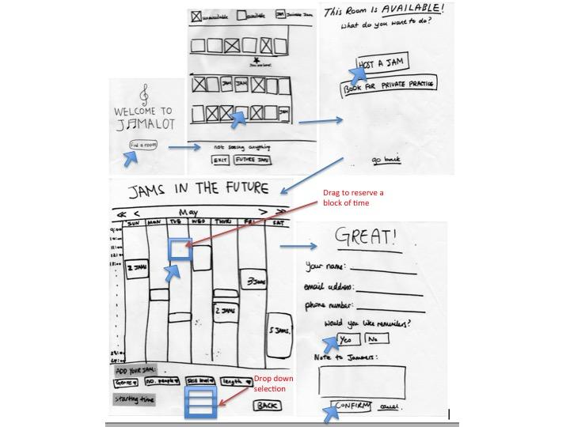
Task 3: Host a Jam

Slide 10
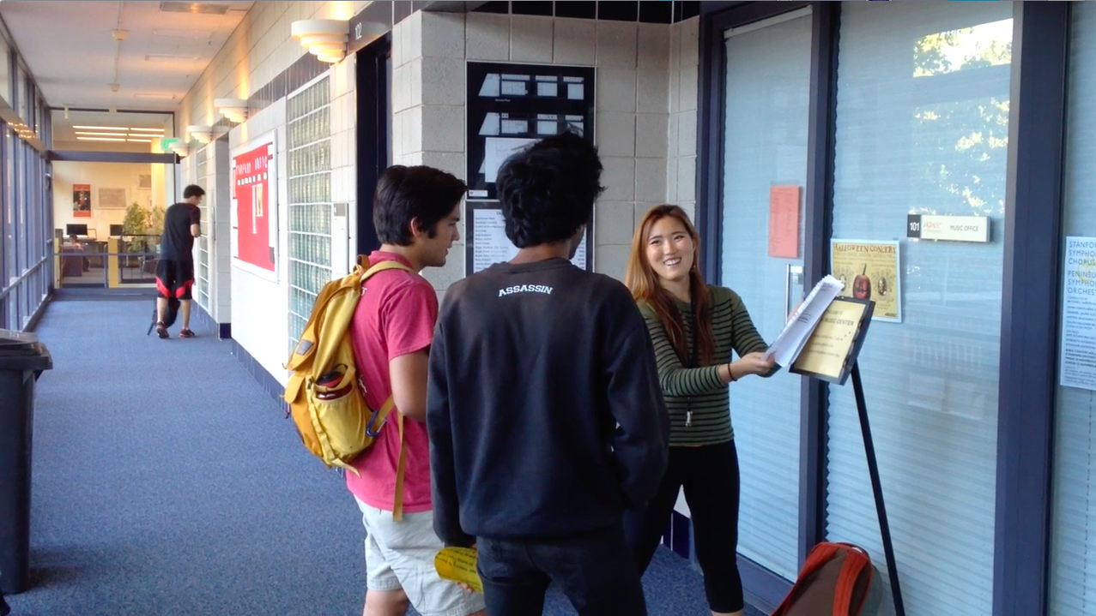
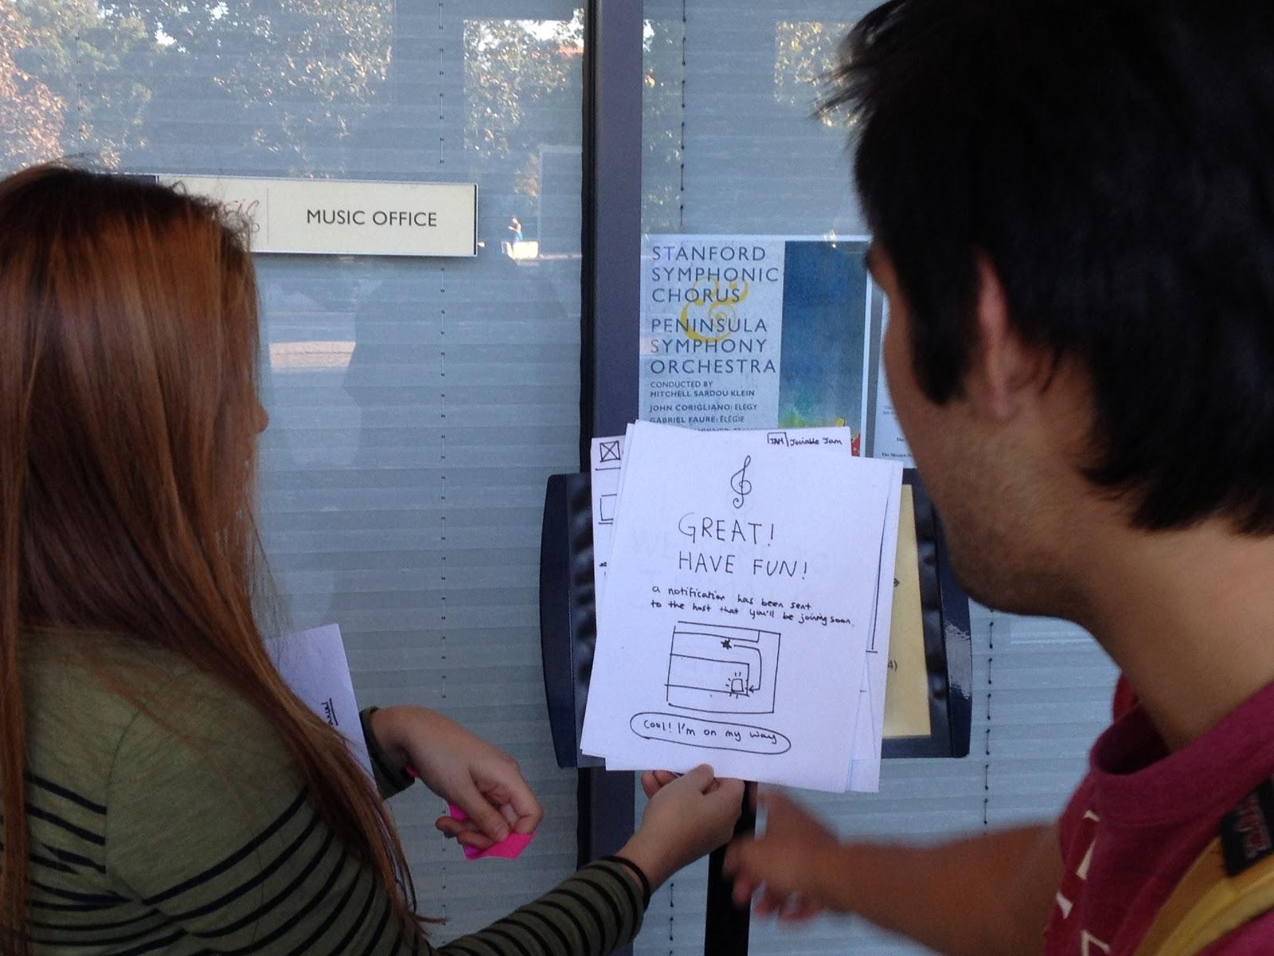
Experimental Method
Participants: Three types of users
Type 1: Musician who practices privately - Jonathan
Type 2: Actively seeks jam sessions - Matthew
Type 3: Passively seeks jam sessions - Frederick
Location: Braun Music Hall
All members of group present for testing
Mohammed - facilitator
Yunha - kiosk
Matthew - scribe

Slide 11
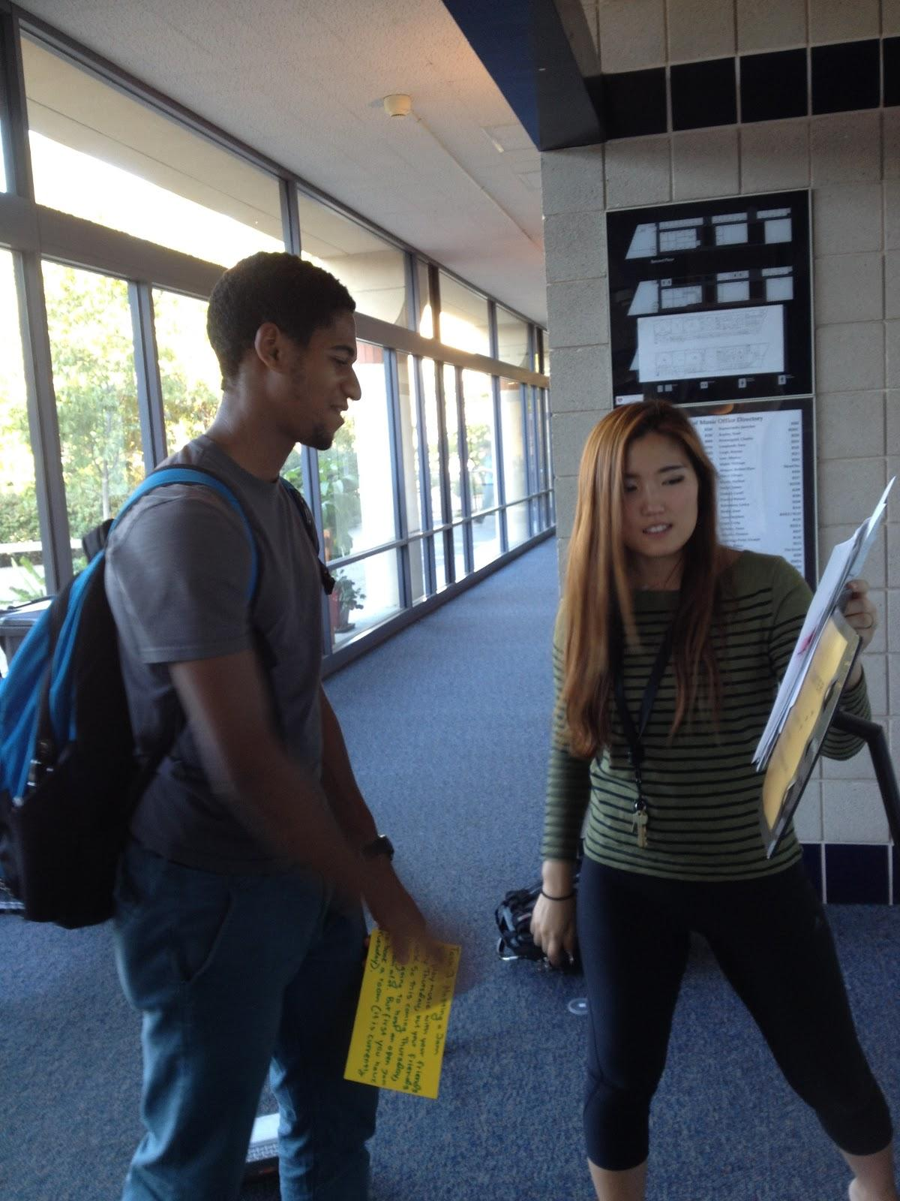
Experimental Results - Jonathon
First Task - Private Practice
seemed intuitive
picked secluded room to practice
confused by map on confirmation page
Second Task - Join a Jam
“maybe this is a blues jam? not sure.” [on calendar]
confirmation page, knew what to do this time
Third Task - Host a Jam
confused on host a jam/ private practice page

Slide 12
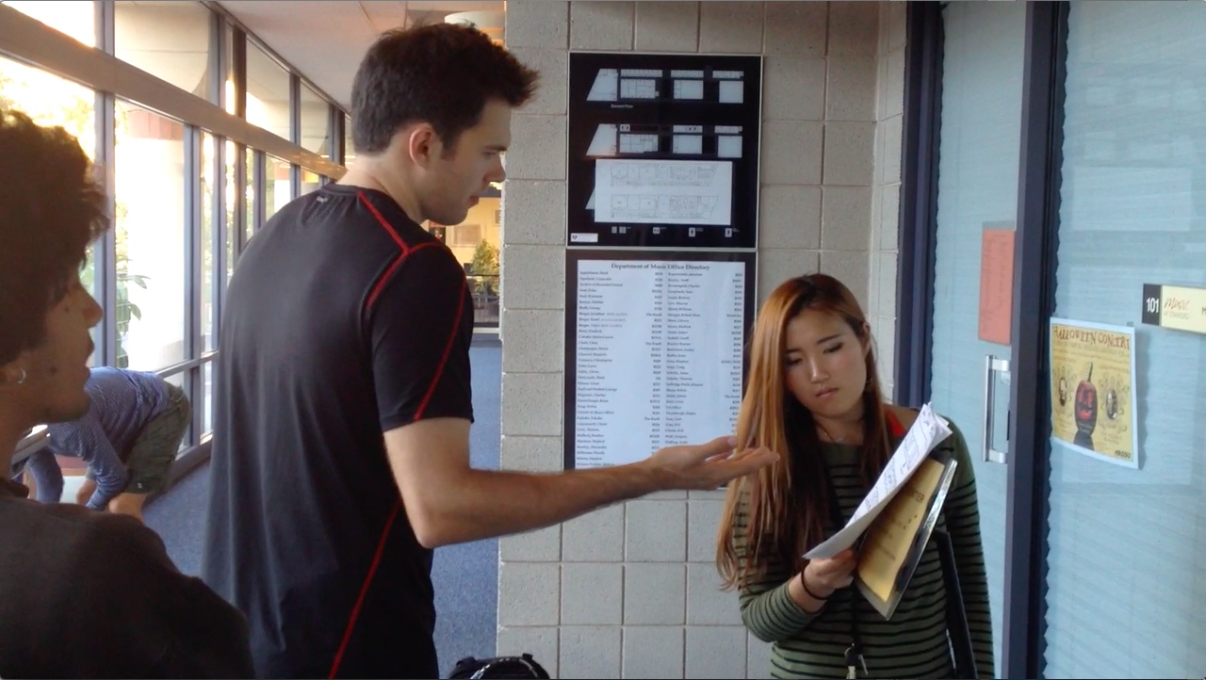
Experimental Results - Matthew
First Task - Private Practice
seemed to like room layout on first page
didn’t immediately get the time entry
didn’t immediately get the map on confirmation page
Second Task - Join a Jam
“I don’t know which one is blues” [on room map page]
“I want to filter by genre”
gets that multiple jams happening at the same time
Third Task - Host a Jam
at first incorrectly set time and date for his jam
“The rooms that are CURRENTLY open should not be the only ones you can book for a future jam”

Slide 13
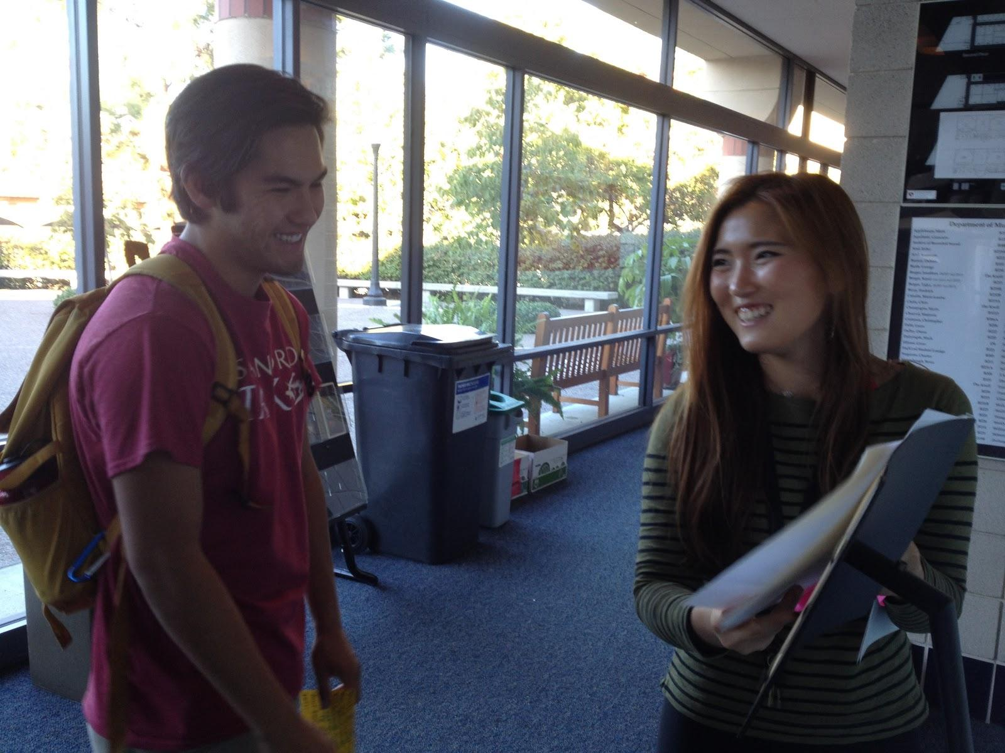
Experimental Results - Frederick
First Task - Private Practice
pauses on room page, took a second to figure out what is here
“I don’t know what that is,” points to map on confirmation page
Second Task - Join a Jam
“do the blank boxes mean open jams or potential spaces for jams”
[on calendar of jams]
paused for a second on the fill out information/ join jam page
Third Task - Host a Jam
Could not distinguish between buttons and typeface
Had to be lead to filling out the specs of the jam

Slide 14
Suggested UI Changes
“It would be cool if it wasn’t just a kiosk, but also an app”
give users ability to create their own genres
allow users to book future jams on the first page
allow users to filter their jam results even before they see the calendar of all jams
make the maps more aesthetically pleasing, user friendly
integrate recording equipment into rooms so that users would be able to listen to their practice session

Slide 15
Summary
Jamalot provides smarter practice sessions
User interacts with kiosk outside of practice room
Tested on three different kinds of users
Some tasks were intuitive (Booking a private session), others were less so (Hosting a Jam)

