Slide 1
Efangelist
Albert Tomasso
Audrey Proulx
Ian Proulx
Sean Klein

Slide 2
Agenda
1
Introduction
2
Value Prop, Problem, and Solution
3
Heuristic Results / Revised Design
4
Current Status
5
Live Demonstration

Slide 3
Agenda
1
Introduction
2
Value Prop, Problem and Solution
3
Heuristic Results / Revised Design
4
Current Status
5
Live Demonstration

Slide 4
EFANGELIST enables listeners to be the ultimate fan…
and artists to cultivate superfans while remaining focused on creating music

Slide 5
Problem:
New artists must build online buzz without investing much
Time
Capital
Technical Expertise
Solution:
Customizable template for branded app with
Access exclusive content
Join a community of fans
Build intimate relationship with artist
Notes:
Upon opening the app, we pushed a dialog box toJean asking for permission to send push notifications, to which she replied “I always say no.” This seemed like a [3] major usability problem if we were counting on these to keep her engaged even after closing the app. After the demo sequence, which she seemed to appreciate, the Livestream interested her: “so you’d actually help them make the music, in a way?” She recognized some of the venues on the “EVENTS” page, which got her excited. When she went to buy her tickets, Jean was pleasantly surprised when the points-earned dialog appeared onscreen. However, when probed, she said “I’m not interested in points so I wouldn’t be the one pushing those things. I wouldn’t want to share my personal information, and wouldn’t want the points anyway.” Again, this seemed like a [4] catastrophic blow, but likewise on further explanation she perked up, saying “tickets and everything, wow—that seems worthwhile.” Interestingly, she had a similar reaction as Holly to the support feature, thinking it was technical support. After 2 out of 2 respondents stumbled over the same label, we crossed it out right after that and replaced it with “CONTRIBUTE.” She also seemed unsure of how to use the fan features, asking “how would I connect with other fans?” Looking at the FanMap feature, she said that “I wouldn’t know what that means.” These seemed like a [3] major usability problem that will need to be addressed.

Slide 6
Agenda
1
Introduction
2
Value Prop, Problem, and Solution
3
Heuristic Results / Revised Design
4
Current Status
5
Live Demonstration

Slide 7
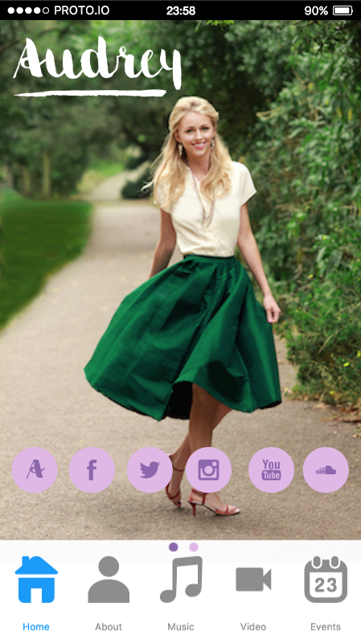
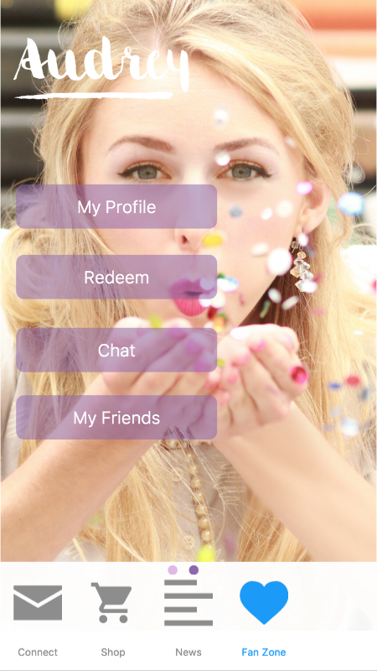
Simplify navigation buttons
Reduce clutter
Prioritize key features
Notes:
Upon opening the app, we pushed a dialog box toJean asking for permission to send push notifications, to which she replied “I always say no.” This seemed like a [3] major usability problem if we were counting on these to keep her engaged even after closing the app. After the demo sequence, which she seemed to appreciate, the Livestream interested her: “so you’d actually help them make the music, in a way?” She recognized some of the venues on the “EVENTS” page, which got her excited. When she went to buy her tickets, Jean was pleasantly surprised when the points-earned dialog appeared onscreen. However, when probed, she said “I’m not interested in points so I wouldn’t be the one pushing those things. I wouldn’t want to share my personal information, and wouldn’t want the points anyway.” Again, this seemed like a [4] catastrophic blow, but likewise on further explanation she perked up, saying “tickets and everything, wow—that seems worthwhile.” Interestingly, she had a similar reaction as Holly to the support feature, thinking it was technical support. After 2 out of 2 respondents stumbled over the same label, we crossed it out right after that and replaced it with “CONTRIBUTE.” She also seemed unsure of how to use the fan features, asking “how would I connect with other fans?” Looking at the FanMap feature, she said that “I wouldn’t know what that means.” These seemed like a [3] major usability problem that will need to be addressed.

Slide 8
Design Principles
App supplement to a website, not an app version of a website
Dynamic vs. static content
Exclusive access to the artist and their media wherever possible

Slide 9
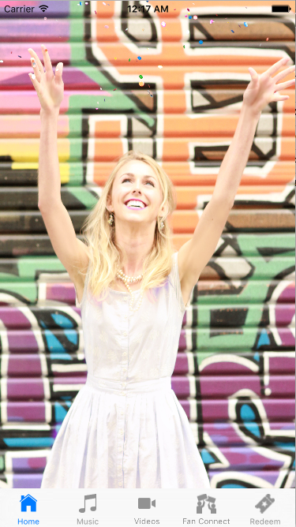
Notes:
Upon opening the app, we pushed a dialog box toJean asking for permission to send push notifications, to which she replied “I always say no.” This seemed like a [3] major usability problem if we were counting on these to keep her engaged even after closing the app. After the demo sequence, which she seemed to appreciate, the Livestream interested her: “so you’d actually help them make the music, in a way?” She recognized some of the venues on the “EVENTS” page, which got her excited. When she went to buy her tickets, Jean was pleasantly surprised when the points-earned dialog appeared onscreen. However, when probed, she said “I’m not interested in points so I wouldn’t be the one pushing those things. I wouldn’t want to share my personal information, and wouldn’t want the points anyway.” Again, this seemed like a [4] catastrophic blow, but likewise on further explanation she perked up, saying “tickets and everything, wow—that seems worthwhile.” Interestingly, she had a similar reaction as Holly to the support feature, thinking it was technical support. After 2 out of 2 respondents stumbled over the same label, we crossed it out right after that and replaced it with “CONTRIBUTE.” She also seemed unsure of how to use the fan features, asking “how would I connect with other fans?” Looking at the FanMap feature, she said that “I wouldn’t know what that means.” These seemed like a [3] major usability problem that will need to be addressed.

Slide 10
Make better use of home screen
Highlight new content
Keep users within the app
Notes:
Upon opening the app, we pushed a dialog box toJean asking for permission to send push notifications, to which she replied “I always say no.” This seemed like a [3] major usability problem if we were counting on these to keep her engaged even after closing the app. After the demo sequence, which she seemed to appreciate, the Livestream interested her: “so you’d actually help them make the music, in a way?” She recognized some of the venues on the “EVENTS” page, which got her excited. When she went to buy her tickets, Jean was pleasantly surprised when the points-earned dialog appeared onscreen. However, when probed, she said “I’m not interested in points so I wouldn’t be the one pushing those things. I wouldn’t want to share my personal information, and wouldn’t want the points anyway.” Again, this seemed like a [4] catastrophic blow, but likewise on further explanation she perked up, saying “tickets and everything, wow—that seems worthwhile.” Interestingly, she had a similar reaction as Holly to the support feature, thinking it was technical support. After 2 out of 2 respondents stumbled over the same label, we crossed it out right after that and replaced it with “CONTRIBUTE.” She also seemed unsure of how to use the fan features, asking “how would I connect with other fans?” Looking at the FanMap feature, she said that “I wouldn’t know what that means.” These seemed like a [3] major usability problem that will need to be addressed.

Slide 11
News Feed
Notes:
Upon opening the app, we pushed a dialog box toJean asking for permission to send push notifications, to which she replied “I always say no.” This seemed like a [3] major usability problem if we were counting on these to keep her engaged even after closing the app. After the demo sequence, which she seemed to appreciate, the Livestream interested her: “so you’d actually help them make the music, in a way?” She recognized some of the venues on the “EVENTS” page, which got her excited. When she went to buy her tickets, Jean was pleasantly surprised when the points-earned dialog appeared onscreen. However, when probed, she said “I’m not interested in points so I wouldn’t be the one pushing those things. I wouldn’t want to share my personal information, and wouldn’t want the points anyway.” Again, this seemed like a [4] catastrophic blow, but likewise on further explanation she perked up, saying “tickets and everything, wow—that seems worthwhile.” Interestingly, she had a similar reaction as Holly to the support feature, thinking it was technical support. After 2 out of 2 respondents stumbled over the same label, we crossed it out right after that and replaced it with “CONTRIBUTE.” She also seemed unsure of how to use the fan features, asking “how would I connect with other fans?” Looking at the FanMap feature, she said that “I wouldn’t know what that means.” These seemed like a [3] major usability problem that will need to be addressed.

Slide 12
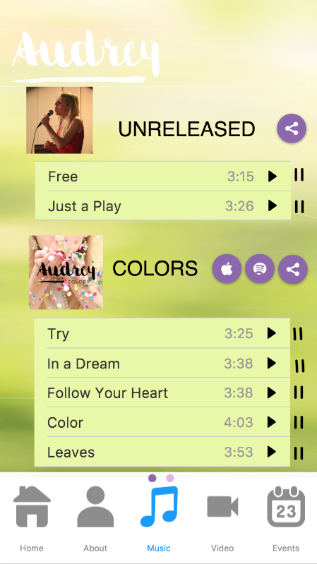
Fix music player bugginess
Notes:
Upon opening the app, we pushed a dialog box toJean asking for permission to send push notifications, to which she replied “I always say no.” This seemed like a [3] major usability problem if we were counting on these to keep her engaged even after closing the app. After the demo sequence, which she seemed to appreciate, the Livestream interested her: “so you’d actually help them make the music, in a way?” She recognized some of the venues on the “EVENTS” page, which got her excited. When she went to buy her tickets, Jean was pleasantly surprised when the points-earned dialog appeared onscreen. However, when probed, she said “I’m not interested in points so I wouldn’t be the one pushing those things. I wouldn’t want to share my personal information, and wouldn’t want the points anyway.” Again, this seemed like a [4] catastrophic blow, but likewise on further explanation she perked up, saying “tickets and everything, wow—that seems worthwhile.” Interestingly, she had a similar reaction as Holly to the support feature, thinking it was technical support. After 2 out of 2 respondents stumbled over the same label, we crossed it out right after that and replaced it with “CONTRIBUTE.” She also seemed unsure of how to use the fan features, asking “how would I connect with other fans?” Looking at the FanMap feature, she said that “I wouldn’t know what that means.” These seemed like a [3] major usability problem that will need to be addressed.

Slide 13
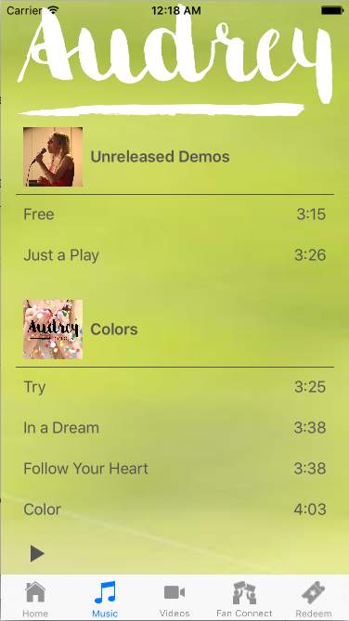
Notes:
Upon opening the app, we pushed a dialog box toJean asking for permission to send push notifications, to which she replied “I always say no.” This seemed like a [3] major usability problem if we were counting on these to keep her engaged even after closing the app. After the demo sequence, which she seemed to appreciate, the Livestream interested her: “so you’d actually help them make the music, in a way?” She recognized some of the venues on the “EVENTS” page, which got her excited. When she went to buy her tickets, Jean was pleasantly surprised when the points-earned dialog appeared onscreen. However, when probed, she said “I’m not interested in points so I wouldn’t be the one pushing those things. I wouldn’t want to share my personal information, and wouldn’t want the points anyway.” Again, this seemed like a [4] catastrophic blow, but likewise on further explanation she perked up, saying “tickets and everything, wow—that seems worthwhile.” Interestingly, she had a similar reaction as Holly to the support feature, thinking it was technical support. After 2 out of 2 respondents stumbled over the same label, we crossed it out right after that and replaced it with “CONTRIBUTE.” She also seemed unsure of how to use the fan features, asking “how would I connect with other fans?” Looking at the FanMap feature, she said that “I wouldn’t know what that means.” These seemed like a [3] major usability problem that will need to be addressed.

Slide 14
Allow users to skip the intro
Tighten visual look of intro screens
Clarify how to earn points in the intro
Notes:
Upon opening the app, we pushed a dialog box toJean asking for permission to send push notifications, to which she replied “I always say no.” This seemed like a [3] major usability problem if we were counting on these to keep her engaged even after closing the app. After the demo sequence, which she seemed to appreciate, the Livestream interested her: “so you’d actually help them make the music, in a way?” She recognized some of the venues on the “EVENTS” page, which got her excited. When she went to buy her tickets, Jean was pleasantly surprised when the points-earned dialog appeared onscreen. However, when probed, she said “I’m not interested in points so I wouldn’t be the one pushing those things. I wouldn’t want to share my personal information, and wouldn’t want the points anyway.” Again, this seemed like a [4] catastrophic blow, but likewise on further explanation she perked up, saying “tickets and everything, wow—that seems worthwhile.” Interestingly, she had a similar reaction as Holly to the support feature, thinking it was technical support. After 2 out of 2 respondents stumbled over the same label, we crossed it out right after that and replaced it with “CONTRIBUTE.” She also seemed unsure of how to use the fan features, asking “how would I connect with other fans?” Looking at the FanMap feature, she said that “I wouldn’t know what that means.” These seemed like a [3] major usability problem that will need to be addressed.

Slide 15
Notes:
Upon opening the app, we pushed a dialog box toJean asking for permission to send push notifications, to which she replied “I always say no.” This seemed like a [3] major usability problem if we were counting on these to keep her engaged even after closing the app. After the demo sequence, which she seemed to appreciate, the Livestream interested her: “so you’d actually help them make the music, in a way?” She recognized some of the venues on the “EVENTS” page, which got her excited. When she went to buy her tickets, Jean was pleasantly surprised when the points-earned dialog appeared onscreen. However, when probed, she said “I’m not interested in points so I wouldn’t be the one pushing those things. I wouldn’t want to share my personal information, and wouldn’t want the points anyway.” Again, this seemed like a [4] catastrophic blow, but likewise on further explanation she perked up, saying “tickets and everything, wow—that seems worthwhile.” Interestingly, she had a similar reaction as Holly to the support feature, thinking it was technical support. After 2 out of 2 respondents stumbled over the same label, we crossed it out right after that and replaced it with “CONTRIBUTE.” She also seemed unsure of how to use the fan features, asking “how would I connect with other fans?” Looking at the FanMap feature, she said that “I wouldn’t know what that means.” These seemed like a [3] major usability problem that will need to be addressed.

Slide 16
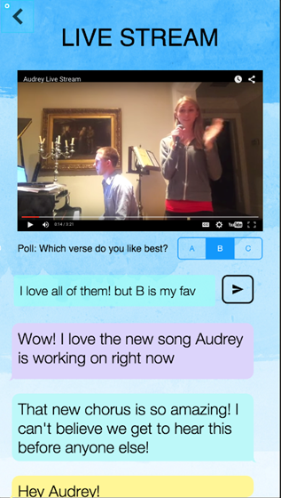
Optimize video playback for mobile
Type below the comments
Notes:
Upon opening the app, we pushed a dialog box toJean asking for permission to send push notifications, to which she replied “I always say no.” This seemed like a [3] major usability problem if we were counting on these to keep her engaged even after closing the app. After the demo sequence, which she seemed to appreciate, the Livestream interested her: “so you’d actually help them make the music, in a way?” She recognized some of the venues on the “EVENTS” page, which got her excited. When she went to buy her tickets, Jean was pleasantly surprised when the points-earned dialog appeared onscreen. However, when probed, she said “I’m not interested in points so I wouldn’t be the one pushing those things. I wouldn’t want to share my personal information, and wouldn’t want the points anyway.” Again, this seemed like a [4] catastrophic blow, but likewise on further explanation she perked up, saying “tickets and everything, wow—that seems worthwhile.” Interestingly, she had a similar reaction as Holly to the support feature, thinking it was technical support. After 2 out of 2 respondents stumbled over the same label, we crossed it out right after that and replaced it with “CONTRIBUTE.” She also seemed unsure of how to use the fan features, asking “how would I connect with other fans?” Looking at the FanMap feature, she said that “I wouldn’t know what that means.” These seemed like a [3] major usability problem that will need to be addressed.

Slide 17
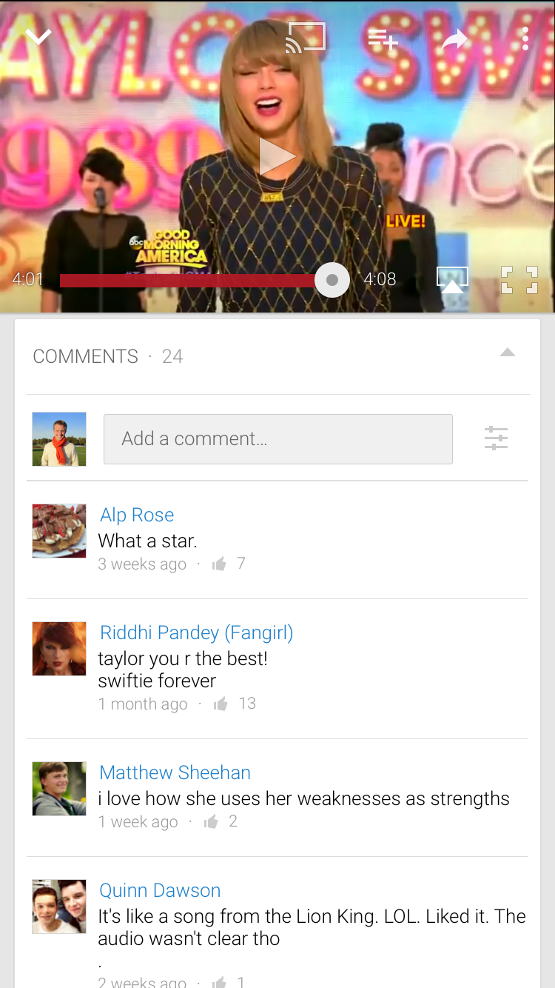
Notes:
Upon opening the app, we pushed a dialog box toJean asking for permission to send push notifications, to which she replied “I always say no.” This seemed like a [3] major usability problem if we were counting on these to keep her engaged even after closing the app. After the demo sequence, which she seemed to appreciate, the Livestream interested her: “so you’d actually help them make the music, in a way?” She recognized some of the venues on the “EVENTS” page, which got her excited. When she went to buy her tickets, Jean was pleasantly surprised when the points-earned dialog appeared onscreen. However, when probed, she said “I’m not interested in points so I wouldn’t be the one pushing those things. I wouldn’t want to share my personal information, and wouldn’t want the points anyway.” Again, this seemed like a [4] catastrophic blow, but likewise on further explanation she perked up, saying “tickets and everything, wow—that seems worthwhile.” Interestingly, she had a similar reaction as Holly to the support feature, thinking it was technical support. After 2 out of 2 respondents stumbled over the same label, we crossed it out right after that and replaced it with “CONTRIBUTE.” She also seemed unsure of how to use the fan features, asking “how would I connect with other fans?” Looking at the FanMap feature, she said that “I wouldn’t know what that means.” These seemed like a [3] major usability problem that will need to be addressed.

Slide 18
Agenda
1
Introduction
2
Value Prop, Problem, and Solution
3
Heuristic Results / Revised Design
4
Current Status
5
Live Demonstration

Slide 19
Tools Being Used
iOS
Originally Objective-C
Decided to learn Swift instead
Using XCode

Slide 20
Implemented Features
Simple task: music player
Simplified bottom navigation

Slide 21
Future Implementation
News feed on home page
Live stream/video features
Fan connect: profile, forum, & events
Redeem page

Slide 22
Plan to Finish
Ian is injured!

Slide 23
Hard-coded Data
Pre-recorded video, no actual live stream
Preset profile
Hardcoded forum posts from fake users
Won’t win real prizes

Slide 24
Agenda
1
Introduction
2
Value Prop, Problem, and Solution
3
Heuristic Results / Revised Design
4
Current Status
5
Live Demonstration

Slide 25
Summary

Slide 26
Questions?

