Slide 1
Efangelist
Albert Tomasso
Audrey Proulx
Ian Proulx
Sean Klein

Slide 2
Agenda
1
Introduction
2
Value Prop, Problem, and Solution
3
Tasks
4
Revised Interface Design
5
Prototype Overview

Slide 3
Agenda
1
Introduction
2
Value Prop, Problem and Solution
3
Tasks
4
Revised Interface Design
5
Prototype Overview

Slide 4
EFANGELIST enables listeners to be the ultimate fan…
and artists to cultivate superfans while remaining focused on creating music

Slide 5
Problem:
New artists must reach consumers without investing much
Time
Capital
Technical Expertise
Solution:
Customizable template for branded app with
Gamified system
Fanzone for fans to connect
More intimate relationship with artist
Notes:
Upon opening the app, we pushed a dialog box toJean asking for permission to send push notifications, to which she replied “I always say no.” This seemed like a [3] major usability problem if we were counting on these to keep her engaged even after closing the app. After the demo sequence, which she seemed to appreciate, the Livestream interested her: “so you’d actually help them make the music, in a way?” She recognized some of the venues on the “EVENTS” page, which got her excited. When she went to buy her tickets, Jean was pleasantly surprised when the points-earned dialog appeared onscreen. However, when probed, she said “I’m not interested in points so I wouldn’t be the one pushing those things. I wouldn’t want to share my personal information, and wouldn’t want the points anyway.” Again, this seemed like a [4] catastrophic blow, but likewise on further explanation she perked up, saying “tickets and everything, wow—that seems worthwhile.” Interestingly, she had a similar reaction as Holly to the support feature, thinking it was technical support. After 2 out of 2 respondents stumbled over the same label, we crossed it out right after that and replaced it with “CONTRIBUTE.” She also seemed unsure of how to use the fan features, asking “how would I connect with other fans?” Looking at the FanMap feature, she said that “I wouldn’t know what that means.” These seemed like a [3] major usability problem that will need to be addressed.

Slide 6
Agenda
1
Introduction
2
Value Prop, Problem, and Solution
3
Tasks
4
Revised Interface Design
5
Prototype Overview

Slide 7
Tasks
Simple: play a song
Medium: provide feedback during a live stream
Complex: earn and redeem points

Slide 8
Agenda
1
Introduction
2
Value Prop, Problem, and Solution
3
Tasks
4
Revised Interface Design
5
Prototype

Slide 9
Major Design Changes
Tutorial of Functionality
Simplification/Clarification of Point System
Removed Clutter/Unnecessary Features
Unsaturated Colors

Slide 10
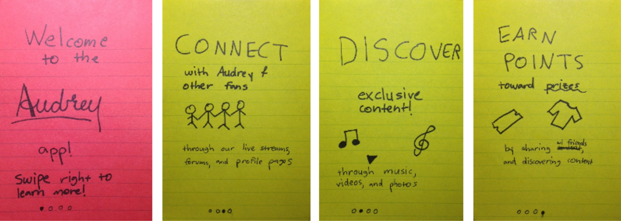
Tutorial of Functionality

Slide 11
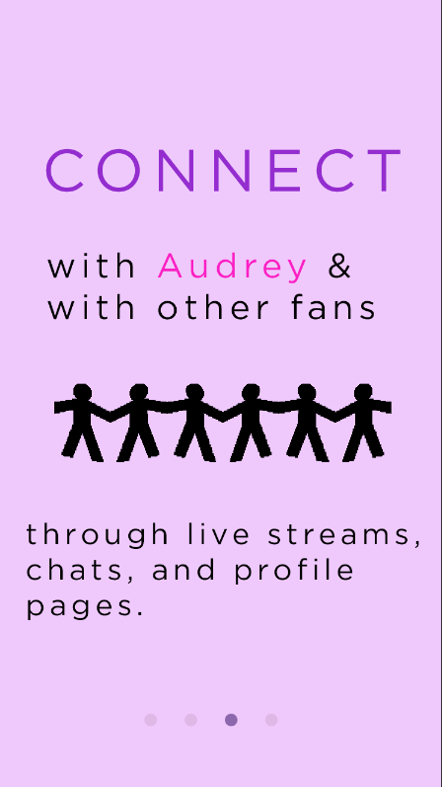
Tutorial of Functionality

Slide 12
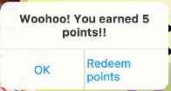
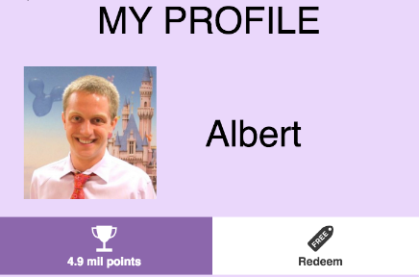
Simplification/Clarification of Points

Slide 13
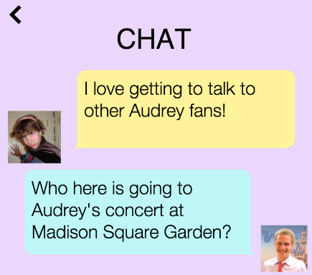
Removed Clutter/Unnecessary Features

Slide 14
Prototype Task Flows
Simple: play a song
Medium: provide feedback during a live stream
Complex: earn and redeem points

Slide 15
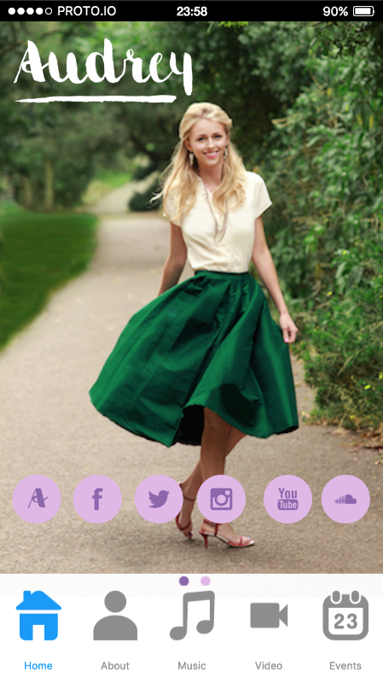
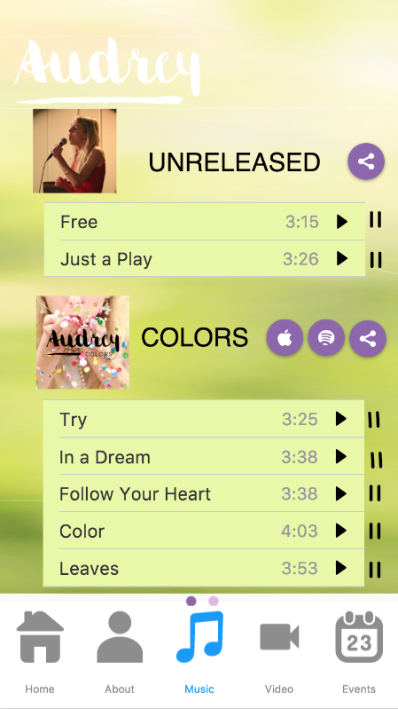
Simple Task: Play a song
Play or pause a song
Click “Music”

Slide 16
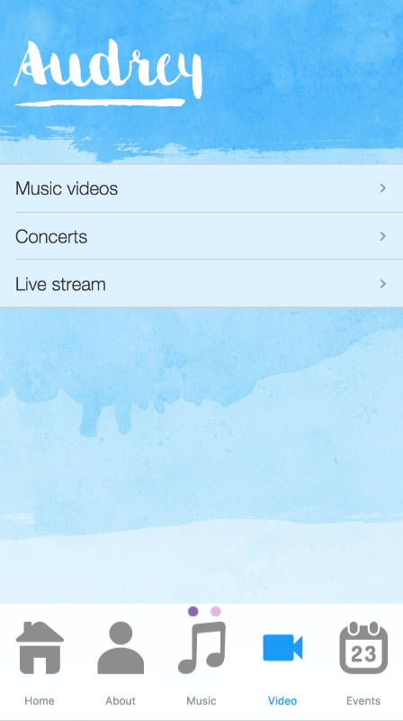
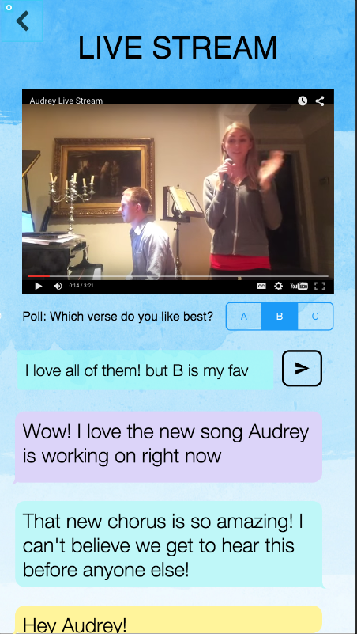
Medium Task: Provide feedback
Vote!
Select “Live Stream”
Comment!
Click “Video”

Slide 17
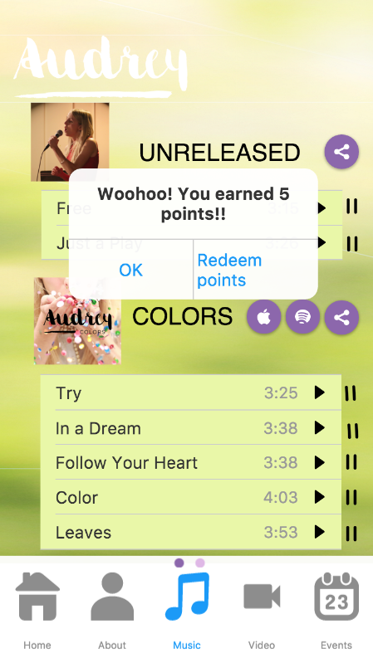
Complex Task: Earn and redeem points
Share music/articles
Click “Redeem points”
Click “Music” or “News”

Slide 18
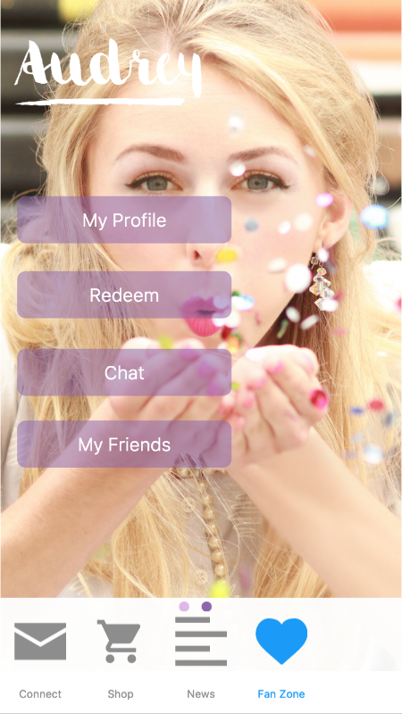
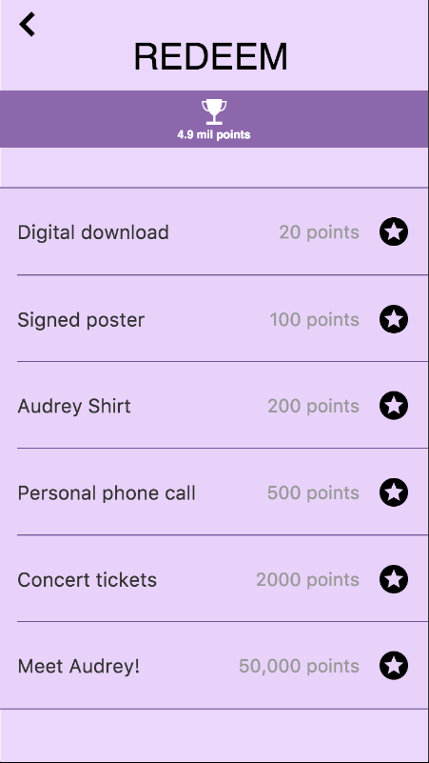
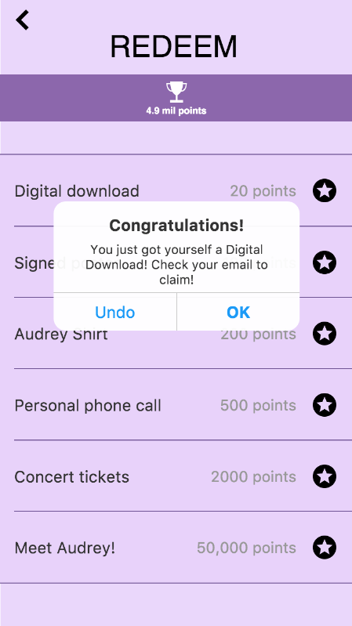
Complex Task Alternative
Click “Fan Zone”

Slide 19
Agenda
1
Introduction
2
Value Prop, Problem, and Solution
3
Tasks
4
Revised Interface Design
5
Prototype Overview

Slide 20
Prototype Overview
Proto.io
Limitations
Hard-coded features

Slide 21
Proto.io
WYSIWYG
Large library of features
Incredibly slow

Slide 22
Limitations
No media player
Used separate play/pause buttons instead
No network connectivity
Can’t keep track of points or friends

Slide 23
Hard-coded Features
Pre-recorded video, no live stream
Preset number of points
Chat content and friends list

Slide 24
Questions?
http://web.stanford.edu/class/cs147/projects/sharing/the_recursive_leapers/

