Slide 1
EFANGELIST
Albert Tomasso
Audrey Proulx
Ian Proulx
Sean Klein

Slide 2
Agenda
1
Introduction
2
Initial Designs
3
Selected Interface
4
Prototypes & Testing
5
Summary

Slide 3
EFANGELIST enables listeners to be the ultimate fan…

Slide 4
…and artists to cultivate superfans while remaining focused on creating music

Slide 5
Agenda
1
Introduction
2
Initial Designs
3
Selected Interface
4
Prototypes & Testing
5
Summary

Slide 6
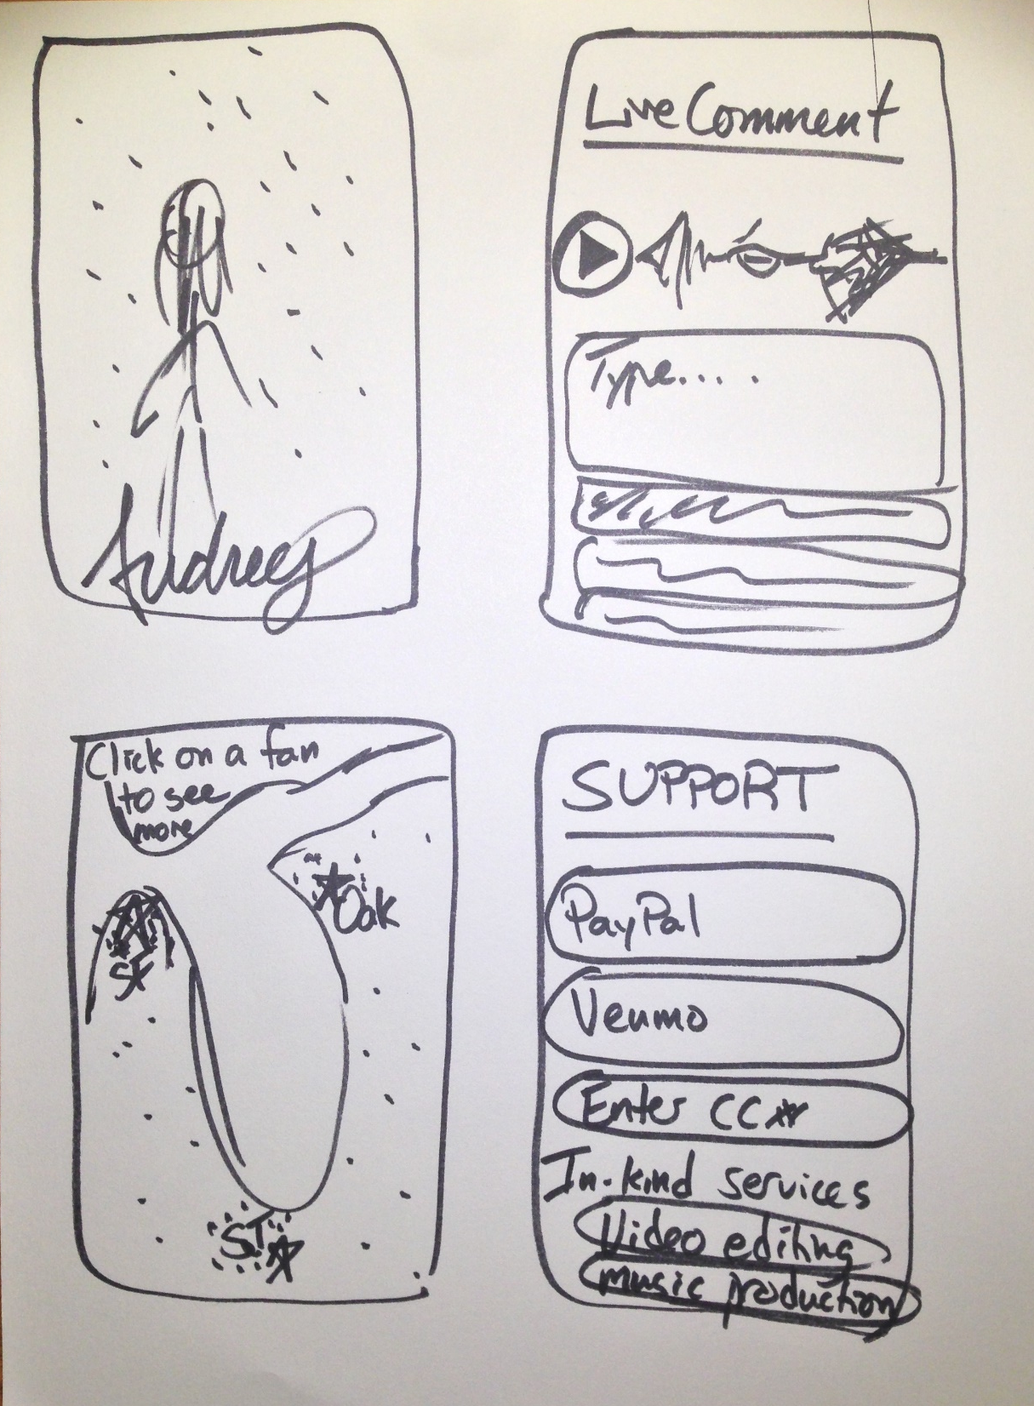
Concept One
Artist-to-Fan
Fan-to-Fan
Fan-to-Artist

Slide 7
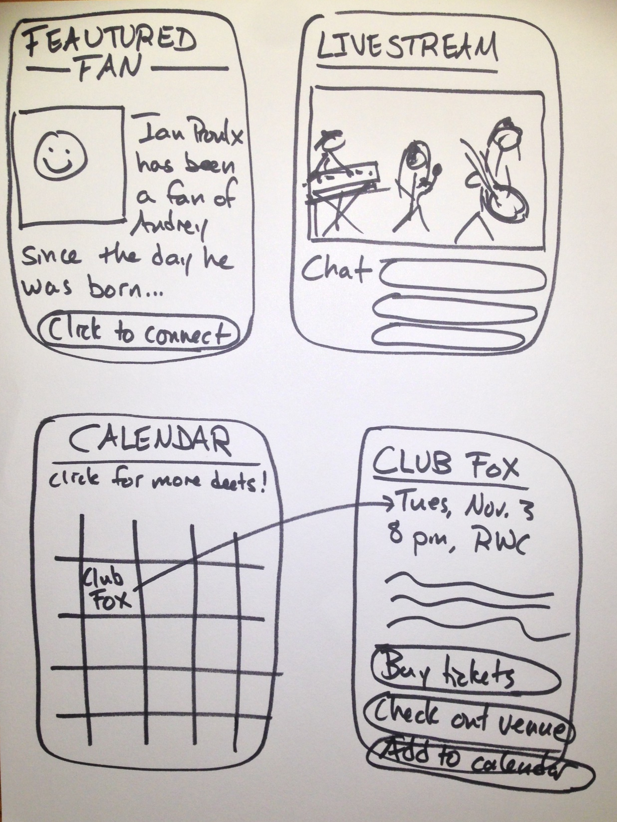
Concept One
Artist-to-Fan
Fan-to-Fan
Fan-to-Artist

Slide 8
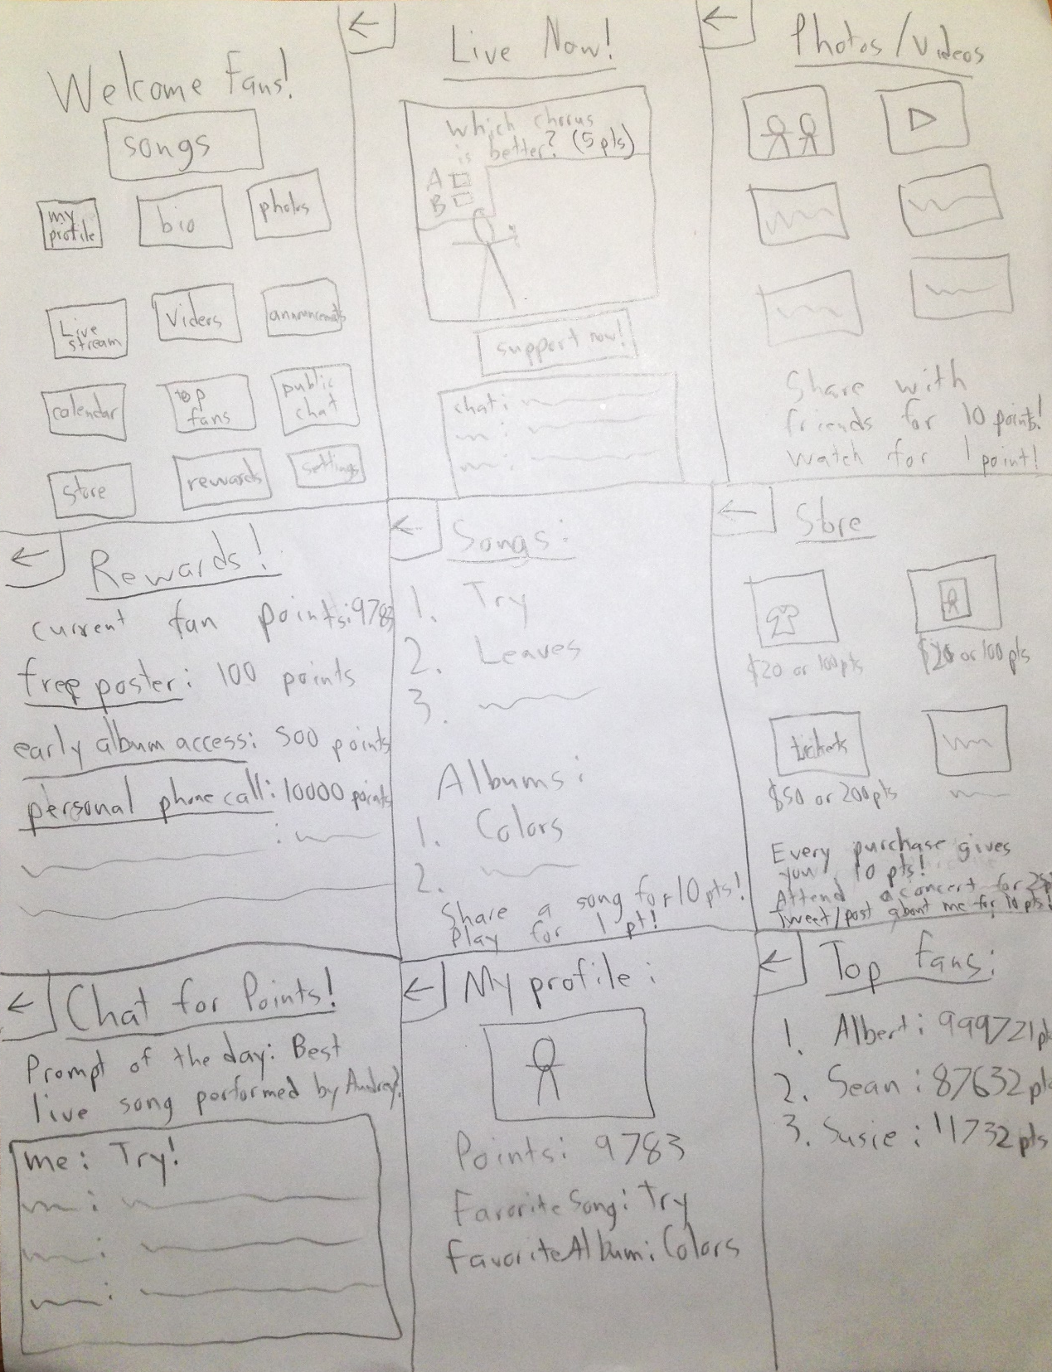
Concept Two
”Mosaic” tiled approach
Emphasis on back-navigation
Introduces points system through performing various tasks

Slide 9
Agenda
1
Introduction
2
Initial Designs
3
Selected Interface
4
Prototypes & Testing
5
Summary

Slide 10
Clean Interface
Robust Features
Notes:
HomeThe landing page.• AboutInformation about the artist, including a short bio and perhaps some fun facts a fan wouldn’t have known before.• MusicAn in-app player for songs by the artist, including unreleased, demo, cover, and acoustic tracks. Links to iTunes to buy songs.• VideoA repository for music videos and concert recordings. A unique feature here is the “livestream,” through which artists can communicate with and receive feedback from fans in realtime.• EventsA calendar of upcoming performances and related events in your area.• ConnectA direct messenger between the fan and the artist. The fan can type messages to send to the artist, who has the option of responding with either text or video messages.• ShopA store to purchase artist-branded apparel, accessories, and all-around swag.• NewsLatest stories of the artist in the news and on music blogs.• PhotosA photo gallery of the artist.• Fan ConnectA mini-platform enabling fans to find each other on a map, communicate through direct messages, post on forums, and organize in-person meet-ups. Also includes the option to link one’s profile to Facebook or other social media.• SupportA portal to contribute financially to the artist through PayPal, Venmo, Stripe, or Credit Card, or offer to contribute with in-kind services such as photography, video editing, audio production, or food.

Slide 11
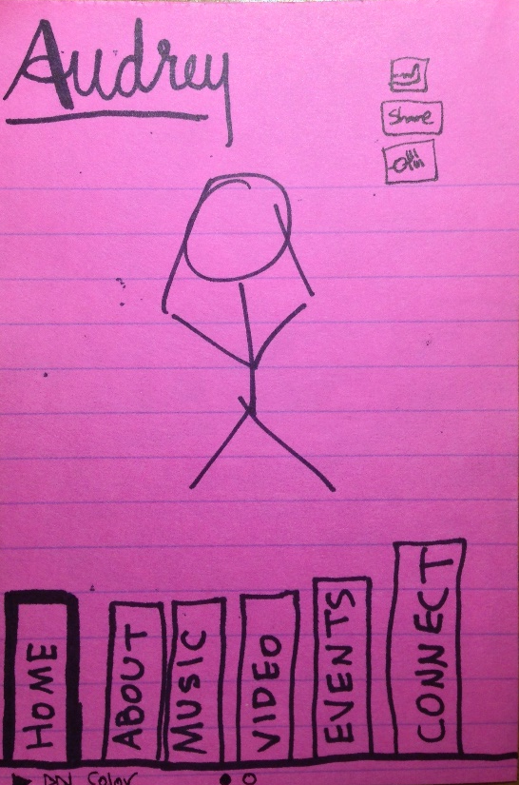
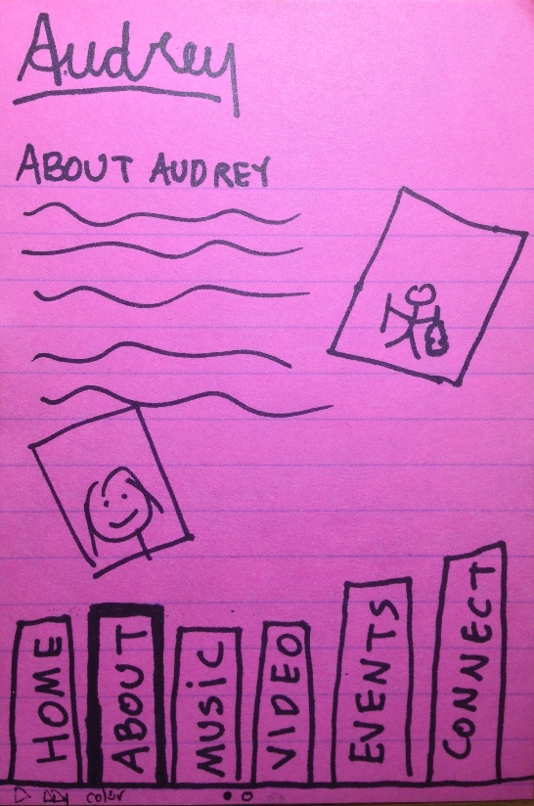
Task One: Learn More About The Artist
press the “ABOUT” button

Slide 12
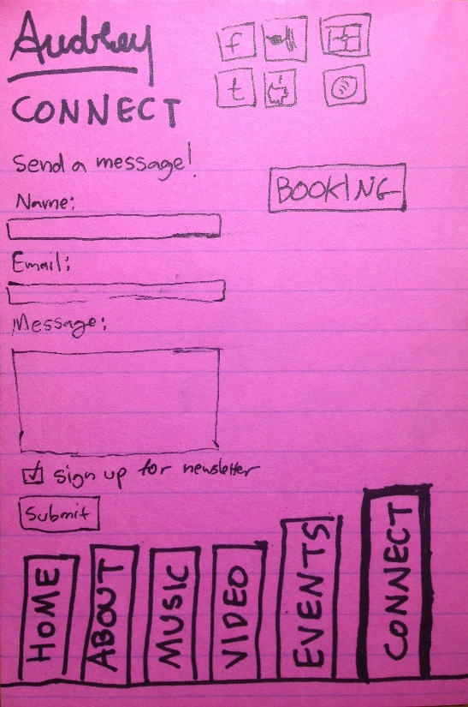
Task Two: Communicate Directly With Artist
press the “CONNECT” button
Then fill out the dialogue box to communicate directly with the artist

Slide 13
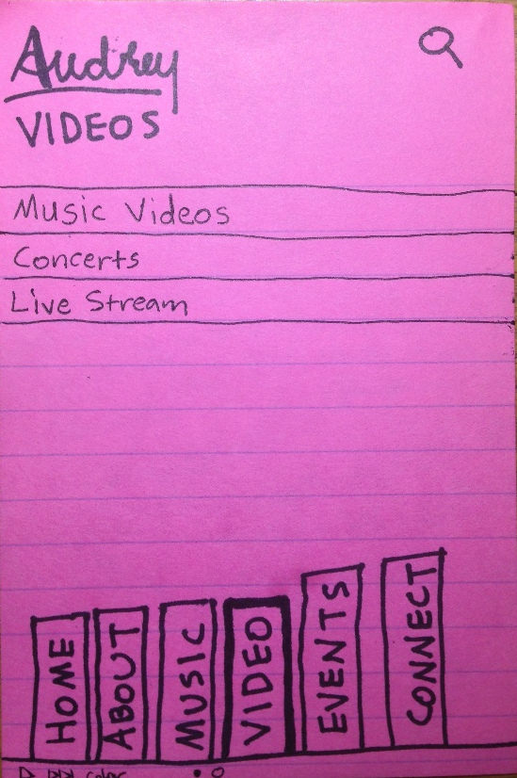
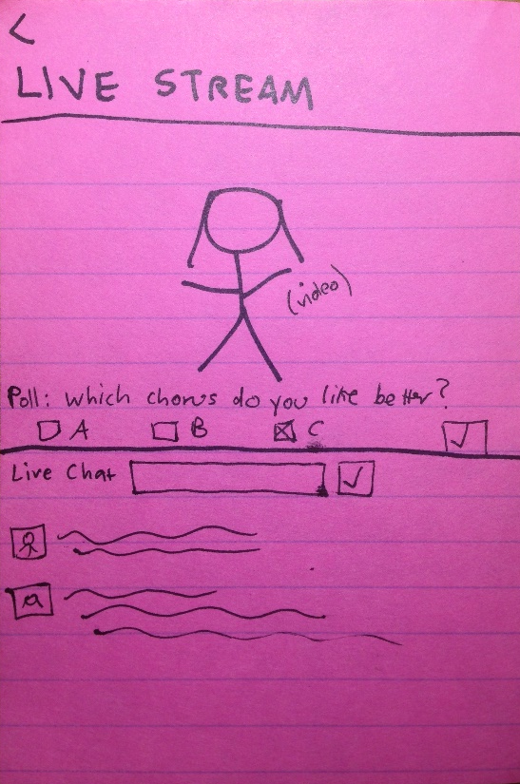
Task Three: Listen To Music and Give Feedback During Livestream
Select
Category
press the “VIDEO” button
Provide feedback in real time through the live chat and multiple-choice interfaces

Slide 14
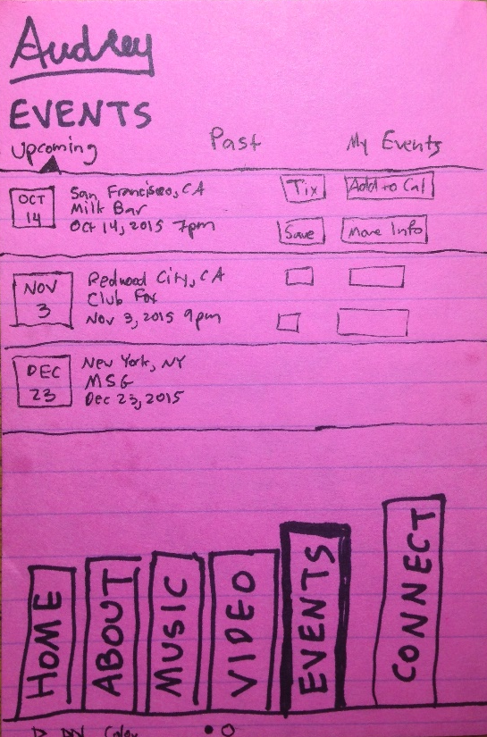
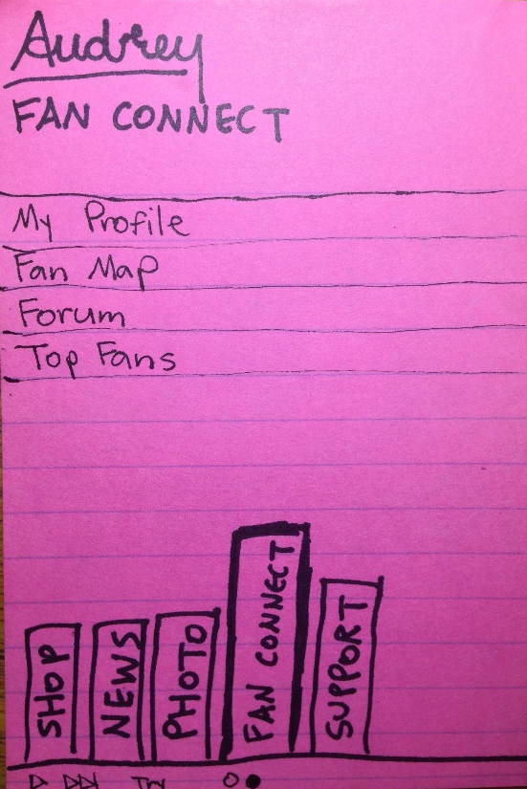
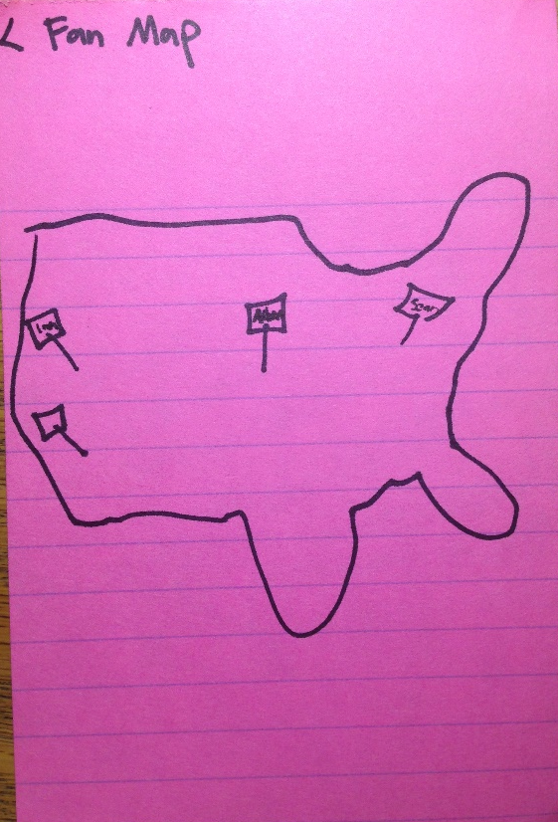
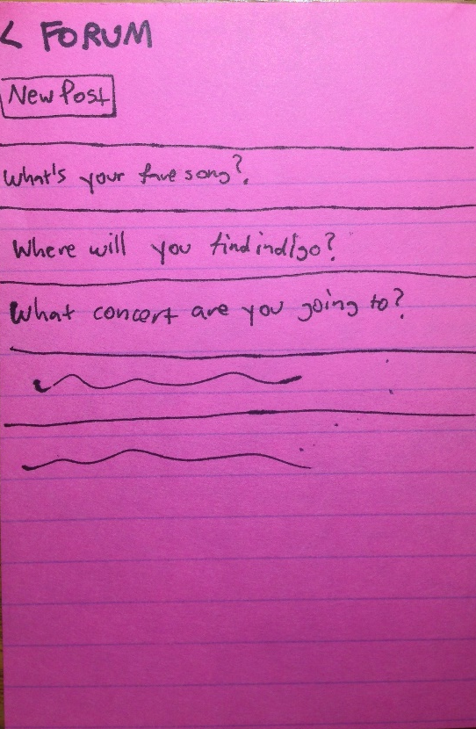
Task Four: Connect With Fans
1. Find & choose an upcoming concert after which to organize a fan party
2. Use “FAN CONNECT” to find other fans nearby, post an invitation on the forum, etc.
3. Celebrate together when your favorite artist comes to town! Bring a friend to spread the word (and earn extra points when they check in on the app)

Slide 15
Agenda
1
Introduction
2
Initial Designs
3
Selected Interface
4
Testing
5
Summary

Slide 16
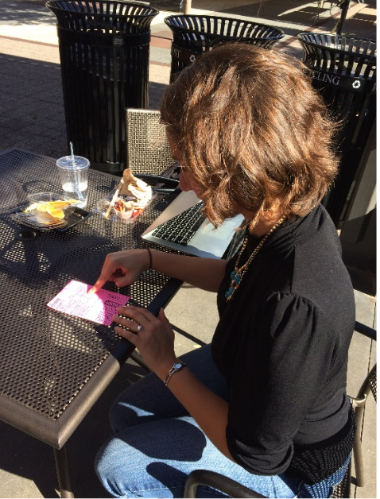
Experiment 1 Holly
Refused push notifications
“I am not interested in points”
“Competition and fandom don’t really go together”
Confusion with points system
Leaderboard
Surprise with Support Tab
Notes:
Holly was curious what a livestream was andenjoyed the result. Holly liked that we have the navigation buttons in the same place on each screen. She stumbled when trying to download the songs she heard in the “MUSIC” tab. We classified this as a [1] cosmetic problem, since her confusion stemmed from the small and illegible drawing of the link to the iTunes store. When she got to the messenger, she questioned whether it would actually be read by the artist, or merely their staff. We classified this as a [2] minor usability problem, since this could be clarified in the app. She was unsure of the difference between “CONNECT” and “FAN CONNECT,” which for us was also a [2] minor usability problem since the admittedly poorly-name tabs could be She was surprised that the “SUPPORT” tab took her to a financial contributions page, since she presumed it meant technical support for the app, which she said “threw me off a little bit.” When we explained it to her, she responded that “Contribute feels like what charities, causes would do. Why would I just give you money?” This conceptual incongruence felt like a [3] major usability problem. Most of all, Holly was confused by the points system, a [4] catastrophic usability problem. At first, she didn’t know what they were or where to find them, looking futiley on the artist’s “ABOUT” page. When she found the leaderboard, she responded that it was “silly,” saying “too many companies have tried this and I just wouldn’t care. I’m not there to compete. Competition and fandom don’t really go together.” When we explained more about how points can be redeemed, she replied that “points as currency makes more sense than just points for their own sake.” Finally, she reflected after finishing with the porotype that “it didn’t seem super easy to get a friend and bring them into my fandom,” which is also a catastrophic usability problem since fan-sharing is in large part the purpose of this app!As a remedy for some of the confusion she experienced, Holly suggested a 3-pane intro the first time a user launches the app. We immediately prototyped it and added it to the system for our next two experiments (see Figure 3b).

Slide 17
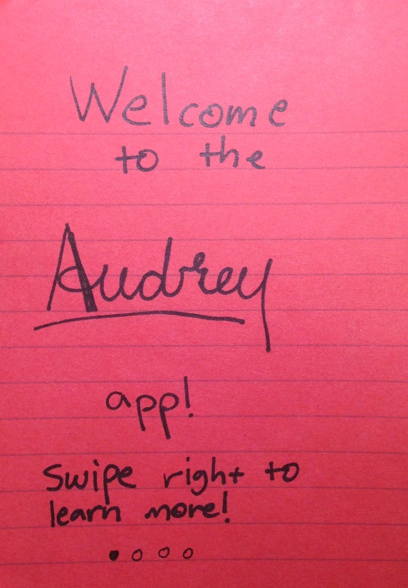
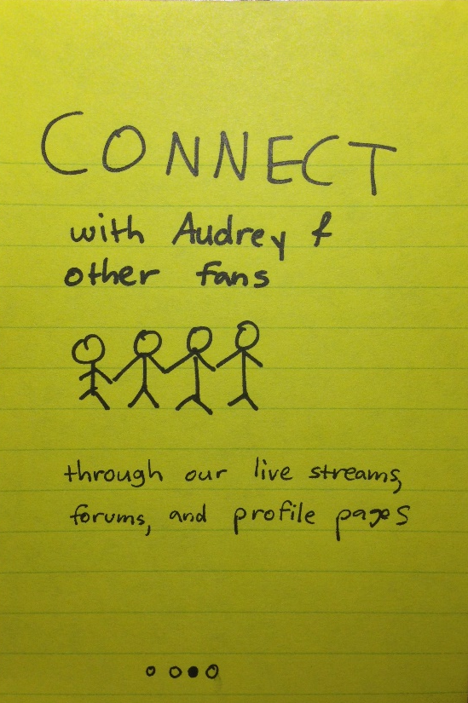
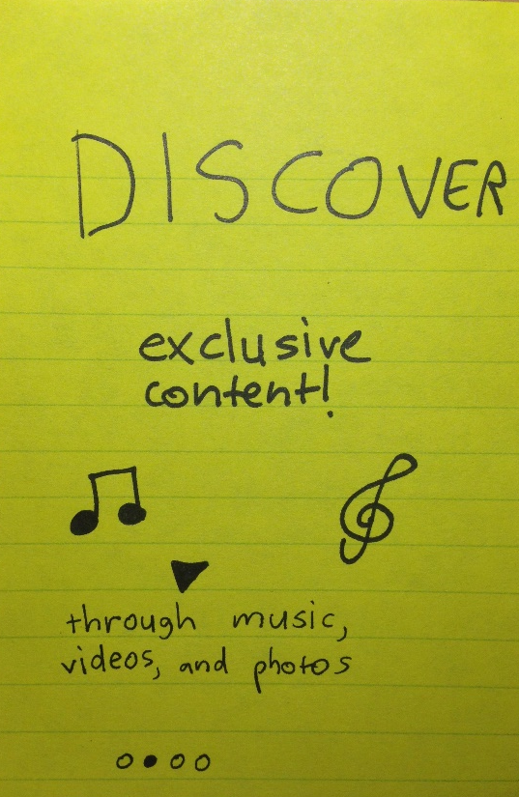
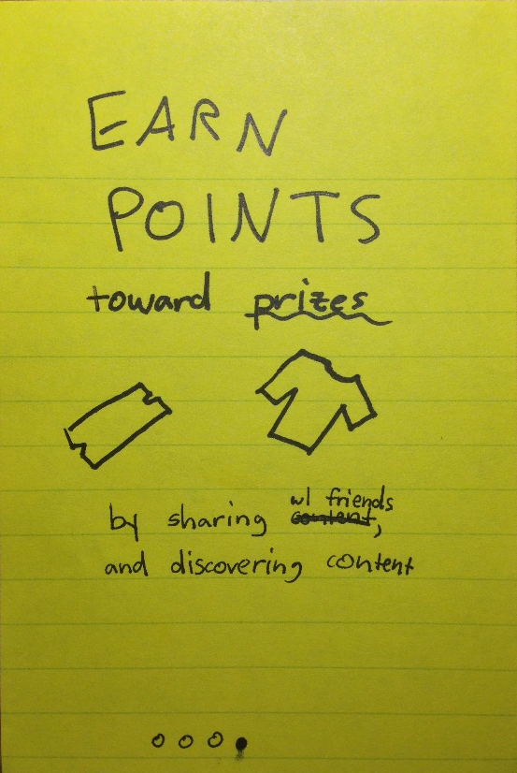
Intro Screen

Slide 18
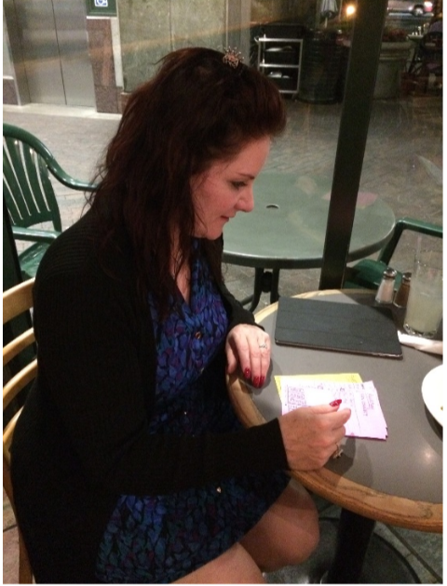
Experiment 2: Jean
”I always say no to push notifications”
“So you would actually help them make music, in a way?”
“How Would I connect with other fans”
Confusion with points system
Notes:
Upon opening the app, we pushed a dialog box toJean asking for permission to send push notifications, to which she replied “I always say no.” This seemed like a [3] major usability problem if we were counting on these to keep her engaged even after closing the app. After the demo sequence, which she seemed to appreciate, the Livestream interested her: “so you’d actually help them make the music, in a way?” She recognized some of the venues on the “EVENTS” page, which got her excited. When she went to buy her tickets, Jean was pleasantly surprised when the points-earned dialog appeared onscreen. However, when probed, she said “I’m not interested in points so I wouldn’t be the one pushing those things. I wouldn’t want to share my personal information, and wouldn’t want the points anyway.” Again, this seemed like a [4] catastrophic blow, but likewise on further explanation she perked up, saying “tickets and everything, wow—that seems worthwhile.” Interestingly, she had a similar reaction as Holly to the support feature, thinking it was technical support. After 2 out of 2 respondents stumbled over the same label, we crossed it out right after that and replaced it with “CONTRIBUTE.” She also seemed unsure of how to use the fan features, asking “how would I connect with other fans?” Looking at the FanMap feature, she said that “I wouldn’t know what that means.” These seemed like a [3] major usability problem that will need to be addressed.

Slide 19
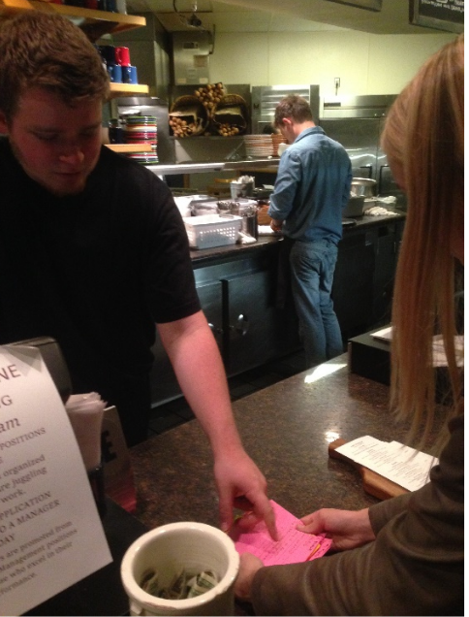
Experiment 3: Jason
On unreleased section – “that’s pretty tight”
Connect Section – Wouldn’t Sign Up
Fear of spam
Points System
Notes:
Jason also immediately rejected the request toallow push notifications. He navigated effortlessly throughout the app—more so than Jean—finding his way quickly to the unreleased section. “That’d be pretty tight! That’s stuff you have to dig for otherwise.” He didn’t assume that “tix” was short for “tickets,” seemingly a [1] cosmetic error that could be fixed by a name change. On the “CONNECT” tab, he said that he would not sign up for the newsletter, since he wasn’t sure if he would get mailed once a week or every few hours. This seemed like a [2] minor usability error since some

Slide 20
Experiment 3: Jason
Notes:
Jason also immediately rejected the request toallow push notifications. He navigated effortlessly throughout the app—more so than Jean—finding his way quickly to the unreleased section. “That’d be pretty tight! That’s stuff you have to dig for otherwise.” He didn’t assume that “tix” was short for “tickets,” seemingly a [1] cosmetic error that could be fixed by a name change. On the “CONNECT” tab, he said that he would not sign up for the newsletter, since he wasn’t sure if he would get mailed once a week or every few hours. This seemed like a [2] minor usability error since some

Slide 21
Agenda
1
Introduction
2
Initial Designs
3
Selected Interface
4
Testing
5
Summary

Slide 22
Takeaways
Went Well
Users indicated want to interact with favorite artist
Generally found the interface predictable
Needs Work
Certain Features Are Ambiguous
Support Feature
Point System
Fan-to-Fan Interaction Improvements
Notes:
Upon opening the app, we pushed a dialog box toJean asking for permission to send push notifications, to which she replied “I always say no.” This seemed like a [3] major usability problem if we were counting on these to keep her engaged even after closing the app. After the demo sequence, which she seemed to appreciate, the Livestream interested her: “so you’d actually help them make the music, in a way?” She recognized some of the venues on the “EVENTS” page, which got her excited. When she went to buy her tickets, Jean was pleasantly surprised when the points-earned dialog appeared onscreen. However, when probed, she said “I’m not interested in points so I wouldn’t be the one pushing those things. I wouldn’t want to share my personal information, and wouldn’t want the points anyway.” Again, this seemed like a [4] catastrophic blow, but likewise on further explanation she perked up, saying “tickets and everything, wow—that seems worthwhile.” Interestingly, she had a similar reaction as Holly to the support feature, thinking it was technical support. After 2 out of 2 respondents stumbled over the same label, we crossed it out right after that and replaced it with “CONTRIBUTE.” She also seemed unsure of how to use the fan features, asking “how would I connect with other fans?” Looking at the FanMap feature, she said that “I wouldn’t know what that means.” These seemed like a [3] major usability problem that will need to be addressed.

