Slide 1
Music Sharing:
FAN BUILDER
Albert Tomasso
Audrey Proulx
Ian Proulx
Sean Klein

Slide 2
Value Proposition:
Keep your favorite artist in your pocket
Problem/Solution Overview:
The success of today’s musical artists is determined as much by their internet following as by their songwriting, in a world that’s moving increasingly mobile. Yet artists must be able to reach consumers without investing much time, capital, or technical expertise, so that they can focus on writing quality music. We provide a customizable template for building an app that will target fans through personal messaging and a gamified system to share the artist with friends.

Slide 3
Complex Task (for artists)
Create and publish your app
Overview:
Using our online platform, artists will customize their app using an interface as simple as drag-and-drop. Artists will select layouts, features, and widgets from our templates designed specifically for connecting with fans. They can upload songs, photos, and other media at any time. When ready, they need only click “publish” for the app to seamlessly appear on the App Store and Google Play within two weeks.

Slide 4
Simple Task (for artists and fans)
Connect artists and fans with video messaging
Overview:
Using our mobile app, artists can record a video message that will instantly notify fans and appear right on their phones. This could be a concert announcement, clips from a new song, an intimate view of an artist kicking back on a Sunday morning—anything at all! The interface for video sharing is effortless for artists and fans alike.

Slide 5
Moderate Task (for fans)
Share with friends to grow the fan base and earn points
Overview:
Fans are incentivized not only to listen to the music, but to pass it on to all their friends—and to engage with the app a lot more. Artists will determine the perks associated with different point levels, such that a certain number of shares might map to a free download; a certain number of tweets/likes/views might earn some sweet swag, or bringing a certain number of fans to a concert might win a private kickback with the artist. All of this would be registered and broadcast publicly through the app.

Slide 6
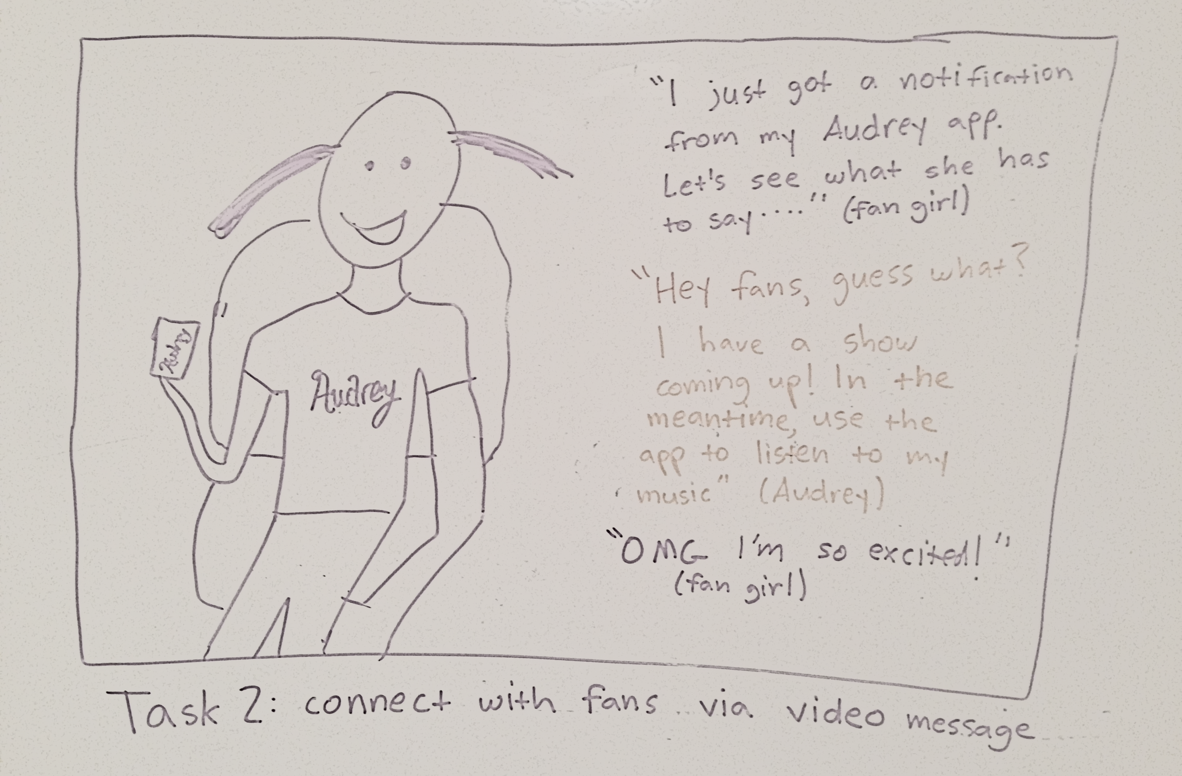
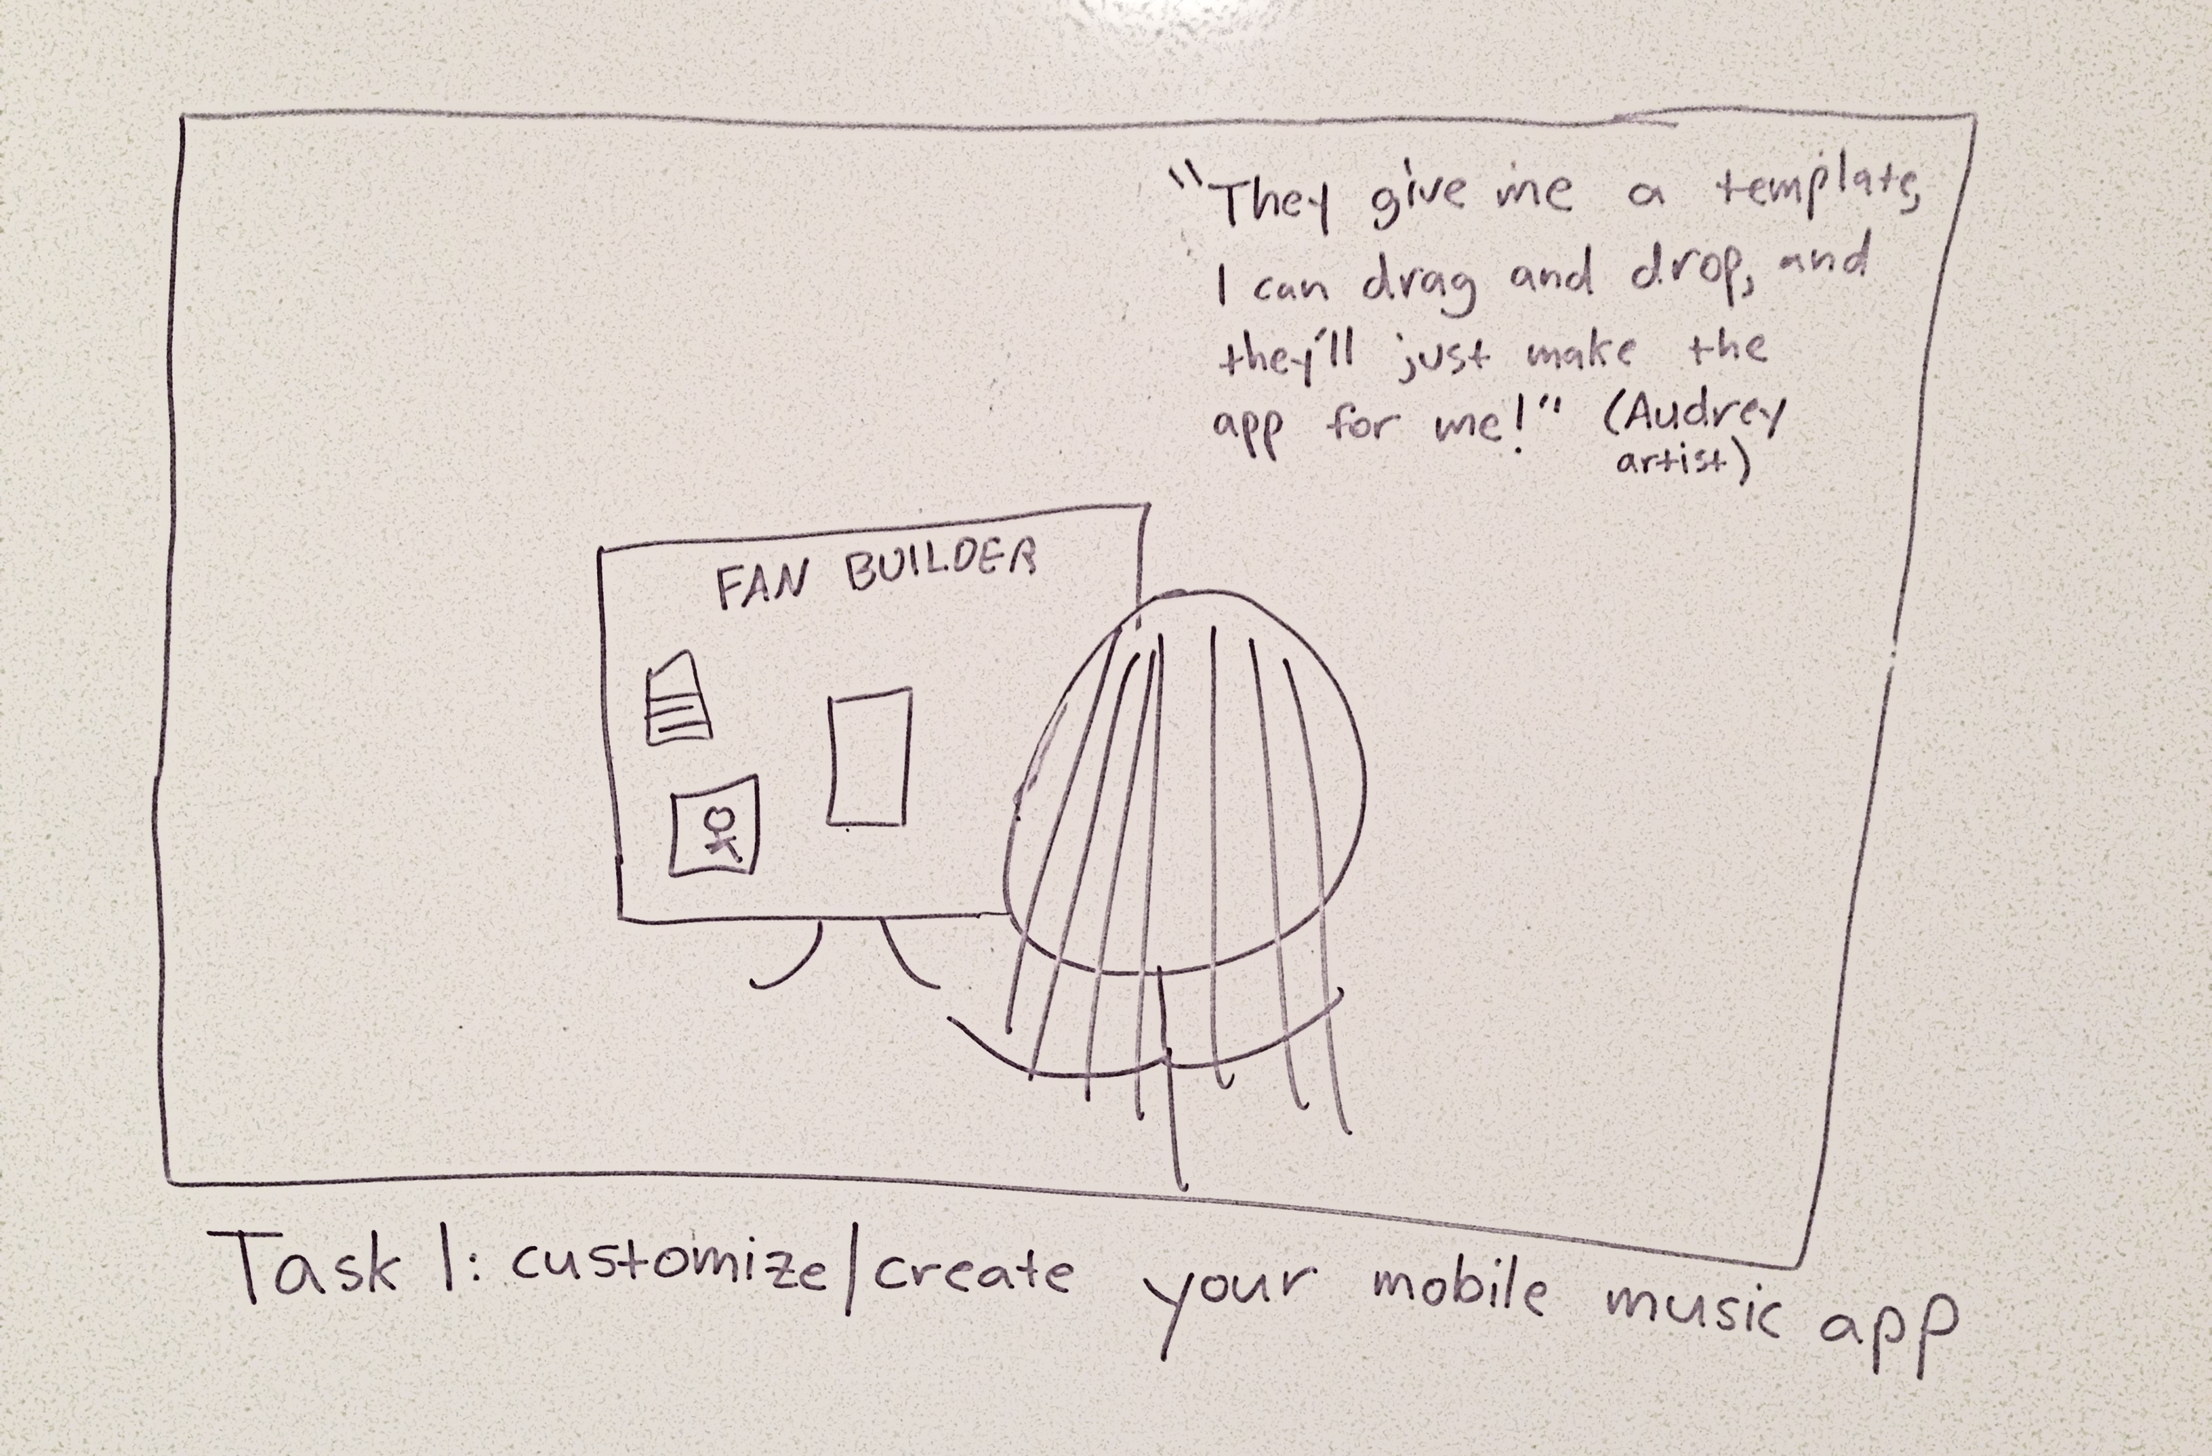
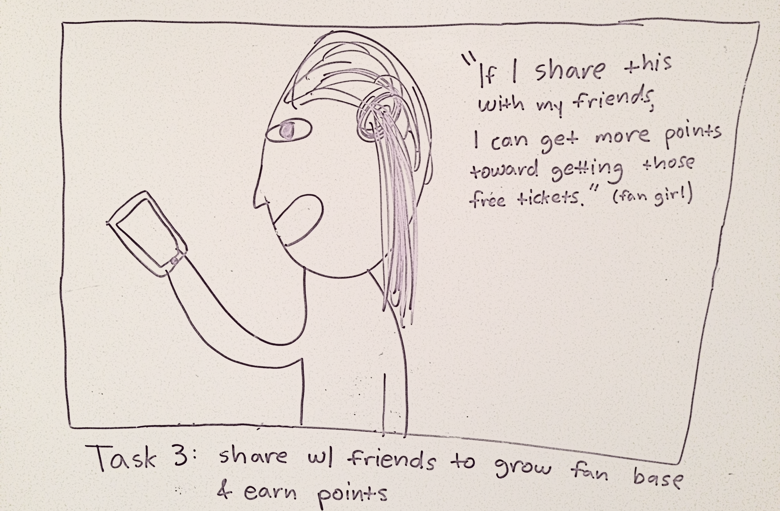
Video Storyboards

