Slide 1
Music Sharing
Albert Tomasso
Audrey Proulx
Ian Proulx
Sean Klein

Slide 2
Agenda
1
Introduction
2
Initial Point of View
3
Additional Needfinding
4
Revised Points of View
5
How Might We Statements
6
Experience Prototypes

Slide 3
Agenda
1
Introduction
2
Initial Point of View
3
Additional Needfinding
4
Revised Points of View
5
How Might We Statements
6
Experience Prototypes

Slide 4
Initial Point of View:
Artists need a way to push music to their target audience without getting lost in the online clutter.

Slide 5
Agenda
1
Introduction
2
Initial Point of View
3
Additional Needfinding
4
Revised Points of View
5
How Might We Statements
6
Experience Prototypes

Slide 6
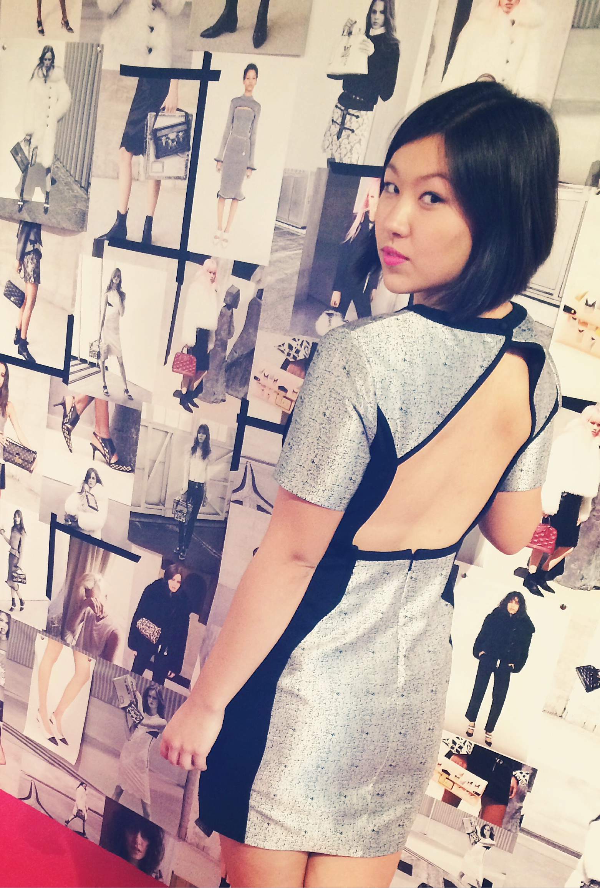
CHRISTINA DONG
Journalism & PR student
Extreme music consumer

Slide 7
I need to find new music. I get really bored hearing the same thing over and over again—it’s like ‘not this again’
I have FOMO if I don’t follow my favorite artists [on social media], but I don’t really do anything with that

Slide 8
BROOKE TOMLINSON
Professional singer/ songwriter trying to make it in Los Angeles

Slide 9
They don’t really sign you unless you have a major internet following already
As an artist, I wish I didn’t have to think about “oh my Instagram,” because that feels very superficial. But that’s like really important now, unlike 5 years ago

Slide 10
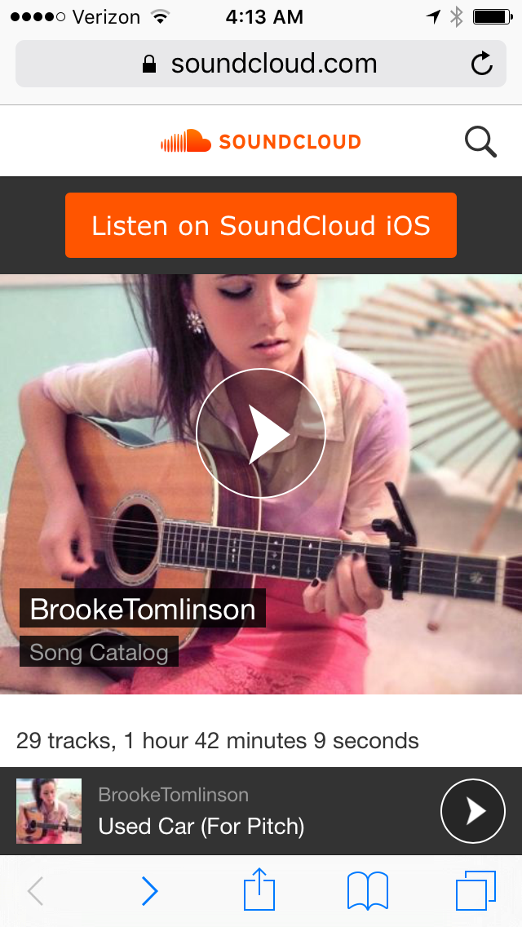

Slide 11
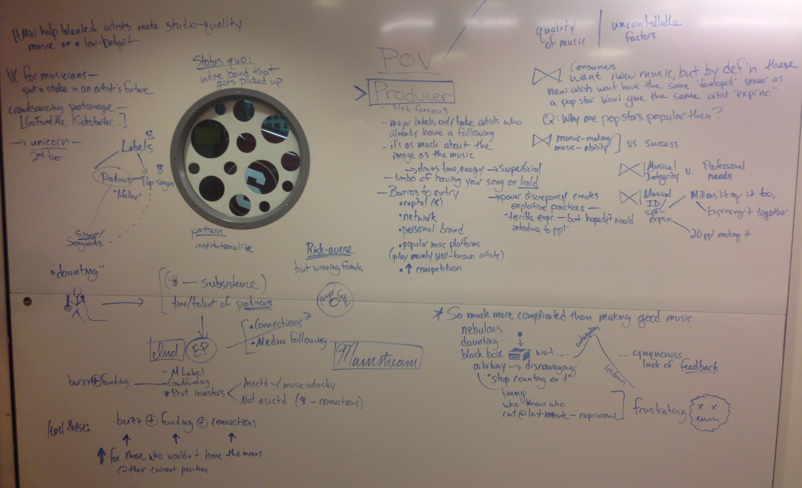

Slide 12
Buzz
+
Funding
+
Connections
Quality of music

Slide 13
Agenda
1
Introduction
2
Initial Point of View
3
Additional Needfinding
4
Revised Points of View
5
How Might We Statements
6
Experience Prototypes

Slide 14
Revised Point of View: Consumer
Consumers need an easy way to find quality music from new artists that matches their taste, in a way that feels like an adventure instead of a chore.

Slide 15
Revised Point of View: Artists
Independent artists need an alternative career path to the time spent networking, cultivating their image, and raising capital, so they can focus on creating quality music.

Slide 16
Agenda
1
Introduction
2
Initial Point of View
3
Additional Needfinding
4
Revised Points of View
5
How Might We Statements
6
Experience Prototypes

Slide 17
Initial Point of View:
Artists need a way to share music with their target audience without getting lost in the online clutter.

Slide 18
POV: Artists need a way to share music with their target audience without getting lost in the online clutter.
HMW help up-and-coming artists share music content in multiple forms beyond a studio album?

Slide 19
POV: Artists need a way to share music with their target audience without getting lost in the online clutter.
HMW help new artists with limited resources develop high quality and personalized means of connecting with potential target audiences?

Slide 20
POV: Consumers need an easy way to find quality music from new artists that matches their taste, in a way that feels like an adventure instead of a chore.
HMW make music discovery feel more like a game than a chore?

Slide 21
Agenda
1
Introduction
2
Initial Point of View
3
Additional Needfinding
4
Revised Points of View
5
How Might We Statements
6
Experience Prototypes

Slide 22
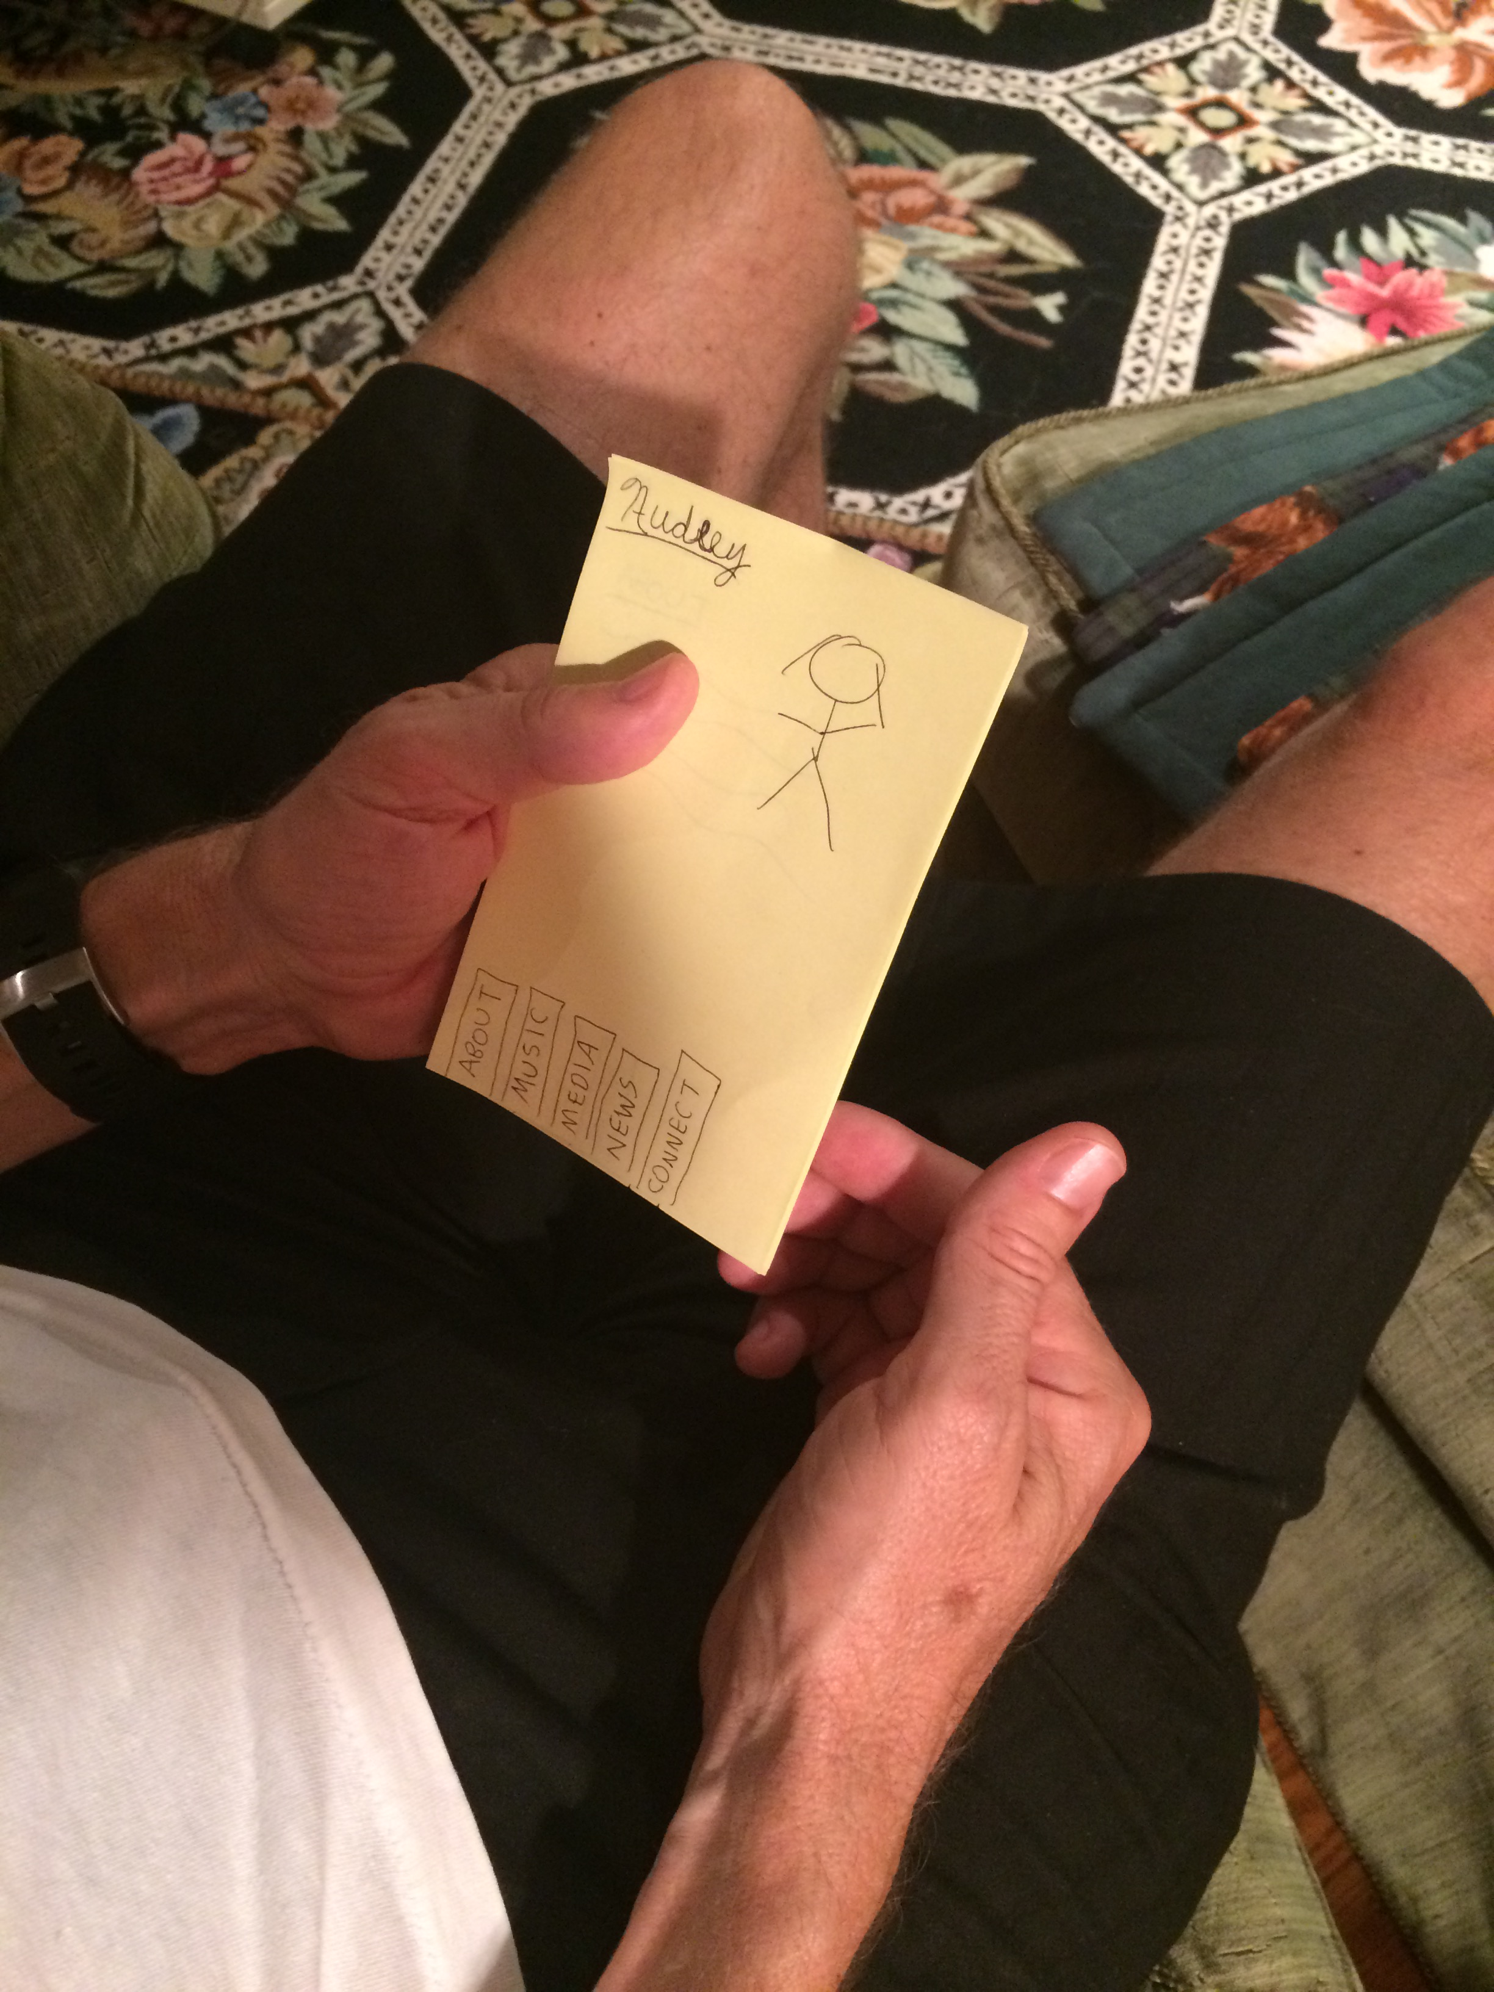
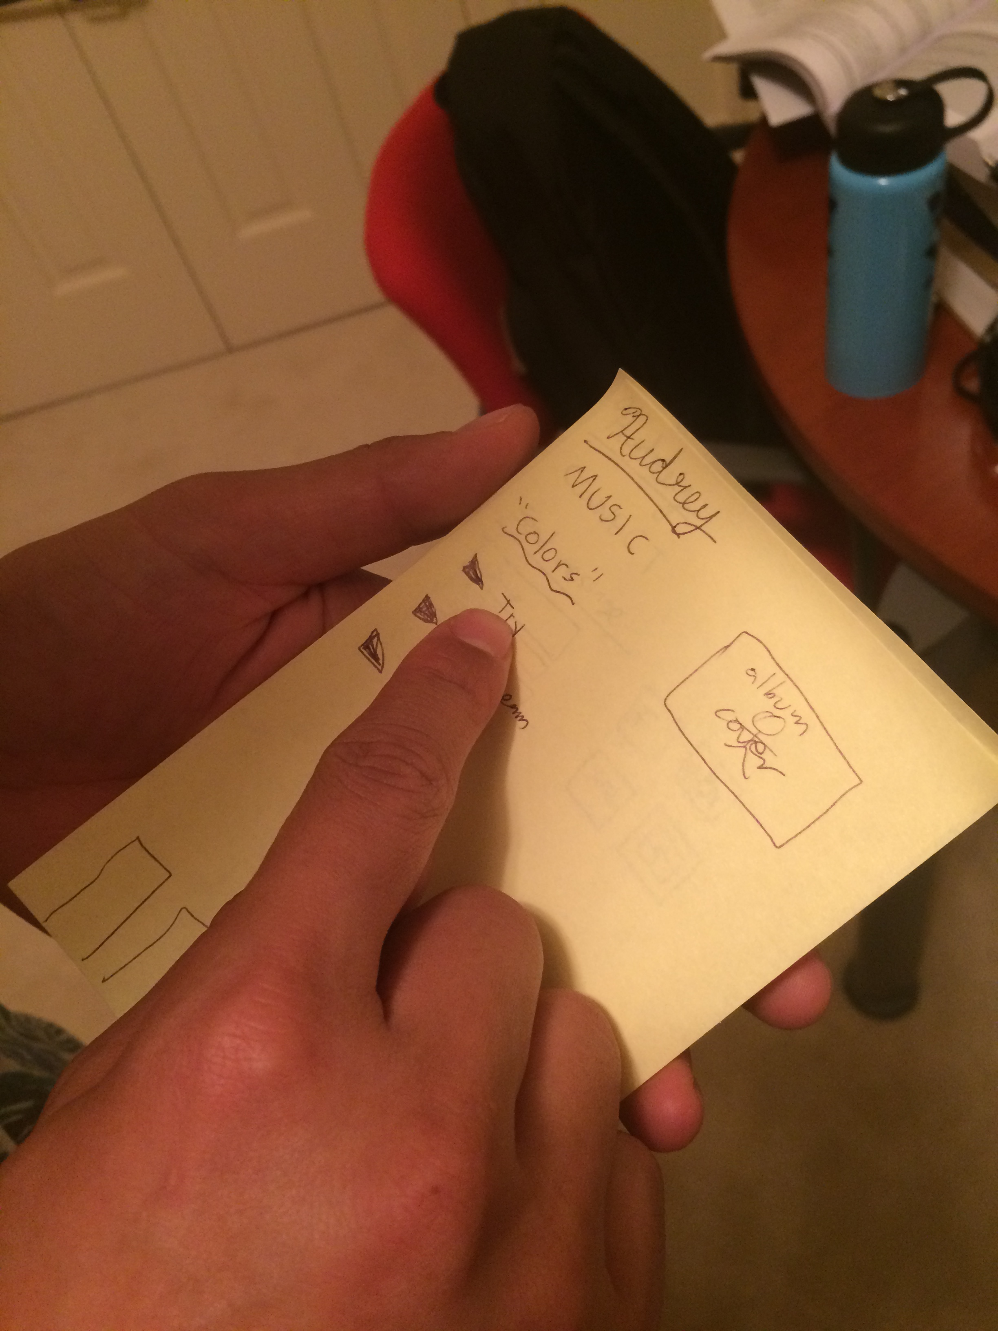
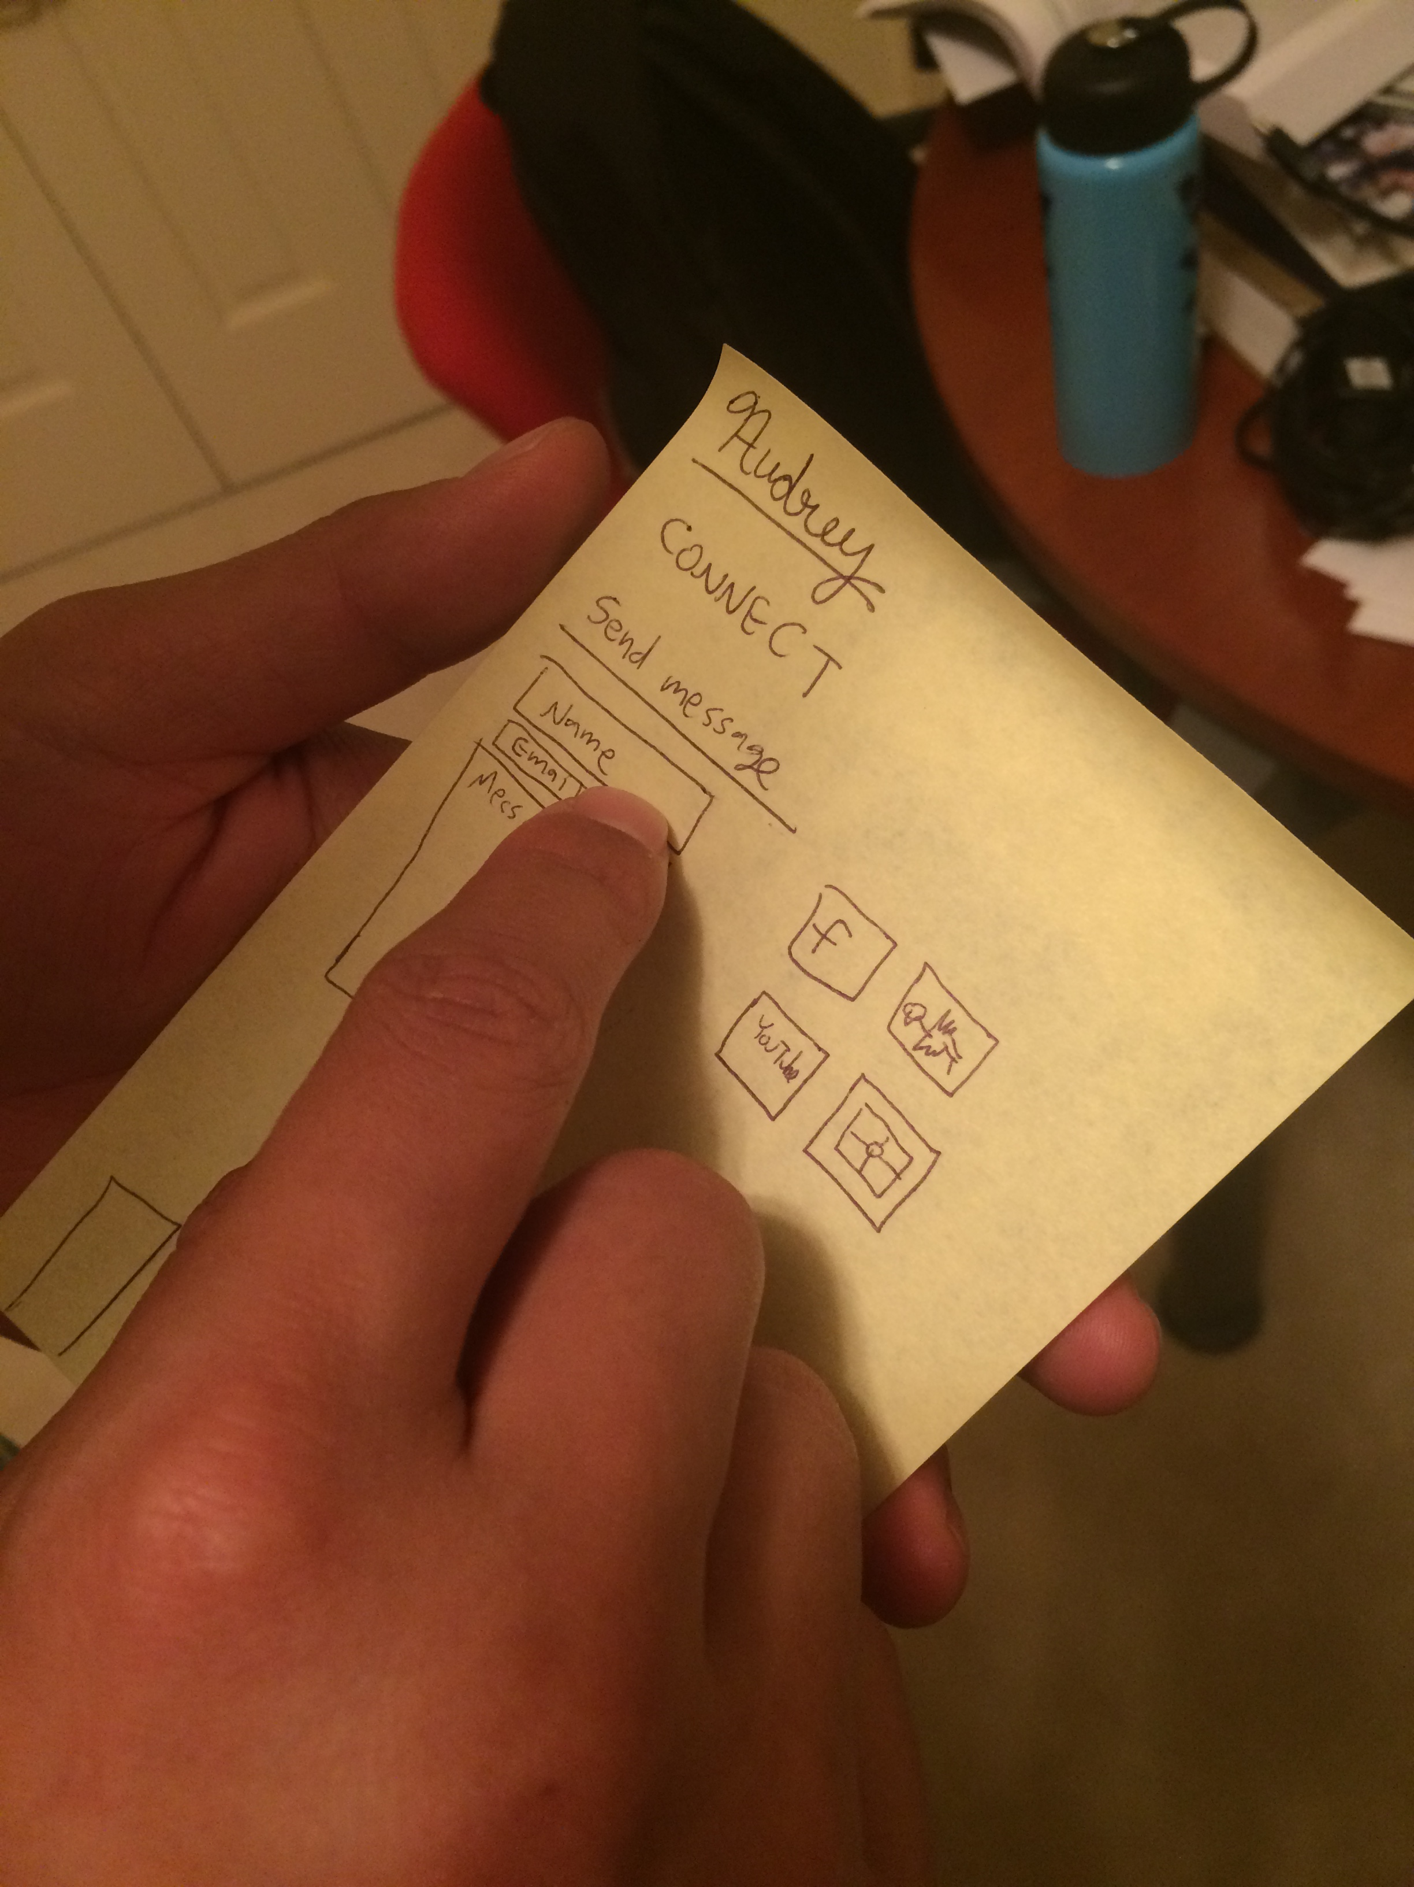
Experience Prototype: Template app-building for musicians
Assumptions:
Artists need and might pay for a service to streamline their digital publicity
Fans want to engage with artists through such a digital app or interface

Slide 23
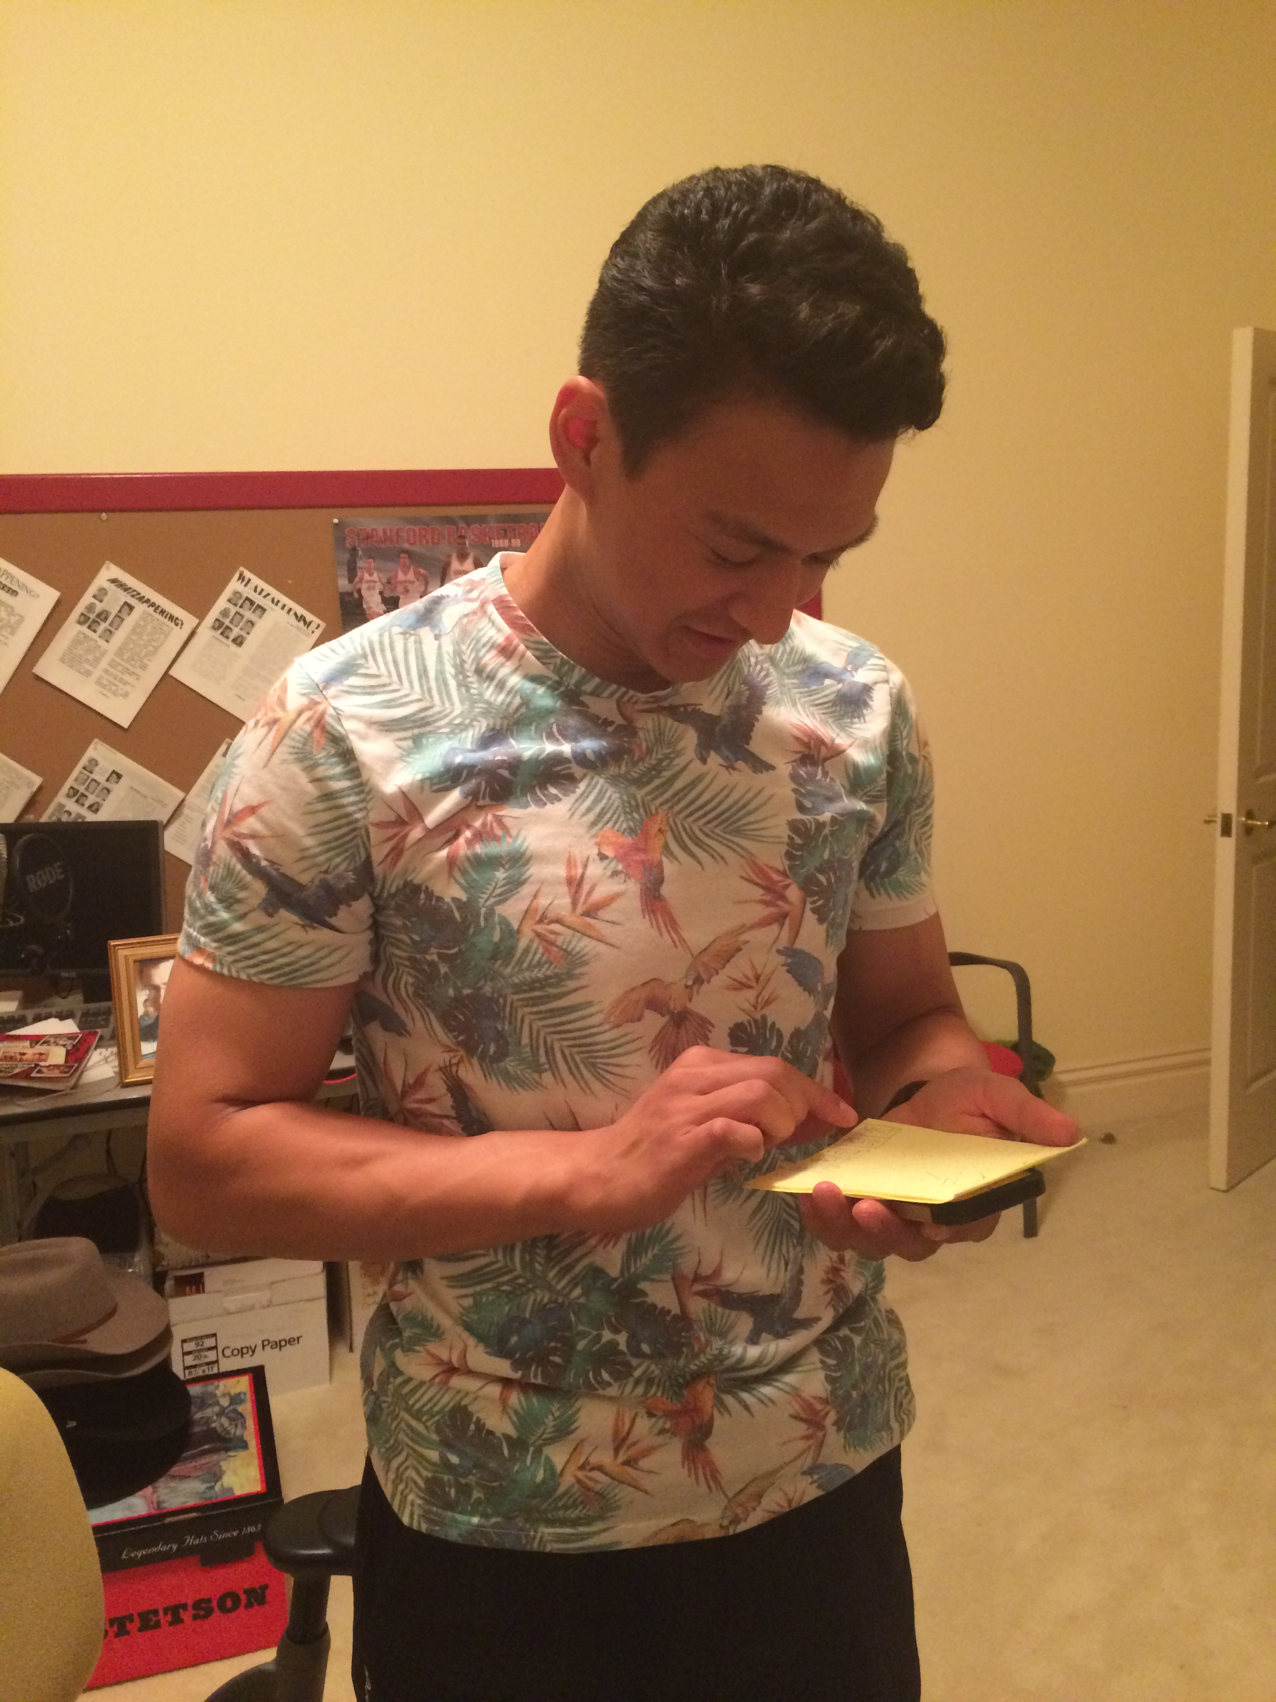
Experience Prototype: Template app-building for musicians
Things that worked:
Simple interface, easy to use
Accessible to non-technical people
Things that didn’t work:
Still unclear whether artists would be receptive
Surprises:
Suggestion that users could recommend new features or customization
New Learnings:
Could be useful for agents as well in scouting new artists. Need to asses this

Slide 24
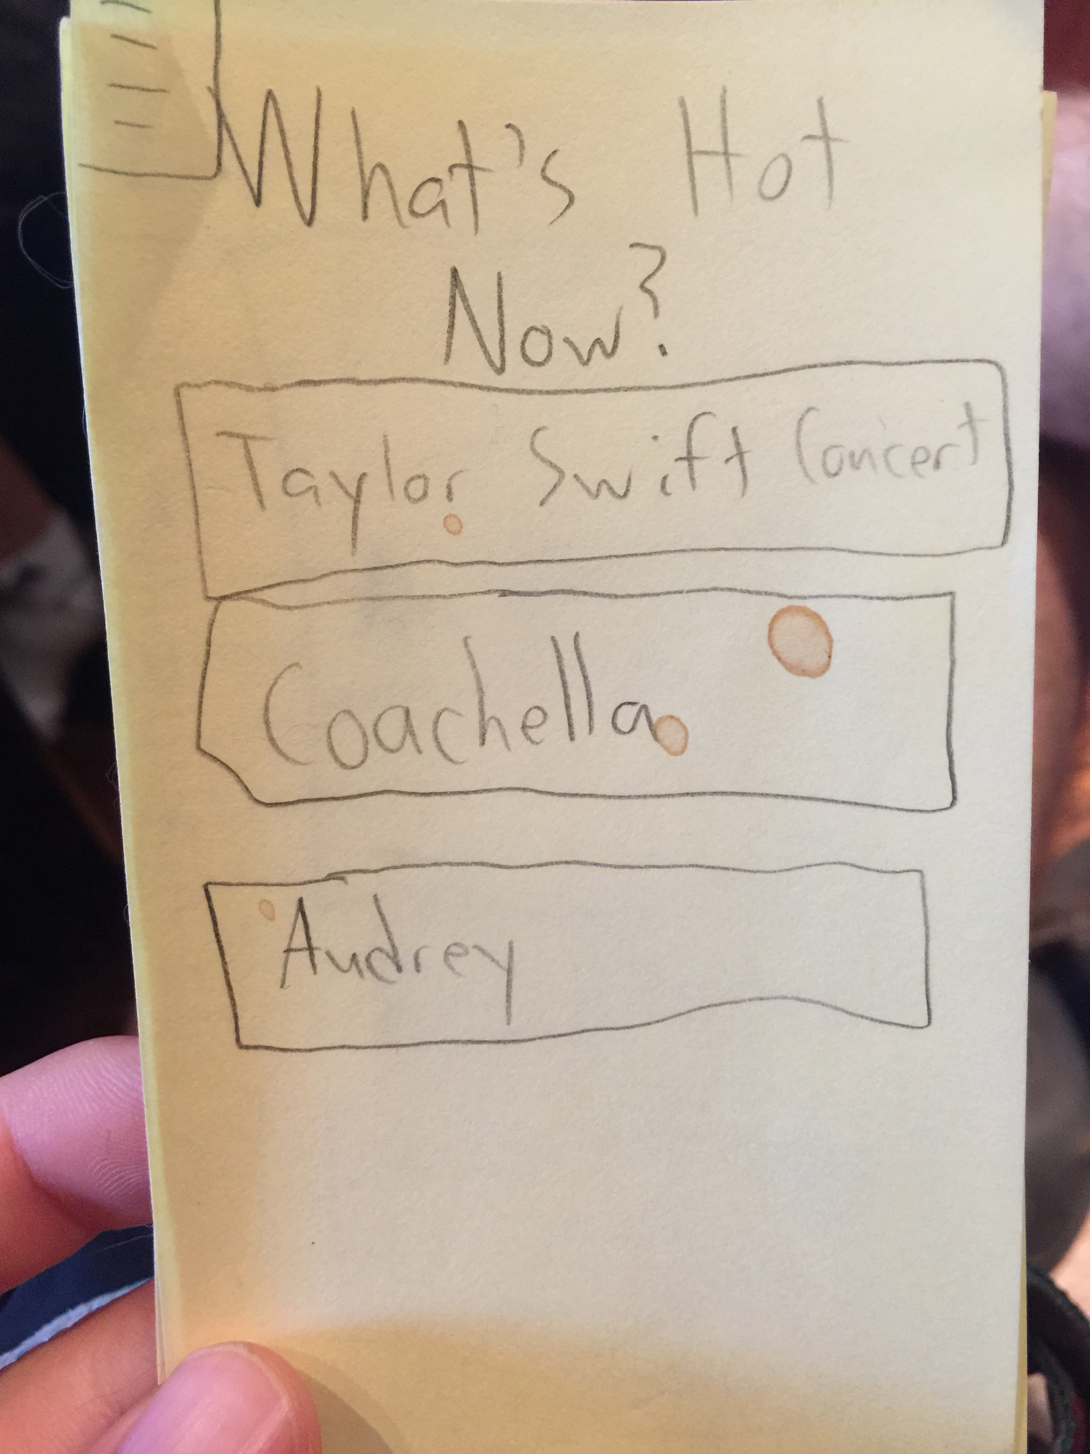
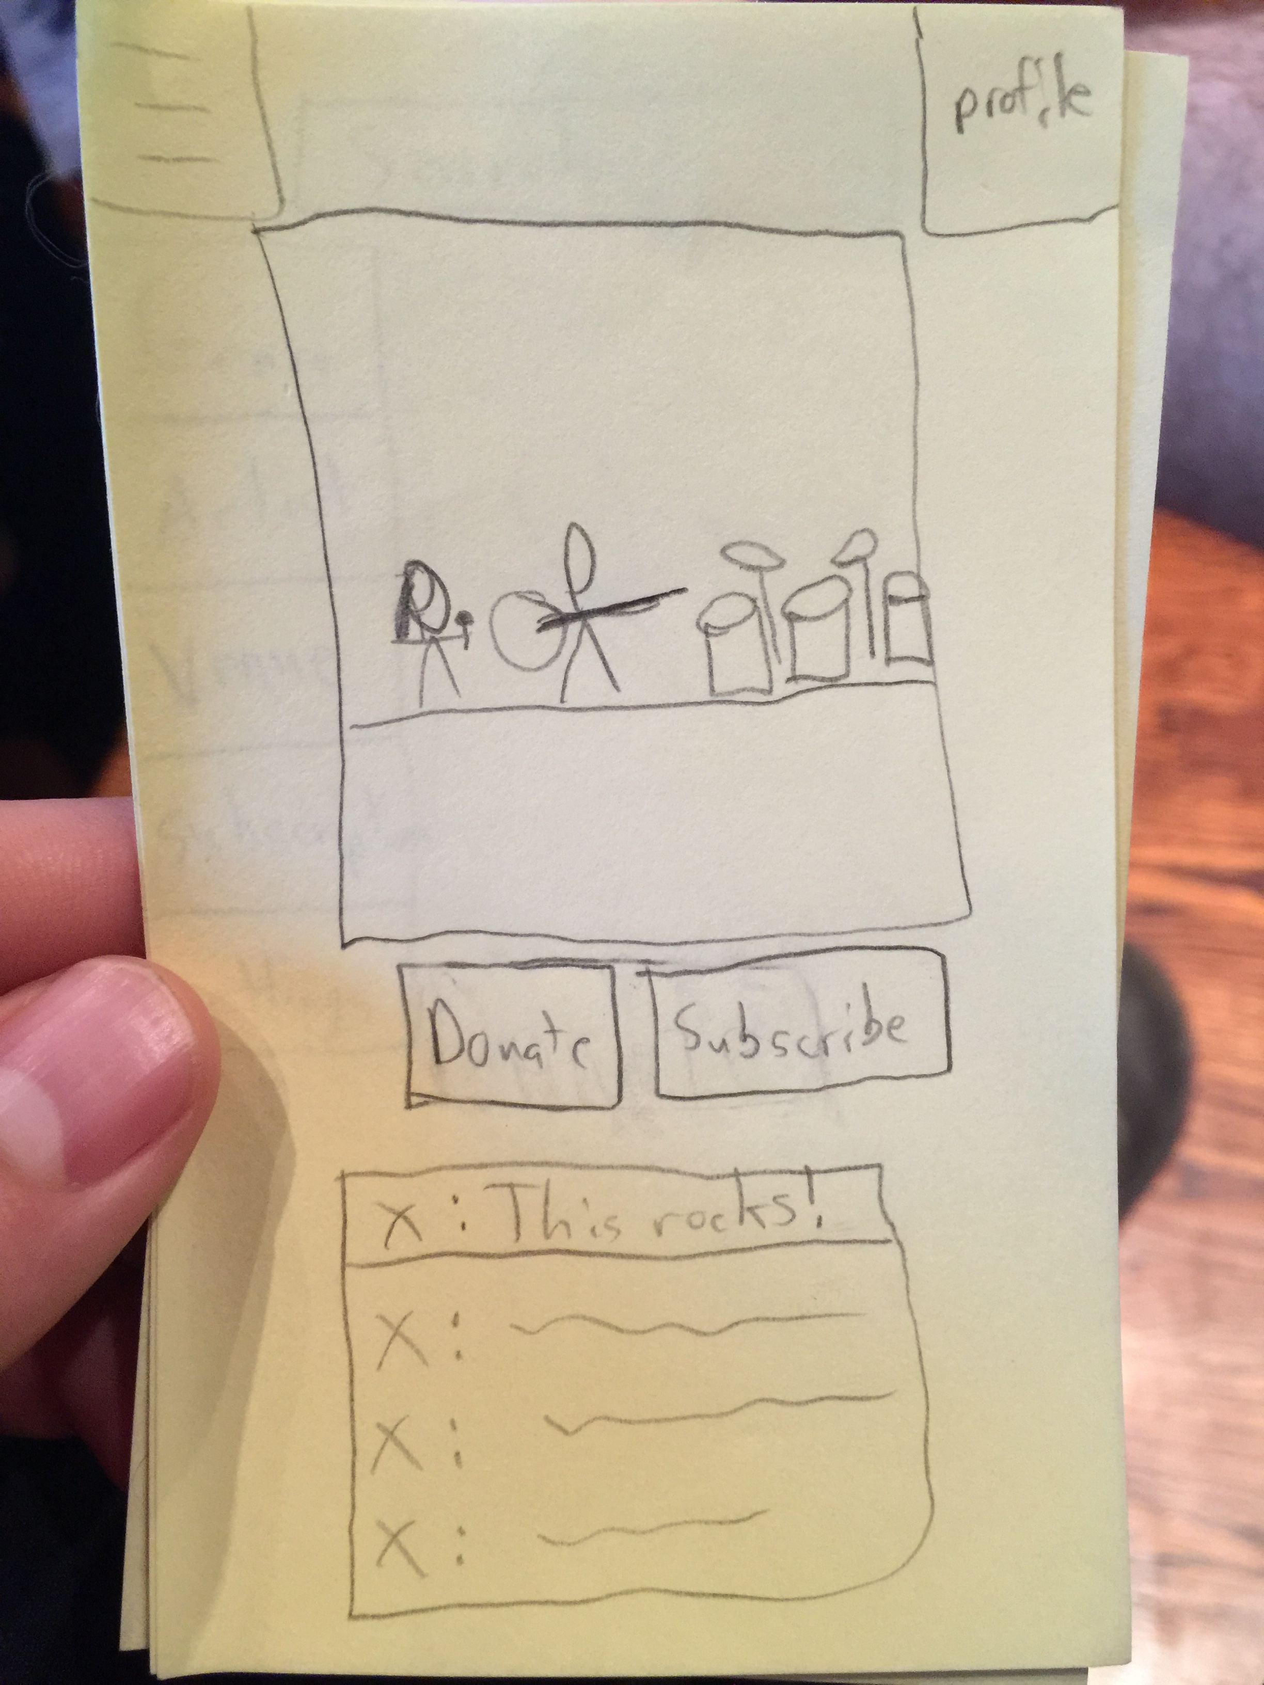
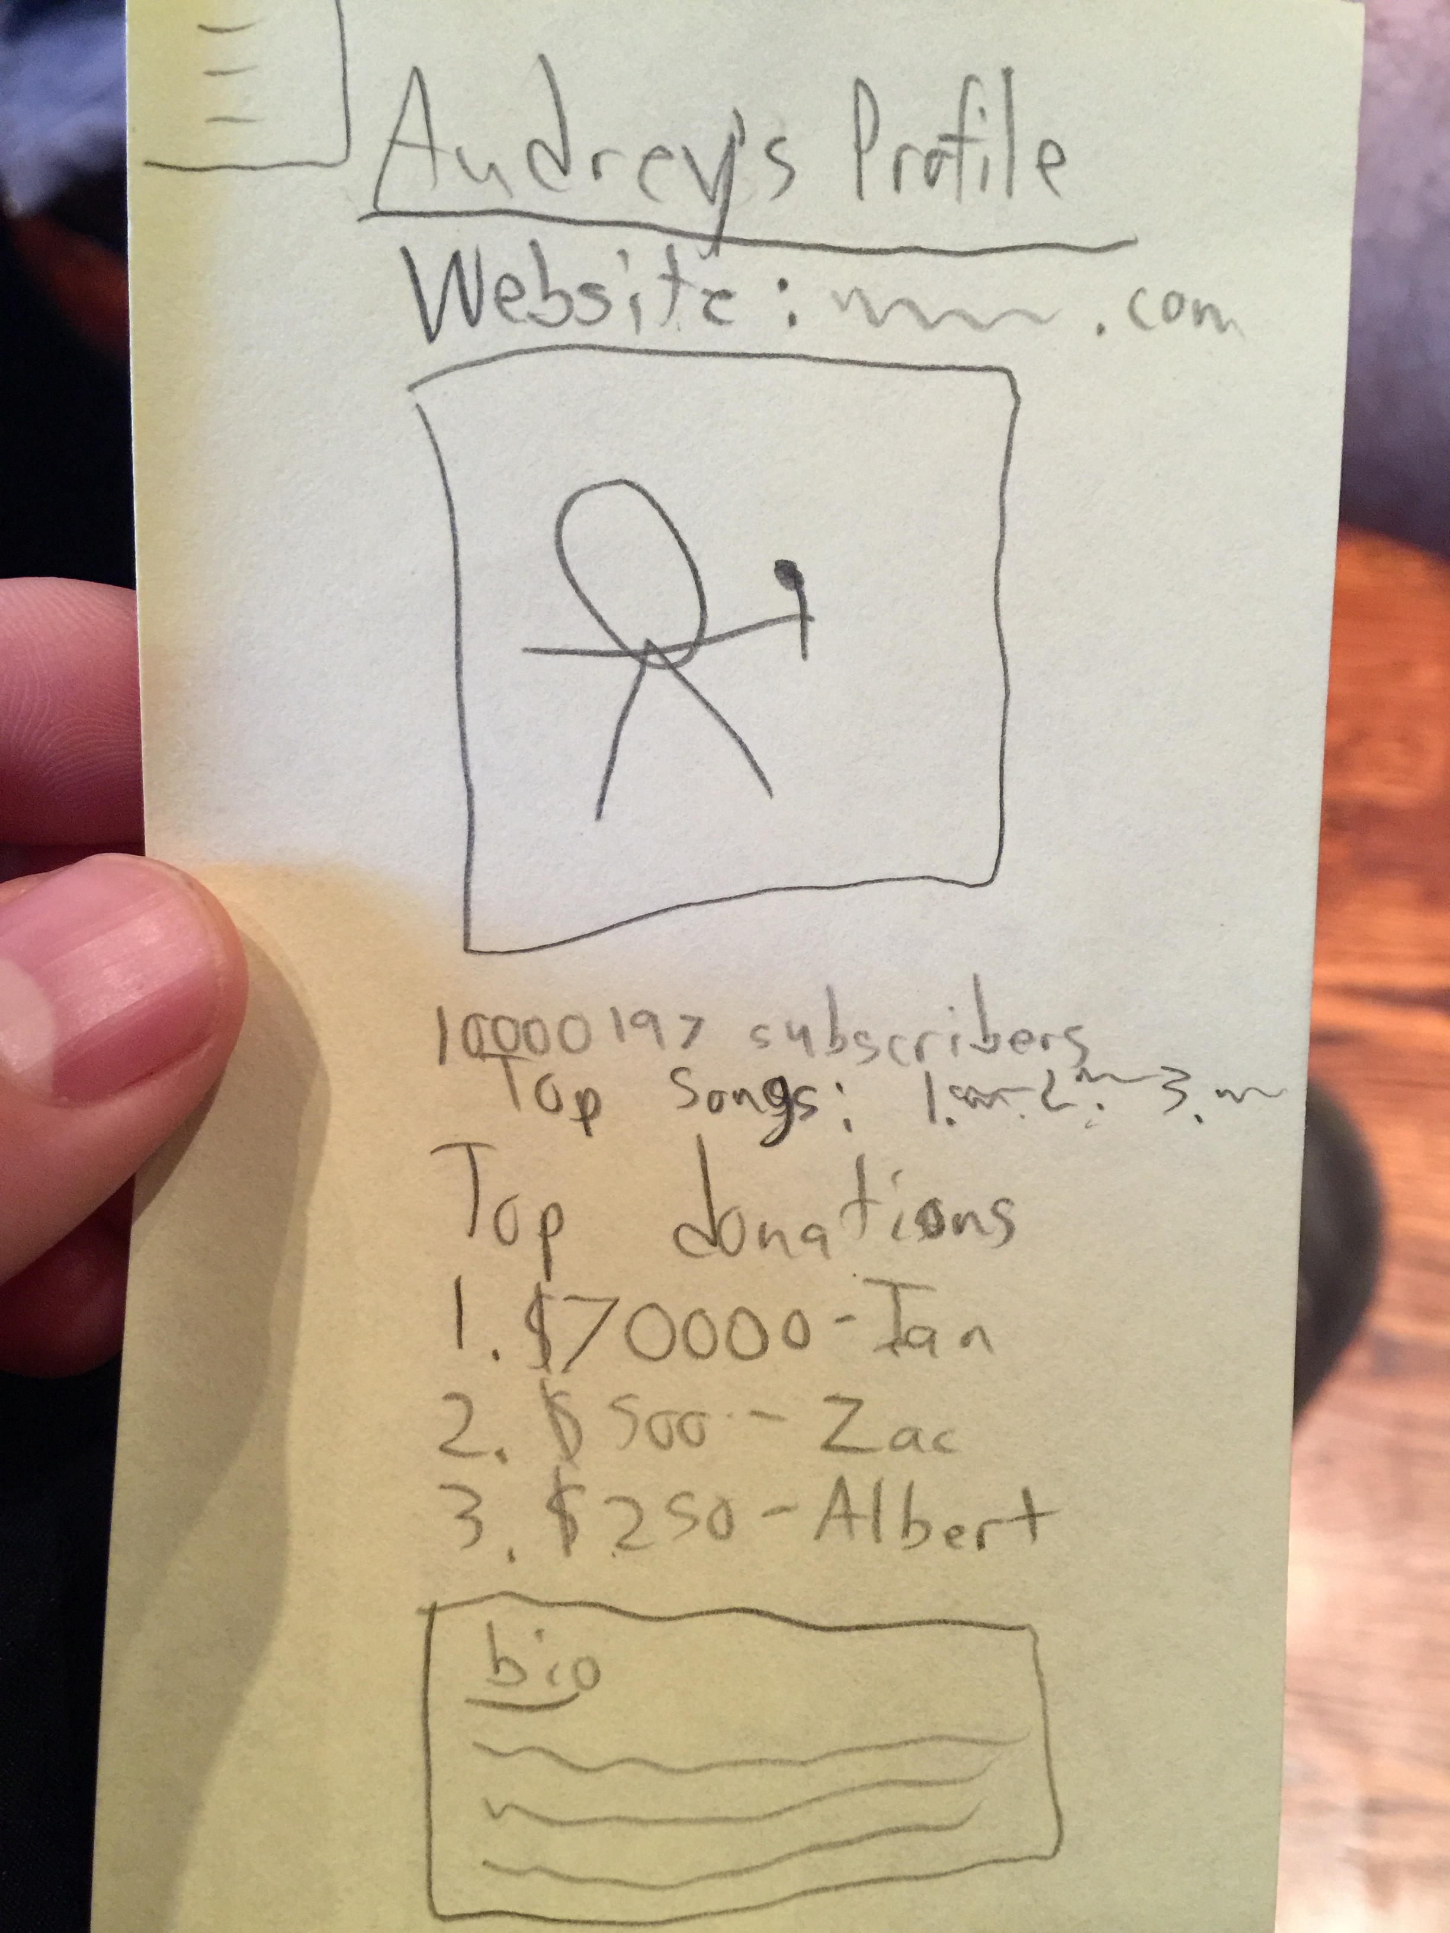
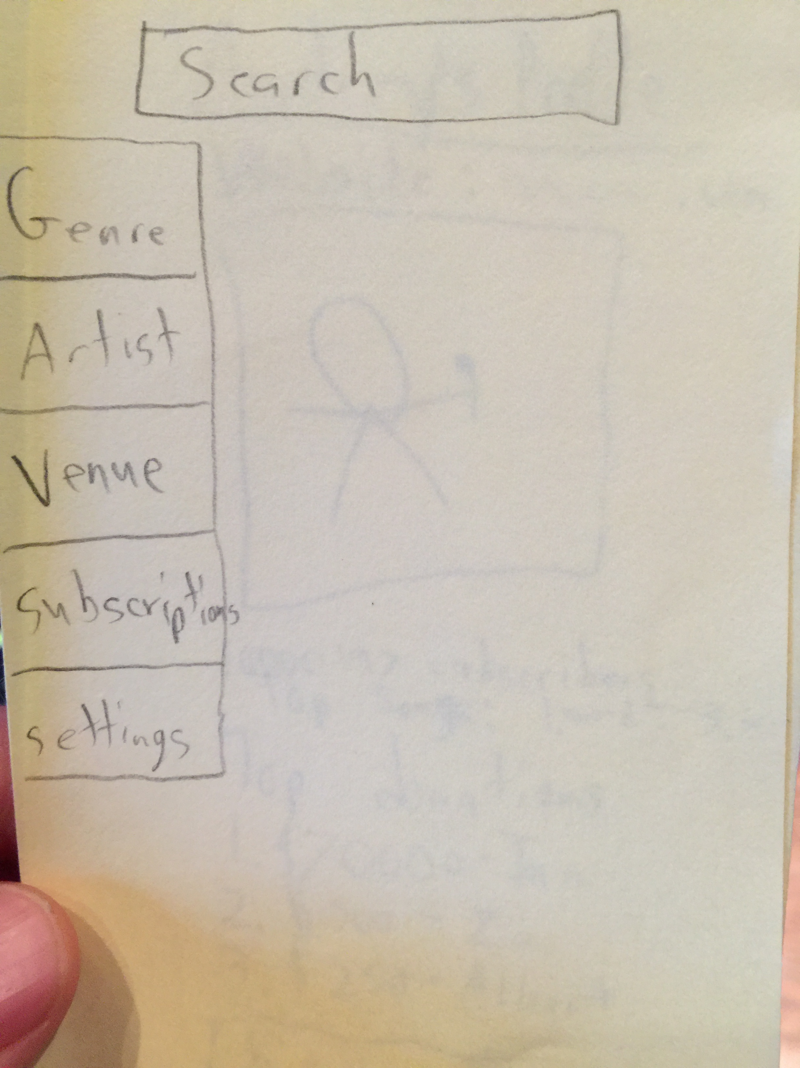
Experience Prototype: Twitch for Musicians
Assumptions:
Fans have a need for an authentic, two-way relationship with artists
A model of unprecedented success in the gaming world could translate to an even broader audience in the music world

Slide 25
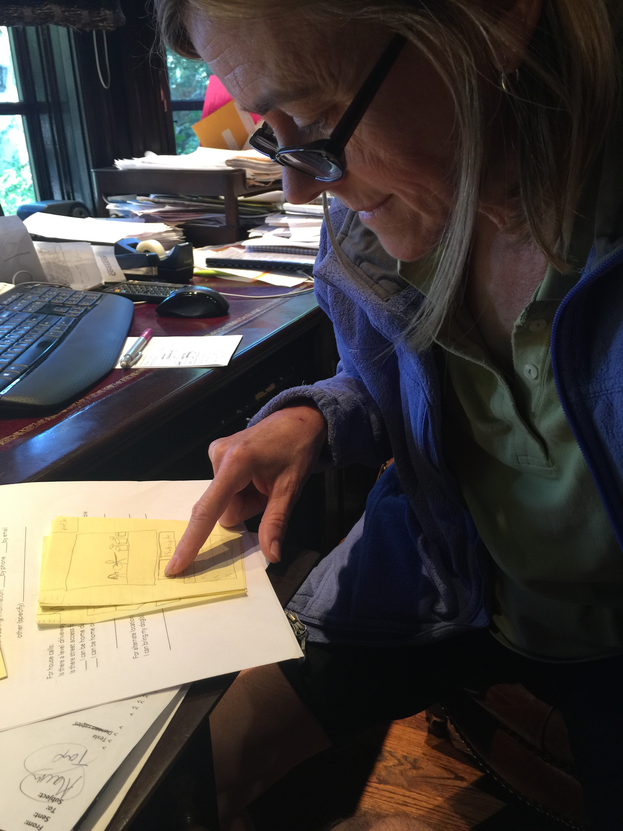
Experience Prototype: Twitch for Musicians
Things that worked:
Ability to add comments, communicate directly with the artist in realtime
Ability to participate in experiences that would otherwise be missed
Things that didn’t work:
Need more options for searching
Surprises:
“Donate” vs. “Support”
New Learnings:
Fans have a need for an authentic, two-way relationship with artists
Live concerts + Oculus Rift

Slide 26
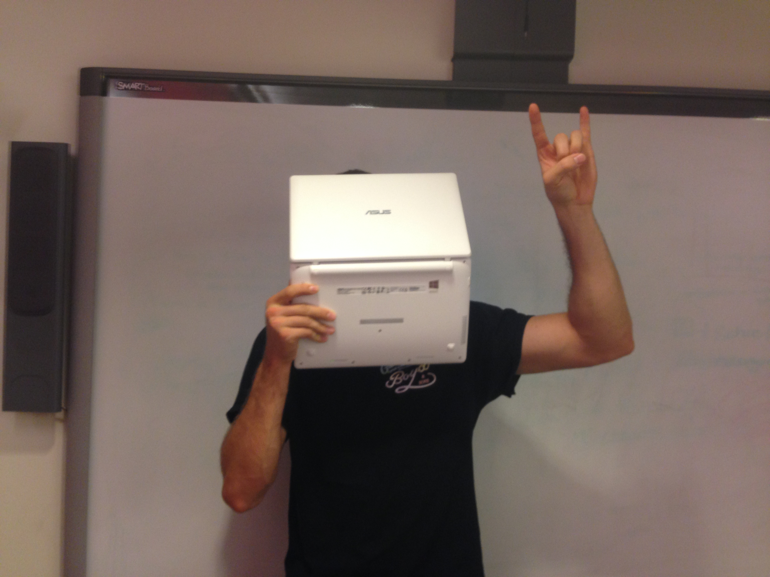
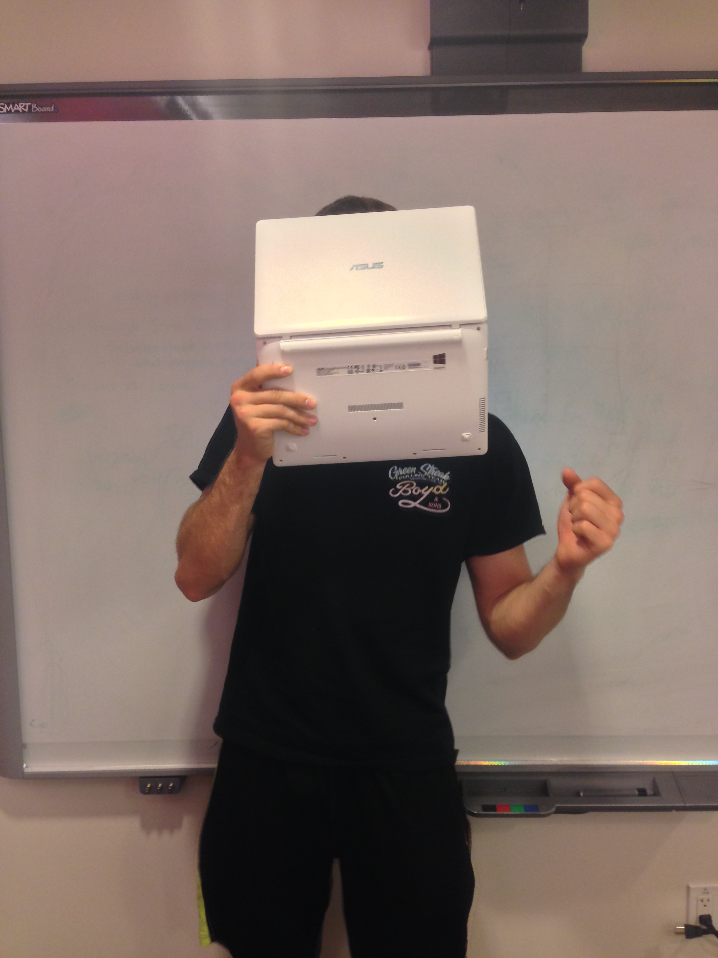

Slide 27
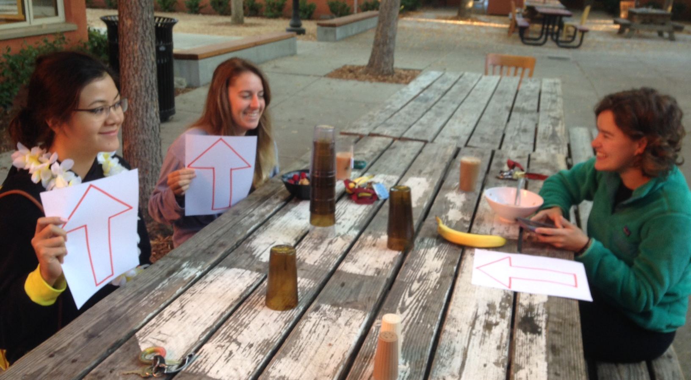
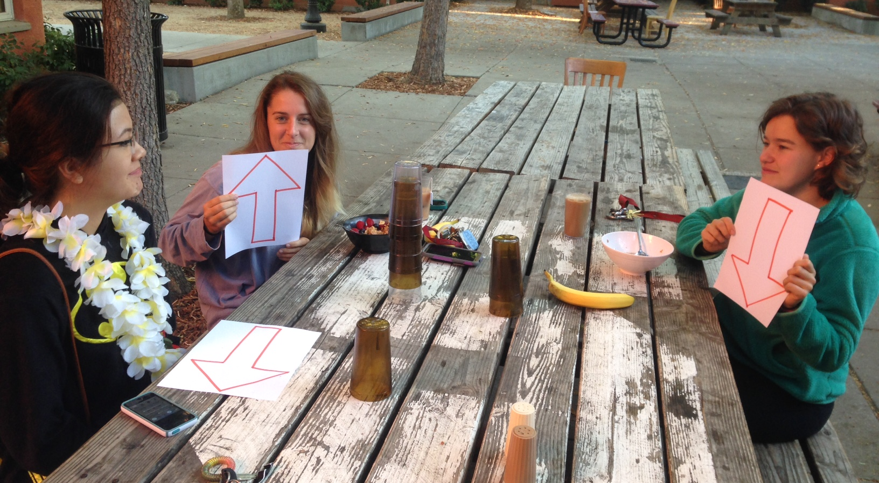
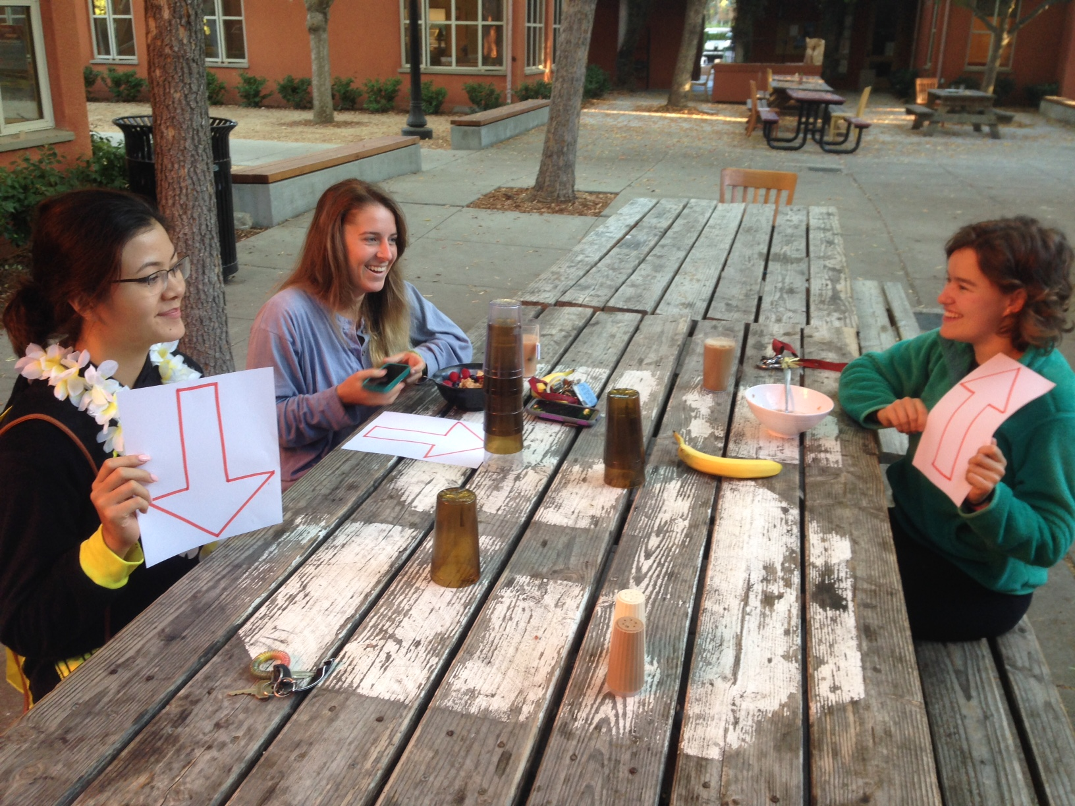
Experience Prototype: Music with Friends
Assumptions:
Music sharing is a social activity
Gamification could be a successful incentive

Slide 28
Experience Prototype: Music with Friends
Things that worked:
Social aspect was fun
Participants shared a variety of songs
Things that didn’t work:
Unclear how compelling it would be without the face-to-face interaction
Points system was hard to keep track of
Surprises:
Some participants struggled to find obscure/novel music to share
New Learnings:
Gamification is promising but needs to be further developed

Slide 29
Music Sharing
Albert Tomasso
Audrey Proulx
Ian Proulx
Sean Klein

