Slide 1
Music Sharing
Albert Tomasso
Audrey Proulx
Ian Proulx
Sean Klein

Slide 2
Agenda
1
Introduction
2
Needfinding Methodology
3
Interview Results
4
Analysis
5
Summary

Slide 3
Agenda
1
Introduction
2
Needfinding Methodology
3
Interview Results
4
Analysis
5
Summary

Slide 4
Participants

Slide 5
LUCY POWERS
Yale freshman
Musical theatre major

Slide 6
MATTHEW BILLMAN
Stanford senior
Fleet Street a cappella
Aspiring professional singer

Slide 7
JENNA JOHNSON
High school senior in Indiana
Captain of her soccer team

Slide 8
KEN KLEIN
Bay Area father
Chairman of Tintri
25 years in software industry

Slide 9
You can use this area for a text treatment that supports your chosen imagery
METHODOLOGY
Chose participants from a range of musical interests and backgrounds
Observed participants finding a new song
Asked about experiences discovering new music and, for producers, disseminating it
Notes:
End on 2:00

Slide 10
Agenda
1
Introduction
2
Needfinding Methodology
3
Interview Results
4
Analysis
5
Summary

Slide 11
INTERVIEW RESULTS: CONSUMERS
Difficult to find new music
Even if you are actively looking
Most people are NOT actively looking for new music
Finding new music is a “passive process”
Lucy finds by “osmosis”
Matt hears music around him
Jenna’s friends suggest new songs
Ken actively looks for new music
Apps, recommendations

Slide 12
It’s definitely passive — I wish I were more active in discovering new music.
Lucy Powers

Slide 13
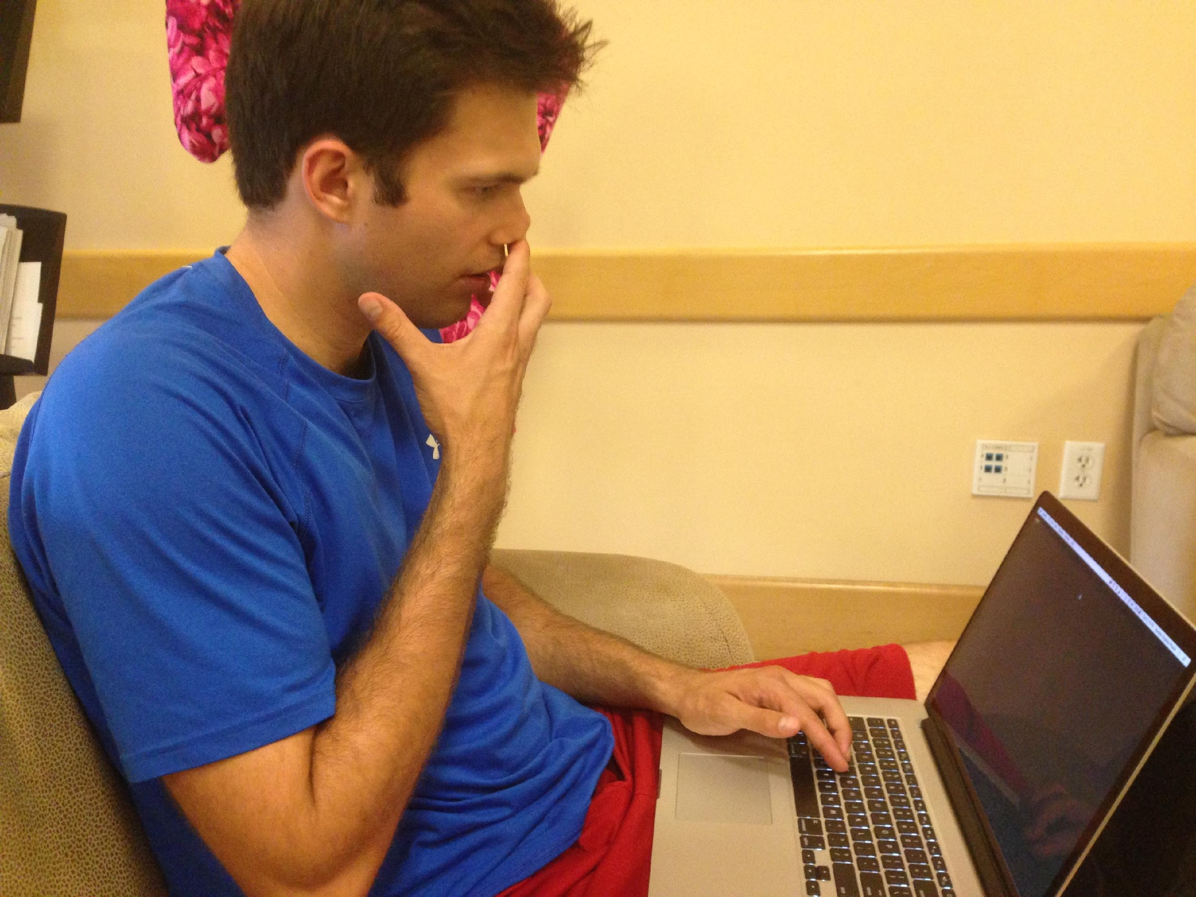
INTERVIEW RESULTS: CONSUMERS
Music discovery is a social process
Matt’s a cappella group prepares albums for road trips
Jenna’s soccer team makes collaborative warmup CDs
Lucy listens to her brother’s and Yale class’s playlist on shuffle

Slide 14
INTERVIEW RESULTS: PRODUCERS
Difficult to get your work out there if you’re not one of the “top few”
Radio plays the same songs over and over
Internet is cluttered with millions of tracks and no easy way to sift through them
Notes:
End on 5:00

Slide 15
Agenda
1
Introduction
2
Needfinding Methodology
3
Interview Results
4
Analysis
5
Summary

Slide 16
CONSUMERS
SAY “I just kinda listen all the time to what’s going on around me.” “My friends and I pass around the AUX cable when we’re driving.” “It’s an effort to find music but I like the discovery - it’s a rewarding experience, kind of like you’re mining for something valuable” | THINK Finding new music = challenge “Happenstance” (chance encounters), often among friends, provides the best exposure to new music Music industry is saturated with artists because of low barriers to entry, but difficult to succeed in because of piracy, etc. Too much bad music on YouTube and SoundCloud
DO Search for recommendations or similar songs on Pandora, Spotify, iTunes Shazam to identify songs around them | FEEL Frustrated at the process of new music discovery Excited by the prospect of discovering new music Needs new music after overplaying songs

Slide 17
PRODUCERS
SAY “I’m not much of a networker. I’d like to get my music out there in a way that doesn’t depend on me being friends with an agent.” “There are lots of starving artists out there—you’ll never have a lack of people to develop your stuff” “You’re selling yourself as a performer—that’s why girls wear makeup and guys show their arms.” | THINK Matt believes live performances are the best way to get discovered Lucy believes an image must be cultivated and sold via technology Interested in facilitating collaboration to crowdsource the making of a song
DO Gigs relentlessly Posting songs online, but not getting many hits Tries different online platforms to facilitate engagement with potential fans | FEEL Feel squeamish about the networking process Desire an easier way of connecting artists with agents, directly Dissatisfied that the music industry is dominated by just a few artists
Notes:
End on 7

Slide 18
Agenda
1
Introduction
2
Needfinding Methodology
3
Interview Results
4
Analysis
5
Summary

Slide 19
SUMMARY
Finding new music is difficult, and most people aren’t actively looking for it
Music discovery is a social process
Consumers wish there were an easy way to be more “active” in discovering new artists that fit their tastes
Producers wish there were a more direct way to get people to listen to their songs sans networking
Most existing music discover apps (e.g., Pandora) recommend already-popular songs
Notes:
End on 9

Slide 20
Questions?

