Slide 1
Interactive High-fi Prototype

Slide 2
Fuss less, Dine more

Slide 3
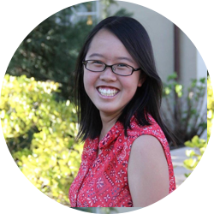
Team Muncher
Peter F.
Monica Y.
Kai Jian C.
Gloria C.
Developer
User Testing
Manager
Designer

Slide 4
Value Proposition
Muncher’s mission is to help you decide where to eat in groups. With the help of human-based artificial intelligence, Muncher understands your preferences and makes the hard decisions for you.

Slide 5
Problem & Solution
Problem | Solution
Hard to decide where to eat in groups | Human-based artificial intelligence
THREE REPRESENTATIVE TASKS:
Decide a place to eat
Deal with user discontent
Coordinate the actual plans
[Moderate]
[Complex]
[Simple]

Slide 6
Overview
Heuristic Evaluation: Results & Revised Design
Prototype Implementation Status
Demonstration of Prototype
Summary

Slide 7
Heuristic Evaluation: Results & Revised Design
1
Focus on level 3-4 issues

Slide 8
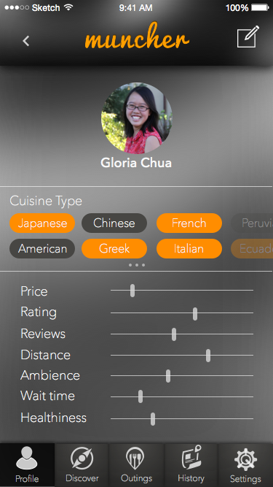
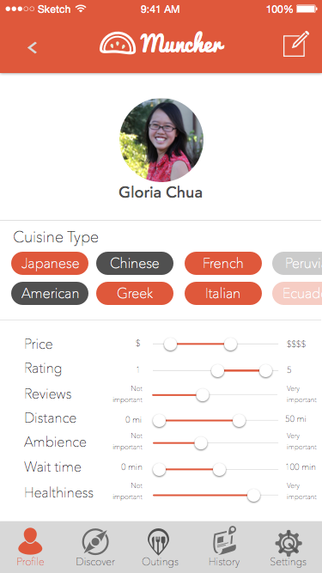
H2-2: In the profile, it is unclear what the ranges are for the values, so the user could not properly gauge their interests
Suggested fix: Two indicators on the bar, one for min and one for max

Slide 9
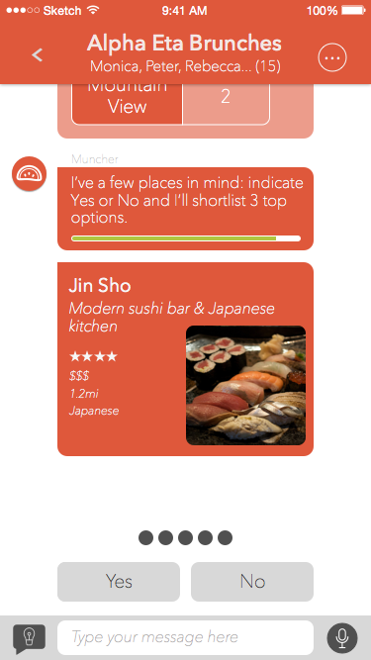
H2-3: Binary options on polls doesn’t allow for user to express opinion if they don’t like either options
Suggested fix: provide another option to allow for user input
Our premise: limited choice
don’t want users to input too much
Option to reject the final decision
pulls out the next best restaurant option

Slide 10
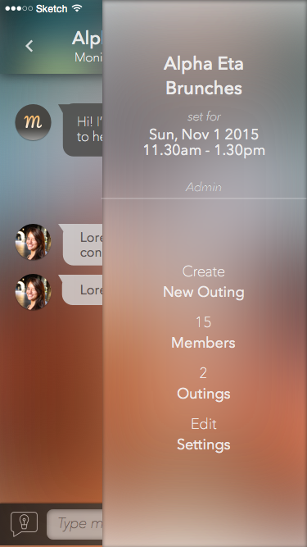
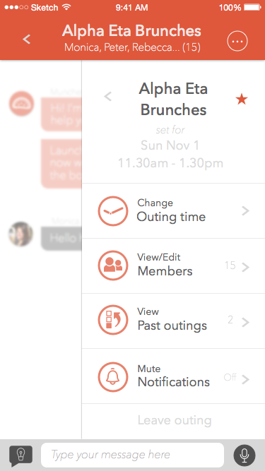
H2-3: No way to return after modifying settings with the (...) button. Clicking back on the conversation is not intuitive
Suggested fix: Consider a < button

Slide 11
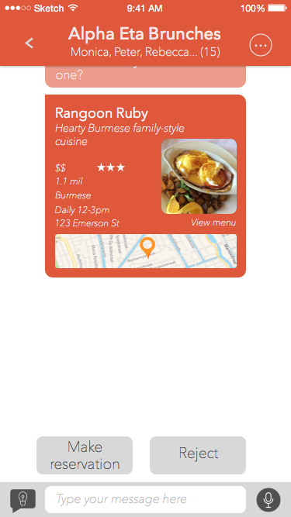
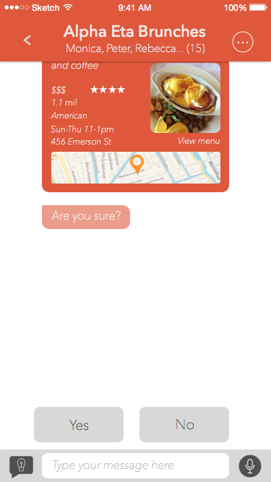
H2-5: Booking a reservation, which is a big step, is only done with one tap
Suggested fix: Presenting a confirmation button before committing reservation

Slide 12
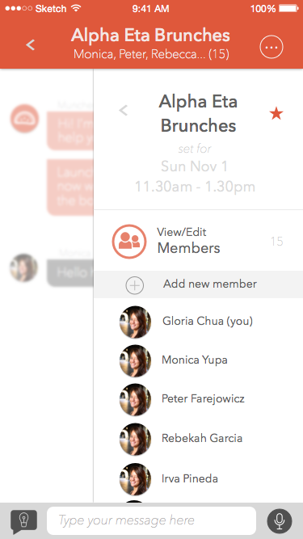
H2-6: On outing info page, there is no clear distinction between actionable vs. non-actionable items. Users have to memorize settings that are clickable
Suggested fix: Make clickable items prominent and different

Slide 13
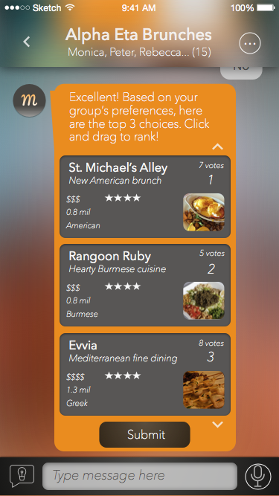
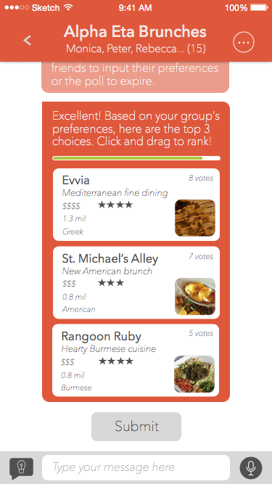
H2-7: In the drag and drop part, it doesn’t seem like the up and down arrows have a function
Suggested fix: Remove redundant arrows

Slide 14
H2-5: It would not be convenient to repeat the entire process if the restaurant is not open or unavailable for reservation
H2-9: Chat-based systems aren’t irreversible, so there’s no way to undo an accidental vote
Suggested fix: NA
We assume the backend will deal with this, not the UI
Wizard of Oz
Suggested fix: NA
Multiple users input multiple votes, so accidental votes do not have much impact
For simplicity
Users can reject restaurants at the final step

Slide 15
Prototype Implementation Status
2

Slide 16
Tools used
Sketch
Xcode

Slide 17
Feature Implementation
IMPLEMENTED
Task 1: Decide a place to eat [Moderate]
Click through choices
UNIMPLEMENTED
Task 1: Decide a place to eat [Moderate]
Messaging keyboard
Scrolling
Interaction with AI
Task 2: Deal with user discontent [Complex]
Task 3: Coordinate the actual plans [Simple]
PLAN: Learn more Swift over Thanksgiving!

Slide 18
Wizard of Oz techniques
Hard-coded data
Human-based AI
Decision-making ranking algorithm
Interaction with multiple users
Text
Polls
Results

Slide 19
Issues/Questions
How to implement fully responsive messaging function?
Genie responses - Natural language processing?
Use database of random Siri responses?
How to imitate behavior of other users within the group?

Slide 20
Demonstration of Prototype
3

Slide 21
Summary
4

Slide 22
Summary
Heuristic Evaluation: Results & Revised Design
5 out of 8 severity-level 3 fixed
Prototype Implementation Status
Task 1 implemented with Wizard of Oz
Missing AI and Messaging features
Allow full paths
Learn more iOS to increase app dynamism!

Slide 23
Thanks!
Any questions?

