Slide 1
INTERACTIVE MEDIUM-FI PROTOTYPE
Notes:
human aspect more apparent
reduce user flow
provide multiple options at decision screen

Slide 2
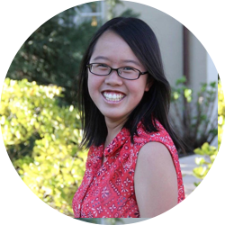
Team Muncher
Peter F.
Monica Y.
Kai Jian C.
Gloria C.
Developer
User Testing
Manager
Designer

Slide 3
1
VALUE PROPOSITION
Problem and solution overview

Slide 5
“Muncher’s mission is to help you decide where to eat in groups. With the help of human-based artificial intelligence, Muncher understands your preferences and makes the hard decisions for you.”

Slide 6
2
TASKS
Actionable things for our users

Slide 7
THREE REPRESENTATIVE TASKS
Decide a place to eat
Deal with user discontent
Coordinate the actual plans
[Moderate]
[Complex]
[Simple]

Slide 8
3
REVISED INTERFACE DESIGNS
Taking it from Low-Fi to Medium-Fi

Slide 9
Major Design Changes

Slide 10
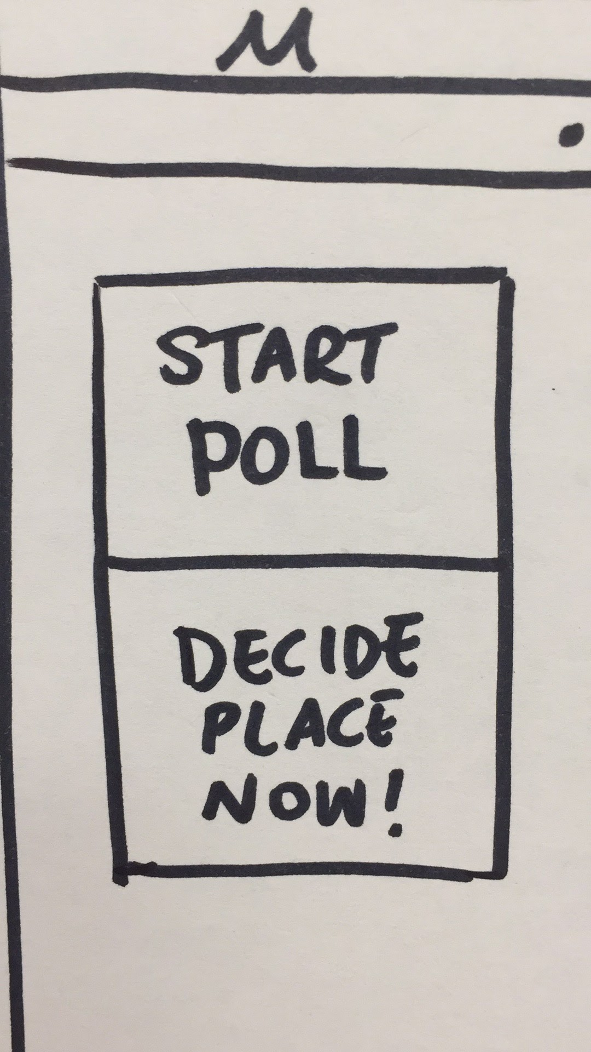
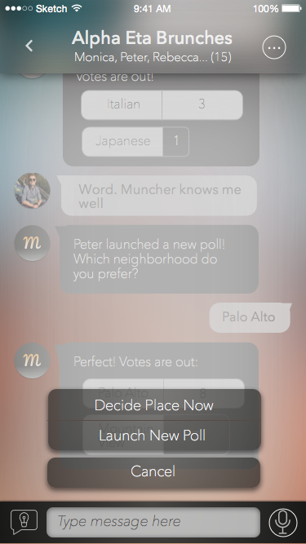
UI CHANGE
#1:
Launching a poll
Integrated launching a poll as an overlay
Keeps the user engaged in the chat
Launched from new lightbulb button instead of “+”
Separates create new outing function from polling

Slide 11
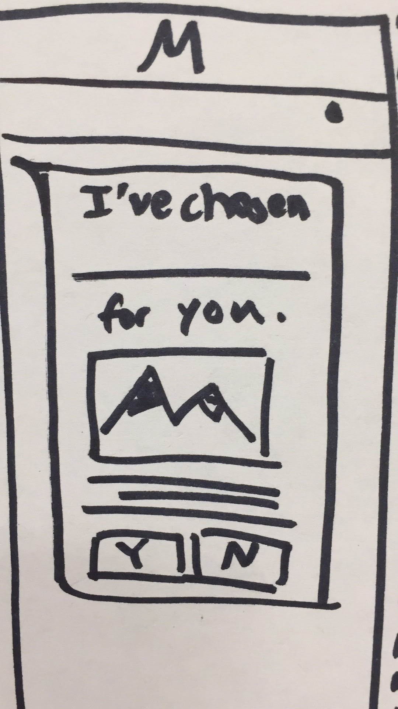
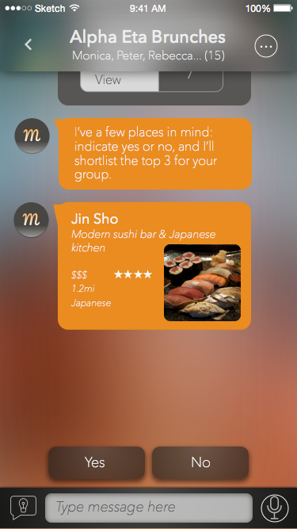
UI CHANGE
#2:
Genie Suggestions
At decision time, multiple suggestions are presented
Provides the user with more variety
Gives the human AI immediate feedback on multiple restaurants

Slide 12
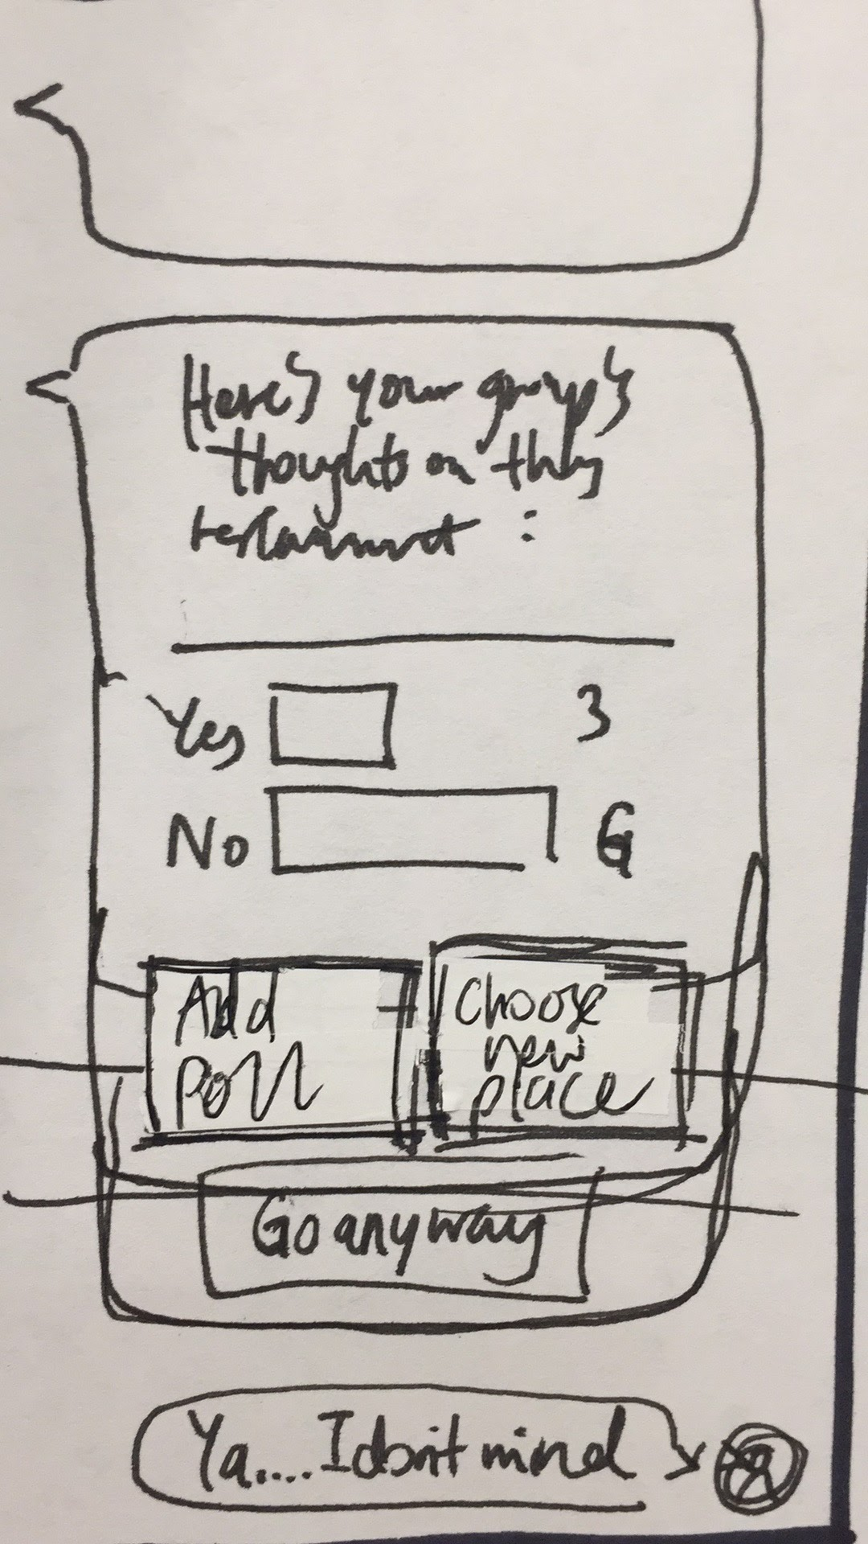
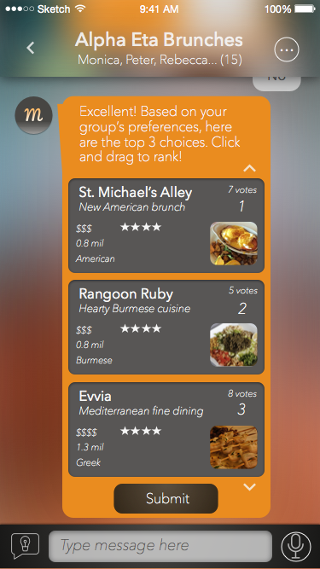
UI CHANGE
#3:
Finalizing a location
Switched to a drag and drop feature instead of buttons
Prevents users from quitting based on boredom
Eliminates endless cycles

Slide 13
Task Flows

Slide 14
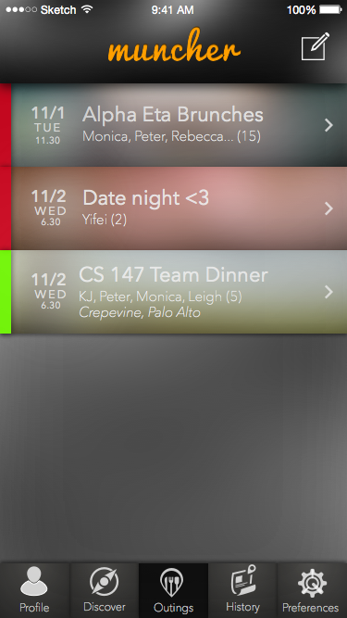
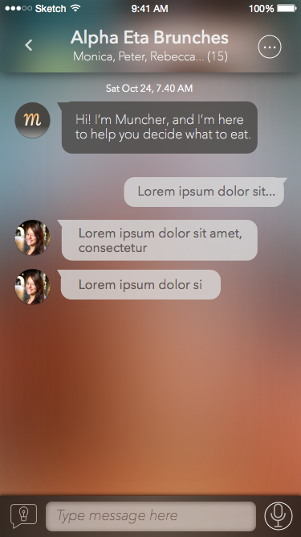
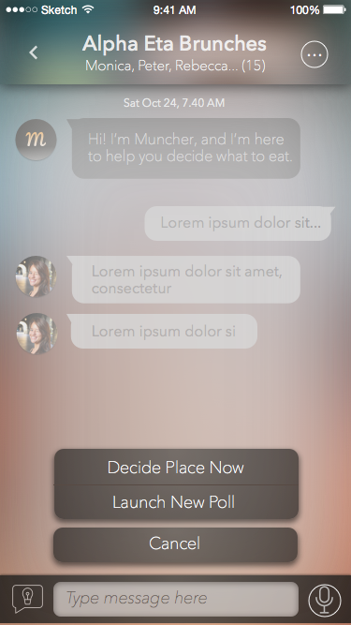
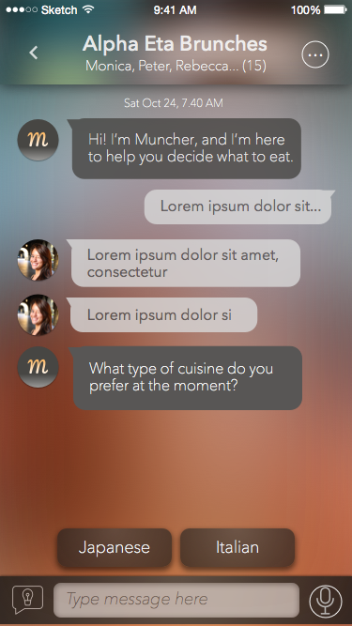
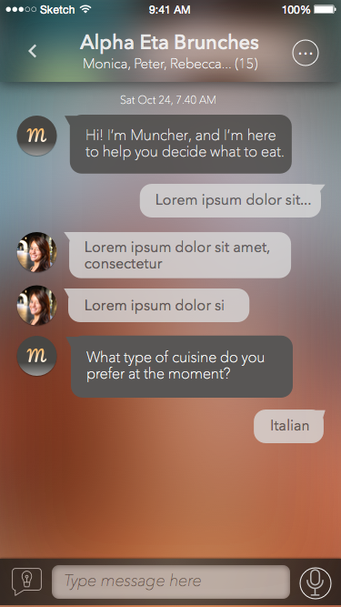
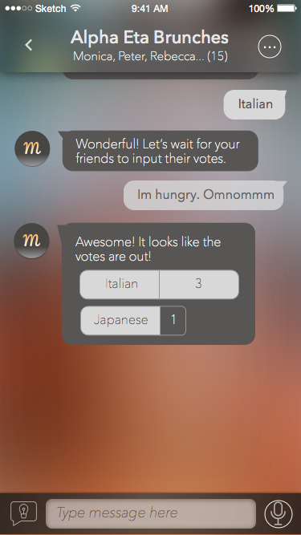
Task #1: Decide a place to eat
Chat room
Actions
Landing screen
Polling

Slide 15
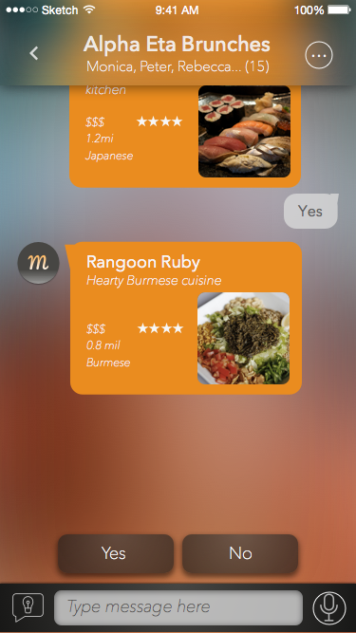
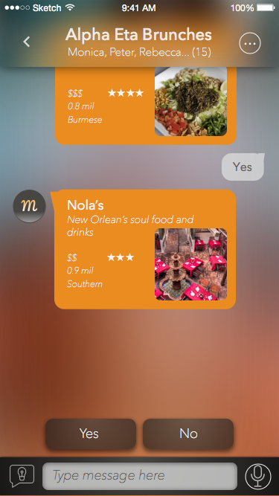
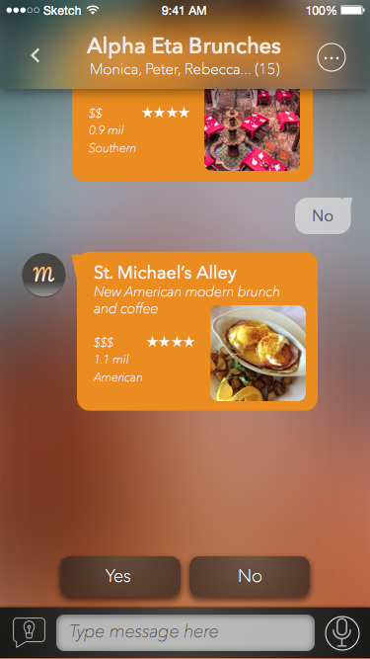
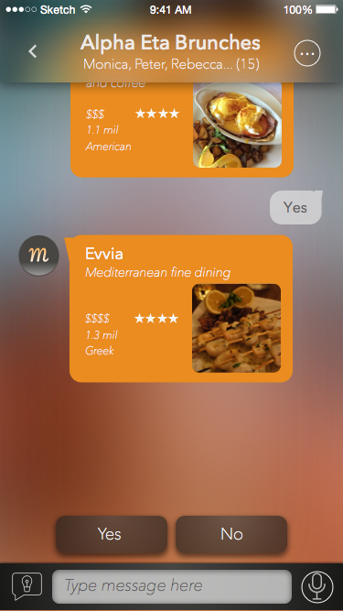
Task #1: Decide a place to eat
Voting

Slide 16
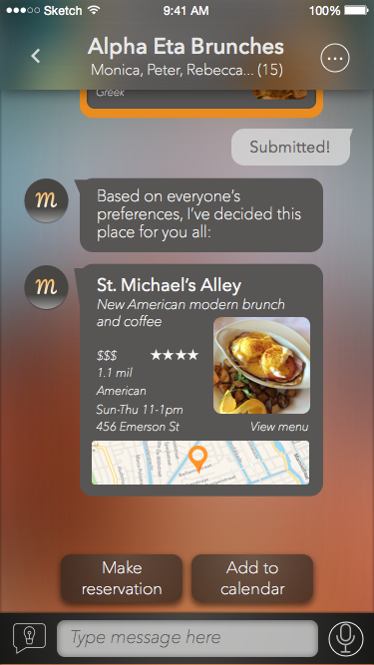
Task #2: Deal with user discontent
Preference ranking
Final decision
Landing screen

Slide 17
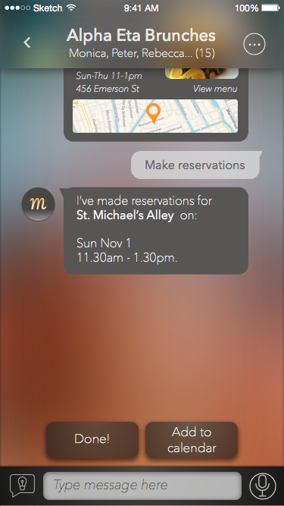
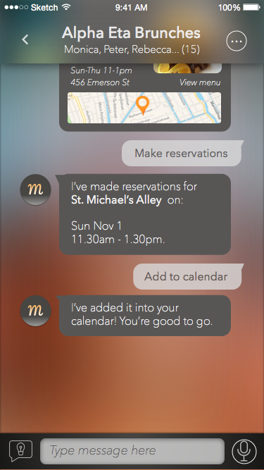
Task #3: Coordinate the actual plans
Options
Reservations
Calendar sync
Landing screen

Slide 18
4
PROTOTYPE OVERVIEW
The “making-of” story behind the app

Slide 19
We used:
Notes:
Sketch, Pop, considered Invision

Slide 20
Allows for clean, aesthetically pleasing iPhone app designs
Look & feel of designs are closer to the final product
Extremely slow
Learning curve for the software
Notes:
Sketch, Pop, considered Invision

Slide 21
We used:
Notes:
Sketch, Pop, considered Invision

Slide 22
Helps link screens together to create a flow
Allows users to simulate the experience of using a real iPhone app
Delayed responses from the interface
Weak transitions between features
Data that users see is static
Notes:
Sketch, Pop, considered Invision

Slide 23
POSITIVES
Cleaner + consistent UI
Every feature is kept within a group chat
Shorter decision making flow
Notes:
Sketch, Pop, considered Invision

Slide 24
NEGATIVES
Static data
Unclear if our color scheme is appealing
Our app could be more visuals and less words
Notes:
data is static

Slide 25
TRADEOFFS
We did not implement a “swipe between cards” feature to keep everything consistent in a group chat
Decided against having an admin for each group for simplicity
Notes:
no WoOZ
no hand-coded

Slide 26
5
ADDITIONAL SCREENS
Extra features

Slide 27
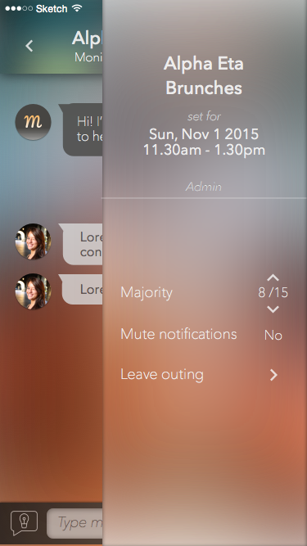
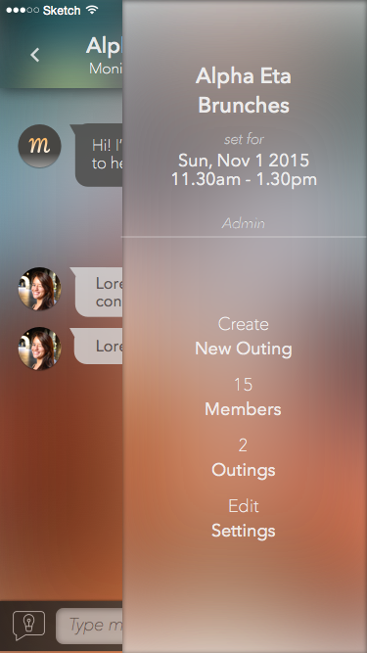
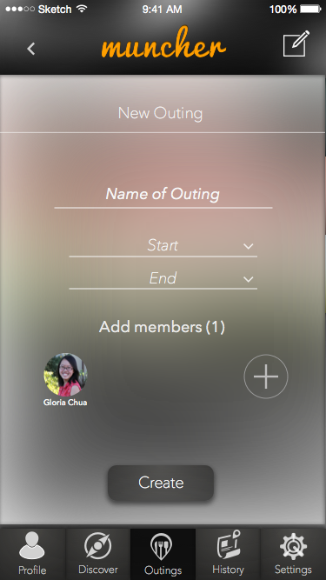
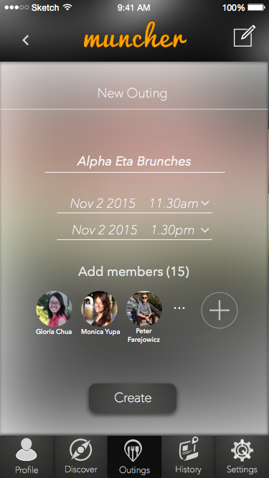
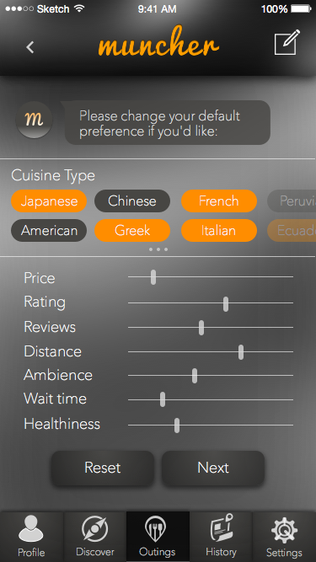
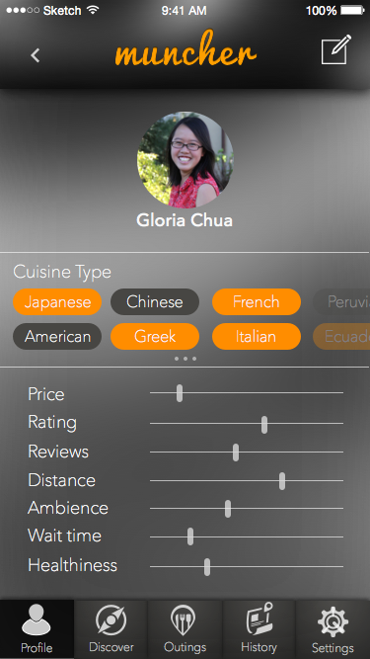
Group creation
Group manager
Profile preferences

Slide 28
6
PROTOTYPE DEMO
The medium-fi prototype

Slide 29
http://stanford.io/1HcAJWD

Slide 30
Thanks!
ANY QUESTIONS?

