Slide 1
Low-Fi Prototyping & Pilot Usability testing
Notes:
Mediator, Human AI, shortlist, poll

Slide 2
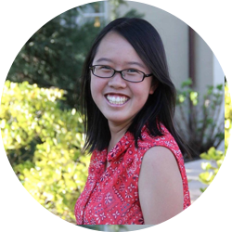
Team Muncher
Peter F.
Monica Y.
Kai Jian C.
Gloria C.

Slide 3
Our Progress
Mission Statement
Interface Brainstorming
Lo-fi Prototyping
Experimental Results
UI Changes

Slide 4
1.
Mission Statement
Value Proposition

Slide 5
“Fuss less, dine more”
Notes:
TODO: Change

Slide 6
2.
Interface Brainstorms
More is more

Slide 8
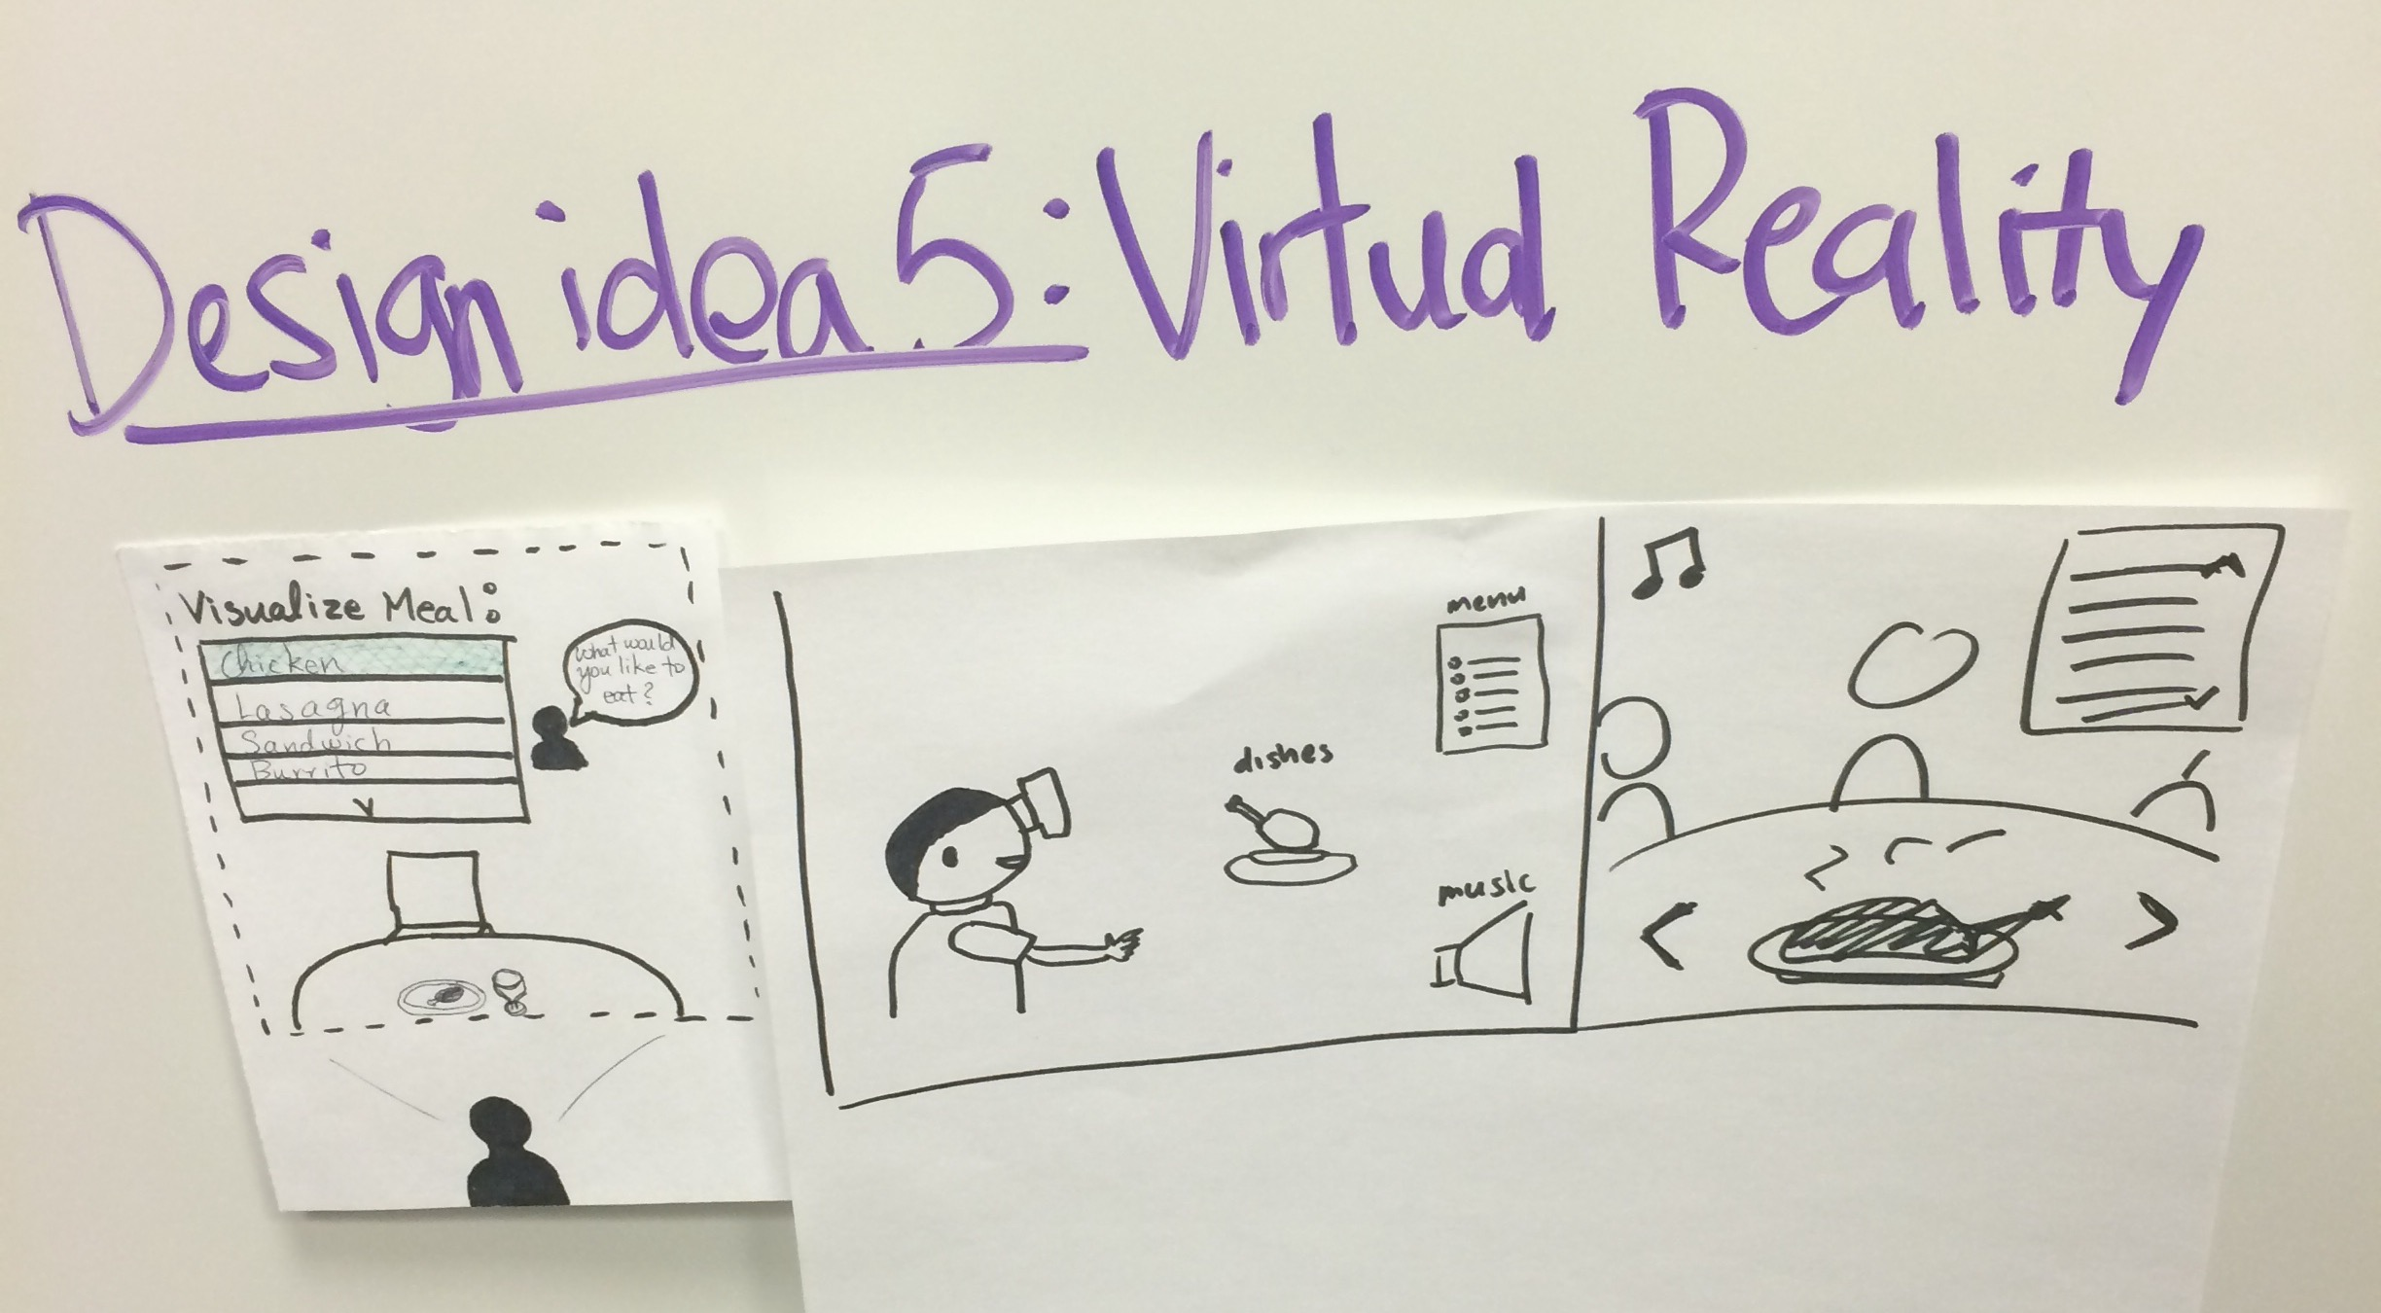
Notes:
We chose a human AI through messaging feature because it allows the muncher genie to join the group message as another human in the conversation and the forced choice design evokes preferences from people.

Slide 9
3.
Selected Interface
Human AI Through messaging

Slide 10
Human AI Through messaging
REASONS
Mediator helps streamline decisions
Most personable & friendly
Most applicable for on-the-go use
Notes:
Introducing an additional participant in the conversation

Slide 11
3.
Low-Fi Prototype

Slide 12
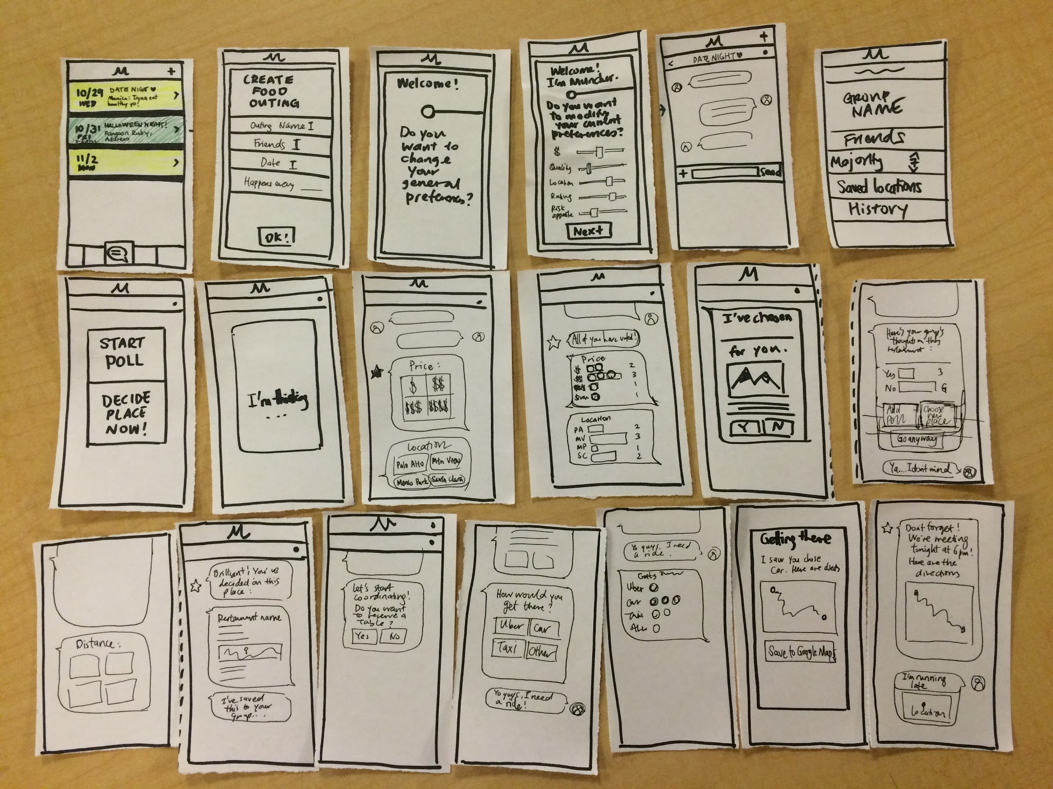
Notes:
we added additional screens and

Slide 13
4.
3 Tasks
Task flow using Low-Fi Prototype

Slide 14
The three TASKS
Deciding a place to eat
Dealing with user discontent
Coordinating the actual plans
Moderate
Complex
Simple
Notes:
Task 1: Deciding a place to eat
Collect individual preferences
Synthesize
Task 2: Dealing with user discontent
Acknowledge disagreements
Validate decisions
Make compromises when disagreement happens
Task 3: Coordinating actual plans
Encourage next steps
Provide navigations and directions
Make sure the event happens

Slide 15
Task 1: Deciding a place to eat
Start food outing
Input initial preferences
Polling: Genie collects and displays votes
Genie selects location

Slide 16
Task 2: Dealing with user discontent
User votes displayed
Add new poll
Choose new place
Go anyway
Choose what is majority

Slide 17
Task 3: Coordinating Actual Plans
Display final decision
Make reservations
Navigation and directions
Reminders before event

Slide 18
5.
Experimental Method

Slide 19
Our process
3
2
3
interviews
principles
questions
Working adult
College student
High school student
Think aloud
Think social
Usefulness of features
Usability (Ease & time)
Personality of genie

Slide 20
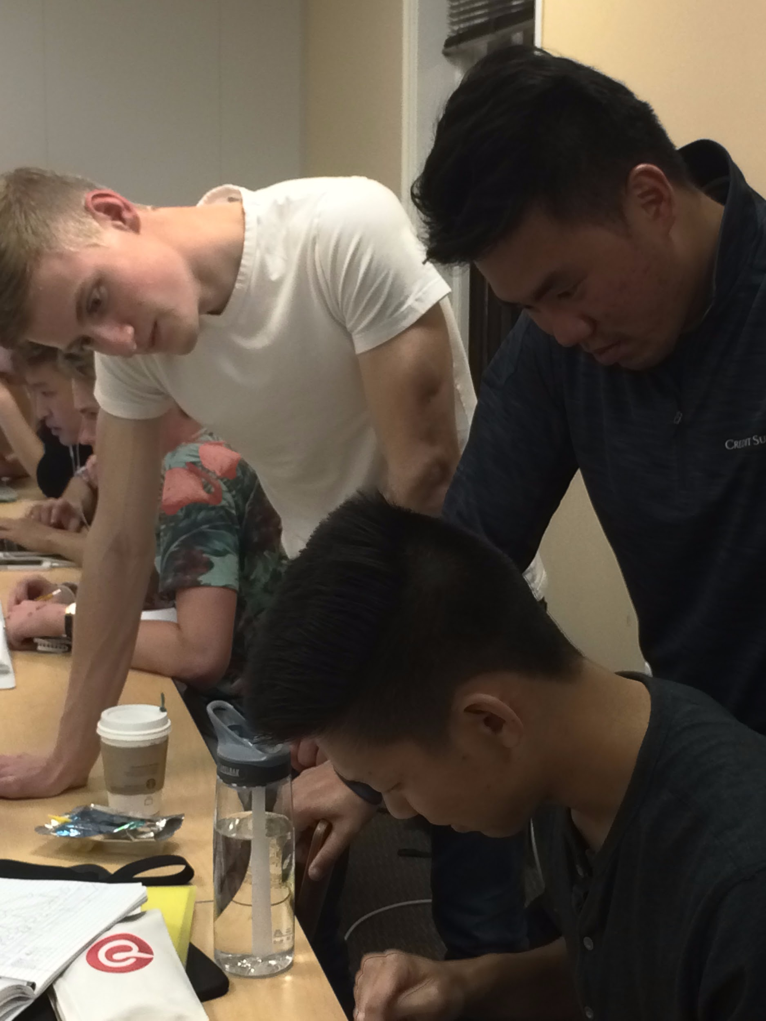
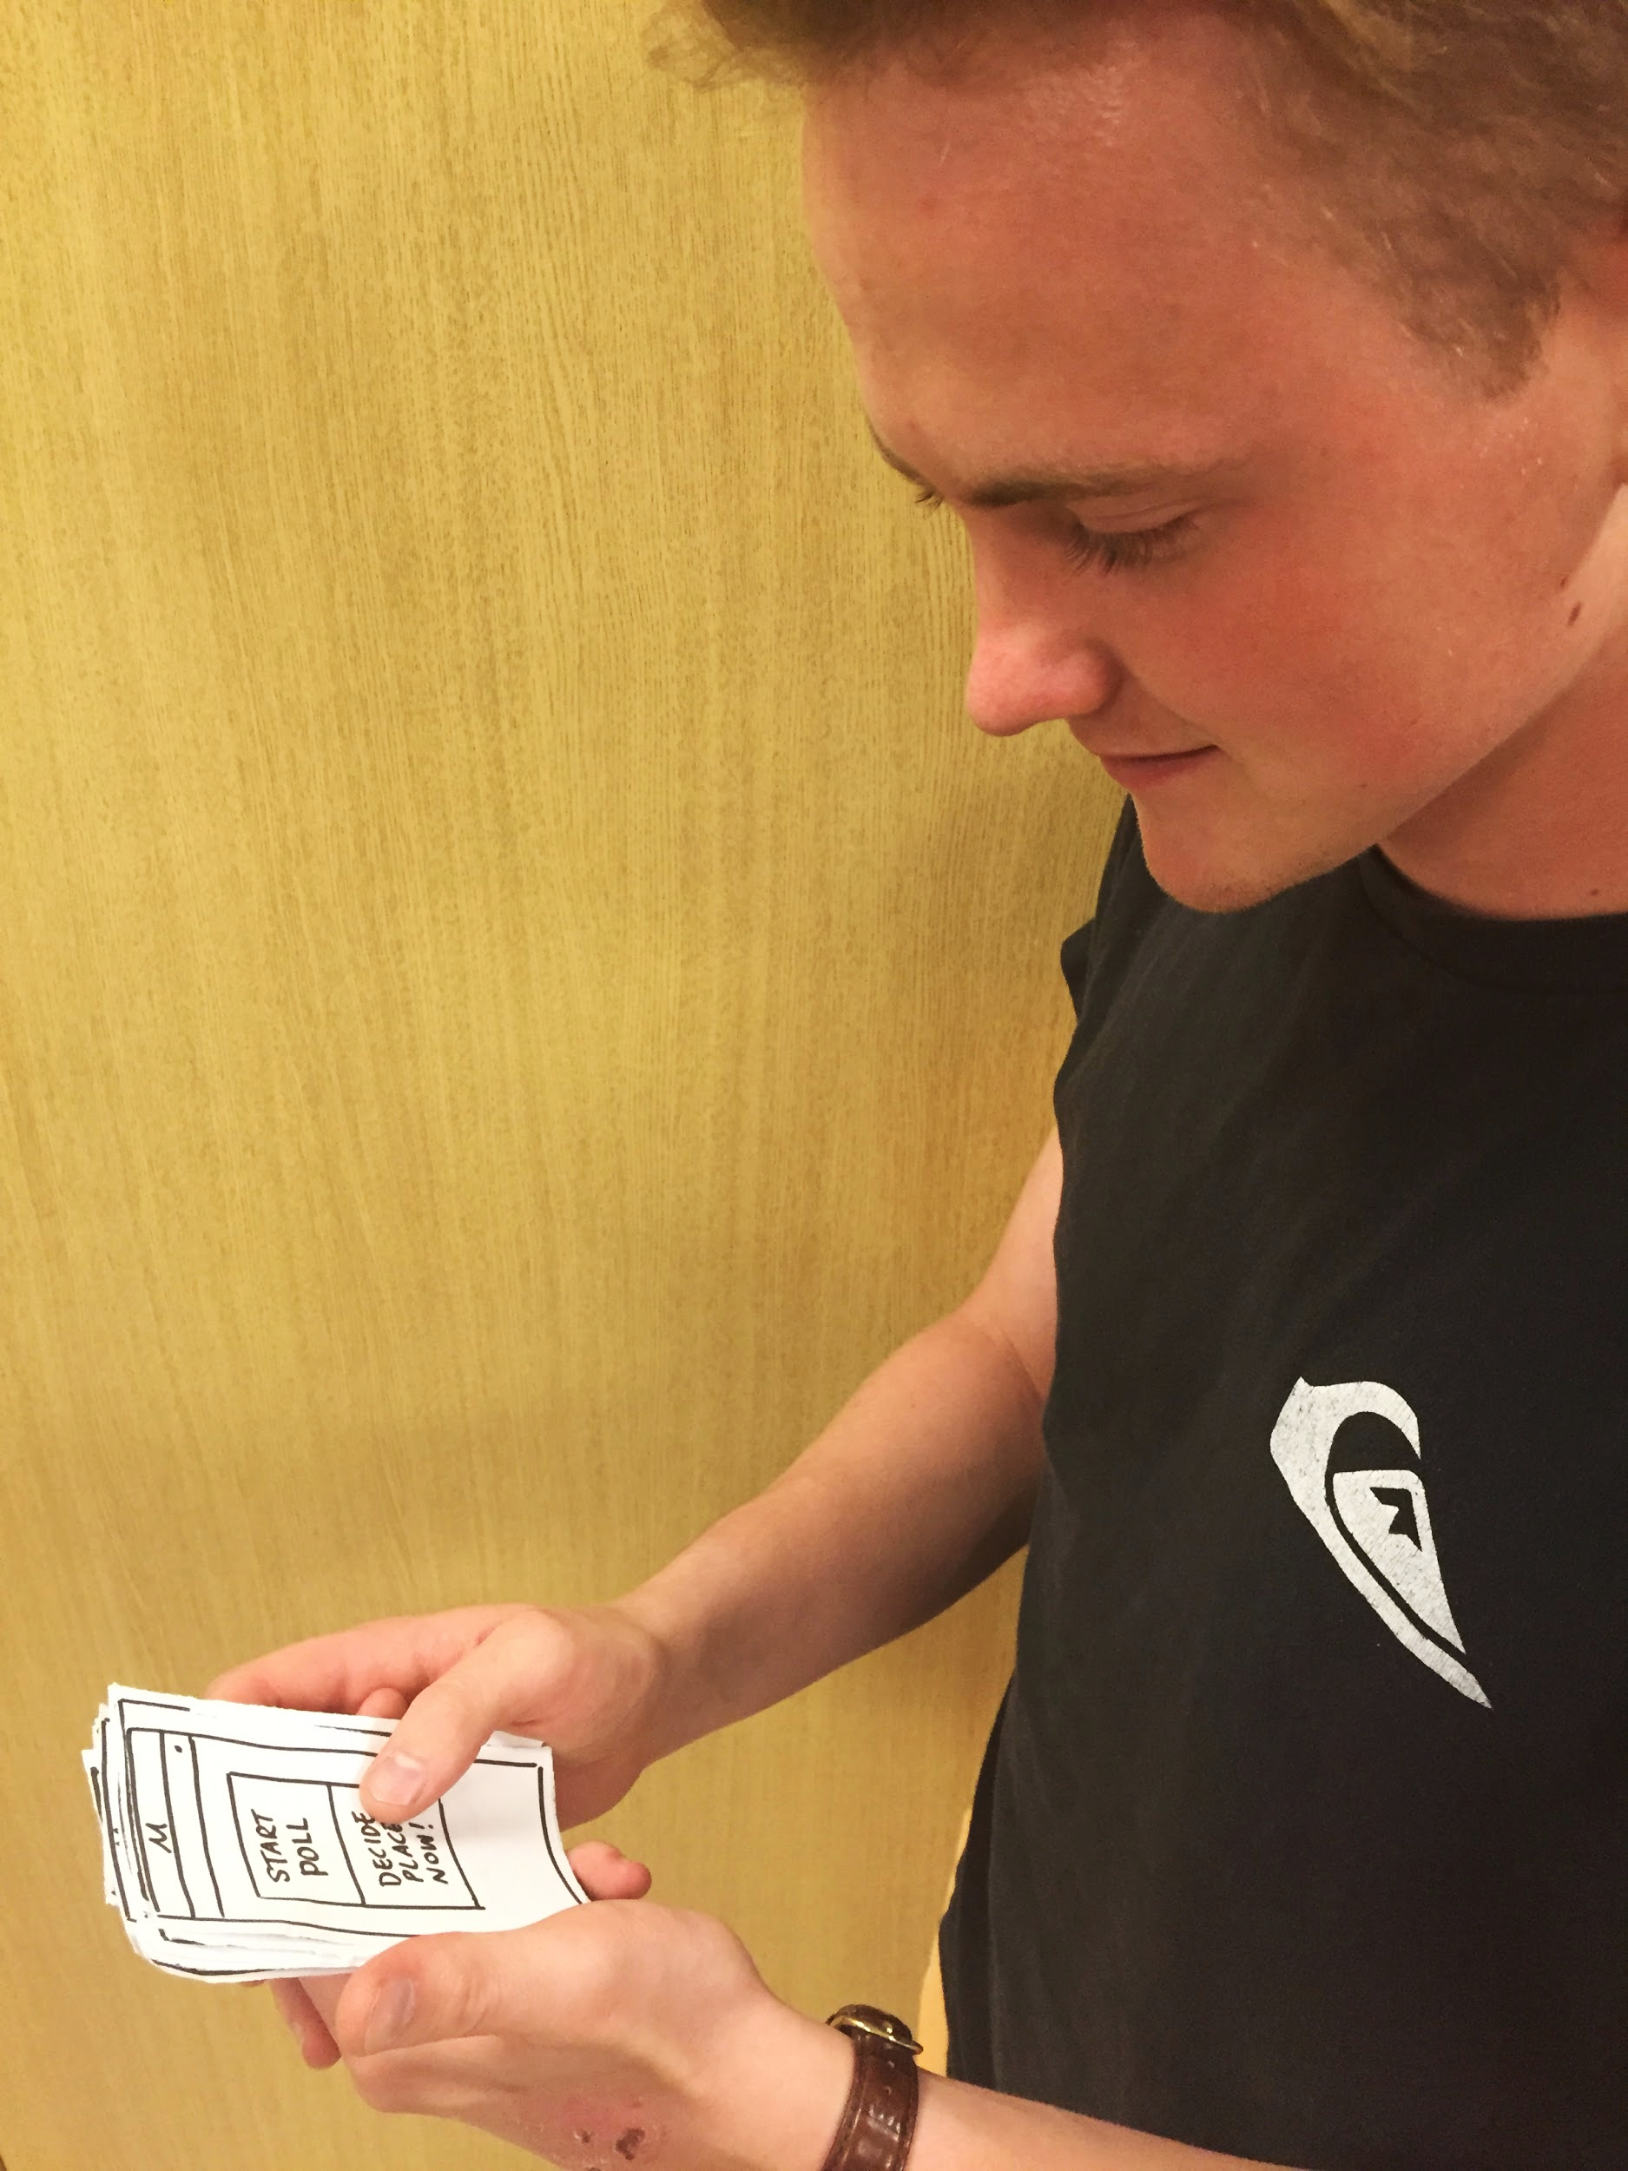
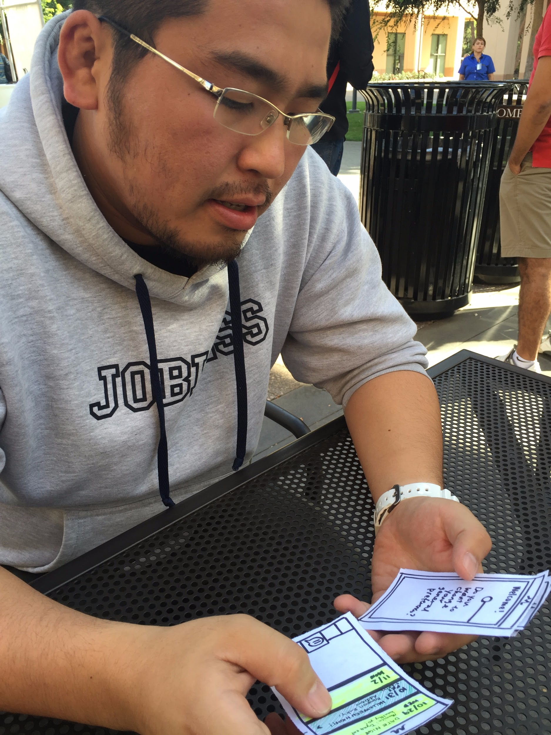
Our process
Notes:
Kelvin Do, Mike Anderson, Andrew Han

Slide 21
6.
Experimental Results

Slide 22
Our Results
Usefulness of features
(+) Reminder before outing
(-) Multiple options instead of one

Slide 23
Our Results
Usability & intuitiveness
(-) Users lost patience after a while
(-) Navigation buttons are vague and confusing

Slide 24
Our Results
Personality
(+) Users really like how someone else made the decisions
(-) The human aspect was not yet very obvious

Slide 25
7.
UI Changes
Suggested from prototype testing

Slide 26
Things to improve
Personality
Make the human aspect of the genie more immediately apparent
Usability
Shorten the user flow, and reduce number of cycles
Usefulness
Provide multiple options at the decision screen, instead of 1

Slide 27
Summary
1.
2.
3.
Key Takeaways
Concept sketching our app led to implementing human AI in messaging
User testing gave us key, actionable insights
Streamlining process flows will be key to improve usability
Notes:
concept sketching led to implementing human AI in messagin
user testing gave us raw, actionable insights

Slide 28
thanks!
Any questions?

