Slide 1
Concept Video

Slide 2
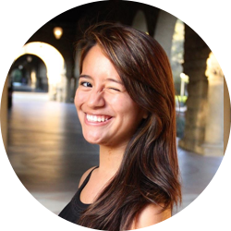
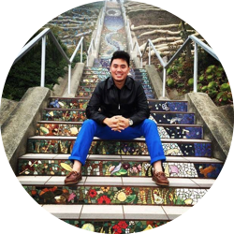
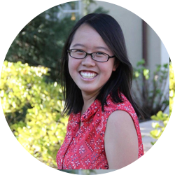
HELLO!
Team Muncher
Peter F.
Monica Y.
Kai Jian C.
Gloria C.

Slide 3
VALUE PROPOSITION
“Fight less, dine more”

Slide 4
PROBLEM & SOLUTION
1
Overview of the problem we aim to solve

Slide 5
PROBLEM & SOLUTION
Context
Have you ever gotten frustrated by deciding where to eat with friends?
Muncher takes the indecision out of the group dining experience.
Problem
Solution
Our human concierge maintains the human touch of interaction, takes into account all your personal preferences, and decides where you should go.

Slide 6
TASKS
2
Core 3 tasks our app enables

Slide 7
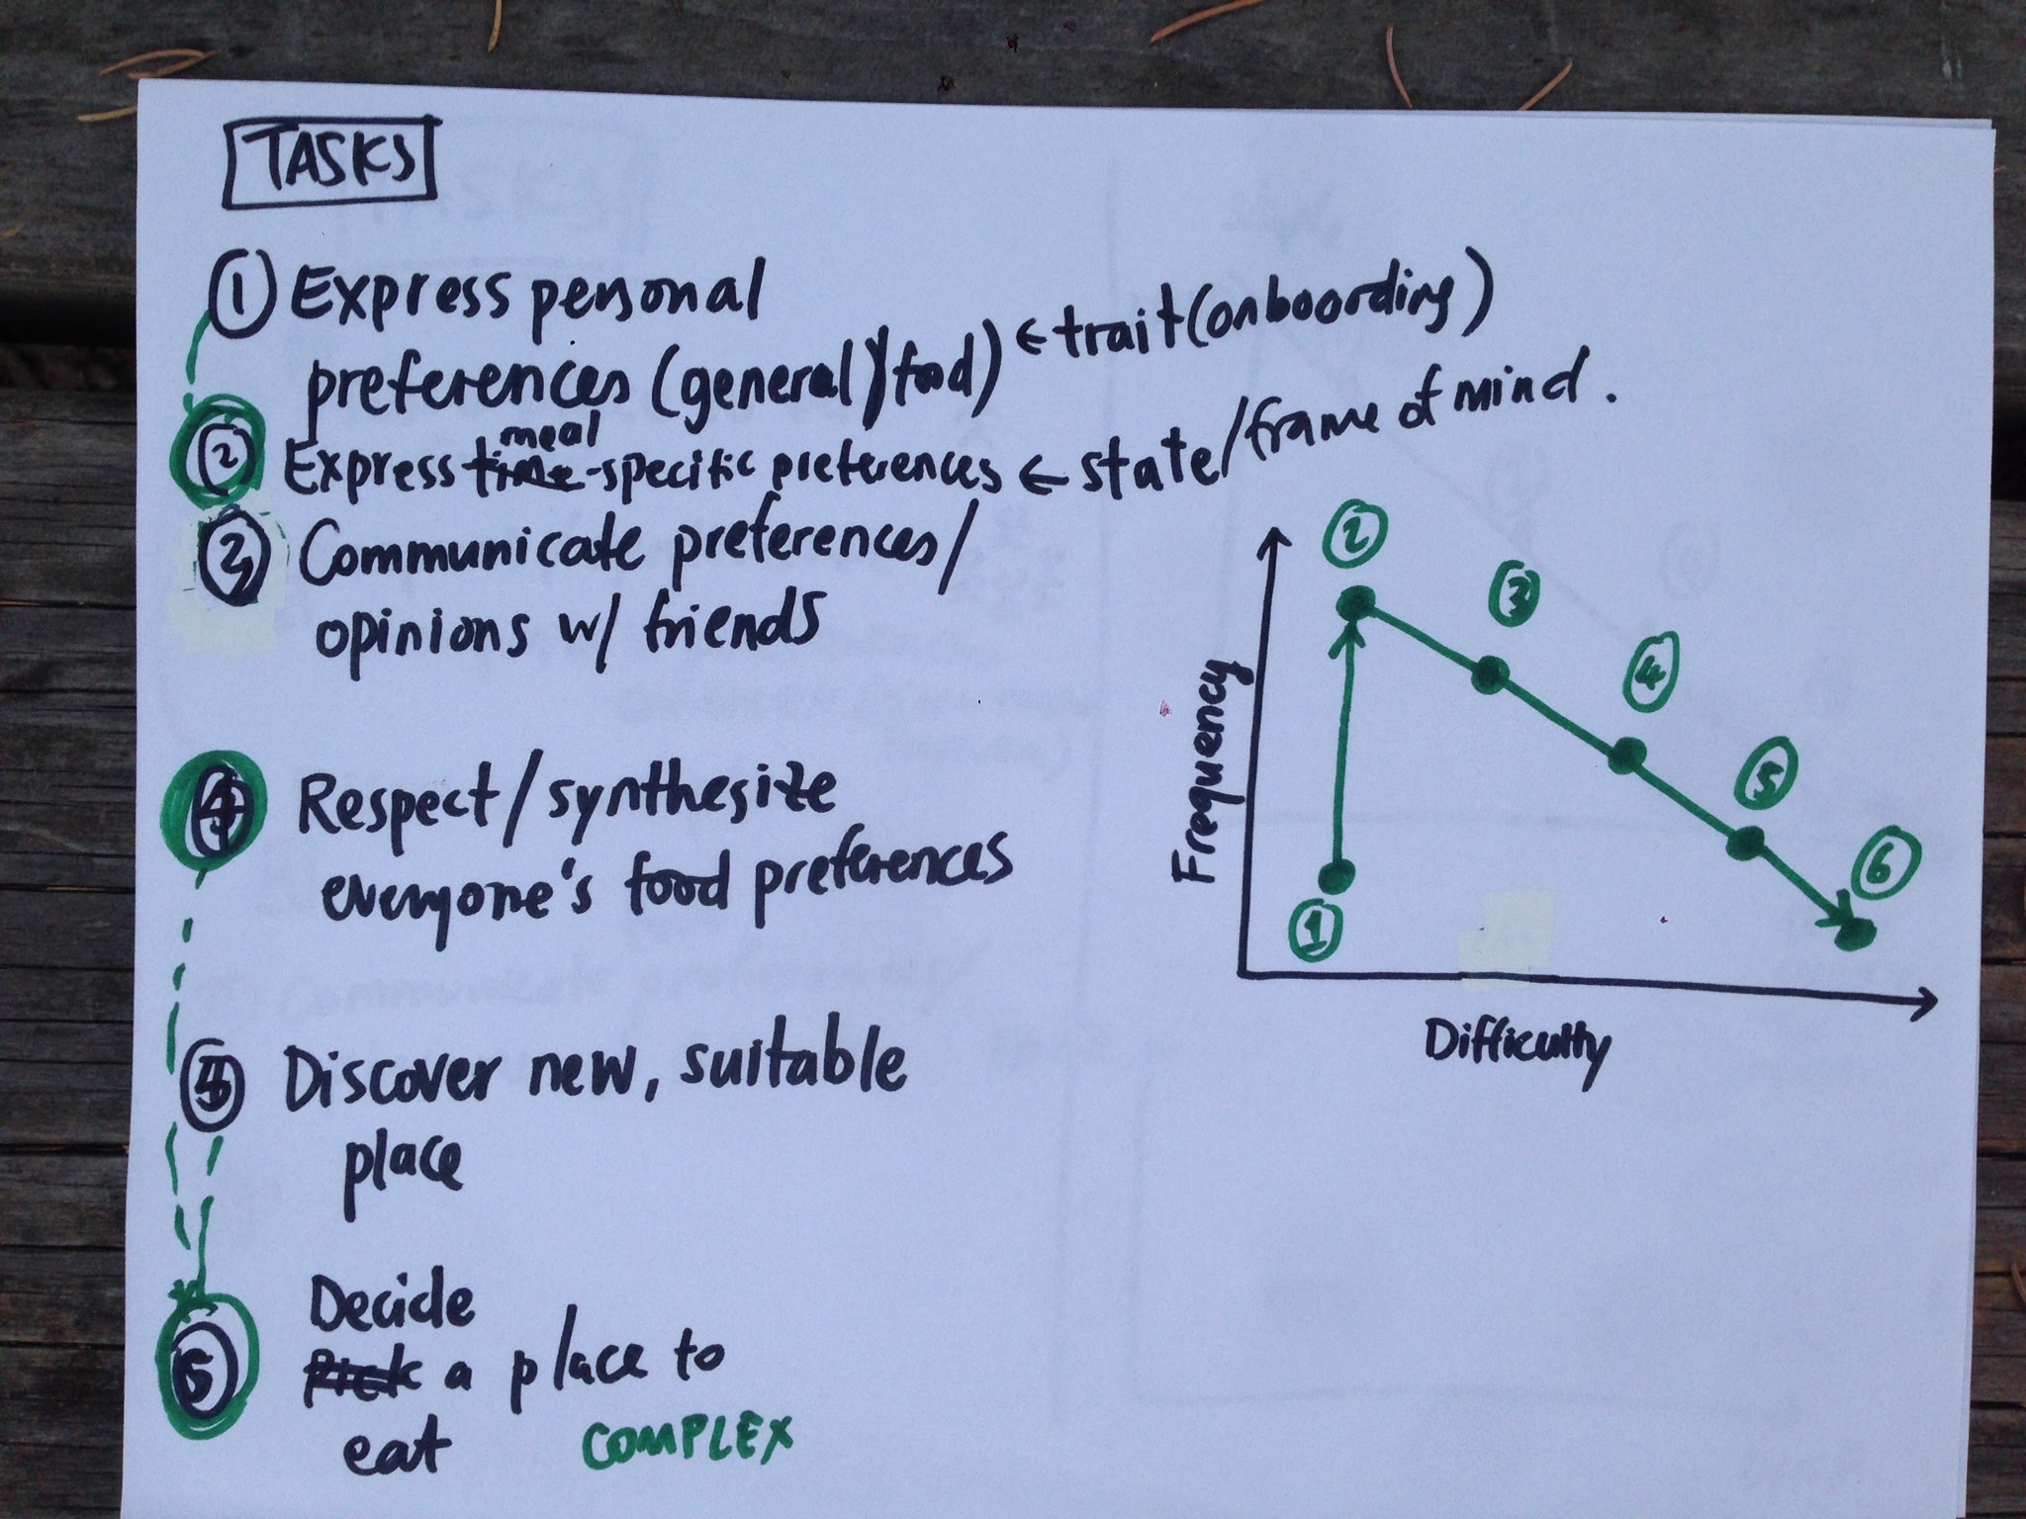
TASKS
TASK 1: (simple)
Express personal preferences and mealtime specific preferences
TASK 2: (moderate)
Respect and synthesize the food preferences of everyone in a group
TASK 3: (complex)
Decide a place to eat

Slide 8
VIDEO STORYBOARDS
3
Scenes to portray our tasks

Slide 9
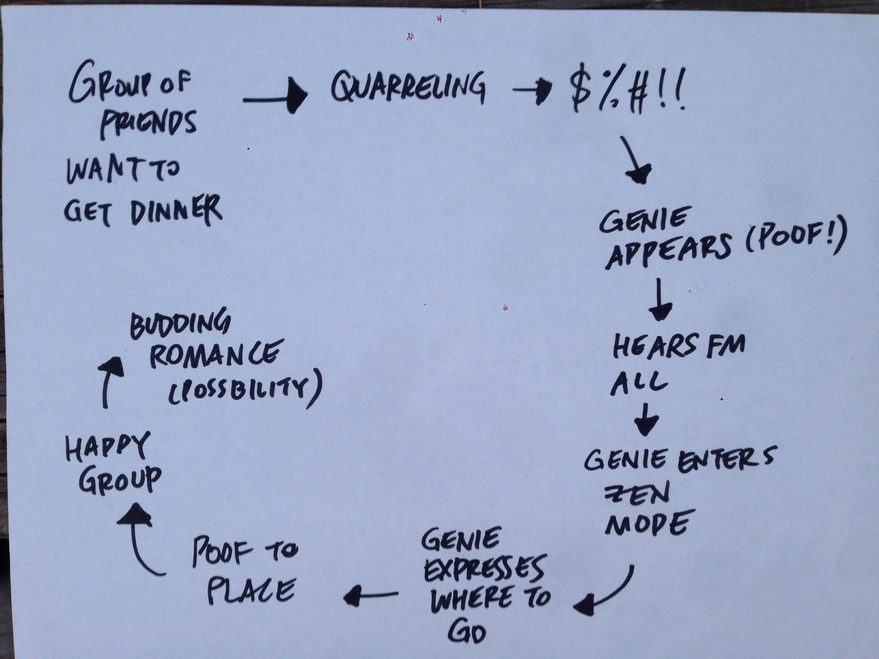
STORYBOARD LAYOUT
Brainstorming on the general flow of the concept video

Slide 10
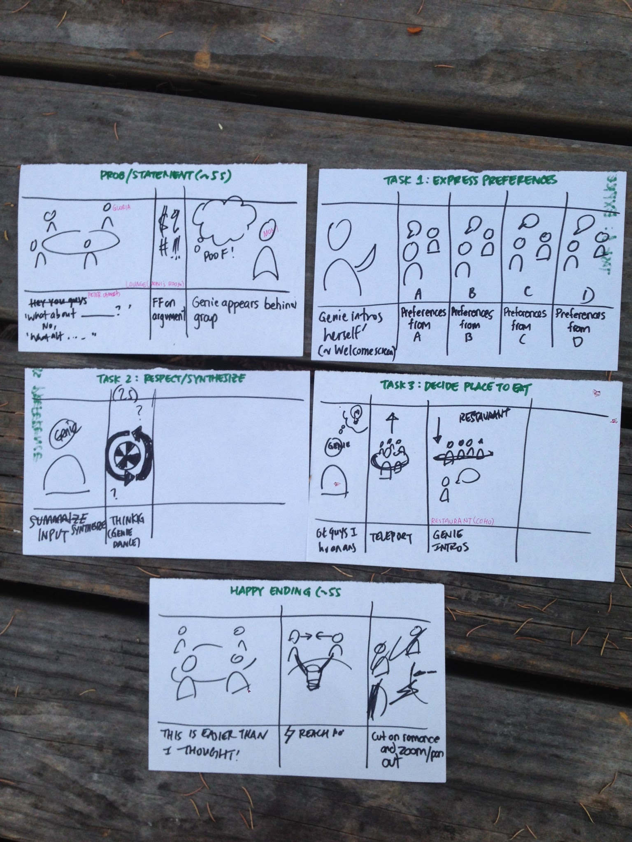
STORYBOARD SCENES
1.
Setting the stage
1.
2.
2.
Task 1
3.
4.
3.
Task 2
5.
4.
Task 3
5.
Resolution/Ending

Slide 11
CONCEPT VIDEO
4
https://youtu.be/fUAK3Cl2M-4

Slide 12
THANKS
Any Questions?

