Slide 1
POV and
Experience Prototypes

Slide 2
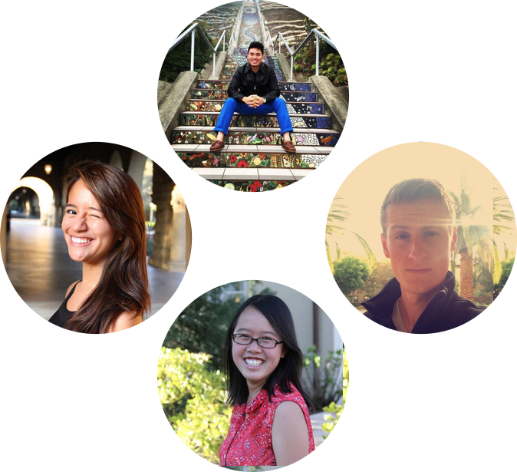
Team Muncher
Peter F.
Monica Y.
Gloria C.
Kai Jian C.

Slide 3
Food Mobility

Slide 4
The past week...
Initial
POV
Revised
POVs
HMW Statements
Experience Prototypes
Need-finding interviews
Brainstorm HMWs
Brainstorm solutions

Slide 5
Initial POV
How we entered this phase of the project

Slide 6
We met ...
21 year-old Jeremy, a college student eating out with his friend at a restaurant
choosing where to eat is a social experience in and of itself -- it reflects his friends’ cultures, backgrounds, beliefs and aesthetics
We were amazed to realize that
create an intentional moment of deeper understanding and mutual appreciation among friends when choosing a place to eat out
It would be game changing to

Slide 7
Additional Needfinding
Conducting more contextual interviews

Slide 8
Interview 1 - Farmer’s Market
Ellen, 40+ year old housewife, Portland
Shops at Farmers’ Markets 3x per week
Values quality food and freshness
We learned she knows the exact details of her favorite farmers’ market, she only visits one market even though there are multiple, and she plans her trip extensively.

Slide 9
Interview 2 - Food Trucks
Jason, 24 year old college grad, Bay Area
Foodie who enjoys trying new foods
Keeps a calendar of certain food trucks
We learned he enjoys the convenient location of trucks, values variety in his food truck choices, and likes to be social in trying new foods with friends.

Slide 10
Revised POVs
Learning from our subjects

Slide 11
Revised POVs
POV #1
We met Judy and Tim who need a more efficient way to shop for groceries because they spend more than one hour in the grocery store despite having a shopping list; it would be game changing if we could save their time walking around the store
POV #2
We met Jeremy who needs to feel he and his friends collectively picked the best place for a group meal based on its purpose because deciding where to eat is a socially important experience; it would be game changing if we could help him and his friends take into account individual values collectively, in deciding where to eat
POV #3
We met Ellen, a health-conscious mother who regularly shops at a farmers’ market, who needs access to fresh and organic groceries because she feels store products are not up to her standards (taste, quality, etc.); it would be game changing if we could help her find the best spots to purchase these groceries

Slide 12
Top HMWs
The best of the brainstorming

Slide 13
1.
HMW keep the human touch in a decision process that is not typically face to face?
from POV #2
We met Jeremy who needs to feel he and his friends collectively picked the best place for a group meal based on its purpose because deciding where to eat is a socially important experience; it would be game changing if we could help him and his friends take into account individual values collectively, in deciding where to eat

Slide 14
2.
HMW help groups discover new qualities about themselves in the process of picking a place to eat?
from POV #2
We met Jeremy who needs to feel he and his friends collectively picked the best place for a group meal based on its purpose because deciding where to eat is a socially important experience; it would be game changing if we could help him and his friends take into account individual values collectively, in deciding where to eat

Slide 15
3.
HMW repurpose the aimless time spent walking around in a grocery store?
from POV #1
We met Judy and Tim who need a more efficient way to shop for groceries because they spend more than one hour in the grocery store despite having a shopping list; it would be game changing if we could save their time walking around the store

Slide 16
Experience Prototypes
Testing our solutions for validity

Slide 17
1
Prototype
How might we keep the human touch in a
decision process that is typically not face to face?
A ‘human concierge’ that coordinated and facilitated the process of choosing what to eat

Slide 18
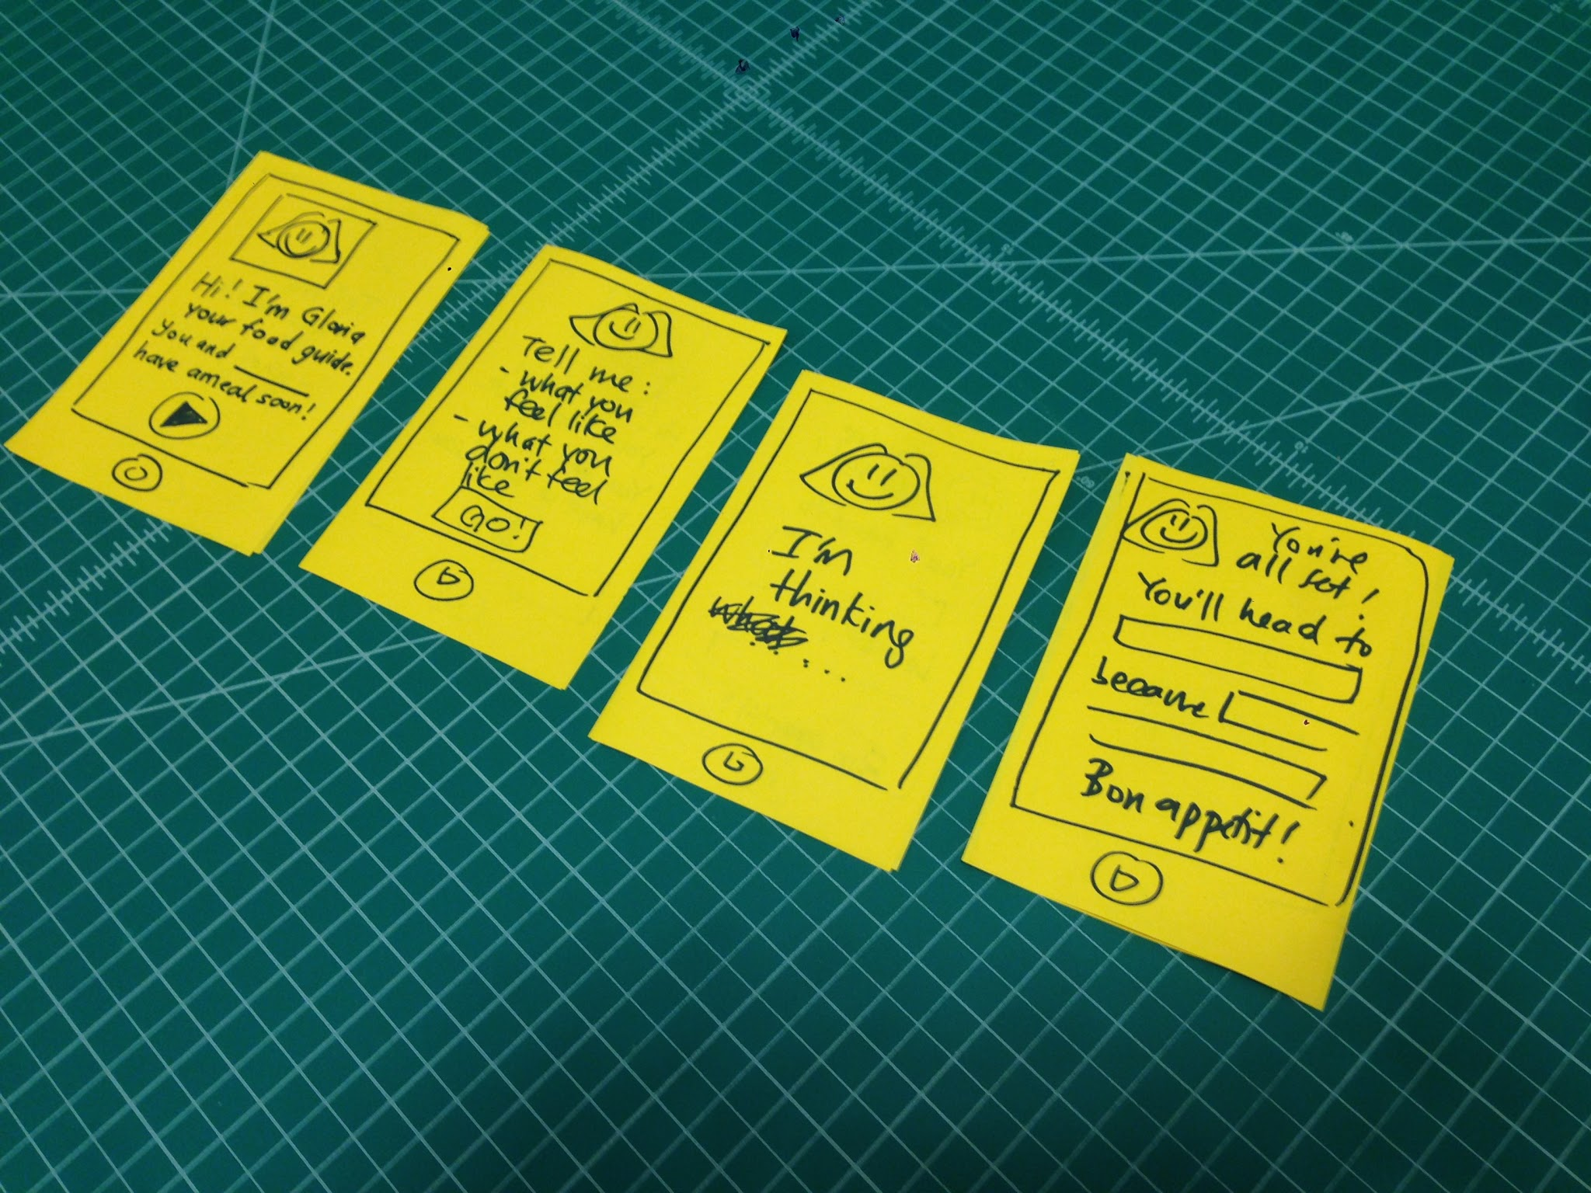
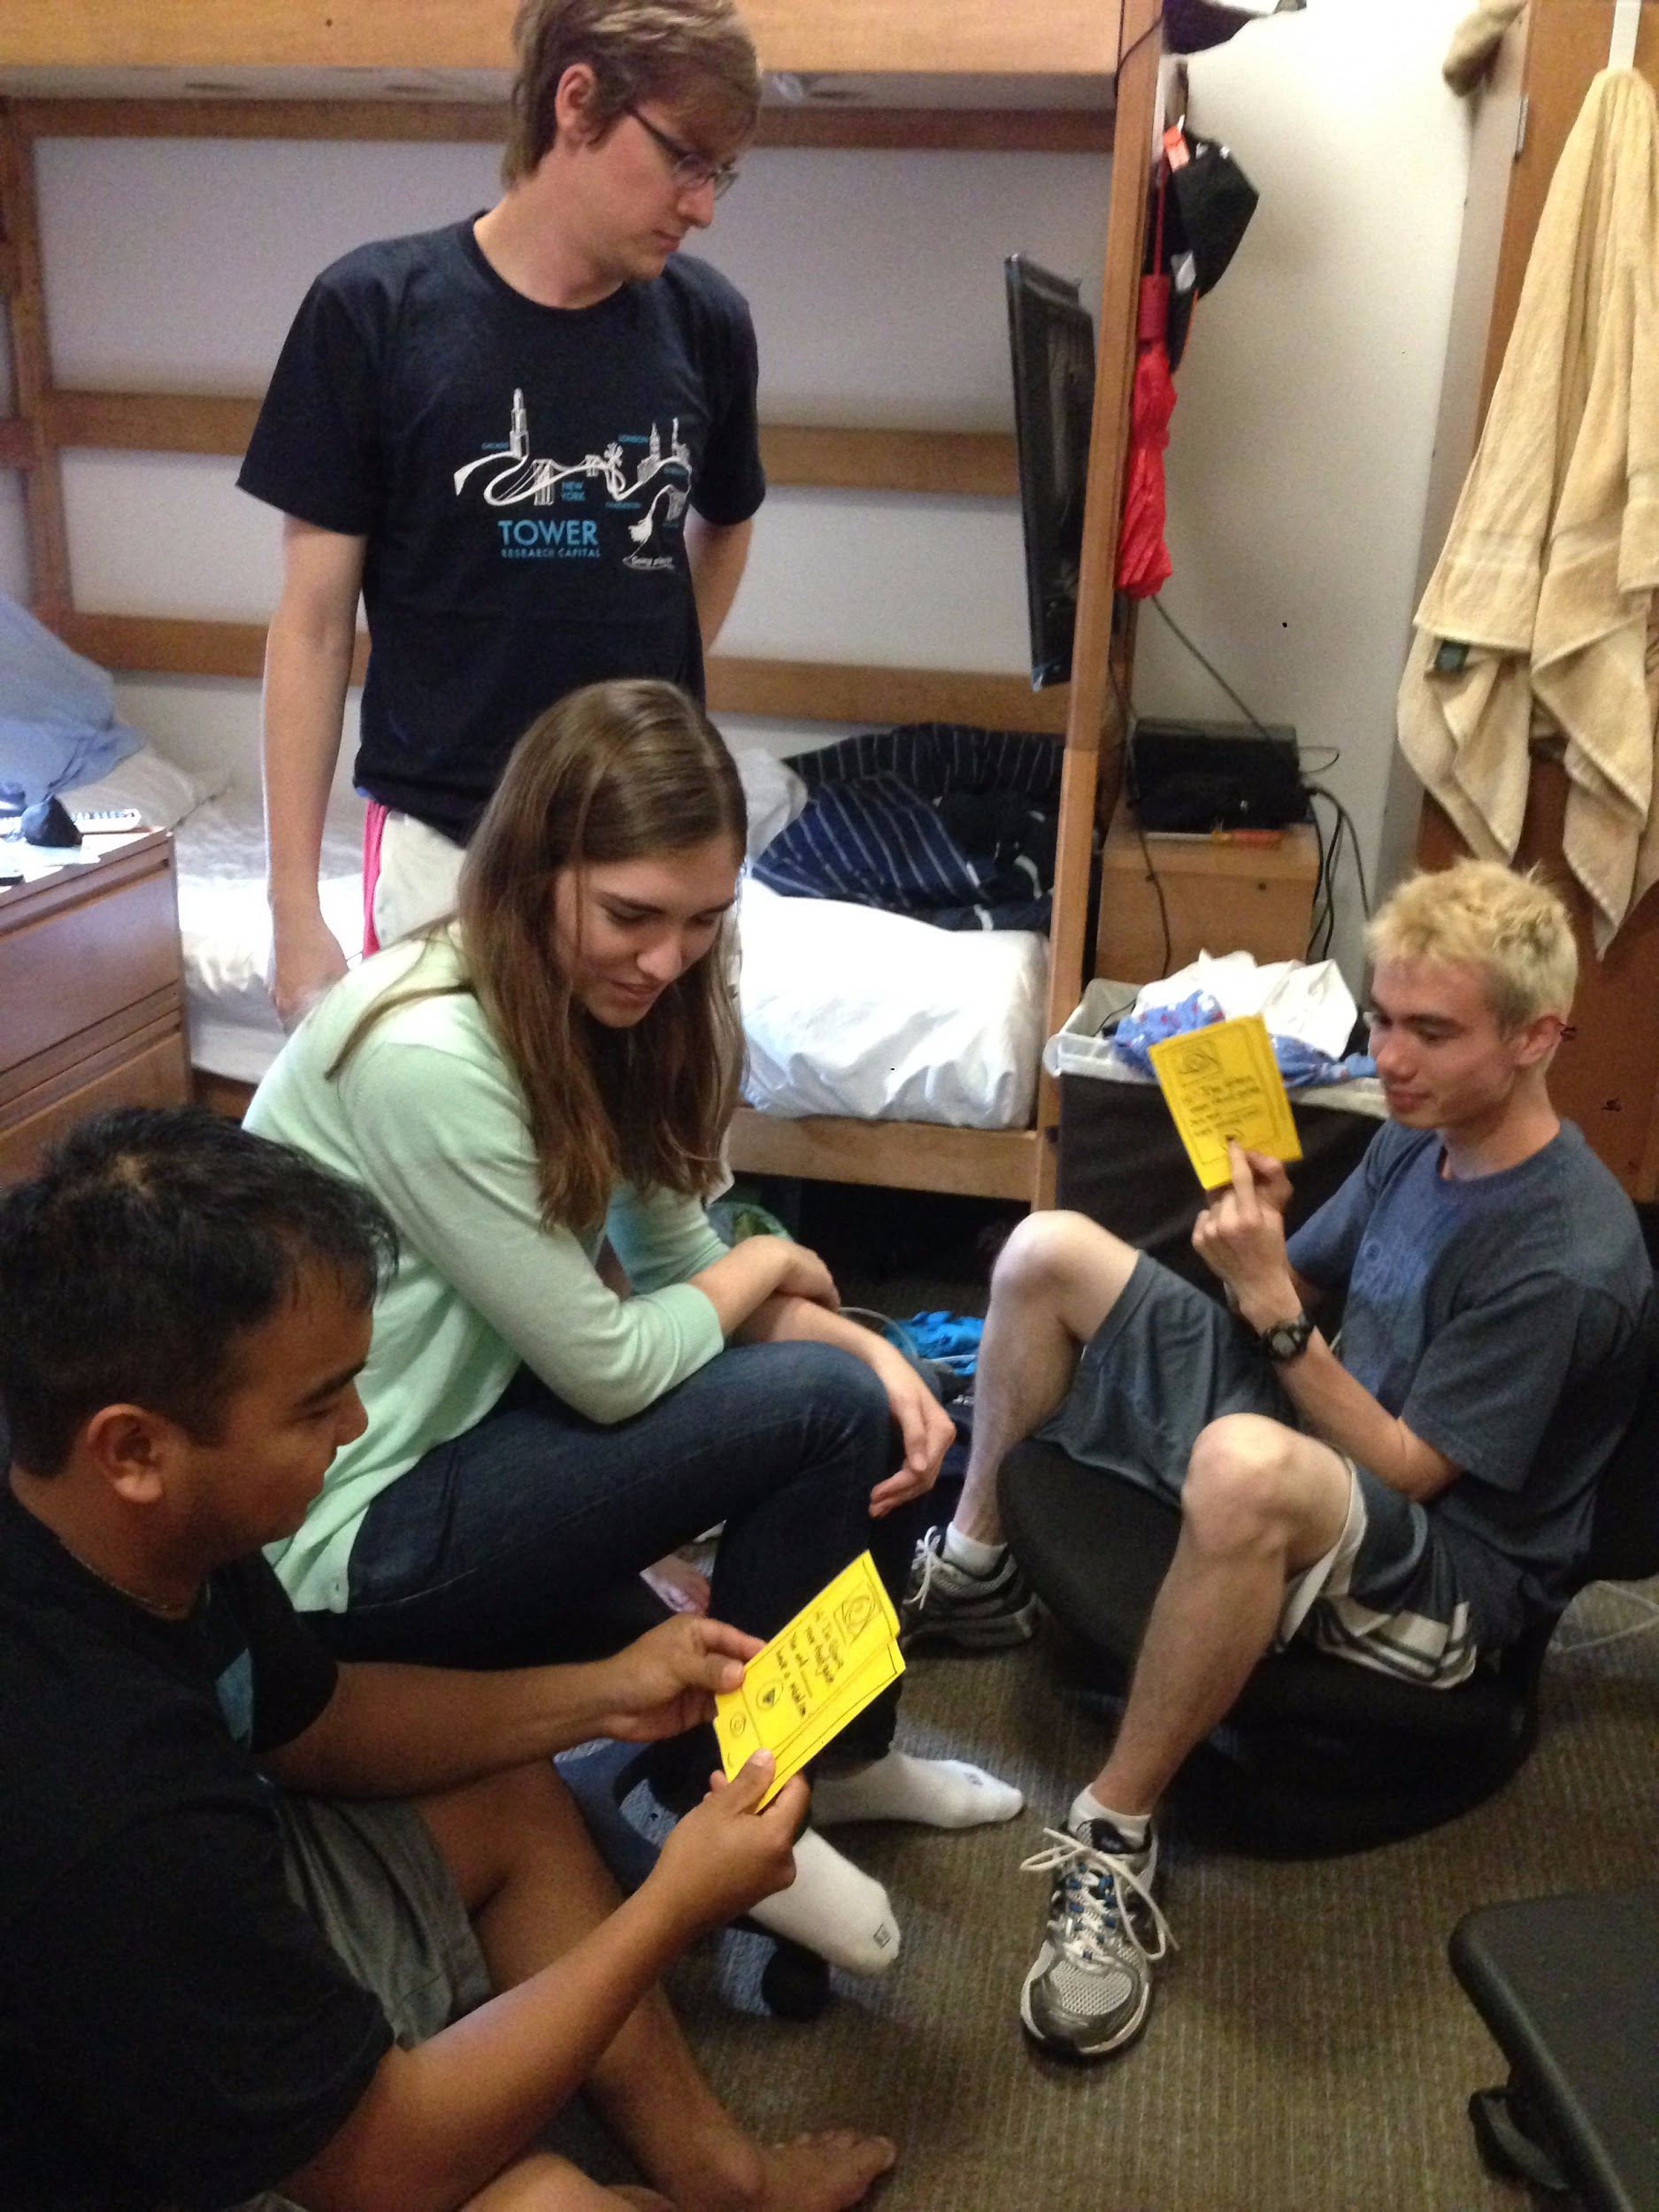
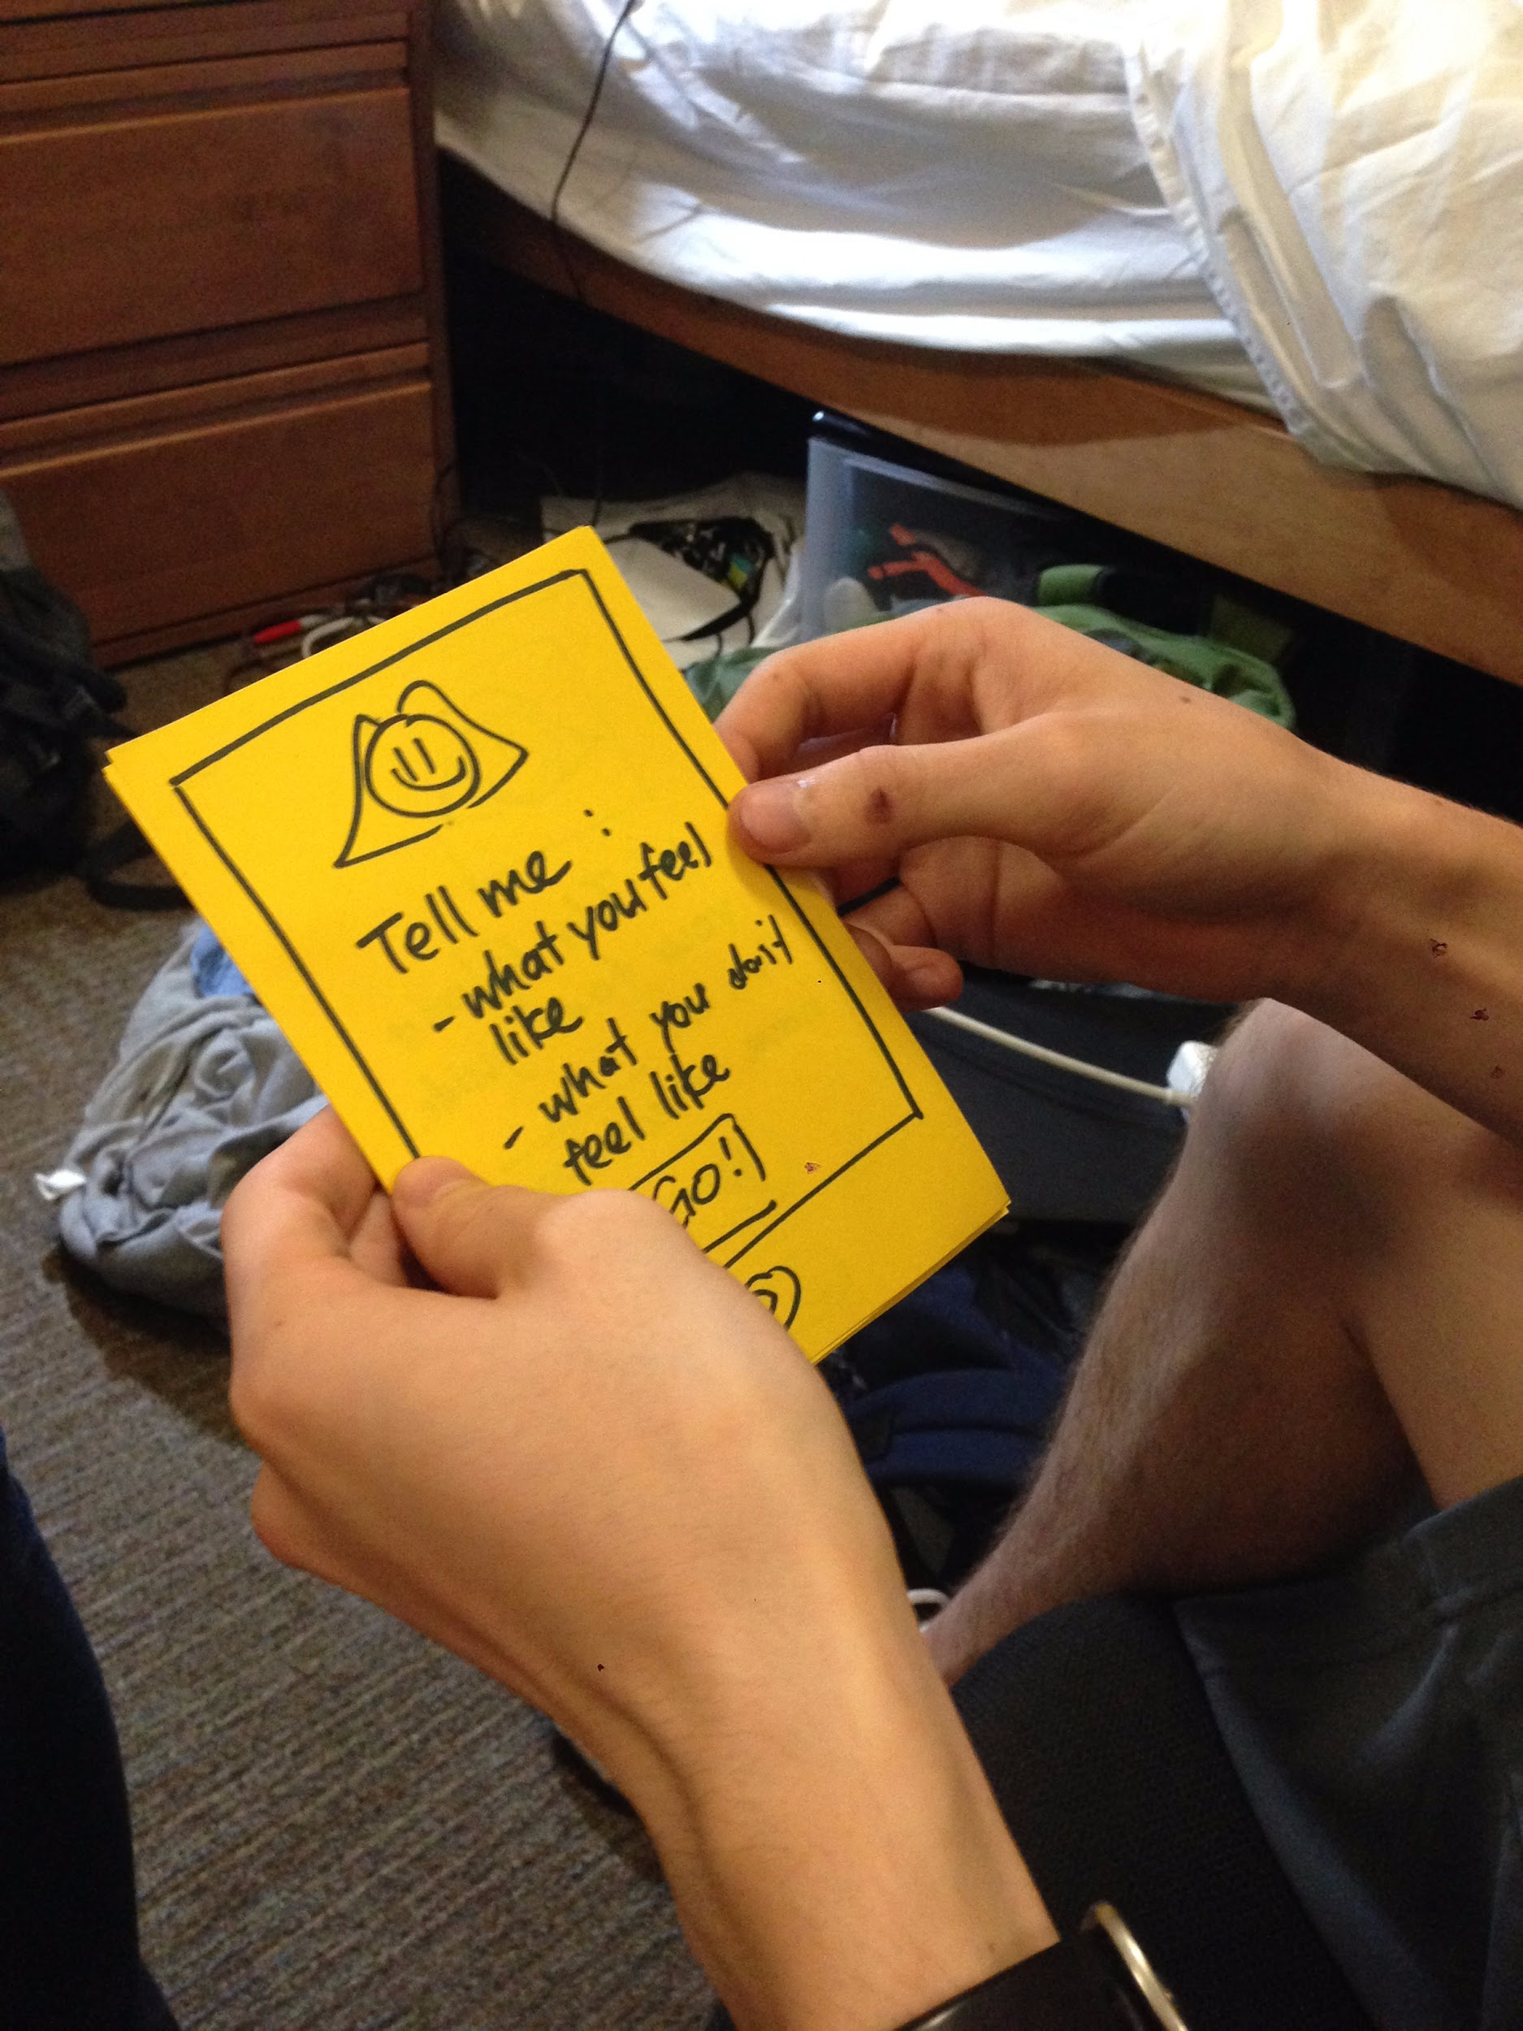
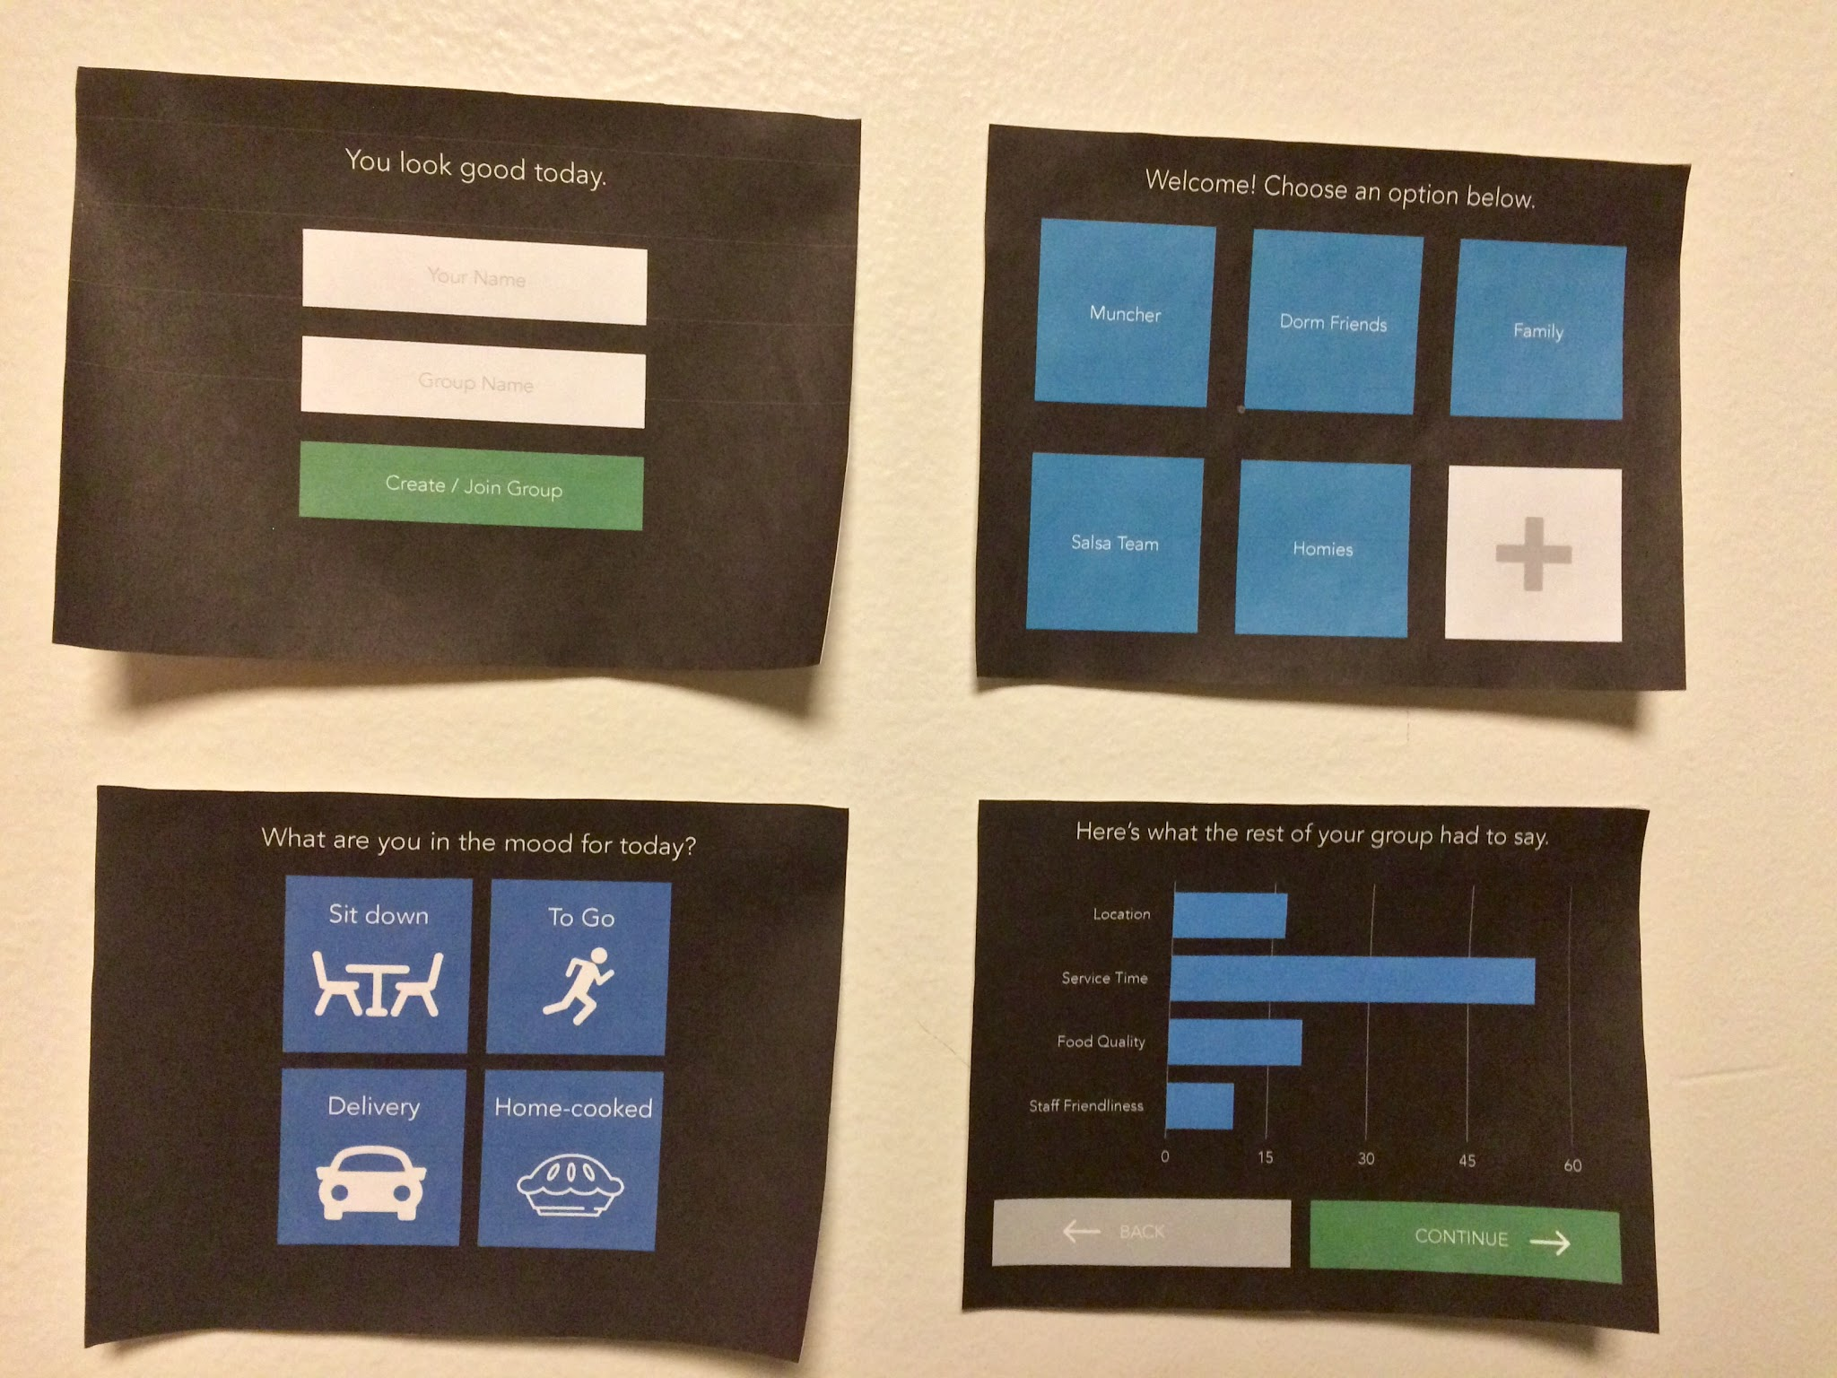
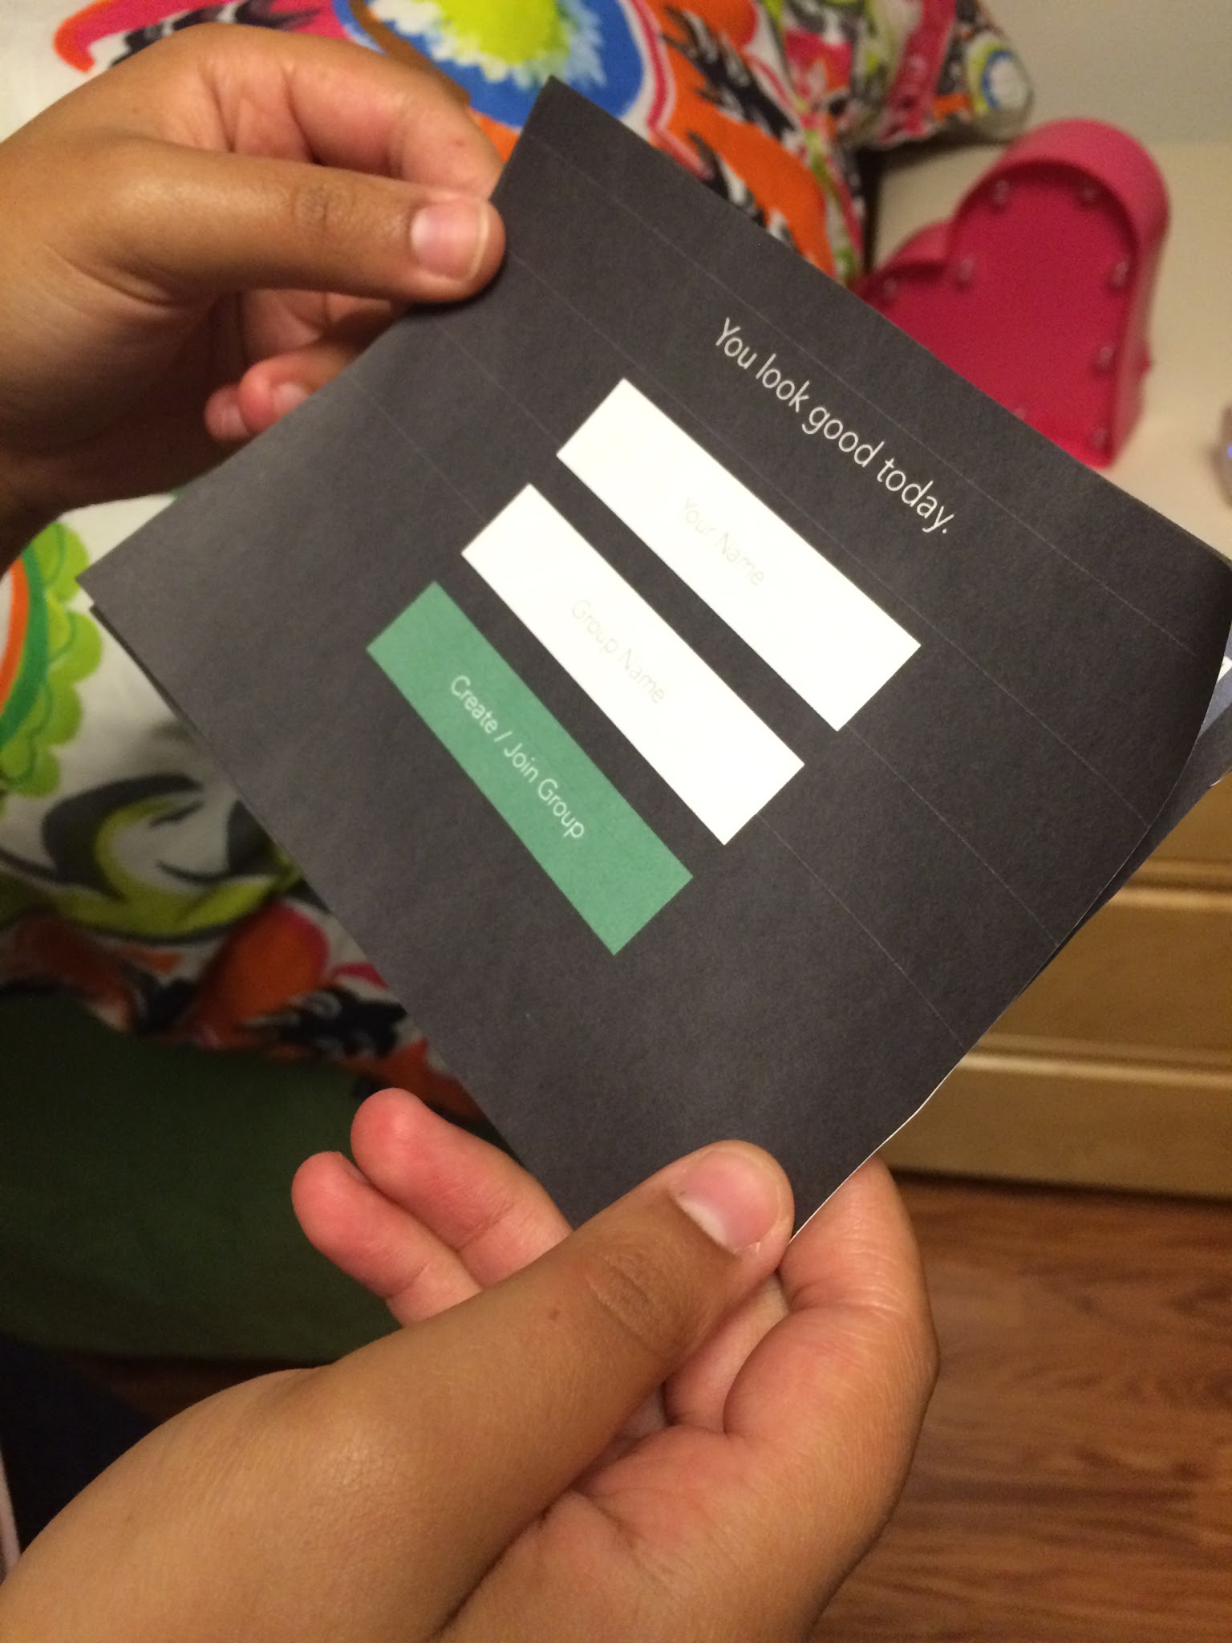
2 prototypes to test different assumptions
Constructing and testing the prototypes

Slide 19
Results
Version 1
Things that worked:
3rd party decision maker helped group get over indecisiveness
“Pulls the group together” and “brings in [the] group aspect” of the experience
Things that didn’t work:
People wanted prompts to be as specific as possible
The human face on prototype was ineffective
What is the interaction with a 3rd party ‘concierge’ like in a group setting?

Slide 20
Results
Version 1
Surprises and new learnings:
Users wanted to interact via voice
Users preferred this more than Yelp, because “it was more than just a list” -- human touch?
Users were more interested in talking to each other than the human concierge
Users might prefer the concierge shortlisting, rather than selecting their choices
What is the interaction with a 3rd party ‘concierge’ like in a group setting?

Slide 21
Results
Version 2
Things that worked:
Also expressed getting over indecisiveness
One user expressed that this gave him great comfort
Things that didn’t work:
Icons that were meant to be simple were intuitive to one user but not the other
User unhappy if restaurant suggested at the end was different than the one (s)he chose.
What is the interaction with a 3rd party ‘concierge’ for non-ordinary users?

Slide 22
Results
Version 2
Surprises and new learnings:
New possible use case: families connecting with their kids in a different way?
Users like the group efficiency it created
User valued humor in the interaction
Concierge guided him through an otherwise unfamiliar technology experience -- human touch
What is the interaction with a 3rd party ‘concierge’ for non-ordinary users?

Slide 23
2
Prototype
HMW help groups discover new qualities about themselves in the process of picking a place to eat?
Pattern recognition that reveals your preferences based on you and your group’s past choices

Slide 24
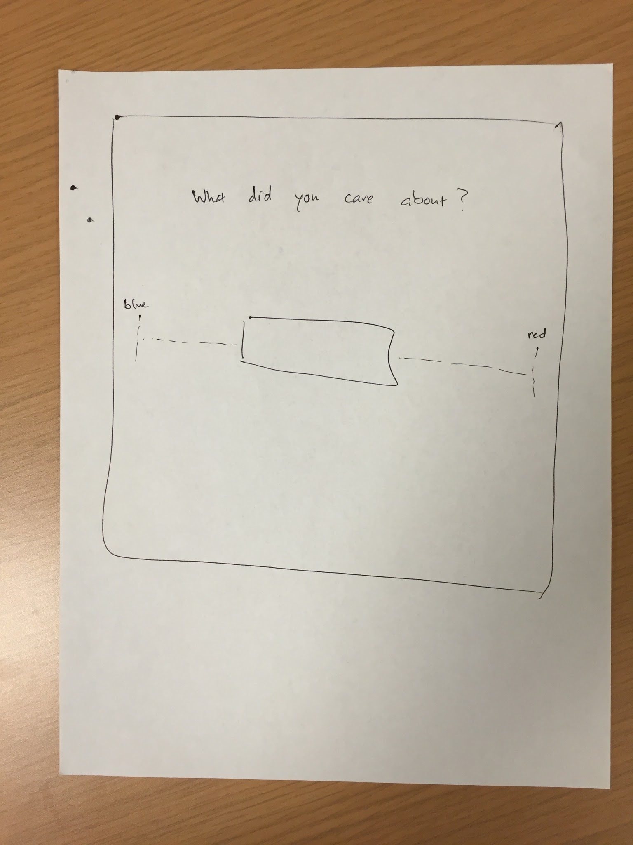
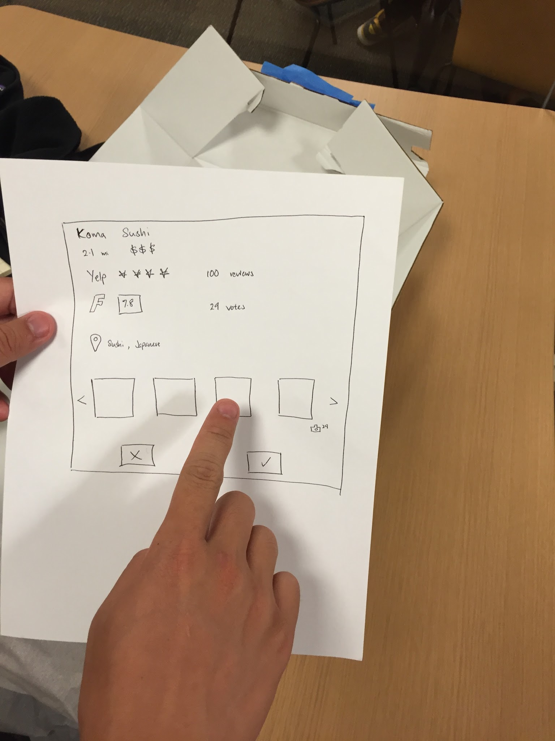
Constructing and testing the prototype

Slide 25
Results
Things that worked:
People wanted restaurant swiping to have pattern recognition
People recognize that pattern recognition means less input
Things that didn’t work:
May said her preferences, like price, change over time
Jessica does not want to do this exercise multiple times
Surprises and new learnings:
Jessica could do the exercise without first swiping for restaurants

Slide 26
3
Prototype
How might we repurpose the aimless time
spent walking around in a grocery store?
Search for coupons online for items in your basket while walking around

Slide 27
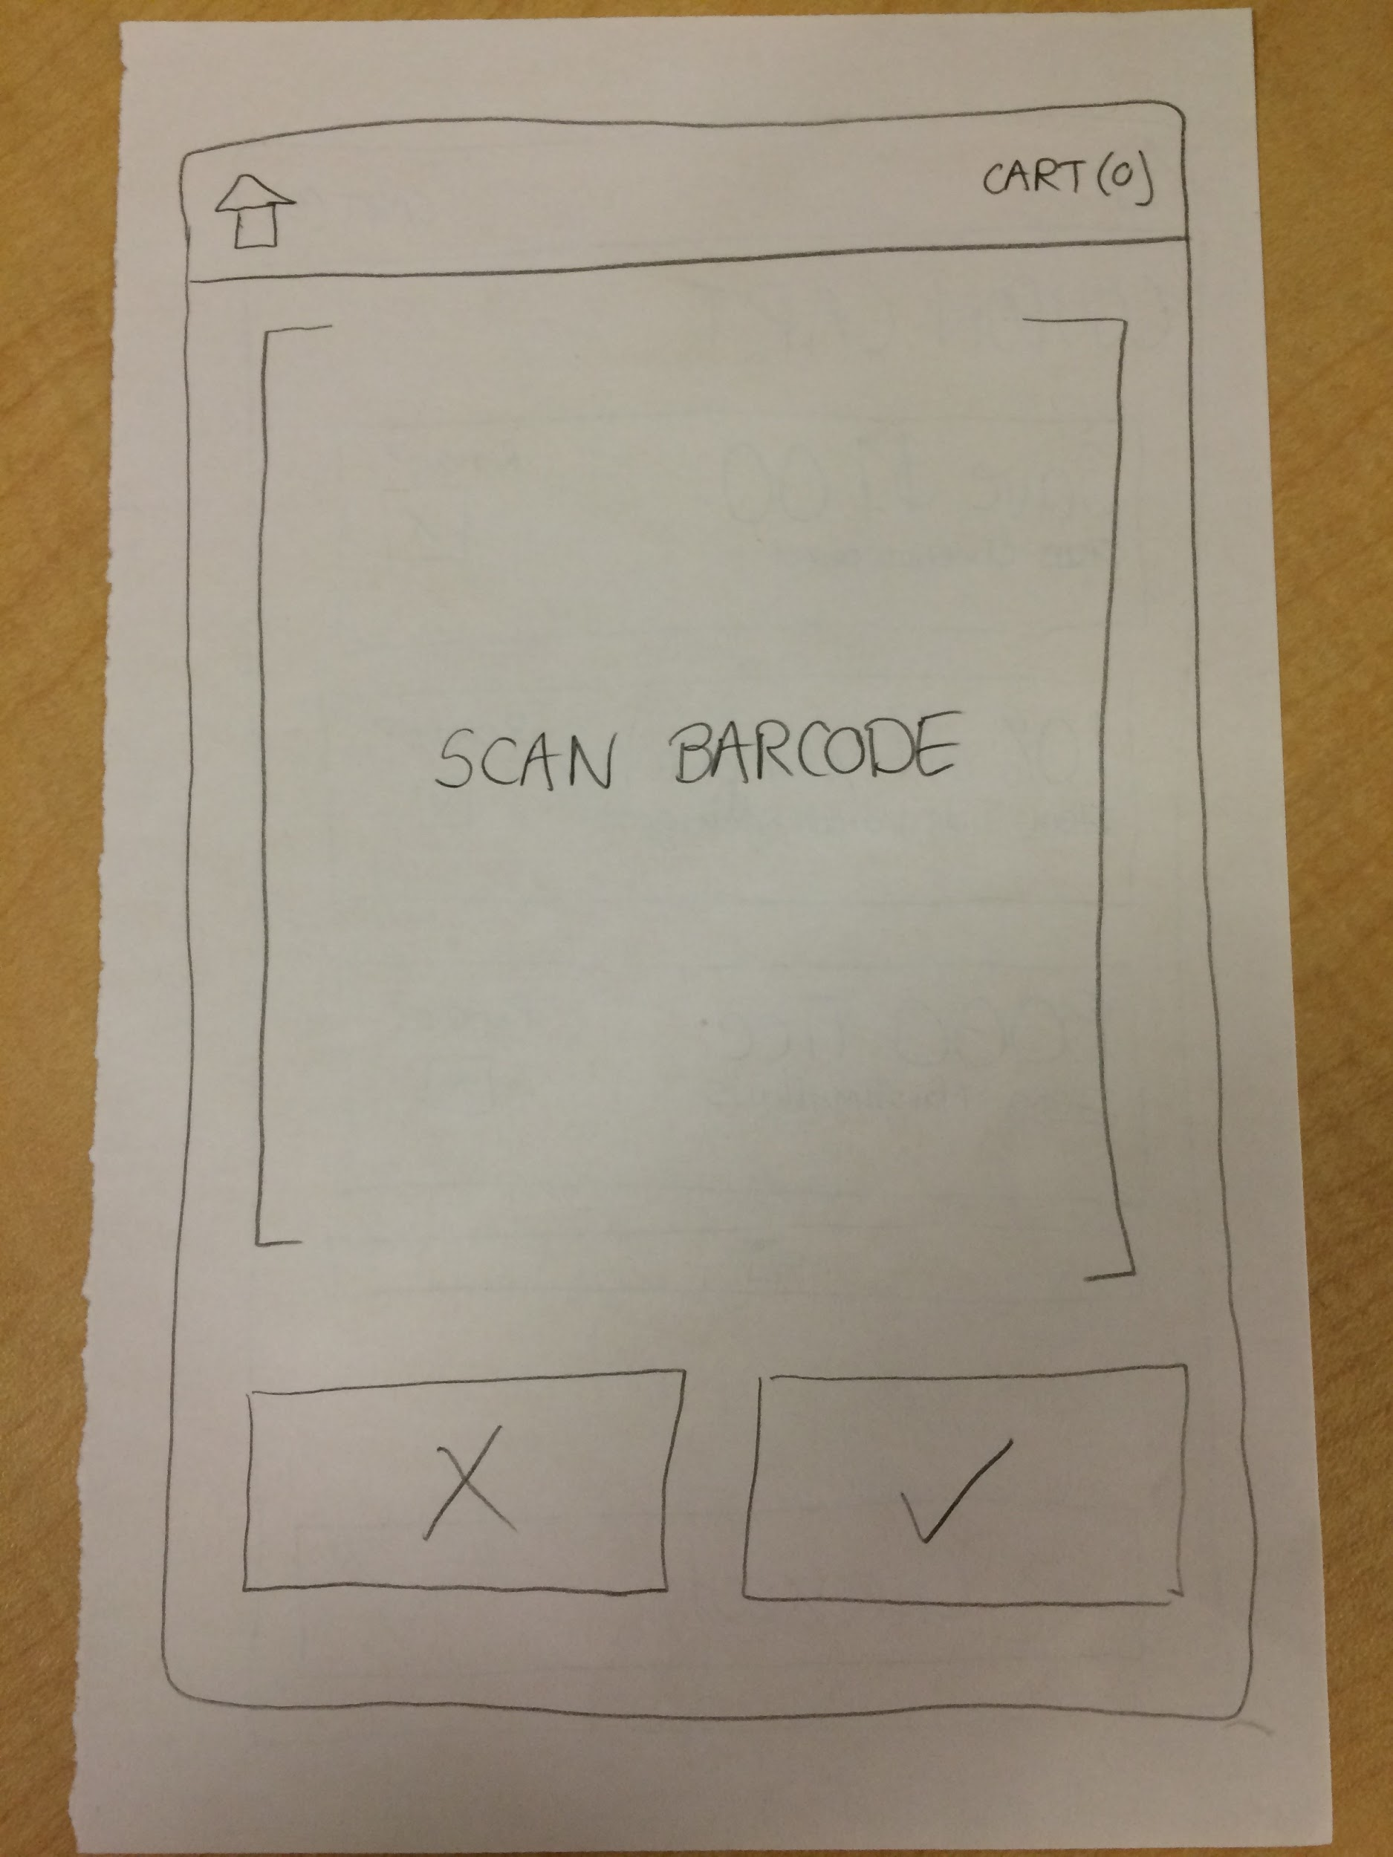
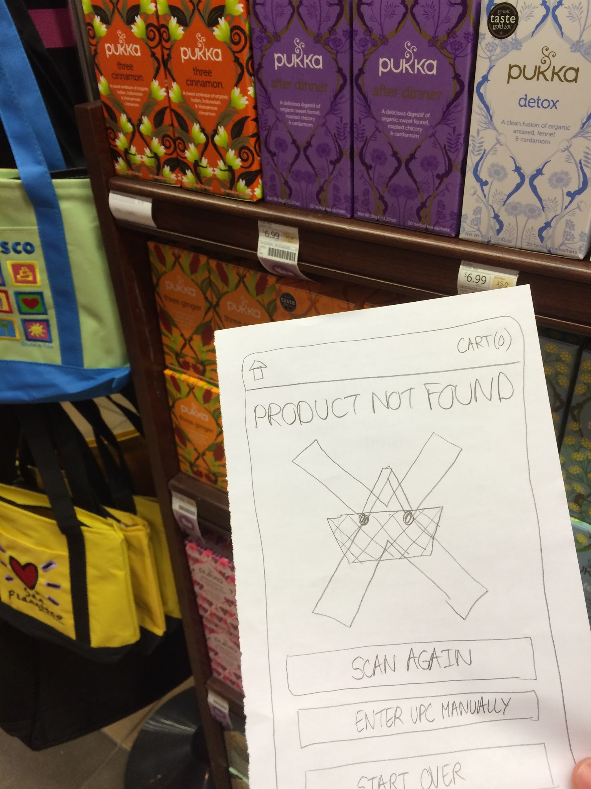
Constructing and testing the prototype

Slide 28
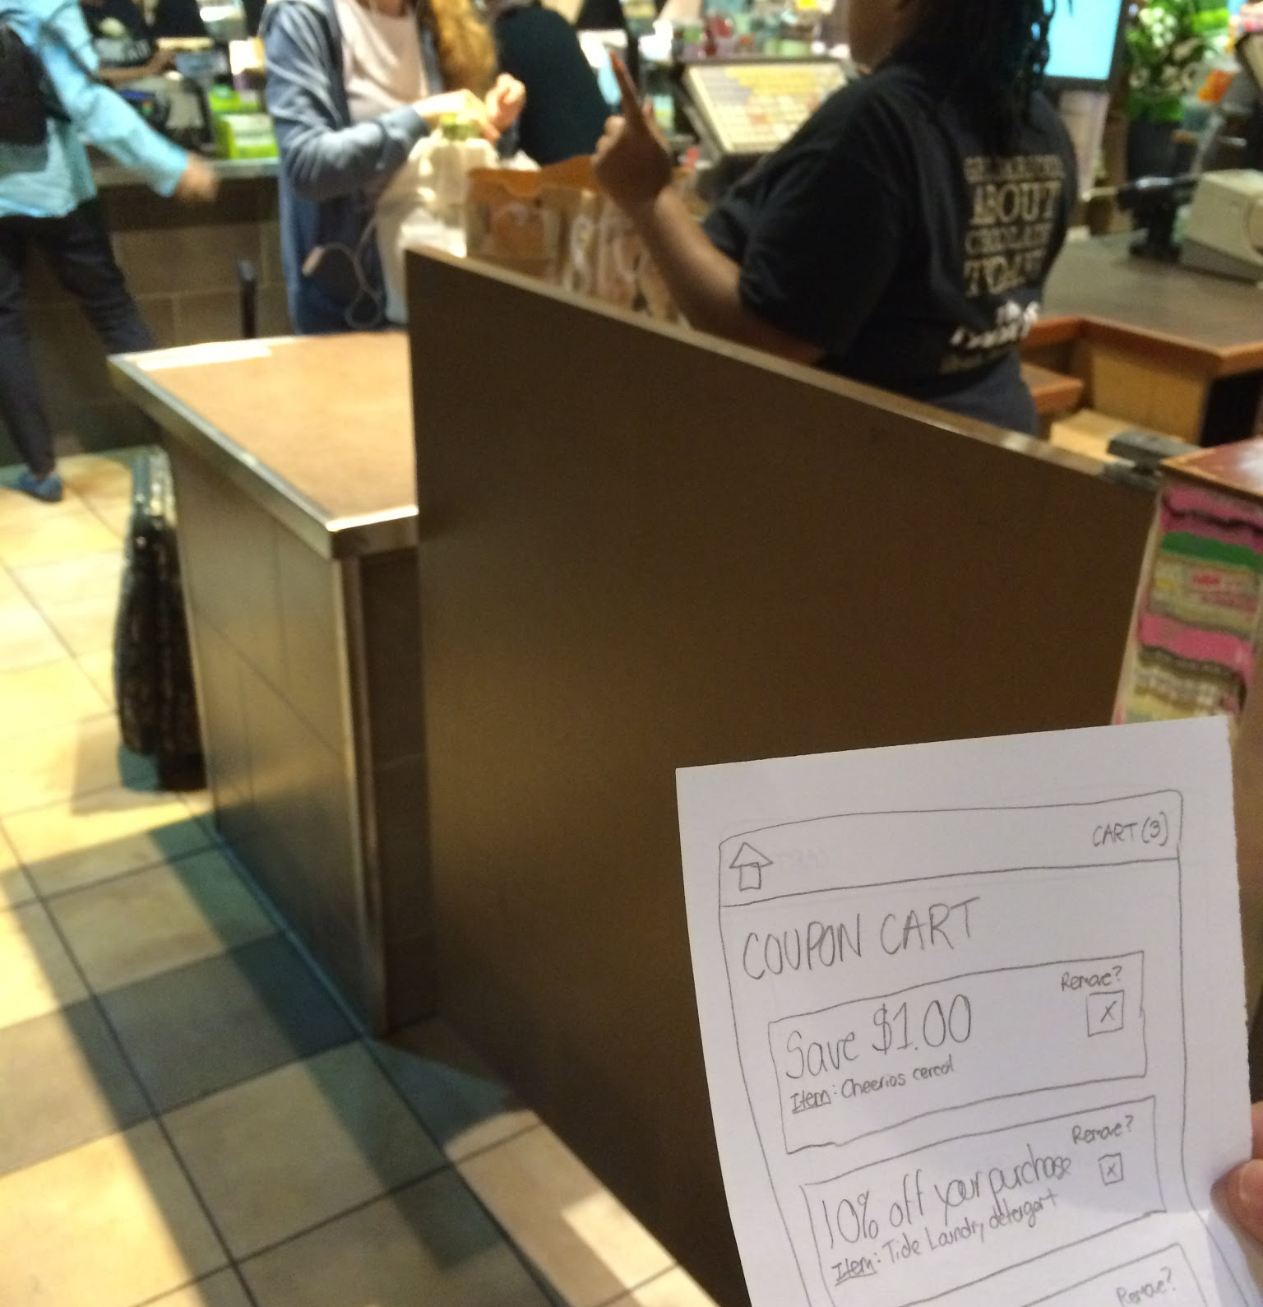
Results
Things that worked:
James was receptive to adding extra action to his routine
Saving money was an attraction
Things that didn’t work:
He did not save any time shopping
Process became repetitive
Surprises and new learnings:
James did not care about spending more time if it saved money

Slide 29
THANKS!
Any questions?

