Slide 1
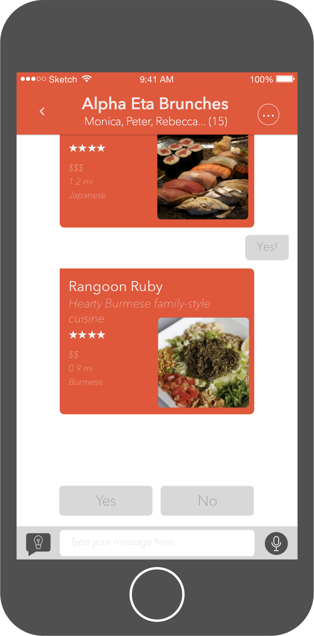
Faster decisions
Group preferences
Get places

