Slide 1
Mingo!
Low-fi Prototyping and pilot usability testing

Slide 2
Presentation Outline
About Mingo
The Low-fi Prototype
UI Task Flows
Pilot Usability Testing

Slide 3

Mingo!
make every mood a travelling mood

Slide 4
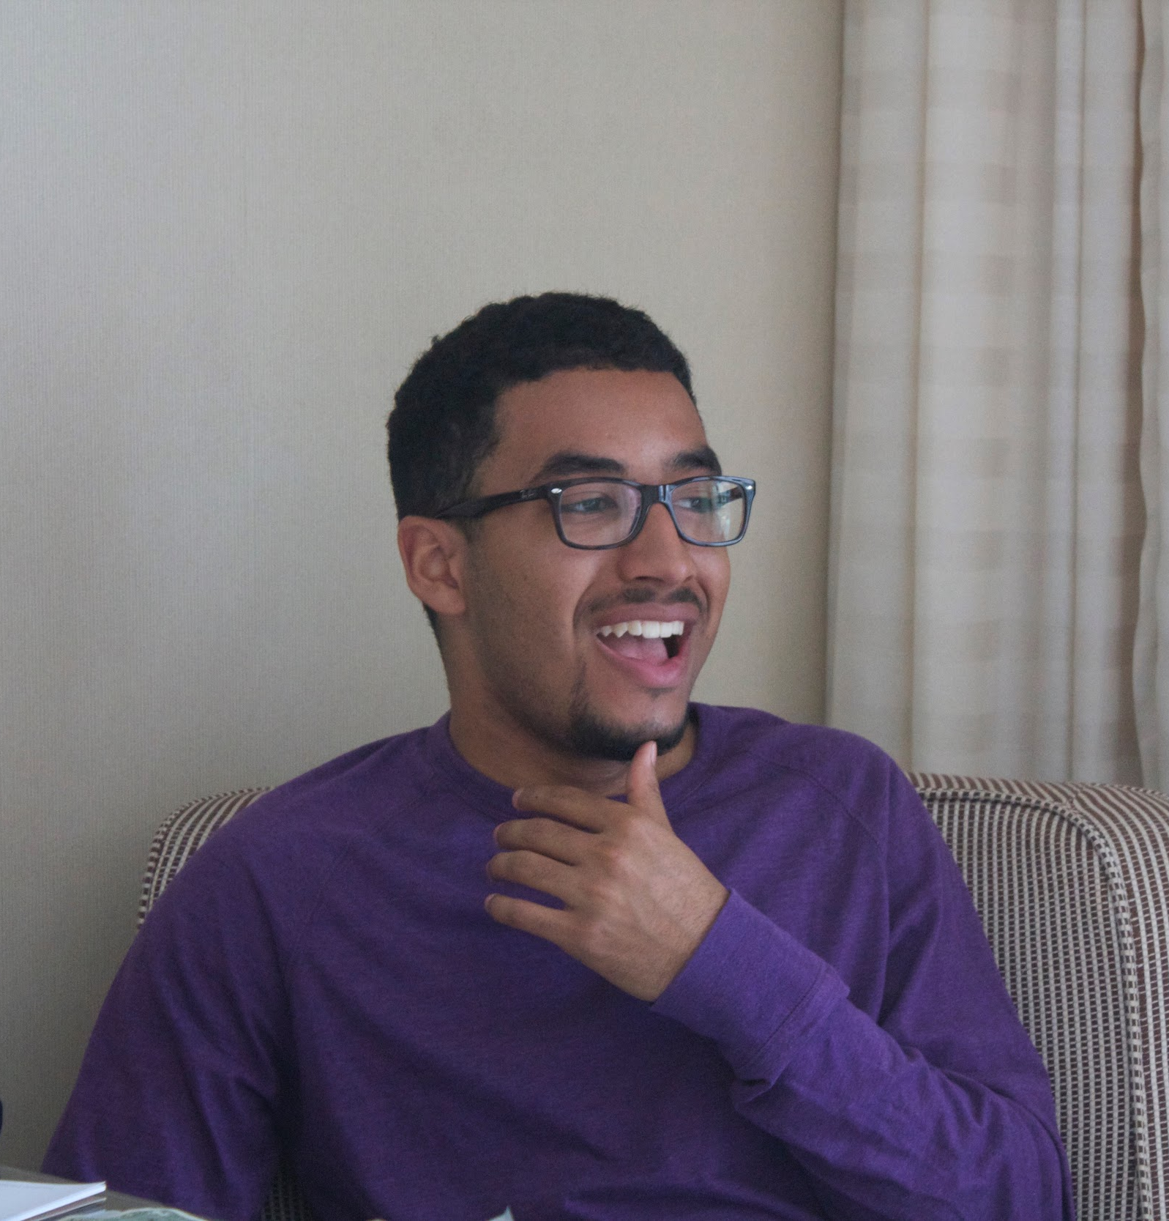
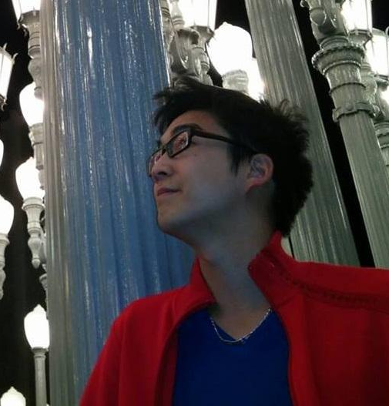
Team Mingo
Ben W.
Kevin H.
Minymoh A.
Our mission:
Mingo aims to prevent ‘travel burnout’ by taking a traveller’s current mood into account when planning an activity. Mingo keeps travel fresh and spontaneous, allowing users to experience popular sights in new ways while also suggesting lesser known sights and experience that help mix up the pace and tone of a trip.

Slide 5
The Prototype

Slide 6
Concepts → Selected Interface
Audio
Mixed
Audio & Touch
Input
Touch
Input
Text
Input
Wearable
We chose to move forward with a touch input design mainly due to the viability and convenience of the input method as well as the current technological limitations of voice input.
Describing your current mood without the help of prompts or suggestions can often be difficult. Our chosen design presents the user with a finite list of moods from which she must choose, facilitating the mood selection process.

Slide 7
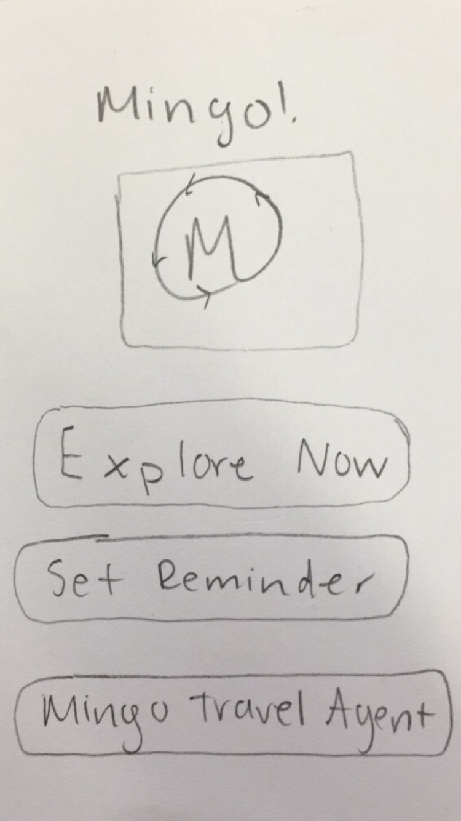
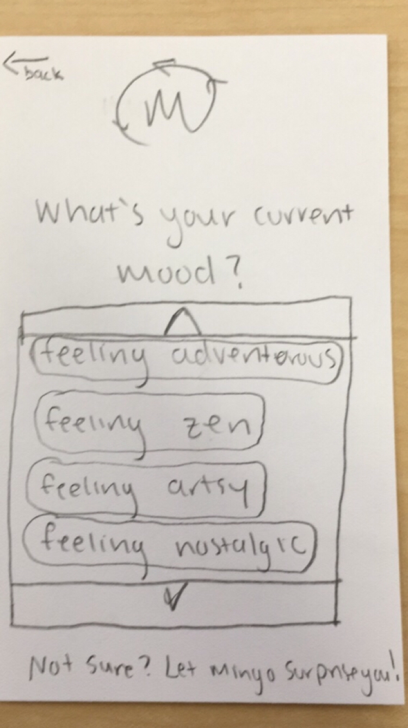
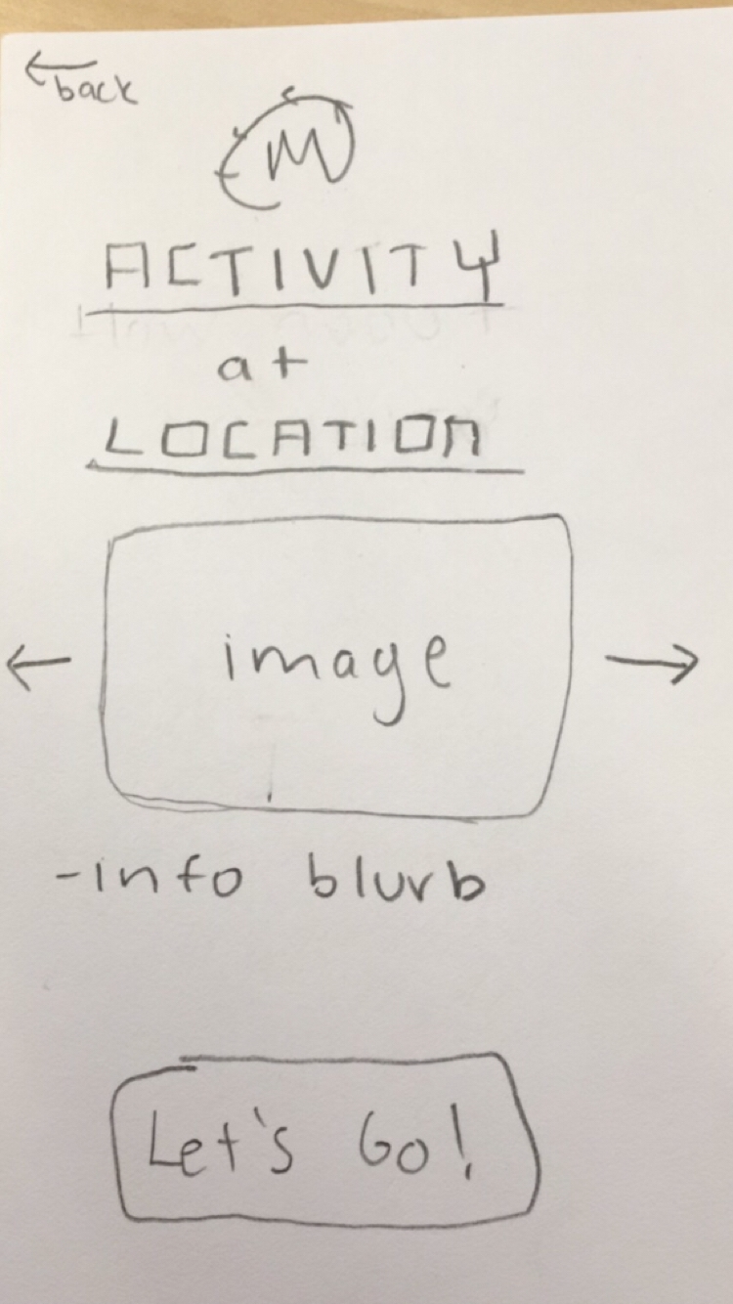
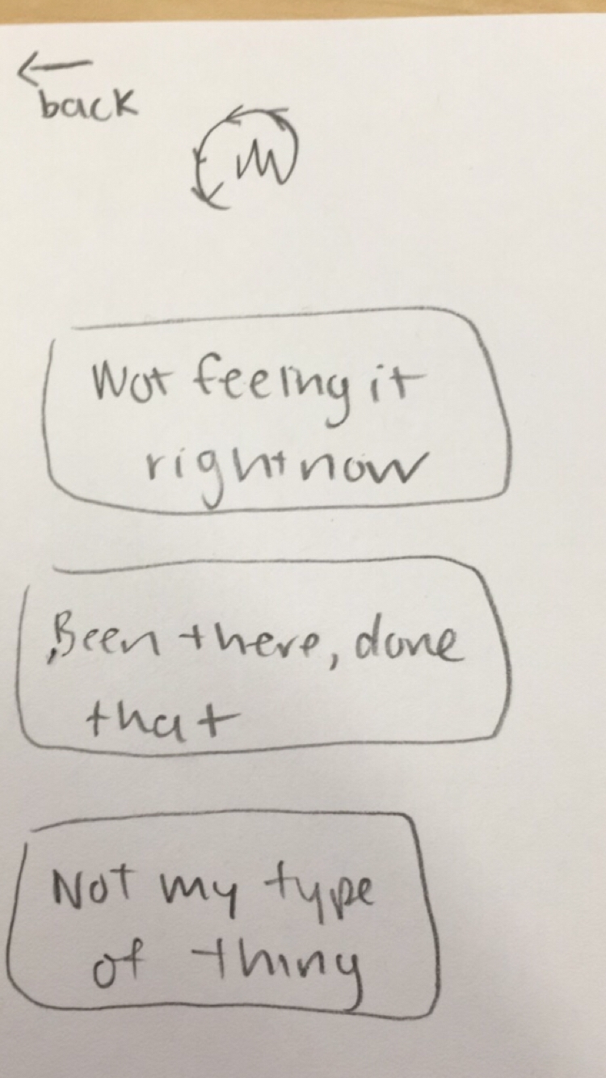
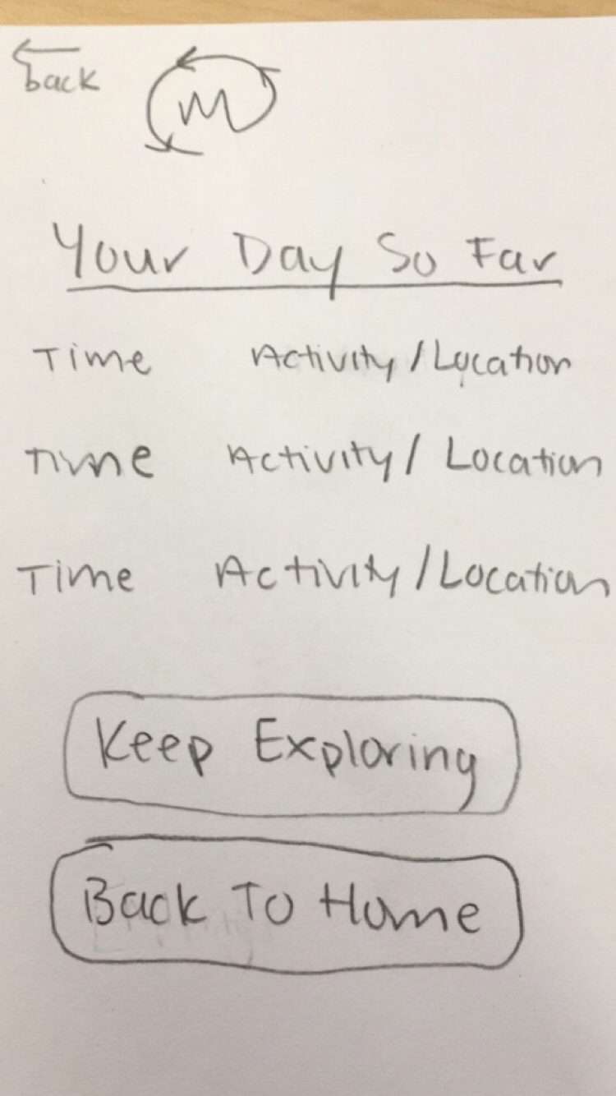
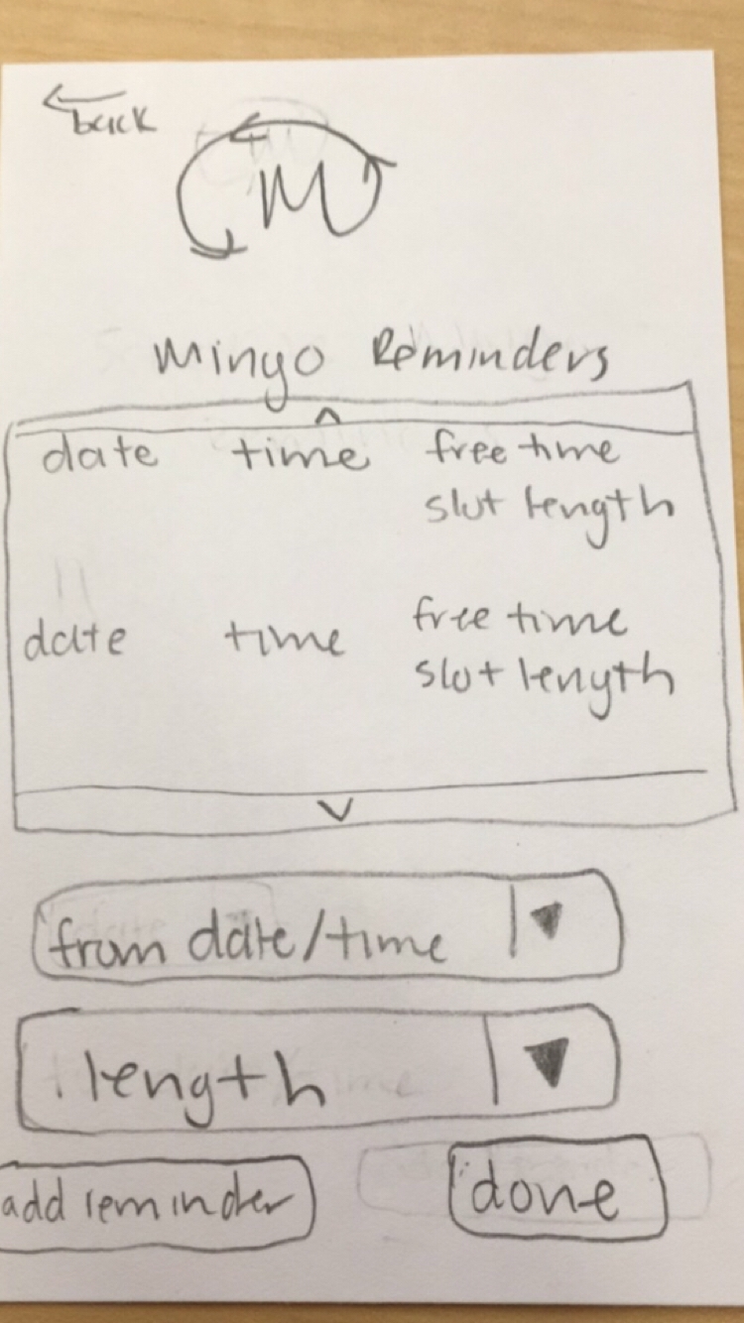
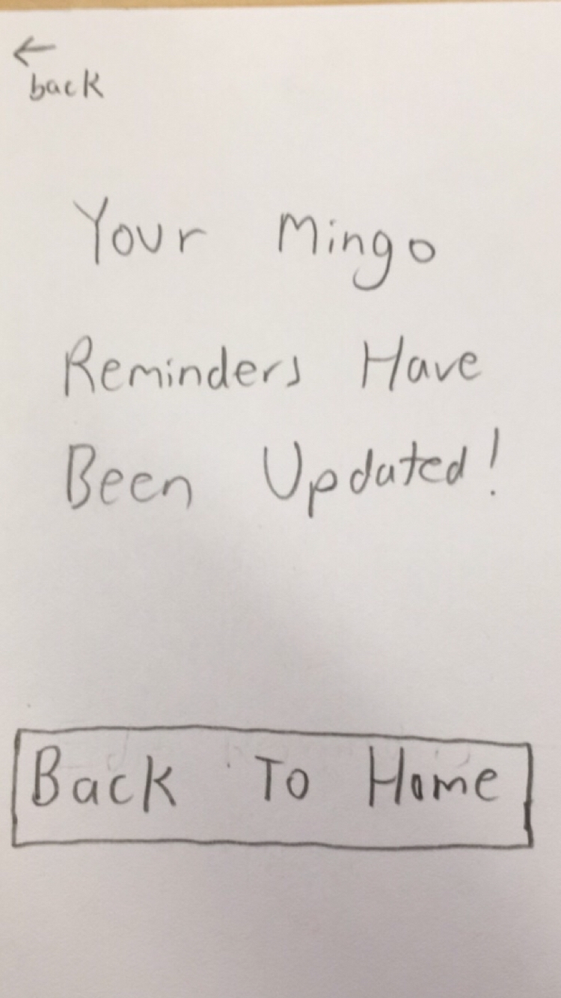
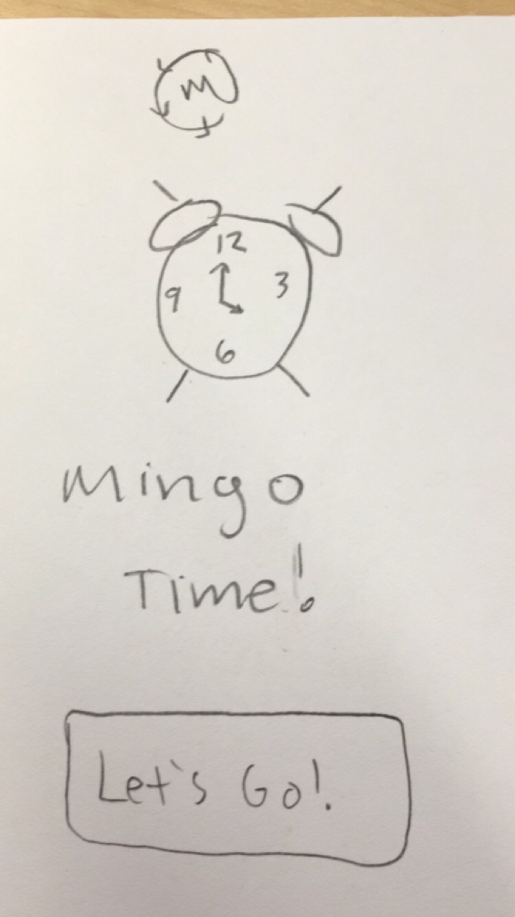
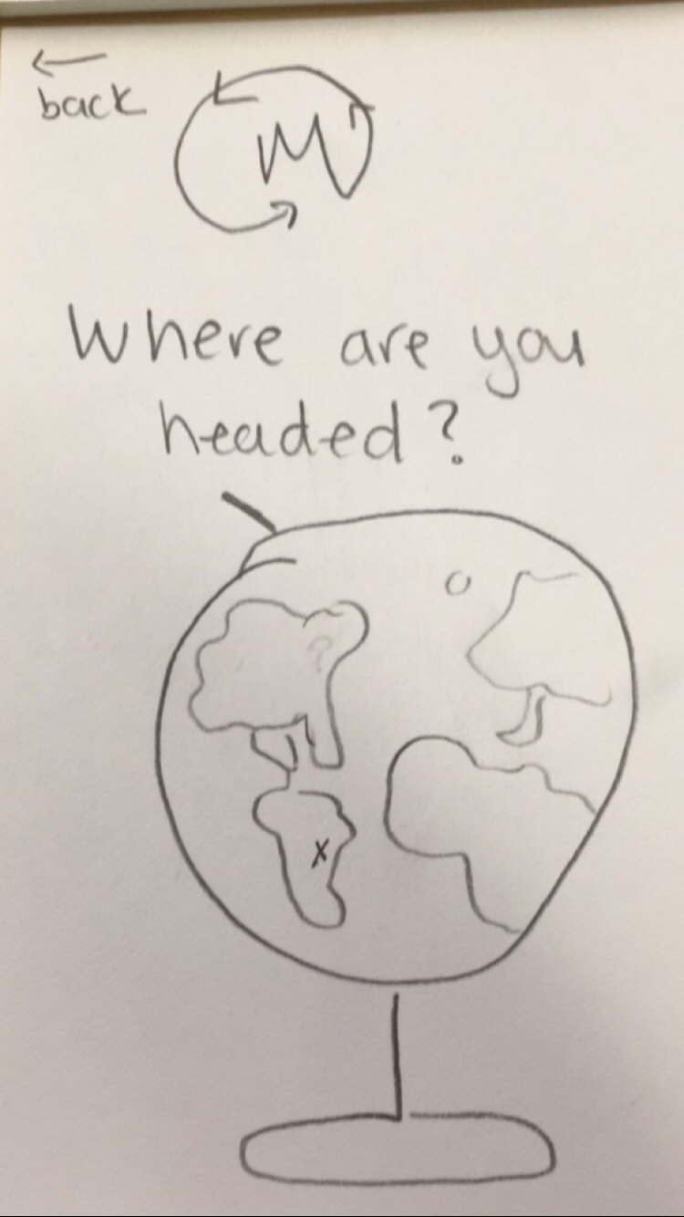
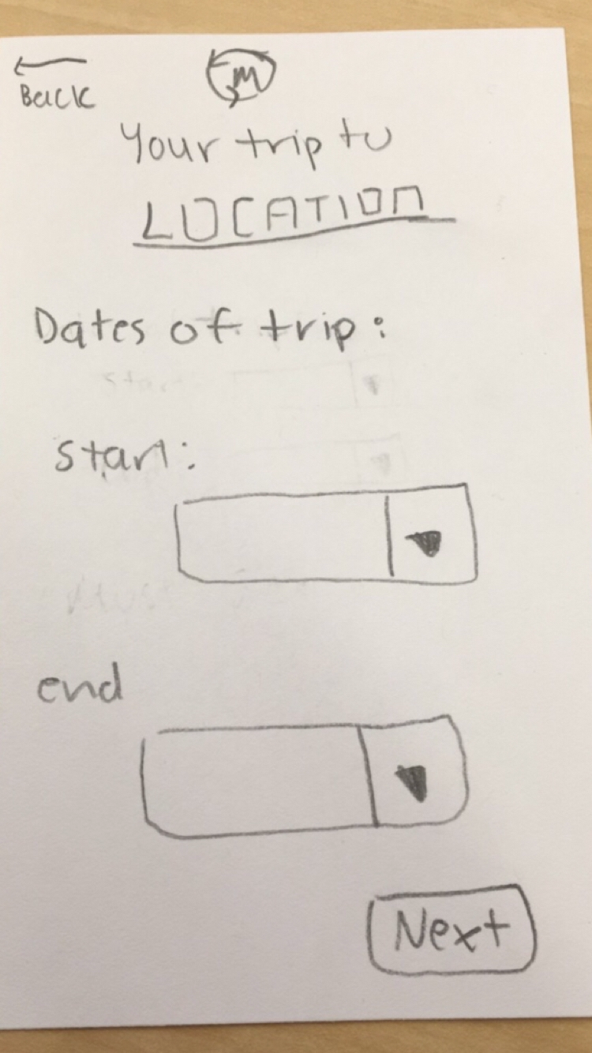
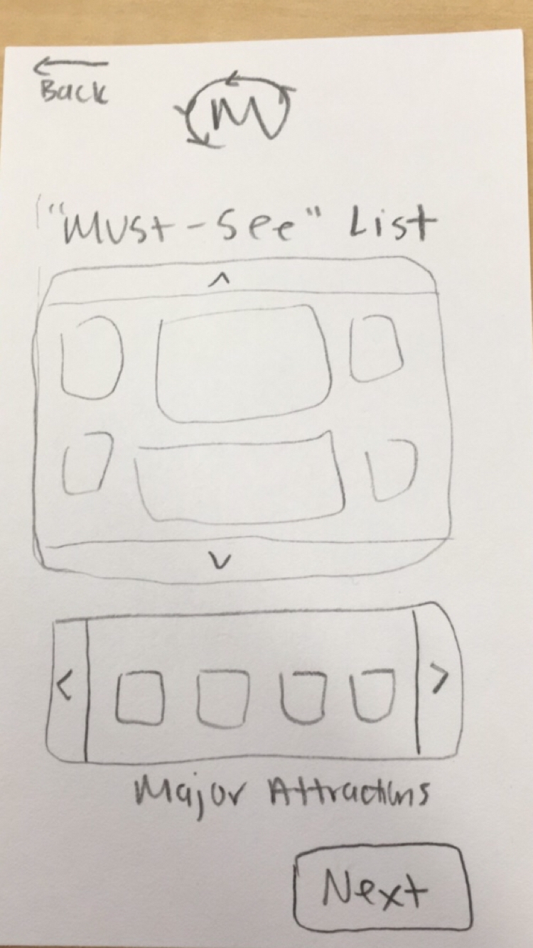
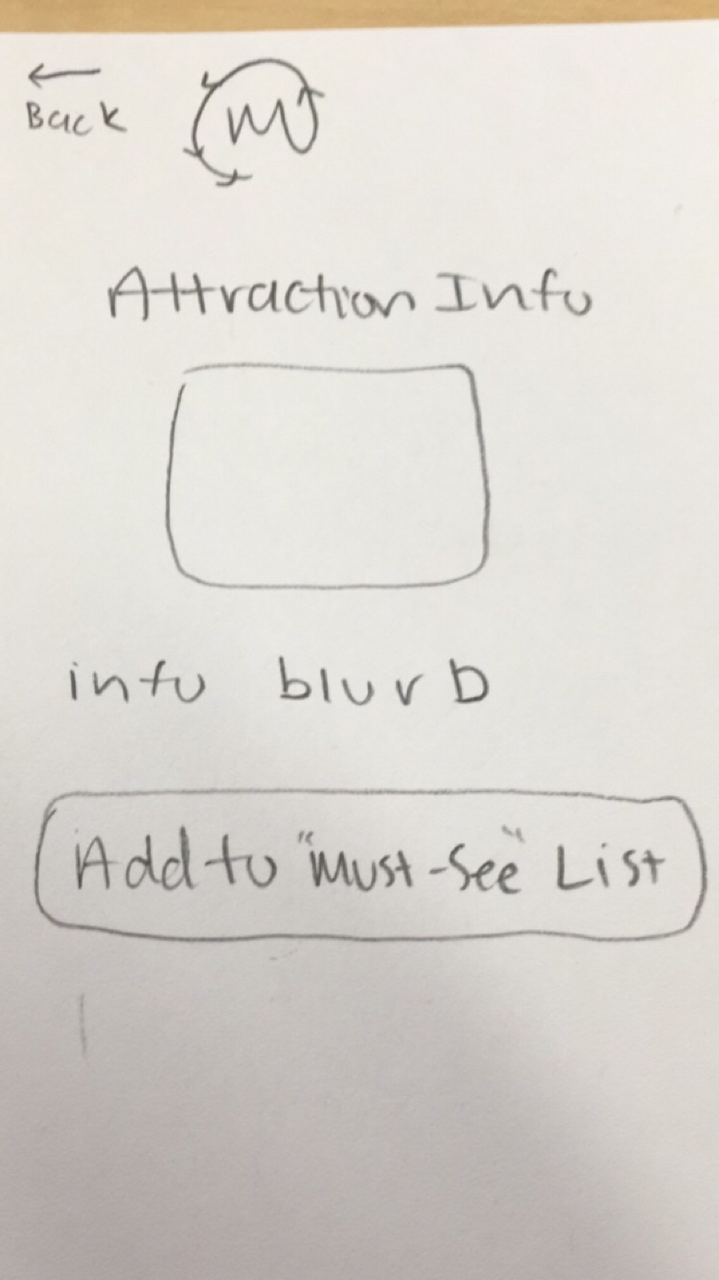
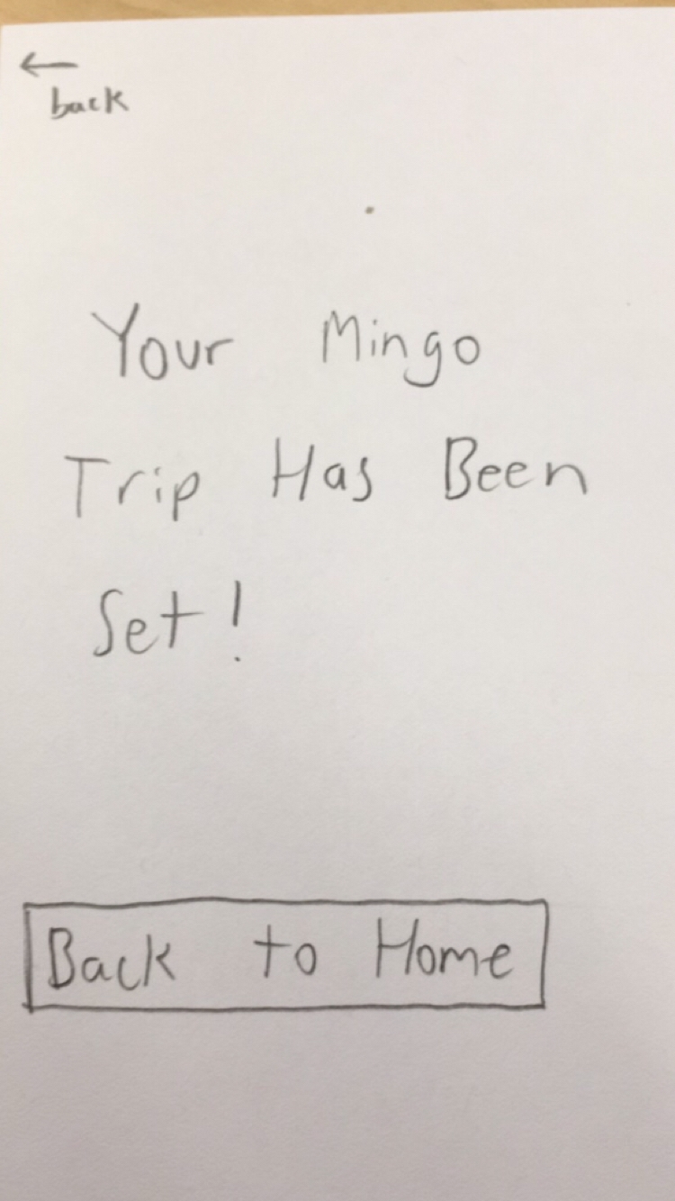
Paper Prototype Structure → POP

Slide 8
UI Task Flows

Slide 9
Task 1
Do Something Based on Current Mood

Slide 10
Task Flow: Do Something Based on Current Mood
Activity Suggestion Screen
Home Screen
Mood Screen

Slide 11
Task Flow: Do Something Based on Current Mood
Activity Rejection Feedback Screen
Activity Suggestion Screen
Past Activities Screen

Slide 12
Task 2
Set a Reminder to Explore During Free Time

Slide 13
Task Flow: Set a Reminder
Home Screen
Reminders Screen
Reminder Confirmation Screen

Slide 14
Task Flow: Set a Reminder
Mingo Alarm Screen
Mood Screen

Slide 15
Task 3
Travel Spontaneously Without Missing Out on Major Attractions

Slide 16
Task Flow: Plan a Spontaneous Trip
Home Screen
Location Screen
Trip Dates Screen

Slide 17
Task Flow: Task Flow: Plan a Spontaneous Trip
Must See List Screen
Attraction Information Screen
Must See List Screen

Slide 18
Task Flow: Task Flow: Plan a Spontaneous Trip
Trip Confirmation Screen
Mingo Alarm Screen
Mood Screen

Slide 19
Pilot Usability Testing

Slide 20
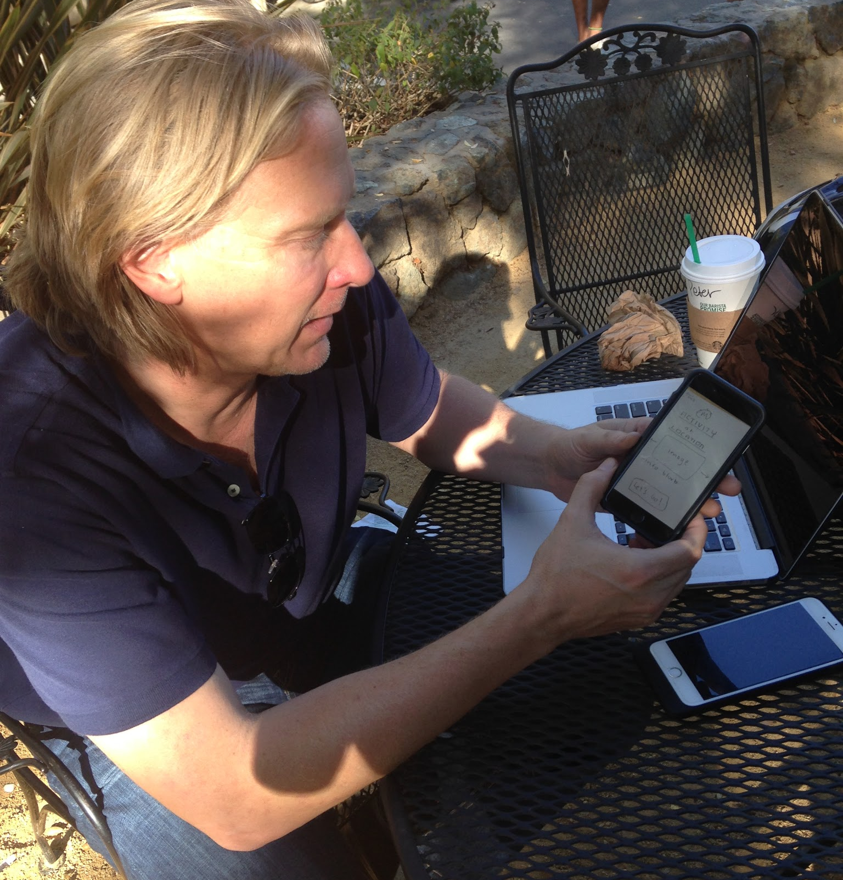
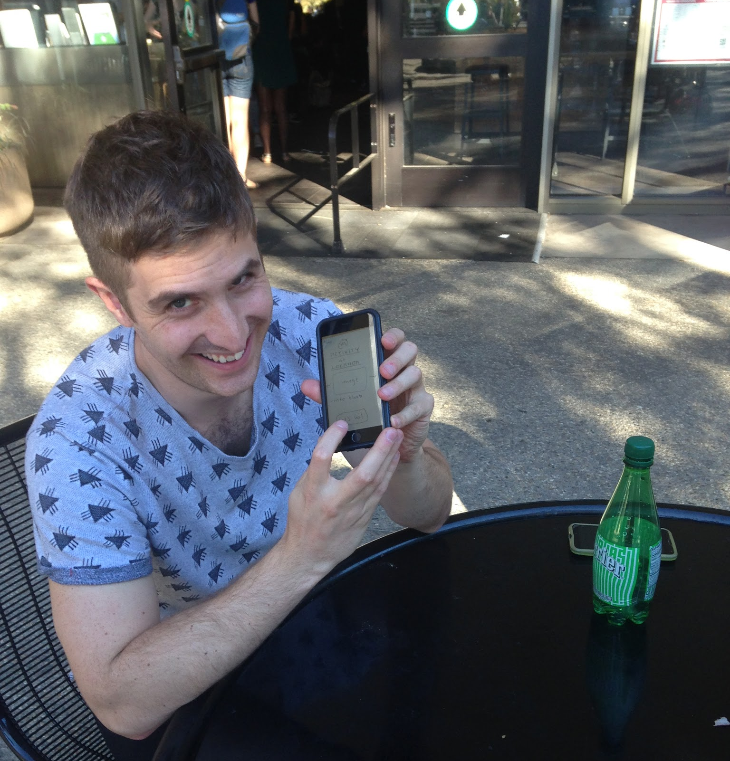
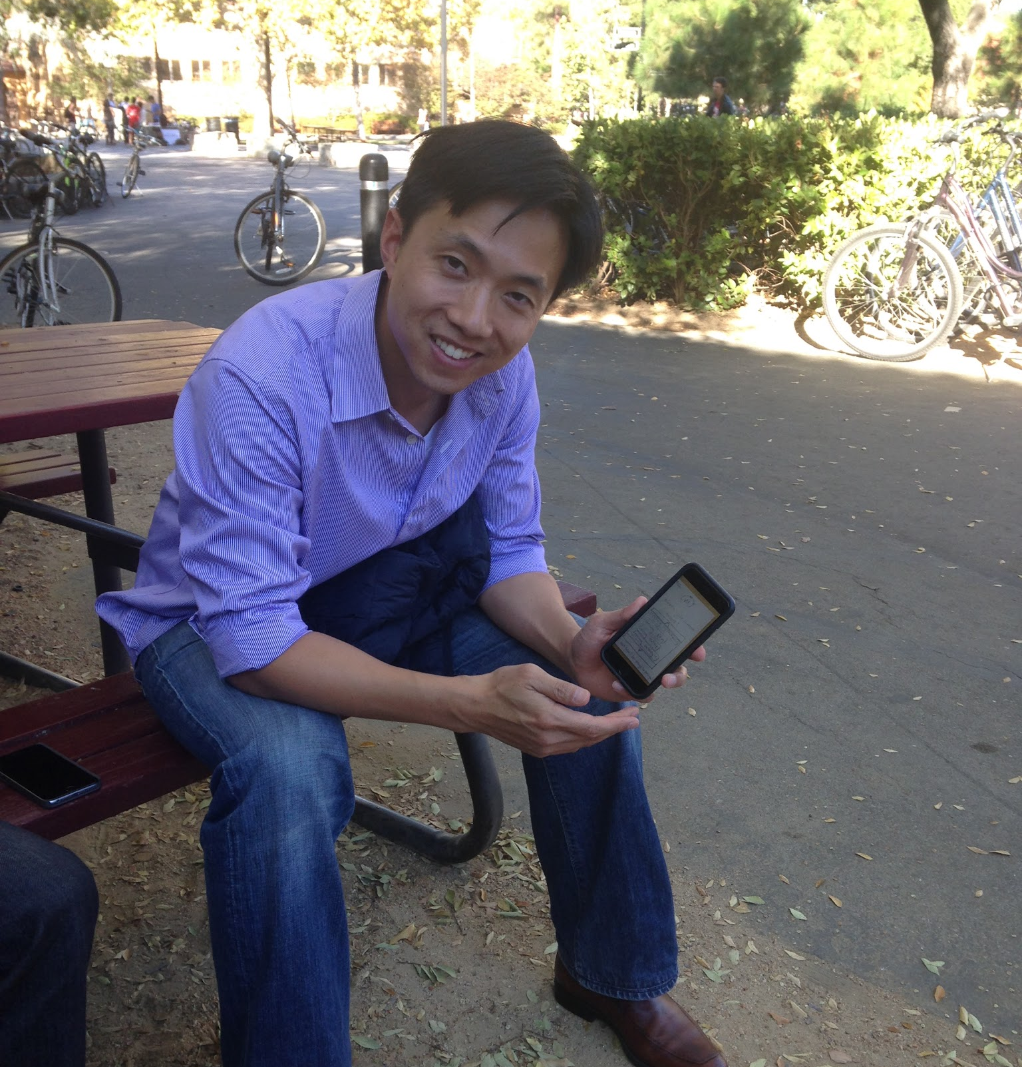
Participants
Peter
45-55
Frequent Business Traveller
Davyde
25-30
Just got back from his honeymoon
Jason
35-40
Moderate business traveller. Travels with family
Kevin
Facilitator
Minymoh
Notetaker/Observer
Notes:
looking for non-stanford students in the tressider area who have experience travelling and are apprachable

Slide 21
Results: Overview
 | Peter | Davyde | Jason | Overview
Task 1: Explore Now | 5 min 2 errors | 2 min 1 error | 3 min 1 error | ~3.3 min 4 errors
Task 2: Set Reminder | 4 min 1 error | 2 min 0 errors | 2 min 0 errors | ~2.7 min 1 error
Task 3: Mingo Travel Agent | 5 min 1 error | 2 min 0 errors | 3 min 0 errors | ~3.3 min 1 error

Slide 22
results: Things That Worked
Loved the overall concept of the app
Liked the idea of being able to do something spontaneous
Loved the flâneur spirit of the app
Navigating through the 3rd task was completely intuitive
Really liked the reminder functionality
Liked both the concept and implementation of the must-see list

Slide 23
Results: Things that Need More Work
Screens
All participants were confused by the arrows on the Activity Suggestion Screen
All participants were confused by the Activity Rejection Feedback flow

Slide 24
Results: Things that Need More Work
Concepts
None of the flows came intuitively to Peter
Davyde thought the second task ruined the spirit of the app
Jason wanted a more customized and personal experience with the app
Peter wanted the app to influence his mood as much as his mood dictated his app experience
Jason felt limited by given mood choices

Slide 25
Changes to UI

Slide 26
Necessary Changes to UI:
The Activity Suggestion Screen
Label the arrows ‘no’
Do away with arrows and ‘let’s go icon’ and use swiping functionality instead
Move from scrolling through suggestions to explicitly rejecting a given suggestion

Slide 27
Necessary Changes to UI:
The Activity Rejection Feedback Screen
Rather than have another screen, perhaps make a pop-up dialogue box that keeps Activity Suggestion Screen blurred in background
Do away completely with getting this feedback

Slide 28
Changes to Consider
Mixed modes of input for moods
Sharing functionality
Incorporating more user feedback (rating sites, reviews, etc.)
Clearer language on icons
?

Slide 29
Thanks!
Any questions?

Slide 30
Credits
Special thanks to all the people who made and released these awesome resources for free:
Presentation template by SlidesCarnival
Photographs by Unsplash

