Slide 1
POVs and Experience Prototypes
Studio Theme: Mobility and Travel

Slide 2
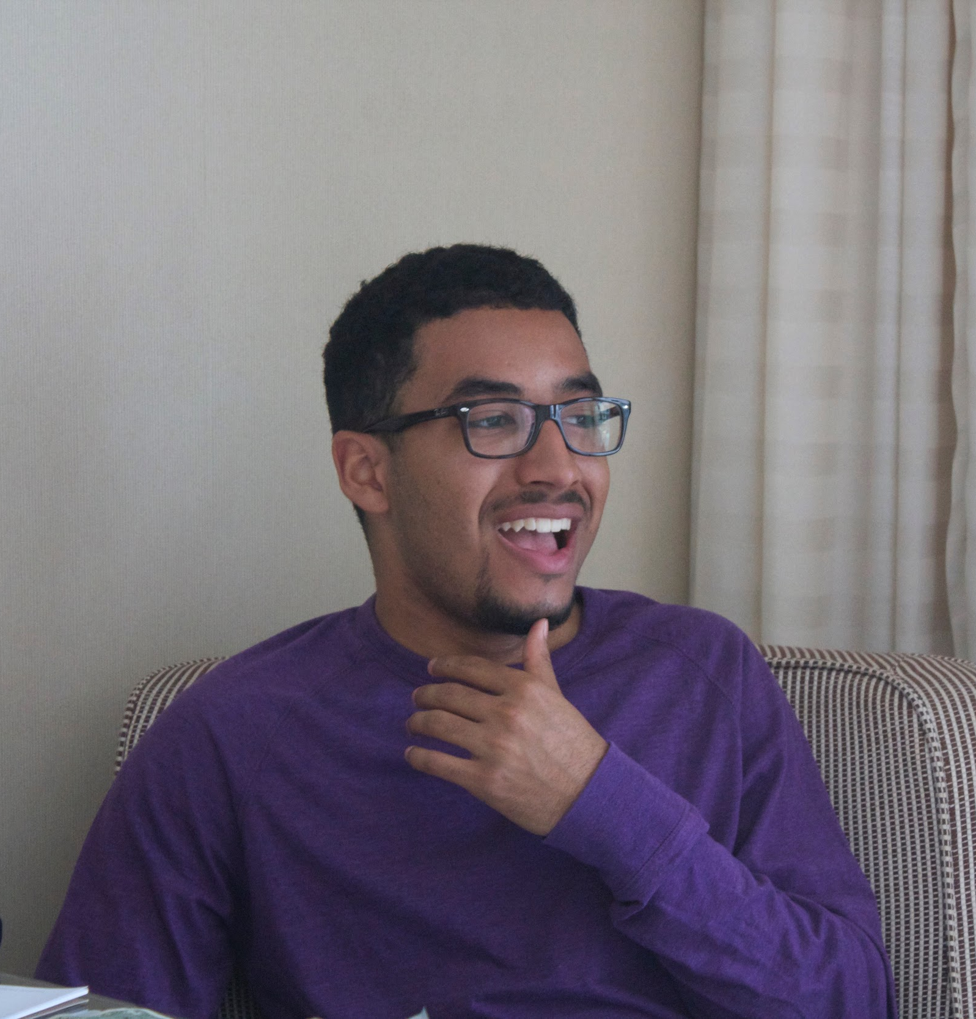

Team Members
Ben
Kevin
Minymoh

Slide 3
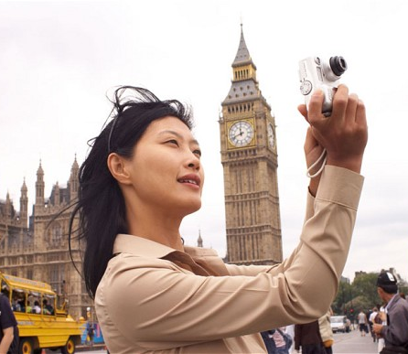
Problem Domain
How do tourists interact with new spaces?

Slide 4

Initial POV
We met some travellers. We were amazed to realize that it is often more difficult to understand where you are in reference to everything around you while travelling. It would be game changing to make this easier.

Slide 5
Additional
Needfinding

Slide 6
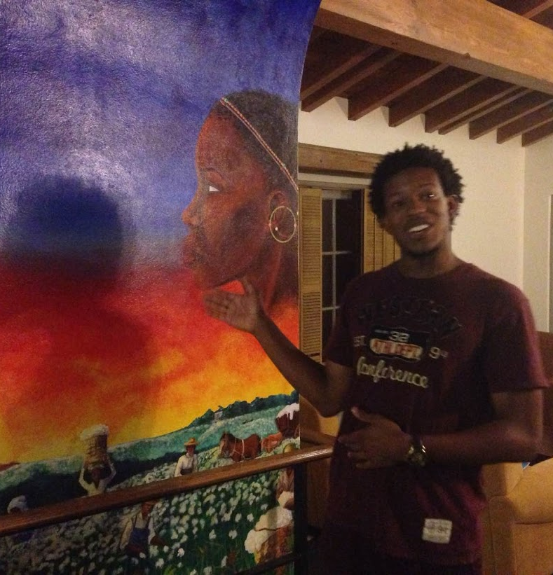


Interviewees
Julien
Chen
Robert
Notes:
Chen: We found out that the family tries to avoid any issues while travelling through excessive planning for all contingencies. Despite excessive planning, however, unexpected events occur, inducing anxiety.
Robert: One of the group’s greatest inconveniences during their travels was the loss of cell phone signal. While it is often much more convenient to use modern technology to plan a trip, the group felt that not having a fail-safe option was a big mistake.

Slide 7
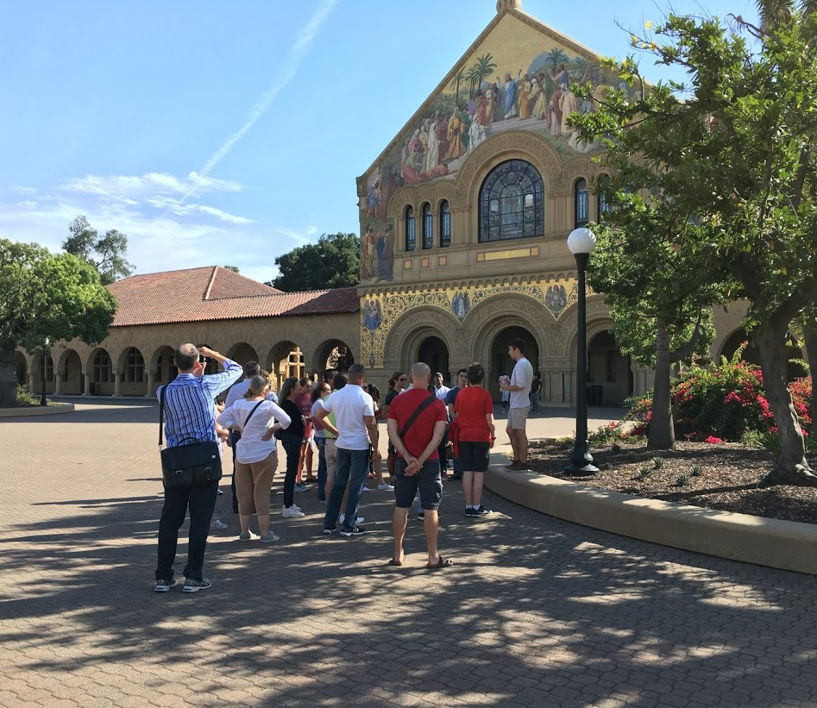
Tourists in Action
Notes:
One interesting thing we picked up on was the prevalent use of paper maps (obtained from the Visitor Center) instead of cell phones.

Slide 8
What we learned
Even with excessive planning, unexpected events can cause anxiety
Loss of cell phone signal is scary
Some tourists still use paper maps

Slide 9
POVs and HMWs

Slide 10

Revised POV 1
We met a college student that embarked on a long backpacking trip. We were amazed to realize that she was suffering from “travel burnout” after visiting one famous sight after another. It would be game changing for her to experience something different or find hidden gems during her travel that perhaps only the locals have knowledge about.

Slide 11
How might we help travelers plan a trip that wasn’t “typical”?
1

Slide 12
How might we help organize trips to minimize traveller’s fatigue while also minimizing the fear of missing out?
2

Slide 13
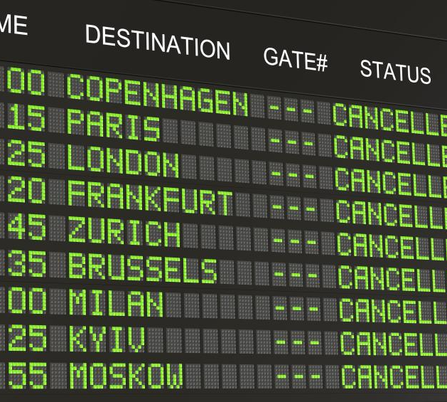
Revised POV 2
We met a family of four with young children. On a trip overseas, they missed the last flight home, necessitating an overnight stay and jeopardizing plans. We were amazed to realize how stressful it was to balance the needs of their children with the need to figure out how to get home. It would be game changing to assist with the process of re-booking travel plans to alleviate the family’s troubles.

Slide 14

Revised POV 3
We met a group of five work colleagues aged around 30 from Shanghai and Guangzhou. We were amazed to realize that unexpected events coupled with lack of access to communication evoked feelings of paralysis and anxiety. It would be game changing to alleviate their anxiety issues during “loss of control” situations.

Slide 15
How might we help people who don’t speak a common language communicate?
3

Slide 16
Experience Prototypes

Slide 17
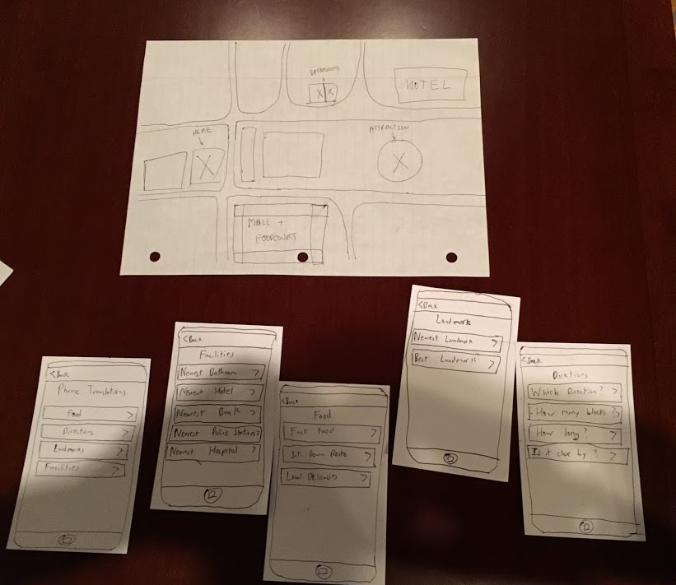
Translation Service
Travellers can benefit from an offline translation service which translated certain pre-selected phrases between two languages.

Slide 18
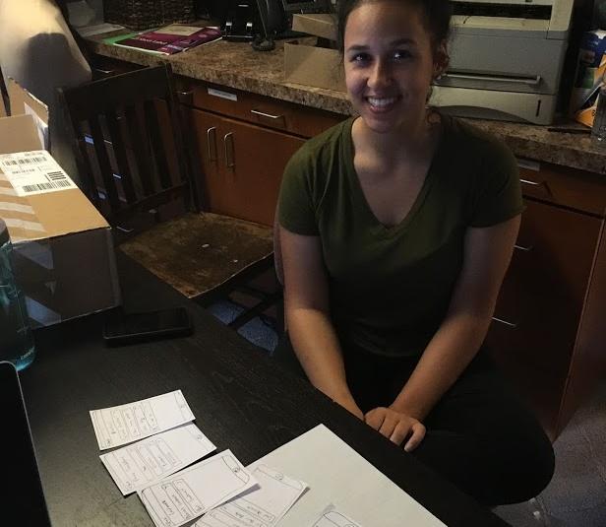
Tiara
We told Tiara to imagine that she was travelling to a location where she did not speak the language.

Slide 19
Results
What worked
The translation of common phrases helped
Both tourists and locals can benefit
What didn’t work
Translations alone are not enough
Common phrases may not cover every scenario
Surprises and New Learnings
Hard to believe that a traveller could be so helpless

Slide 20
While our initial assumption was valid, in order to pursue this solution, we would have to further assume that it is common for travellers to visit foreign places without accounting for the language barrier issue.

Slide 21
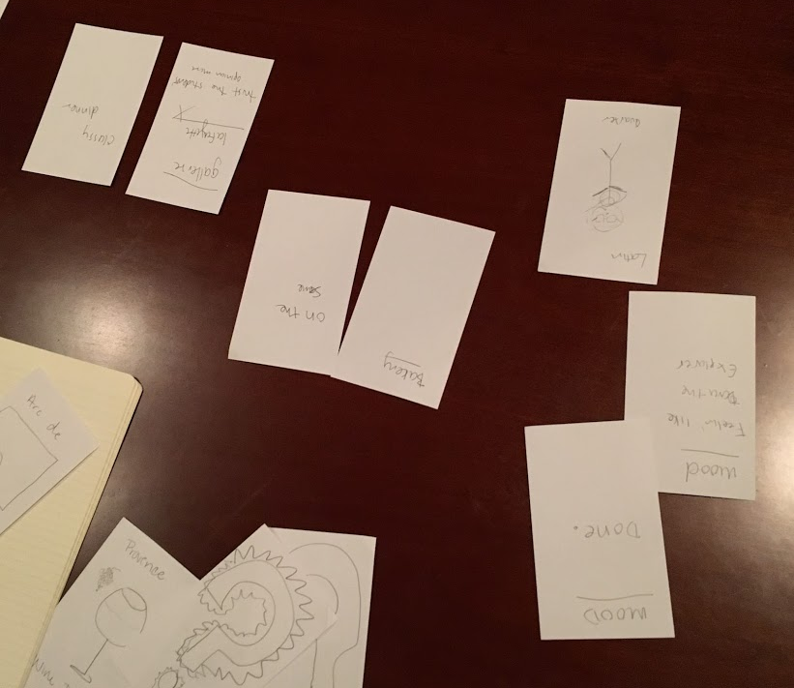
Mood-based Planning
Users are willing completely cede control and leave trip planning partially up to chance.

Slide 22
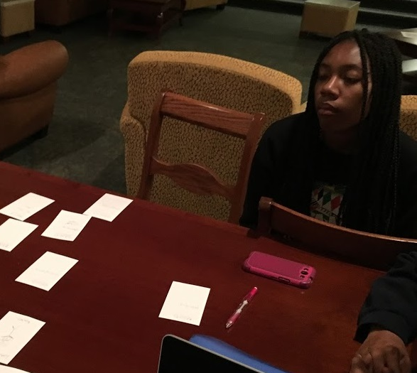
Alona
We told Alona that she had just woken up in Paris, but had yet to plan out her day. She would then choose her activities based on her mood.

Slide 23
Results
What worked
Trip becomes much more spontaneous
Makes planning somewhat easier
What didn’t work
Mood and desires don’t always match
Possible to miss out of “must-see” attractions
Surprises and New Learnings
Can be a dynamic and fun way to plan out a trip

Slide 24
Our assumptions were mostly valid, provided that a user is willing to cede control.

Slide 25
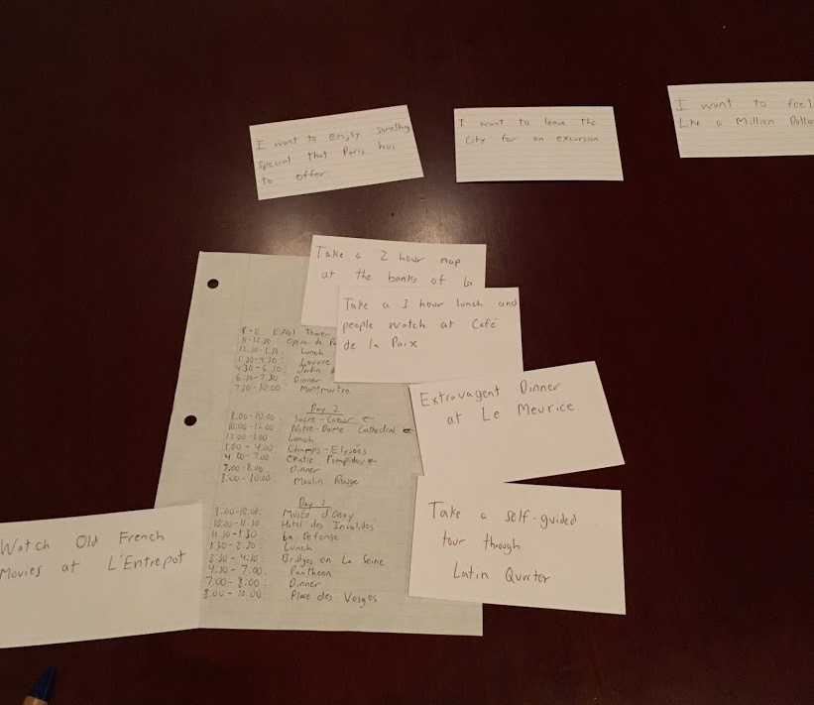
Burnout Prevention
Exchanging existing entries in a jam-packed itinerary with new desire-focused activities can help ease travel burnout.

Slide 26
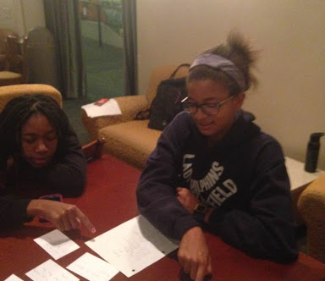
India
We told India to imagine that she had been travelling for a long time and was completely burnt-out.

Slide 27
Results
What worked
Doing something for yourself can prevent burnout
Unwinds a packed itinerary
What didn’t work
Alternate activities are not always the solution
Altering itinerary can cause logistical issues
Surprises and New Learnings
Better to do something you want instead of something you feel like you should do.

Slide 28
Our assumption was valid. Doing something for yourself can help re-energize your desire for travel.

Slide 29

The best travel experiences are often the ones that elicit a profound emotional response from the traveller.

Slide 30
Thanks!
Any questions?

Slide 31
Credits
Special thanks to all the people who made and released these awesome resources for free:
Presentation template by SlidesCarnival
Photographs by Unsplash

