Slide 1
Needfinding
Studio Theme: Mobility and Travel

Slide 2
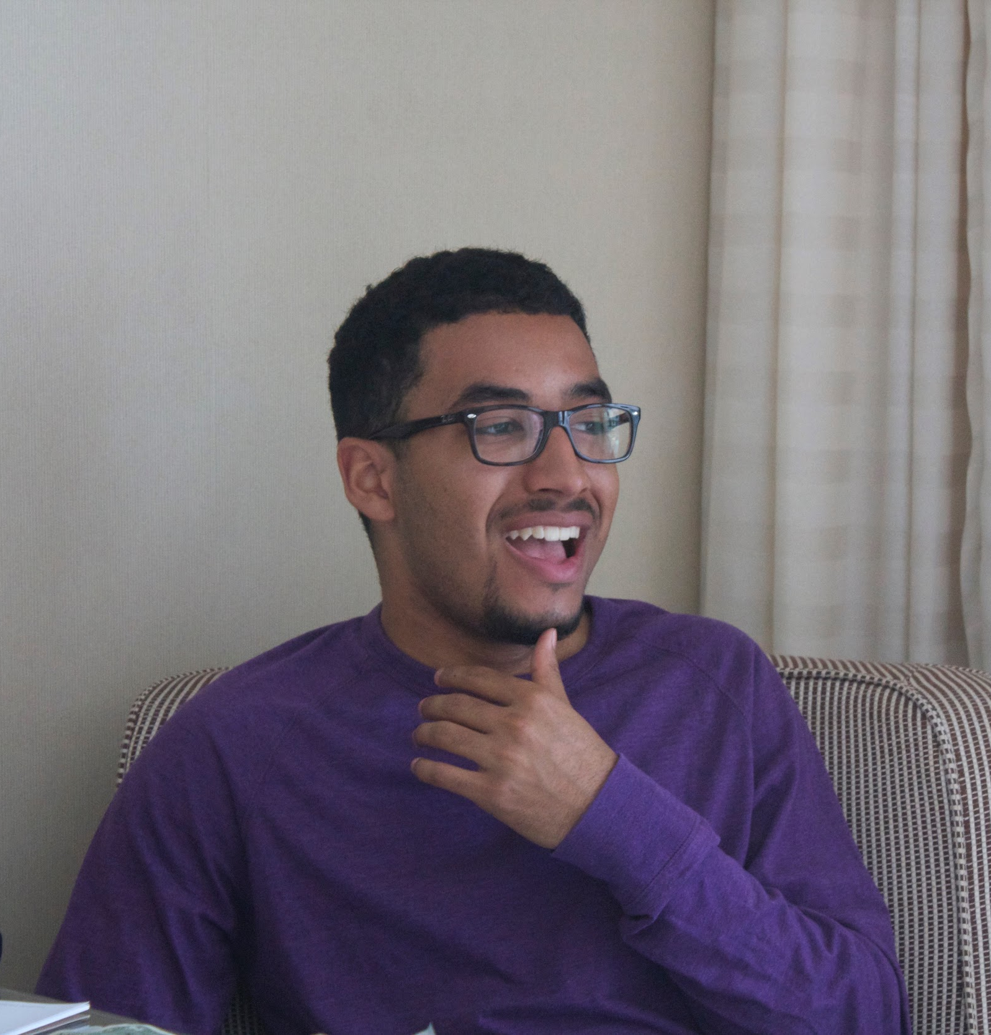
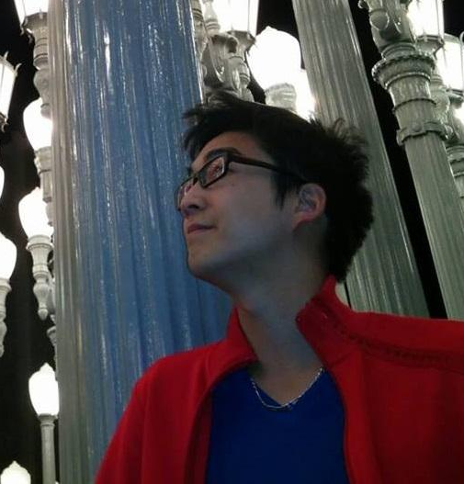
Team Members
Ben
Kevin
Minymoh

Slide 3
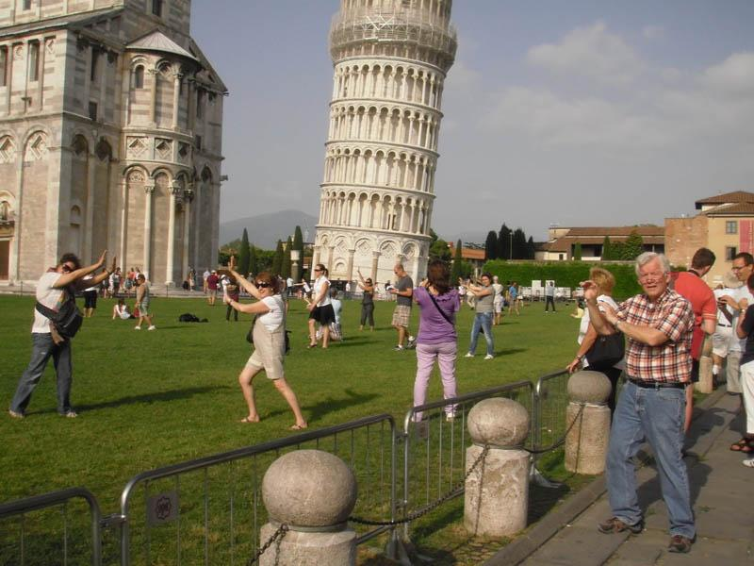
Problem Domain:
Tourists’ experiences in navigating new places
Notes:
We want to dive into tourism
Why do people travel?
How do tourists handle being somewhere new?
What do they use to orient themselves?
What can go wrong?

Slide 4


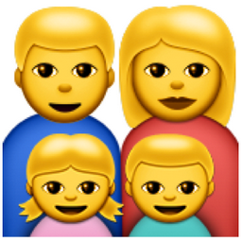

Interviewees
Tyler
Joy
Edward and June
Stanford Tour Guide
Notes:
Why they were chosen?
Edward and June: They represent an extreme user (they often travel with their children).
Julien: Tour Guide. An interesting case, we thought it may provide additional insights into travel.
Tyler: New to traveling; took a huge trip to ecuador this summer
Joy: Travels a lot; has been to west africa, santiago, cambodia, thailand, japan
How were they recruited?
Edward and June: Met them at the Stanford Visitor Center.
Julien: Worked at Stanford Visitor Center.
Tyler: Wrote about her experience online, and is good friend of Ben
Joy: Personally knows Ben

Slide 5
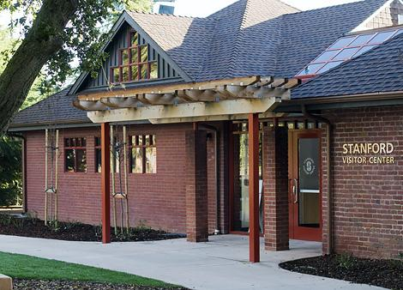


Interview Locations
Stanford Visitor Center
Starbucks
Skype

Slide 6
Questions Asked (Tourists)
Where are you from?
Why do you travel?
What made you decide to visit...?
.
.
.
Notes:
Where are you from?
Why do you travel?
What made you decide to visit...?
How many people are you travelling with? How did/do you coordinate/plan with your fellow travellers? Tell me how you felt about the coordination process.
How do you decide what to do when you visit?
What kind of apps/tools do you use (maps, calendars, reservation making, transportation) when you travel? Which one do you rely most on and why?
Have you faced any major difficulties on this trip? Elaborate.
What’s the most frustrating traveling experience you’ve had? What made it so frustrating?
Tell me about a time where things didn’t go according to plan (Missed planes/trains etc.). How did it make you feel? Was there anything that could have been improved?
Explain your idea of a perfect trip.

Slide 7
Questions Asked (Tour Guide)
Why did you decide to tour guide?
Talk us through the process of taking a group on a tour.
What’s the most common question you get asked by tourists?
.
.
.
Notes:
Why did you decide to tour guide?
Talk us through the process of taking a group on a tour.
What’s the most common question you get asked by tourists?
As a visitor center worker, what do you think is most important tourists experience when visiting? Why?
Since becoming a tour guide, have you been on any trips on which you took a guided tour? Which ones stood out to you and why?
Has being a tour guide had any effect on your travel habits?

Slide 8
Some Interesting Quotes

Slide 9
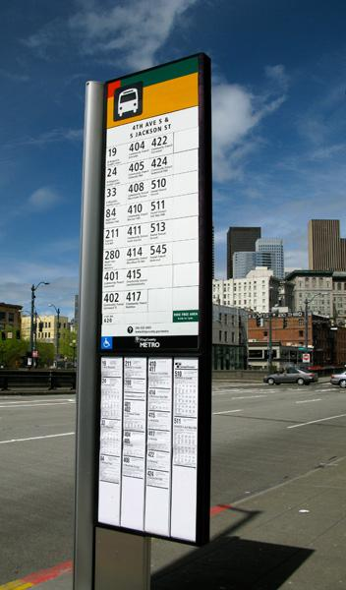
Tyler
“We didn't look into bus times prior to getting to the bus station, due to our assumption (and some reassuring words from locals) that the buses ran at all hours.”

Slide 10
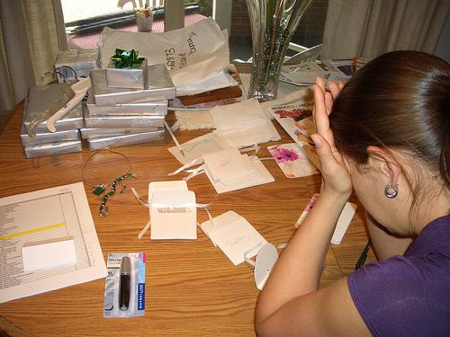
June
“Trips to a new location where we explore new things are more worthwhile versus trips purely for relaxation, but sometimes, the planning makes it feel like less of a vacation and more of a job.”

Slide 11
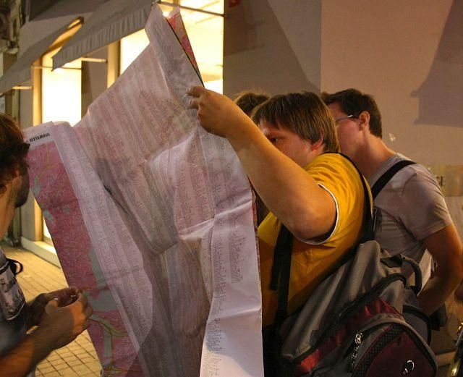
Joy
“. . .Making use of the little time we had in Bangkok (two days.) It was a big deal when we were not able to find a temple we wanted to visit until we walked around for 30 minutes and asked about 4 different people for directions. Then we had less time to explore other sites.”

Slide 12
Results: Tensions, Contradictions, and Surprises
Notes:
There is a connection between tourists and locals
Delayed trip plans and bad customer service caused tension
Being immersed in foreign culture can make simple things, such as checking bus schedules, difficult and scary
The couple seemed to schedule their trip meticulously but mentioned that excessive planning “feels like a job and not a vacation”.
Tourists want to know a place intimately in a short amount of time
The couple displayed both attentiveness (planning) and carelessness (hotel booking).

Slide 13
Analysis
Notes:
The issue of time constraints came up in every interview
It’s very easy to remember a trip by the bad experiences
Technology Gap: While ride-sharing is seemingly ubiquitous among young people, older people are less willing to adopt it.
Knowing the ‘book version’ of the history and culture of a place can help travellers situate themselves in their environment
It’s easy to visit a location without ever truly having to interact or engage with the location and its residents

Slide 14
Empathy Map: Say (1)
“Trips to a new location where we explore new things are more worthwhile versus trips purely for relaxation, but sometimes, the planning makes it feel like less of a vacation and more of a job”
“When I went the the Pearl Harbor Museum, I sat around and read everything, like every single word, that was on the walls to fill in what was missing in the audio tour”
Notes:
“If we see something that wasn’t planned on our trip, we will check it out if we have time”.
“Even though we understand that it was our fault the flight was missed, the “don’t care” attitude of the airline representatives was frustrating”
“We didn’t look closely enough at the email confirmation for the booking”
“Perhaps a phone confirmation after booking something online would be nice”
“Trips to a new location where we explore new things are more worthwhile versus trips purely for relaxation, but sometimes, the planning makes it feel like less of a vacation and more of a job”
“We didn't look into bus times prior to getting to the bus station, due to our assumption (and some reassuring words from locals) that the buses ran at all hours.”
“When I went the the Pearl Harbor Museum, I sat around and read everything, like every single word, that was on the walls to fill in what was missing in the audio tour”

Slide 15
Empathy Map: Say (2)
“Major difficulties on this trip was making use of the little time we had in Bangkok (two days). It was a big deal when we were not able to find a temple we wanted to visit until we walked around for 30 minutes and asked about 4 different people for directions. Then we had less time to explore other sites.”
Notes:
“Most people are like ‘Oh I’ve heard Stanford is nice, we should go visit’’”
“The most frequently asked questions are about Stanford’s size. People want to know about the history and stuff too, but the first question is always, how big is Stanford?”
“The most important part of the tour is definitely the personal stories. My Obama story is always a hit, but people want to know about everyday life at Stanford”
“Major difficulties on this trip was making use of the little time we had in Bangkok (two days). It was a big deal when we were not able to find a temple we wanted to visit until we walked around for 30 minutes and asked about 4 different people for directions. Then we had less time to explore other sites.”

Slide 16
Empathy Map: Do
Couple was uneasy when telling airline story, laughing when telling hotel story
Visibly flustered as she recounts the story
Notes:
Couple was uneasy when telling airline story
Last story was told in a rushed manner
Laughing when telling story (good customer service experience)
Stern “no” when asked if couple used ride-sharing services.
Visible flustered as she recounts the story
Spoke more animatedly (more hand and head movements) about Stanford traditions/quirky facts that were integral to his own experience
Audible frustration

Slide 17
Empathy Map: Think
Customer service plays a large factor in the enjoyment of a trip
Tourists visit places because they’ve been told to or they feel that they’re supposed to rather than out of pure curiosity
There’s always something missed by a guided tour and it’s up to the traveller to fill in the blanks for himself
Notes:
Distrust of ride-sharing services (Uber)
Some travel is almost purely for the kids’ benefit
Believes in a somewhat strict schedule during travel
Email confirmation after booking is not enough and often misread
Customer service plays a large factor in the enjoyment of a trip
Transportation in foreign places is scary because there is no sense or understanding of scale and being grounded in where you’re currently located
Tourists visit places because they’ve been told to or they feel that they’re supposed to rather than out of pure curiosity
Tourists want to understand the scale and scope of the space they are in to better orient themselves
Tourists use guides to get a feel for everyday life at a high level with little vulnerability on their ends
There’s always something missed by a guided tour and it’s up to the traveller to fill in the blanks for himself
Does not enjoy wasting time on seemingly simple tasks

Slide 18
Empathy Map: Feel
Much more trusting of in-person advice versus online resources
People want to get to know the idea of a place rather than actually getting to know a place.
Notes:
Bad customer service made the couple feel frustrated and helpless.
Good customer service turns a bad situation into a funny one.
Much more trusting of in-person advice versus online resources
GPS has simplified travel, made couple feel more in control and less likely to get lost.
No sense of orientation left individual feeling lost even though she hadn’t moved
People want to get to know the idea of a place rather than actually getting to know a place.
Frustration when restricted from doing simple things

Slide 19

Needs
- Discover: Where am I? Who am I in relation to where I am?
- Commute: How do I get around?
- Explore: What should I do here?
- Prepare: How much should I plan?

Slide 20

Insights
Balance
Familiarity
Culture differences
Notes:
Balance between spontaneity and planning when it comes to traveling
Getting to know a place through reading/research/guided tours vs. getting to know a place through personal experience
Culture differences can give rise to many problems

Slide 21
Summary

Slide 22
It is often more difficult to understand where you are in reference to everything around you while travelling
Interactions with people can ease the challenge
Notes:
There are also a lot of tradeoffs in spending time, and having someone there to show you the ways eases that process.

