Slide 1
Home Clear
Medium-Fi Prototype

Slide 2
Bringing transparency to real-estate
Solving the key-issue of inaccessible and inaccurate information in the real-estate market by providing an intuitive service to inform a potential home buyer, rentor, or land developer

Slide 3
tasks
Verifying information on a specific home, simple
Researching different home listings, medium
As a land-developer, research lots, complex

Slide 4
Interface Changes

Slide 5
I would like to have the ability to compare one home to another with a favoriting mechanism or side by side comparison

Slide 6
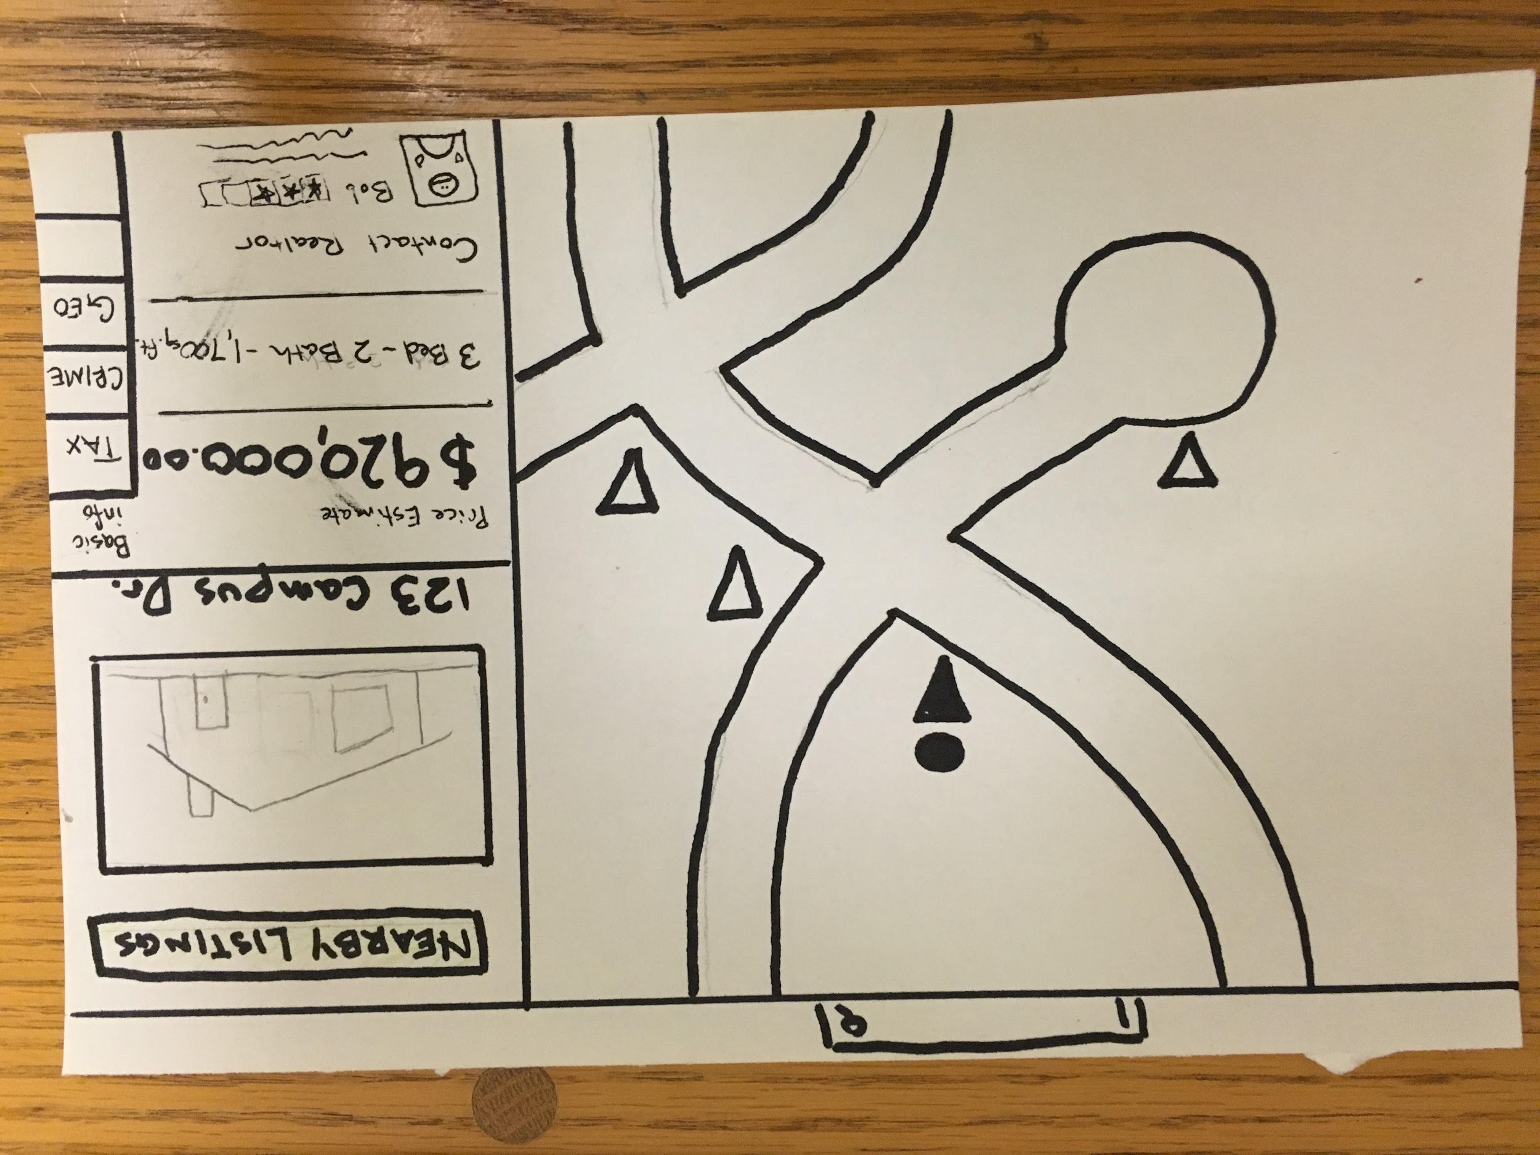
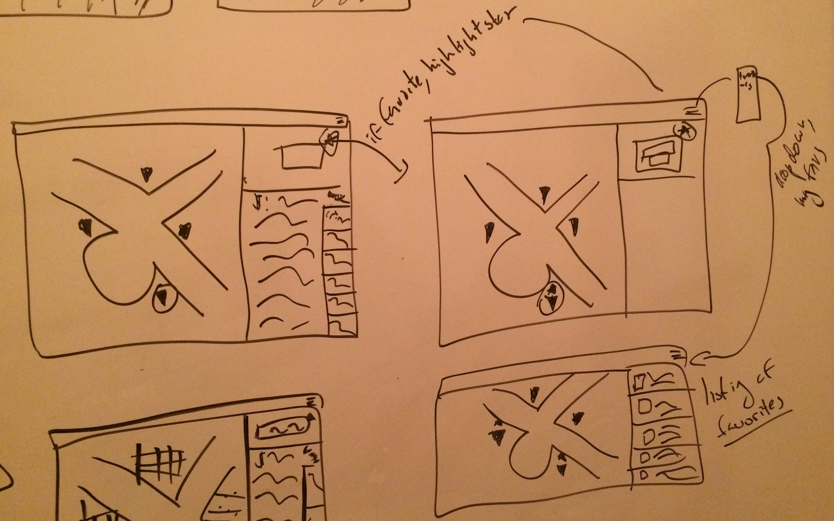
favorites
Add a star icon to detail view to be able to favorite a home.
Add drop down menu to go to listings-style view of favorites.

Slide 7
I’m not sure where the lots filters is...

Slide 8
Lots
Add extra tab to launch screen with ‘lots’.

Slide 9
How do I tell if a lot is for sale or not?

Slide 10
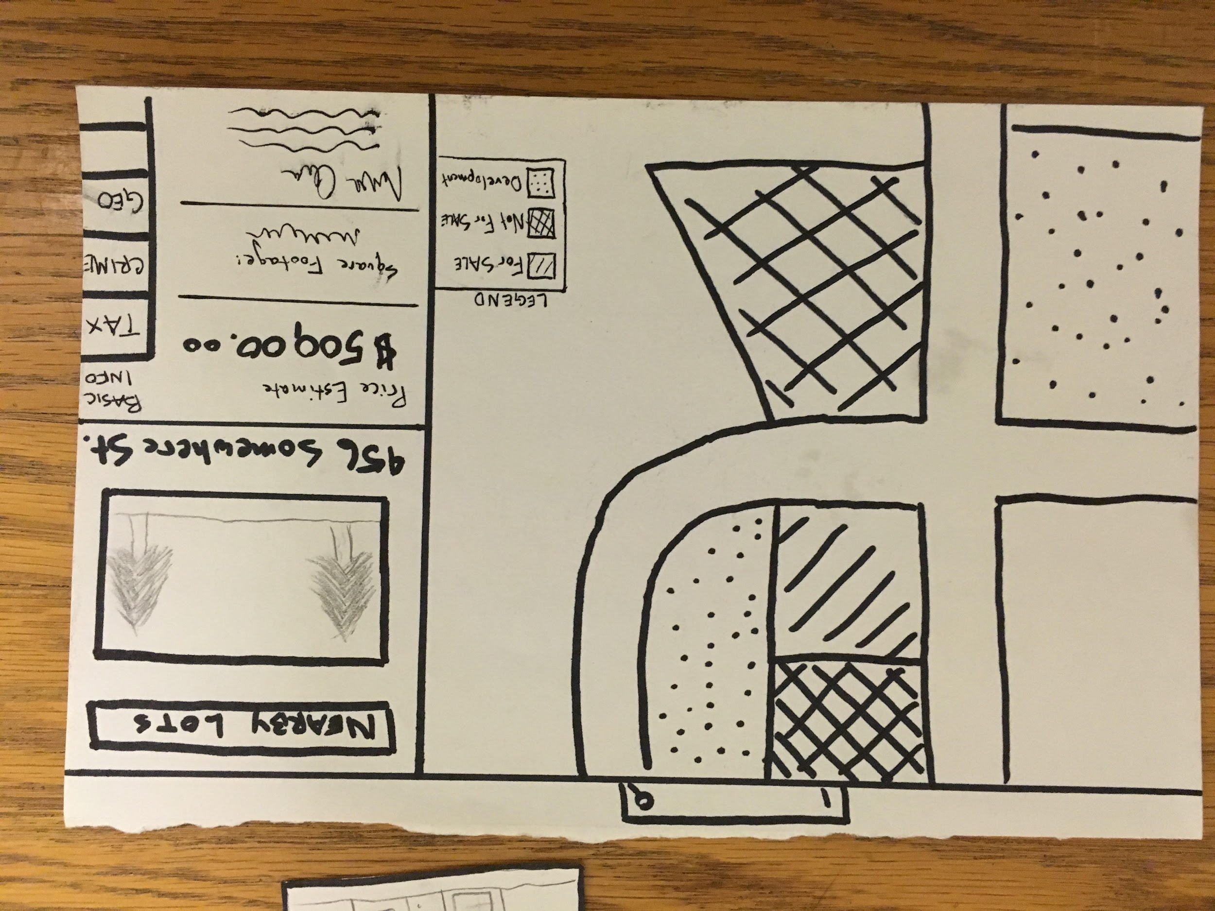
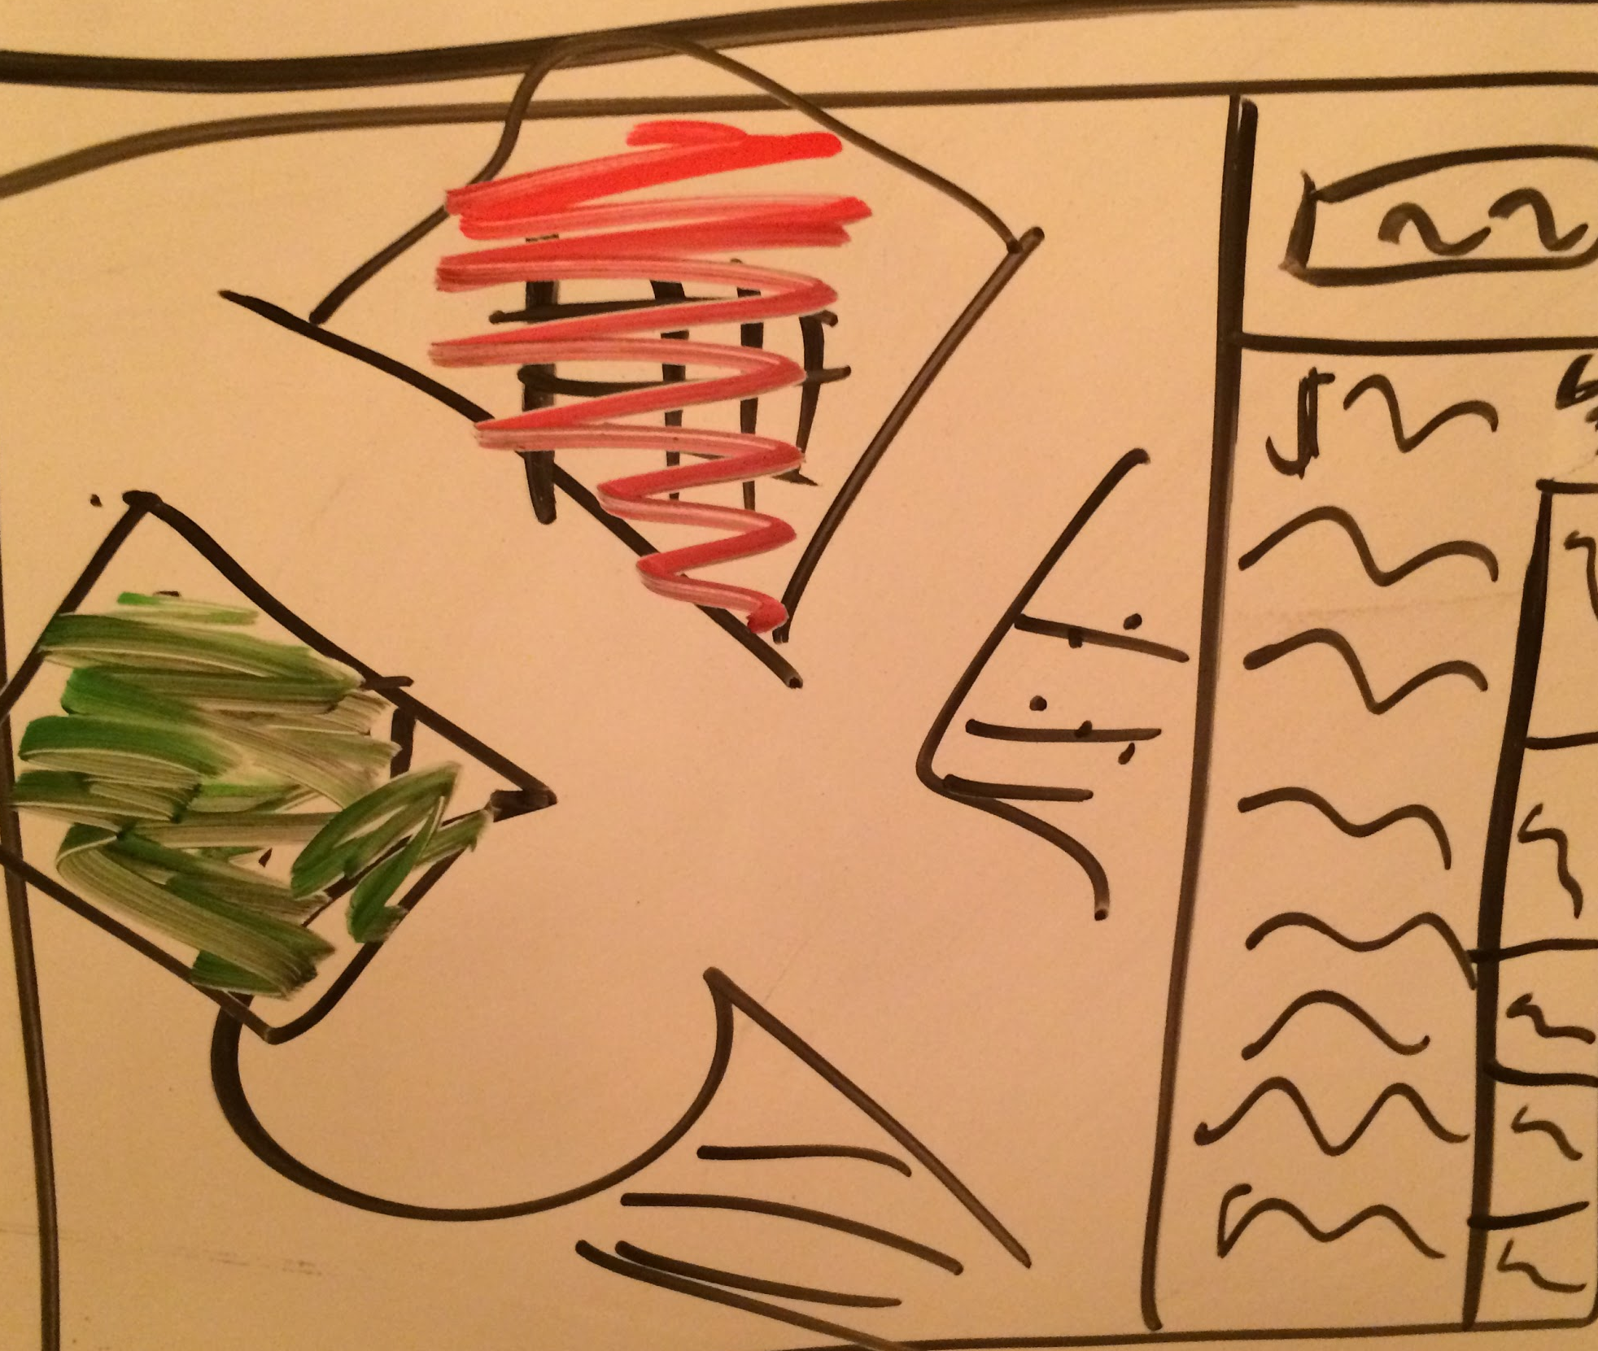
Lots - Legend
Instead of a legend, color code lots.

Slide 11
Task Flows

Slide 12
Verifying information on a specific home
simple

Slide 13
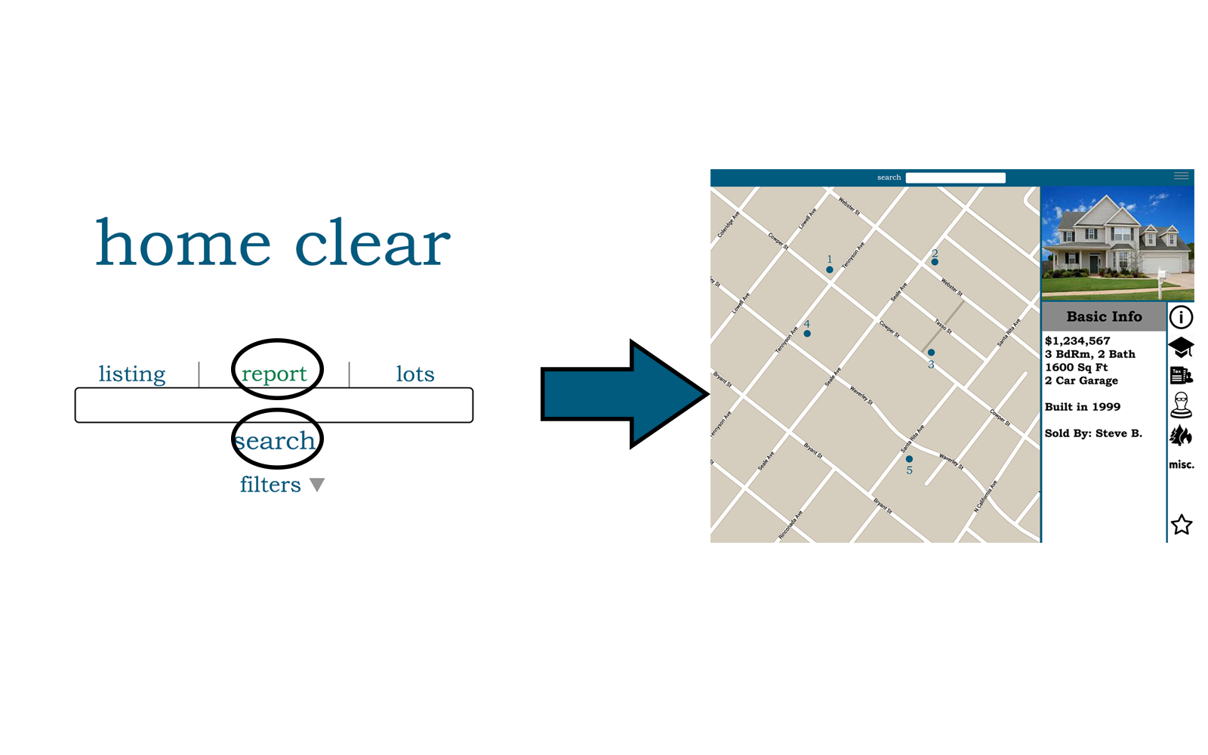
Verifying info on a specific home
redesigned launch screen
with three tabs for search selection
select report, search for address, see report

Slide 14
Researching different home listings
medium

Slide 15
Research different home listings
select listing, search for address, specifiy optional filter, see listings near address

Slide 16
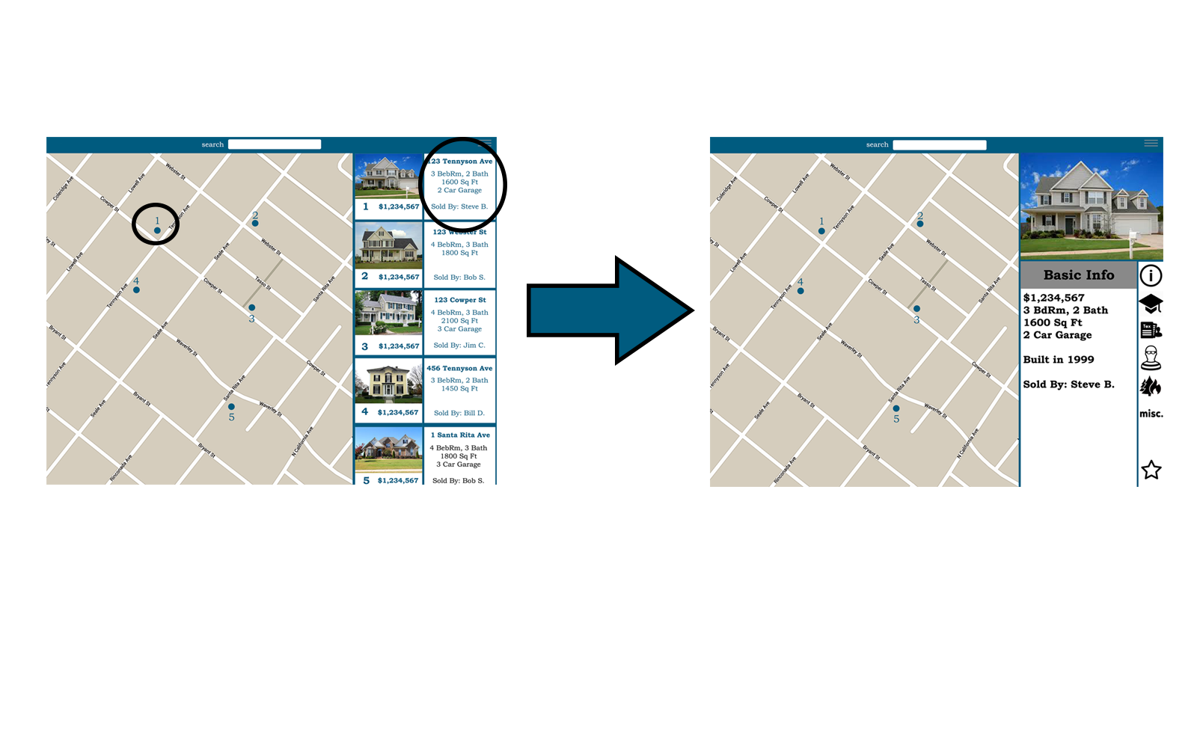
Research different home listings
from listings view, can select home on map or side pane to view detailed information

Slide 17
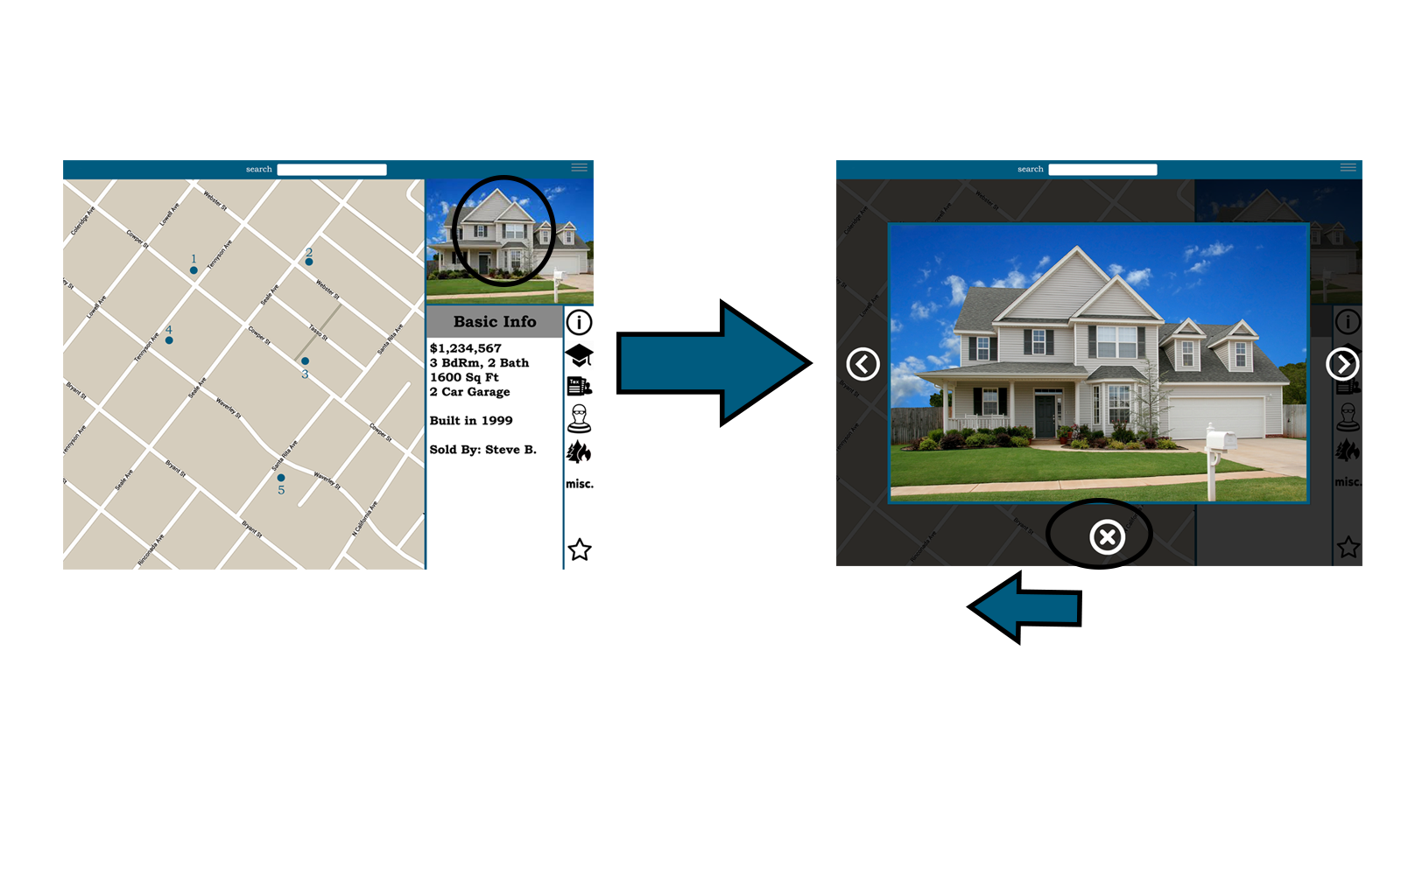
Research different home listings
from detailed view, can scroll through photo carousel by clicking on home image, click x to return to view

Slide 18
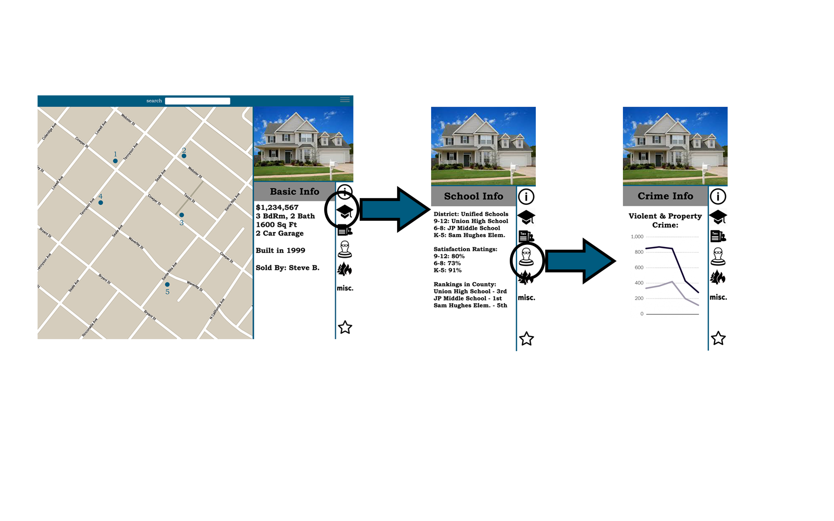
Research different home listings
from detailed view, can select different tabs to look at different information

Slide 19
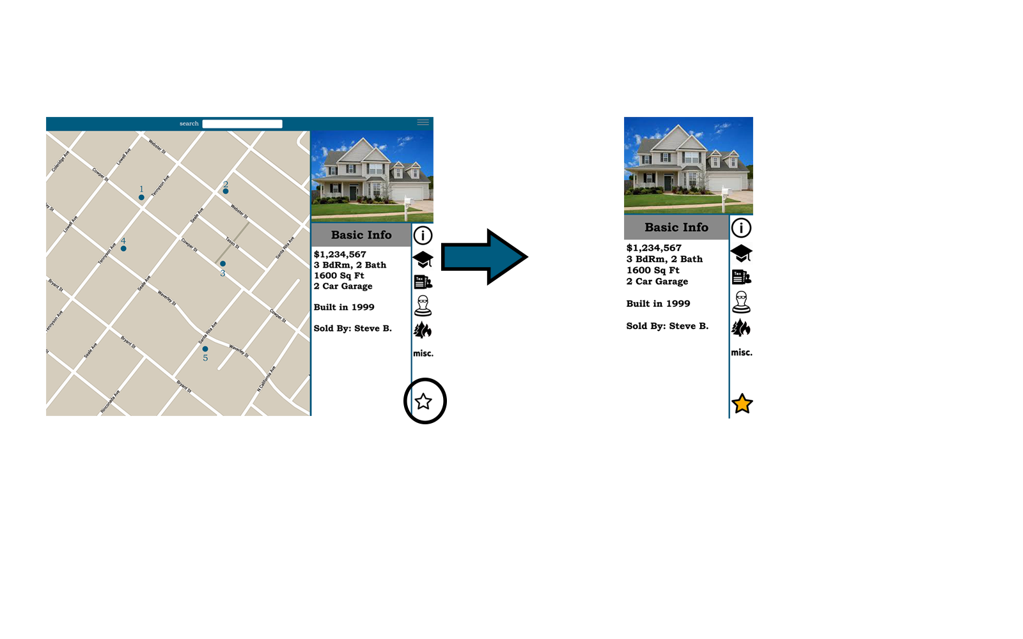
Research different home listings
from detailed view, can select the star icon to favorite the home

Slide 20
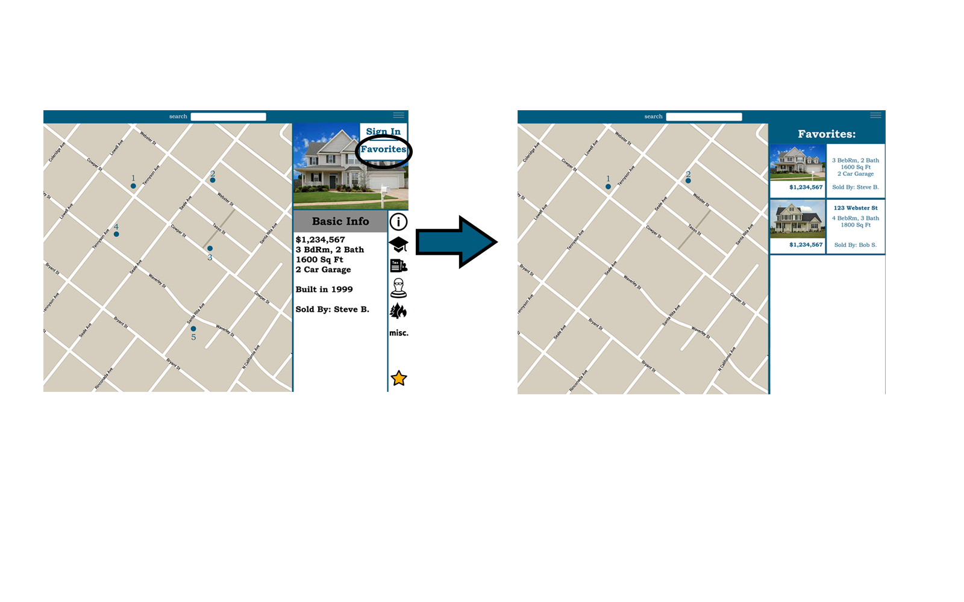
Research different home listings
from map view, can use drop down on top right to access favorites panel

Slide 21
As a land-developer, research lots
complex

Slide 22
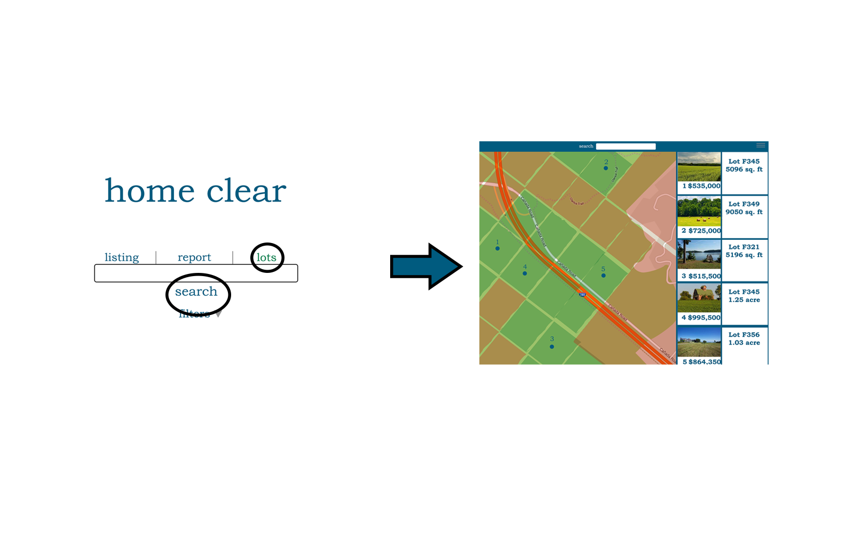
Research lots
from launch screen, select lots, search for adress, brings up map view with lot overlay and listings

Slide 23
Prototype Overview

Slide 24
Tools
PHOTOSHOP
INVISION

Slide 25
Photoshop
Benefits
Creative control
Allowed re-using of assets
Downside
No pre-made UI elements
Time consuming

Slide 26
InVision
Benefits
Fast and easy
Allows for different modes
Provides link
Downside
No good layering options

Slide 27
Limitations
Unable to input search - fabricated search results
Unable to interact with any database - fabricated tab data
Unable to sort with filters
Due to time, only fleshed out one home

Slide 28
Overall
Gives idea of how app will function
More interactive than lo-fi
Allows for more feedback

Slide 29
thanks!
ANY QUESTIONS?
https://projects.invisionapp.com/share/3J4QKFDAY#/screens

