Slide 1
HomeClear

Slide 2
Bringing Transparency to Home Buying

Slide 3
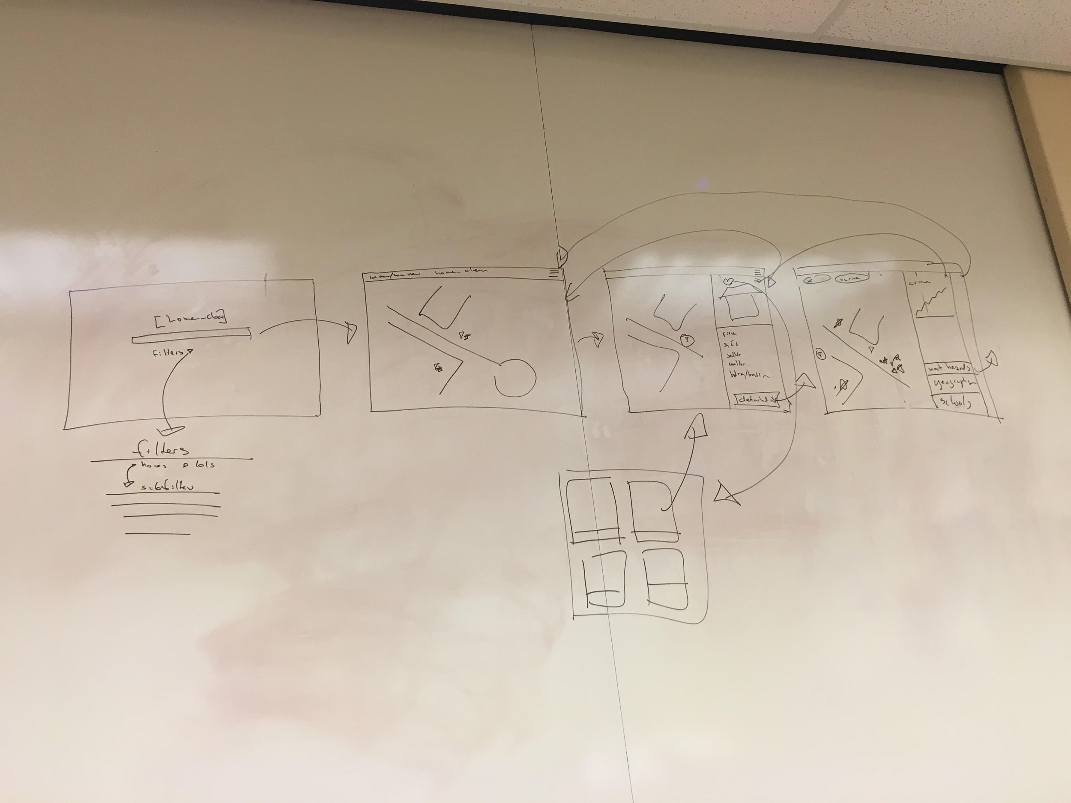
Selected Interface
Flexibility between platforms
Consistent UI
Short & intuitive taskflows

Slide 4
Low-fi Prototype

Slide 5
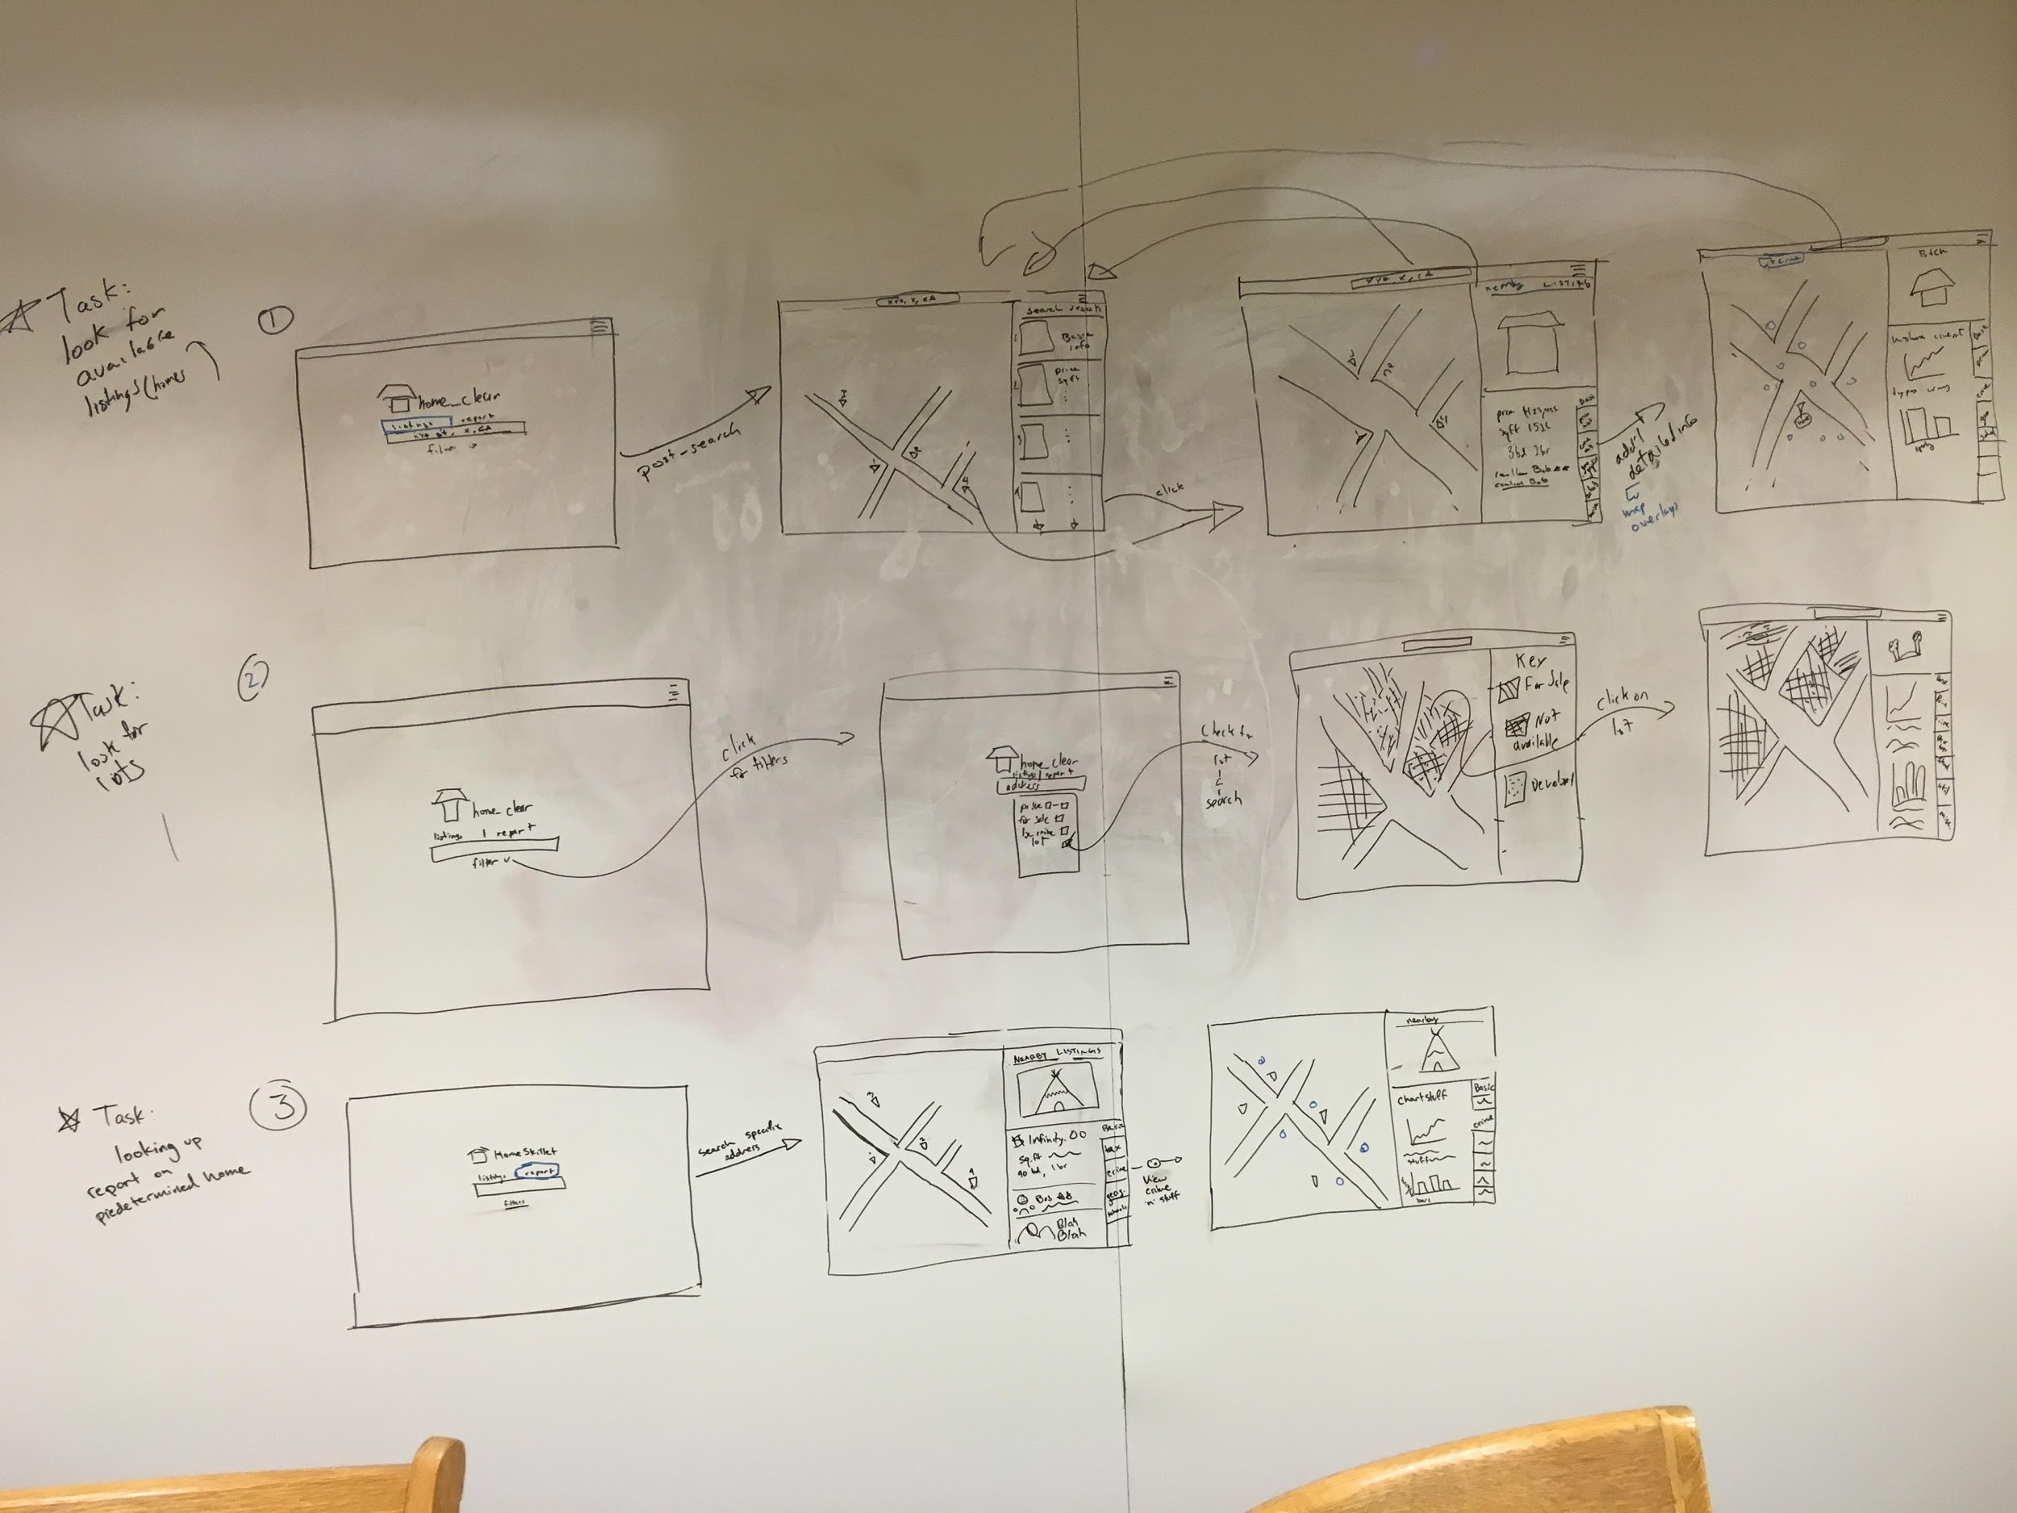
Tasks & Task Flows
Browse Listings
Research
Filter Specifics

Slide 6
Experimental Method
Sought out older individuals
Relevant experience

Slide 7
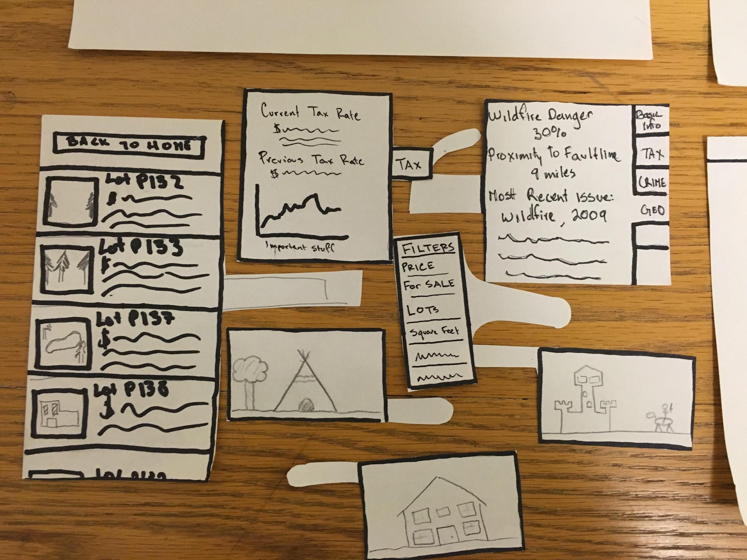
Shirdella
Handled all tasks well
Versatility to the prototype
Struggled with task #3
Unsure about certain UI elements

Slide 8
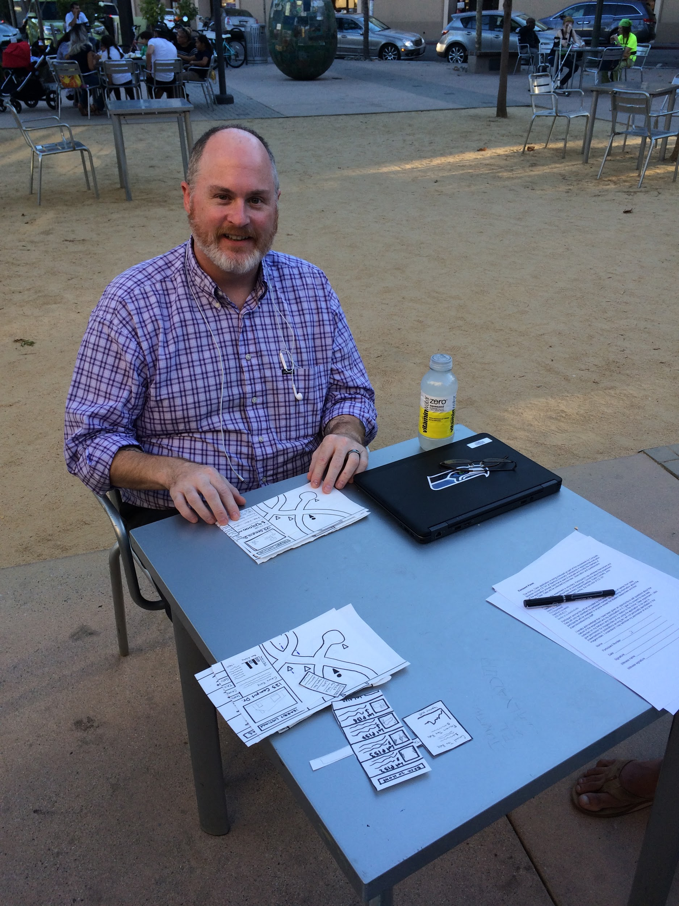
Darren
Found the interface intuitive
Suggested Tooltips
Also unsure about UI elements

Slide 9
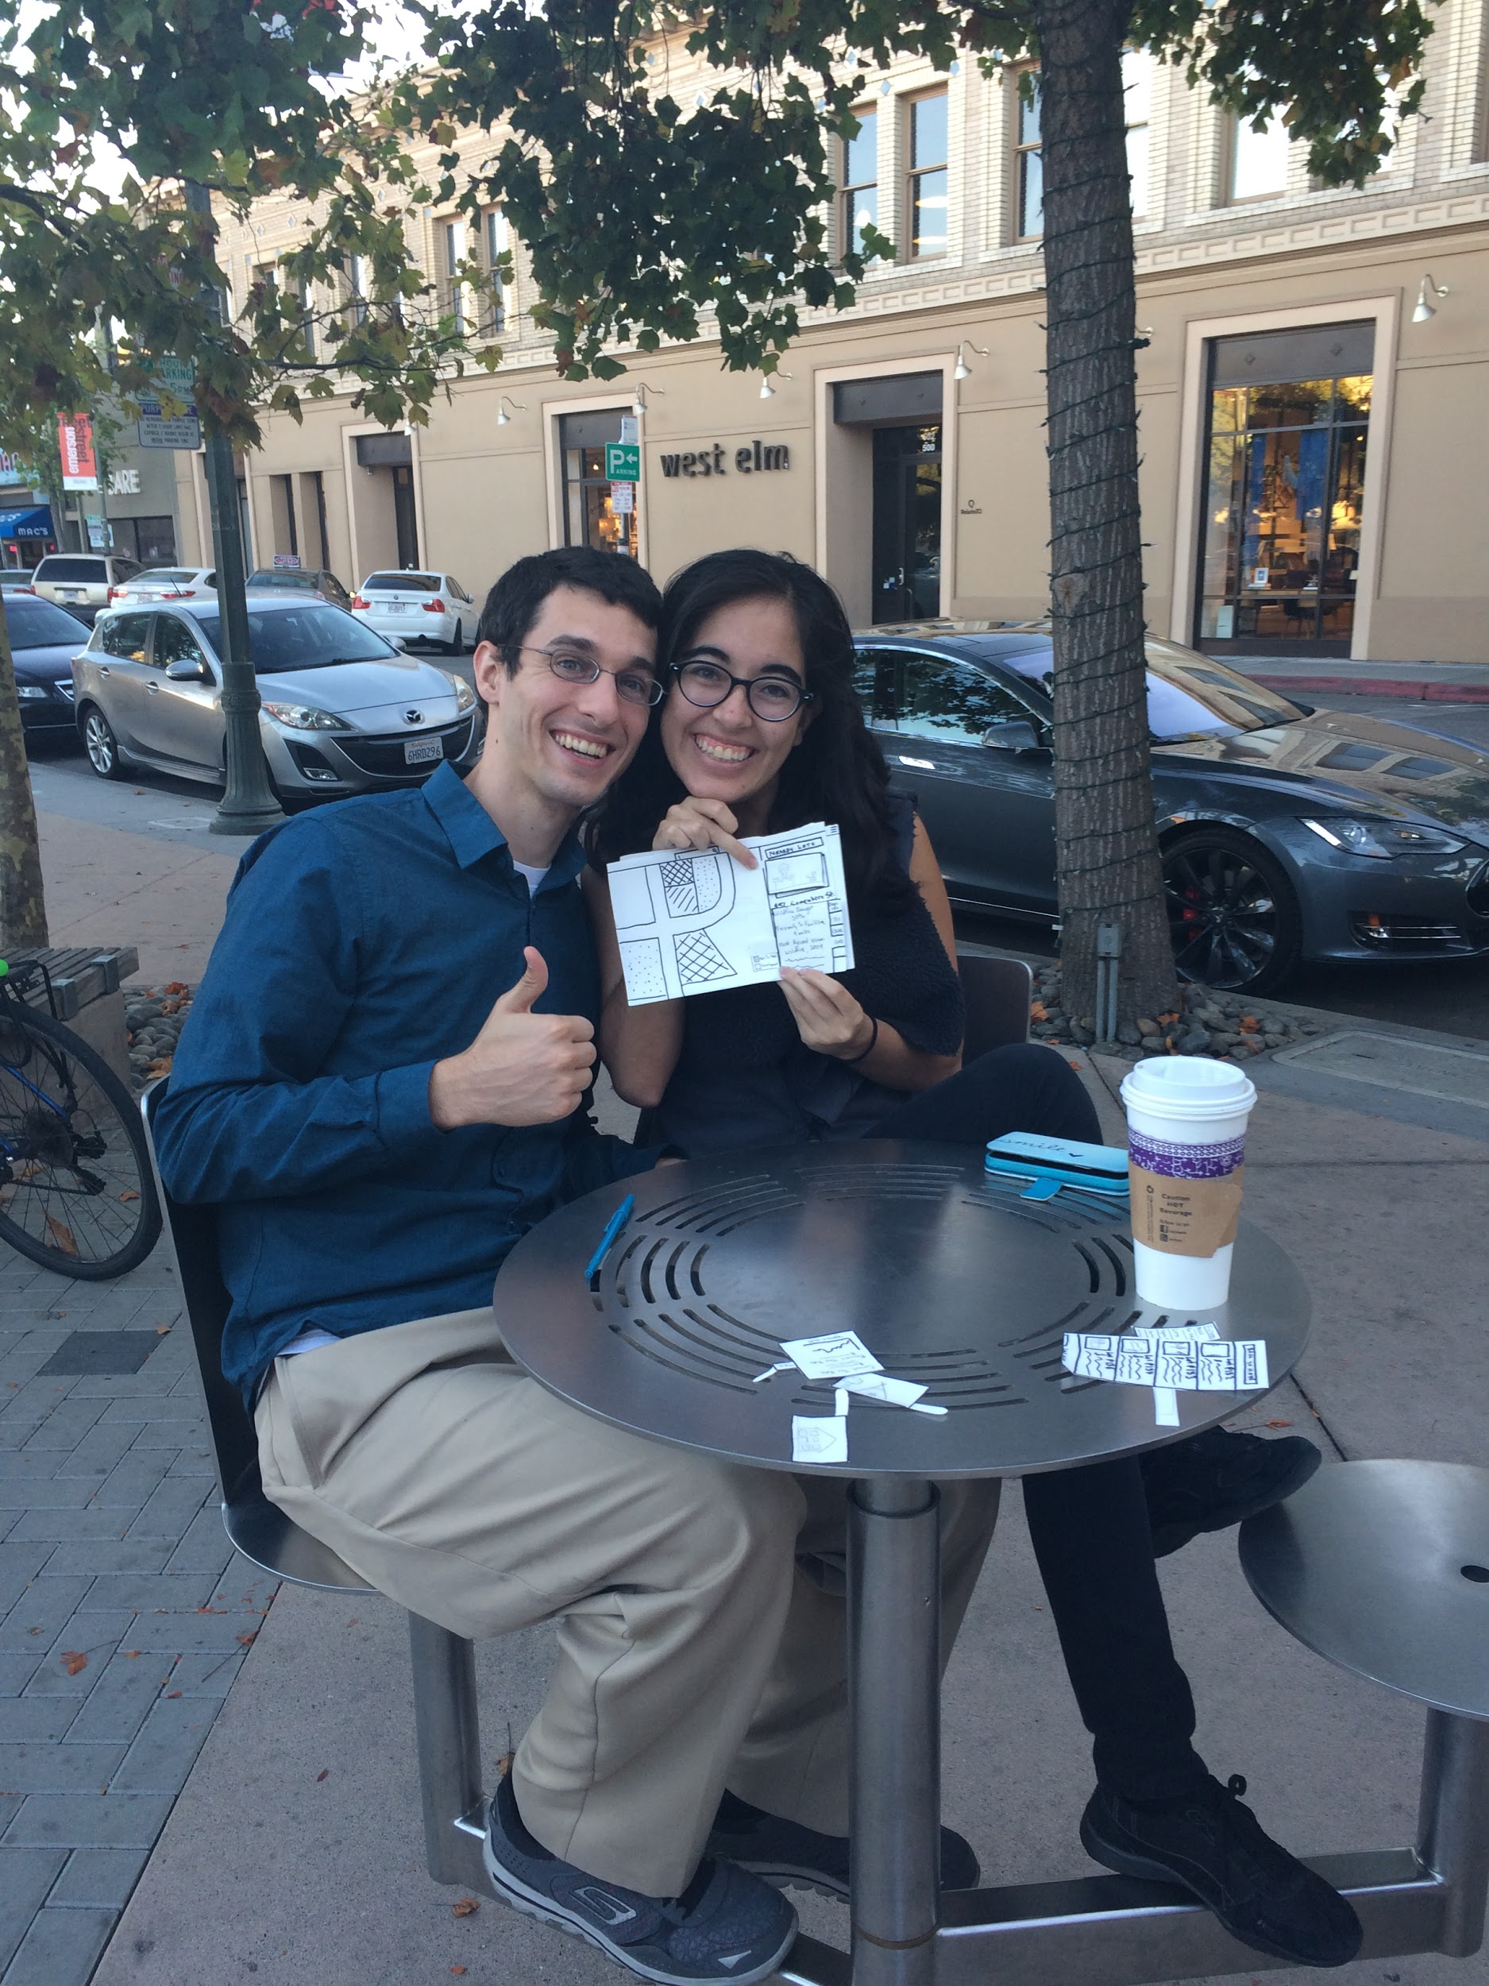
Allen & Florencia
Worked as a couple
Map overlays
More Images
Side-by-side comparisons

Slide 10
Suggested UI Changes

Slide 11
Paper Prototyping led to issues with understanding UI elements.

Slide 12
New Users
Tooltips vs. Onboarding
More Pictures
Solution: Simplicity

Slide 13
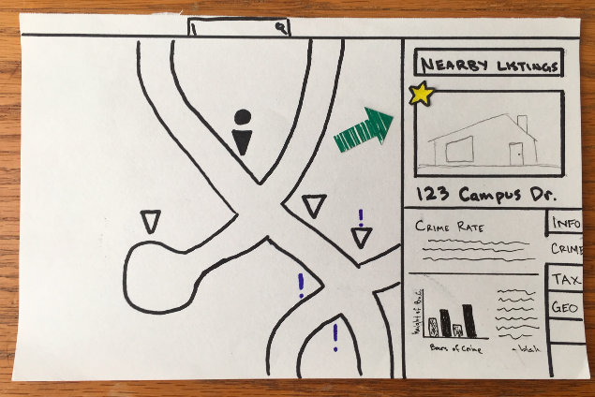
Frequent Users
Side-by-Side Comparisons
Favorite Listings

Slide 14
Thanks!
Any questions ?

