Slide 1
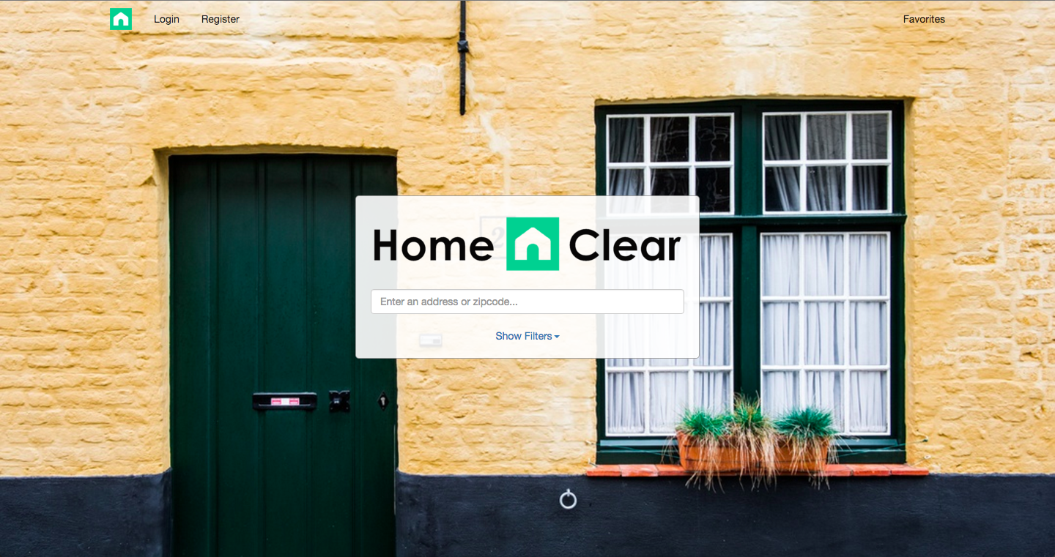
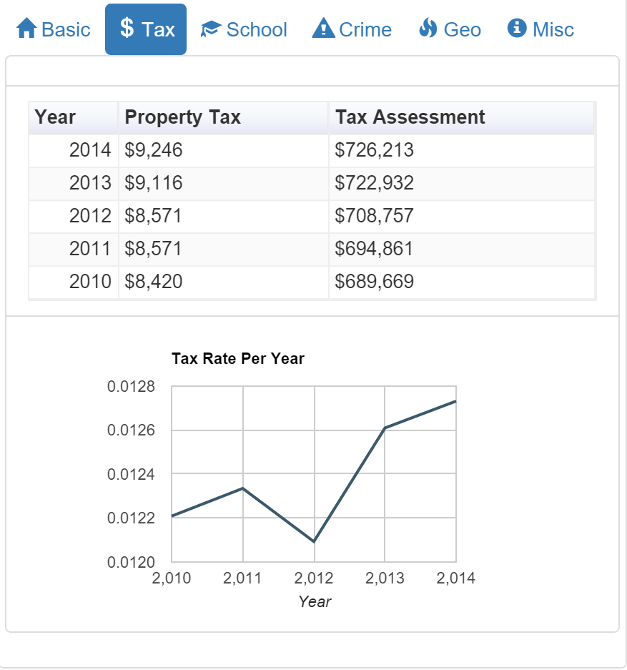
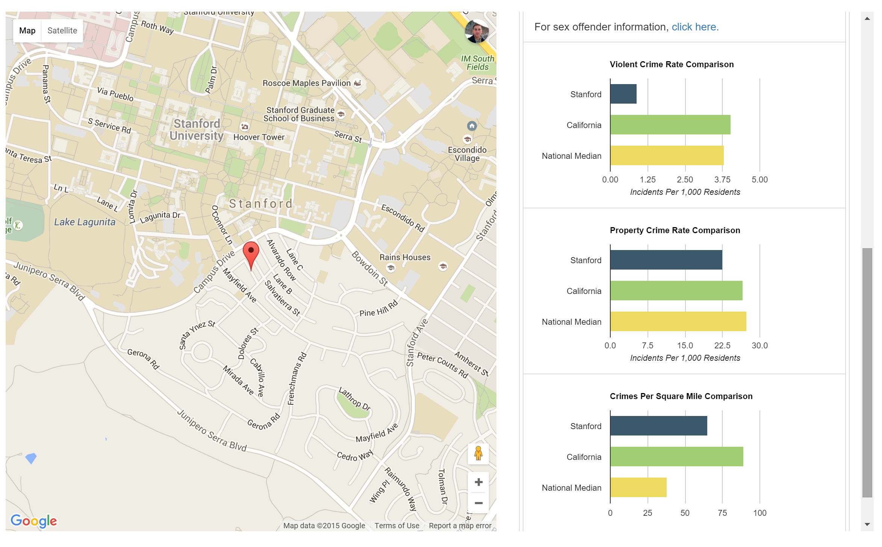
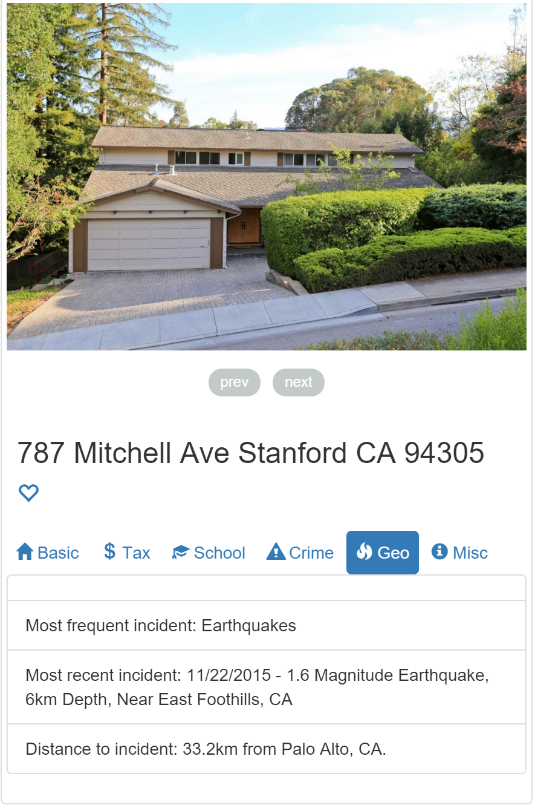
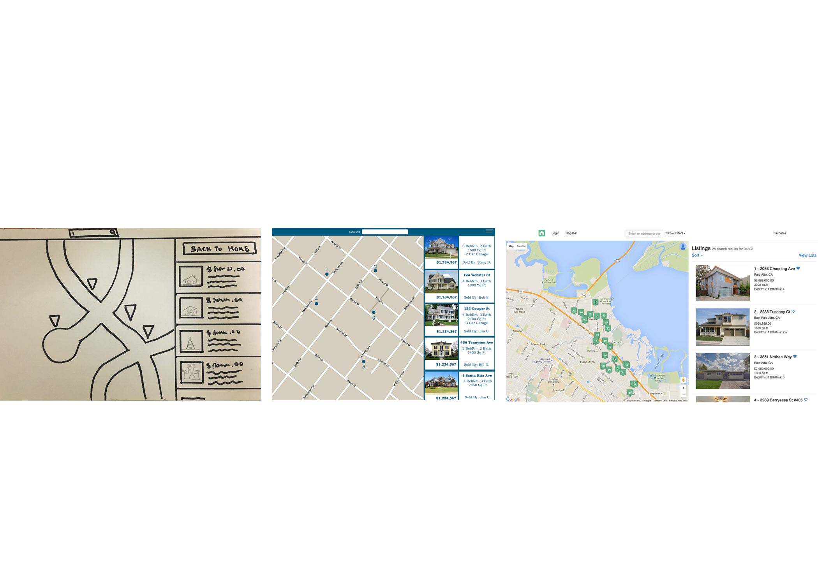
Bringing Transparency to Real Estate
Overview
We cut through the fog of misinformation by aggregating data relevant to a home and presenting it to you in a clear intuitive fashion.
Tax Information
Analyze the tax evaluation of your future home
Crime Statistics
Compare your future home with state and national crime rates
Geographic Data
See information on geographic concerns for your future home
Design Iteration of Listings View
Alexei Bastidas. Austin Connelly. John Valentine
hci.stanford.edu/courses/cs147/2015/au/projects/mobility/homeclear

