Slide 1
Further Exploration into Home-Buying and Relocation
By Alexei Bastidas, Austin Connelly, and John Valentine

Slide 2
Going In
Pride/excitement about first home purchase.
Relocating unnecessarily stressful/complicated.
Lack of transparency -- nature of business?
Drawn out process.
Modern web tools not trustworthy. Word of mouth/open houses/ads most successful.

Slide 3
Delving Deeper
Wandered the streets of downtown Palo Alto.
Wanted to focus in on two distinct areas - finding/buying the house, and the actual process of physically relocating.
Added new questions to our list about things such as commute, experience helping friends/family move, etc.

Slide 4
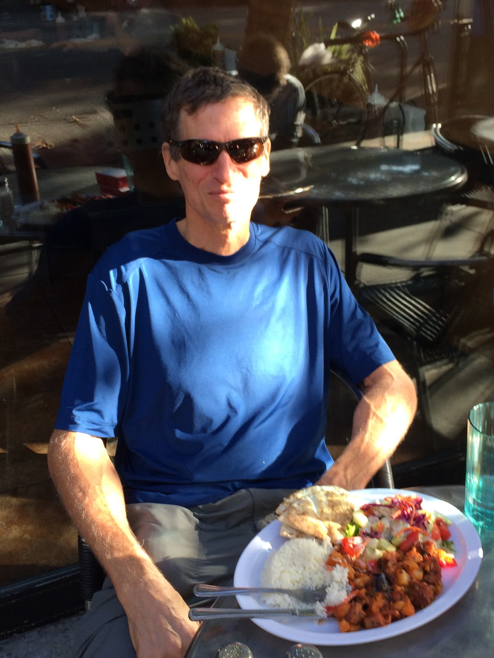
Lane Wilson
Former Stanford Graduate Student now working in Maryland.
Has bought and sold property both for the sake of moving and for property’s own sake.
His girlfriend is a realtor, so he has both the outside and the inside scoop.
Notes:
Tell story of interview.

Slide 5
Insights from Lane
Hates losing track of his stuff in the process of moving.
Thinks he has too much unnecessary stuff that he takes with him.
Believes realtors in general have no idea what they are talking about.
Can be as far as 10% off on price estimates.
Was visiting a home that has “basically a dump in the backyard, and they didn’t say a thing”
Believes realtor was simply unaware, not dishonest.
His girlfriend is a realtor.
Thinks market is made inefficient due to sellers withholding information.
Managed to get good deal on land in Maryland by doing research.

Slide 6
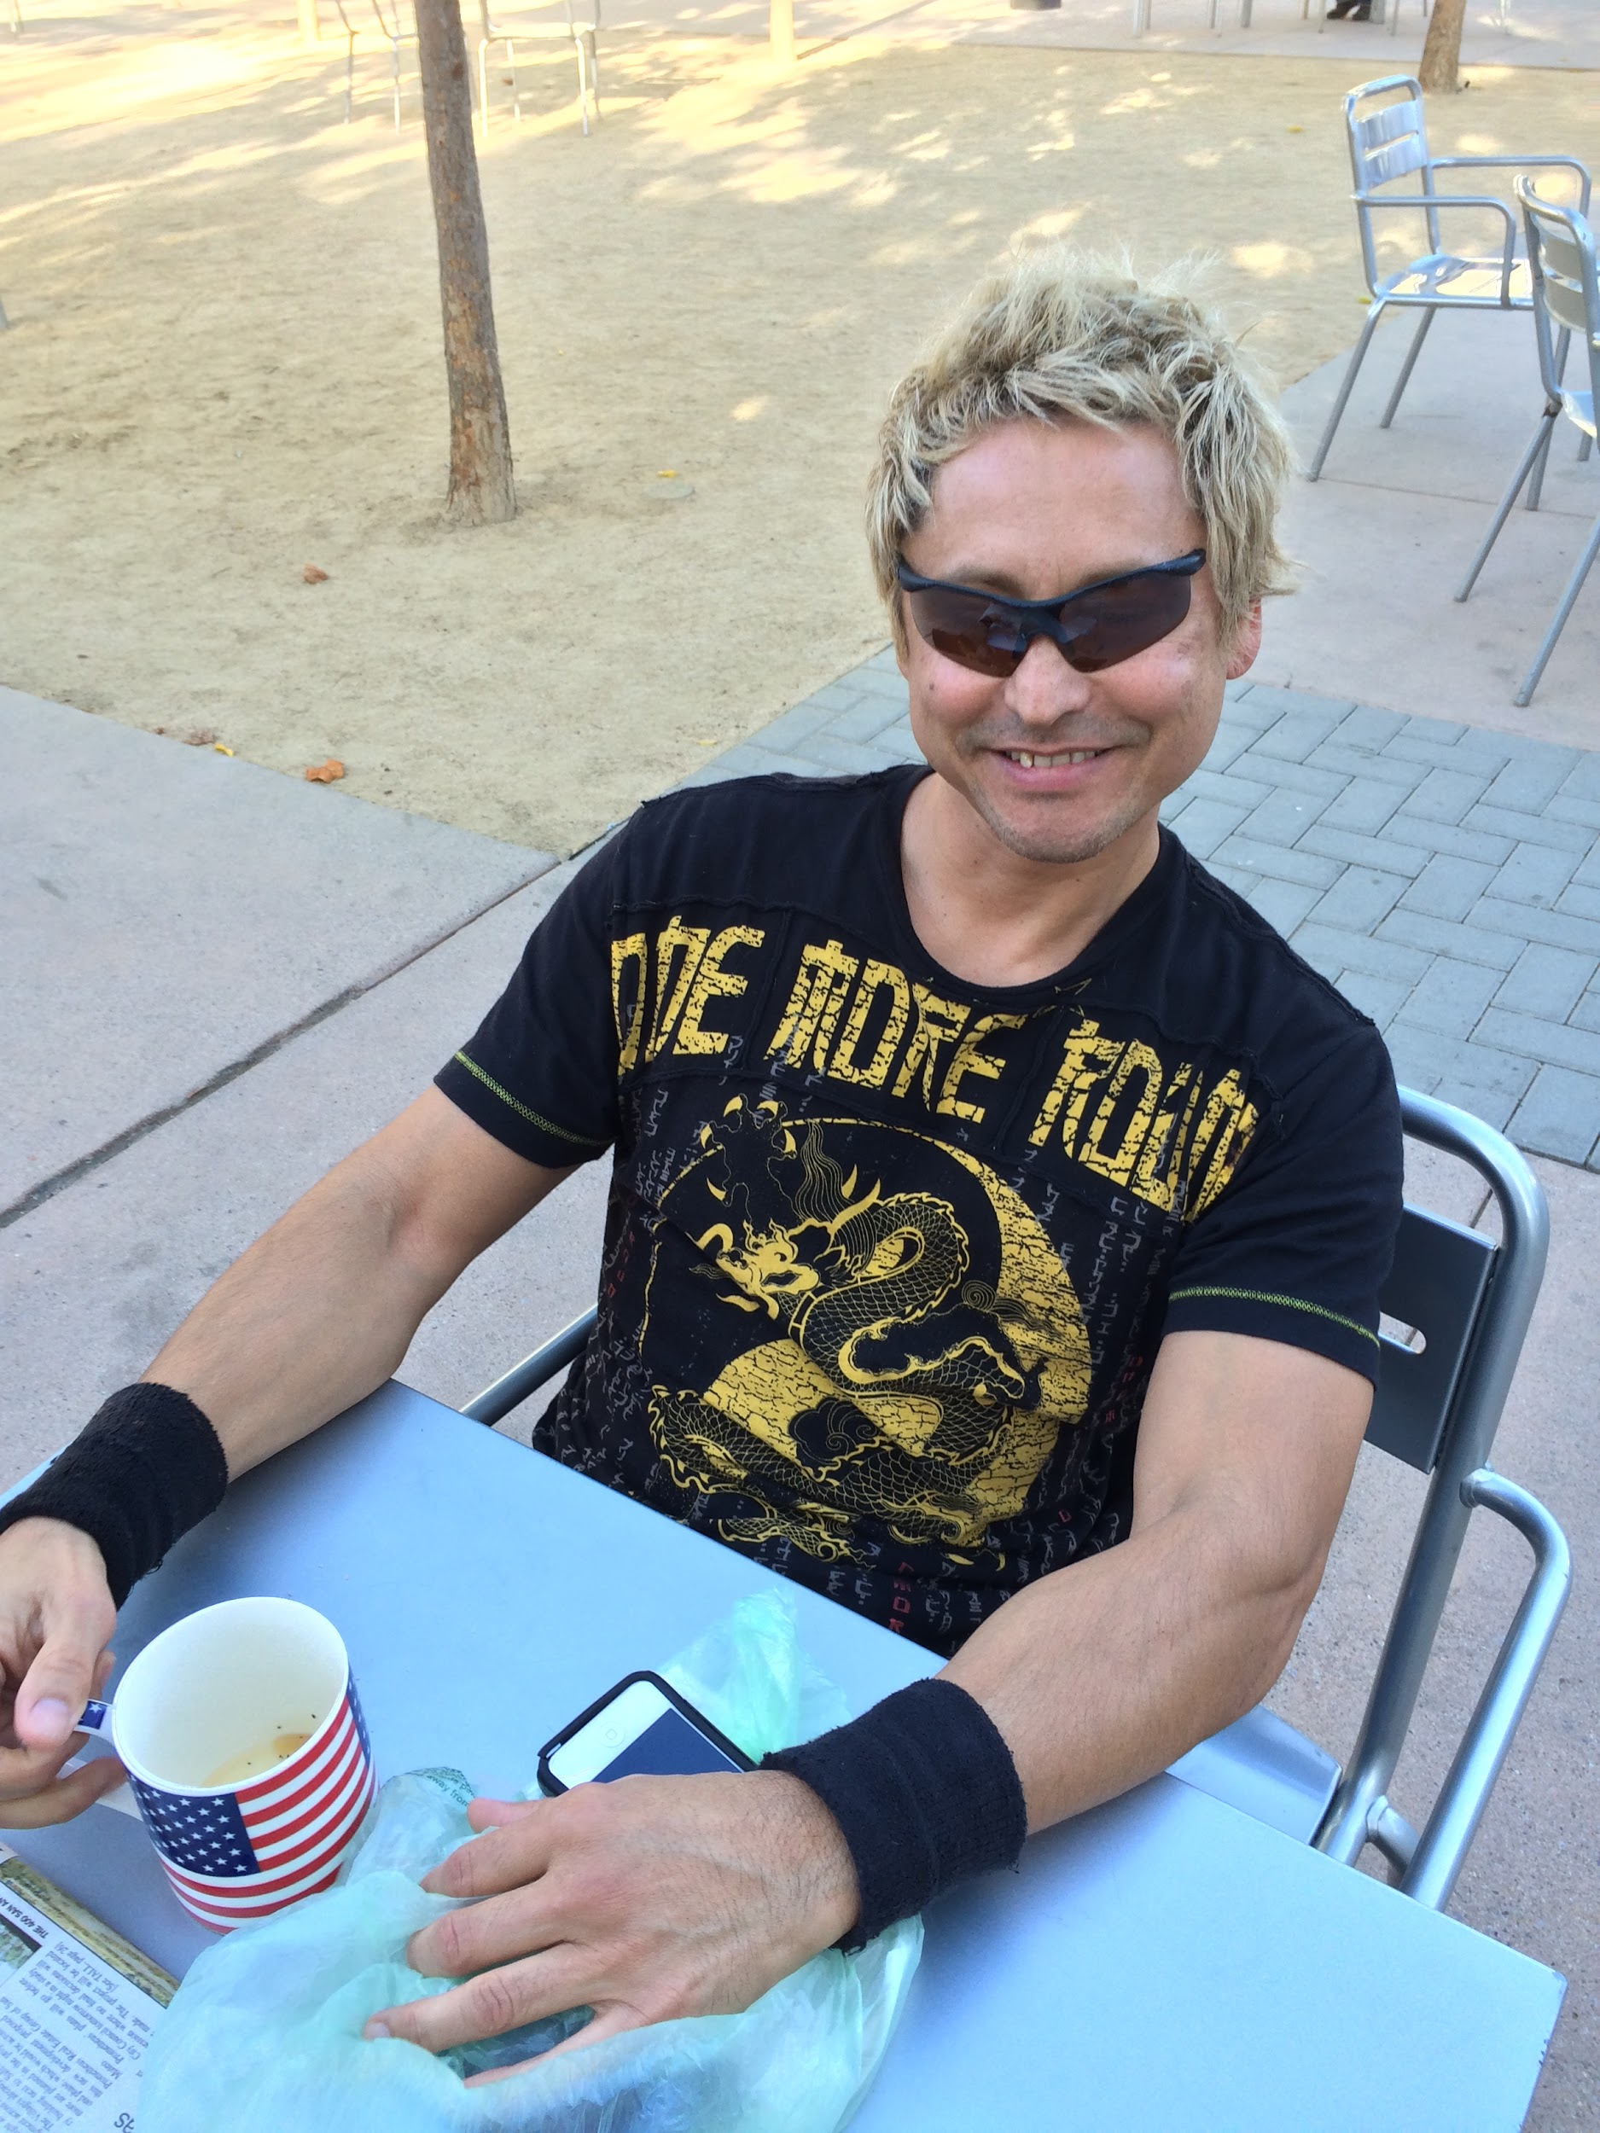
Jay P.
Former business owner in downtown Palo Alto.
Originally from Paris.
Lost home and business in a bad breakup 5 years ago.
Loss of home ruined his credit.
Struggled very much finding housing (but he’s doing fine now!).

Slide 7
Insights from Jay
Housing and rent prices have skyrocketed in the last few years.
Due to bad credit it took a very long time to find a place to live.
Ended up with an apartment in Mountain View that he was lucky to get for an incredibly good price.
Is nervous to report regular wear & tear of his apartment for fear of his rent going up.
It happened once in the past, now he fixes things himself.
After losing his home he put all his things in storage, most are still there.

Slide 8
Revised PoVs
We met David Serpa and Lane Wilson, who need an easier way to get accurate information about for-sale properties so buyers can educate themselves without being misled. It would be game changing if there was a site that made all information available to realtors available to the public.
We met Lane Wilson, who needs to keep track of his random junk while moving so it doesn’t get lost. It would be game changing if we could find a way to organize and catalogue his belongings during a move.

Slide 9
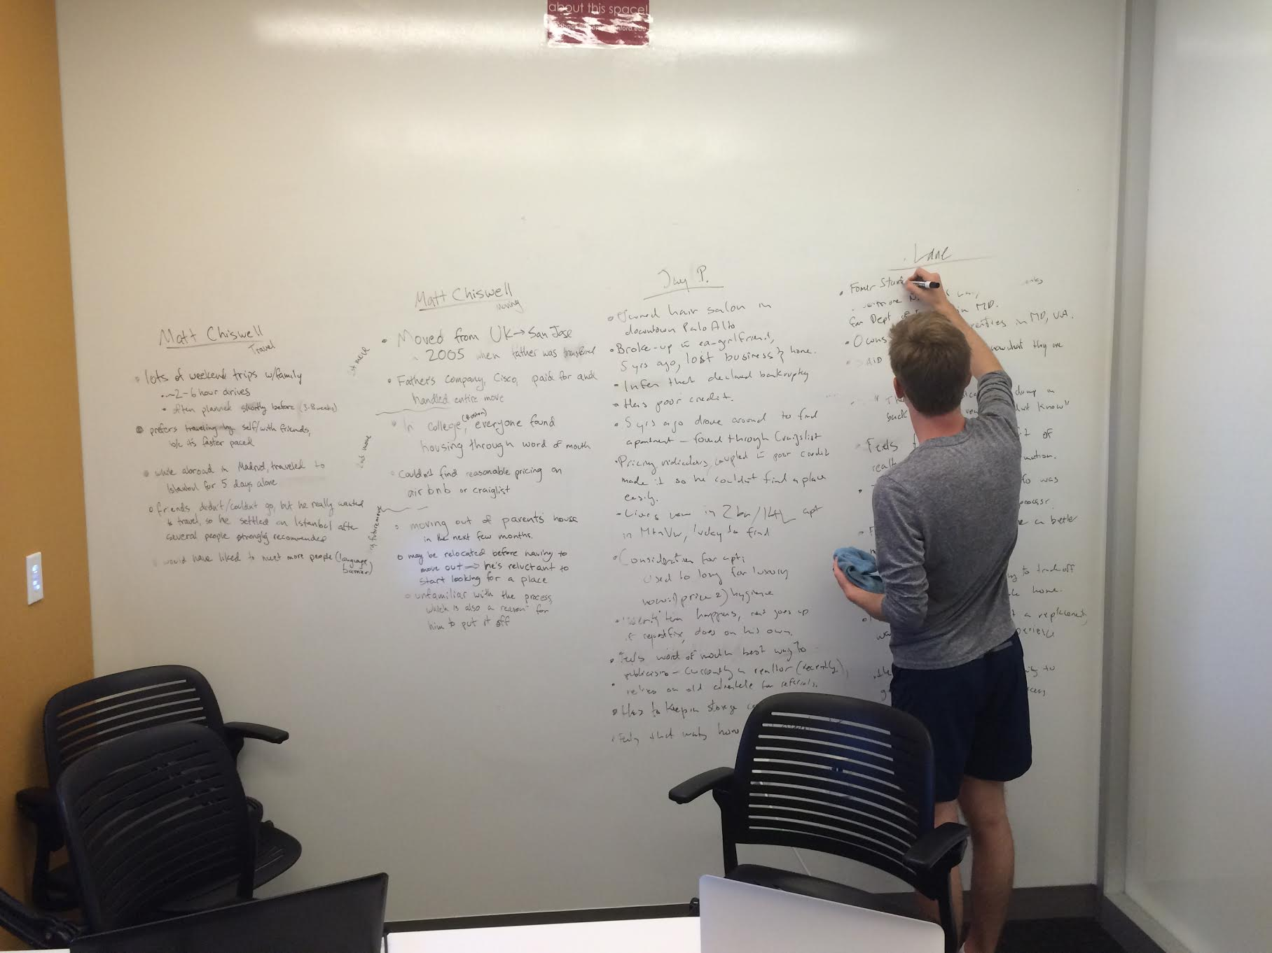
Brainstorming

Slide 10
How might we...
Streamline the process of categorizing and cataloging your stuff.
Stemmed from the PoV we got from Lane regarding losing things during the moving process.

Slide 11
How might we...
Put together all the government/realtor/seller information into a readily accessible/interactive tool.
Stemmed from the PoV we got from David and Lane, regarding how difficult it can be to find accurate information with or without the help of a realtor.

Slide 12
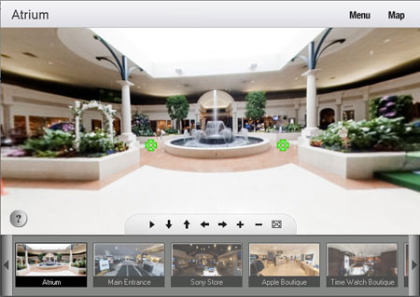
How might we...
Create an interactive experience that is better than a slideshow.
From the PoV we got from Lane about how most “virtual tours” are really just a slideshow of photos and seem insufficient to get a feel for a house.

Slide 13
Testing

Slide 14
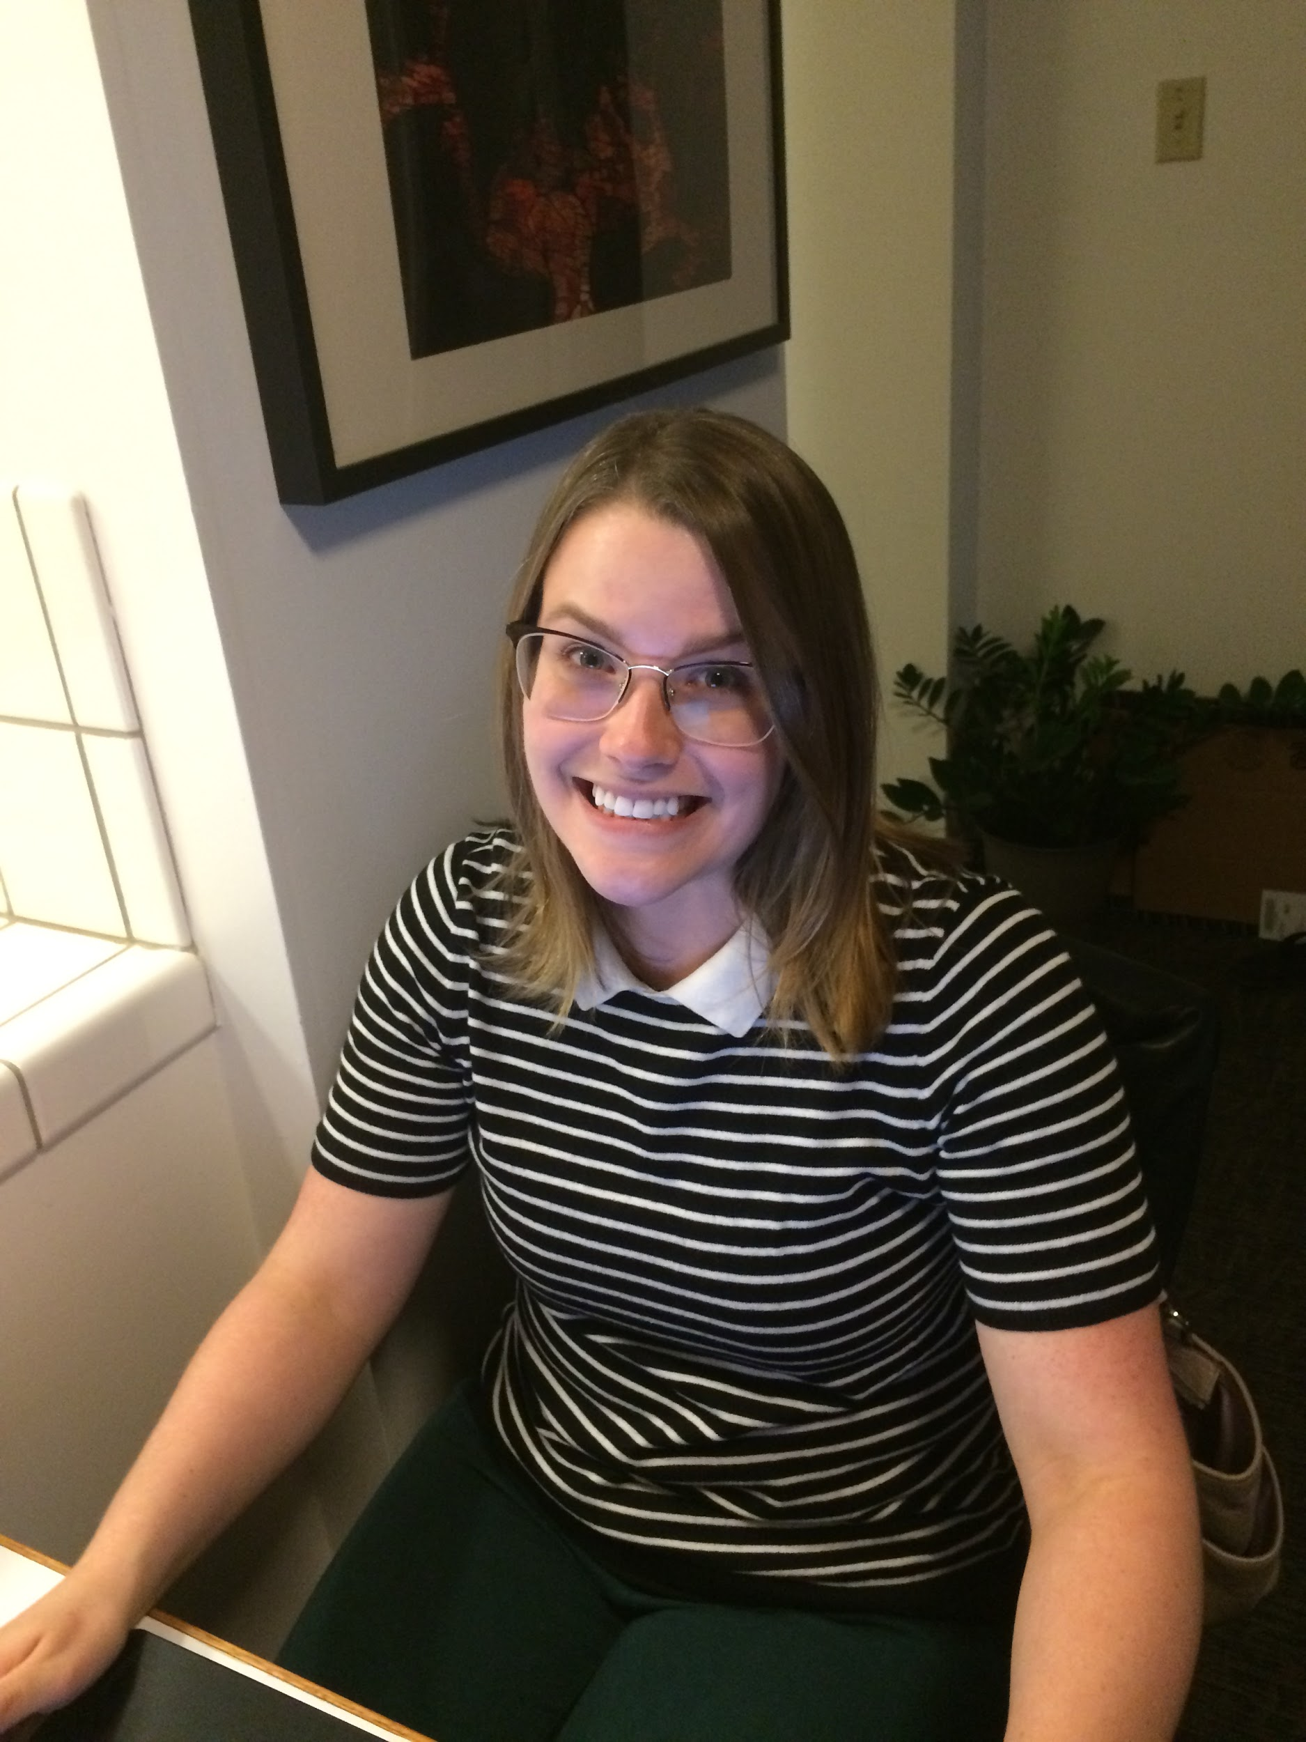
The Subject
Emily Christensen.
Accountant working in San Jose.
Recently moved from Orange County.

Slide 15
Prototype 1
Sketched out mock-up of mobile app.
Designed to be used while packing to catalog what item goes in which box.
Information to be entered through voice activation.
Tested by having our tester go through the motions of packing a box, and using her voice to interact with the app.

Slide 16
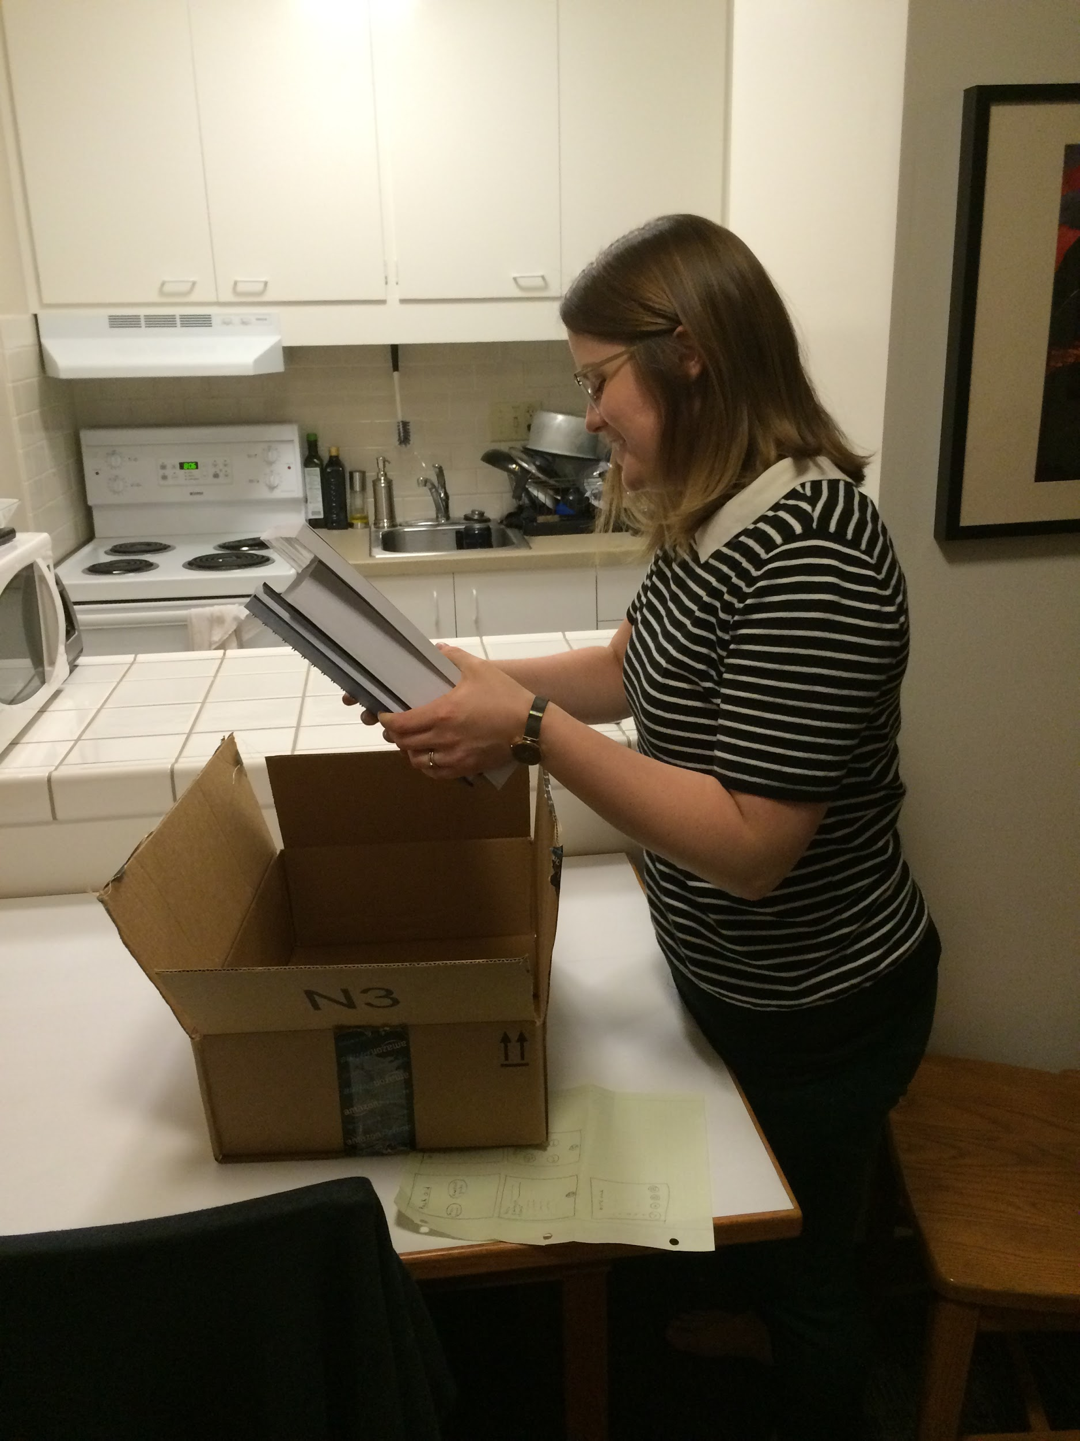
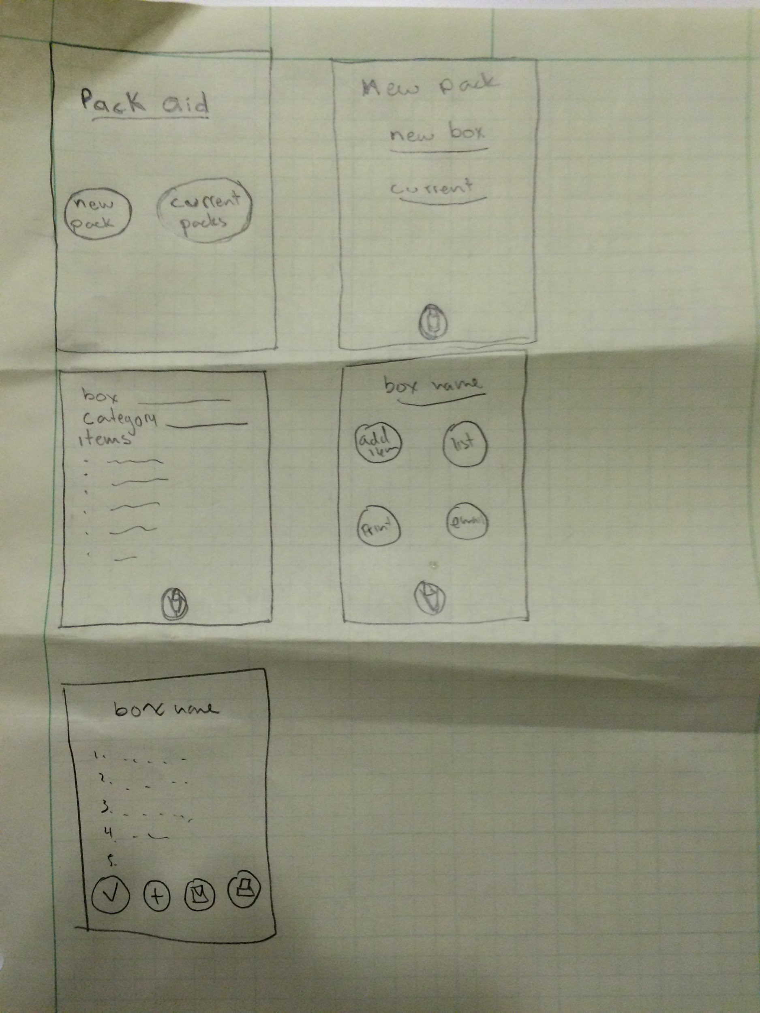
Images

Slide 17
Takeaways
Things that worked:
Interface felt intuitive.
Voice control.
Things that didn’t:
Unclear commands.
Surprises:
How much easier the voice control makes use.
New Learnings:
We possibly need a way to explain which vocal commands to use.

Slide 18
Prototype 2
Digital mock-up of a web-based interactive floorplan.
Designed to be used to get a feel for the layout of the house and test furniture configurations.
Also useful for viewing photos with the knowledge of where in the house each photo is.
Tested by having user move through the image as if it were a website.

Slide 19
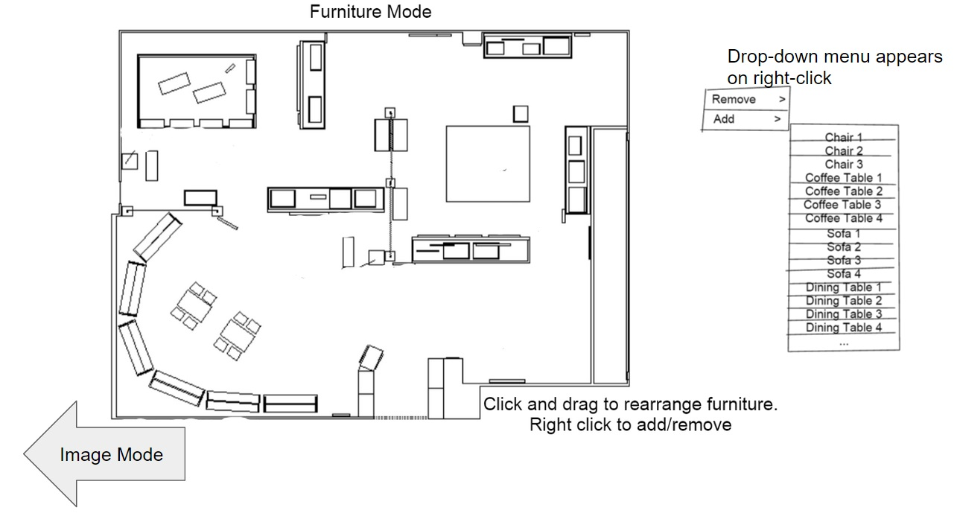
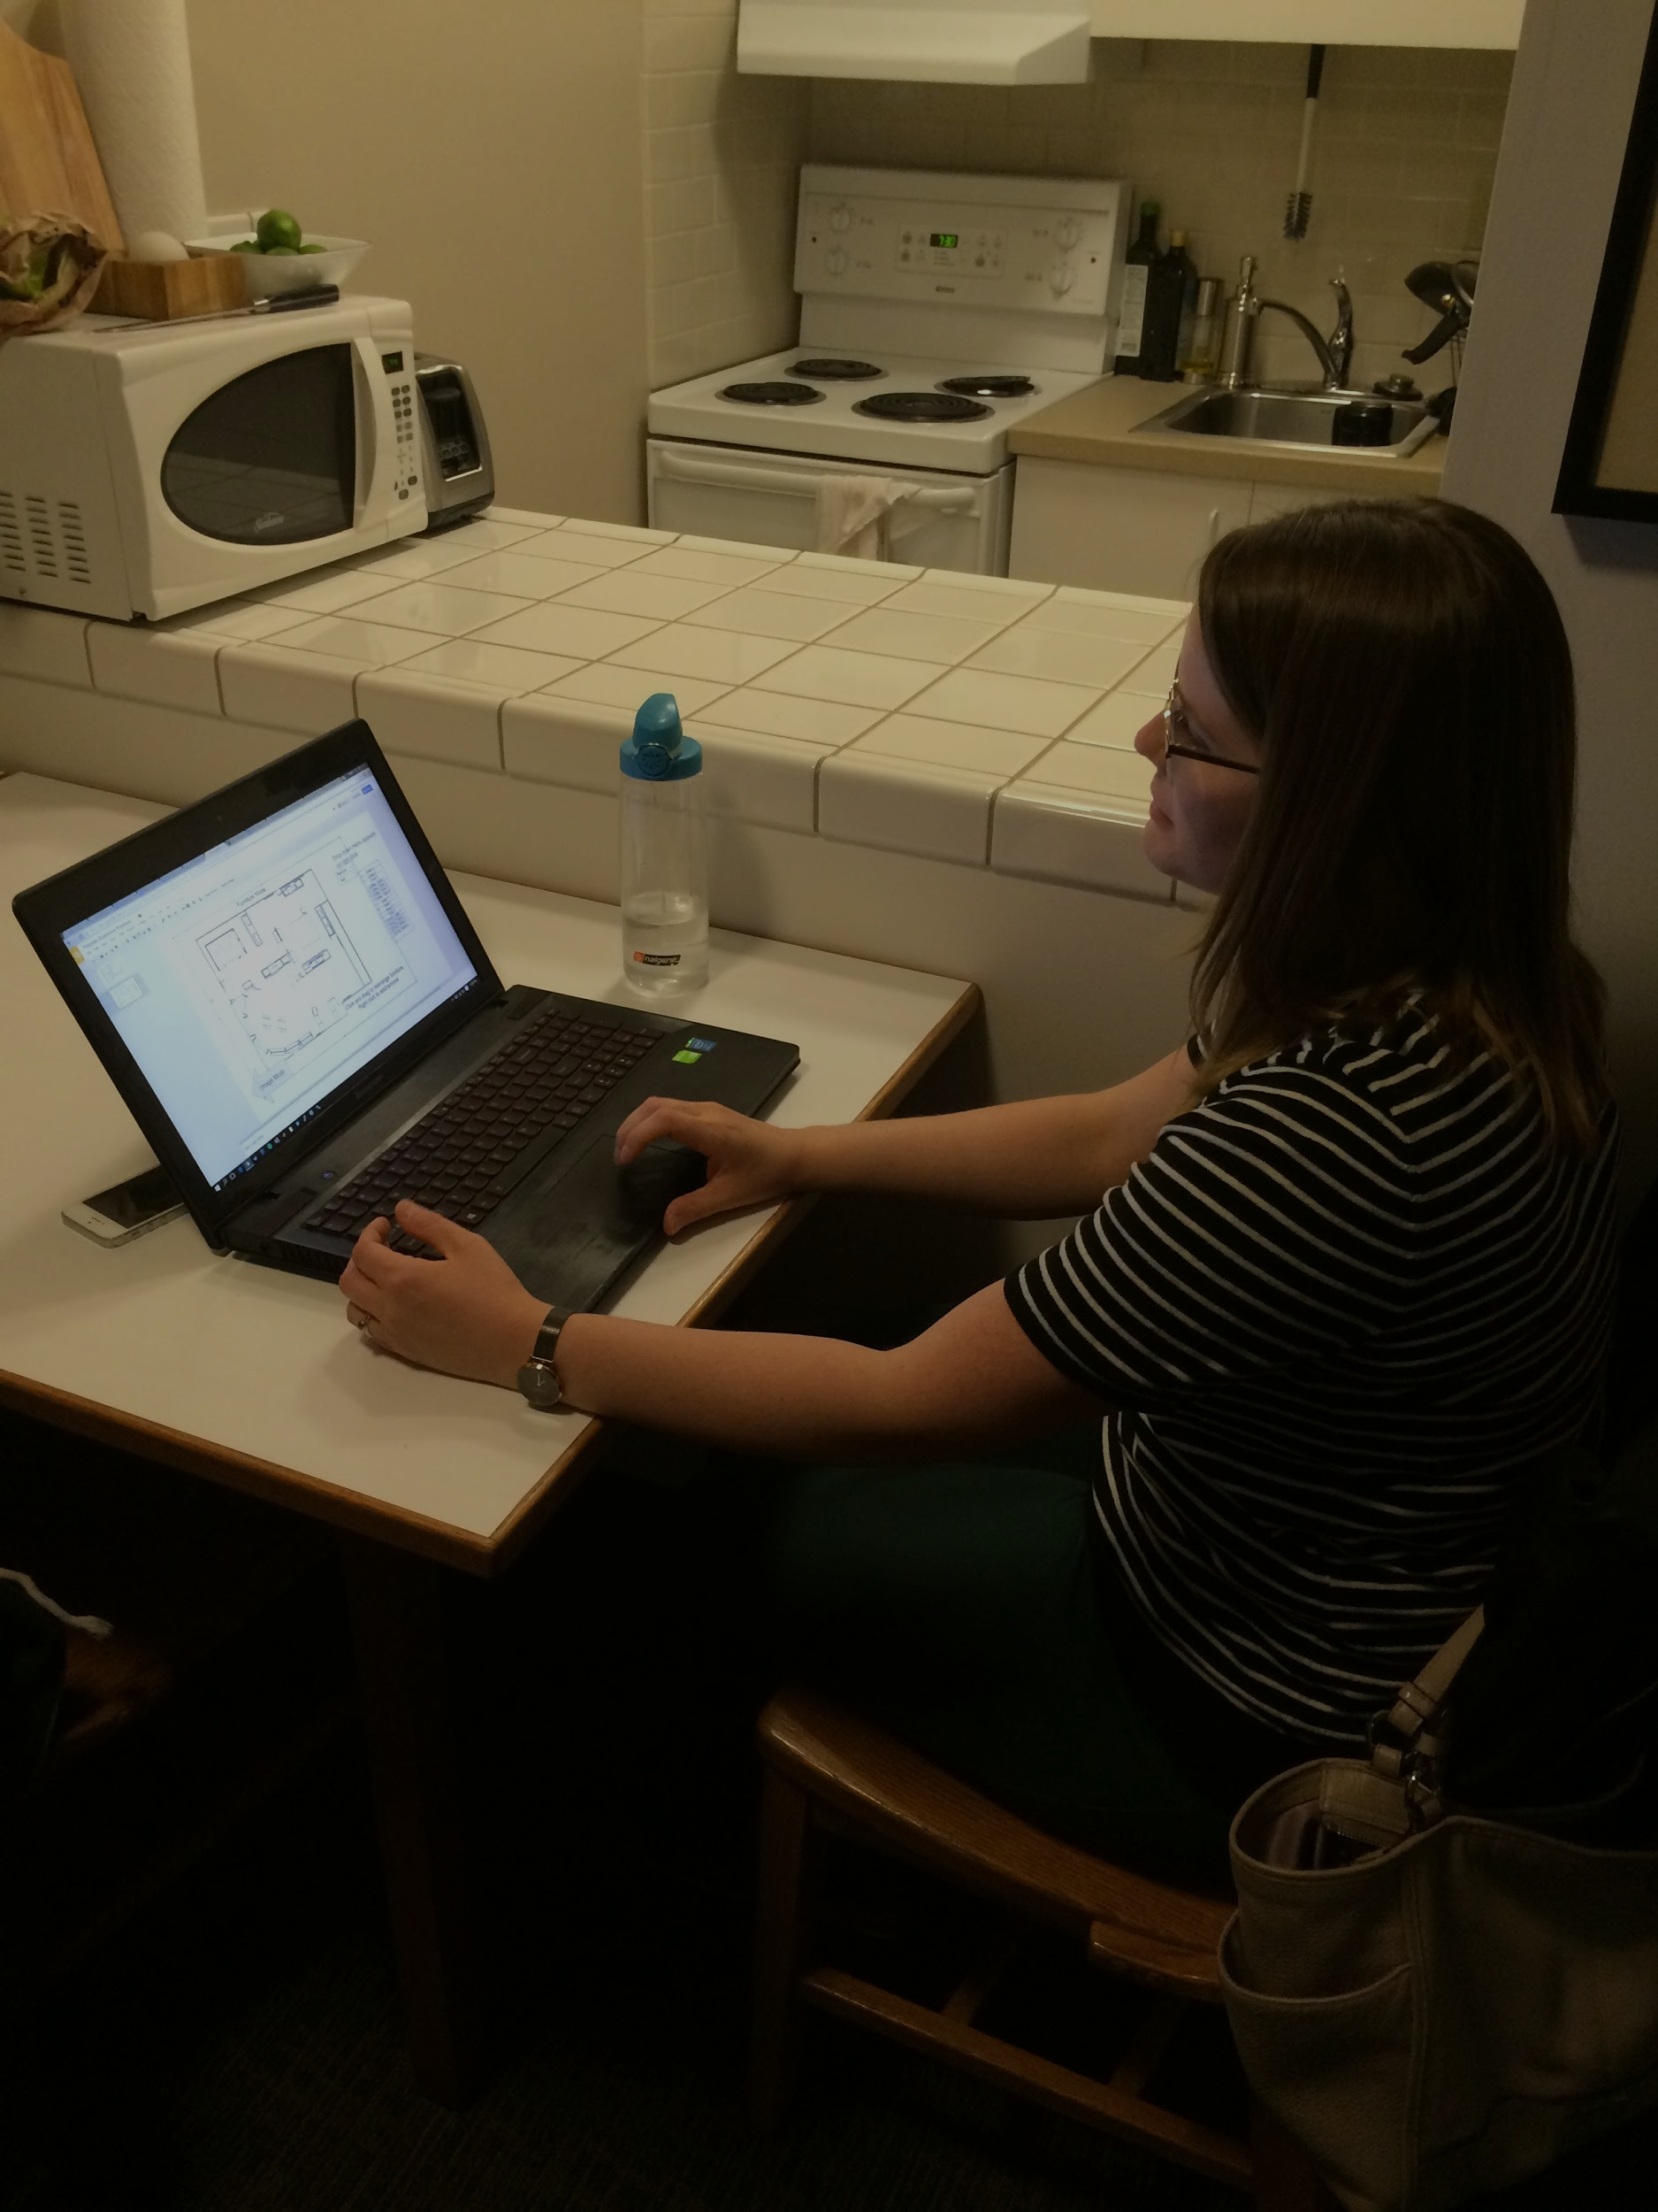
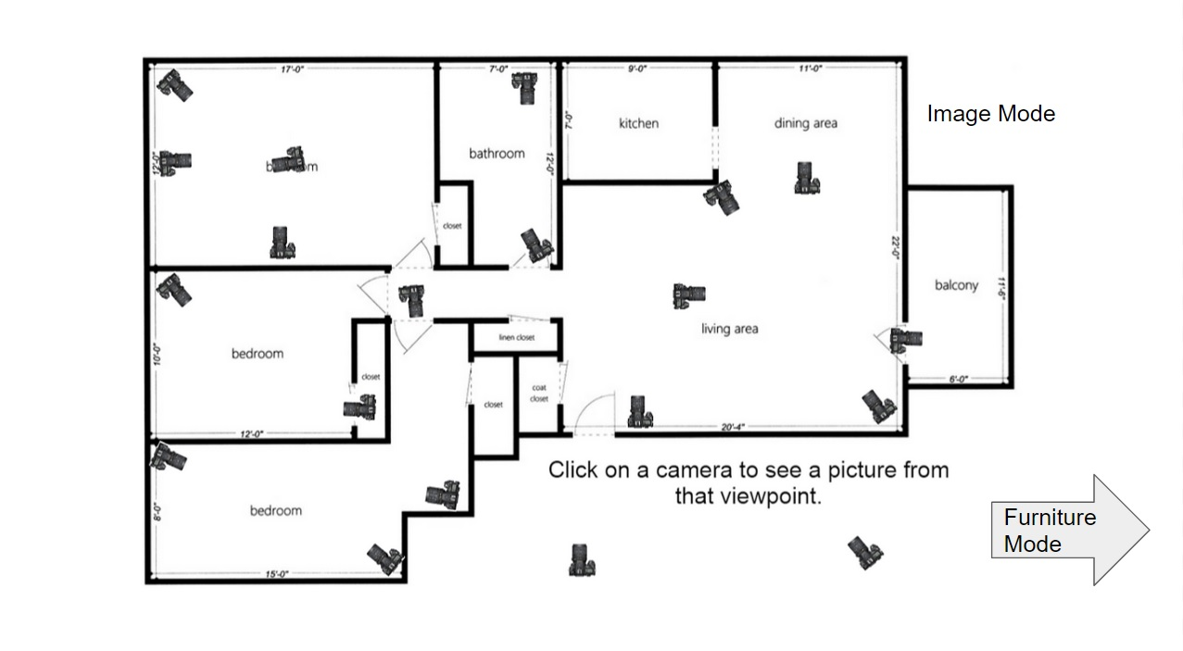
Images

Slide 20
Takeaways
Things that worked:
Intuitive layout.
Things that didn’t:
Confusion over how photos would be different from regular photo tour.
Concern photos would have fishbowl filter.
Surprises:
There were several things that Emily came up with which we had not considered, such as ways to add new furniture items to the interface.
New Learnings:
This idea needs some work, but some new features have come to mind.

Slide 21
Prototype 3
Mock-up of a mobile app.
Designed to help look up information about for-sale properties.
Gets info from reports on crime rates, natural disasters in history/expected future, etc.
Tested by building scenario in which Emily had already found a home she was interested in, and was looking up anything that might cause trouble.

Slide 22
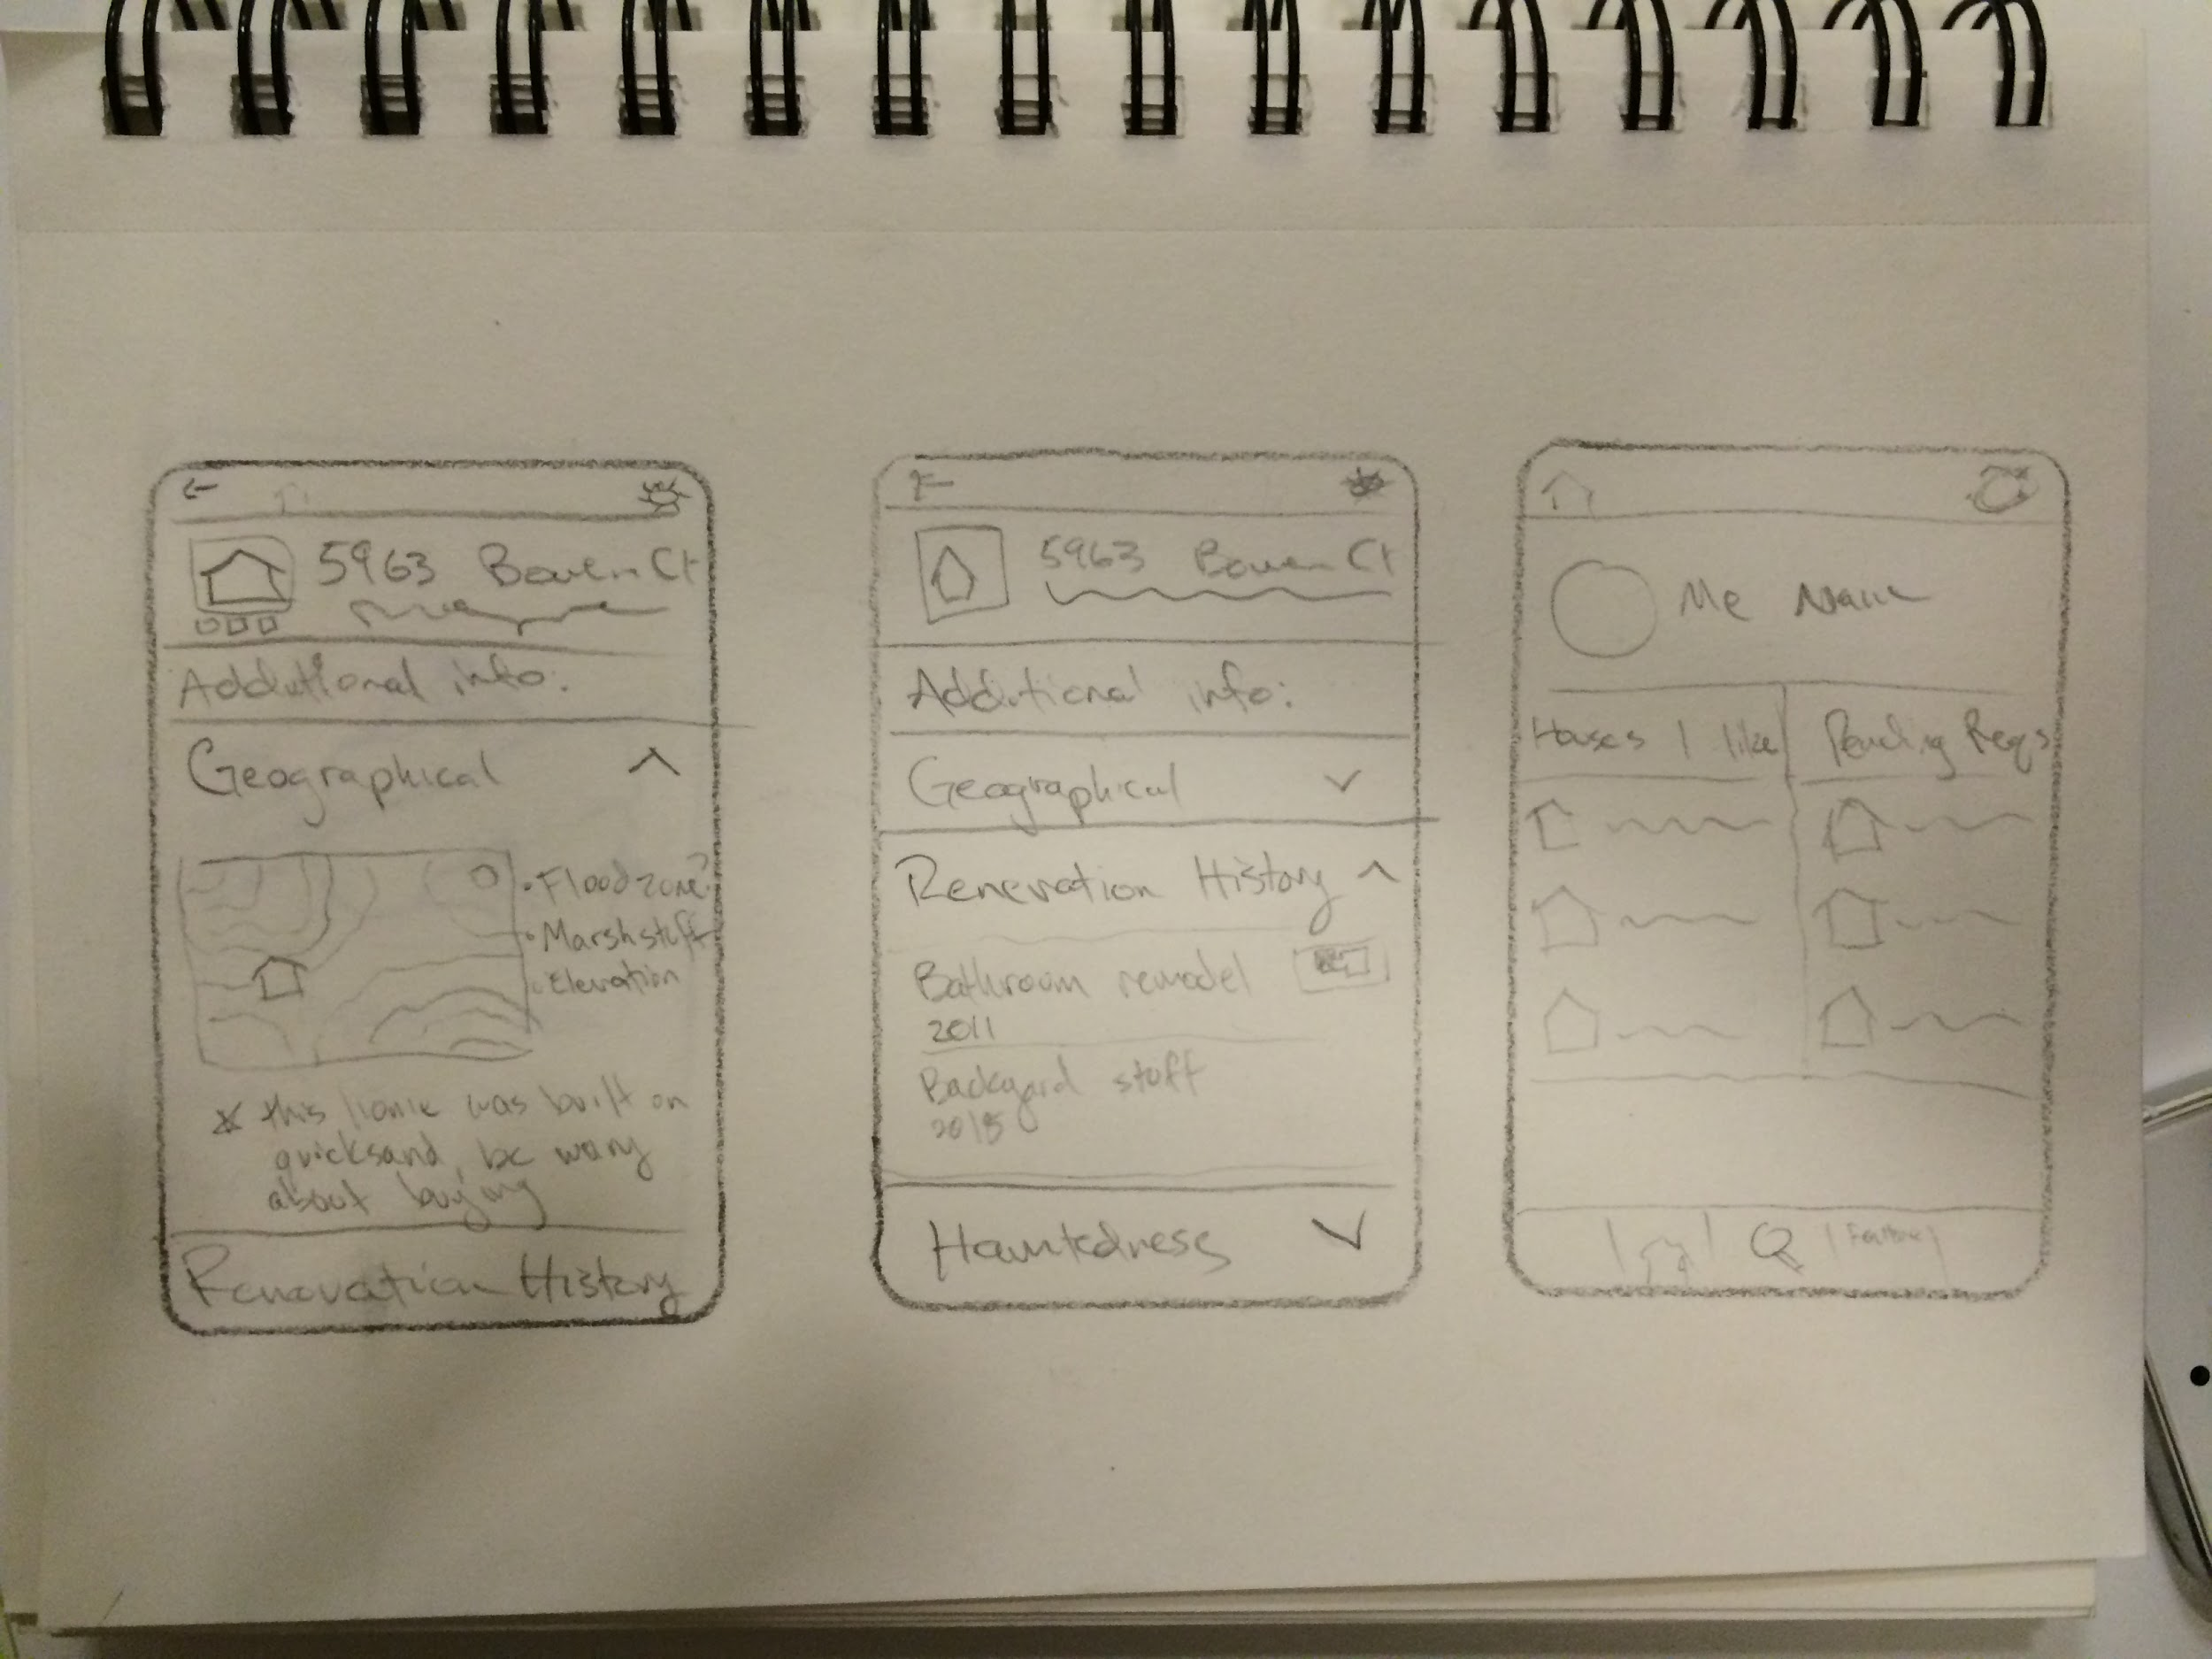
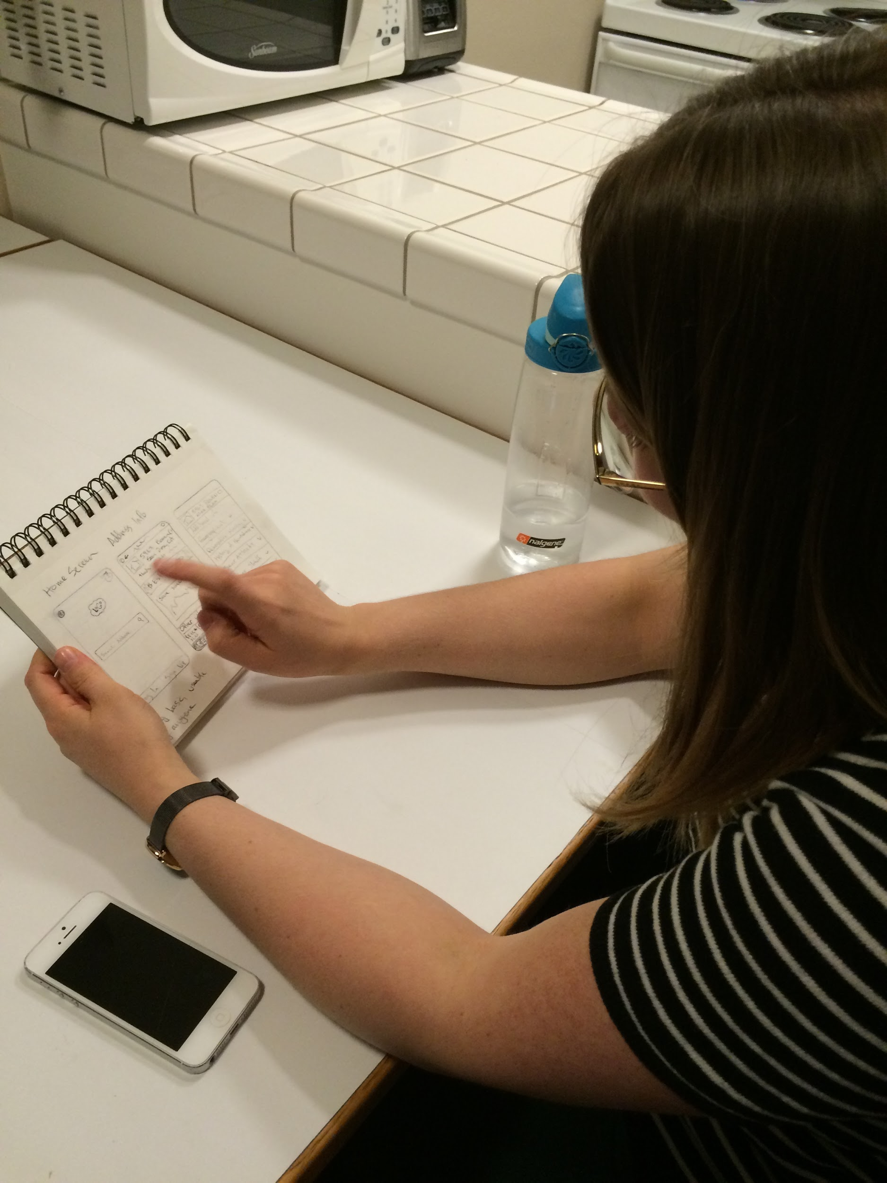
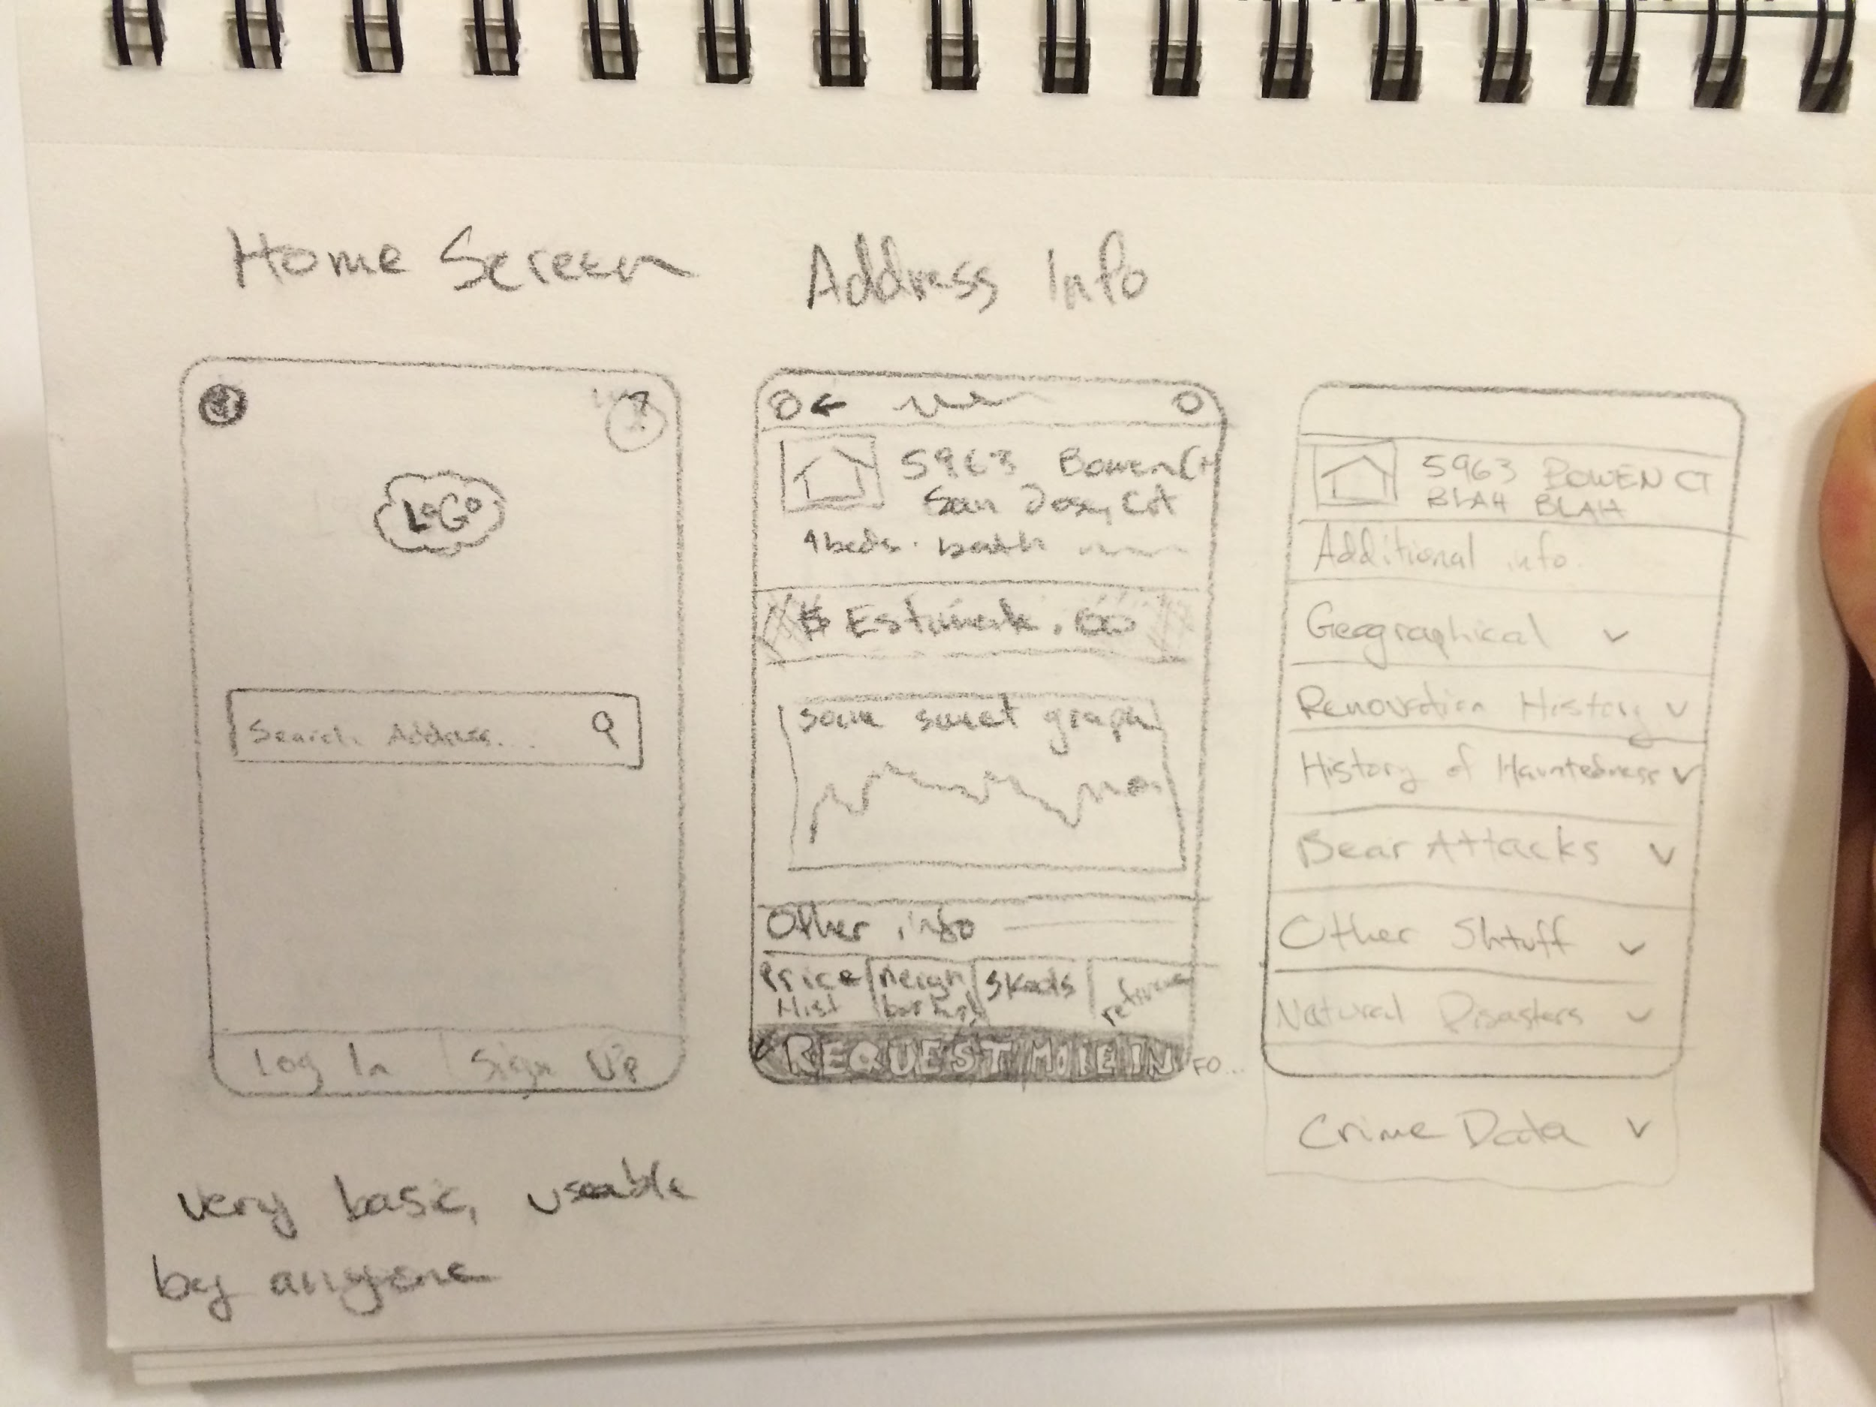
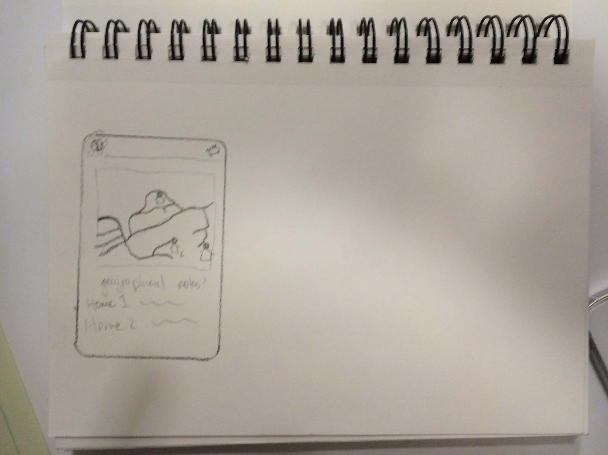
Images

Slide 23
Takeaways
Things that worked:
Subject felt service would be extremely beneficial while homebuying.
Things that didn’t:
Interface felt too cluttered, non-intuitive.
Surprises:
Said a home-search feature would feel more intuitive.
New Learnings:
This application may need to much space for a mobile phone, perhaps would work better on a tablet or computer.

