Slide 1
Low-fi Prototyping &
Usability Testing
Niharika B, Phoebe F, Karen T, Manikanta K

Slide 2
OVERVIEW
Low-fi Prototyping
Mission
Selected Interface
Prototype iteration
Usability Testing
Method
Results
Learnings

Slide 3
Low-fi Prototyping

Slide 4
MISSION
HealthMap
Stay confident and accountable about your health before getting in a car.

Slide 5
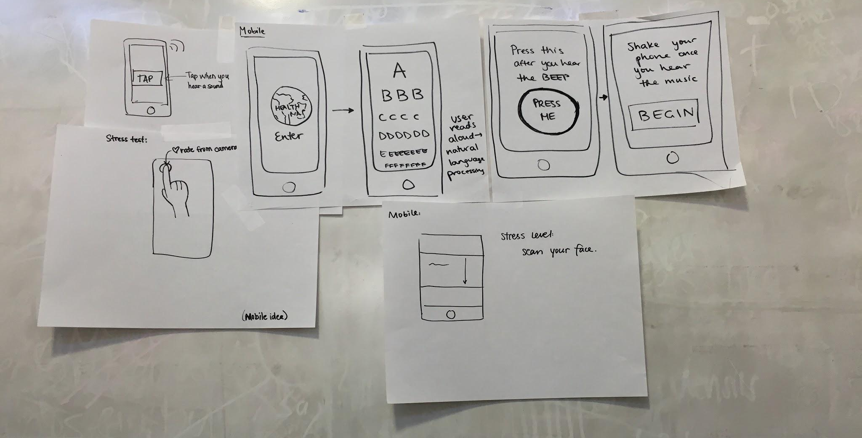
INTERFACE
Why mobile?
Quick & Efficient
Notes:
We sketched 15 - 20 sketches over 5 modalities: VR, AR, Wearables, Hardware device, mobile

Slide 6
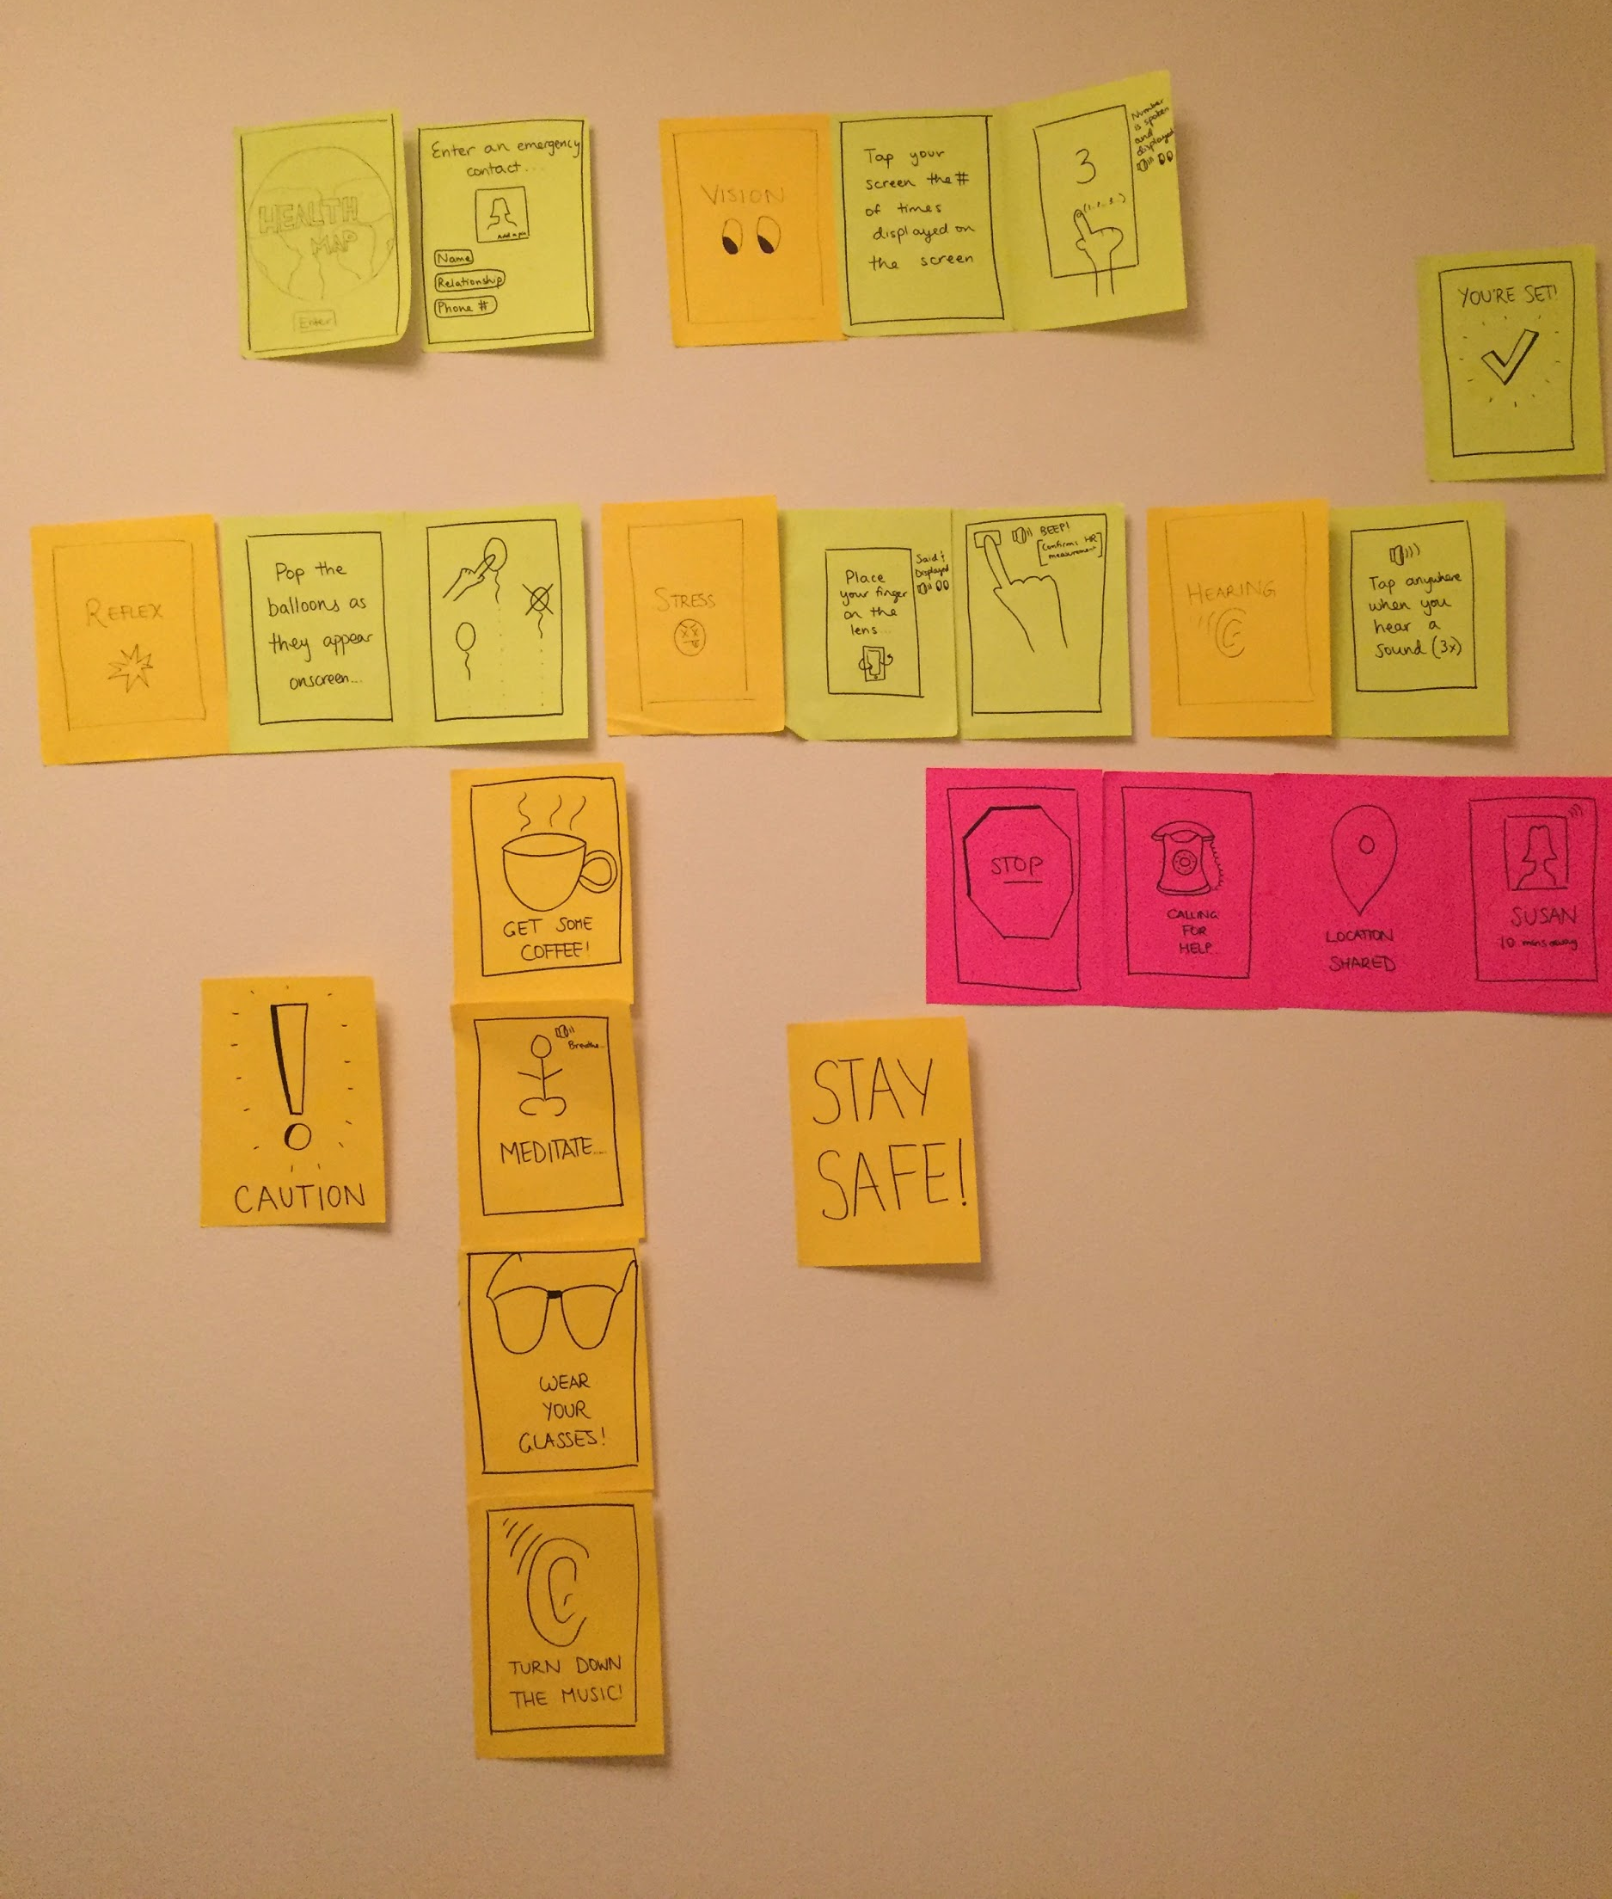
PROTOTYPE

Slide 7
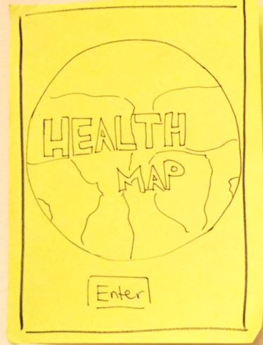
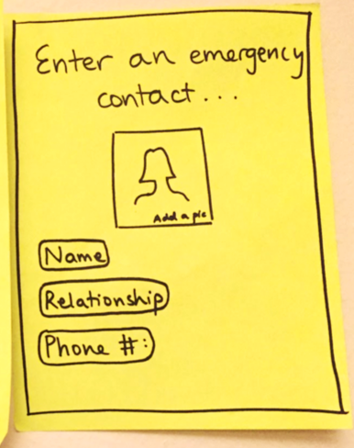
ONBOARDING

Slide 8
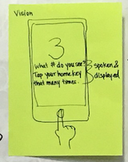
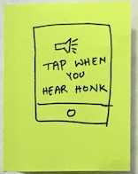
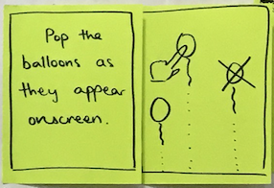
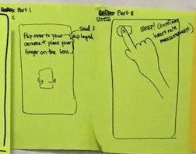
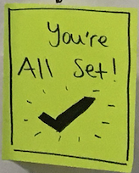
TASK 1
vision
Hearing
Reflex
Stress
if passed
if passed
if passed
if passed all tests
“I want to know if I am fit enough to drive” – Complex
Notes:
Vision
Hearing
Reflex
Stress
Tests are presented sequentially.
If passed all tests, then show the “you are all set screen”
The whole process should take less than a minute. Each task is about 10 - 15 sec.
If interrupted, start from the particular test. Timeout if it exceeds 1 min.

Slide 9
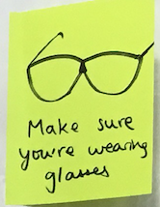
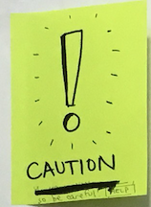
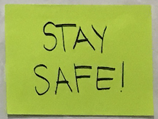
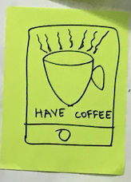
TASK 2
If had inconsistent results
vision
reflex
“I want to know how to be a safer driver” – simple
Notes:
If the user had inconsistent results in any of the tests, we prompted them with a caution screen, and showed them suggestions.

Slide 10
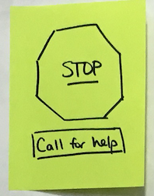
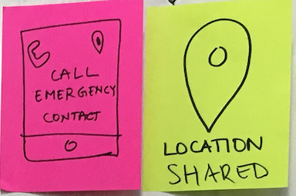
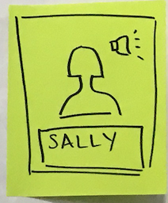
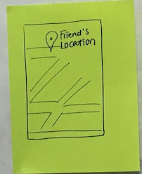
TASK 3
User
Taps CFH
EC accepts call
Emergency Contact
“I want to get help when I need help” – moderate

Slide 11
Usability Testing

Slide 12
METHOD
3 participants @ Tresidder
Diverse demographic background
Not incentivized
Given a scenario and asked to complete each of the 3 tasks
Notes:
We tried to cover a diverse age group of people that drive on a regular basis.
We asked them if they would be interested in participating in a short interview to give some feedback for a course project.
We followed the script to first give each participant some explanation on the high-level goals of the product, and then gave them a scenario and asked them to complete each of the 3 tasks, while thinking out loud.

Slide 13
RESULTS P1
Panda Express Employee
19 yrs
Commutes daily in car
Quickly identified the intention of the product
Appreciated relevance of the tests for driving
Confused by the text description of vision test
Notes:
Confused about the text largely due to his level of education but it is a strong indication that we should make the test understable to various audience groups.

Slide 14
RESULTS P2
Entrepreneur
64 yrs
Commutes daily in car
Excited about the reflex and stress tests
Surprised that HealthMap is self-interpreted
Preferred to call 911 instead of preset emergency contact
Notes:
“People are not receptive to machines telling them not to drive, they may drive anyways”.

Slide 15
RESULTS P3
Teaching Staff
36 yrs
Commutes daily in car
Impressed with the stress test
Liked that HealthMap is easy to set up
Wanted to have an emergency call button without going through the tests
Notes:
e.g., when she is in a car accident

Slide 16
LEARNINGS
Make test description understandable
e.g., add audio cues + visual cues
Change the size of the number in vision test
Enable emergency calling that bypasses tests
e.g., user can dial 911 in one click.
Feed user’s and family’s health information and history
e.g., this info will help paramedics in emergency

Slide 17
SUMMARY
Low-fi prototyping
Prototype testing
Usability-wise
Feature-wise
Hope to validate our design changes in future studies

Slide 18
THANKS!
Any questions?

