Slide 1
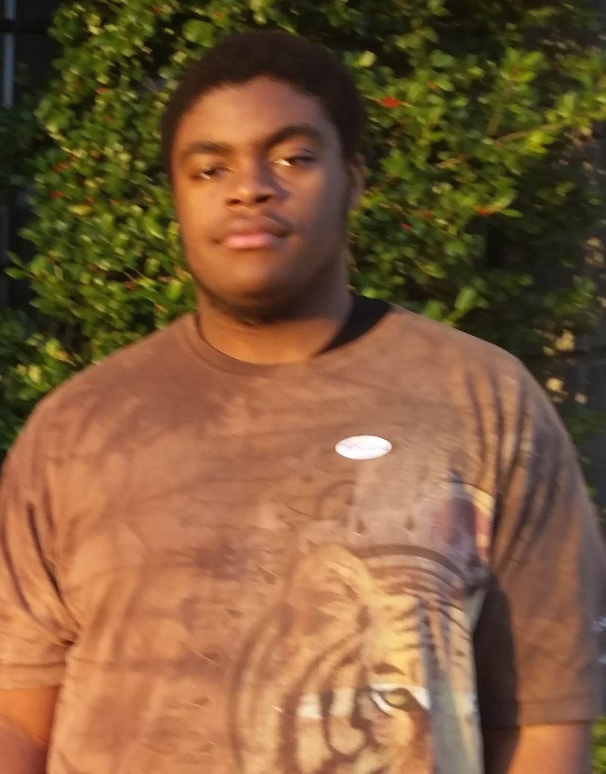
Project Perfect
Priyanka Rao
Gerardo Sanz
Ikechi Akujobi
Filippa Karrfelt
Team EduConnect
Presenter: Priyanka Rao

Slide 2
Problem
Solution
Teachers and students find it time-consuming and difficult to successfully create and complete class projects.
A tablet app that streamlines class projects from teacher creation to student submission

Slide 3
Value Proposition
Painless class projects

Slide 4
Tasks
Complex: Teacher creates and assigns a class project with background info, a list of supplies, and instructions for students to follow.
Medium: Student works through project step-by-step and asks questions to teacher as needed.
Simple: Student submits completed class project to teacher for review.

Slide 5
Design Change #1 – Navigation Bar
Relocated Q/A & Nav Buttons

Slide 6
Design Change #2 – Creation of New Pages
Swiping vs. Tapping

Slide 7
Design Change #3 – Text Editing
Customization vs. Ease

Slide 8
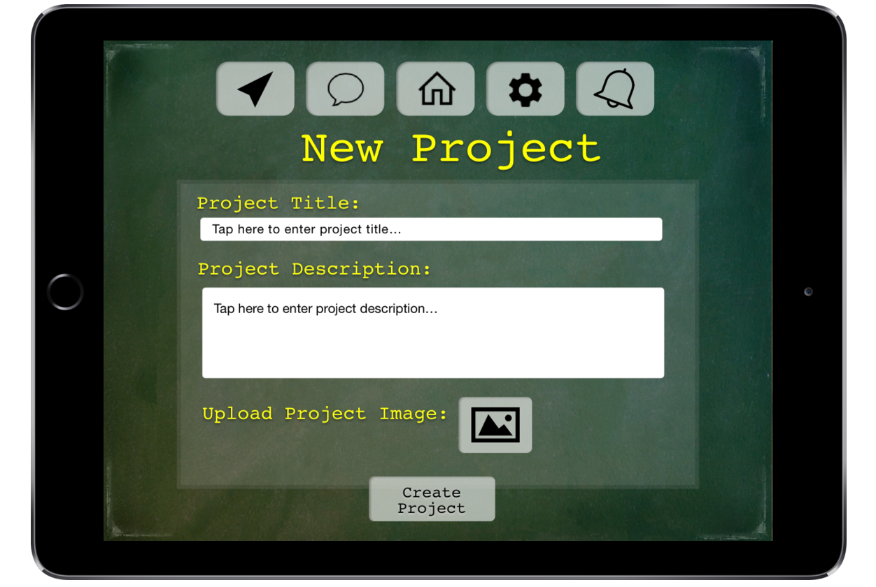
Task Flow #1 – Creating a Project

Slide 9
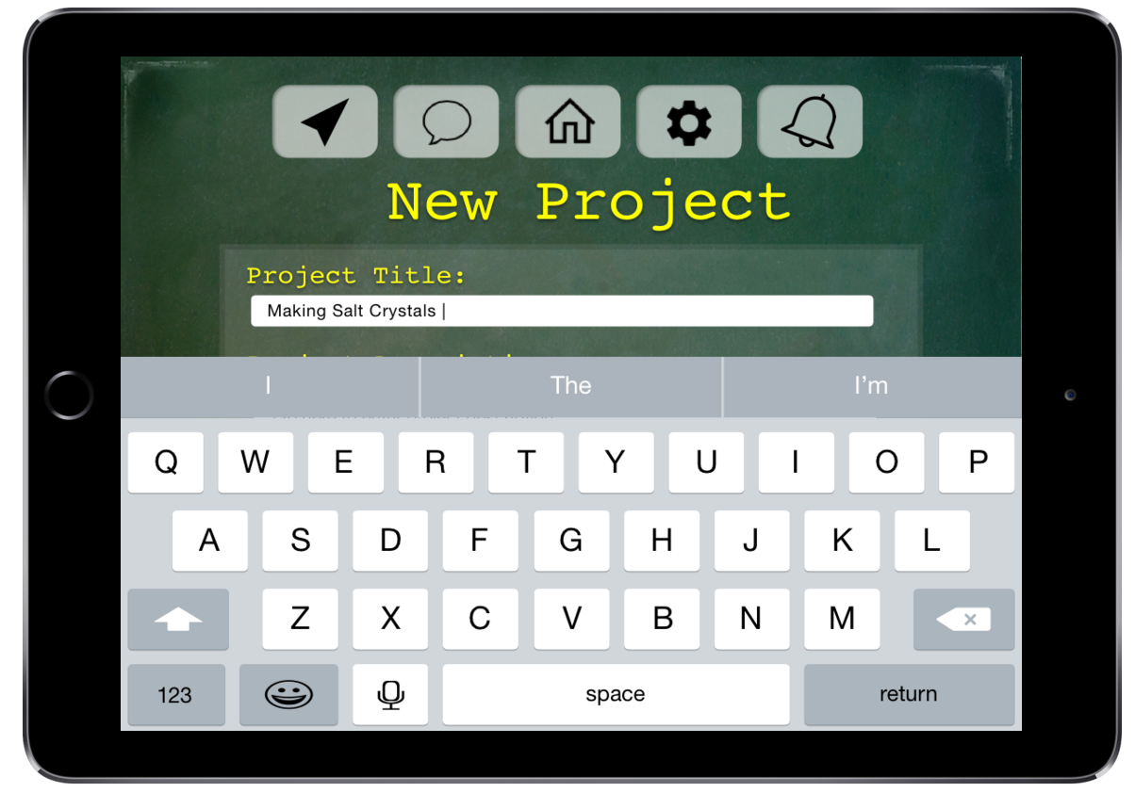
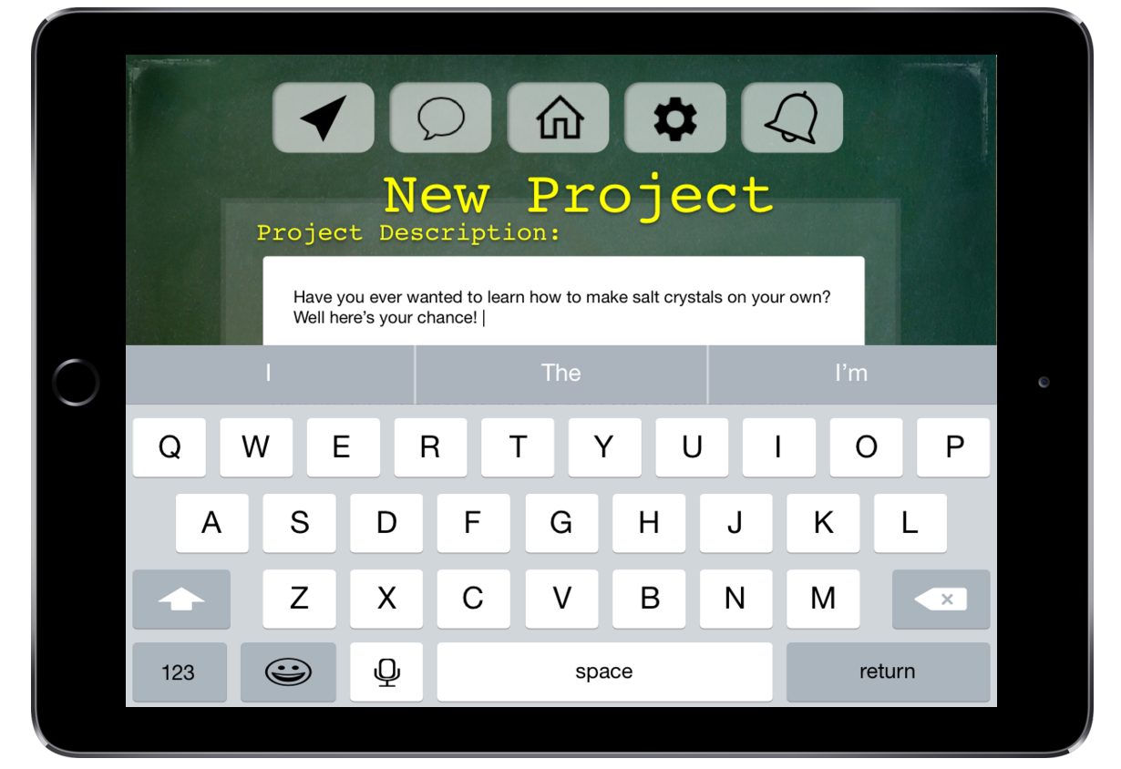
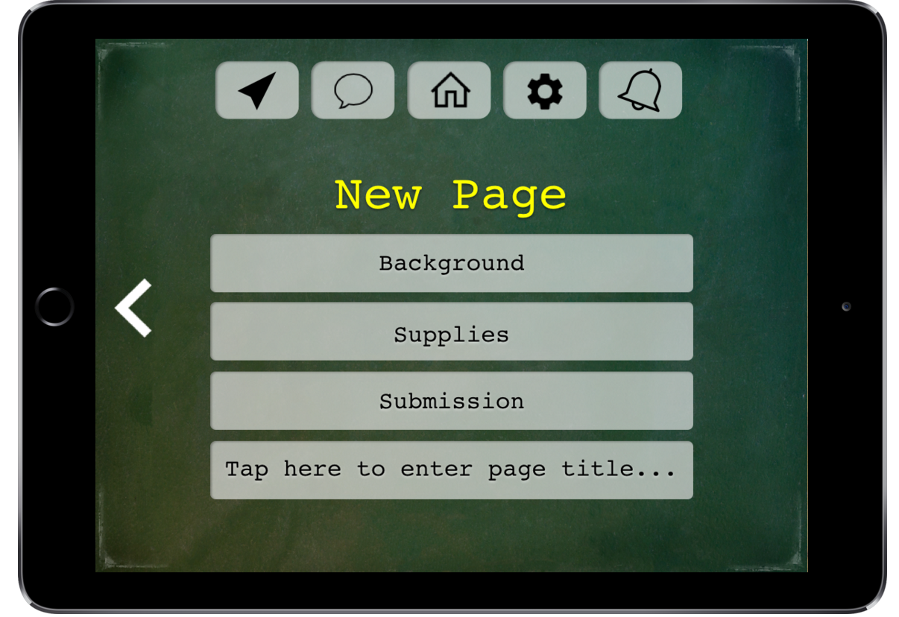
Task Flow #1 – Creating a Project

Slide 10
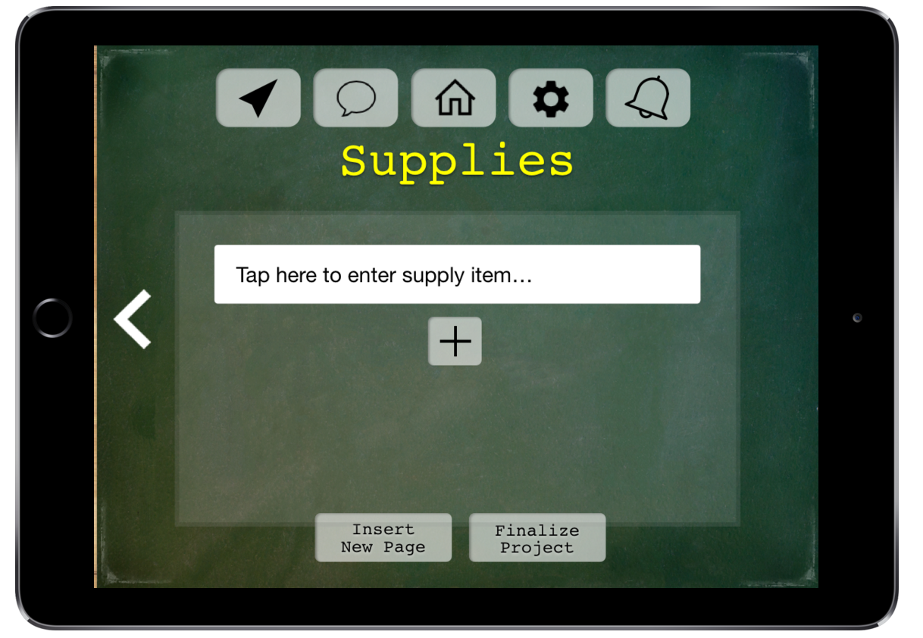
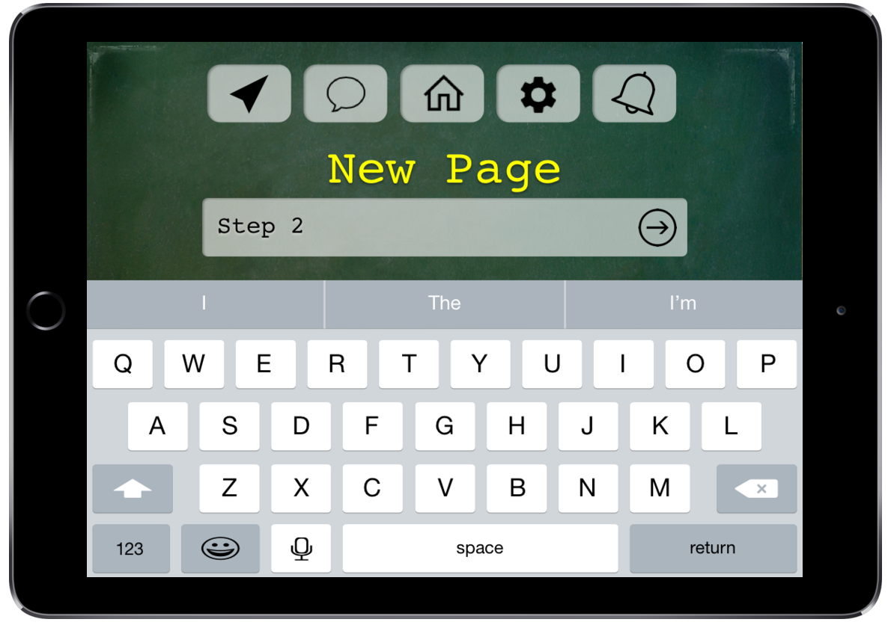
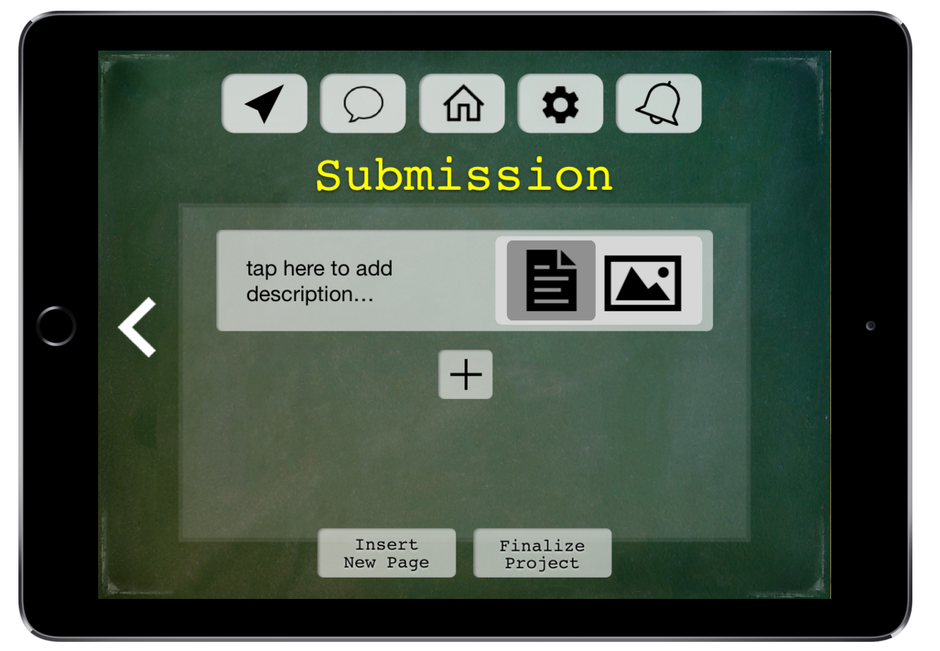
Task Flow #1 – Creating a Project

Slide 11
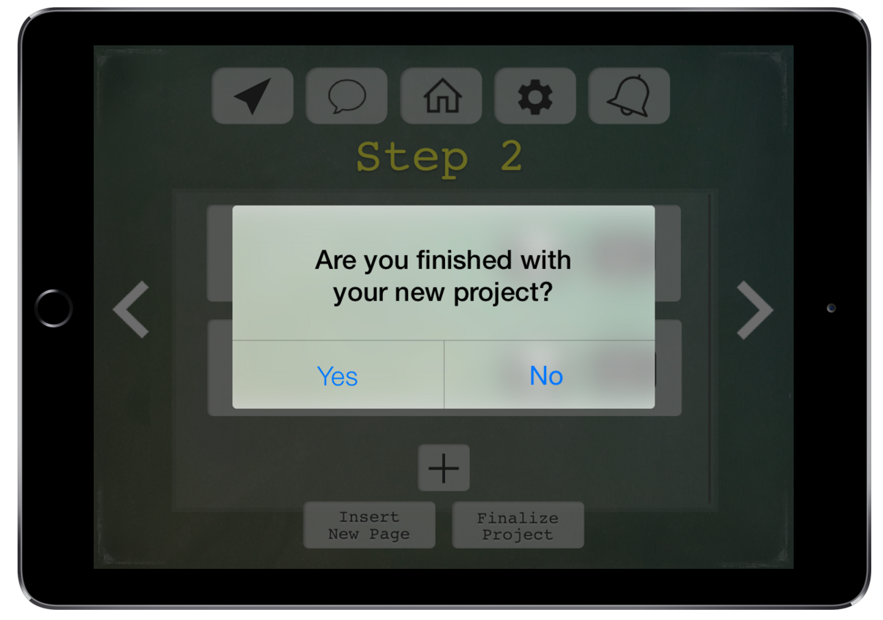
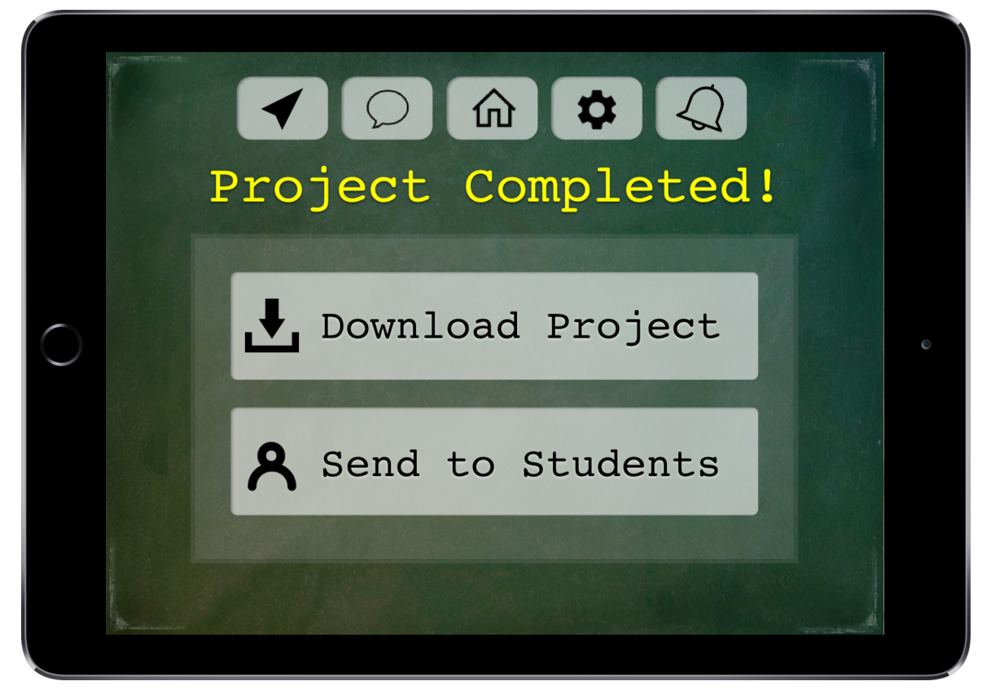
Task Flow #1 – Creating a Project

Slide 12
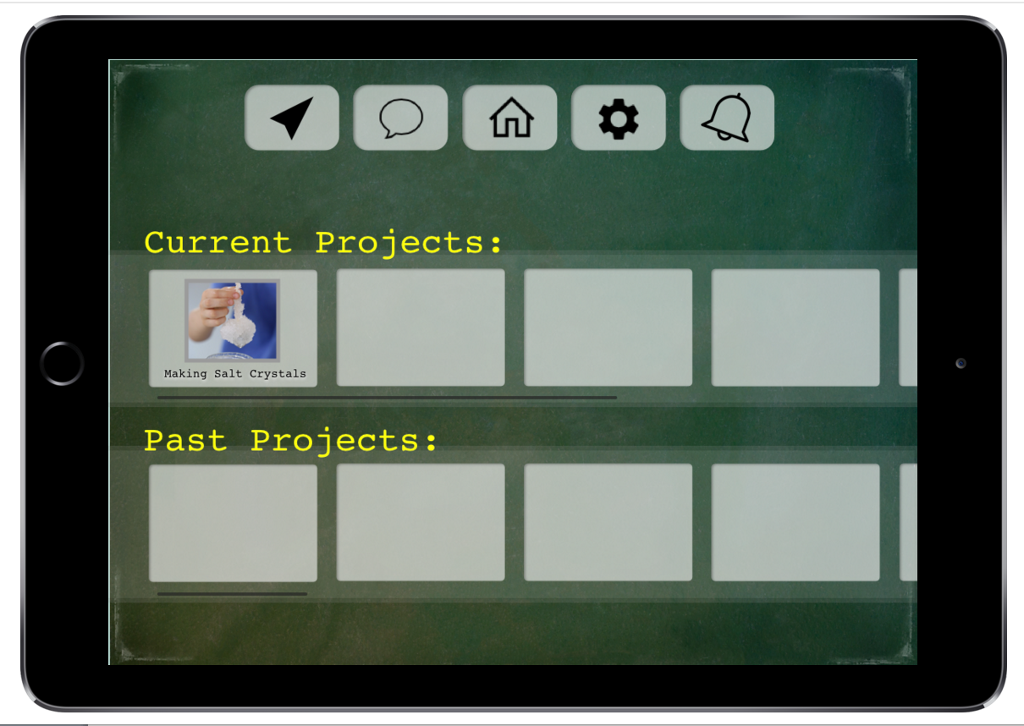
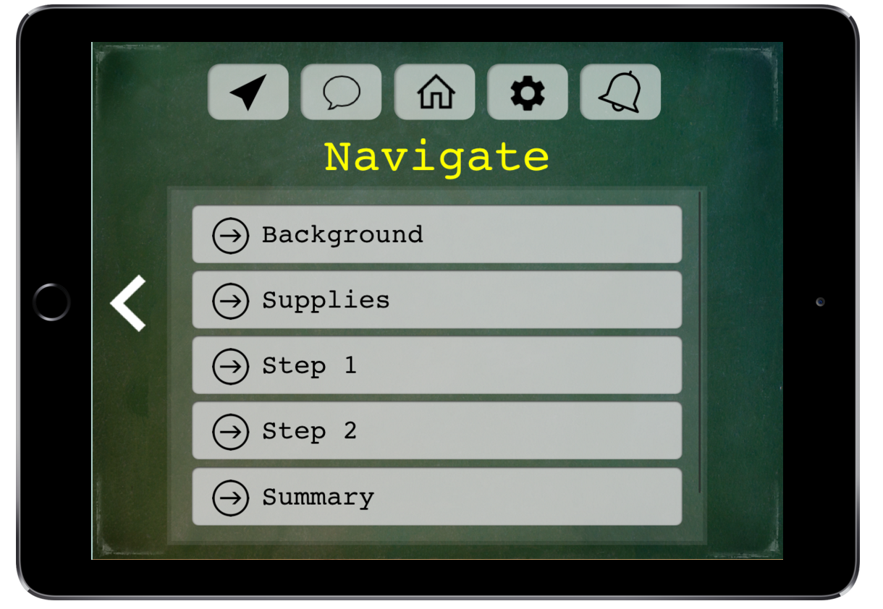
Task Flow #2 – Doing a Project

Slide 13
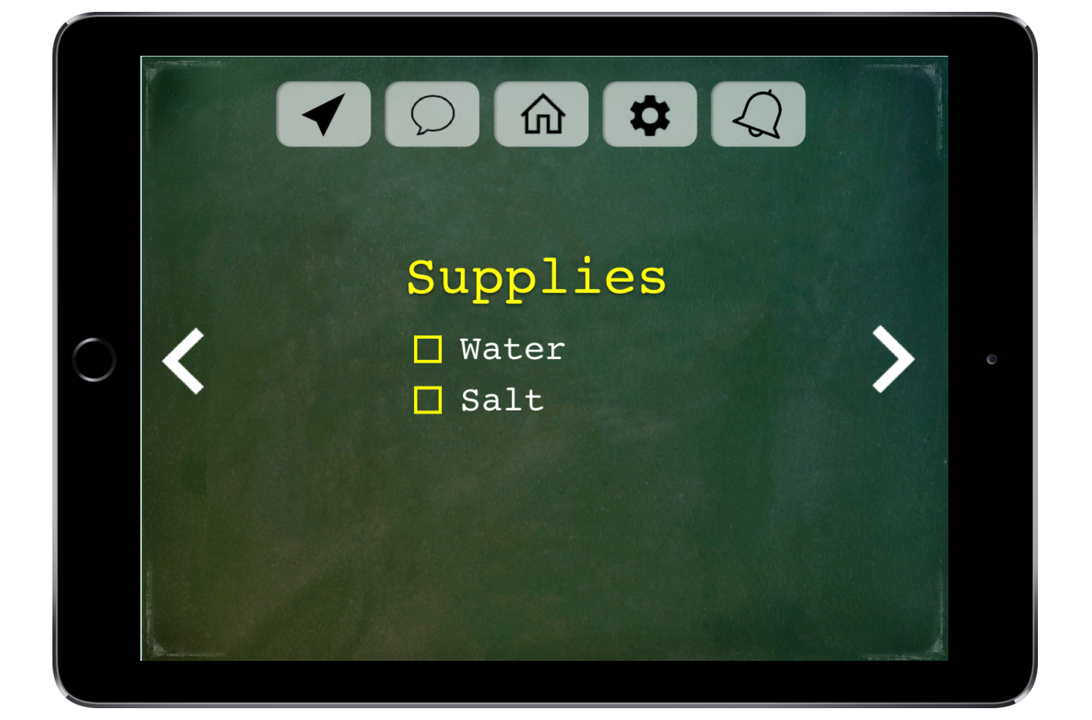
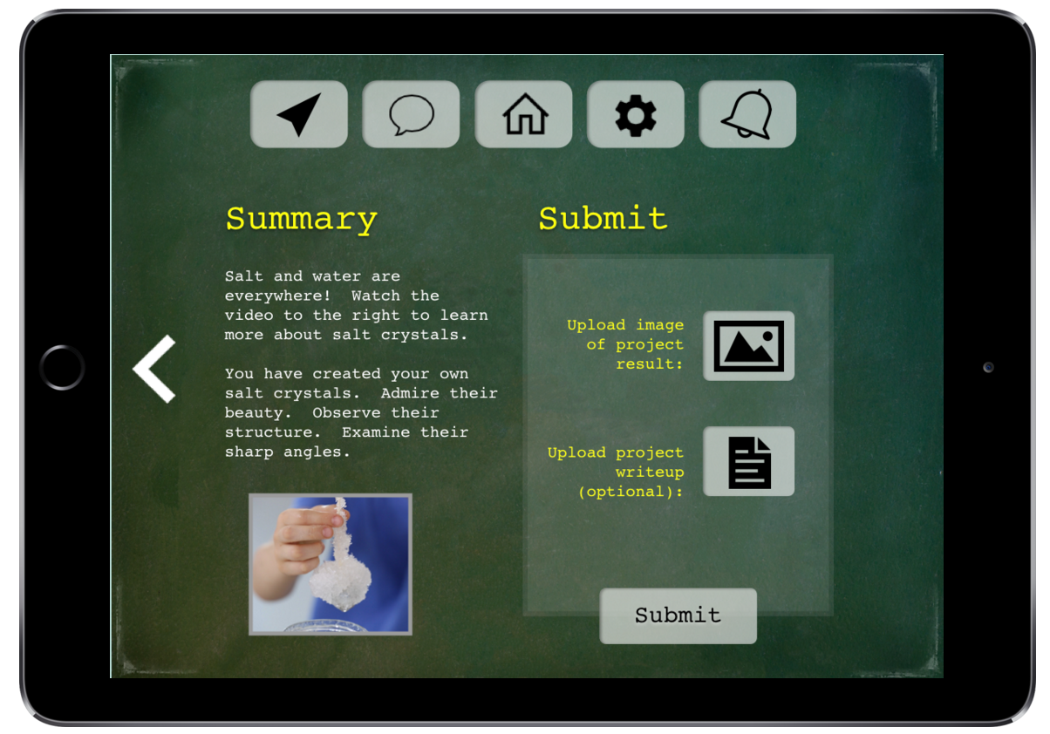
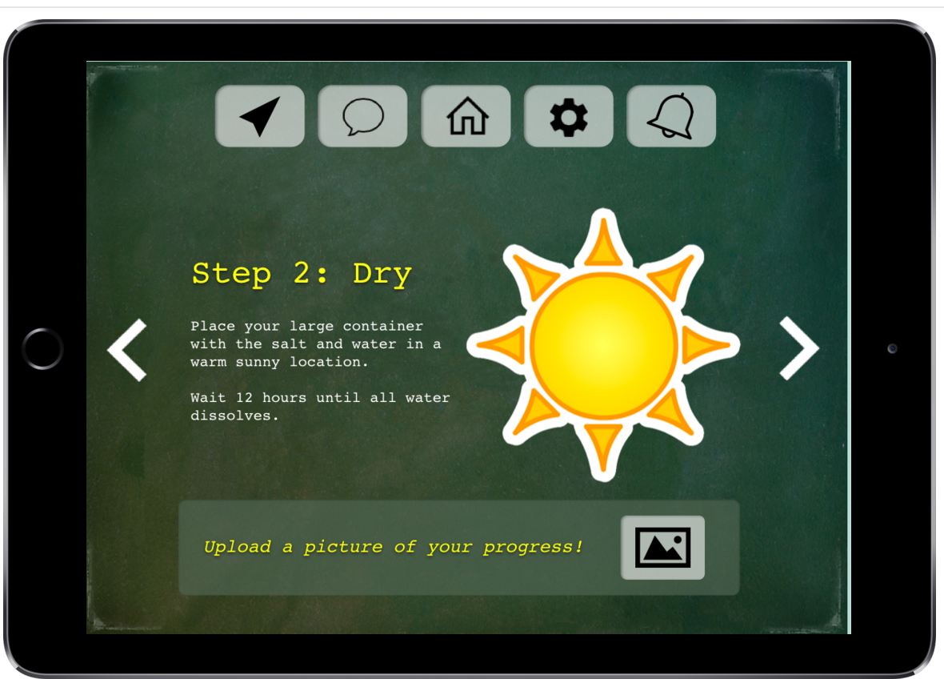
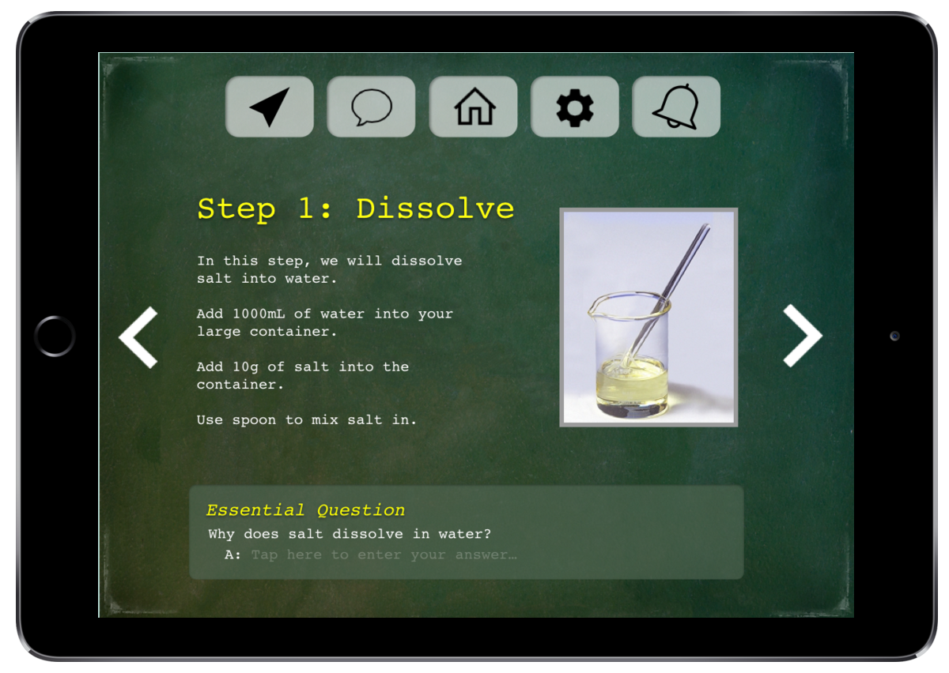
Task Flow #2 – Doing a Project

Slide 14
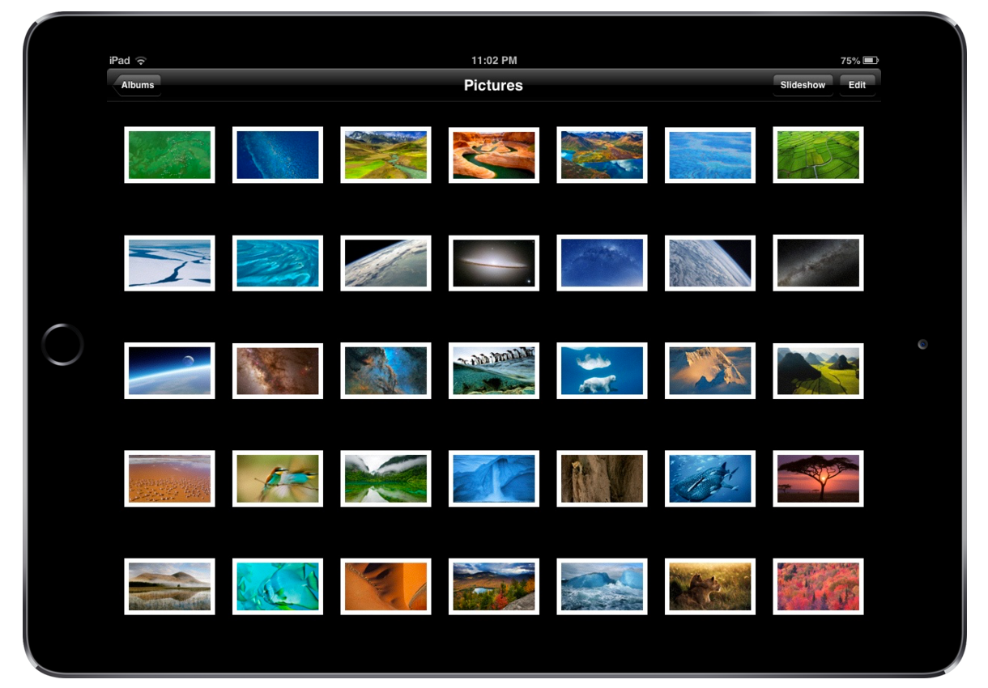
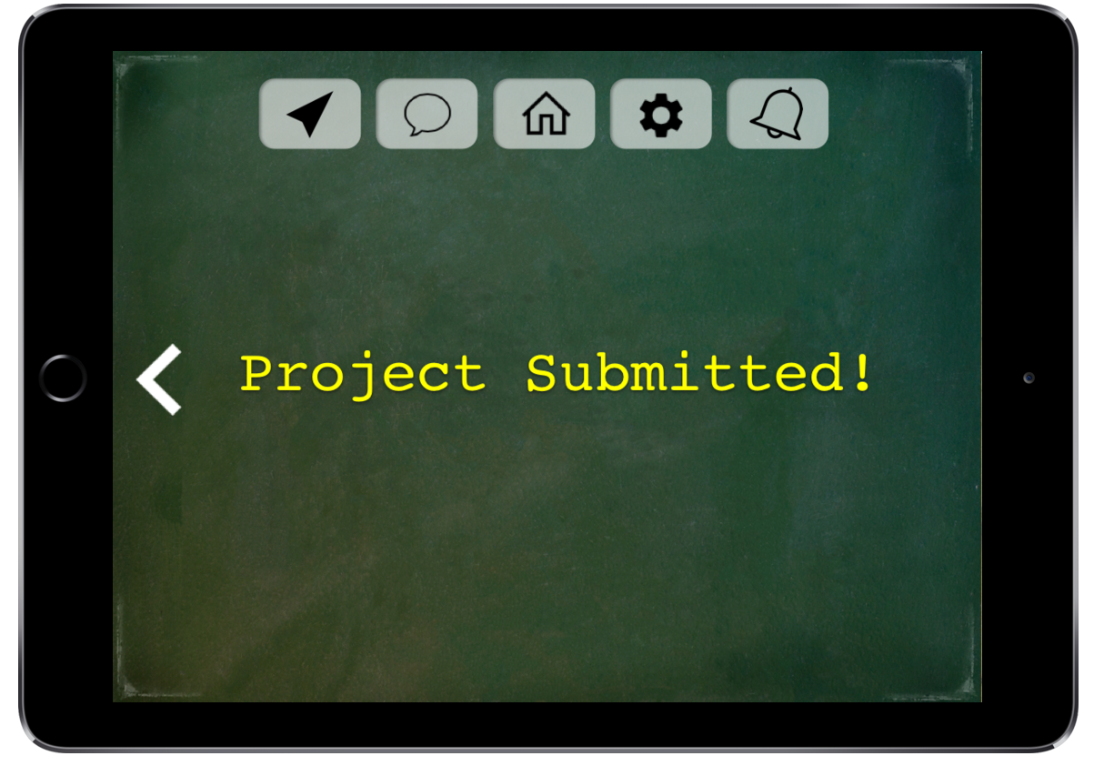
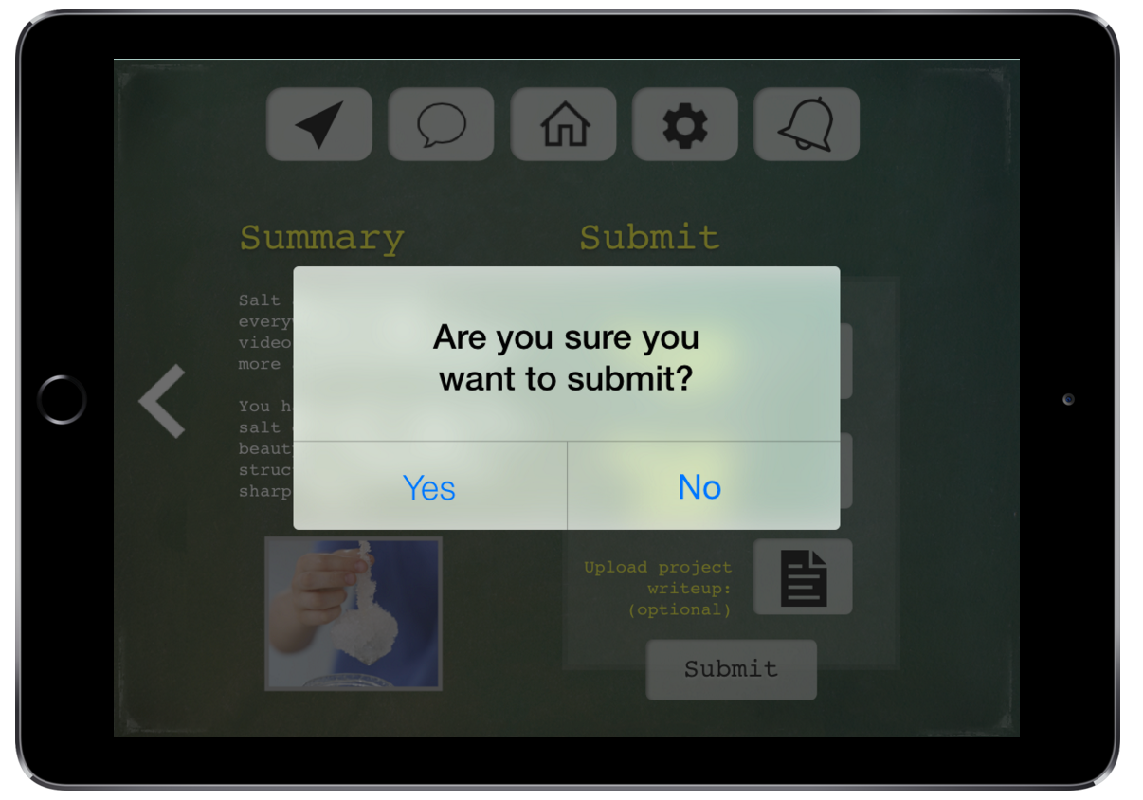
Task Flow #3 –Submitting a Project

Slide 15
Prototype Tool: Sketch
How it helped
How it did not help
Graphical interface
Easy to duplicate pages
Made us think about feasibility
Ex. Review page for submission
Huge learning curve
Bad AI?
Duplicating vs. copying pages
Hard to implement dynamic features
Ex. Going back

Slide 16
Prototype Overview
Tradeoffs
Feasibility vs. usefulness
Student pages vs. teacher pages
Simplicity of task vs. simplicity of implementation

Slide 17
Prototype Overview
Omitted
Select class page
Review of submission page
Browse existing projects page
Navigation for teacher

Slide 18
Prototype Overview
Wizard of Oz techniques
Duplicated many screens
Abstracted away some of the project creation
Hand-coded
Made up project for student
Project creation page
Uploading text
Uploading images

Slide 19
Thank You!

Slide 20
Medium-Fi Prototype Link
https://marvelapp.com/b2jh55

