Slide 1
Developing the Design:
Lo-fi Prototype
EduConnect
Presented by Ikechi Akujobi

Slide 2
Introduction

Slide 3
Overview
Mission statement
Chosen interface
Lo-fi prototype and three tasks
User testing
Changes to Make

Slide 4
Our mission is to bring painless class projects to classrooms everywhere by creating a virtual platform where teachers can easily create and assign projects, and students can easily complete and submit them.

Slide 5
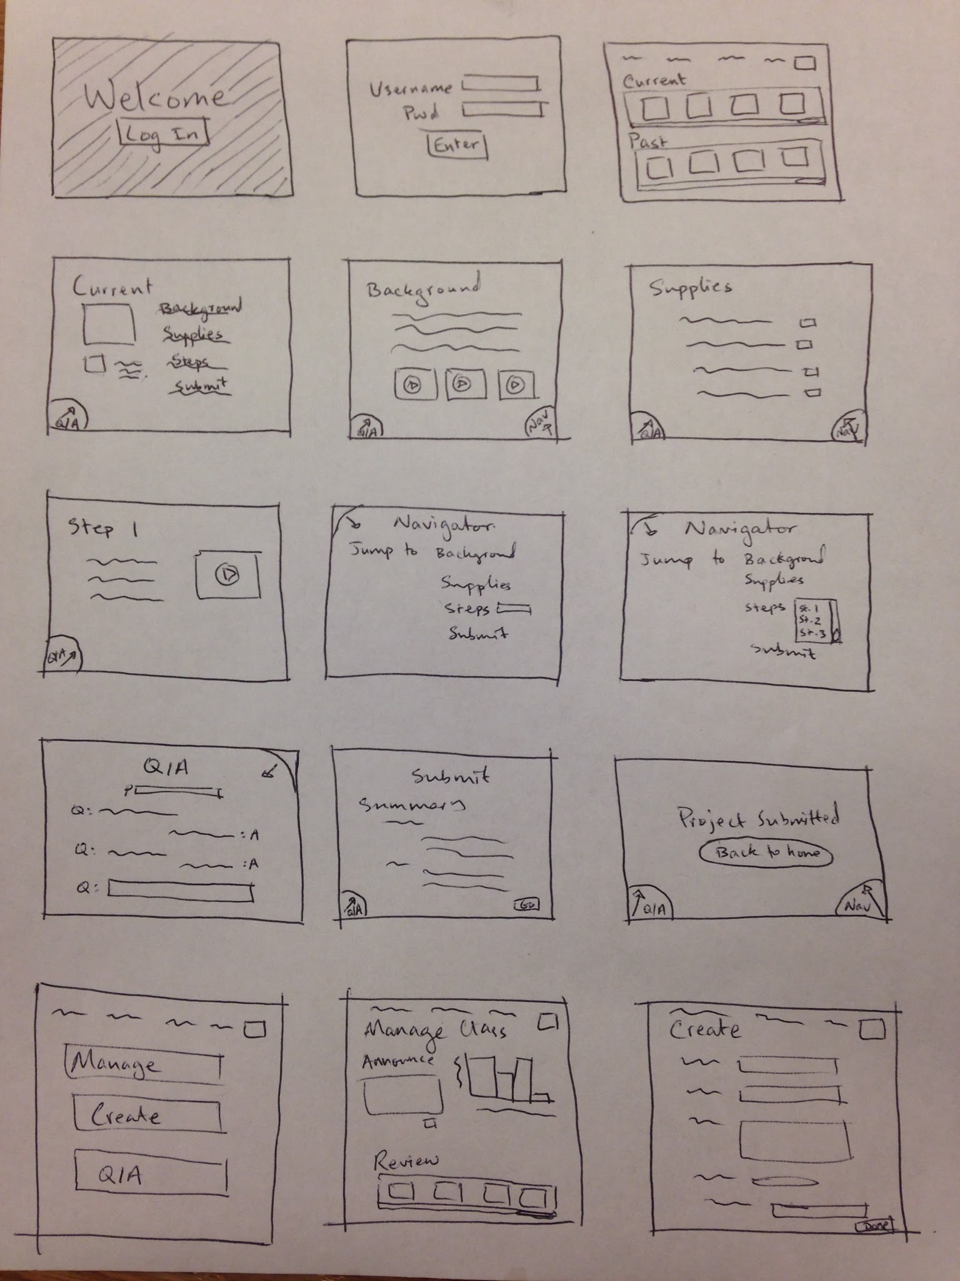
iPad Interface
Pros:
Mobility
Simplicity
Touch interface
Screen space
Communication w/ apps

Slide 6
Lo-fi Prototype

Slide 7
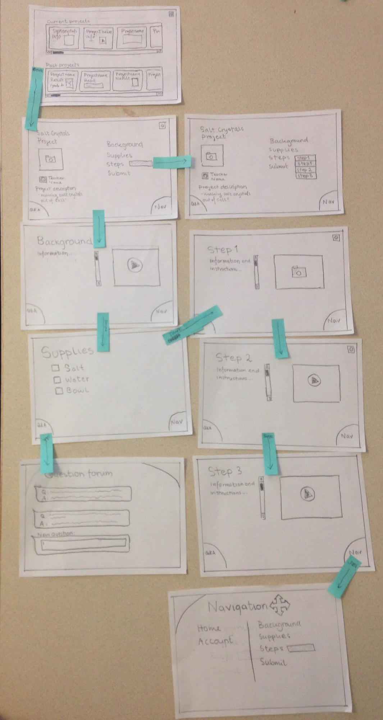
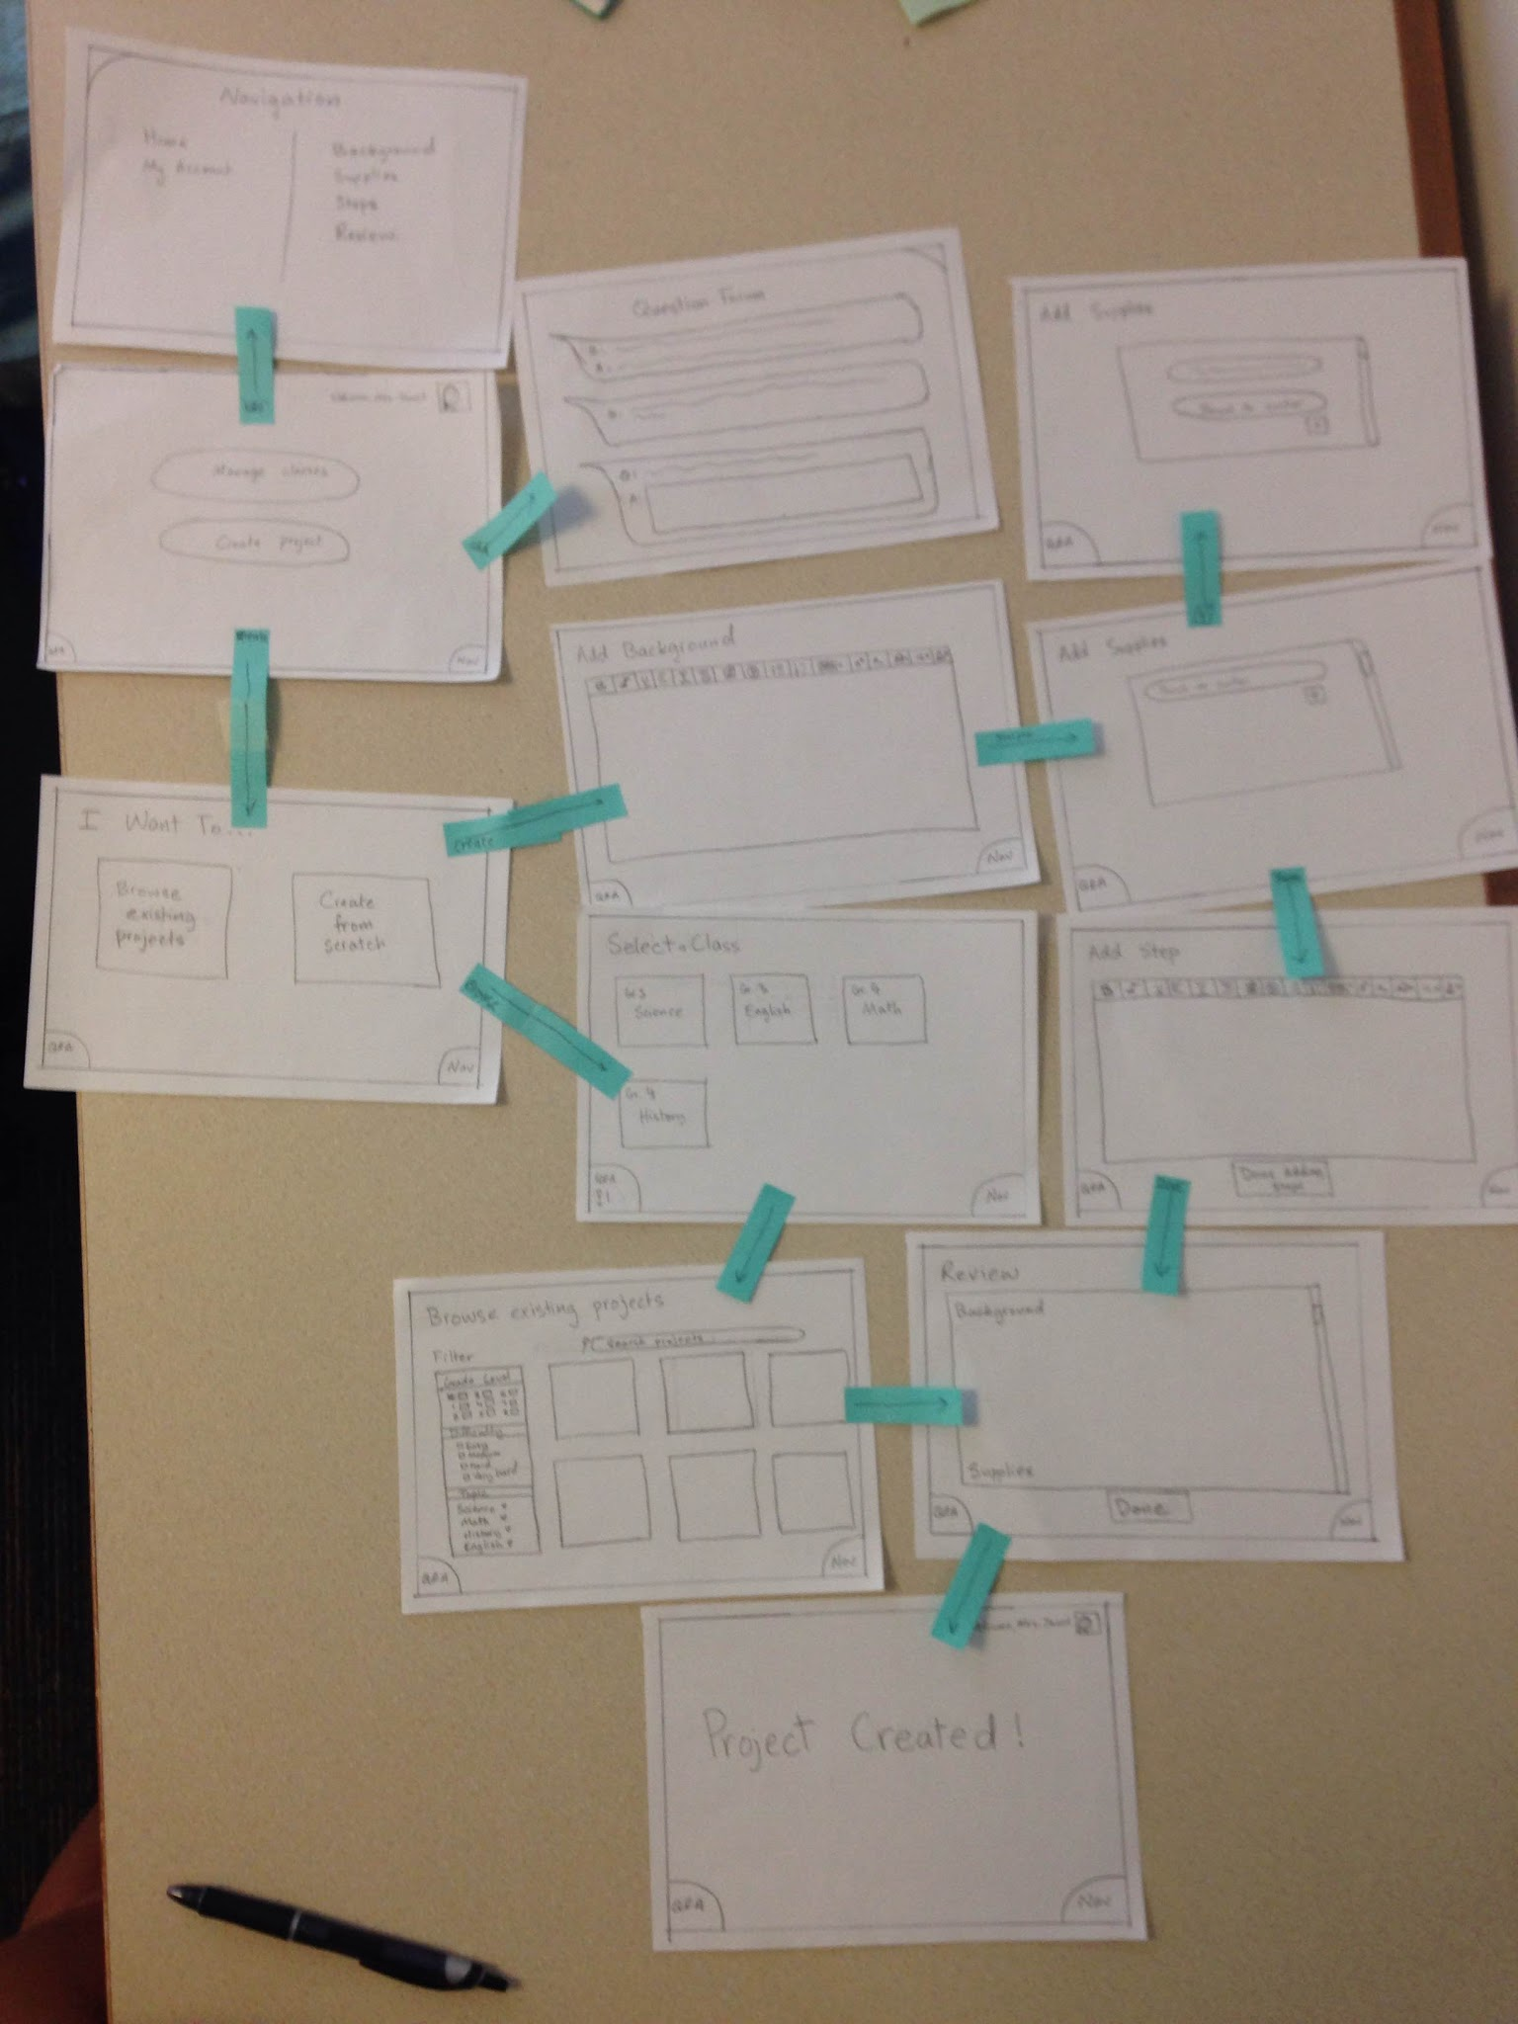
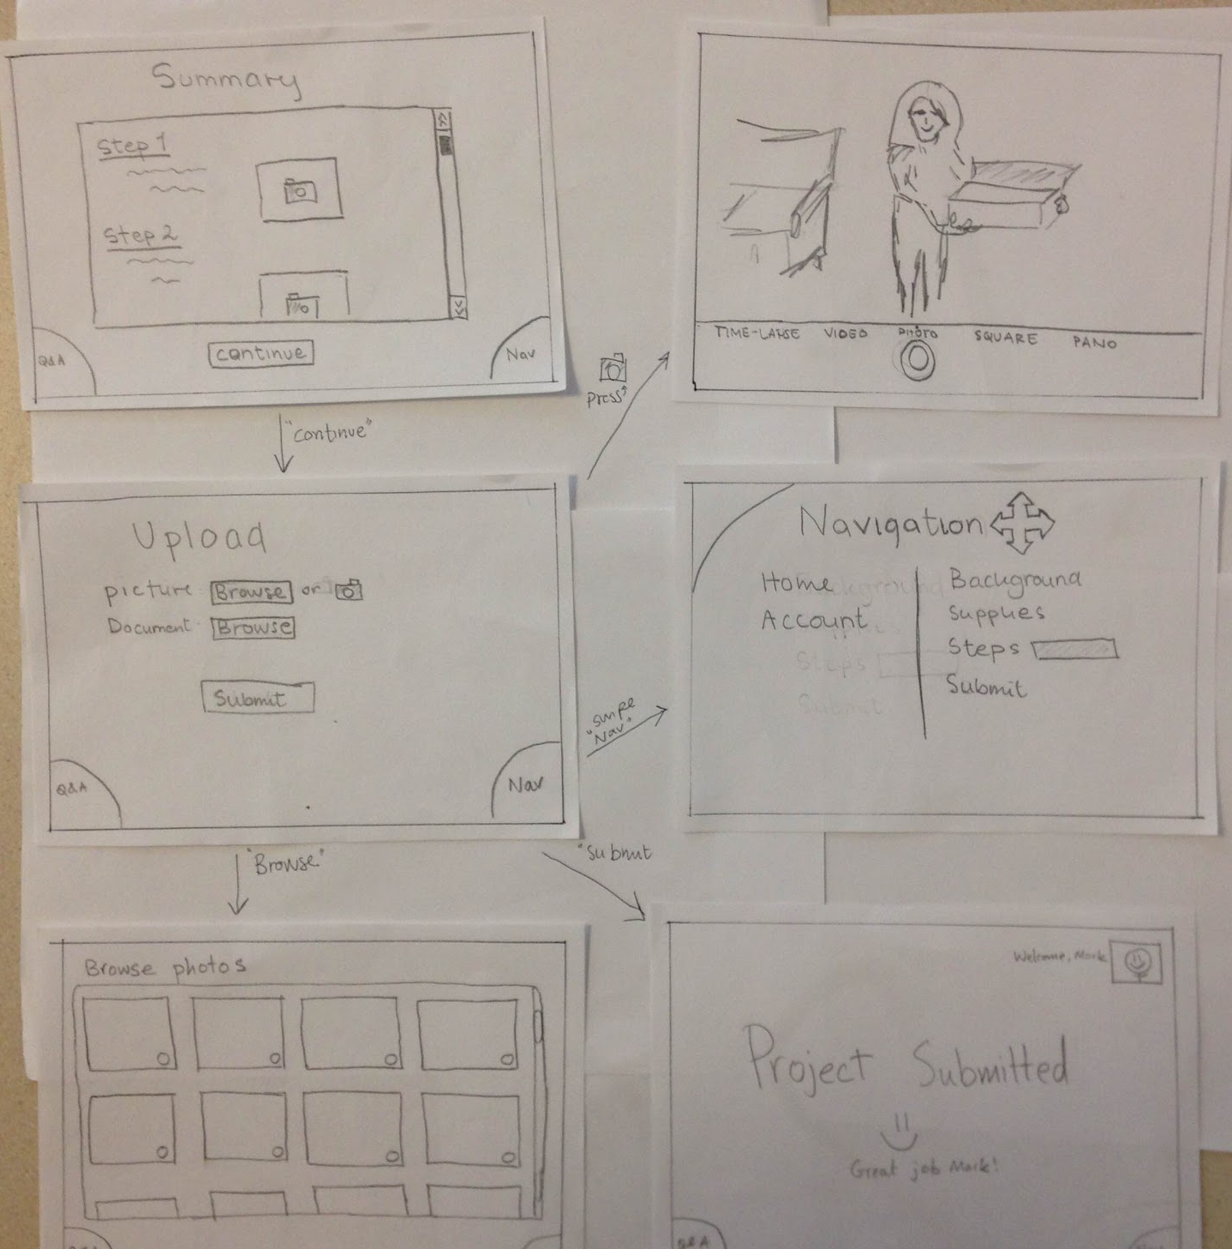
Lo-fi prototype structure
Simple Task
Medium Task
Complex Task

Slide 8
Task 1: Creating and Assigning Project
Teacher creates and assigns a class project with background info, a list of supplies, and instructions for students to follow.

Slide 9
Click create project

Slide 10
select class

Slide 11
press browse existing projects

Slide 12
Press create from scratch

Slide 13
Swipe right

Slide 14
Press +

Slide 15
Swipe right

Slide 16
Press “done adding steps”

Slide 17
Press “done”

Slide 18
Swipe Nav

Slide 19
Swipe Q&A

Slide 20
Task 2: Doing the Project
Students work on the project step-by-step and ask questions when needed.

Slide 21
Scroll through list, press a project

Slide 22
Press drop down bar

Slide 23
Swipe right

Slide 24
Swipe right

Slide 25
Swipe right

Slide 26
Swipe right

Slide 27
Swipe right

Slide 28
Swipe Q&A at any point of project

Slide 29
Swipe to go to Navigation at any point in project

Slide 30
Task 3: Submitting the Project
Students submit the completed class project for teacher review.

Slide 31
Press continue

Slide 32
Press “browse”

Slide 33
Press the camera button

Slide 34
Documents
Press browse

Slide 35
Press “submit”

Slide 36
Testing

Slide 37
Experimental Method
Target Audience: Elementary school teachers and students
Quick questions to understand context and technical background
Introduction of the user’s context
Completion of relevant tasks
Feedback/Comments/Suggestions

Slide 38
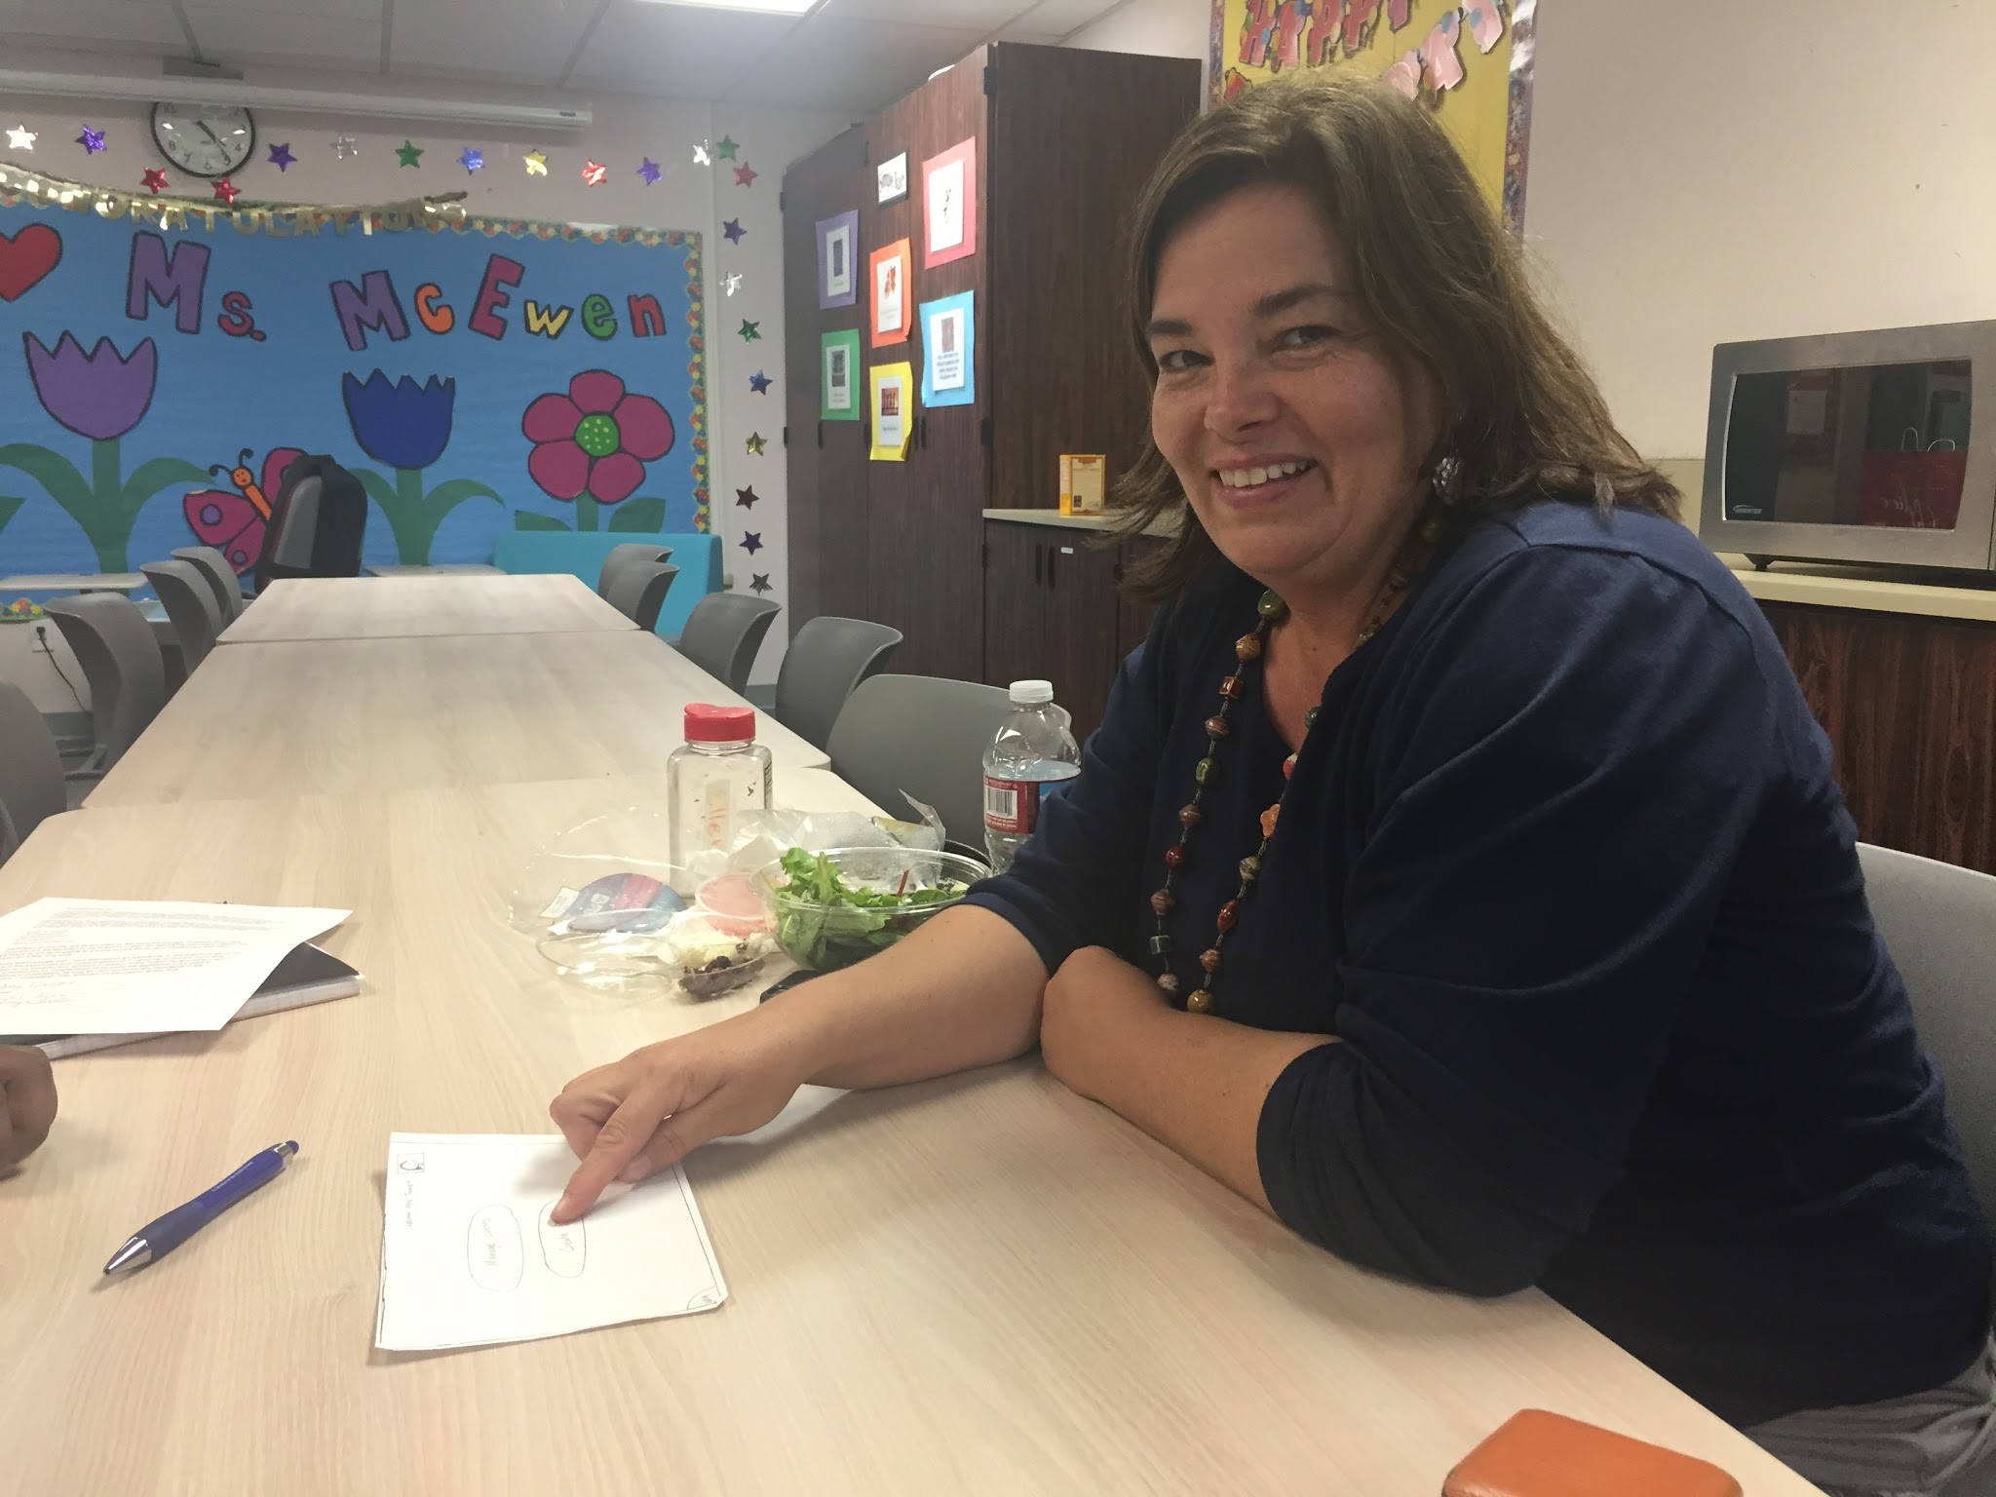
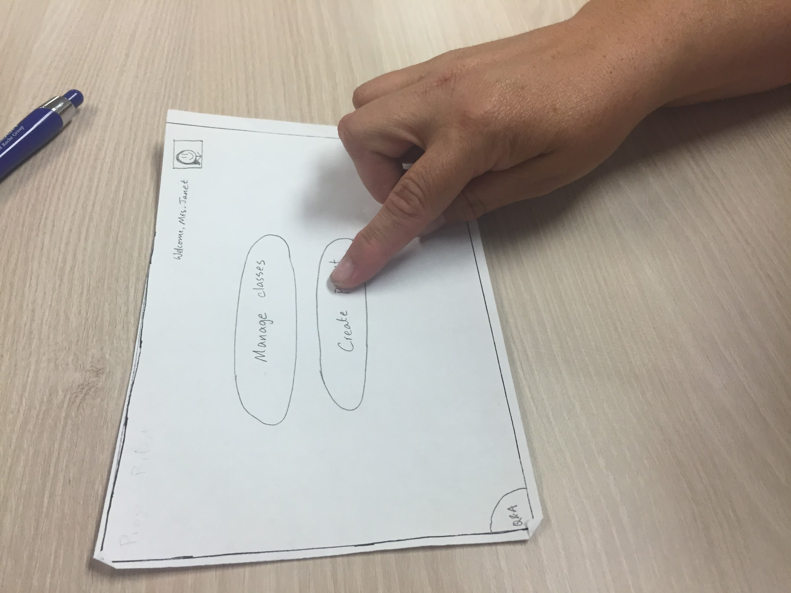
Test 1: Teacher
Figured out the interface quickly
Flow fit thought process
“Nav” and “Q/A” buttons not obvious
Adding pictures/video to pages was not obvious
Felt student could answer questions
Wanted export option

Slide 39
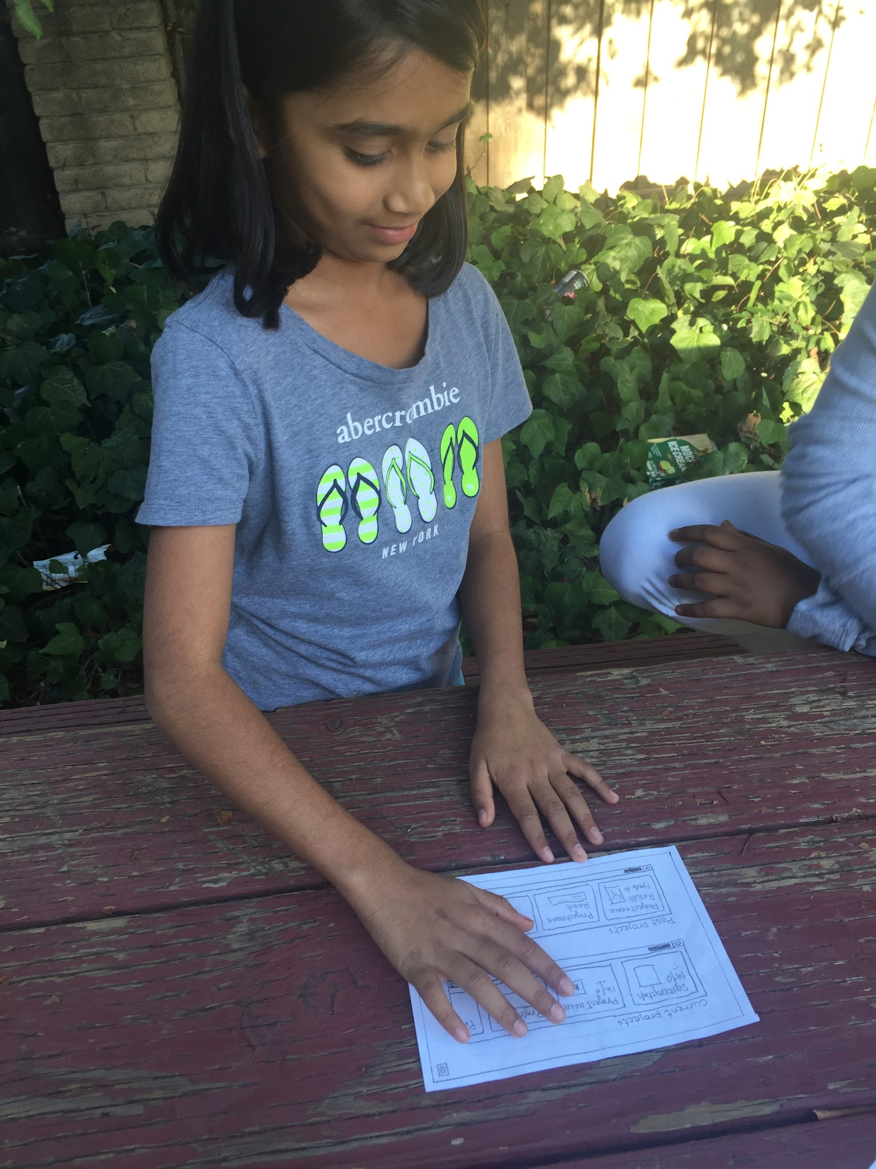
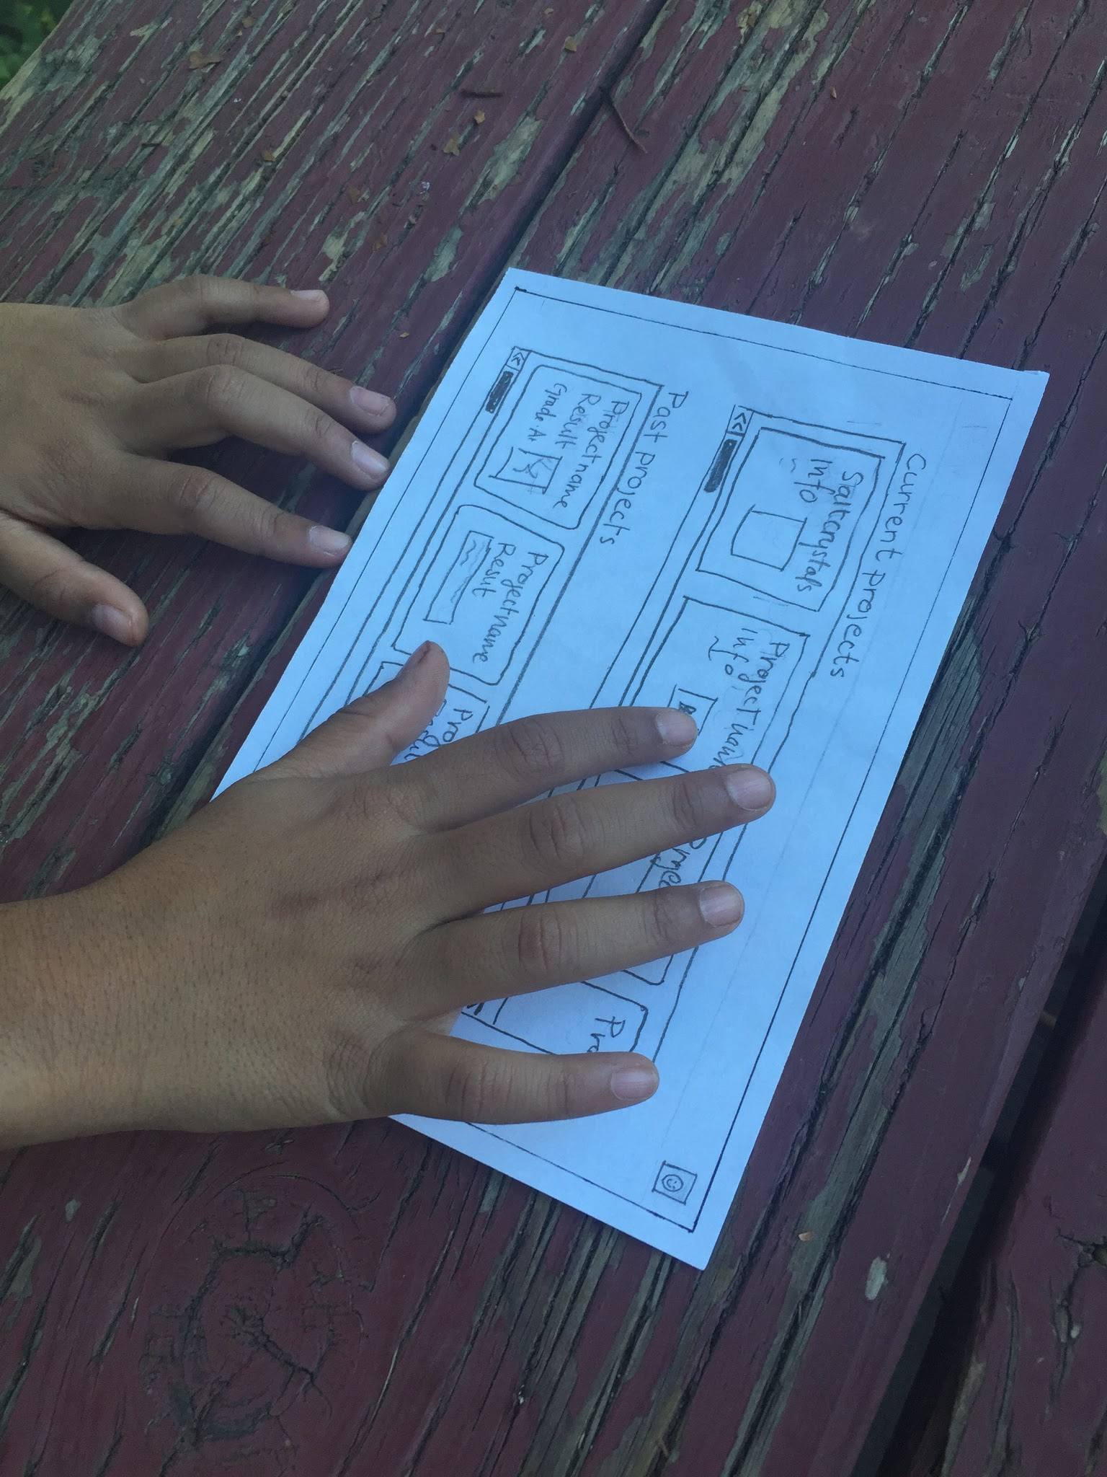
Test 2: Student 1
Thought the landing page was intuitive
Liked swiping between pages
Didn’t find corner button obvious
Felt like questions did not need to be private
Wanted to answer Q/A questions

Slide 40
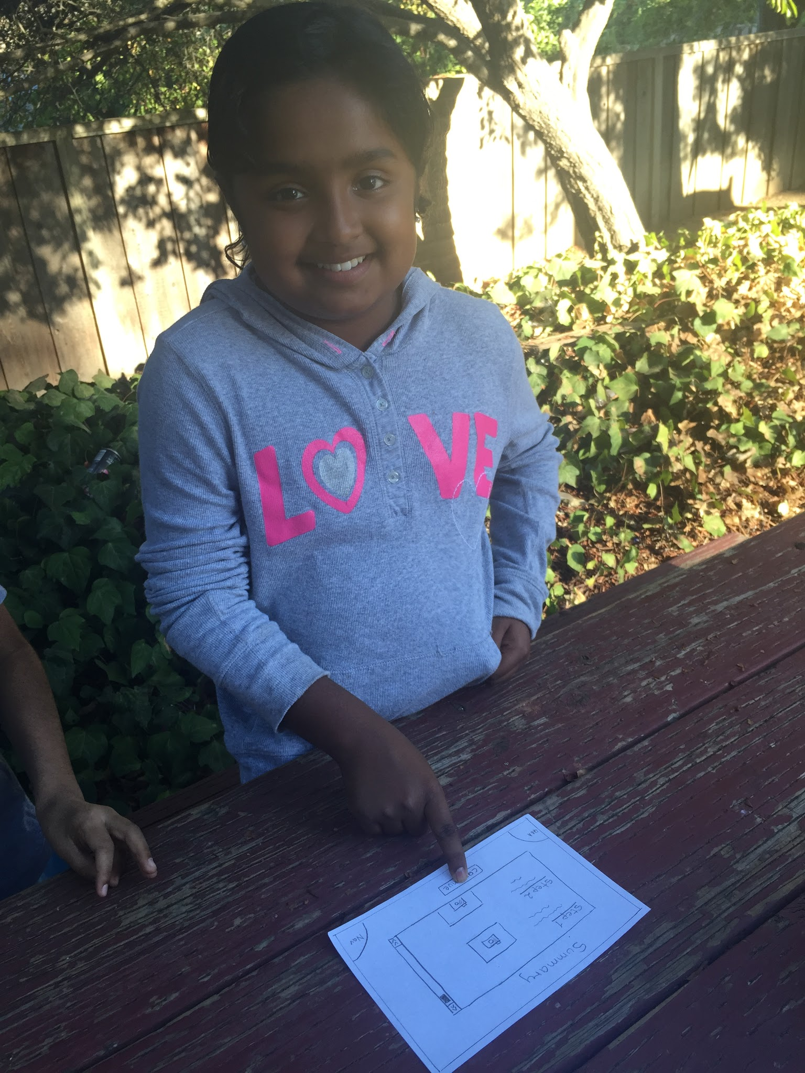
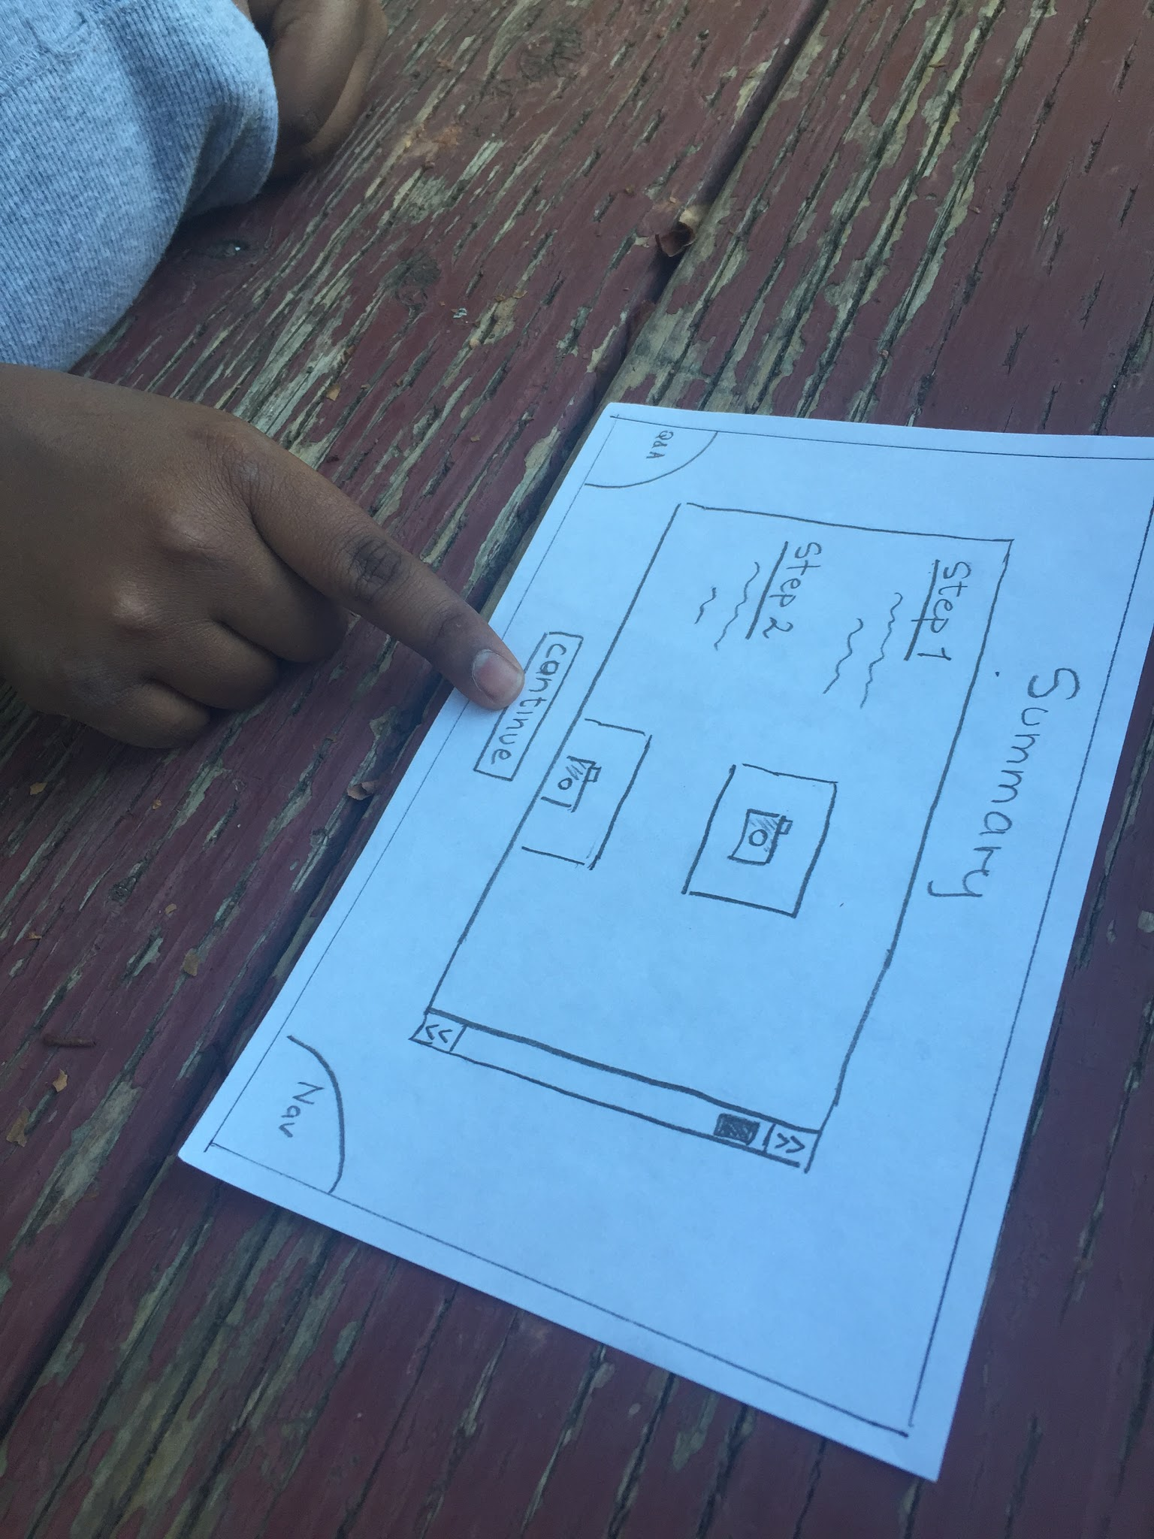
Test 3: Student 2
Wanted section for just-assigned projects
Wanted comments for questions
Confused by what “Nav” was
Thought corners could be touch-based as well
Really likes using the interface

Slide 41
Moving Forward

Slide 42
Changes to Current UI
Improve clarity and relevance of titles and headers
Change design and/or positioning of Q/A and Nav button to make them less confusing
Possible redesign project creation pages

Slide 43
Added features
Let students answer questions
Include way to export created projects
More student-to-student interaction

Slide 44
Summary
Task flows were seen as intitive
Opinions on the interface were generally positive
Need to improve our UI to mitigate confusion
New features of the app we need to add on

Slide 45
Thank you!

