Slide 1
Focusing In:
Points of View and Experience Prototypes
EduConnect
Presented by: Gerardo Sanz

Slide 2
Introduction
Notes:
Introduce Teammates!!
Focus area: within education -> the elementary school!
after needfinding, we became interested in exploring relationships between teachers, students, and parents - so we wanted to build a project on which all of these actors would interact
let’s take a moment to look back at the conclusion of last week’s needfinding efforts -- the first POV is as follows...

Slide 3
We met Professor Ellis who needs to homeschool his child because of irreconcilable differences with his child’s teacher over grading and structure of schoolwork. It would be game changing if we could facilitate productive and responsive conversations between teachers and parents in the elementary school setting.
Notes:
ask someone to read this

Slide 4
We met Zilan, a 6th grader, who needs learning to be interactive and fun because of the way she likes to engage with information. It would be game changing if we could make schoolwork more hands-on and active for young children.
Notes:
ask someone to read this
-> we wanted to learn more, so we embark in the process of additional needfinding

Slide 5
Additional Needfinding

Slide 6
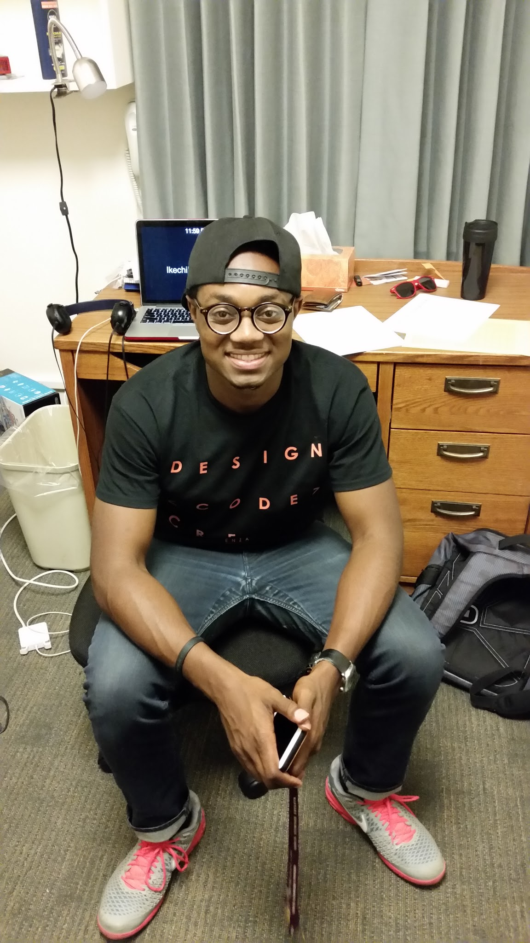
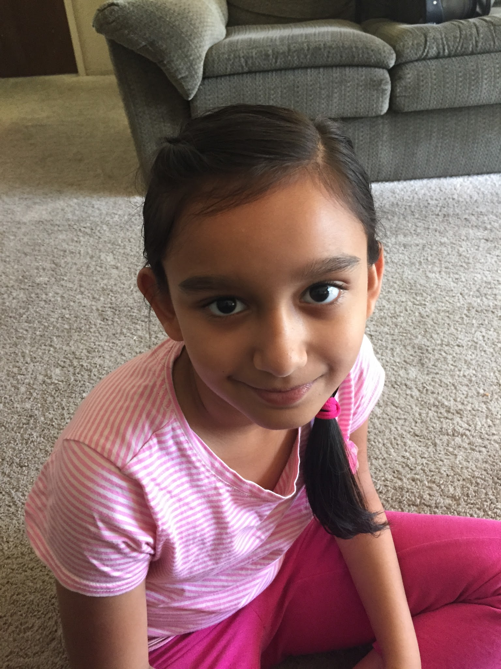
Additional interviews
Shalini Rao - 5th grade, Cupertino
Likes science because of the experiments
The teacher doesn’t check what they learn
She’s using Gmail, Edmodo and class website
Brandon Hill - Senior Public Policy
“Banana project” in 4th grade introduced him to social justice
We inferred that introducing diverse topics can spark life long interest
Notes:
banana project: letter writing young child farm workers

Slide 7
“The project made me interested, and in high school I took action myself.”
Brandon
“Watching the reaction made me more curious.”
Shalini
“The project made me interested, but in high school i took action myself”
“Learning is the best part of school”
Notes:
Further Insights to share in class:
With the brandon quote -- shows how project based work can be extremely impactful
With teh Shalini quote -- project based work boosts intellectual curiosity, but also memory! anecdote about 15ml
Another strong memory of a project
Shalini gets information from school from multiple sources
she likes hands on, especially science lab

Slide 8
Revised Points of View
Notes:
emphasize synthesis of perspectives and lessons learned

Slide 9
Revised Points of View
We met Ivan, Zilan, and Brandon, current and former public school students --
We were amazed to find that they all expressed feelings of empowerment and engagement as a result of project-based coursework.
It would be game changing to make project-based work the centerpiece of the modern classroom.
We met Professor Ellis, a professor at Stanford and parent of a homeschooled child and Rachel Baker, former teacher and current professor at UC Irvine --
We were amazed to find how lapses in communication can lead to educational failure.
It would be game changing to facilitate conversations inside and outside the classroom.

Slide 10
How Might We...

Slide 11
POV to HMW
We met Ivan, Zilan, and Brandon, current and former public school students --
We were amazed to find that they all expressed feelings of empowerment and engagement as a result of project-based coursework.
It would be game changing to make project-based work the centerpiece of the modern classroom.
How might we incorporate academic curriculum into interactive and collaborative projects?

Slide 12
POV to HMW
We met Professor Ellis, a professor at Stanford and parent of a homeschooled child and Rachel Baker, former teacher and current professor at UC Irvine --
We were amazed to find how lapses in communication can lead to educational failure.
It would be game changing to facilitate conversations inside and outside the classroom.
How might we use technology to strengthen the student-parent-teacher relationship?

Slide 13
POV to HMW
We met Ivan, Zilan, and Brandon, current and former public school students --
We were amazed to find that they all expressed feelings of empowerment and engagement as a result of project-based coursework,
It would be game changing to make project-based work the centerpiece of the modern classroom.
We met Professor Ellis, a professor at Stanford and parent of a homeschooled child and Rachel Baker, former teacher and current professor at UC Irvine --
We were amazed to find how lapses in communication can lead to educational failure.
It would be game changing to facilitate conversations inside and outside the classroom.
How might we identify and incorporate a child’s interests into coursework to increase ownership and engagement?

Slide 14
brainstorm
How might we incorporate academic curriculum into interactive and collaborative projects?
How might we use technology to strengthen the student-parent-teacher relationship?
How might we identify and incorporate a child’s interests into coursework to increase ownership and engagement?

Slide 15
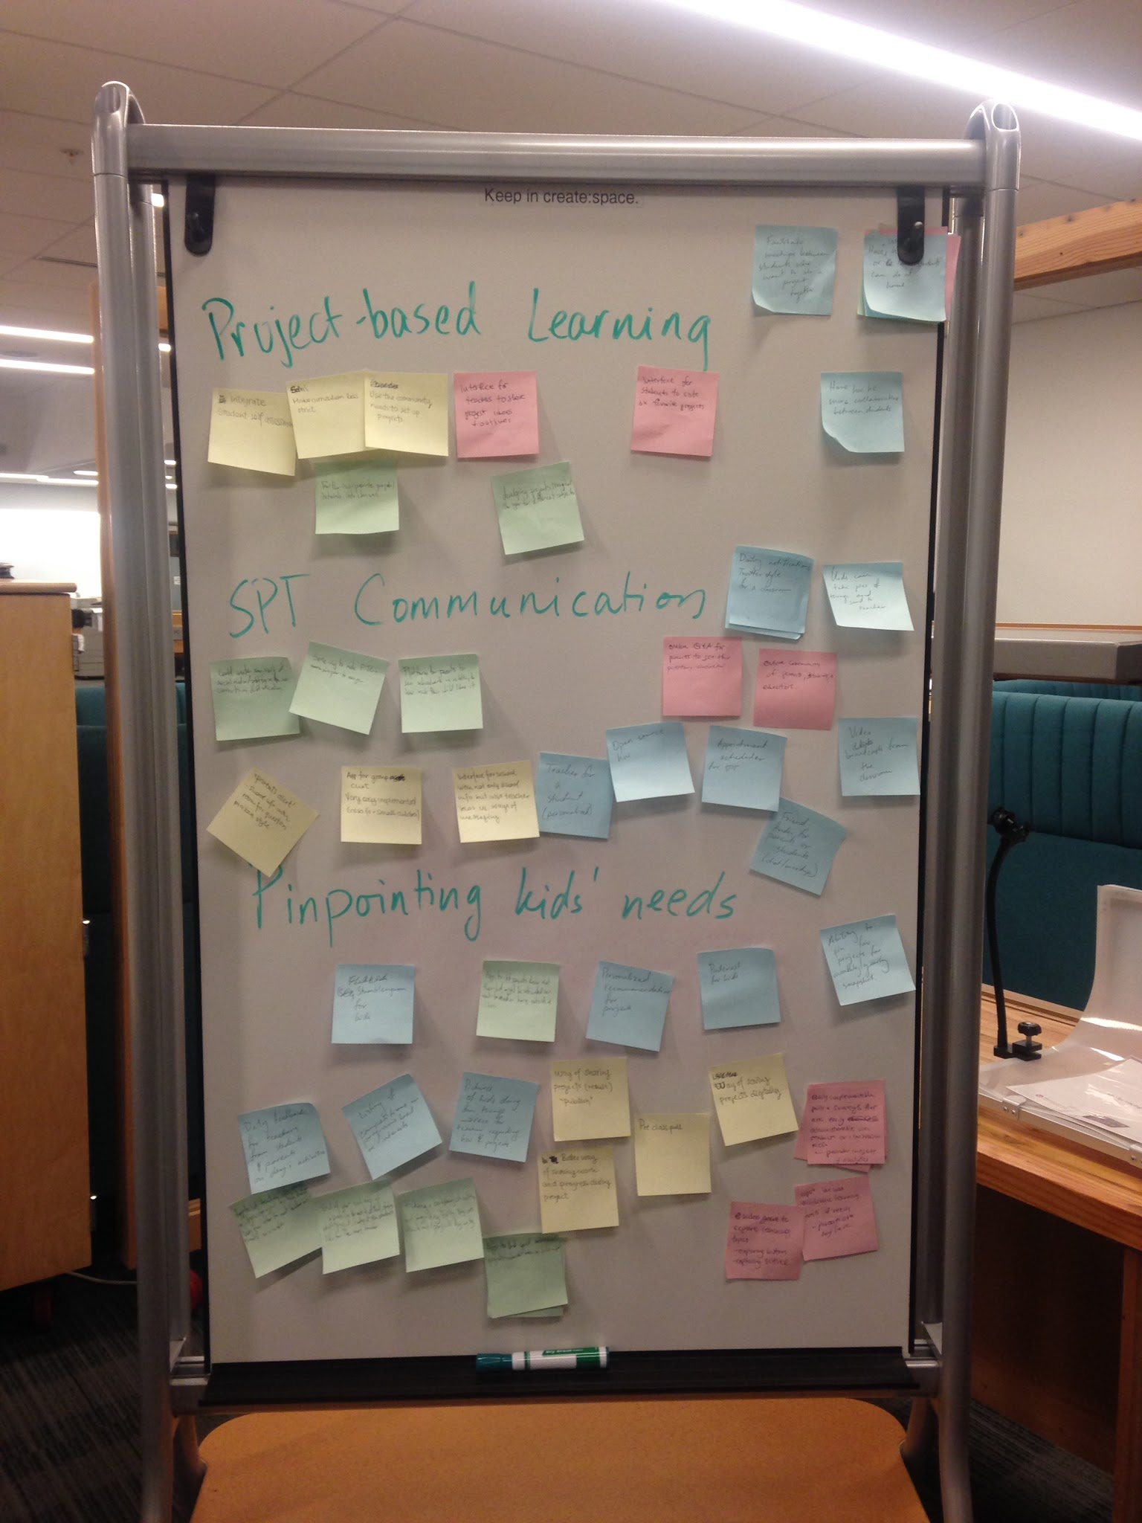

Slide 16
Experience Prototypes

Slide 17
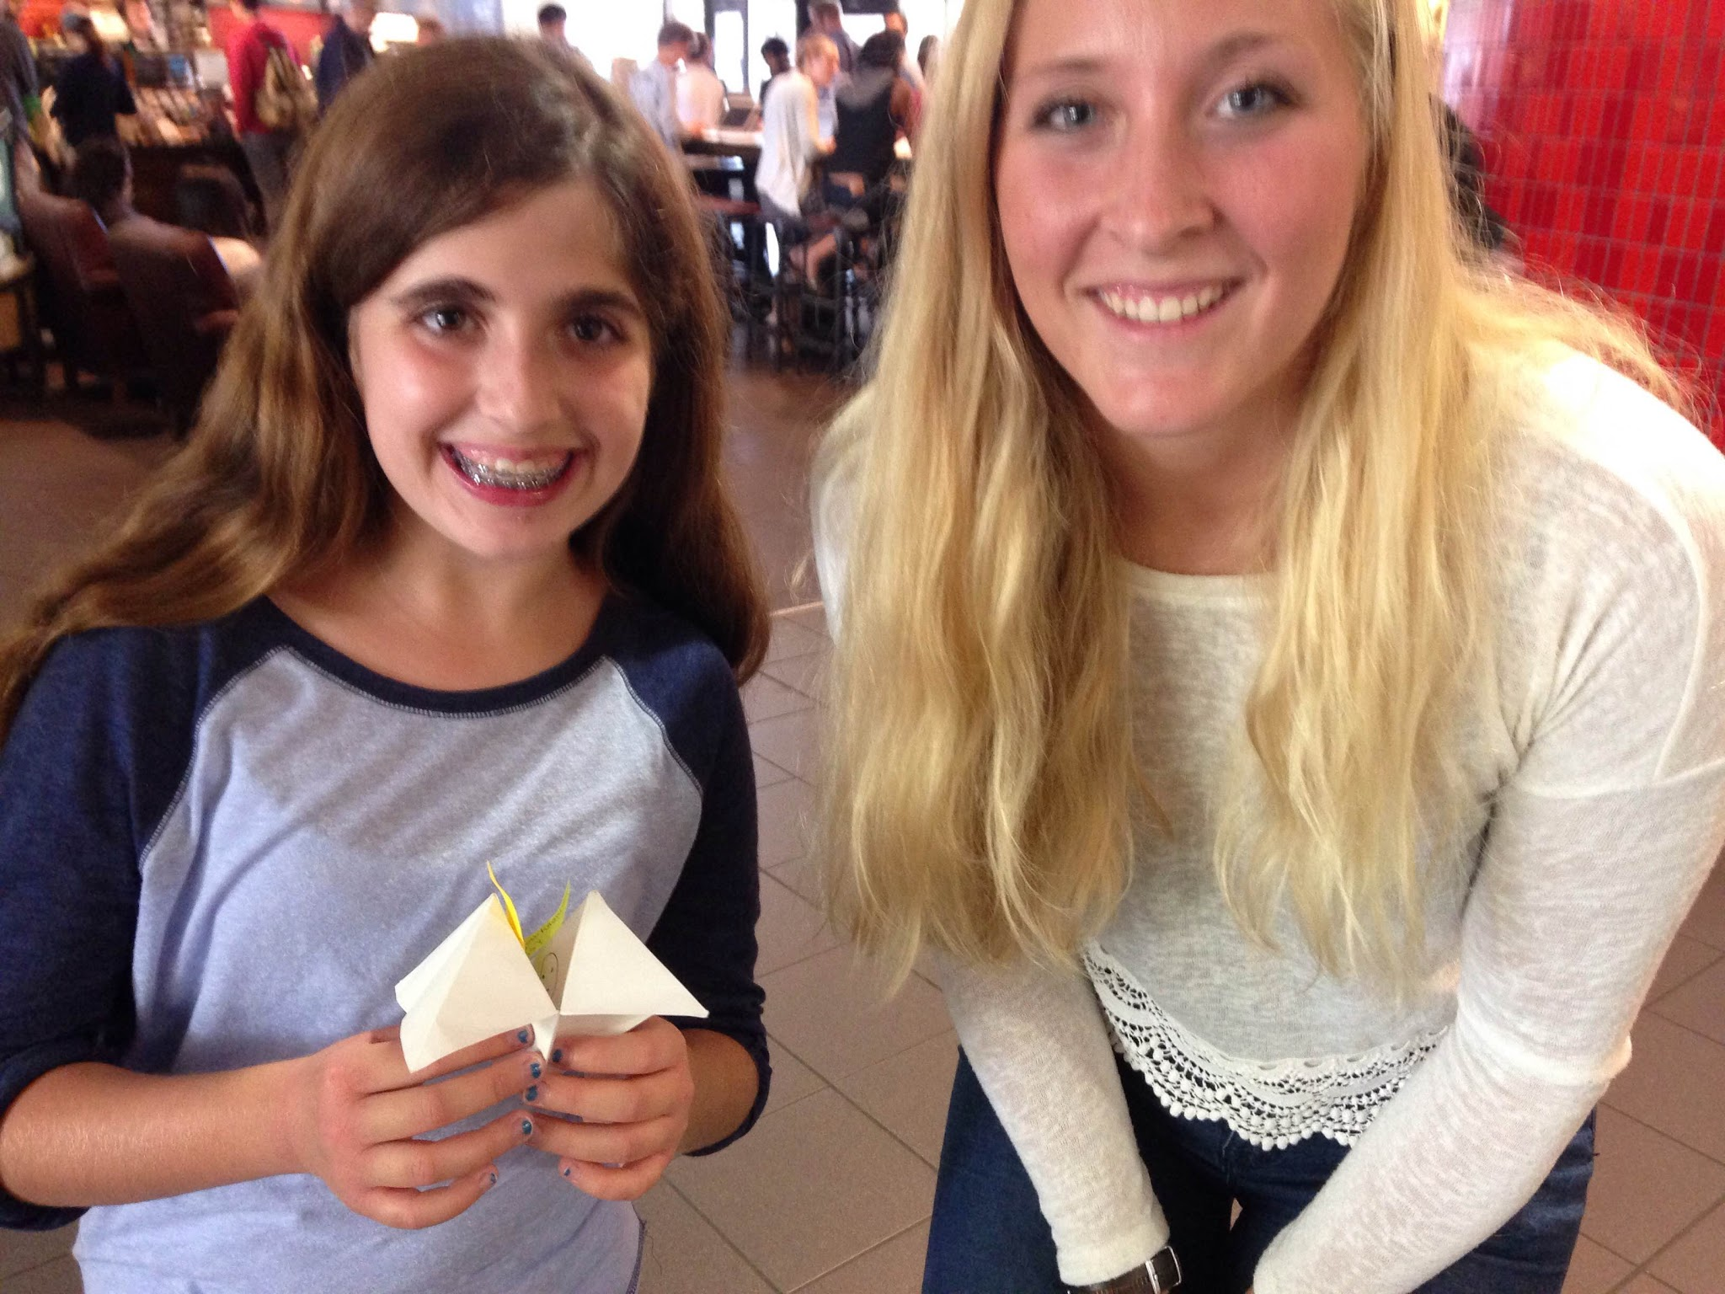
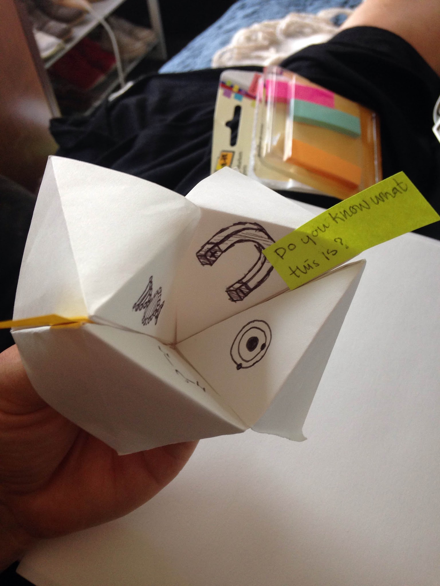
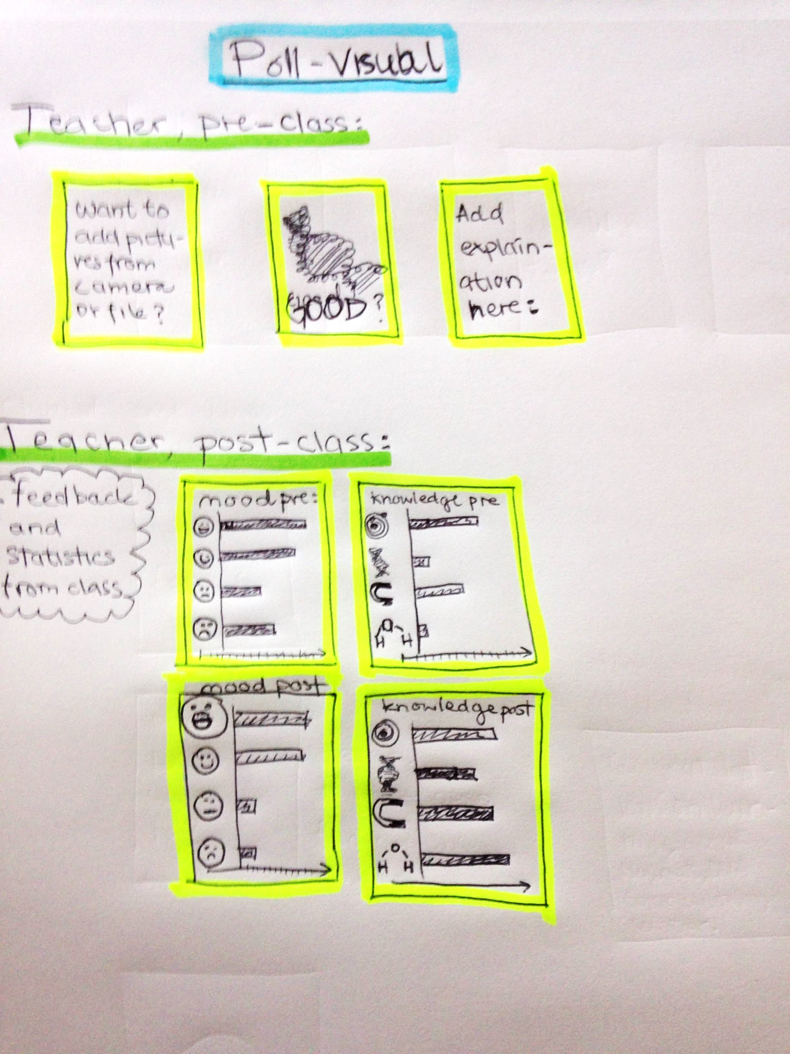
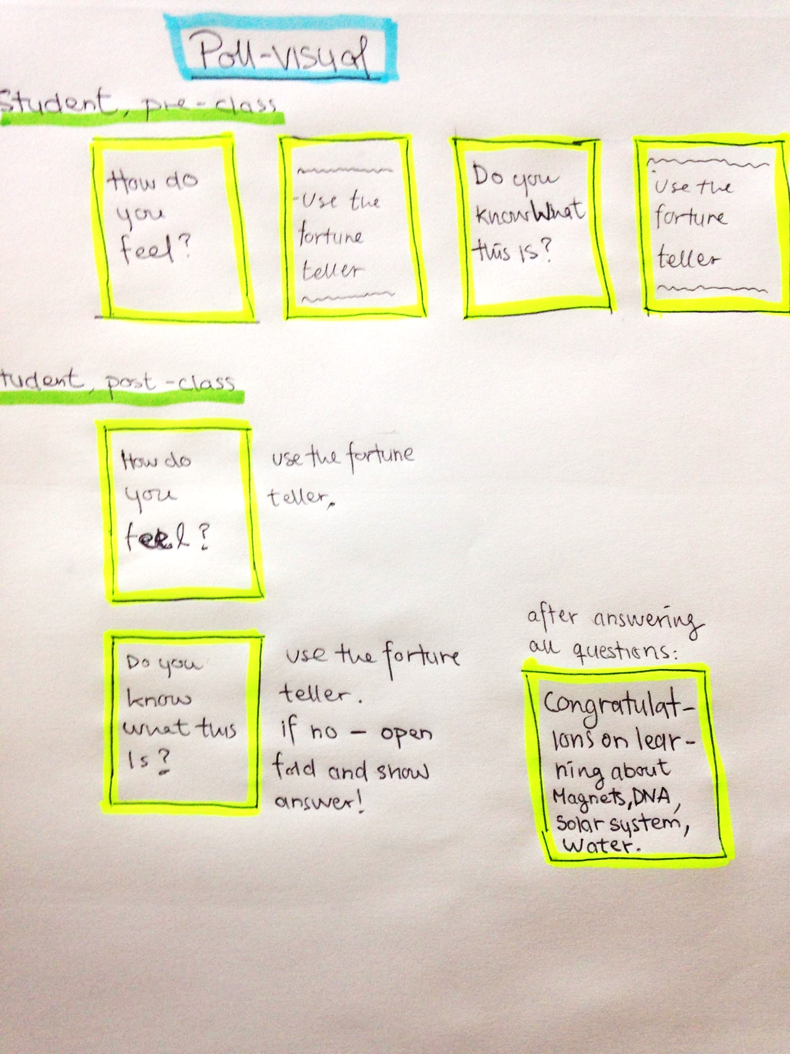
We want to pinpoint a child’s interests…
Visual approach to in-class polling that provides insights to teachers!
We found...
student wanted to talk more about understanding
simplicity/visual nature was well received
relying too much on visuals might leave questions unanswered, or leave too much to interpretation

Slide 18
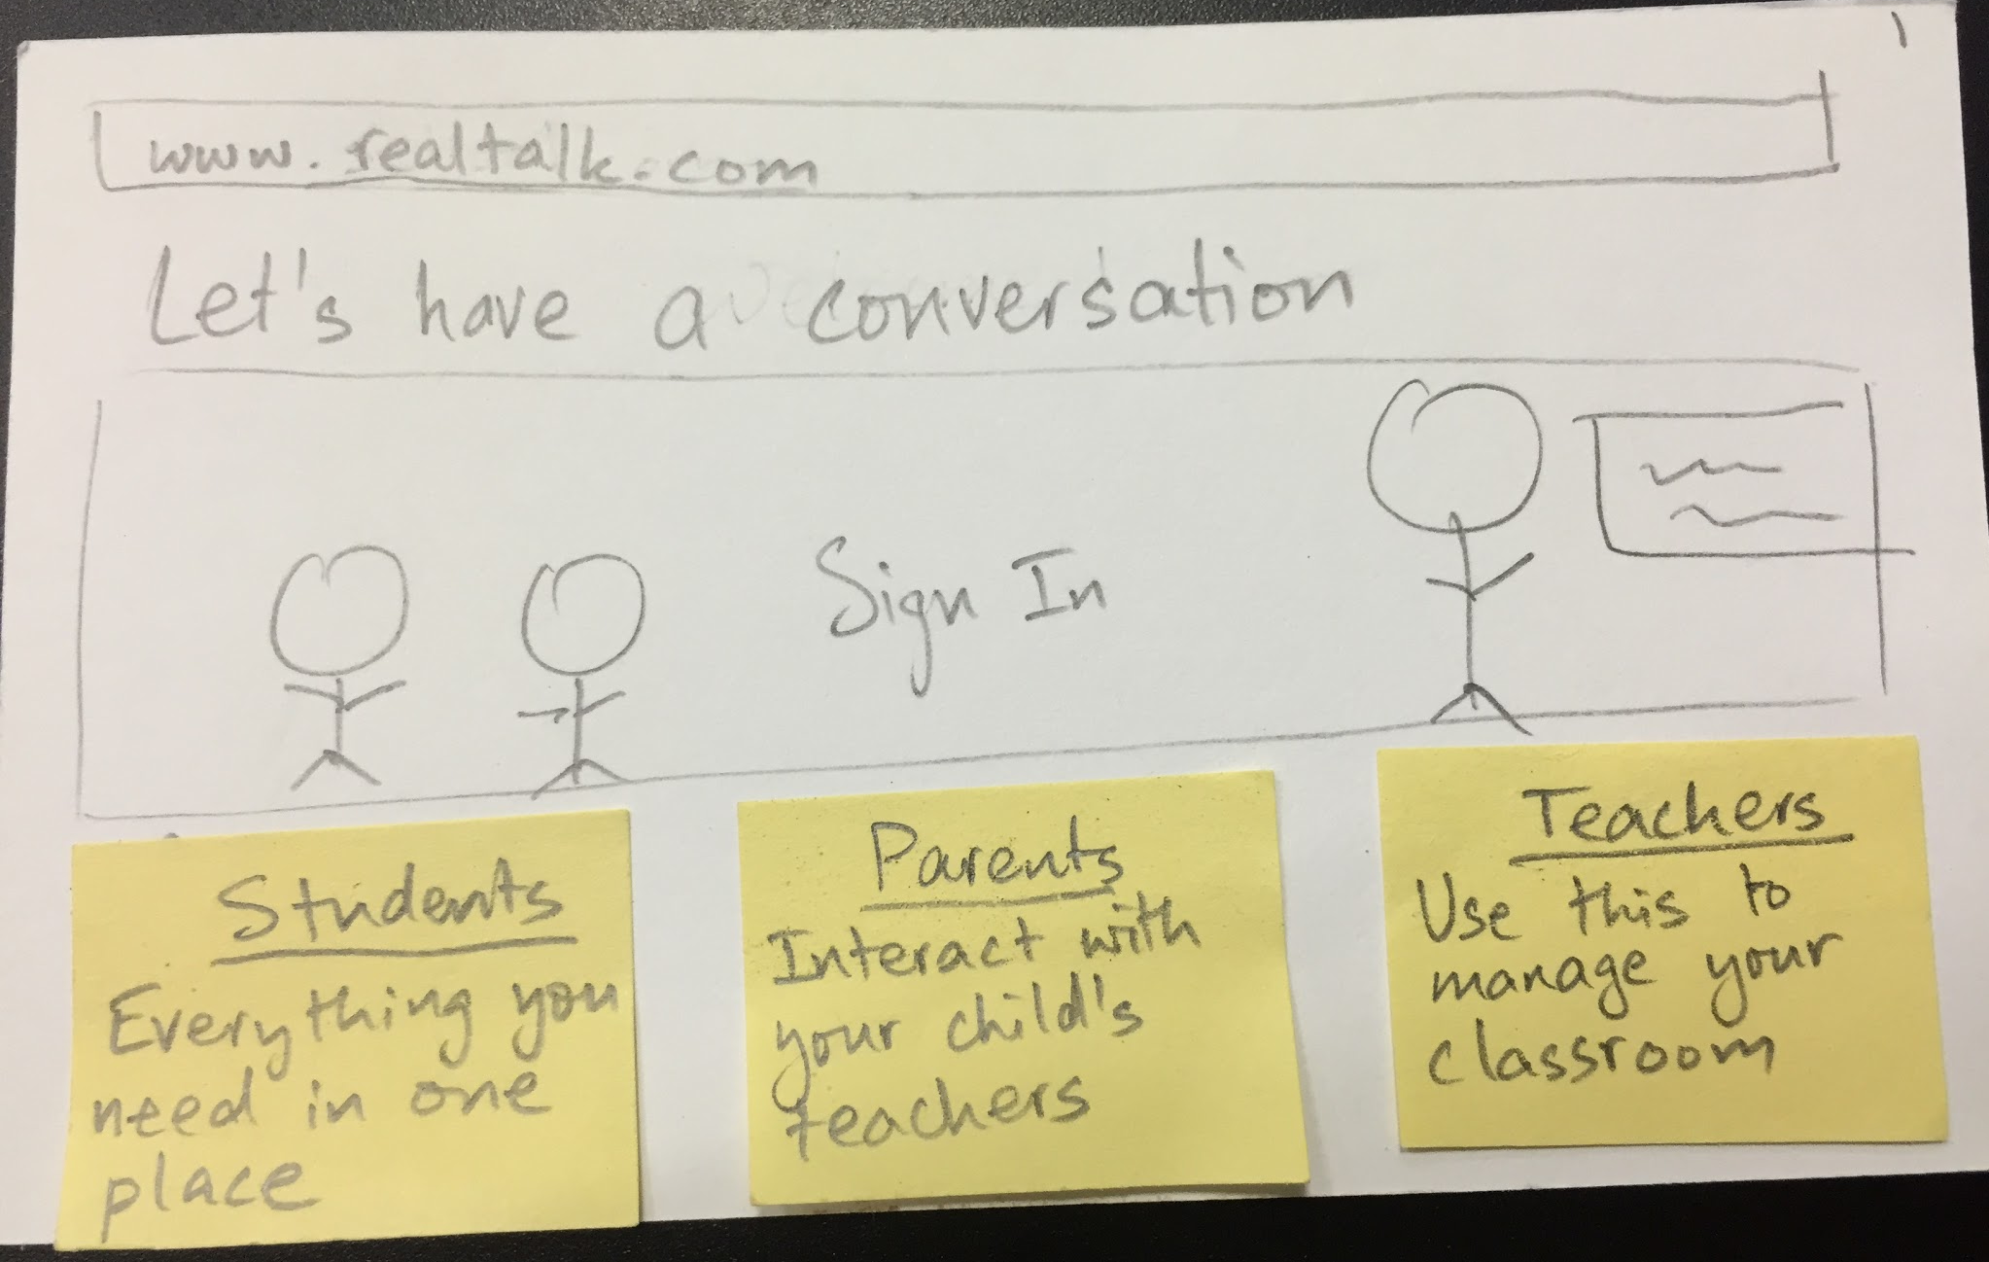
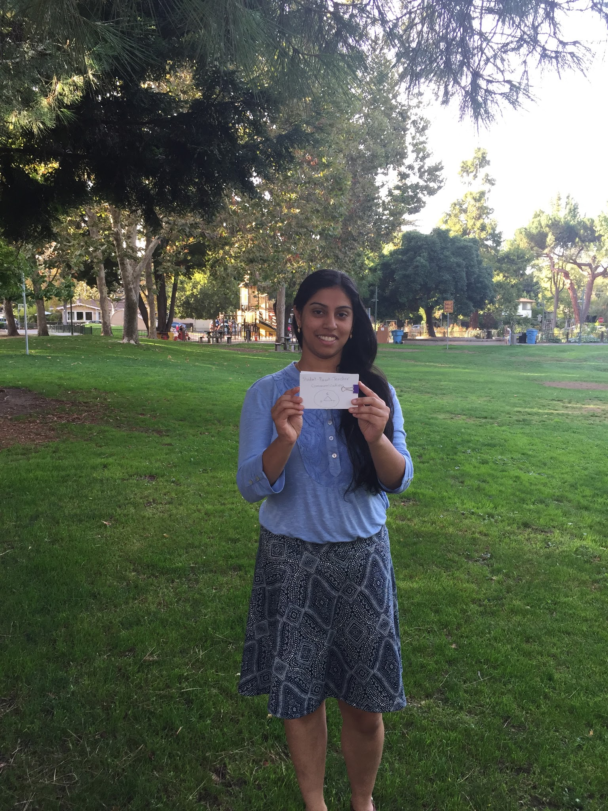
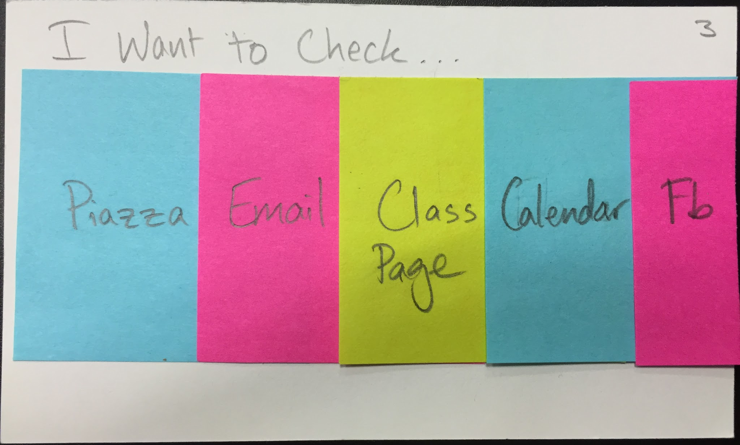
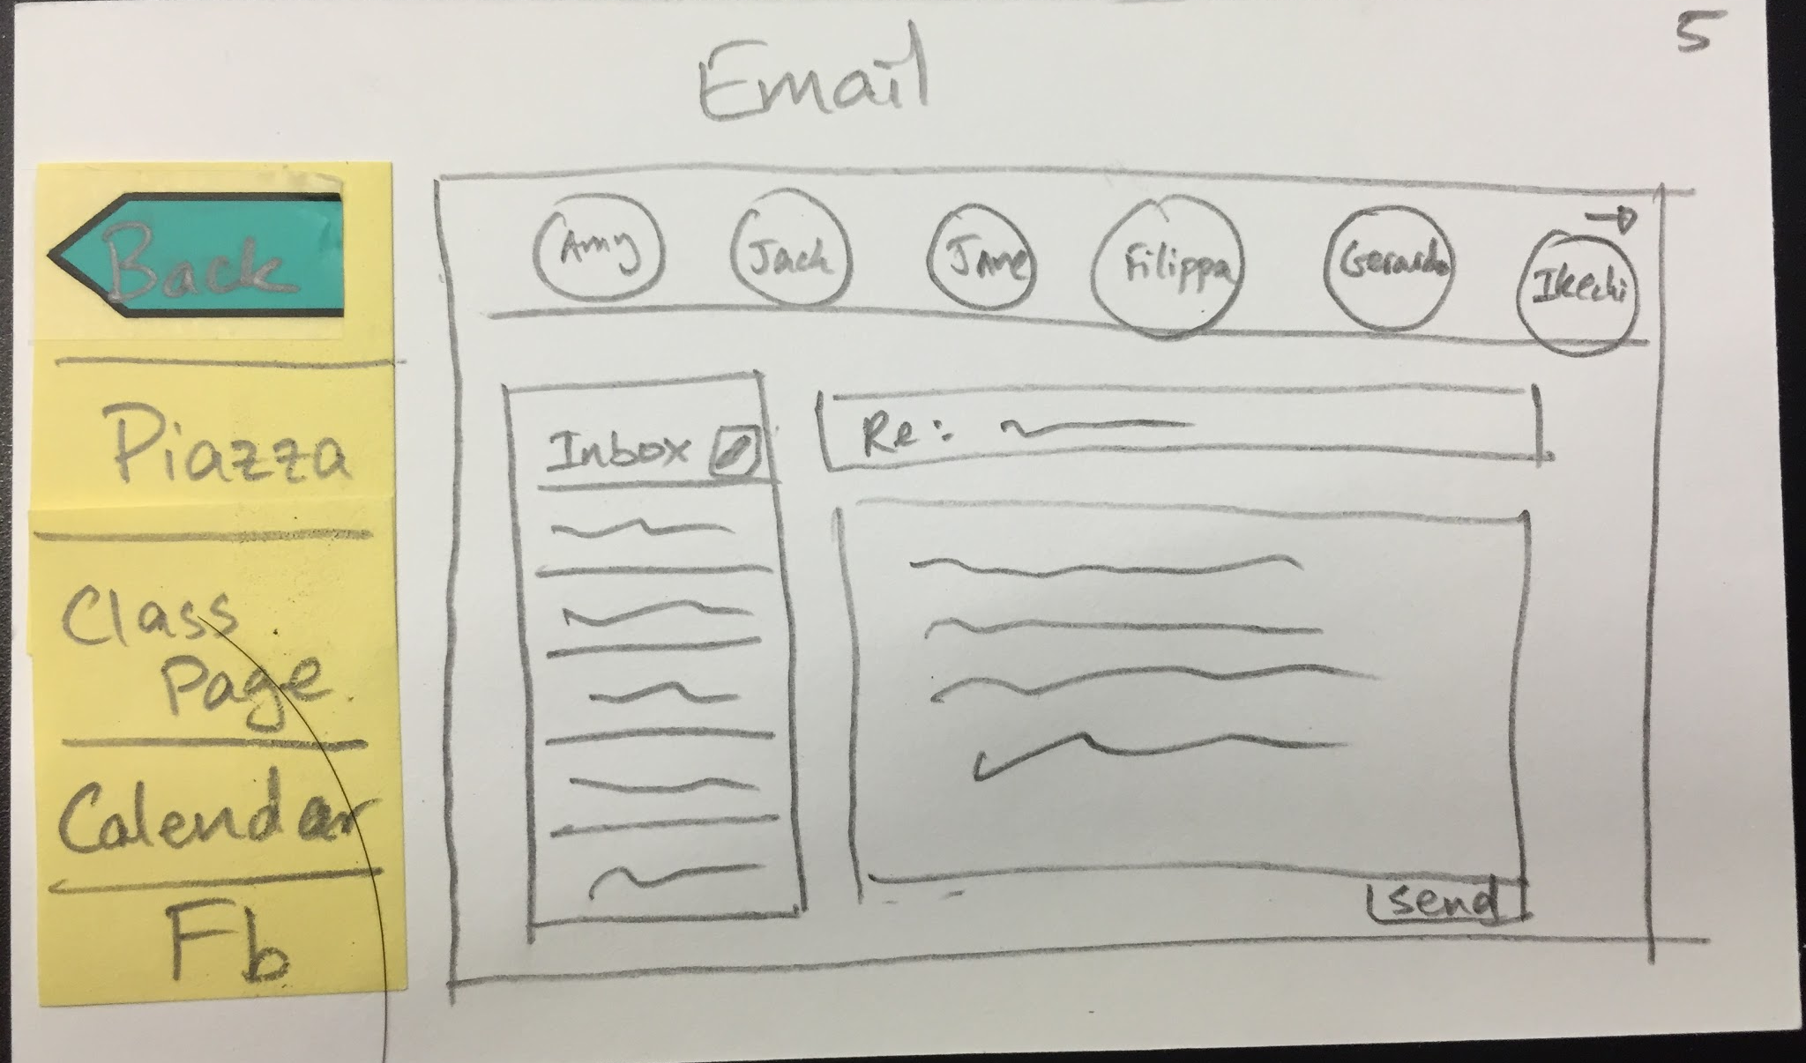
We want to leverage technology to improve the student-parent-teacher relationship...
Cross Platform interface for parents, students, and teachers to share questions, updates, and relevant documents. We want to “put it all in one place”!
facebook was a no-no
having everything in one spot was good

Slide 19
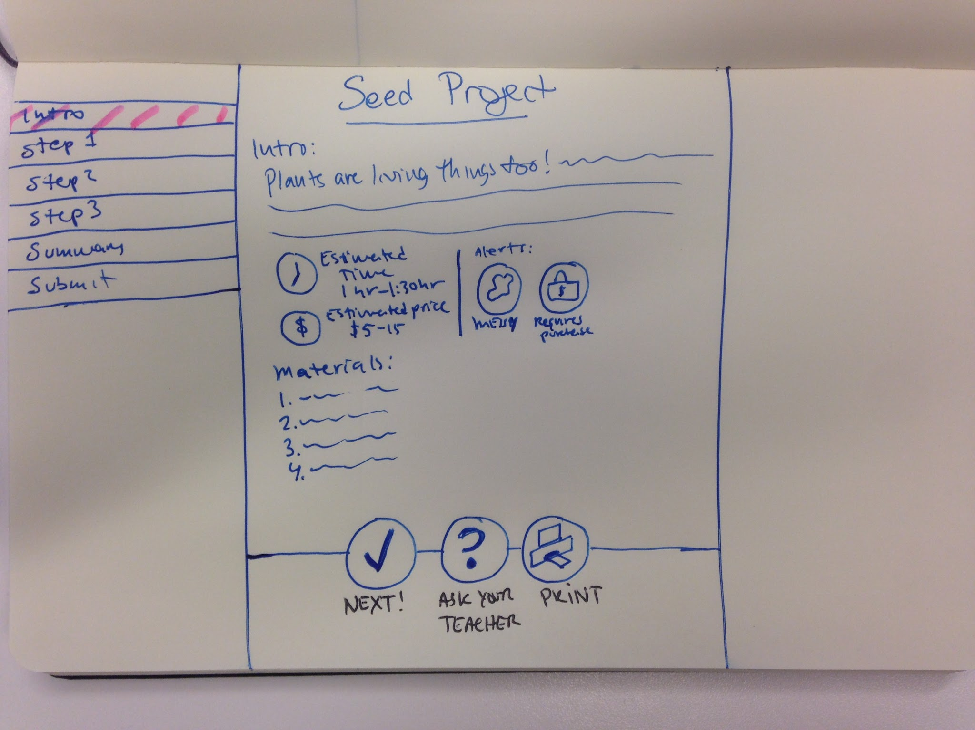
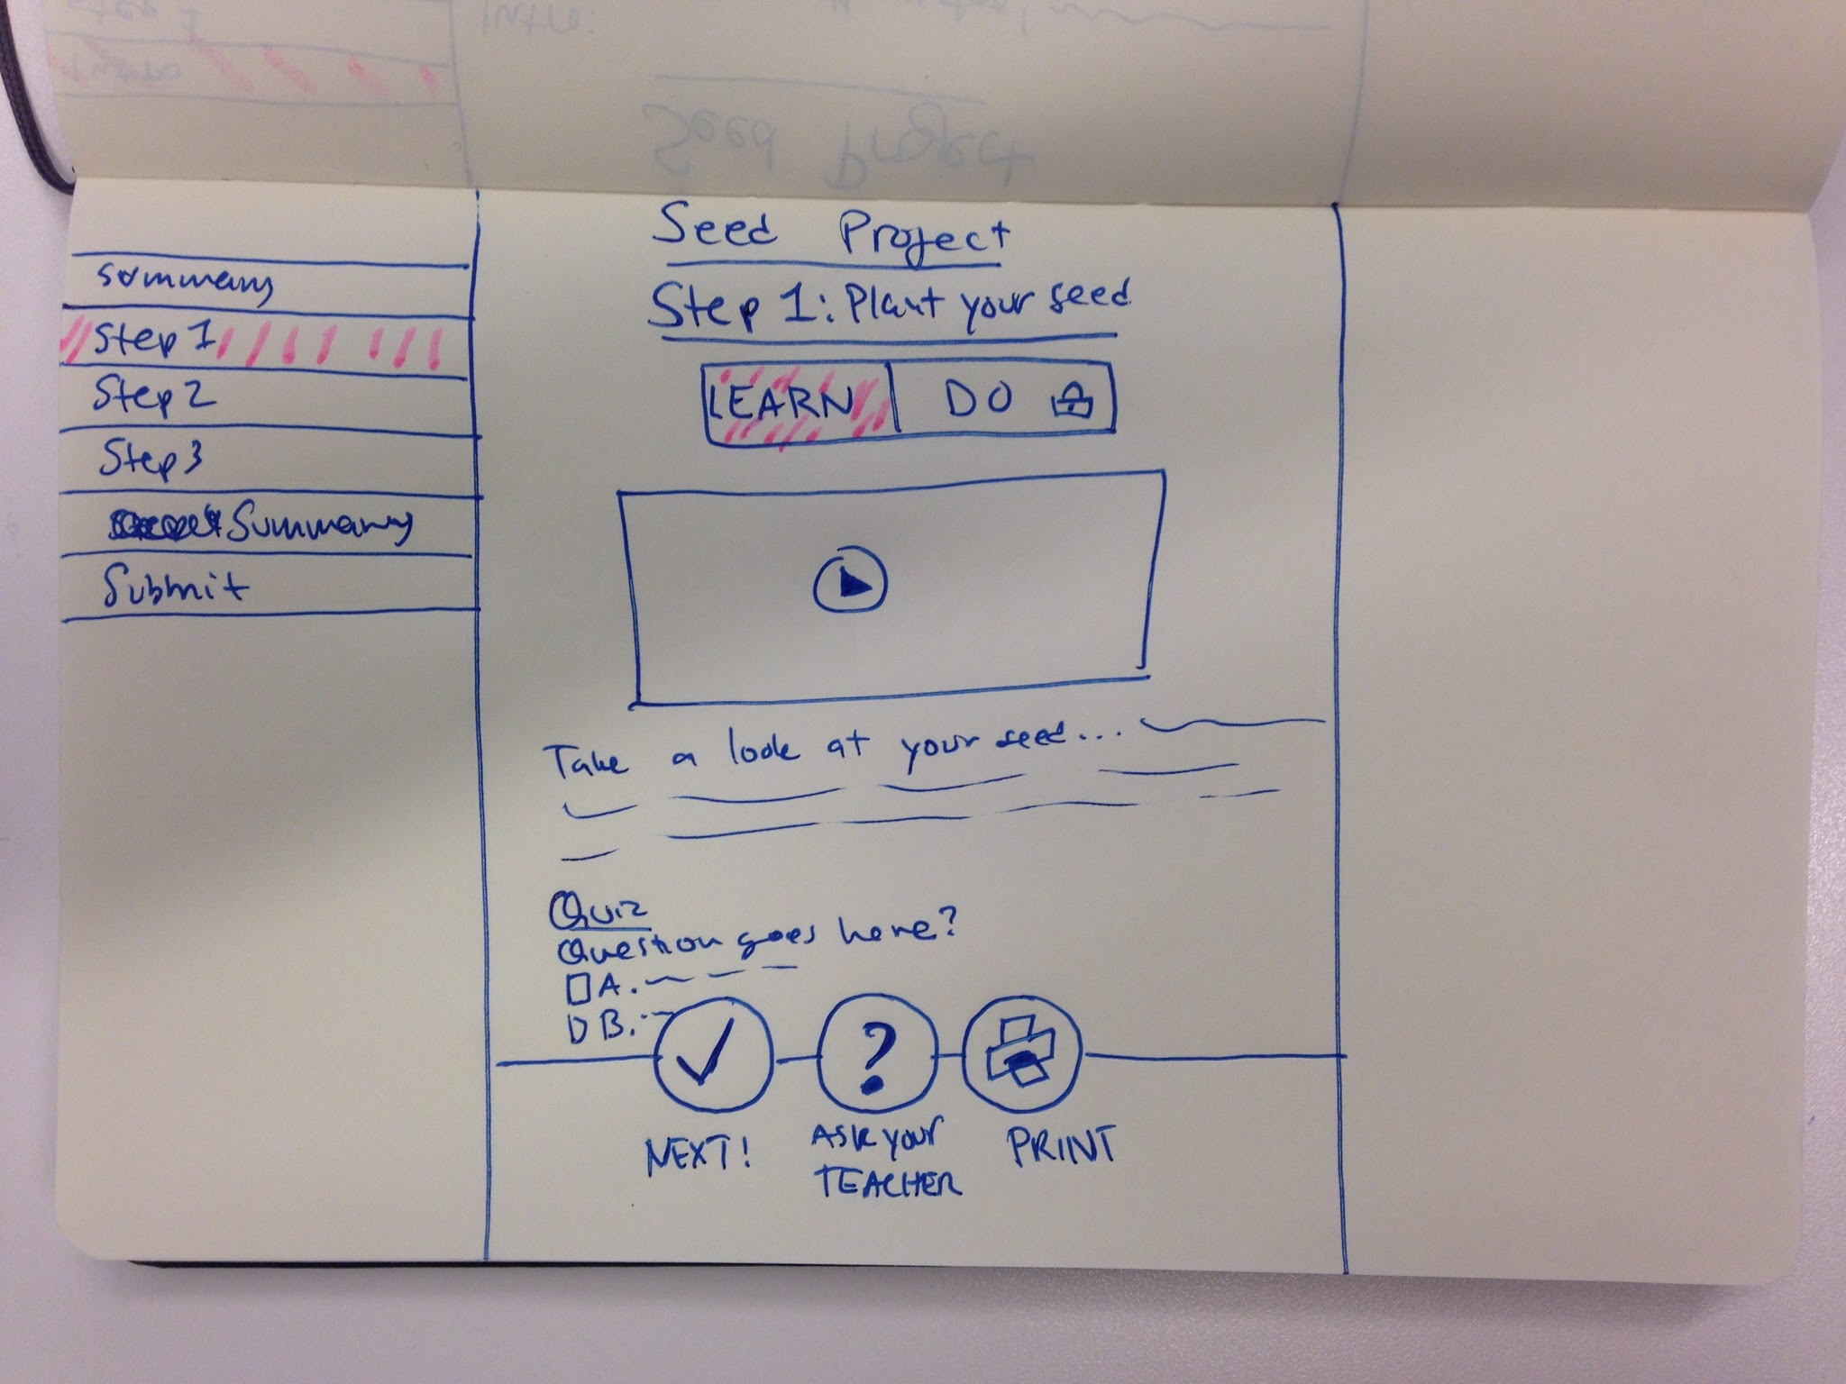
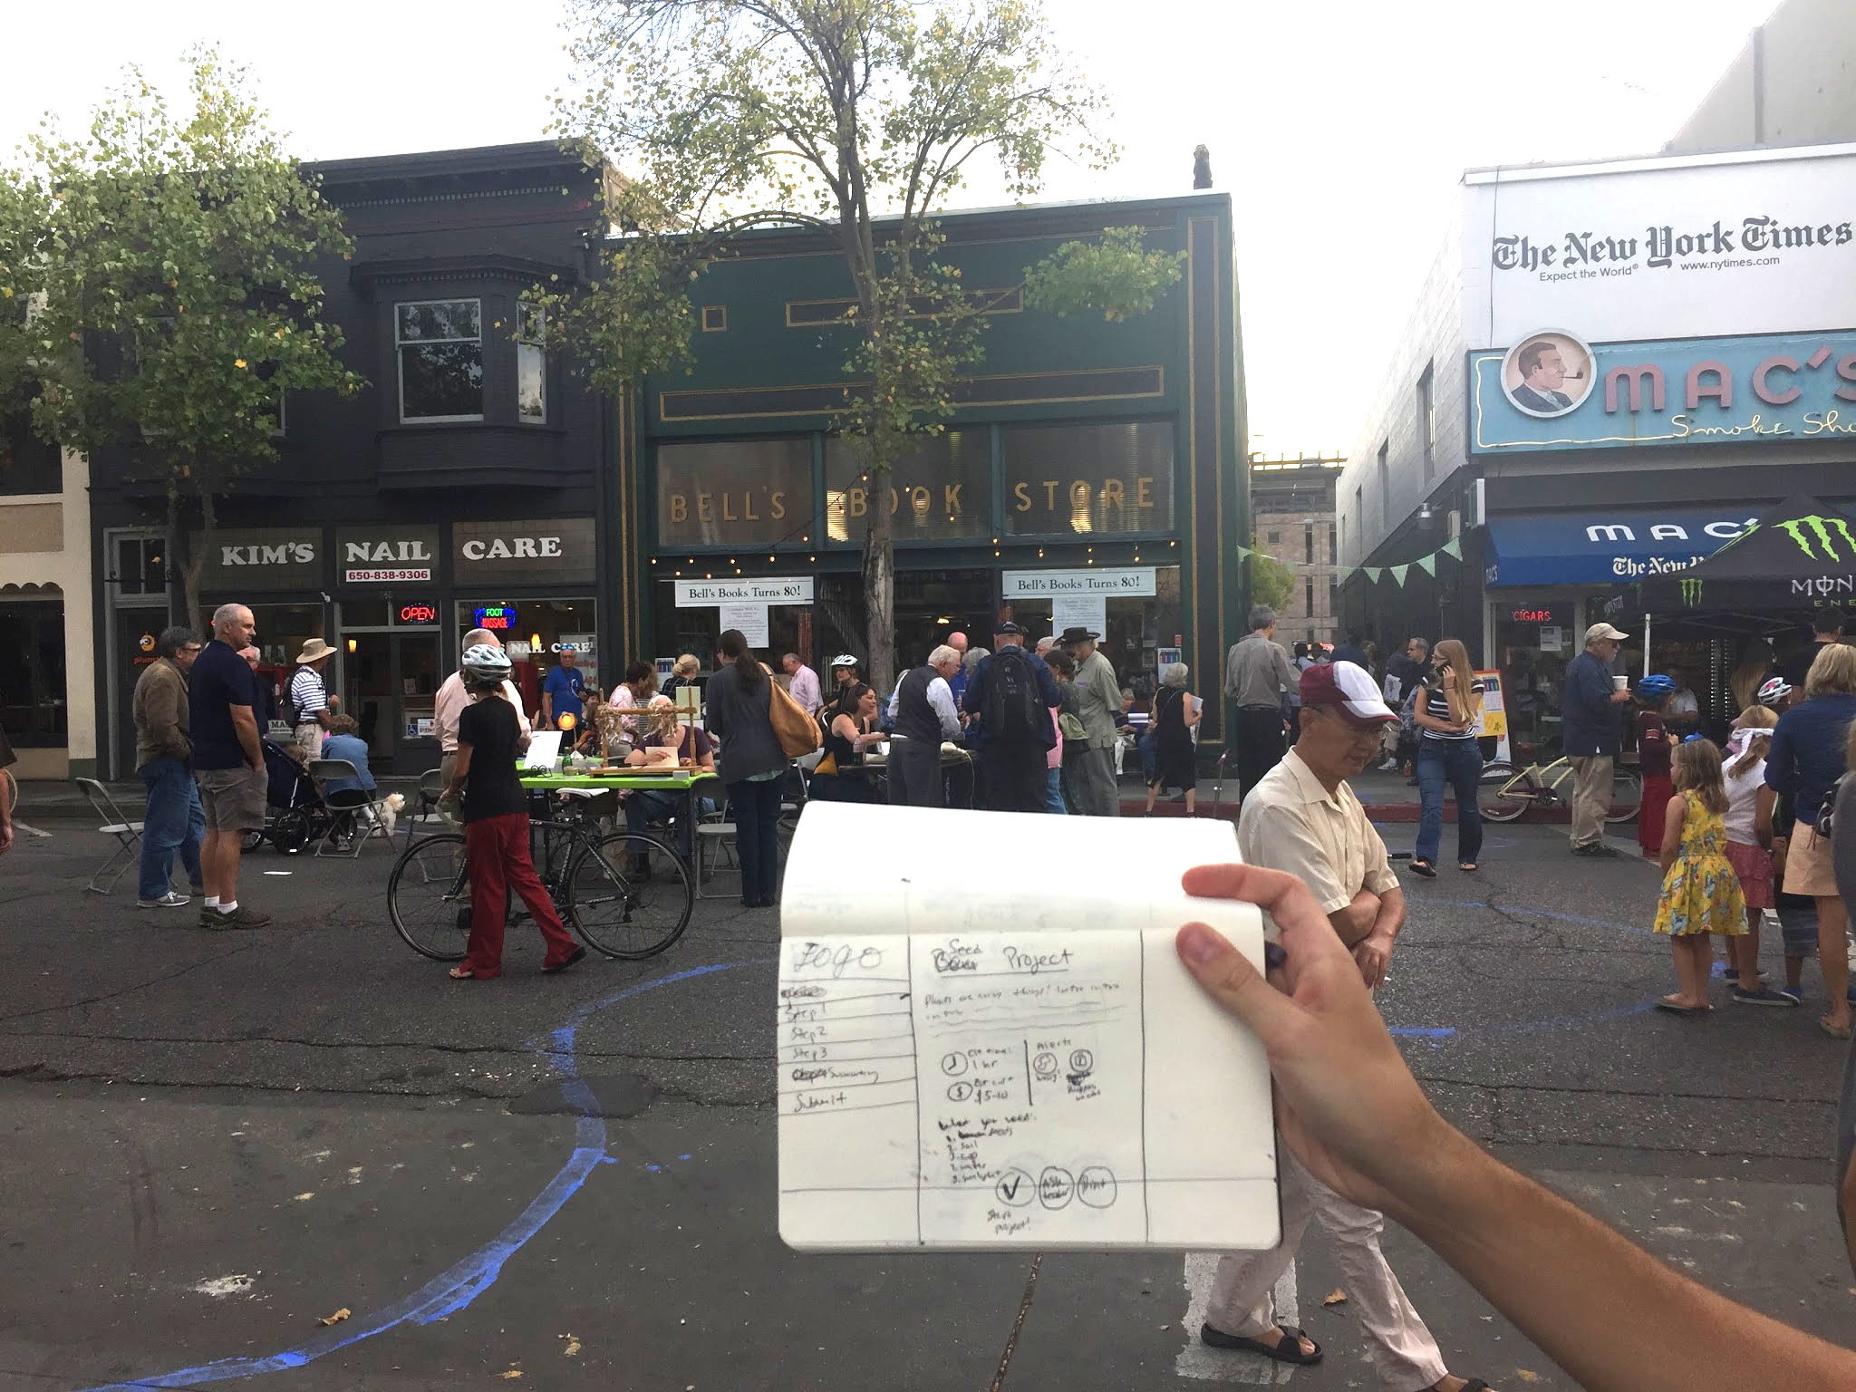
We want to incorporate academic curriculum into interactive and collaborative projects...
Online graphics-based platform for students to work through projects at home.
we found that parents were particularly concerned about children losing papers on the way home from school
parents appreciated the opportunity to ask questions directly, as it addressed the problem of not being able to get in touch with teachers
performed best in user testing! addressed pain points, and was most interaction driven

Slide 20
Thank you!

Slide 21
Aditional HMW’s
Teachers and parents:
Use the parent's’ interest kids school work in a positive way?
Use communication between parents and teachers to help teachers develop lesson plans?
Make parent-teacher meetings more convenient?
Bring the convo to technology they use daily?
Make communication more responsive?
Make conversation regular, responsive and productive?
Make the conversation between parents teachers like if they were friends?
Make complaining, loud and annoying parents helpful?
Create an environment where teachers don’t have to communicate with parents?
promote free flow of info between the home and the classroom?
Help teachers reach out to students / students reach out to teachers / teachers to parents?
Help ease parental stress?
Leverage projects to help parents feel more connected?
Help resolve conflicts between parents and teachers?

Slide 22
Additional HMW’s
Students
Find ways to make the other class work just as exciting?
introduce kids to a wider range of topics?
Make parents and other people in their neighborhood more involved in projects?
Empower kids further in their work?
Find resources and partners for school so they can do interesting projects?
Make other coursework as engaging as projects?
Encourage diversity?
Integrate kids learning in school with what projects they do outside of school?
Make projects like those in higher education?
Help students learn more by projects then regular curriculum?
Have kids engage with projects outside of class?
Incourage teachers to let students know more about a subject outside of class?
Increase students interests in school through projects?
Increase engagement and empowerment outside of projects?
let kids further (?) what they’re interested in at home?
Make school more like an educational playground?
Make projects feel like it’s something kids will be willing to do outside of school?

Slide 23
Brainstorm Solutions: Student-Parent-Teacher Communication
Online community of SPT
Kids can take pics of things and send to teacher to help teacher design lessons
Video broadcasts from classroom
Friend finder for parents/students to chat or meetup
Appointment scheduler
Online Q/A for parents to get their questions answered
Daily notifications, Twitter style
Integrate Piazza, Fb, mail
Open source HW
Interface for school with not only school info but also teacher bios with ways of messaging teachers
App for group chat
Parents alert
Management app for parent-teacher conferences
Platform for parents to see schoolwork in relation to how much their child likes it
Could create some sort of social media platform to see comments on child’s education
Web calls for parents and teachers

Slide 24
Brainstorm Solutions: Project-based Coursework
Integrate student self-assessment
Make curriculum less strict
Further incorporate projects and tutorials into classwork
Use the community needs to set up projects
Interface for teachers to share project ideas and outlines
Developing projects throughout the year for different subjects
Interface for students to vote on fav projects
Facilitate meetups between students who want to do a project together
Have HW be more collaborative
Have a lot of how-tos or labs students can follow at home, integrate with one-click purchases
App that integrates learning materials with project outlines and specifiications
Have teachers upload projects for students to work on at home
Letting kids know of other activities related to their fav projects
App for coming up with extended projects
Online tools for project implementation (posterboards, collages, models)

Slide 25
Brainstorm Solutions: Pinpointing Children’s Interests
Website for teachers to track and share students progress with parents
App for teachers to rate interest on topic/project that they can give other teachers
Track projects that students like for the teacher’s use
Suggesting books for children
Daily feedback for teachers from students and parents
Listing of competitions or programs based on interests
Pictures of kids having fun -> recs for teacher regarding HW and projects
Find good activities/projects based on interests
Suggest at-home activities for different subjects
Better way of showing work and progress during project
Way of sharing projects
Pre class poll
Input on academic/learning goals and needs, parents are key here
Video game to explore learning topics
Easily implementable polls and surveys that provide data and analytics
Platform that integrates input and feedback from parents and students
Manage info about school and how lesson plans have met student needs
Way of saving projects
Ability to pin and look at a snapshot of projects
Pinterest for kids
Personalized recommendations for projects
App to let parents know what their kid might be interested in
Stumbleupon for kids

