Slide 1
PayAbility
Medium-Fi Prototype
Team: ThisAbility
Presentation by Musila Munuve

Slide 2
Problem: Over 5% of people have disabilities such as nonverbal learning disorder and dyscalculia, rendering them unable to do basic math calculations. In daily life, this makes it difficult to compare prices and pay for things while shopping.
Solution: To make paying easier and less stressful, the PayAbility app helps users compare prices, stay within budget, and pay with exact change.
Value Proposition:
To empower people with math learning disabilities to compare prices, stay within budget, and pay with exact change.
Problem/Solution Overview:

Slide 3
Simple Task: Set a budget
The user wants to set a budget so that they can stay within budget and avoid overspending.
Medium Task: Compare prices
The user wants to compare the price of two items to determine which item is cheaper.
Complex Task: Pay with exact change
The user wants to know exactly what bills and coins to take out of their wallet in order to pay for their purchase.
Notes:
Note: We decided to change “Set a budget” to be our simple task because it ultimately requires less input on behalf of the user than the “Compare prices” task, which is now our medium task.

Slide 4
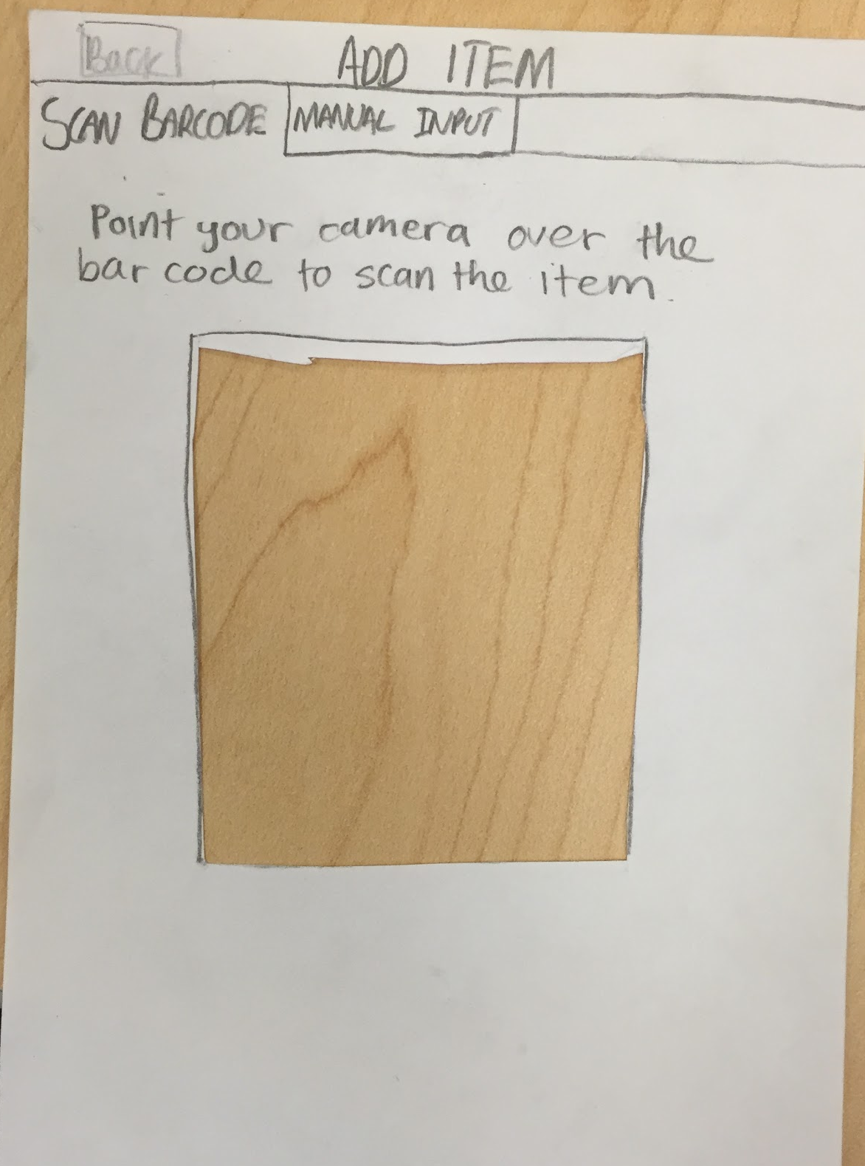
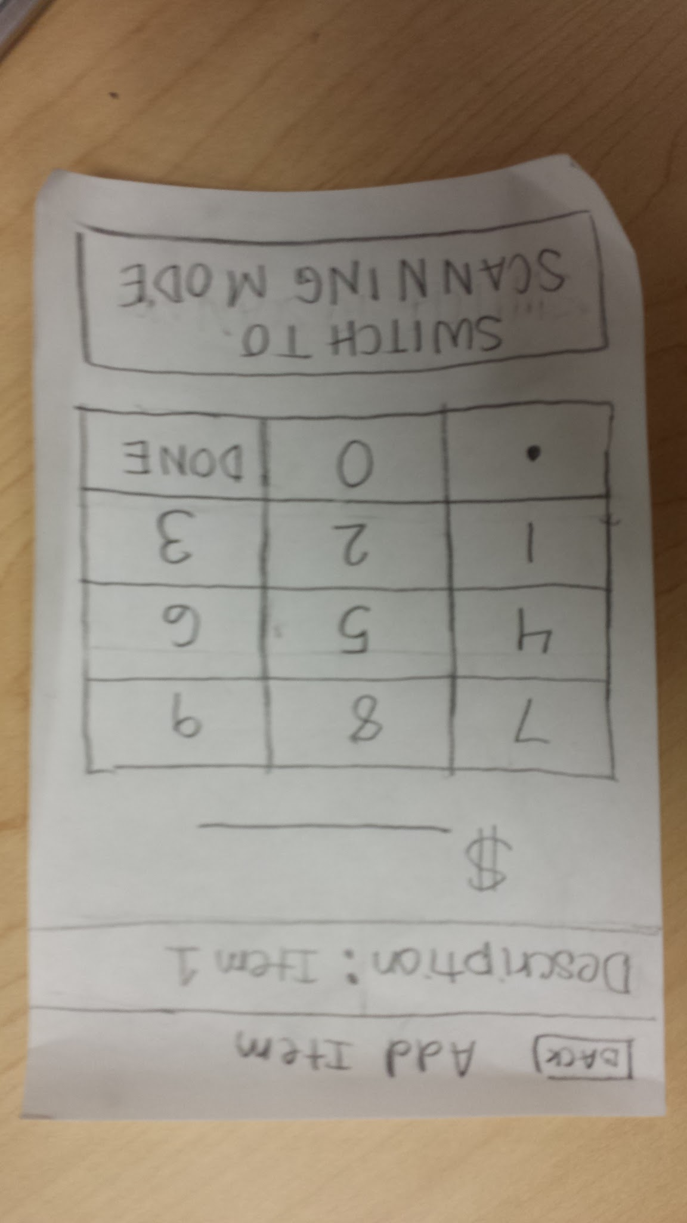
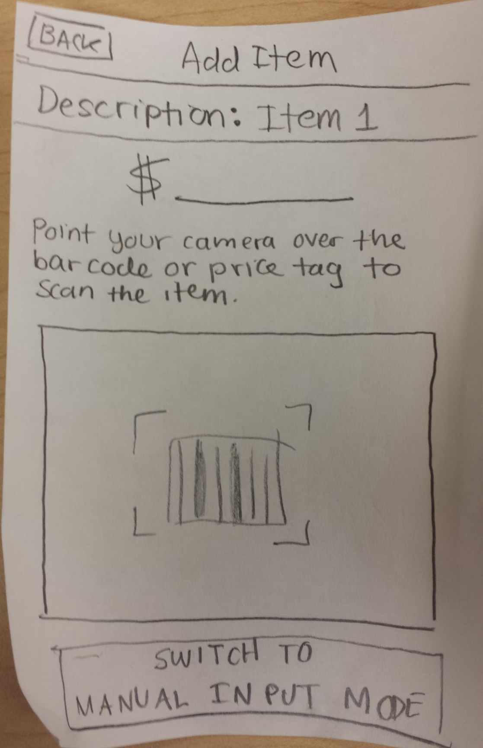
Design Change Price Input
Before:
After:

Slide 5
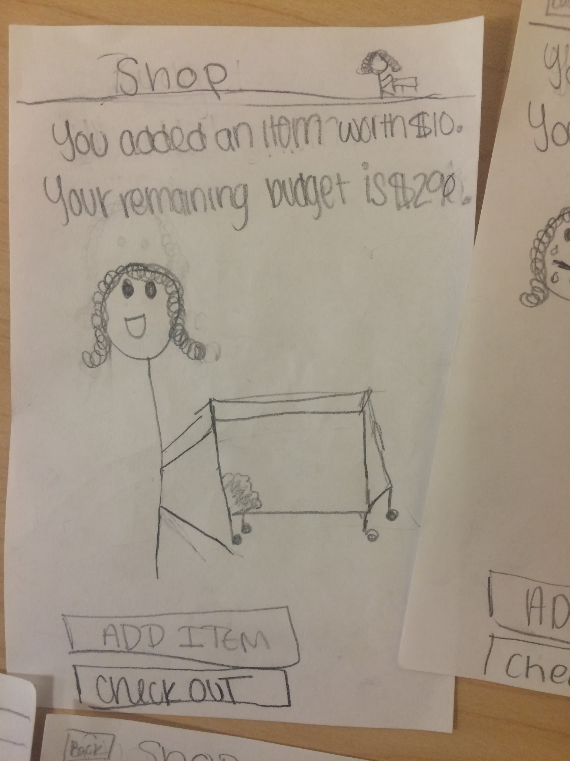
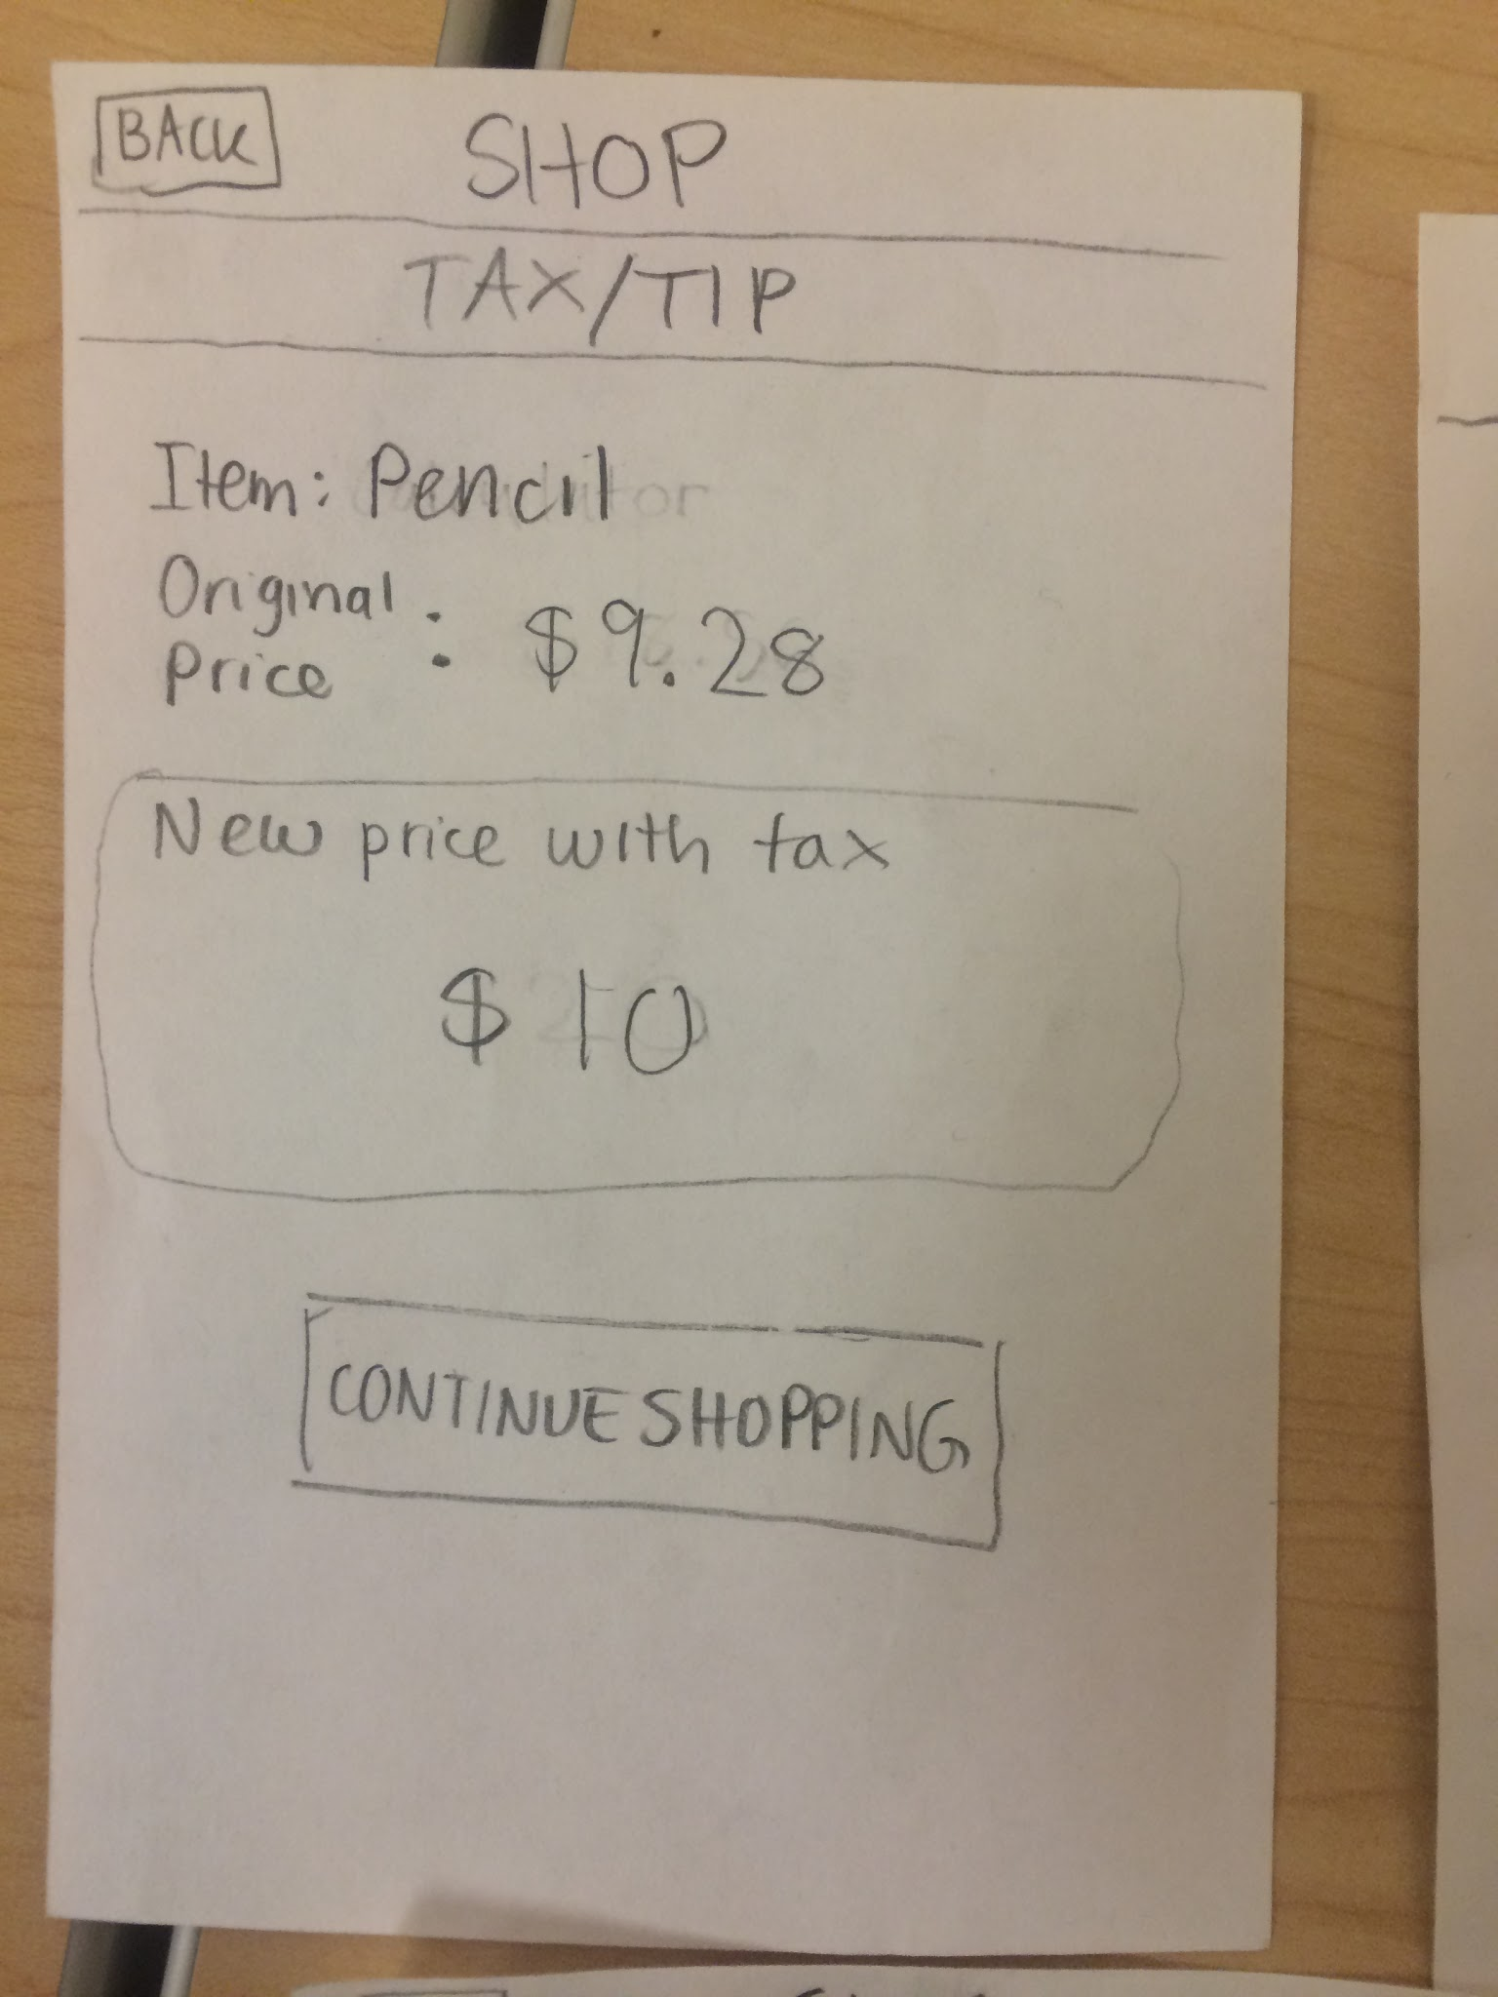
Design Change Tax and Tip Flow
Before:
After:

Slide 6
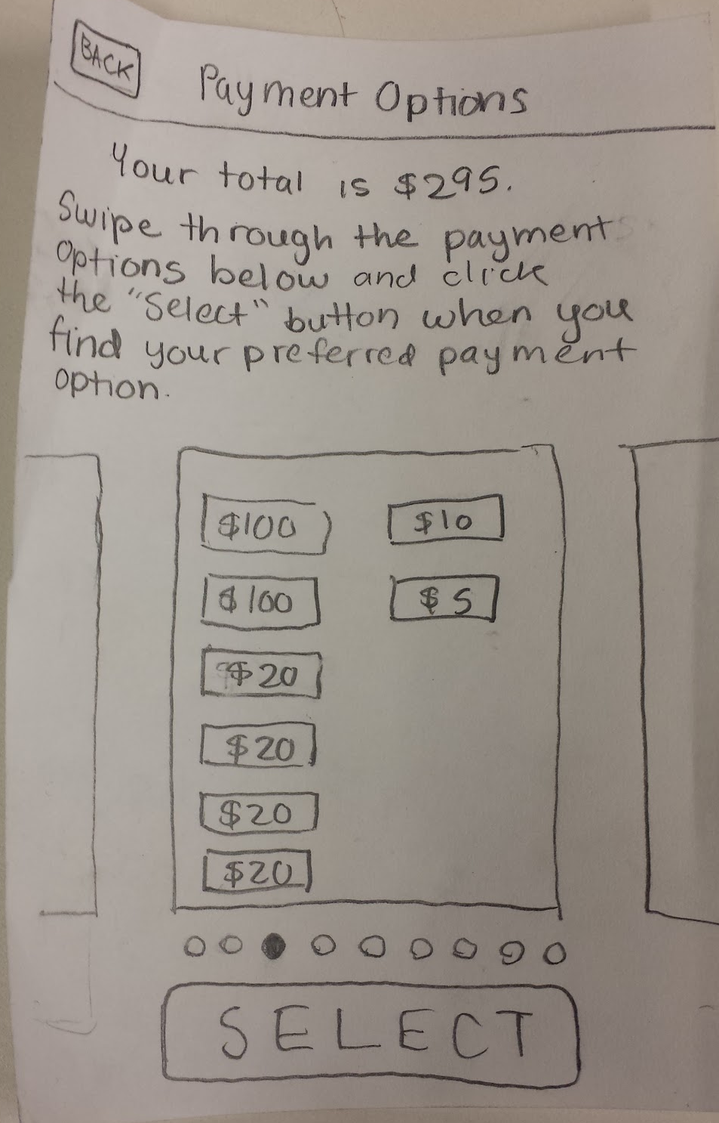
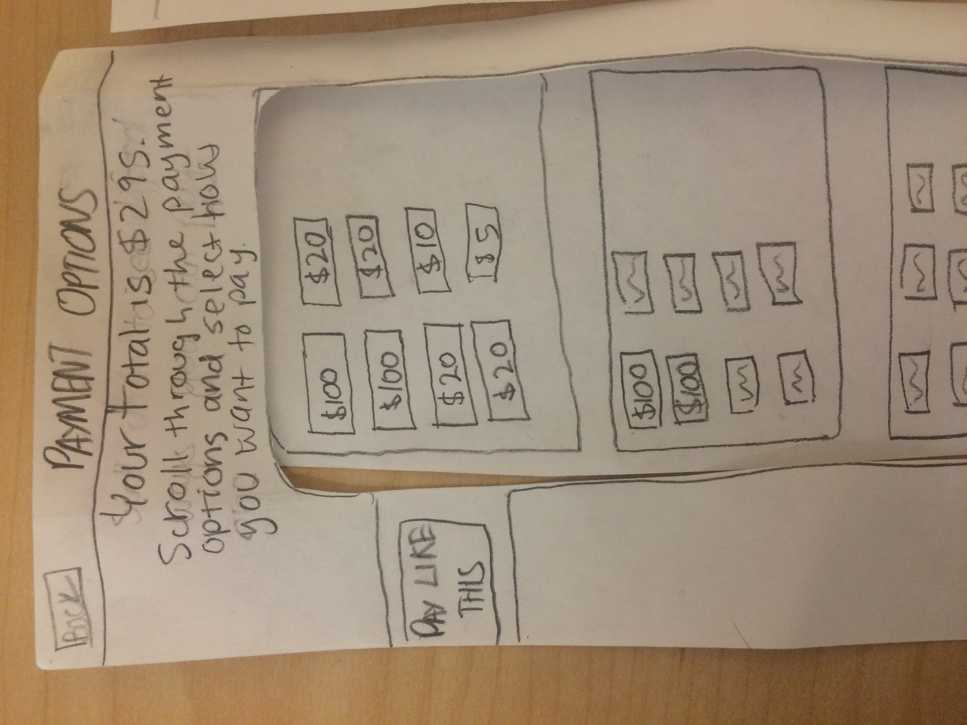
Design Change Payment Options
Before:
After:

Slide 7
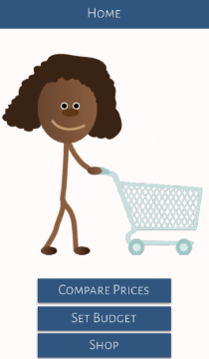
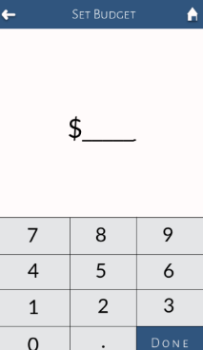
Task Flow Set A Budget
1
2
3

Slide 8
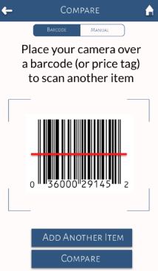
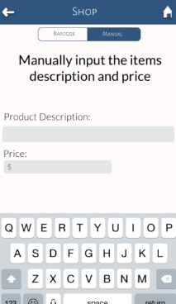
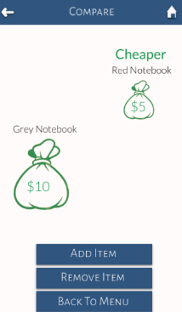
Task Flow Compare Prices
1
2
3
4

Slide 9
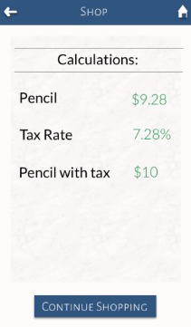
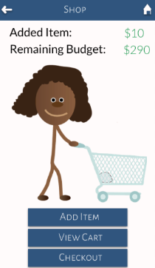
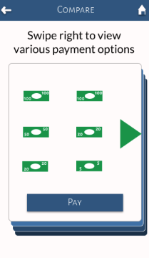
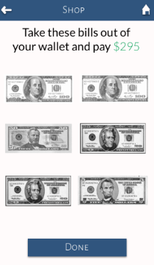
Task Flow Pay With Exact Change
1
2
3
4
5
6

Slide 10
Prototyping Tools
Sketch and Marvel
Pros:
low learning curve
iOS template in Sketch
smooth transitions in Marvel
more realistic look, feel, and flow
Cons:
no online collaboration
time consuming
could not simulate the backend functionality
could not simulate advanced features (e.g. using the camera to scan barcodes)
limited screen usability

Slide 11
Limitations & Tradeoffs
Cannot display dynamic cartoon animations
No access to camera or GPS data
Can only work with a specific set of items in a specific order

Slide 12
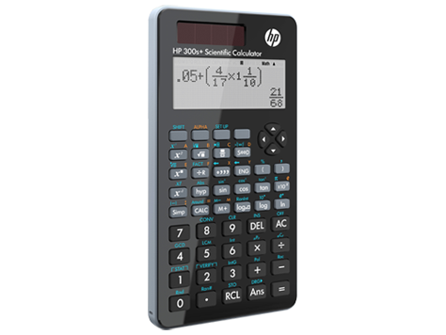
Wizard of Oz & Hardcoded Features
Wizard of Oz
Pretend we can translate final price into the correct set of bills and coins
Pretend we can recommend the best item to remove if the user goes over budget
Hardcoding
Budget amount and item prices
Items to be purchased
Order of items
User’s current location

Slide 13
Thank You!

