Slide 1
Hi-Fi Prototype
Midpoint Presentation
PayAbility
Team: ThisAbility
Notes:
Musila: 2 minutes up to slide 4
Lynne: 2.5 minutes slides 5-7
Nicole: 1.5 minutes slides 8-9
Jorge: 1.5 minutes slides 10-12
Nicole: 1.5 minutes for live presentation

Slide 2
Value Proposition
Problem
Solution
PayAbility aims to empower people with math learning disabilities to compare prices, stay within budget, and pay with exact change.
Over 5% of people have disabilities such as nonverbal learning disorder and dyscalculia, rendering them unable to do basic math calculations. In daily life, this makes it difficult to compare prices and pay for things while shopping.
To make paying easier and less stressful, the PayAbility app helps users compare prices, stay within budget, and pay with exact change.

Slide 3
Today’s Presentation
Heuristic Evaluation
Revised Design
Implementation
Live Demonstration

Slide 4
Heuristic Evaluation Results
Heuristic Violation | Severity
Compare items task flow seems to go in a loop | 3
Unclear what “Add Item” button in “Compare Prices” screen does | 3
“Remove” button in “Compare Prices” screen seems unnecessary | 3
No way to store user's information with login | 3
No backspace option when setting budget | 4
No “Cancel” option when adding an item | 3
Overwhelming number of payment options | 4
New sketches: https://marvelapp.com/hifh9i
Notes:
Ended up going in a loop trying to figure out how to compare the two items in the prototype. I would click the manual tab and enter the pencil, and then press continue shopping and add the laptop but after I added the laptop, the compare prices screen didn’t come up and it was back to having no items in the cart. The comparison only came up if I clicked “add another item” under the barcode, which isn’t on the manual page and I overlooked it several times. Make this button more prominent and on the manual input page.
On the compare screen where the comparison between items is shown, it is unclear what the “add item” button will do: is it adding one of these two items to the cart or is it adding another item to the comparison?
The compare items page “remove item” button seems to force more clicks than necessary. Removing items could be as simple as pressing an “x” next to the item
Not having a login, hinders the user in a number of ways: If they accidentally close the app, they may lose all of their information, and the Shop button can’t “learn” what dollars
When I’m inputting a price manually, I can’t erase any of the numbers I’ve inputted if I make a mistake; you need a backspace button.
Users may not always want to add an item immediately after scanning it. There is no way to “undo” an added item or to check before adding it.
T he screen where the user can swipe to select a payment option can be overwhelming as the possibilities of how to pay for something increases to extreme amounts as the total price goes up (so many different UI screens). To simplify this, the UI should ask the user what bills they have and how many of each they have, and then display the possibilities from there in order to prune the seemingly infinite combinations of payment options.

Slide 5
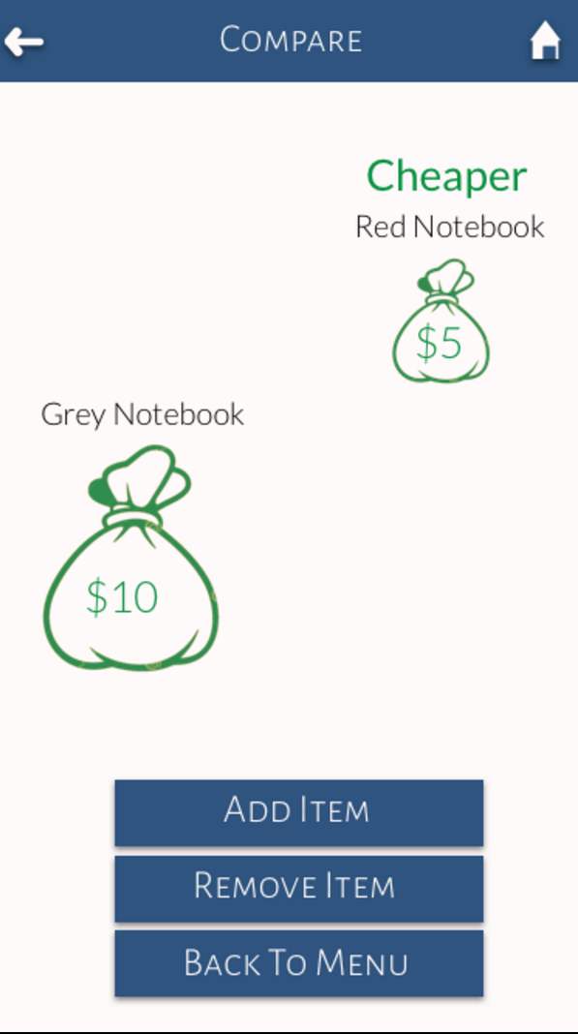
Design Changes
“Compare Prices” Task Flow
Getting rid of the “Remove” button
Getting rid of “Add Item” button and changing money bags to buttons to add items to cart
Explicit instructions stating you can only compare up to two items
Notes:
On the Price screening after scanning an item, we should provide an option to “Cancel” and return back to the Scanner.

Slide 6
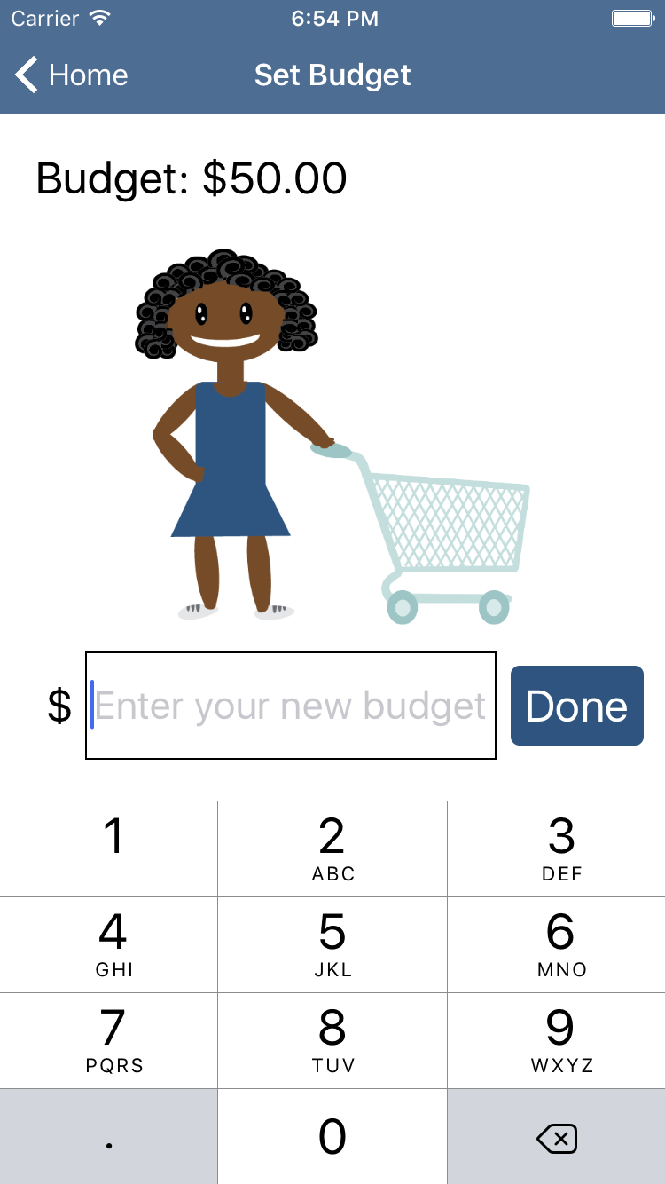
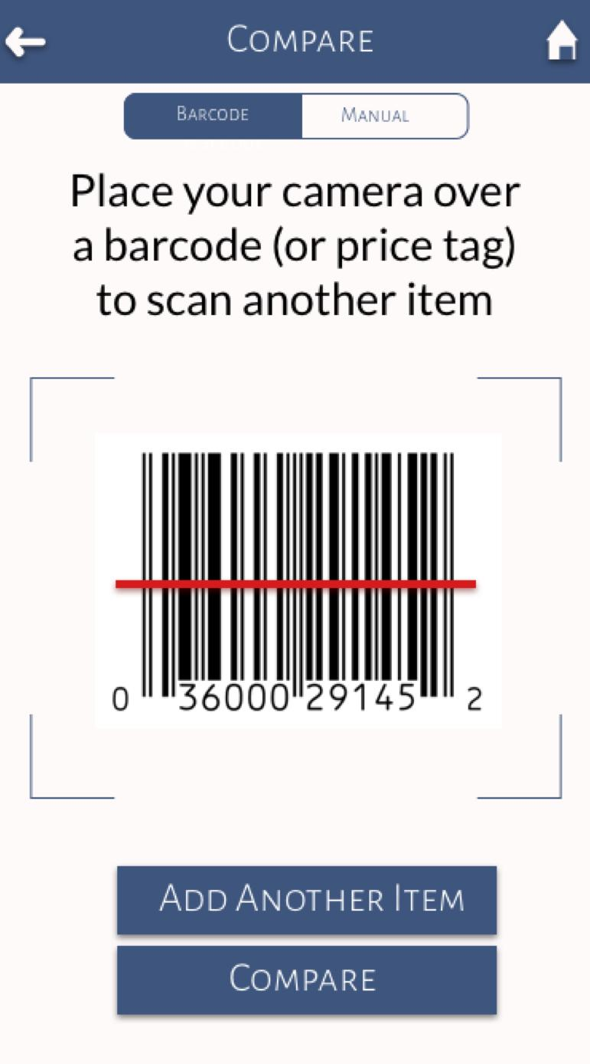
Design Changes
User Control and Freedom
Redesign of calculator
Cancel item after scanning

Slide 7
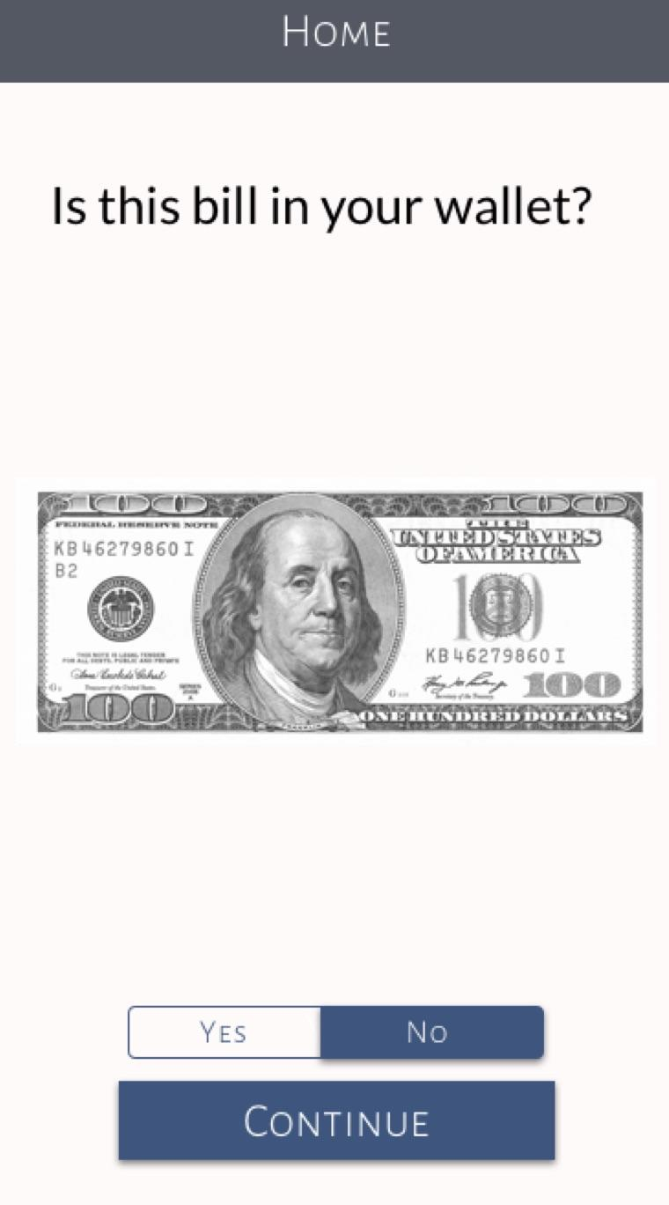
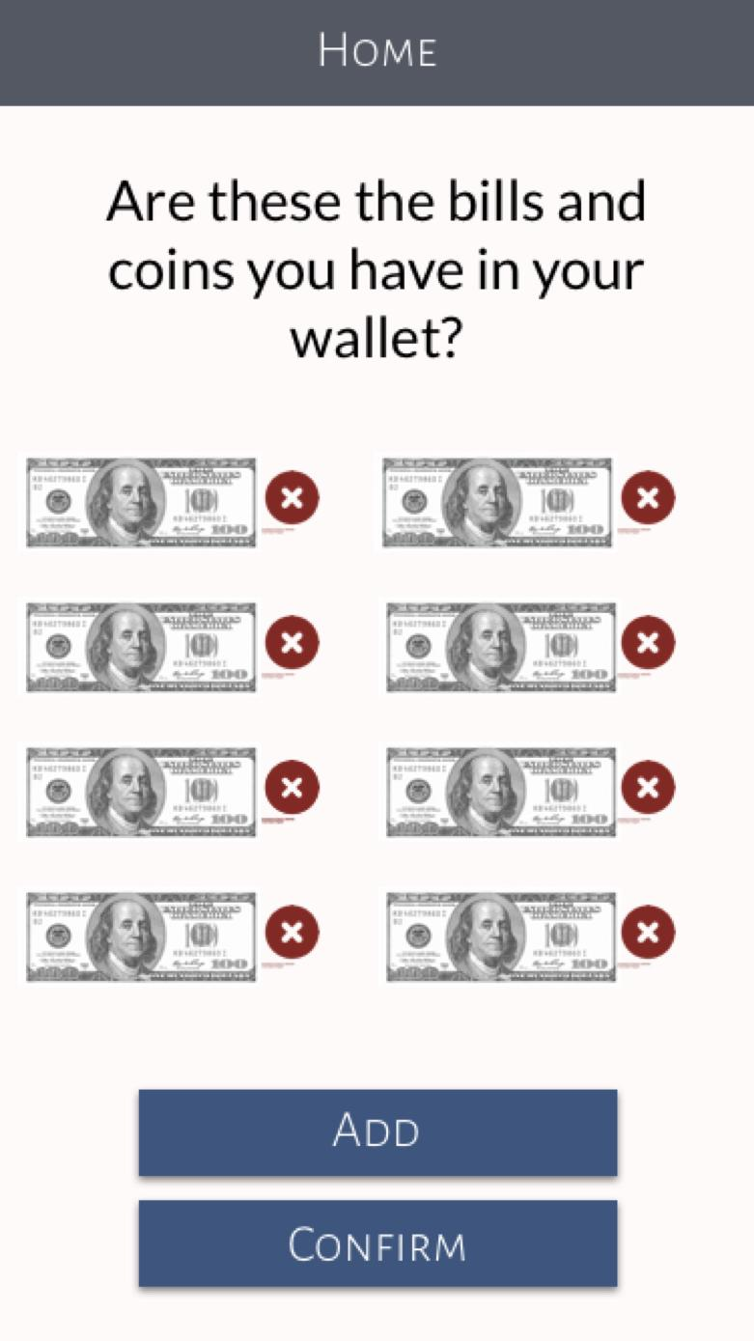
Design Changes
Overwhelming Payment Options
User inputs the types of bills and coins they have before shopping
Then we only need to show a couple of payment options at checkout

Slide 8
Implementation
iPhone Application
Tools Used
Objective C
Xcode
Parse framework
Issues
Xcode only available on Mac
Collaboration on Xcode is difficult

Slide 9
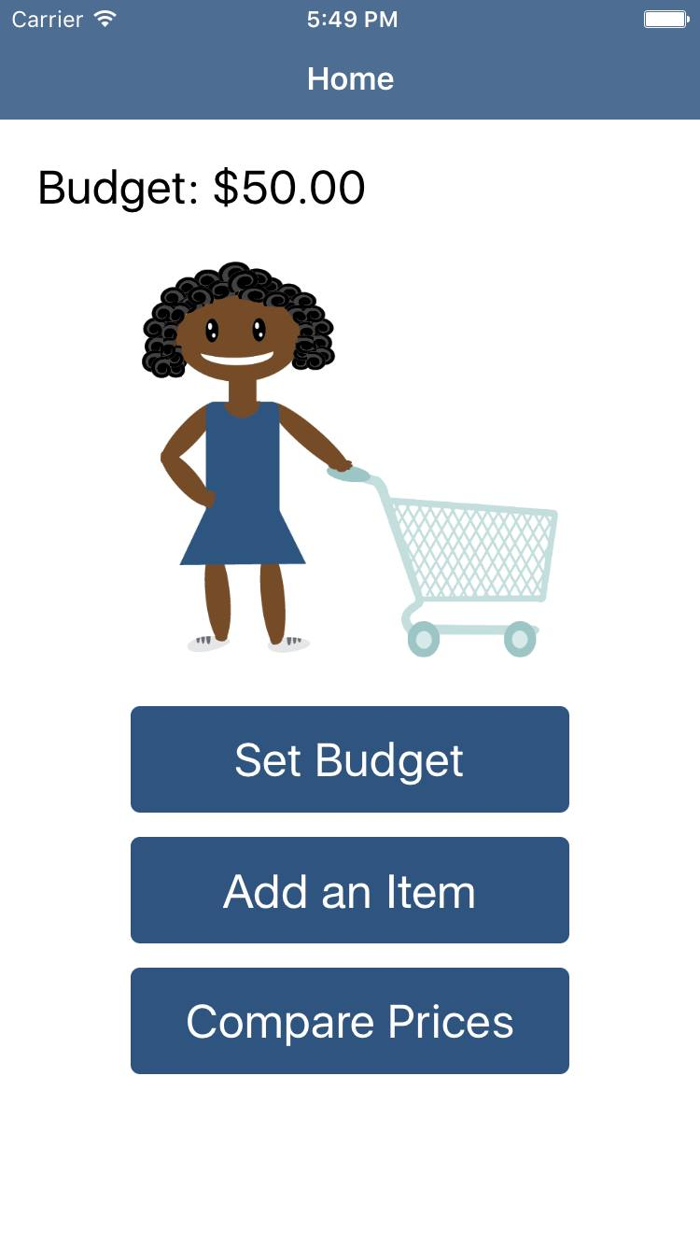
Implementation
Currently Implemented
Features
Launch screen
Home screen
“Set Budget” task
Price input keyboard
Zero budget and full budget images

Slide 10
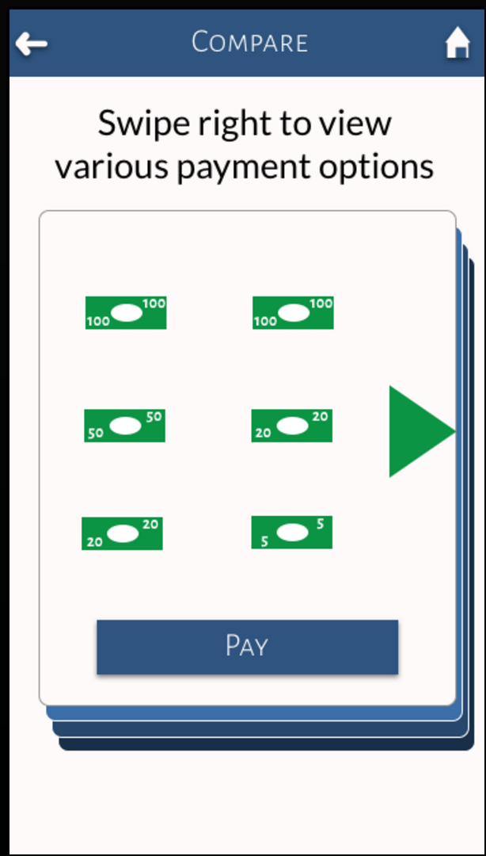
Implementation
Missing Features
“Compare Prices” task
“Add An Item” task
manual input
barcode scanning/ OCR
payment options screen

Slide 11
Implementation
Plan to Finish
Work during Thanksgiving break
Focus on core functionality first
Use Wizard of Oz and hard coding for difficult-to-implement features

Slide 12
Implementation
Wizard of Oz
Barcode scanning & OCR
Selecting the bills to show in the payment options screen
Hard Code
Specific set of items and their prices

Slide 13
Live Demonstration

