Slide 1
PayAbility
Team Name: ThisAbility
Musila Munuve, Jorge Cueto, Lynne Sneed, Nicole Crawford
Concept Video: https://youtu.be/c4itqibYgsE

Slide 2
Value Proposition:
Problem/Solution Overview:
“Paying made easy.”
Problem: Thousands of people have learning disabilities that prevent them from understanding numbers and performing simple mathematical calculations. In daily life, this makes it difficult to understand prices and pay for things while shopping.
Solution: To make paying easier and less stressful, the PayAbility app performs price calculations for users and visually depicts the bills and coins needed to make a purchase.

Slide 3
Simple Task: Compare Prices
Medium Task: Stay Within A Budget
Complex Task: Pay With Exact Change
The user wants to compare the price of different items to determine which item is cheaper.
The user wants to stay within a predetermined budget and avoid overspending.
The user wants to know exactly what bills and coins to take out of their wallet in order to pay for their purchase.

Slide 4
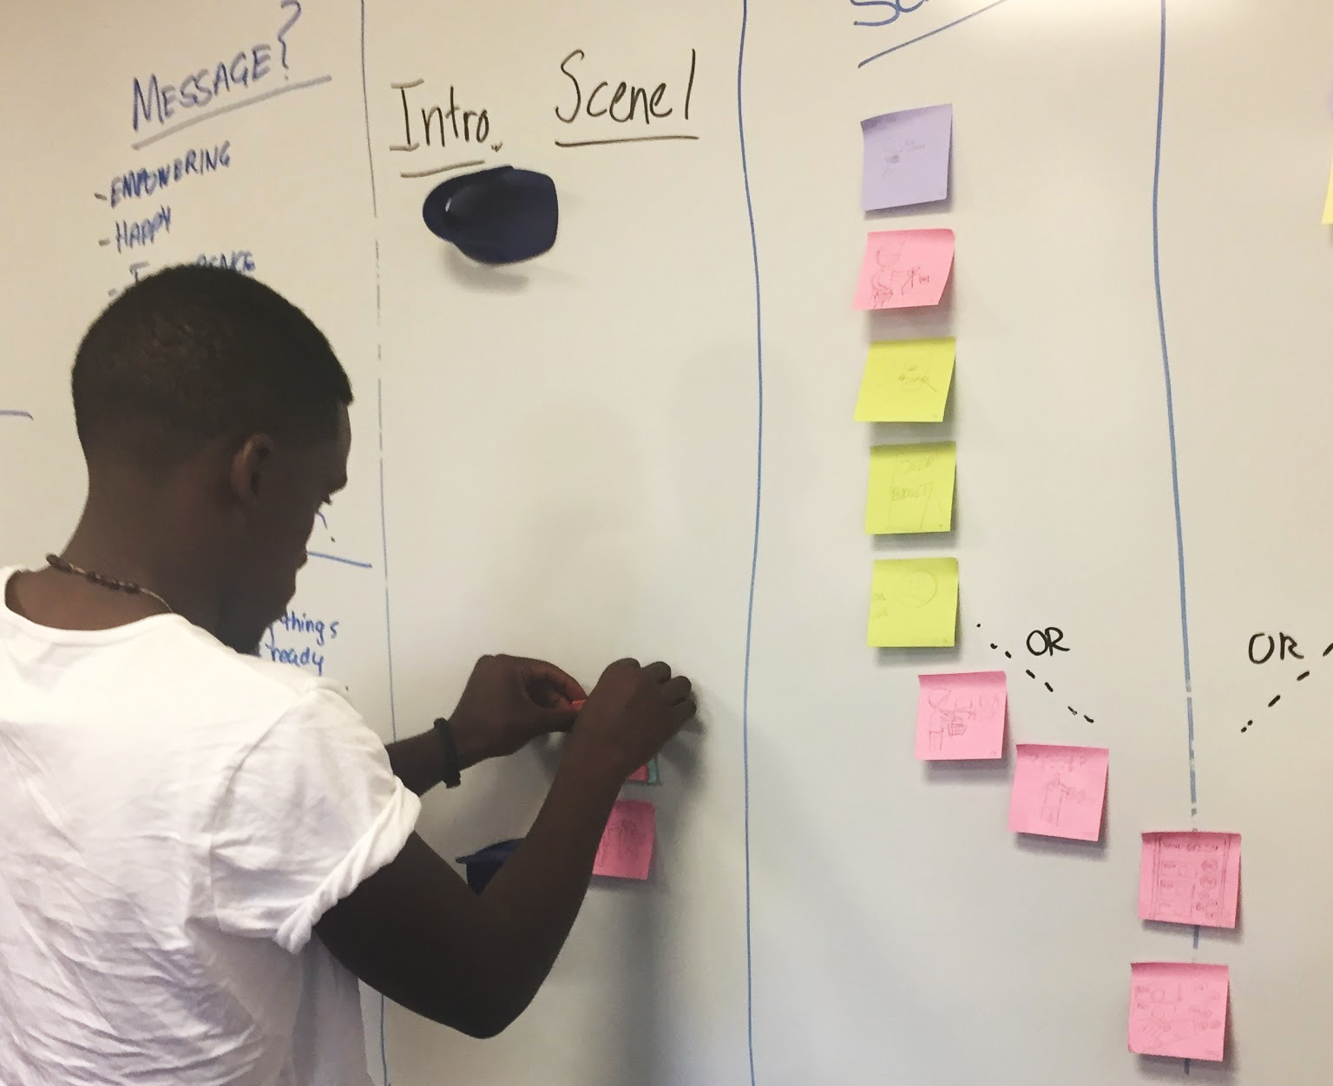
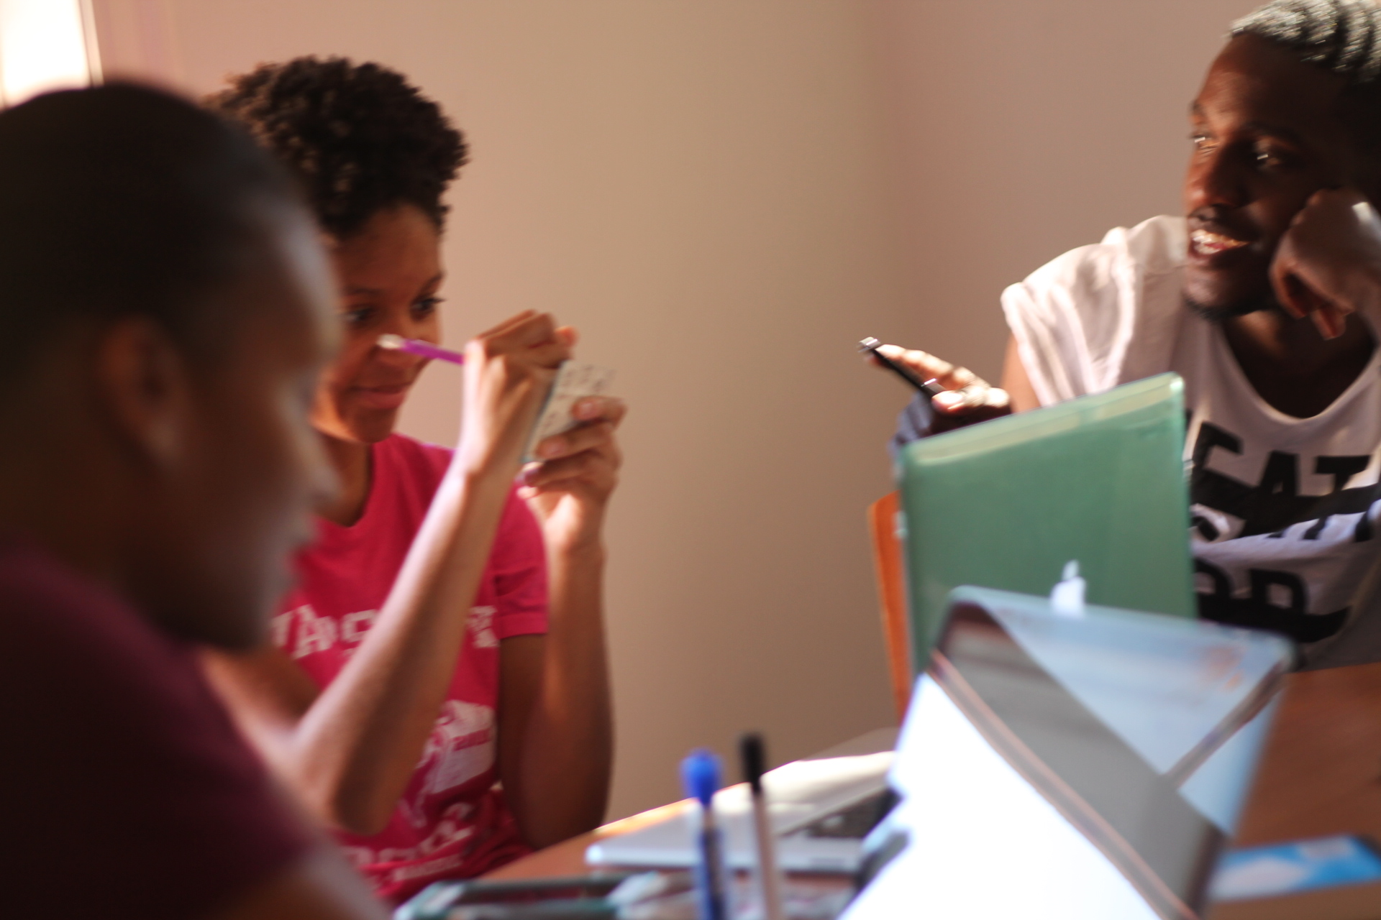
Storyboard:
Intro & Scene 1
Scene 2
Scene 3

