Slide 1
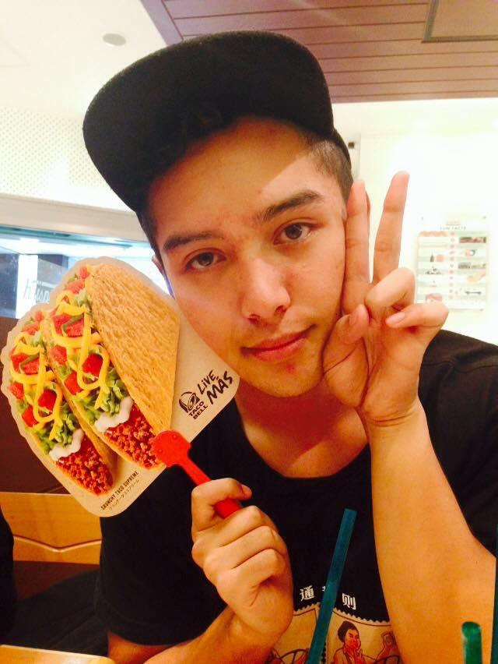
HelpList
Team Friendship
Minmin, Santos, Andrés
Notes:
MARVEL LINK: https://marvelapp.com/1d2i819

Slide 2
Value Proposition
Anonymous in-class asking, ranking and answering questions for college lectures
Notes:
College students can’t always ask questions when they get confused in lecture, which may lead to not being able to understand the remainder of the lecture. Furthermore, it is not always apparent which questions are the ones that the majority of students are confused about to faculty, or to students who are willing to help. We are building an unintrusive mobile platform where college students can stay engaged and understand lectures by anonymously asking questions, getting their questions answered, and helping others learn by answering questions.

Slide 3
Problem?
Big lectures are not engaging and don't allow students to receive help if they don't understand something.
Solution: offer a non-intrusive way to ask/answer questions to clear up questions/reinforce concepts.

Slide 4
Tasks
Same tasks
Simple: Ask a question
Medium: Answer a question
Complex: Find a previously asked question

Slide 5
UI Changes

Slide 6
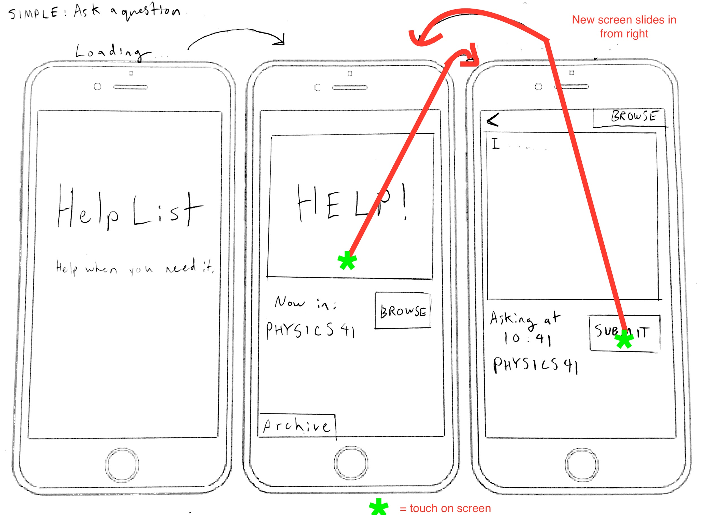
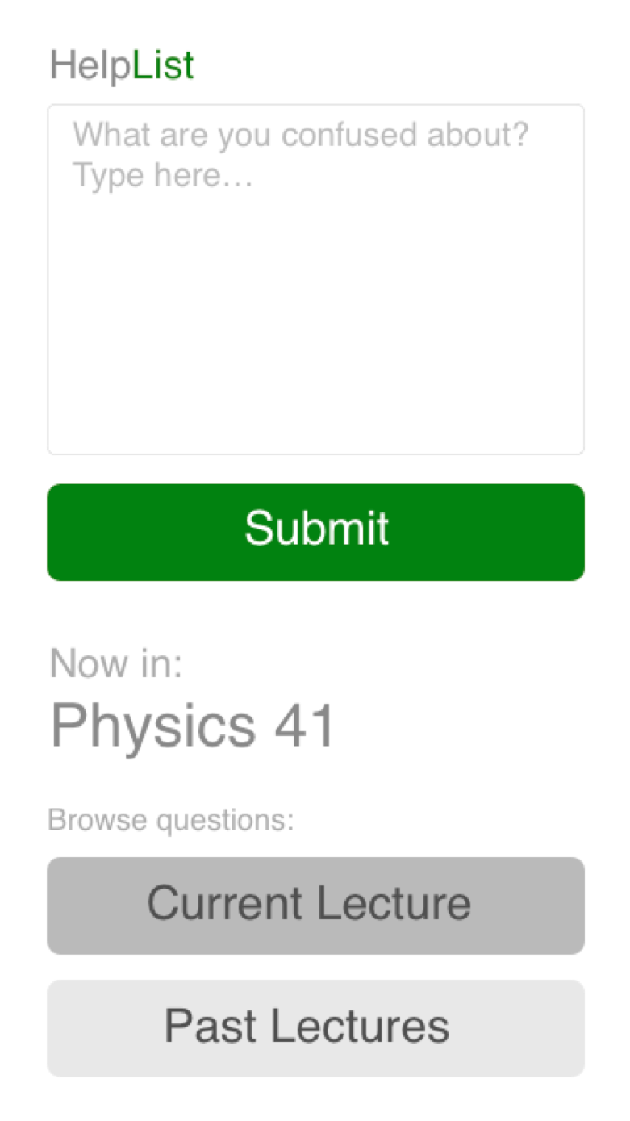
UI Changes
Notes:
Archive button was split into two bigger buttons, current and past lectures
Help button was unnecessary/redundant
Archive button was confusing to users, not prominent
Submit button green, boldest because it is most important feature. Buttons are in order of descending boldness.

Slide 7
UI Changes
Notes:
Search all button changed to a search all bar -- Ask on this screen still does opens the original prompt to ask a question for the current lecture
Old button was redundant and easy to miss because it was at the bottom.

Slide 8
Storyboards

Slide 9
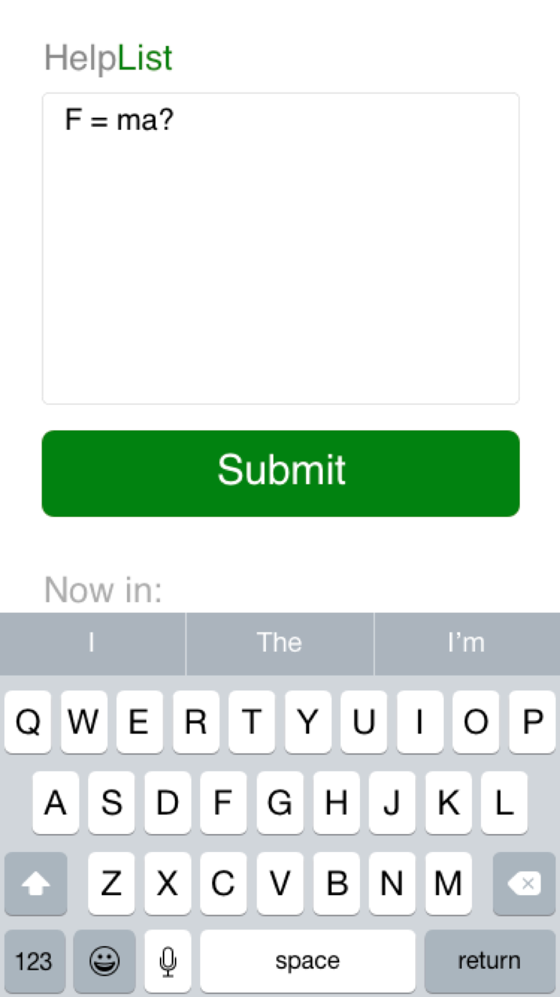
Simple task: ask a question
= tap (one at a time)

Slide 10
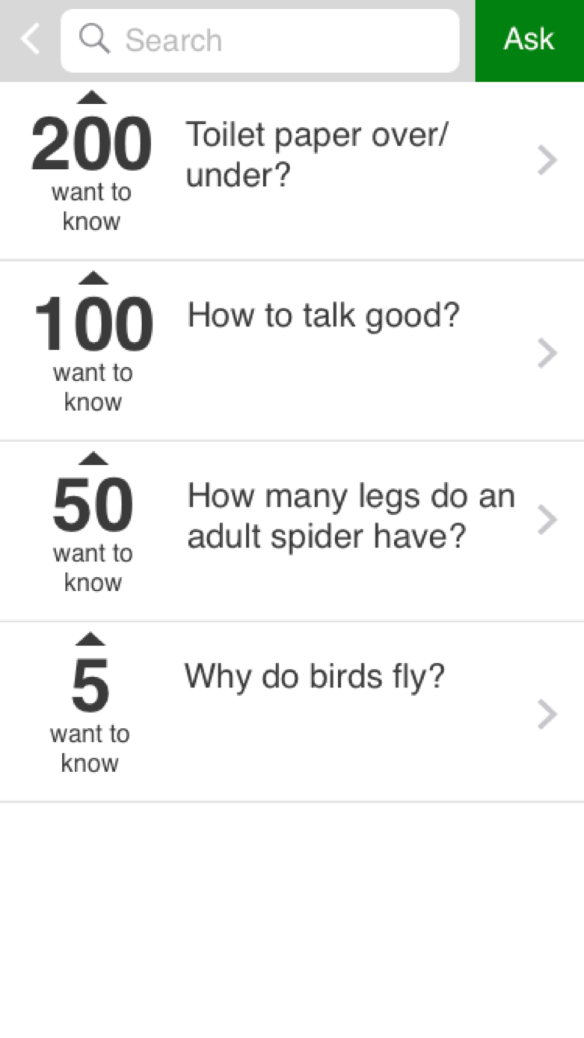
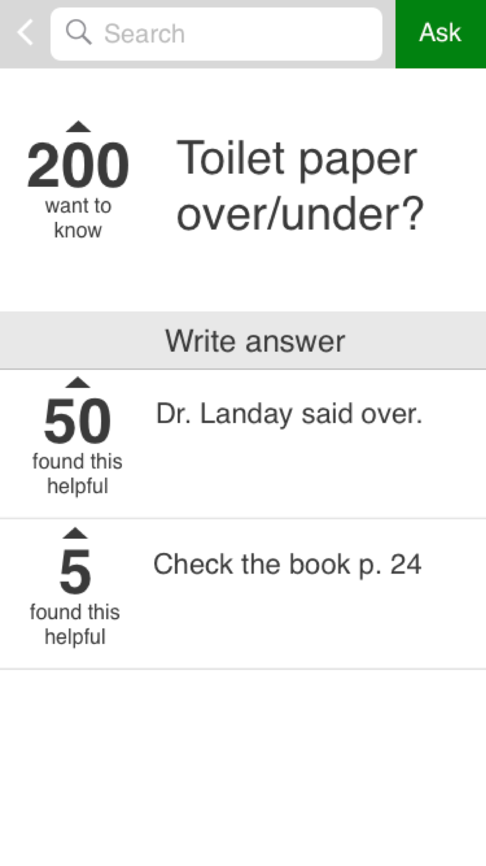
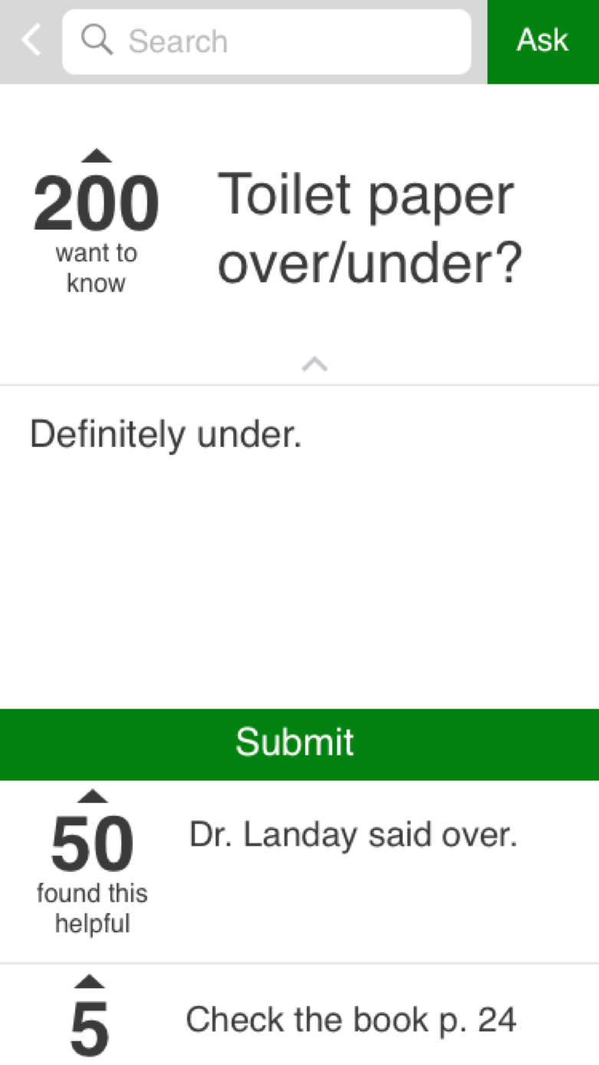
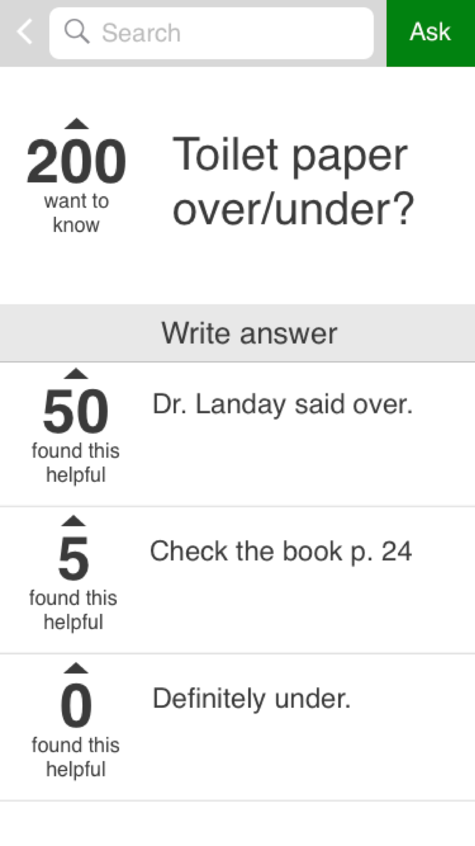
Medium task: answer a question
slideout

Slide 11
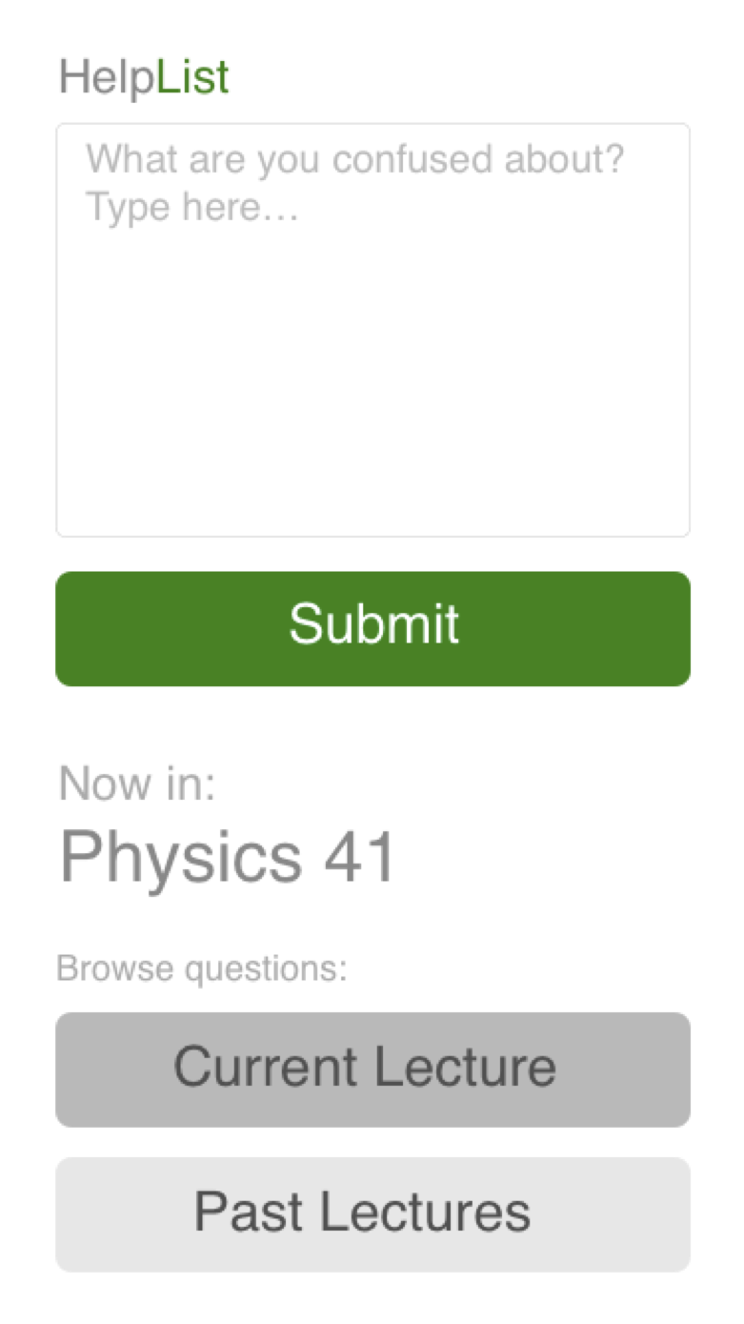
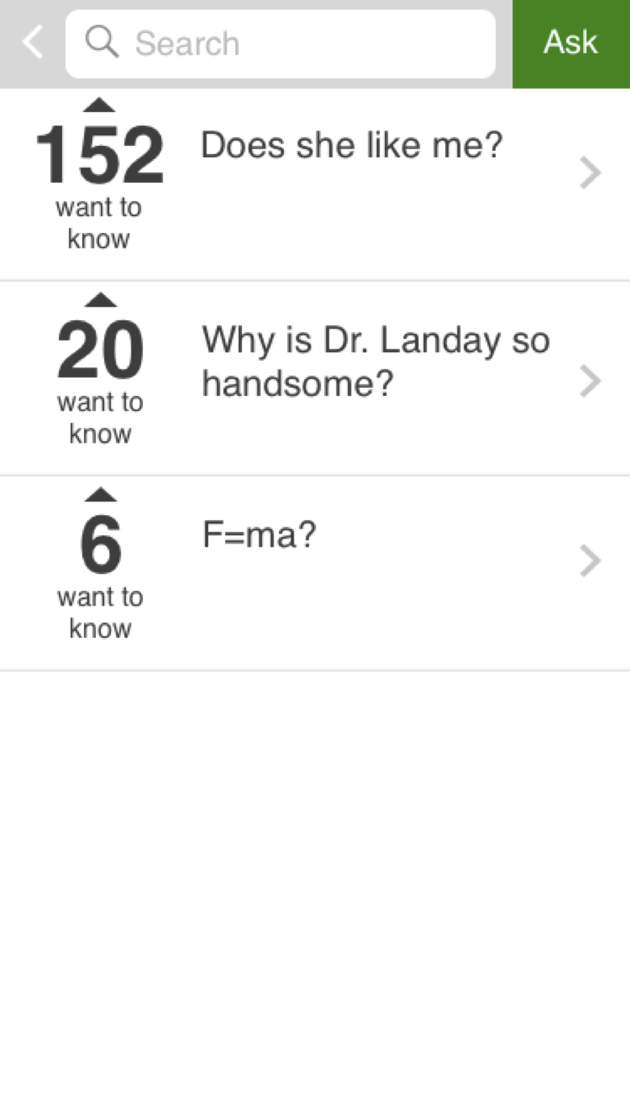
Complex task: find a question from a previous lecture

Slide 12
Prototyping tools
Used Sketch for creating
Comes with UI kit
Simple interface
Very intuitive
Auto-align
Limited
Used Marvel for animating
Very easy to use
Effective at creating flows
Limited -- made a lot of hard-coded work

Slide 13
Limitations of Prototype
Search not implemented
Typing of questions not implemented → hard-coded questions
No scrolling → limited repertoire of questions
Only question implemented fully, with answers and the means to provide an answer

Slide 14
“Wizard of Oz” techniques
Smart "current lecture" and sign-in
No typing capabilities
Notes:
automatically signs you into lecture based on location, here we just hard-coded it as physics 41
The app does not provide allow typing, so we hard-coded in questions and potential answers and all you do is hit submit

Slide 15
Hard-coded features
Input text
Number of votes
Existing questions
With answers
Past lectures
Current lecture

Slide 16
Additional Screenshots/Notable UI Changes

Slide 17
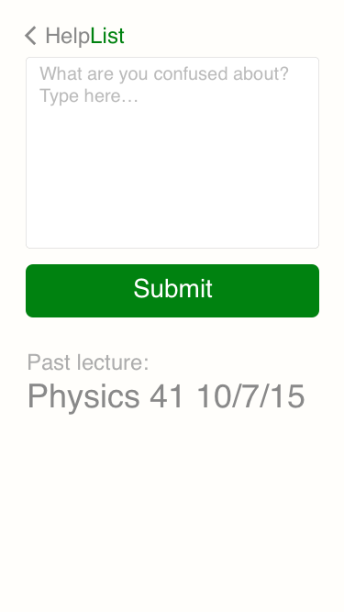
Notes:
Upvote ability, "submitted" flyby, past question asking screen.
"Good" was changed to "want to know", more positive nuance

Slide 18
Notes:
Green submit, "found this helpful" change and "give help" is now "write answer".
The submit button now follows consistency, more clear than before because it didn't change. "Write answer" is more clear.
Upvote text is now "Found this helpful", more positive nuance

