Slide 1
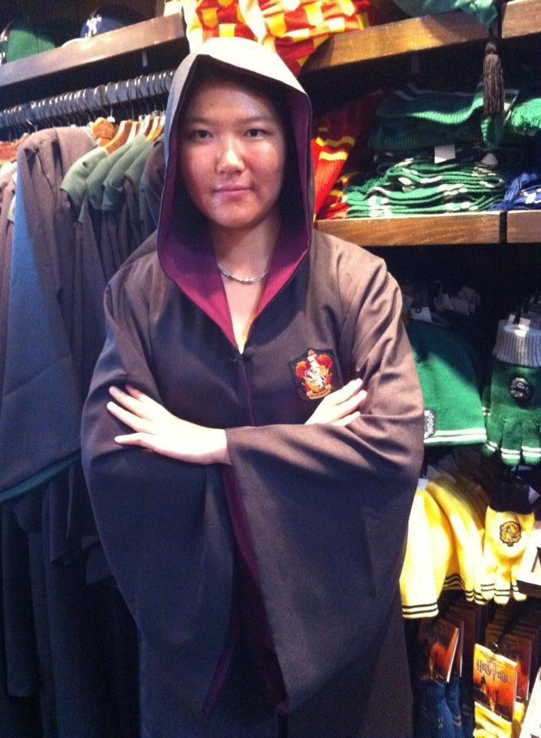
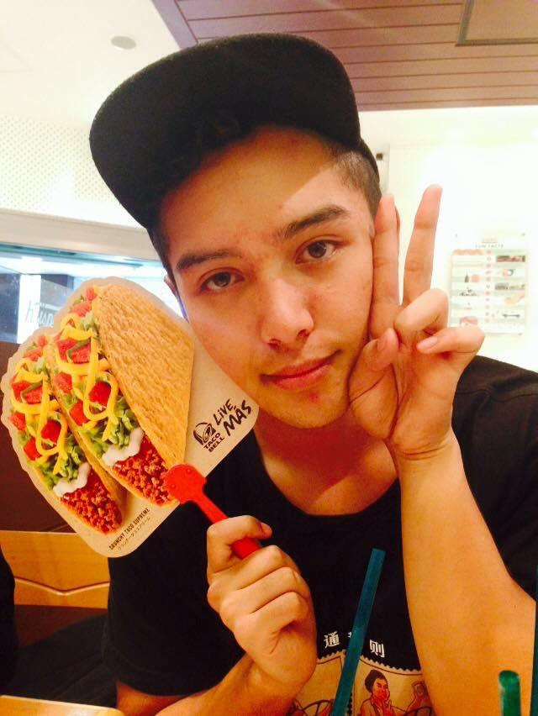
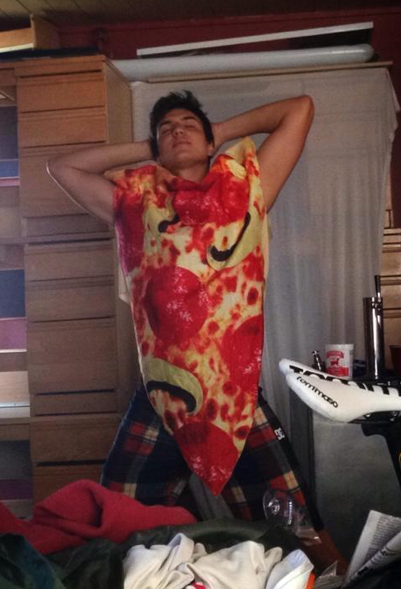
HelpList
Team Friendship
Minmin, Santos, Andrés

Slide 2
Value Proposition
Anonymous in-class asking, ranking and answering questions for college lectures
Notes:
College students can’t always ask questions when they get confused in lecture, which may lead to not being able to understand the remainder of the lecture. Furthermore, it is not always apparent which questions are the ones that the majority of students are confused about to faculty, or to students who are willing to help. We are building an unintrusive mobile platform where college students can stay engaged and understand lectures by anonymously asking questions, getting their questions answered, and helping others learn by answering questions.

Slide 3
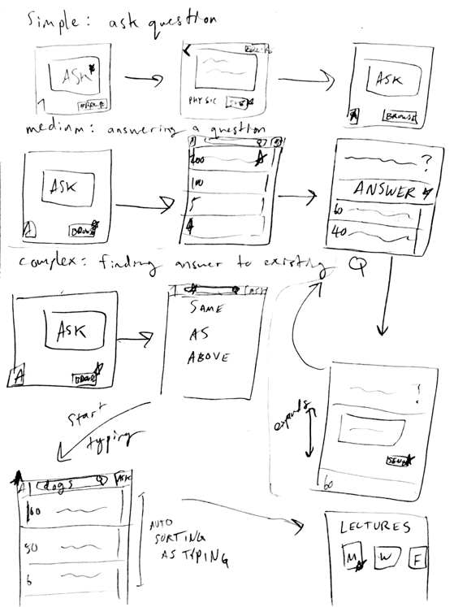
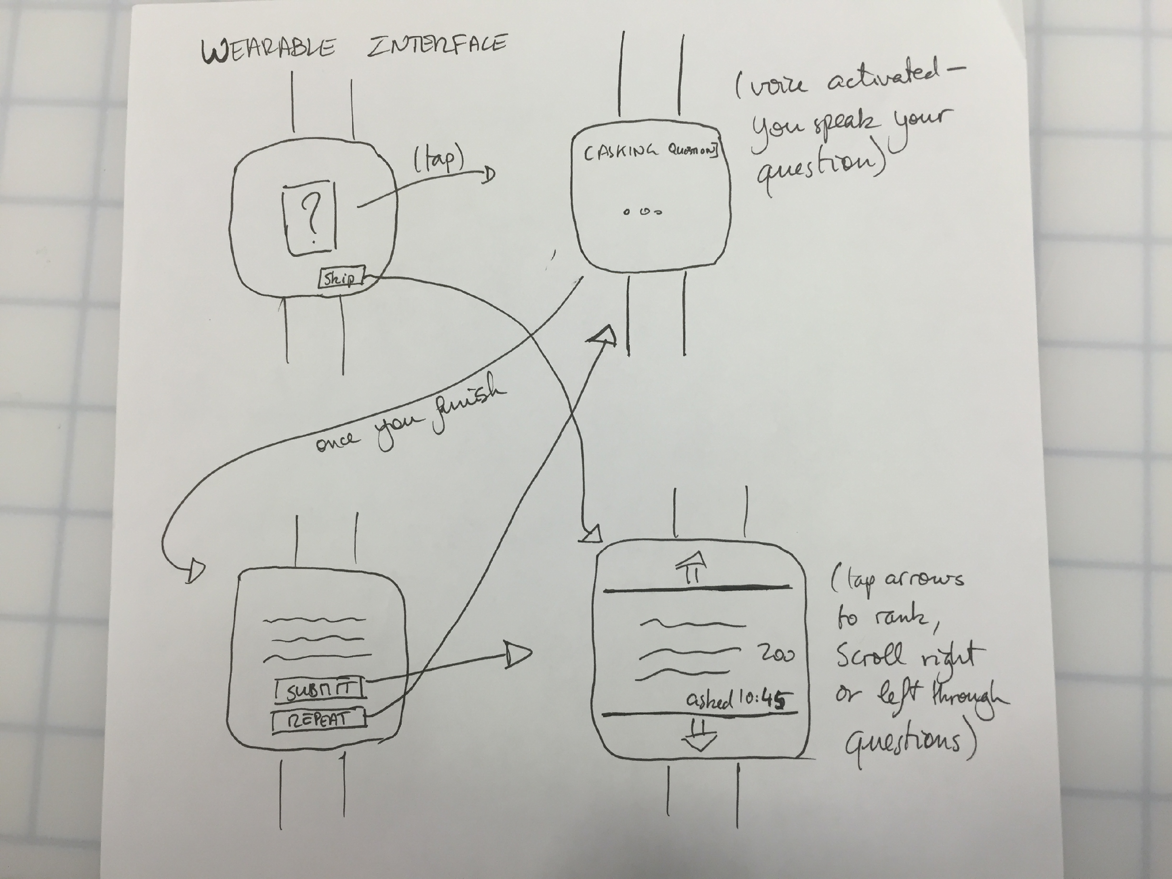
UI designs
Mobile app and wearable app
Mobile is more accessible - more people have access to a smartphone than to a smart watch
Interface is easier to manage - we would need speech recognition in a watch and that would be disruptive in a classroom
Notes:
We sketched multiple UIs of different modalities, including mobile apps, wearable apps, voice interaction, force touch, and web apps (Figure 1). The two UIs that we chose were a mobile app (Figure 2) and a wearable app (Figure 3). The mobile app emphasizes on simplicity. The home screen features buttons for functions that students use most frequently: ask a question and answer a question. The wearable app running on smart watches can be controlled by voice as well as touch and scrolling. Students can interact with it through voice and tapping.

Slide 4
UI Storyboards

Slide 5
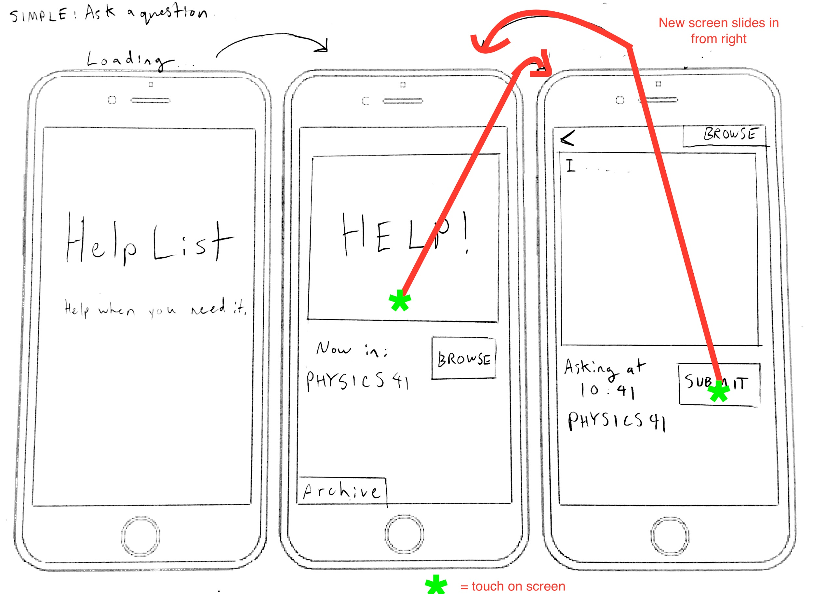
Simple Task: Ask question
(text input)
Notes:
Simple task: ask a question.
In this task, a student gets confused in lecture and wants to submit a question anonymously. He/she taps on the icon of the app, which brings him/her into the home screen of the app. He/she then taps the big “Help” button on the screen, which will takes him/her to a screen with a text box. He/she can then type in the question, and hits submit button. Once he/she hits submit, he/she will be taken back to the home screen

Slide 6
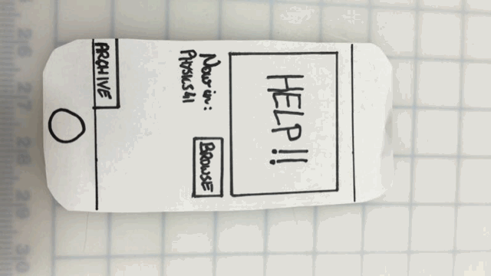
Task 1: Ask questions
Notes:
simple task: ask a question

Slide 7
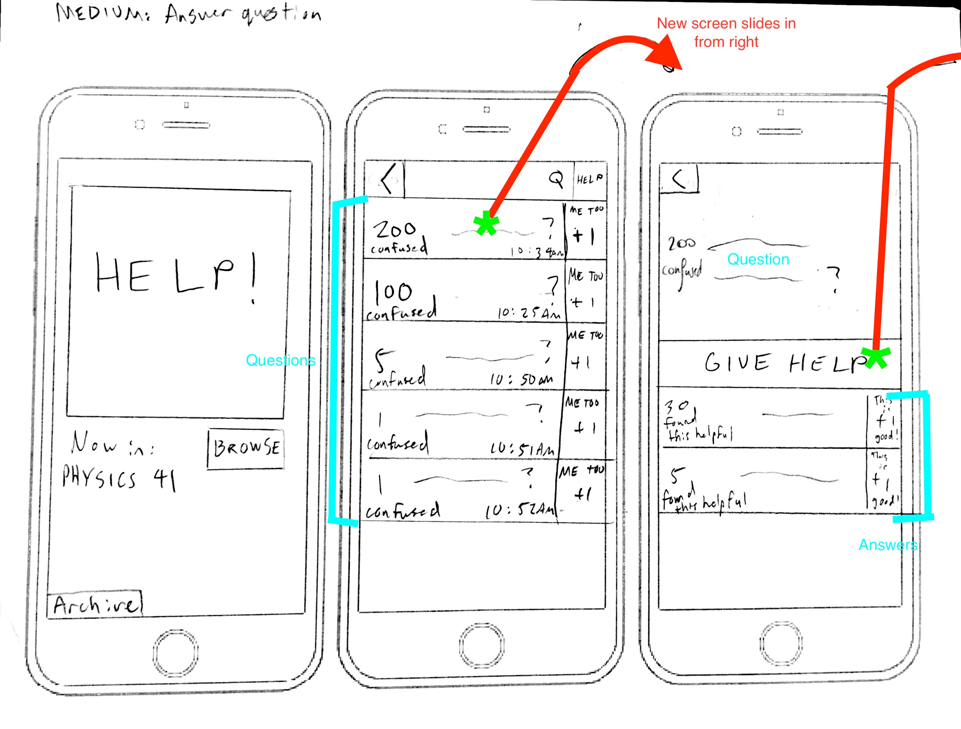
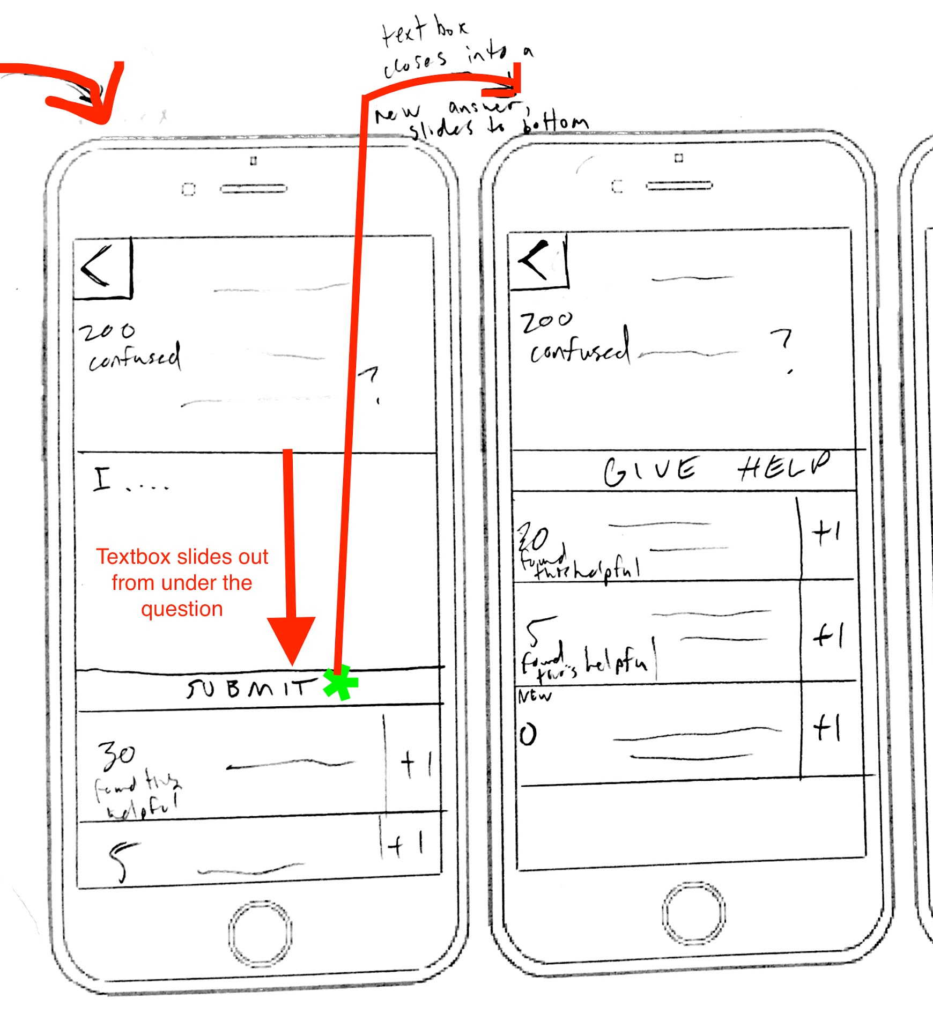
Medium Task: Answer question
Notes:
Medium task: Answer a question
In this task, a student or teacher is going to answer questions that have been asked. They will touch the “browse” button, which will take them to a screen with the questions asked listing in the descending order of the number of votes that the questions have received. They can then tap on the question that they want to answer. The question will then enlarge to show the full text, and other people’s answers will also appear. They can then tap “Give help”, which will pull down a text box for them to enter their answer. They can then tap “Submit” to submit their answer.

Slide 8
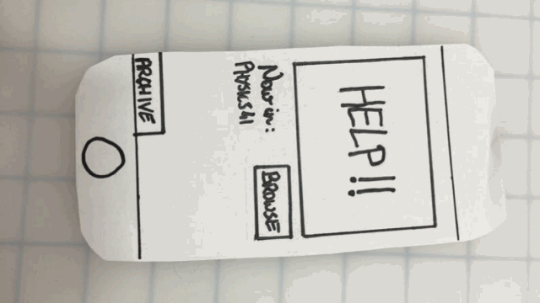
Task 2 Answer QUestions
Notes:
medium task: answer a question

Slide 9
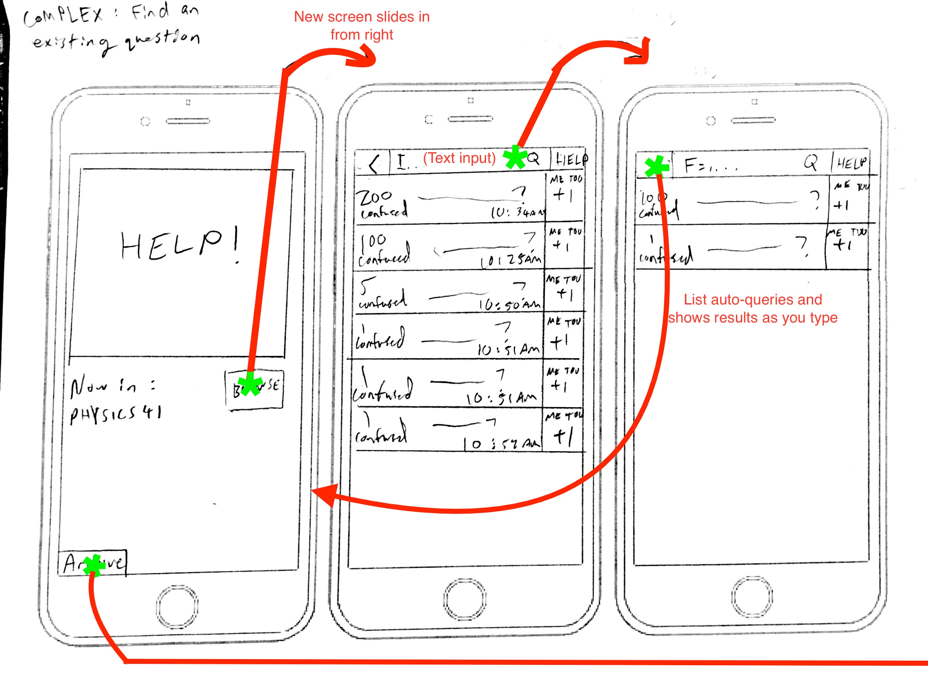
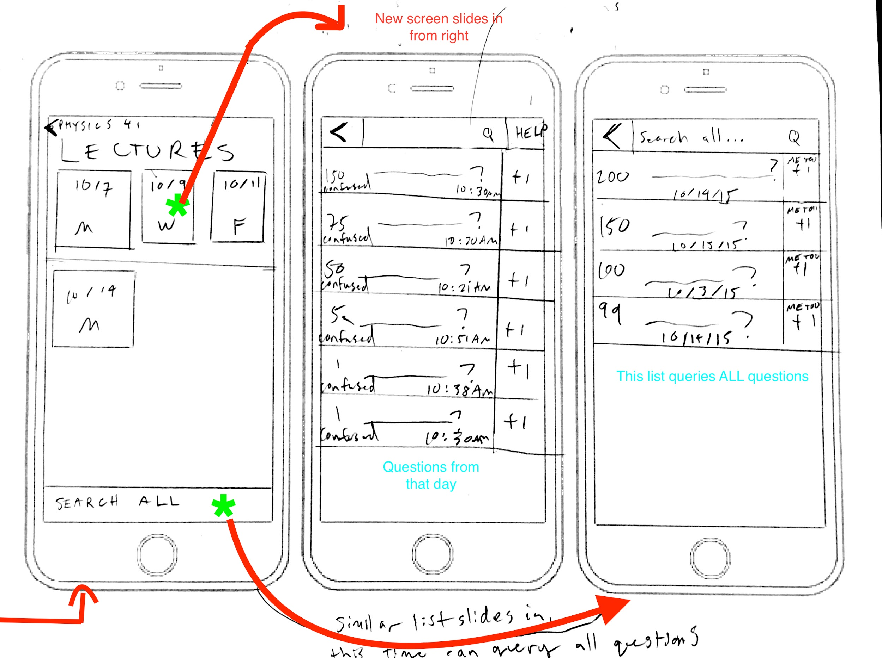
Complex Task: Find previously asked question
Notes:
Complex task: Find an existing question
A student can look for an existing question by clicking “browse” on the home screen, which will take them to the screen with lists of questions. They can type key words in the search bar. In this case, the questions that contain the key words will be filtered and displayed on the screen.If they didn’t find the question, they can click back and go back to the home screen, and then they can click on “Archive” to go to the screen with all the existing lectures. They can then click on each lecture to browse the questions asked in that specific lecture. Or they can click “search all” to search all the lectures.

Slide 10
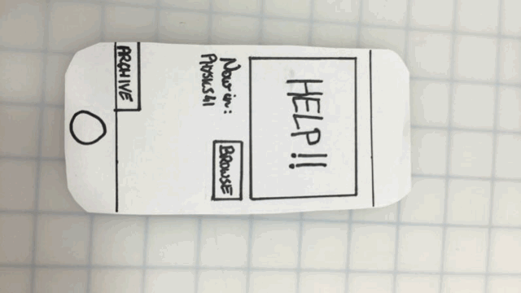
Task 3 Find Questions
Notes:
hard task: find an old answered question

Slide 11
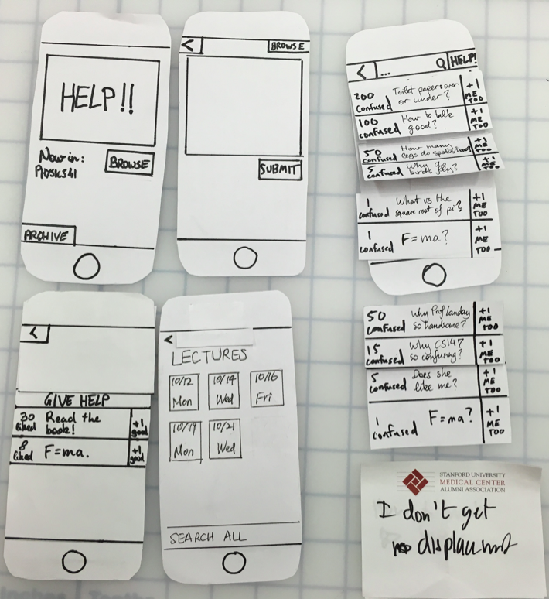
Prototype

Slide 12
Experimental method
Recruited volunteers outside big lecture halls
Conducted experiments in lecture
Santos was the computer, Andrés was the facilitator, Minmin was the notetaker
We showed them the interface then asked them to perform our three tasks
Notes:
Tasks:
We asked them to perform all the three tasks (ask a question, answer a question, find a question) in the lecture.
Testing procedure:
The full testing script is in Appendix. We first introduced ourselves, what we were trying to do, a brief overview of our mobile app. And then the facilitator asked the participants to perform the three tasks in sequence, and the “computer” switched the paper screens according to the participant’s reactions. After one task is finished, the “facilitator” would give the participant a thumb up to indicate that the task is finished. And after the testing is done, the facilitator would ask the participant for his/her feedback.
Roles of each team member:
Santos acted as the computer, Andres was the facilitator and Minmin was the observer.
Test measures:
In the testing, we were observing the participants’ speed and how they interact with our app while listening to the lecturer.

Slide 13
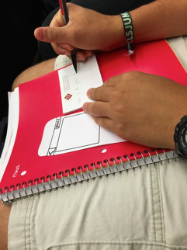
Results: Participant 1
Task 1 Ask a question was very easy for him.
Notes:
Task 1 was very easy for him. He quickly figured out how to use the interface to ask a question -- immediately touched the help button.
Task 2: He was quick to figure out he needs to tap “Browse” on the 1st screen, and then he directly tap on one of the questions.
Task 3: he clicked on “back” several times, and he went through most of the lectures in “Archive”, and then finally clicked on search all and found the question he was looking for. This is a minor usability problem (level 2) because in the end he managed to finish the task. From this incident, we realize that we need to make the search process easier.

Slide 14
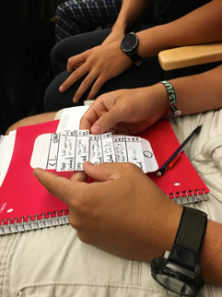
Results: Participant 1
Task 2 Answer a question: He was quick to figure out “Browse” and tapping on question
Notes:
Task 1 was very easy for him. He quickly figured out how to use the interface to ask a question -- immediately touched the help button.
Task 2: He was quick to figure out he needs to tap “Browse” on the 1st screen, and then he directly tap on one of the questions.
Task 3: he clicked on “back” several times, and he went through most of the lectures in “Archive”, and then finally clicked on search all and found the question he was looking for. This is a minor usability problem (level 2) because in the end he managed to finish the task. From this incident, we realize that we need to make the search process easier.

Slide 15
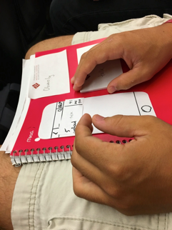
Results: Participant 1
Task 3 Find a question: Clicked on “back” several times, went through most of the lectures in “Archive”, finally clicked on search all and found the question he was looking for.
Notes:
Task 1 was very easy for him. He quickly figured out how to use the interface to ask a question -- immediately touched the help button.
Task 2: He was quick to figure out he needs to tap “Browse” on the 1st screen, and then he directly tap on one of the questions.
Task 3: he clicked on “back” several times, and he went through most of the lectures in “Archive”, and then finally clicked on search all and found the question he was looking for. This is a minor usability problem (level 2) because in the end he managed to finish the task. From this incident, we realize that we need to make the search process easier.

Slide 16
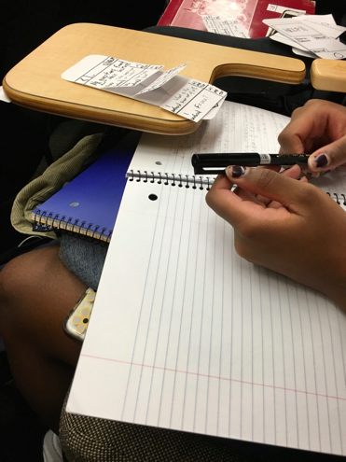
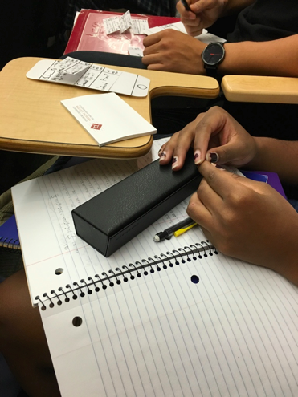
Results: Participant 2
Notes:
Task 1: She tapped on “Browse” instead of “Help” -- this was not a major usability problem (level 2), because she hit the smaller help button on the next screen, but later said she didn't realize the big help button the first screen was a button due to the low-fidelity nature of the prototype. This is a minor usability problem (level 2).
Task 2: She tapped on “Browse” as we designed, and it was easy for her to understand that she needs to tap on the question and enter her answer. However, she didn't realize at first how to submit the question (by tapping "give help" again) making it a minor usability problem (level 2).
Task 3: She did not notice the “Archive” button, and she went back and forth several times but found it eventually and used the search function/archives of questions very easily (level 2).

Slide 17
Results: Participant 2
Task 1: Click on “Browse” instead of “Help”
Task 2: Didn't realize at first how to submit the question, confused by “Give help” after she typed in answer
Task 3: Didn’t notice the “Archive” button, and went back and forth several times but eventually used the search function/archives of questions very easily

Slide 18
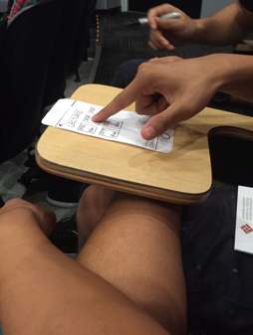
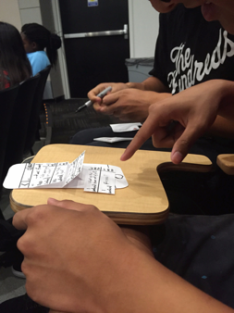
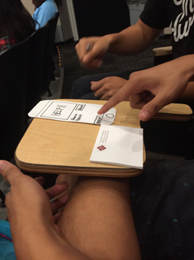
Results: Participant 3
The tasks were intuitive for him.
Notes:
Task 1: No problems.
Task 2: No problems.
Task 3: No problems.
The tasks seemed most intuitive for him: he breezed through them and did not seem to struggle with anything.

Slide 19
Discussions
Cosmetic changes:
Make “Archive” button more obvious
Make “Search” bar more obvious
Make the Help button pop up by using bright color
Usability changes:
Change “give help” to “submit” after they start typing
Make search process simpler and more intuitive

Slide 20
Summary
Some cosmetic and usability changes needed
Participants liked the interactive nature and the anonymity of the app
Liked the “+1” up-vote button
Appreciated the simple interface for submitting questions in class

