Slide 1
Connect
by Low Income & Minorities in Education

Slide 2
MAKING DREAMS ACCESSIBLE
BY ASSISTING LOW-INCOME AND MINORITY STUDENTS
IN FINDING AND EXPLORING THEIR PASSIONS

Slide 3
Institutional racism and classism CREATE unique barriers for low-income and minority students, ISOLATING THEM FROM INFORMATION AND OPPORTUNITIES THAT COULD PROPEL THEIR CAREERS

Slide 4
Introduces students to careers that fit interests
Provides a knowledge base on different career paths
Shares low-cost academic opportunities of interest
Provides platform to share opportunities

Slide 5
Heuristic Evaluation Results and Revised Design
Implementation Status
Demonstration
Summary

Slide 6
Heuristic Evaluation Results and Revised Design
Implementation Status
Demonstration
Summary

Slide 7
heuristic violation
revised design
No clear way to logout | Add dropdown in header with Logout
Hard to tell how far along in quiz | Have quiz all on one page
One direction quiz | Have quiz all on one page
Why did I add friend | get rid of friends-not the purpose of the app

Slide 8
heuristic violation
revised design
Unclear how to add programs | Ability to add programs from the homepage
No way to search by program Name | Simple yelp like search with filter options
Magnifying icon confusing | Adding tutorial for first time users No longer a map
Plus icon confusing | Can add reviews from main page no longer add friend option

Slide 9
Heuristic Evaluation Results and Revised Design
Implementation Status
Demonstration
Summary

Slide 10
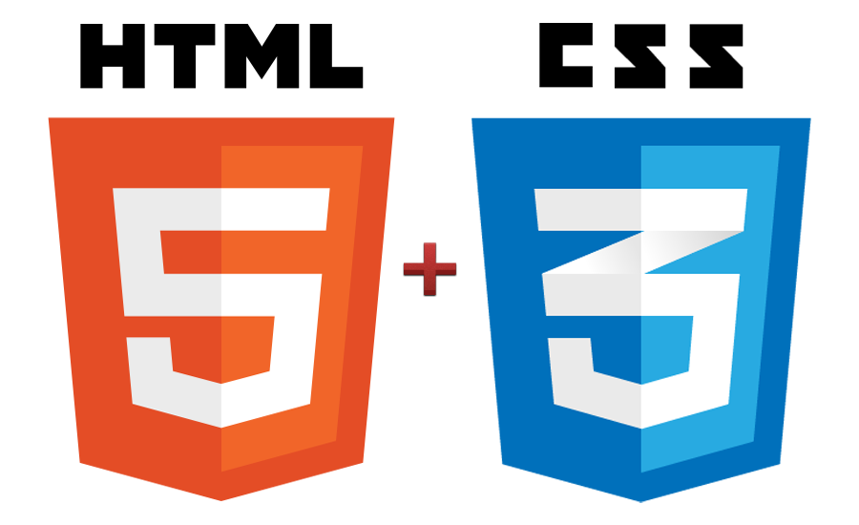
tools used
HTML
CSS
Ruby on rails
jquery MOBILE

Slide 11
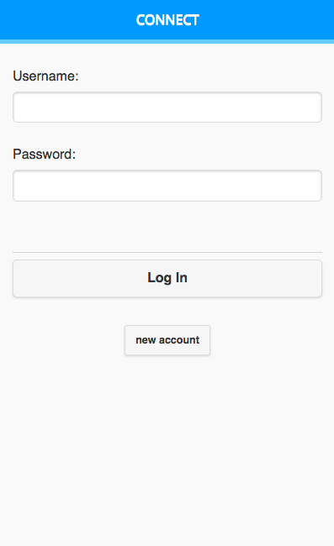
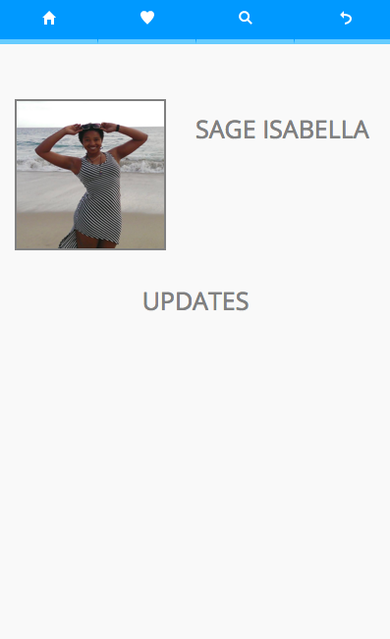
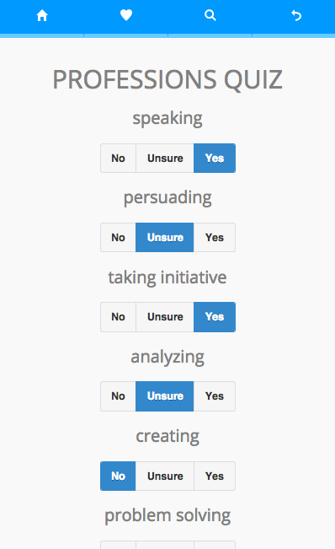
implemented features
Professions
Result Tags
Quiz Scoring
Results

Slide 12
unimplemented features + plan
find summer opportunities
add summer opportunities
review summer opportunities
add/remove professions
search professions
Home Page

Slide 13
Wizard of oz Techniques / Hard Coded Data
pre-populated summer programs
careers are hard coded

Slide 14
Heuristic Evaluation Results and Revised Design
Implementation Status
Demonstration
Summary

Slide 15
Heuristic Evaluation Results and Revised Design
Implementation Status
Demonstration
Summary

Slide 16
SUMMARY
we’ve completed one task - yay!
a lot more left to complete
continue to use same tools
continue to address heuristics along the way

