Slide 1
LiME
Low Income Minorities in Education
Notes:
Notes:
Pictures from Jasmine’s Mom and Sister
Pictures of Testing
Add in new interview bullets
Whether or Not Assumptions Were Valid

Slide 2
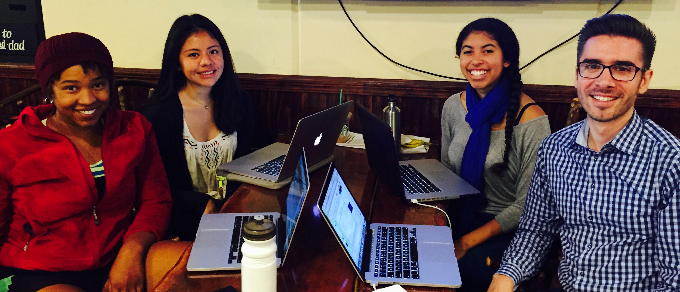
Sage, Betsy, Jasmine, Cristian
How to expose low-income minority students to STEM education

Slide 3
Initial POV

Slide 4
We met K and we were amazed to realize that he considered engineering a new field. It would be game-changing to make information about engineering more accessible.

Slide 5
Additional Needfinding Results

Slide 6
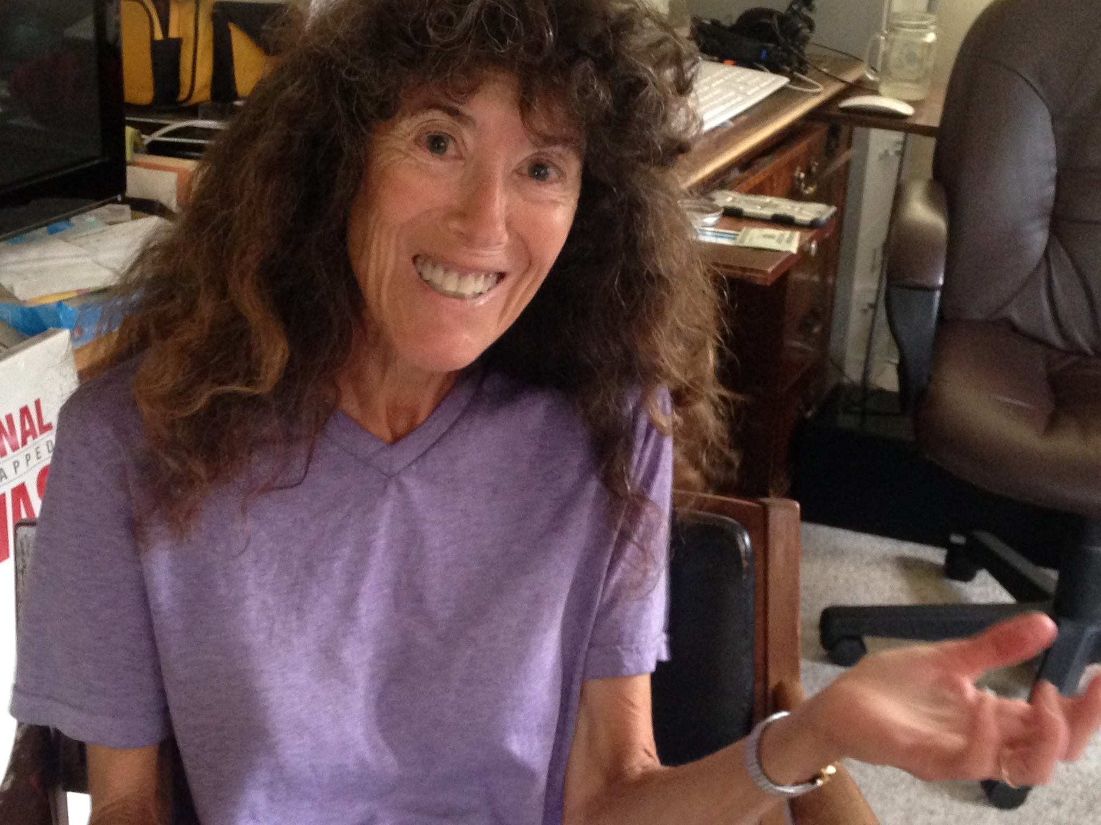
Pic of Donna
“You can’t make every child be a computer scientist”
Notes:
need to make sure students who aren’t interested in stem don’t feel inferior

Slide 7
“My Spanish-speaking students like math because they don’t have to learn as many new words.”
Notes:
even within our target demographic there will be a lot of variation - different subgroups have different needs

Slide 8
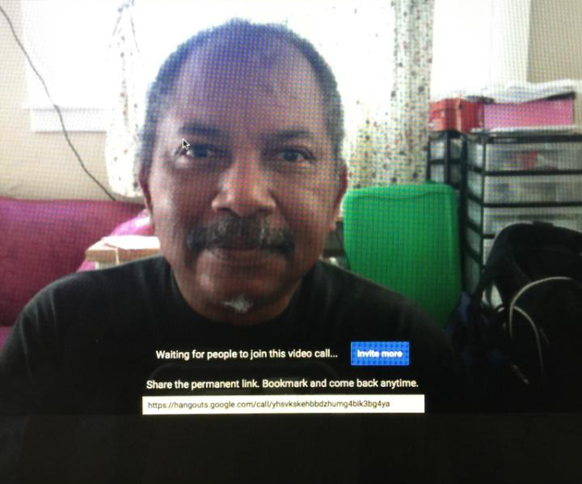
Not everyone has the same conception of what STEM means
Notes:
we were thinking narrowly - more hardcore science, technology, engineering, math. he mentioned things like teaching the elderly to use computers or using computers for work. to what degree do we want to address more basic competency

Slide 9
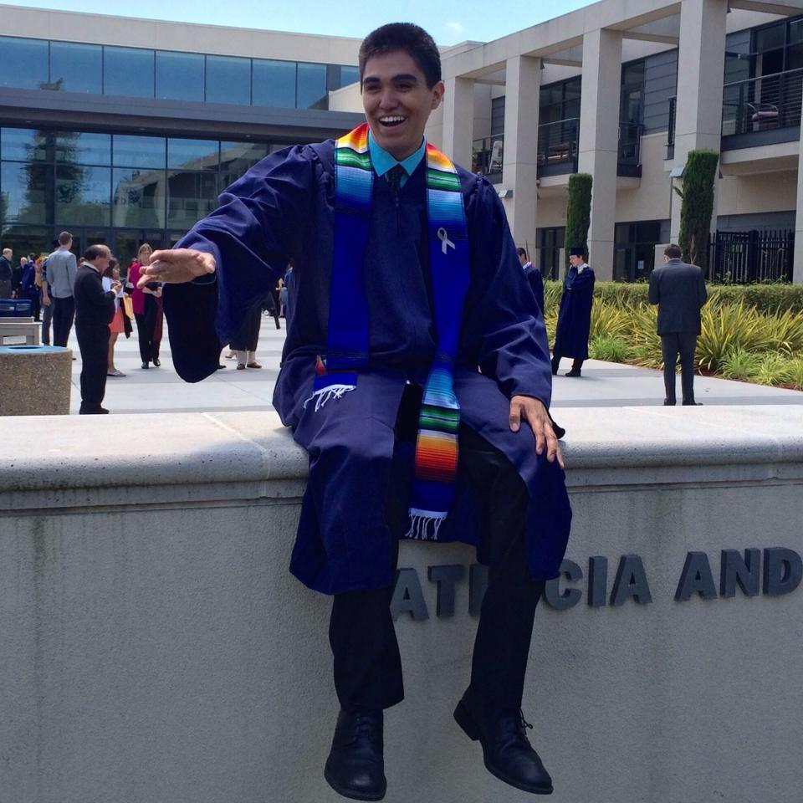
Seeing low income minority college student excel is more inspiring than seeing/hearing from successful adults in the workforce.

Slide 10
Revised POVs

Slide 11
We met Matt and
were amazed to realize that adult encouragement mattered significantly for students.
it would be game-changing if we connected adults with spare time to young adults to encourage and teach them.
Notes:
thought it would be more about peer validation

Slide 12
We met Keven and
were amazed to realize that many low income minority homes have technologies like gameboys and tvs, but students don’t consider tech a career option because they don’t see people like them working in stem.
it would be game-changing to increase the visibility of minorities working in STEM.
Notes:
surprised that teachers could actually see the difference

Slide 13
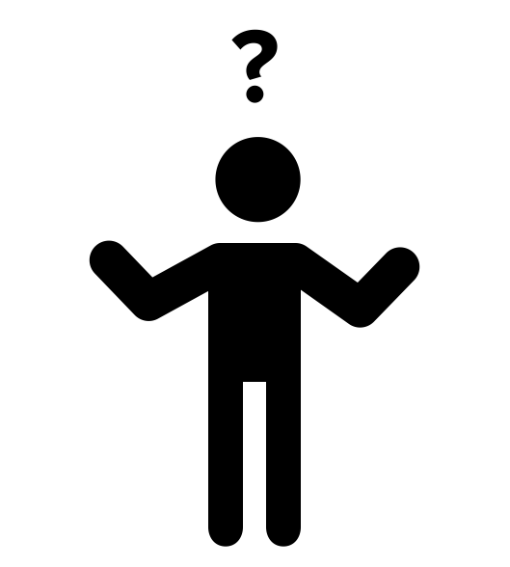
We met Char and
were amazed to realize that she only enjoyed STEM subjects when she understood them.
it would be game-changing to help her realize that not understanding something right away is normal and doesn’t mean that you should give up.

Slide 14
Top HMWs

Slide 15
HMW give students the ability to ask questions to experienced professionals (of varying backgrounds)

Slide 16
HMW write articles that students can understand on big research publications

Slide 17
HMW end the glorification of natural intelligence and increase appreciation for hard work

Slide 18
Experience Prototypes

Slide 19
teach it. learn it. do it. be it.
scaffolded learning. digestable. interactive.

Slide 20
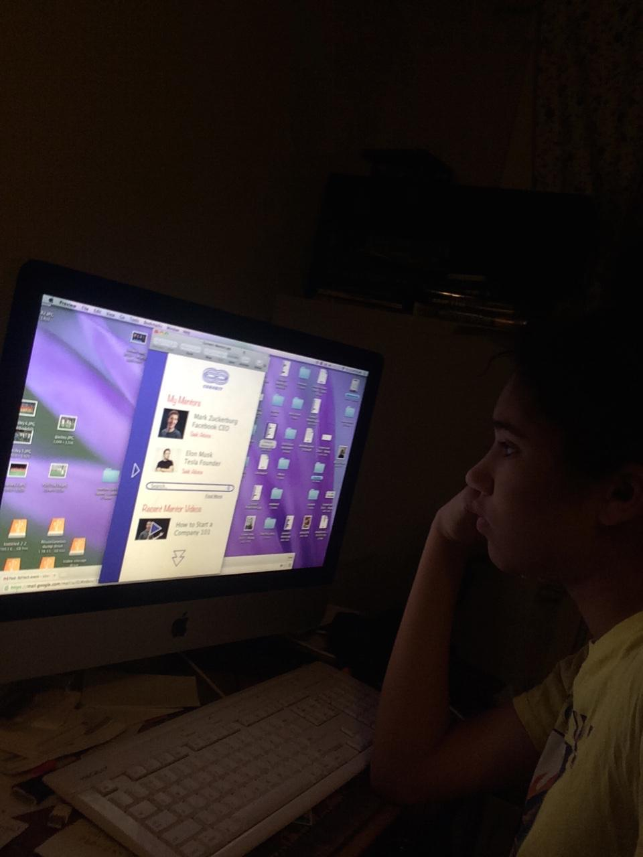
Loves doing experiments
Likes video
Even inexpensive materials might be difficult
More interested in working solo
Games

Slide 21
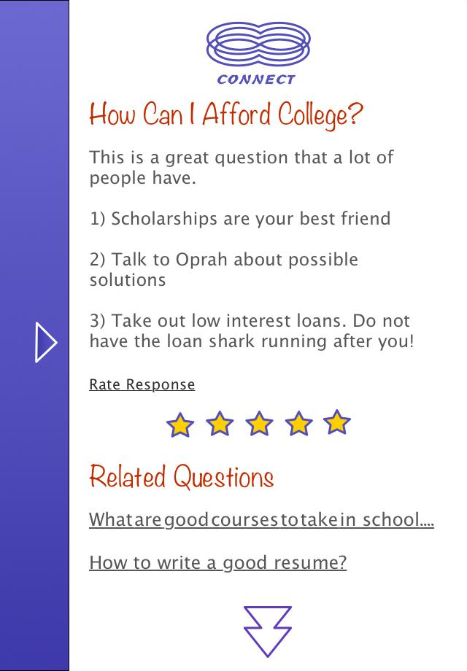
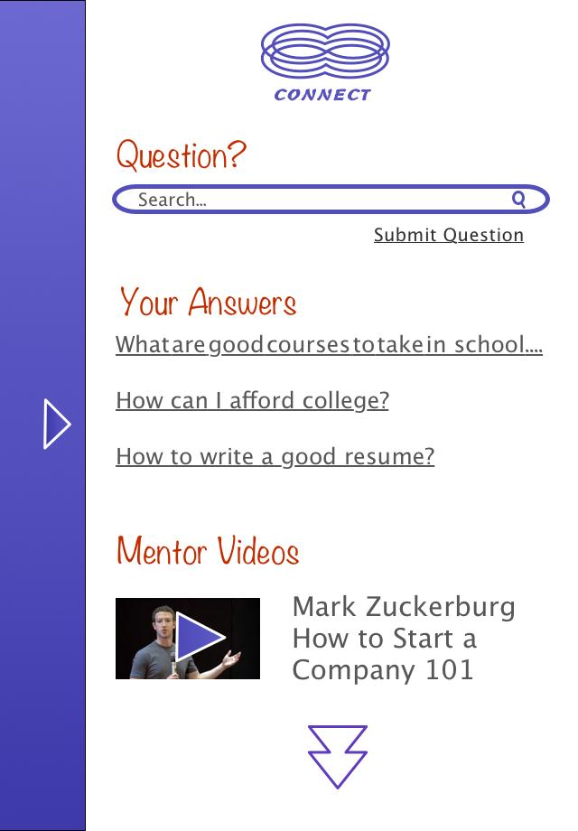
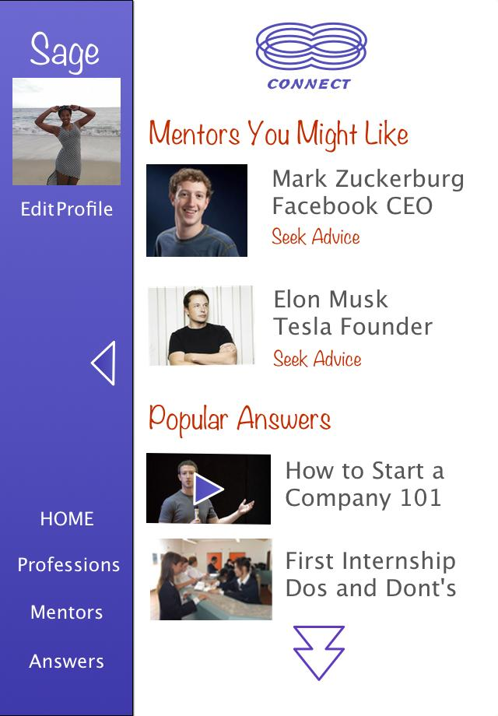
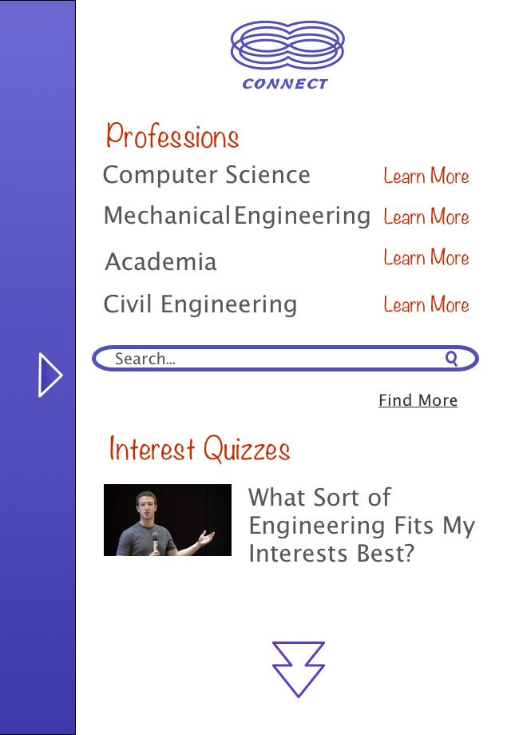
connect
Advising. Answers. Crowdsourced knowledge

Slide 22
Interested in learning from adults
More personalized would be better
Some want social component
Enthusiastic!
Teens love quizzes
College students as well as professionals

Slide 23
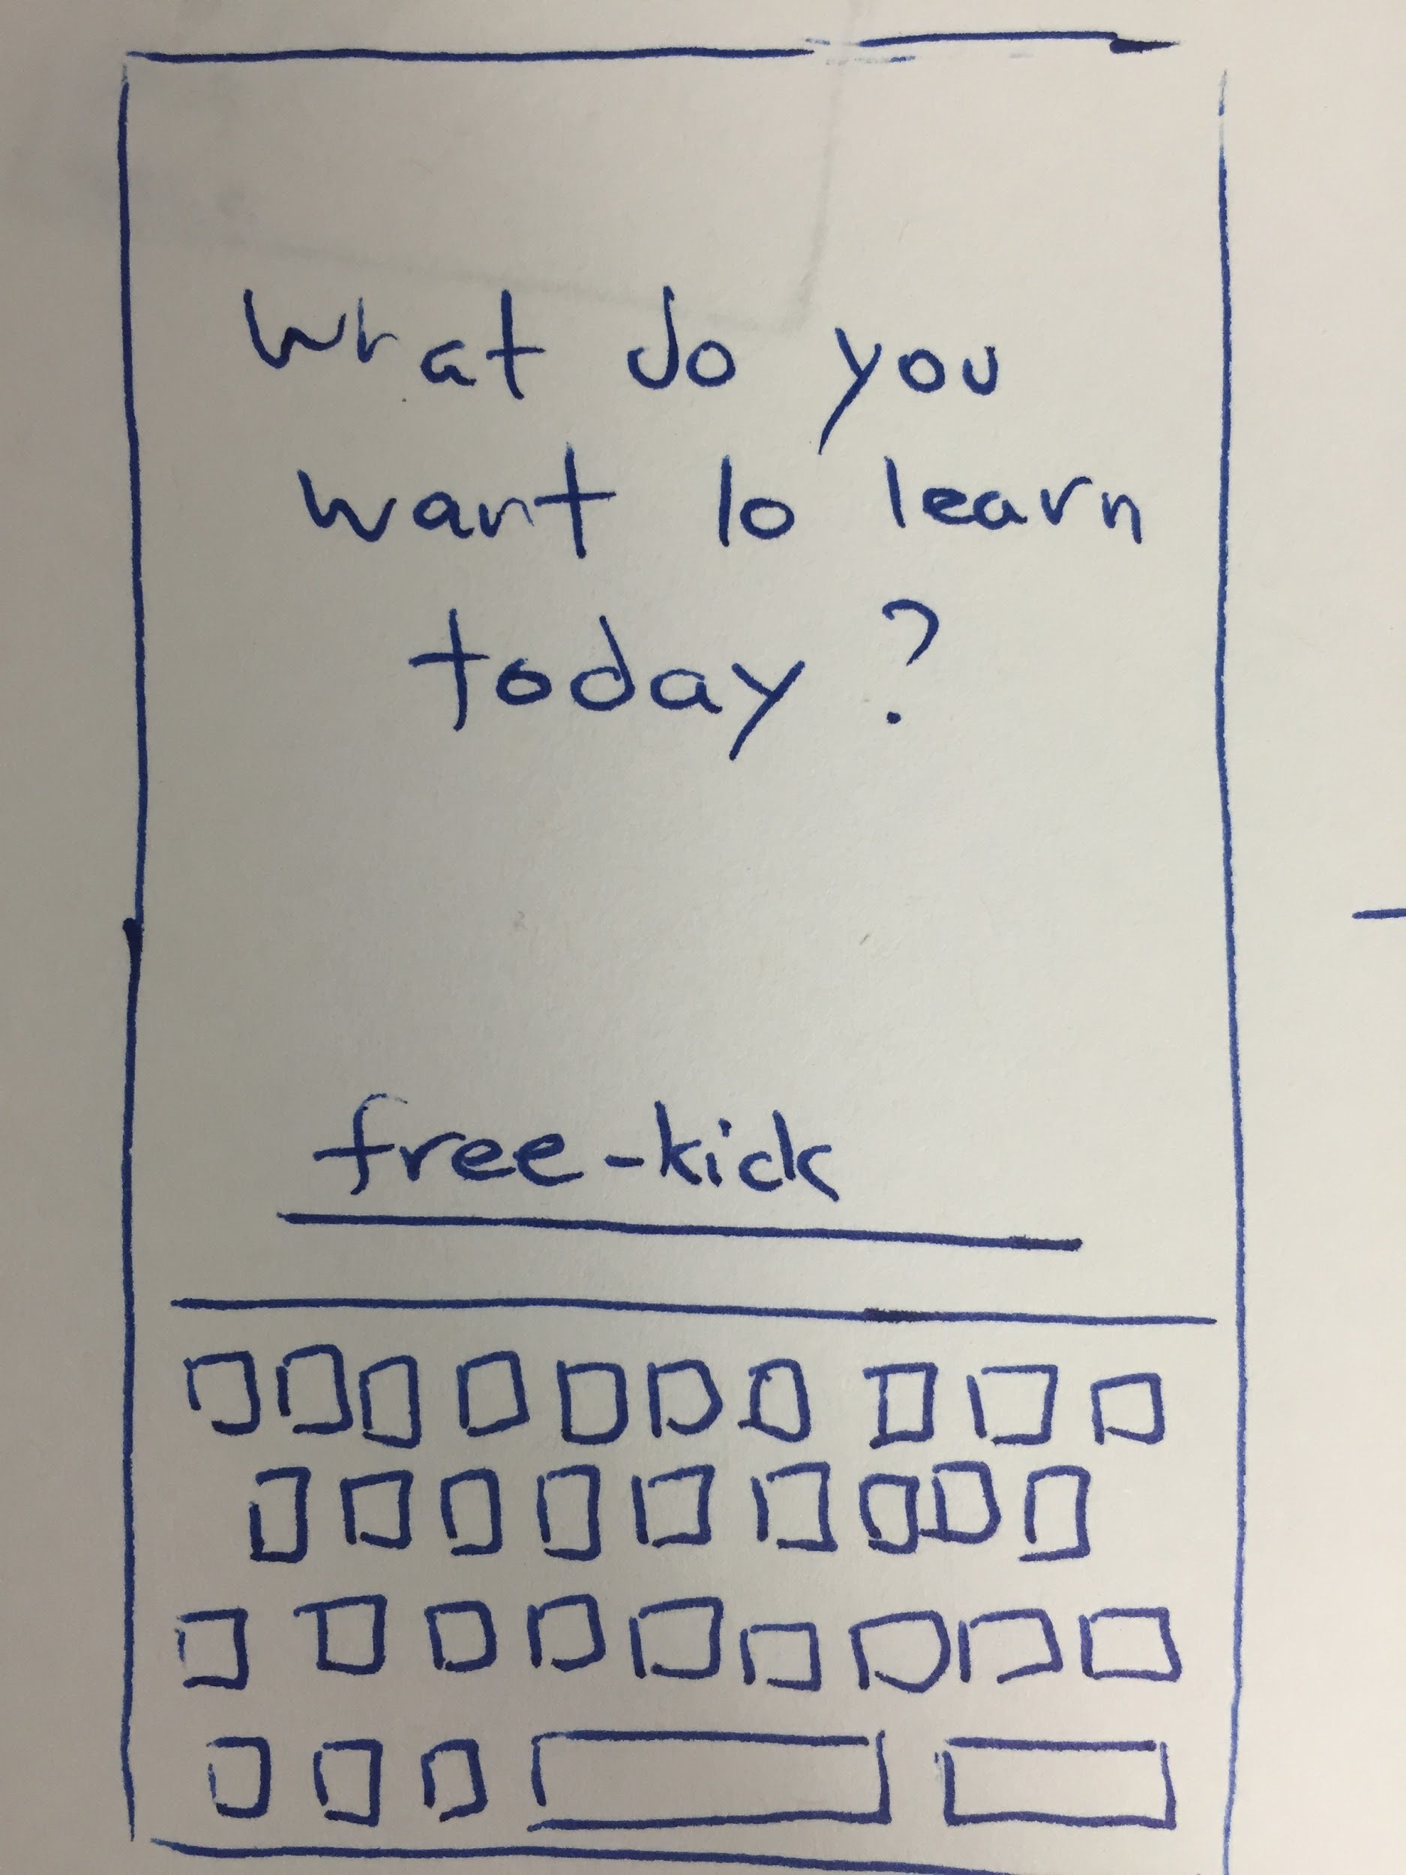
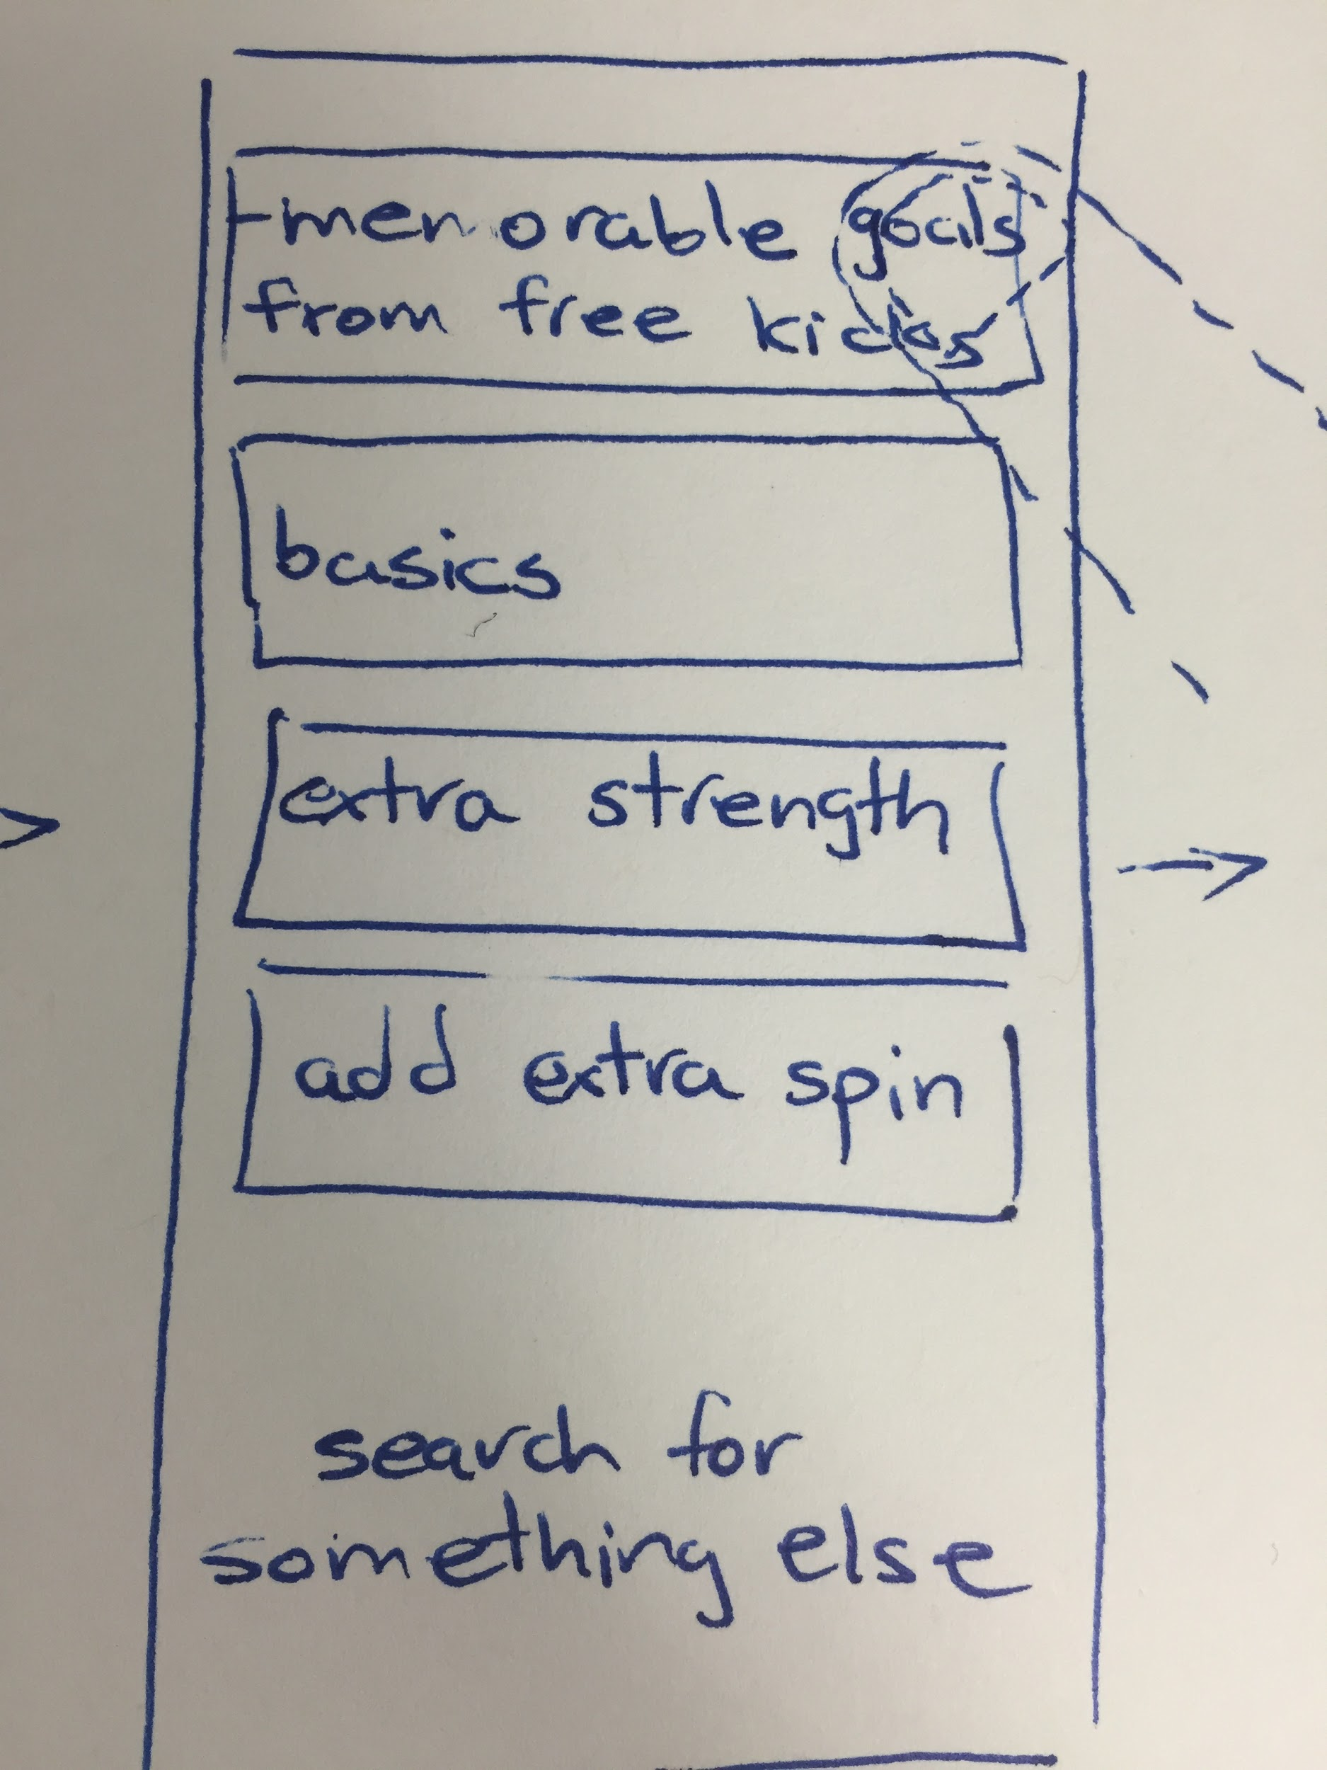
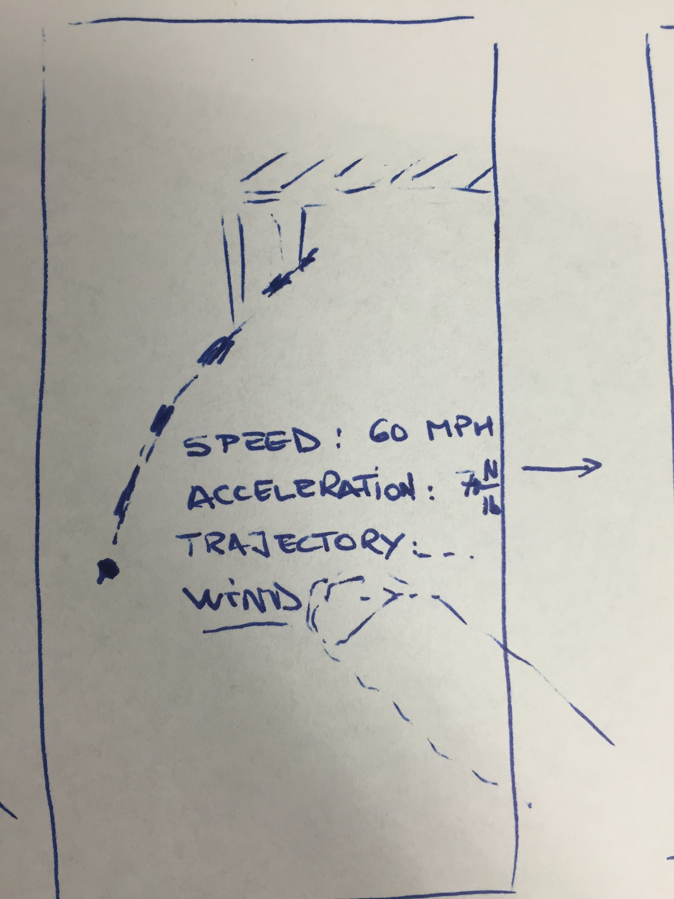
inside out.
personalized. creative. real life applications

Slide 24
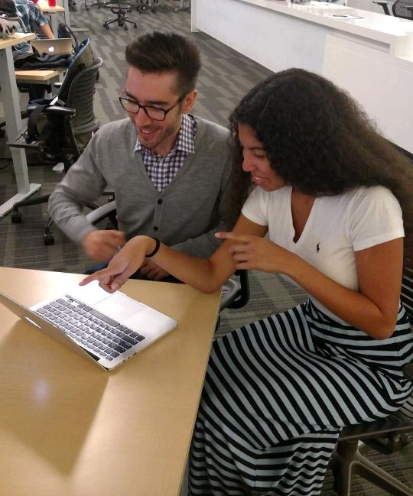
Can learn about topics she’s interested in
Not always interested in delving deeper
No profile
What is a social app

Slide 25
Image Sources
Parent and Child Image - by Gregor Črešnar
Tablet Image - by Tahsin Tahil
Question Image - by Jessica Lock

