Slide 1
Low-fi Prototype and Testing
click Education

Slide 2
Mission Statement: Never Leave Class Confused
Two perspectives:
Student
Confused about lecture topics
Teacher
Confused about student performance

Slide 3
Problem/Solution Overview
Problem:
Students don’t want to publicly admit that they don’t understand class material, so teachers don’t have a reliable means by which to determine their students’ comprehension until it’s too late.
Solution:
Anonymous student feedback removes the participation barrier, enabling teachers to both revisit what was misunderstood in real-time and to update their lesson plans based on this information.

Slide 4
Overview of Talk
Brainstorming and picking between possible devices and UIs
Narrowing UI flow for each task
Constructing prototype for tasks and necessary functionality
User experimentation and feedback

Slide 5
Overview of Talk
Brainstorming and picking between possible devices and UIs
Narrowing UI flow for each task
Constructing prototype for tasks and necessary functionality
User experimentation and feedback

Slide 6
Possible UI choices
Device choices
iPad vs. iPhone vs. Apple Watch vs. Google glasses
Student-feedback mechanisms
Binary choice, slider, dial, etc.
Teacher in-class feedback mechanism
Alarm, notification, screen change
After-class data visualization for feedback
Frequency graph, “Current Status” graph, etc.

Slide 7
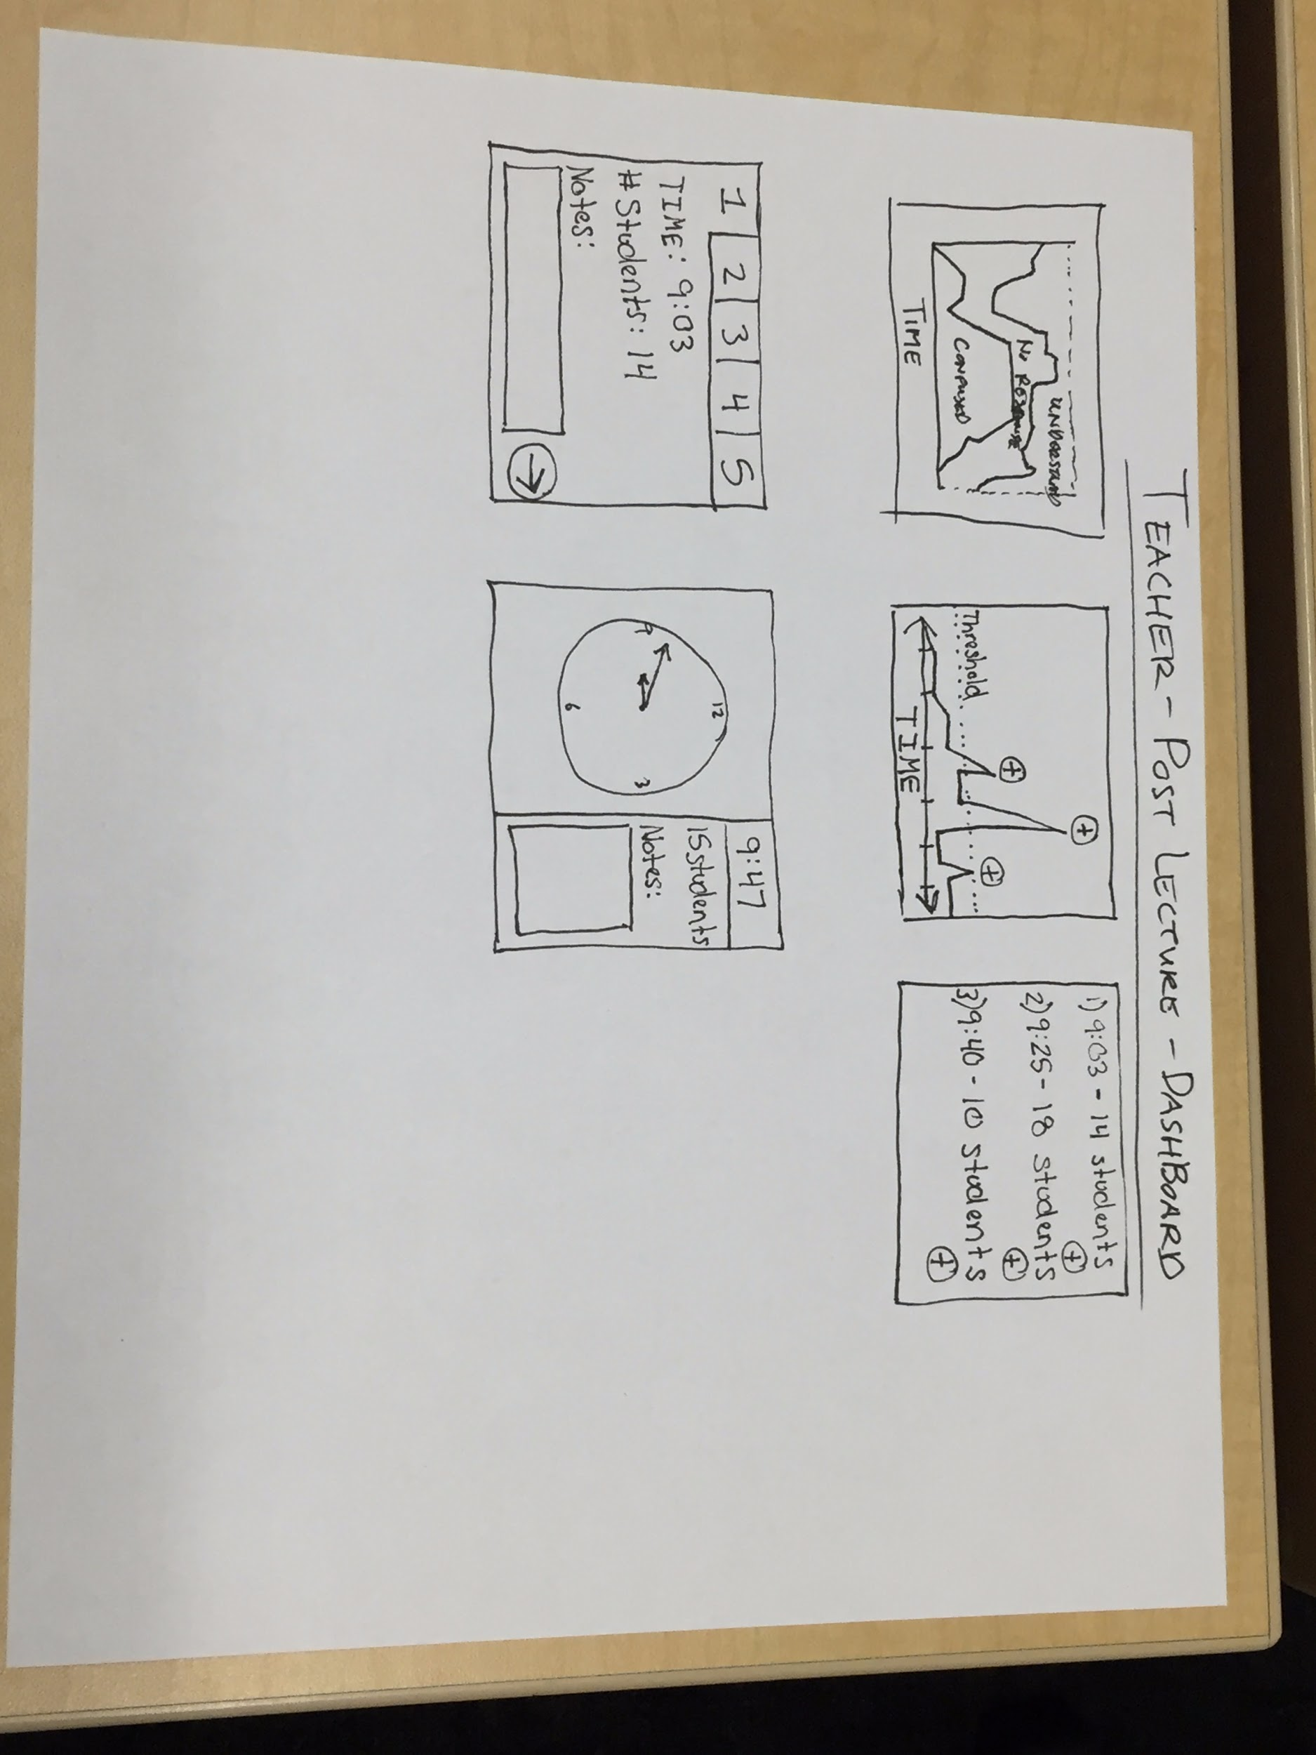
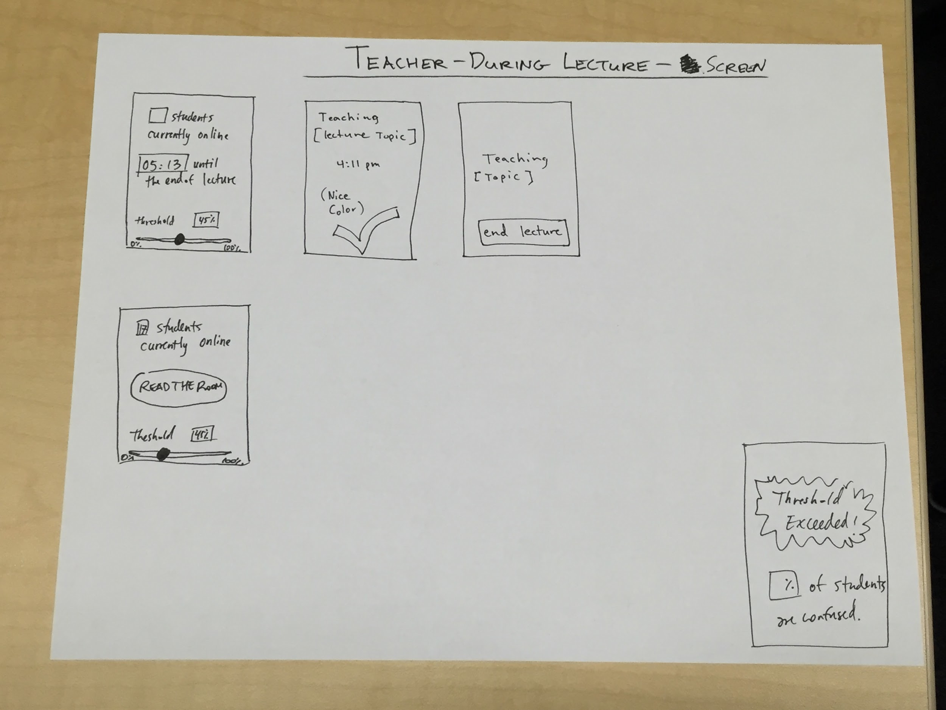
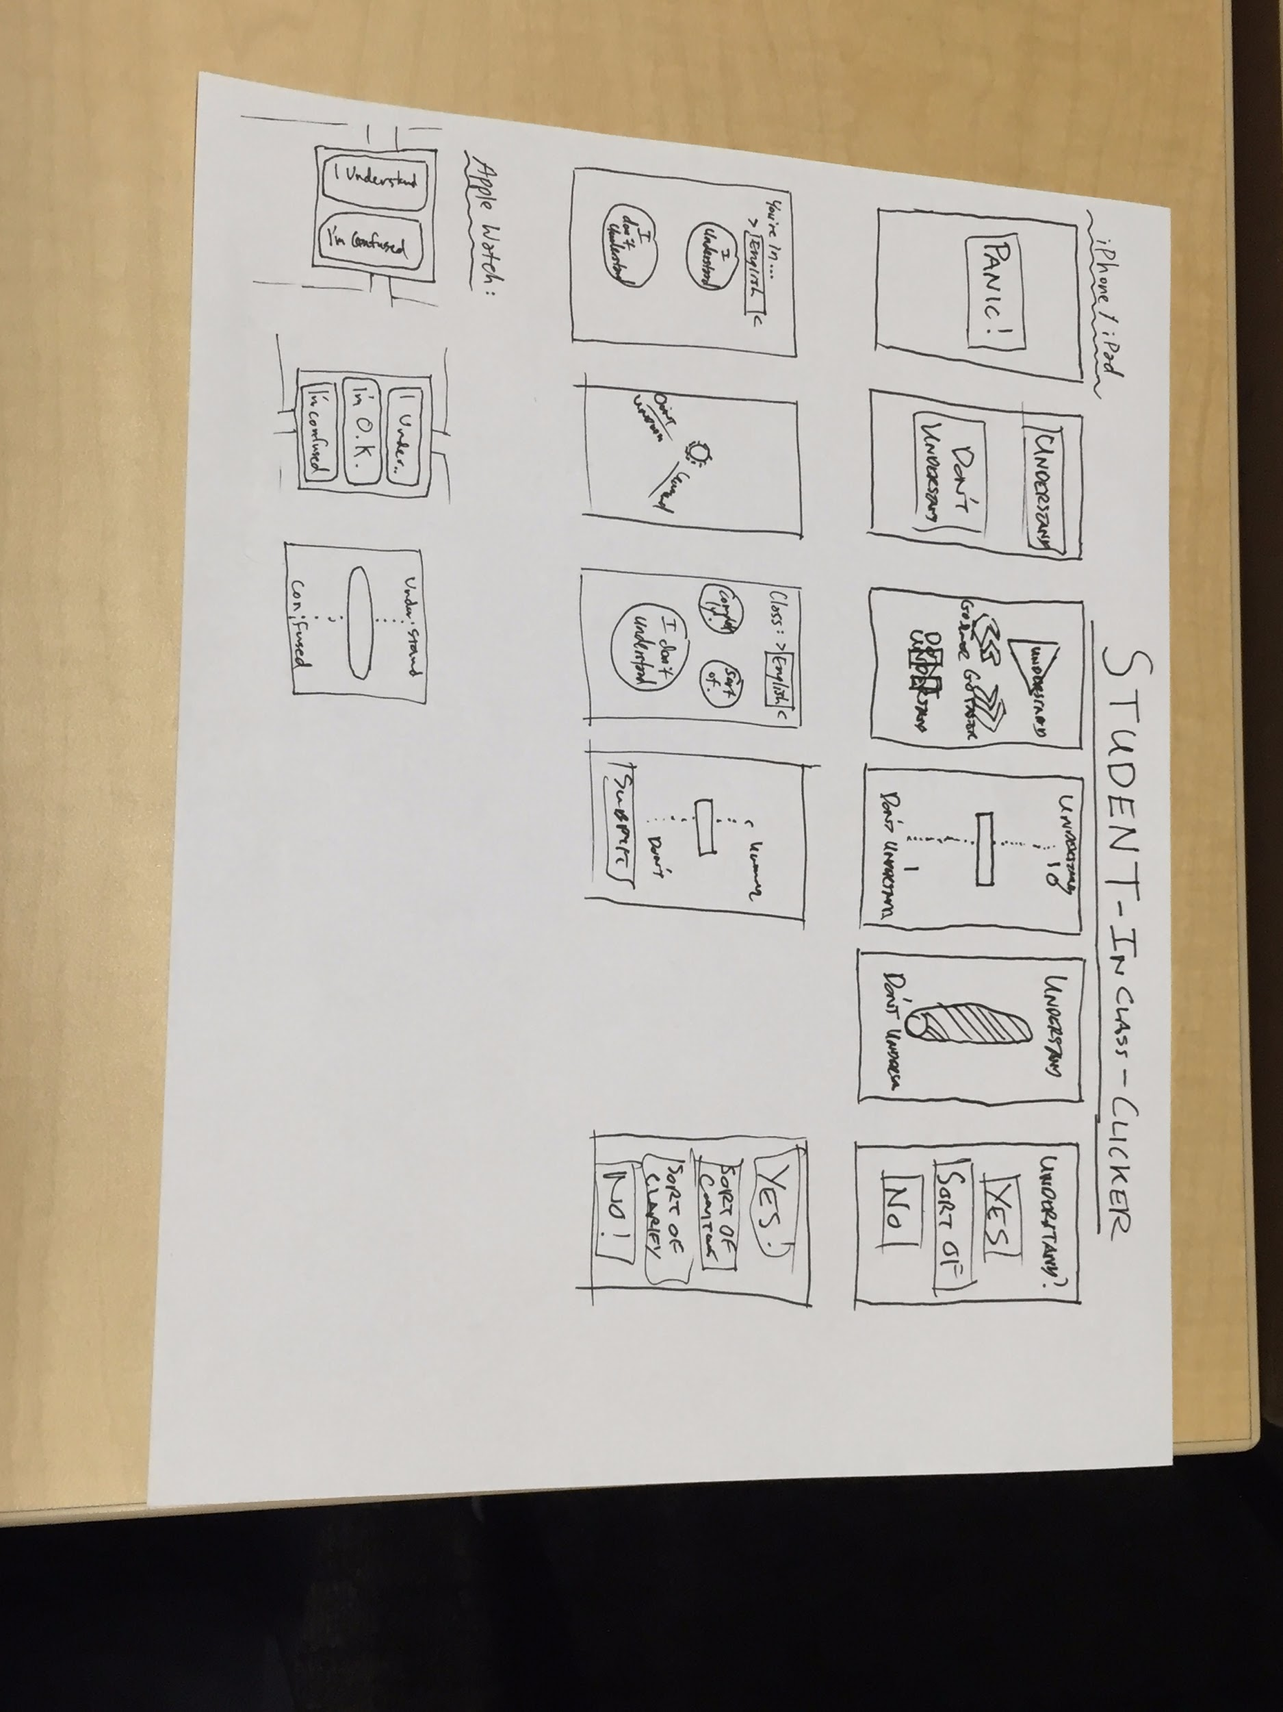
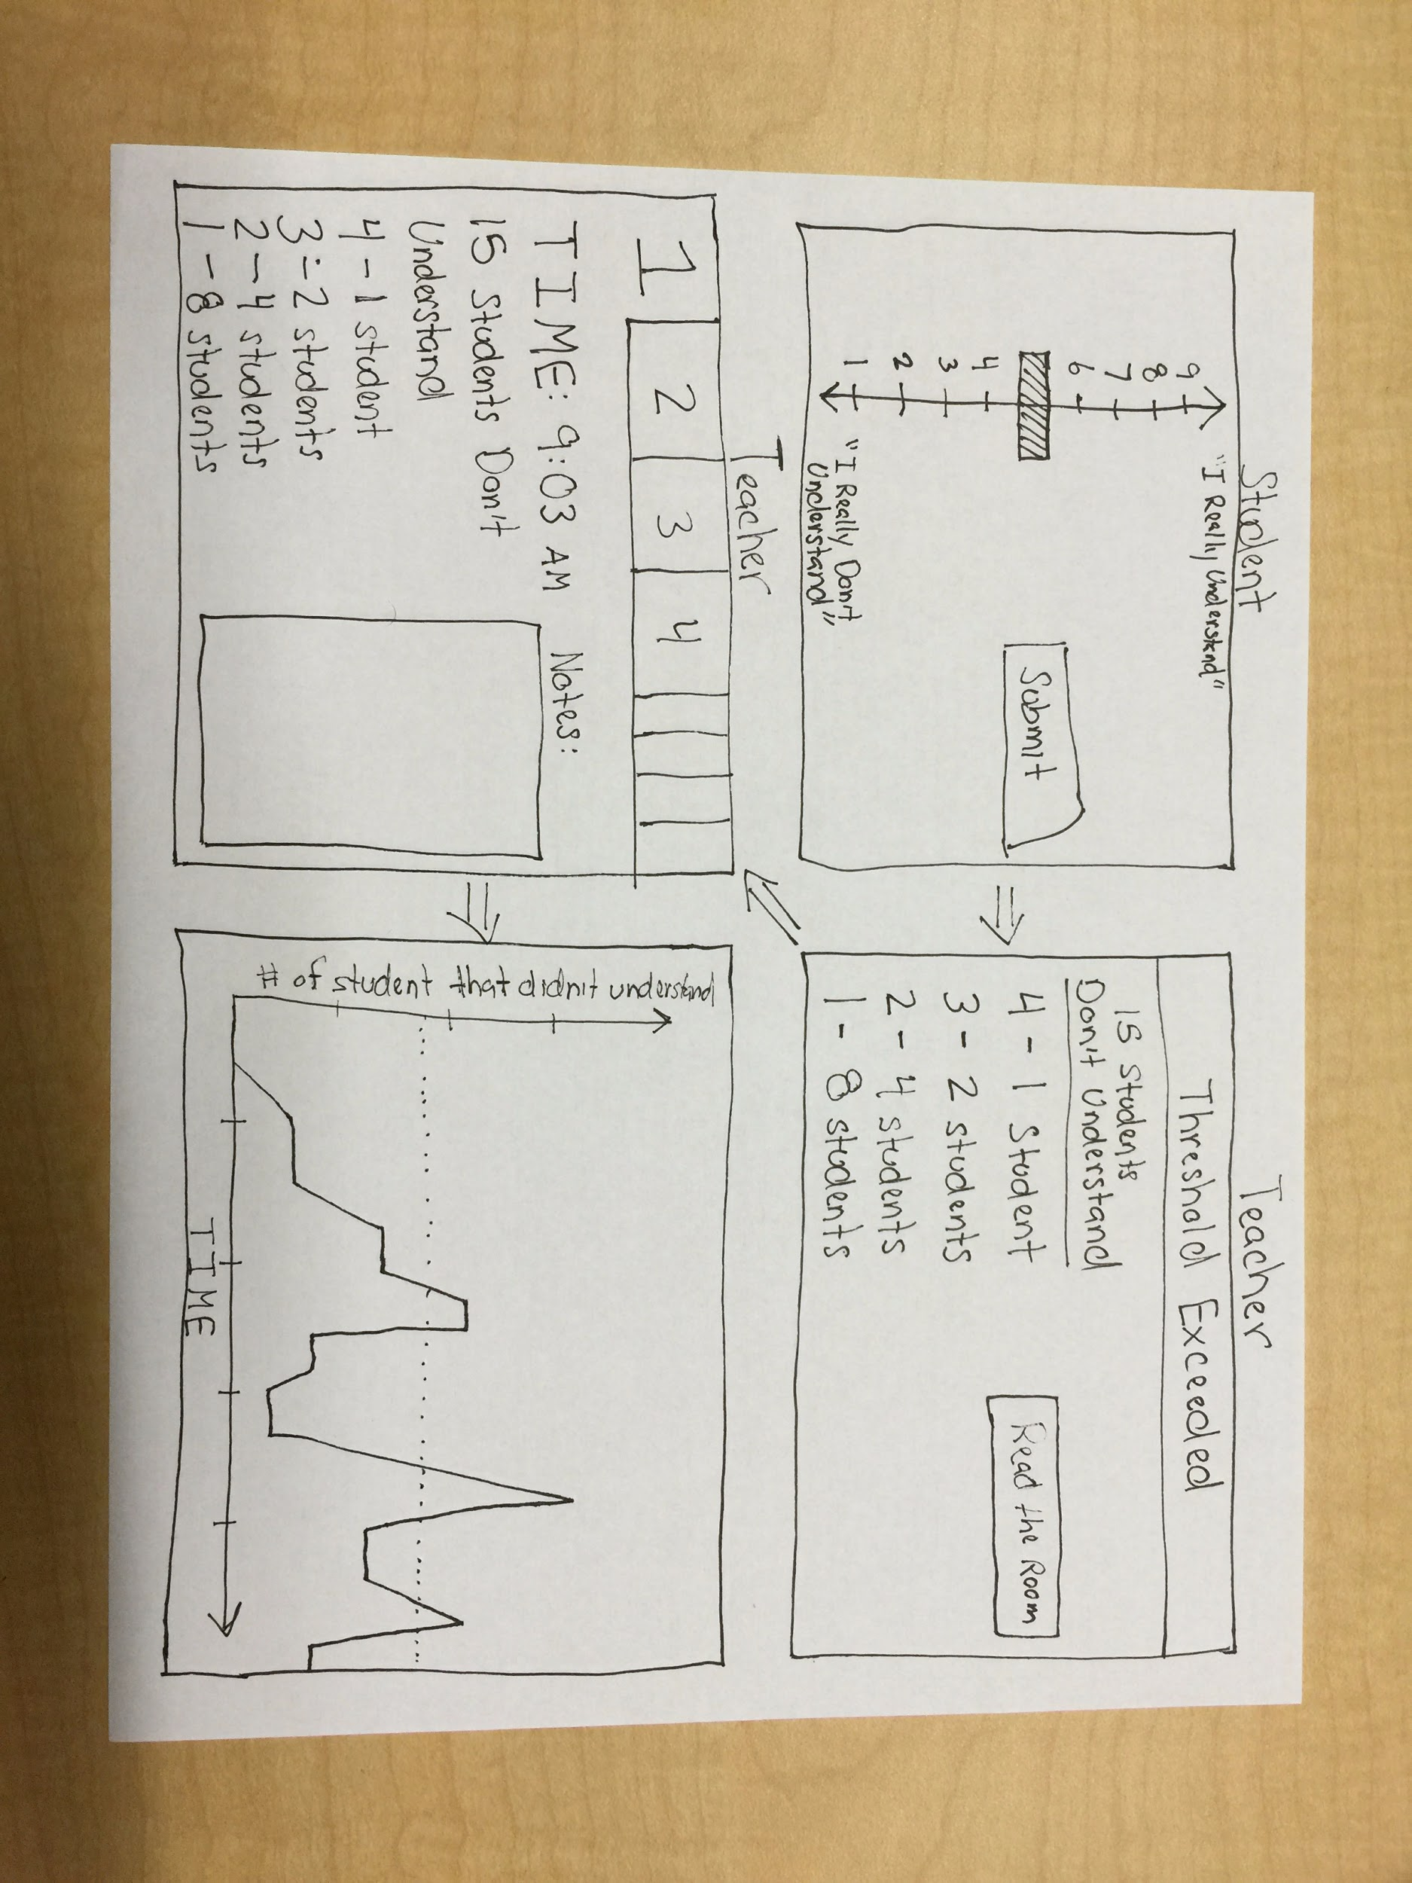
● Selected Interface & Rationale (1 slide)

Slide 8
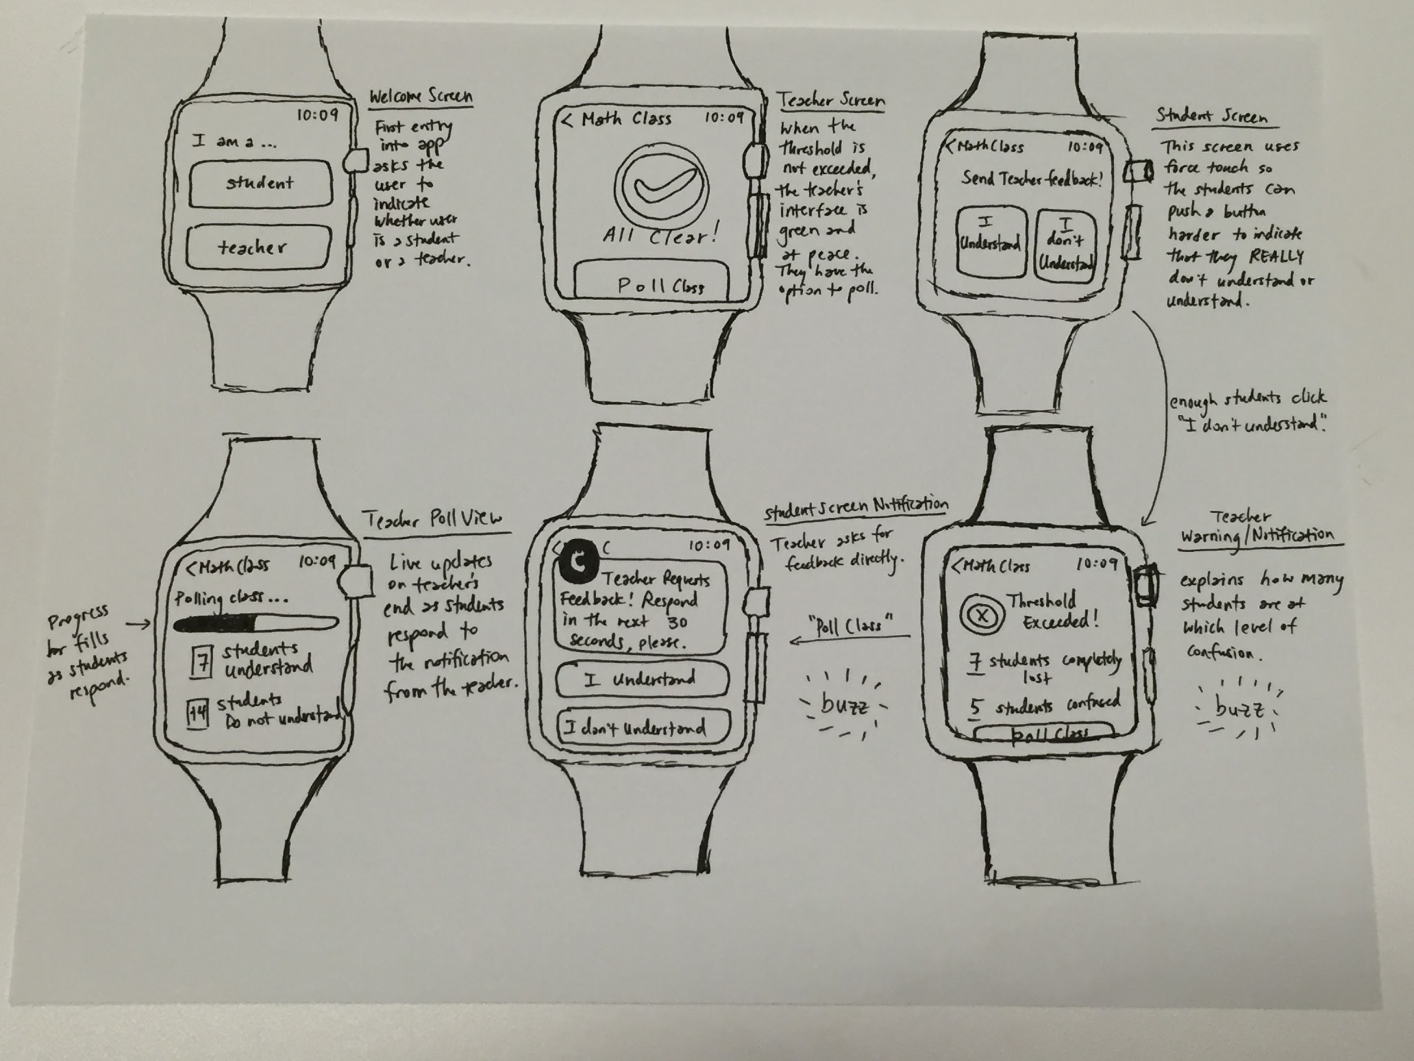

Slide 9
Interface Choice and Brief Justification
We decided iPads/iPhones because:
Although Apple Watch was convenient for student input and teacher notifications, it’s constrained by low adoption.
More importantly, most other interfaces were cumbersome on such a small screen, especially after-lecture review
iPads and iPhones were the opposite: all interfaces were intuitive and convenient, and adoption is high

Slide 10
Interface Choice and Brief Justification Continued...
We decided on binary input because:
It’s less disruptive (brief glance at phone)
Easier for teacher to interpret than “continuous” input

Slide 11
Overview of Talk
Brainstorming and picking between possible devices and UIs
Narrowing UI flow for each task
Constructing prototype for tasks and necessary functionality
User experimentation and feedback

Slide 12
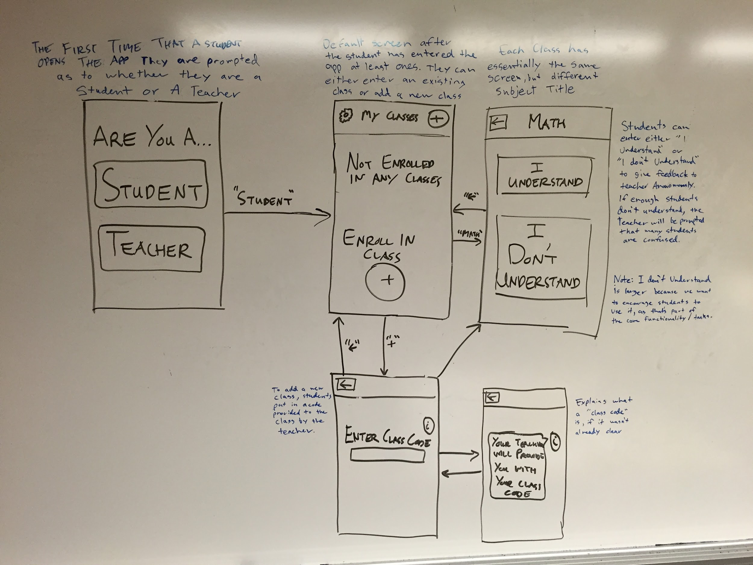
Task 1: Student Gives Feedback

Slide 13
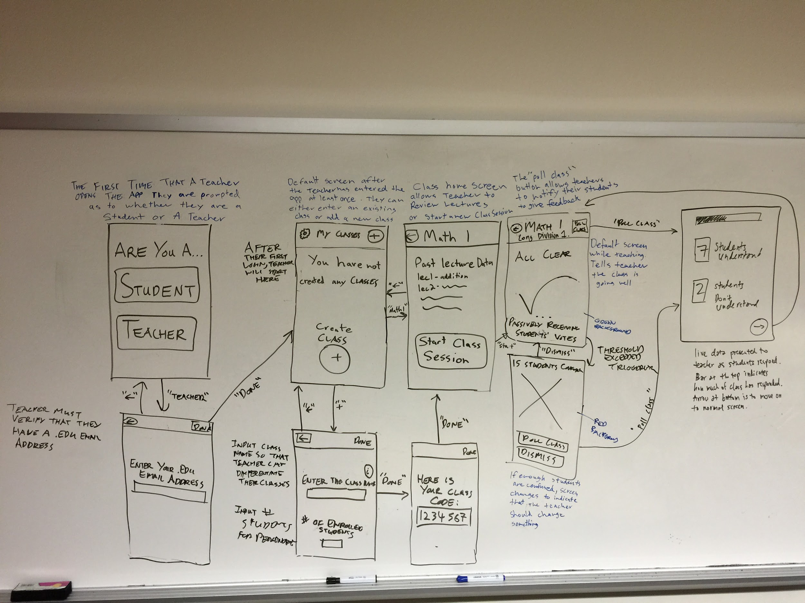
Task 2: Teacher “Reads the Room”

Slide 14
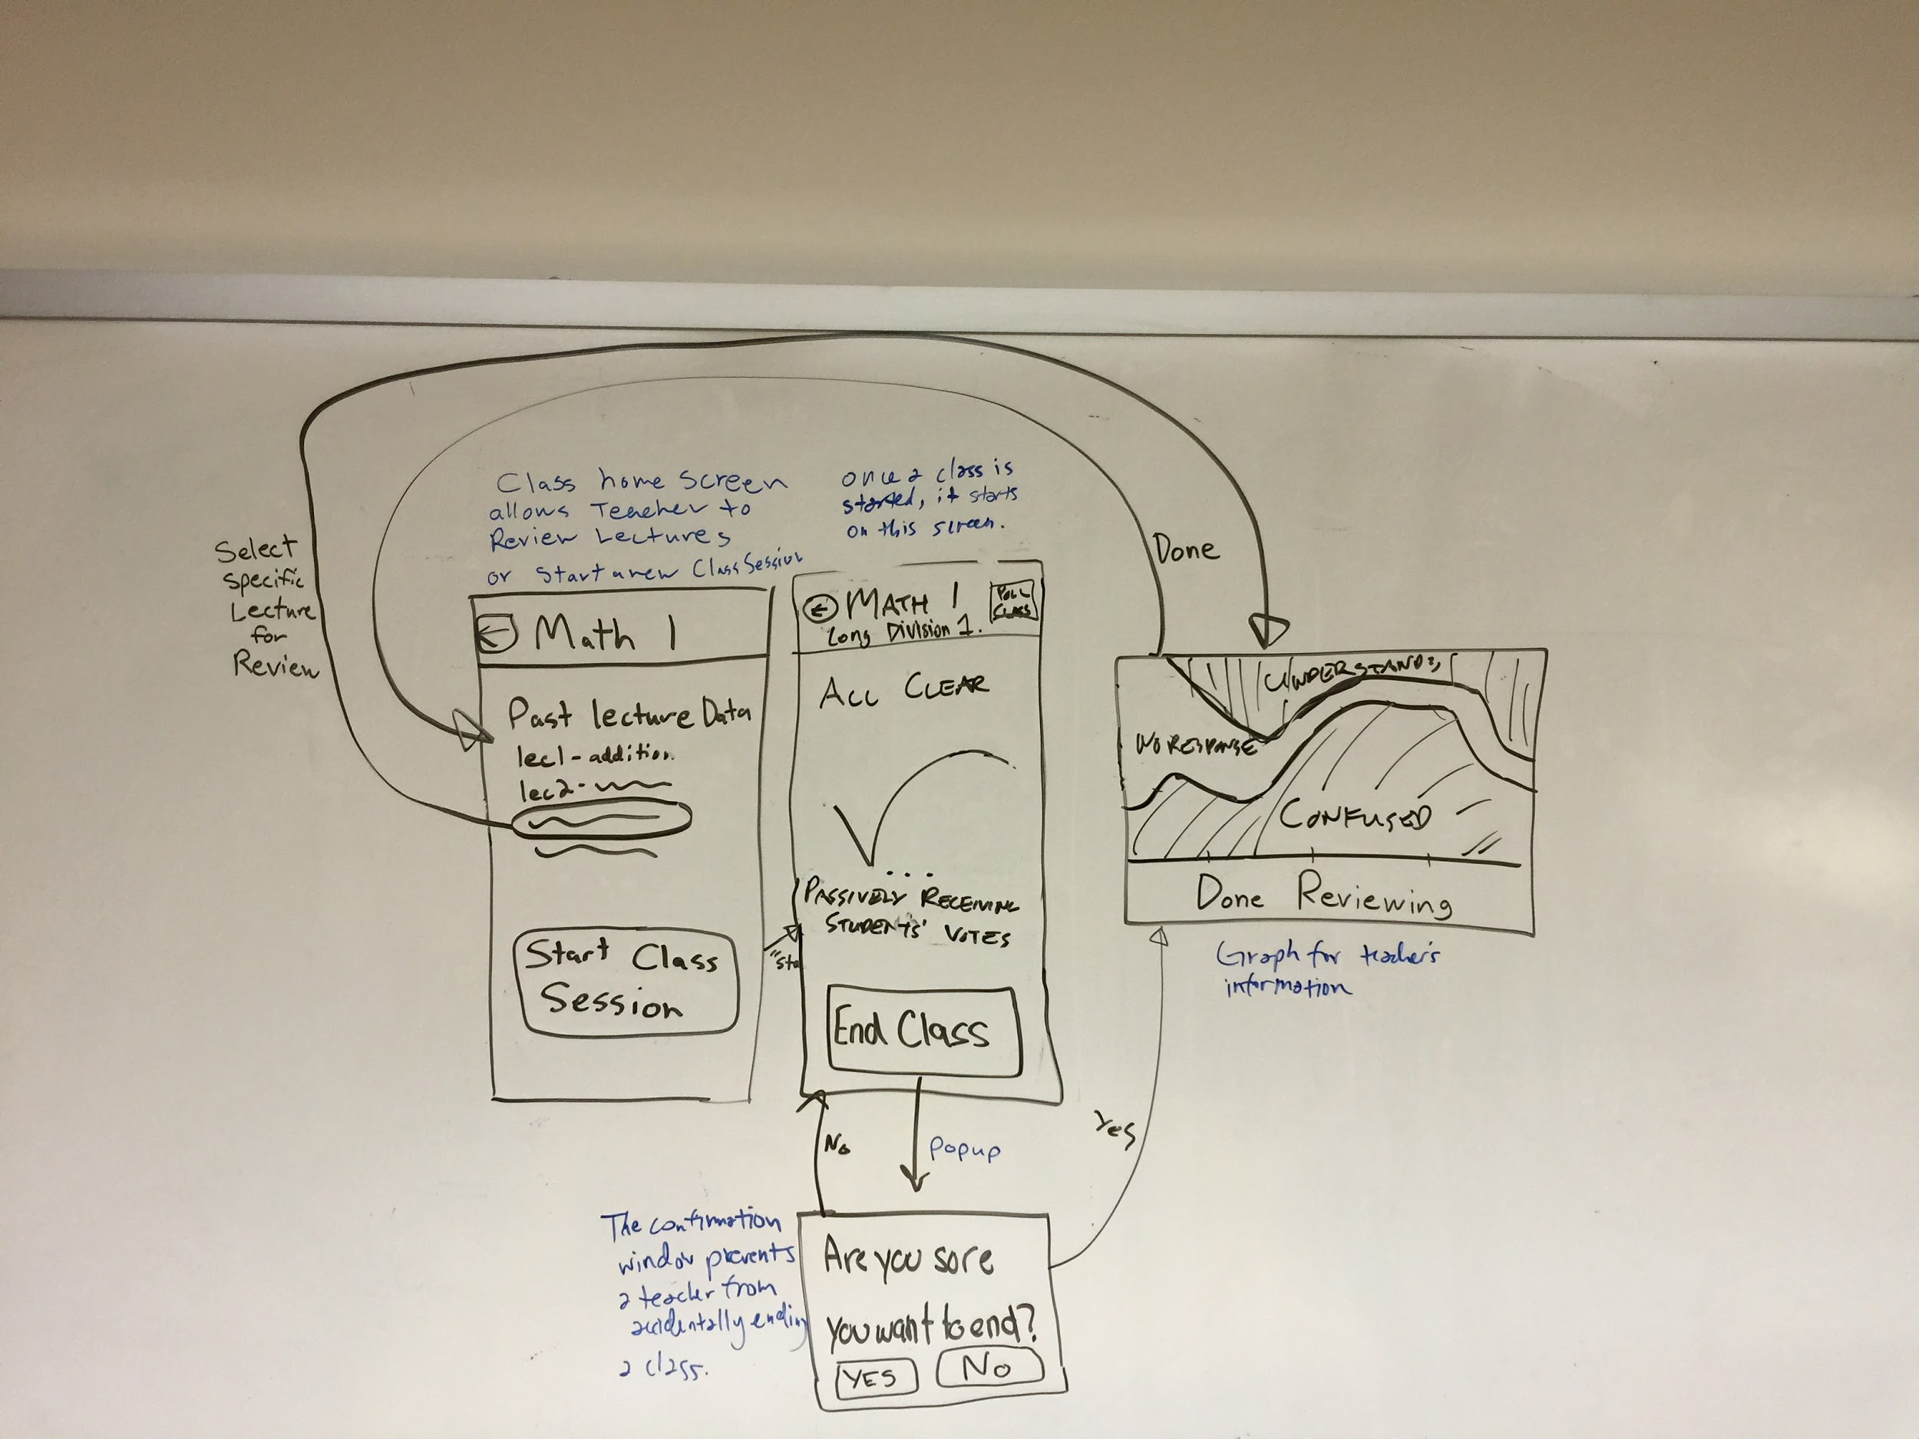
Task 3: Teacher Reviews Lecture

Slide 15
Overview of Talk
Brainstorming and picking between possible devices and UIs
Narrowing UI flow for each task
Constructing prototype for tasks and necessary functionality
User experimentation and feedback

Slide 16
Prototype Decisions
Used the Style and Technique recommended by Landay: Pen and Paper for Low-Fi Prototype
Also allowed trying on-site updates of prototype
Significant use of pop-ups (also in flow) because:
Simple way to transmit small bits of information
Avoids user losing track of place in app

Slide 17
Flow & Low-Fi Animation

Slide 18
Task 1: Student Gives Feedback

Slide 19
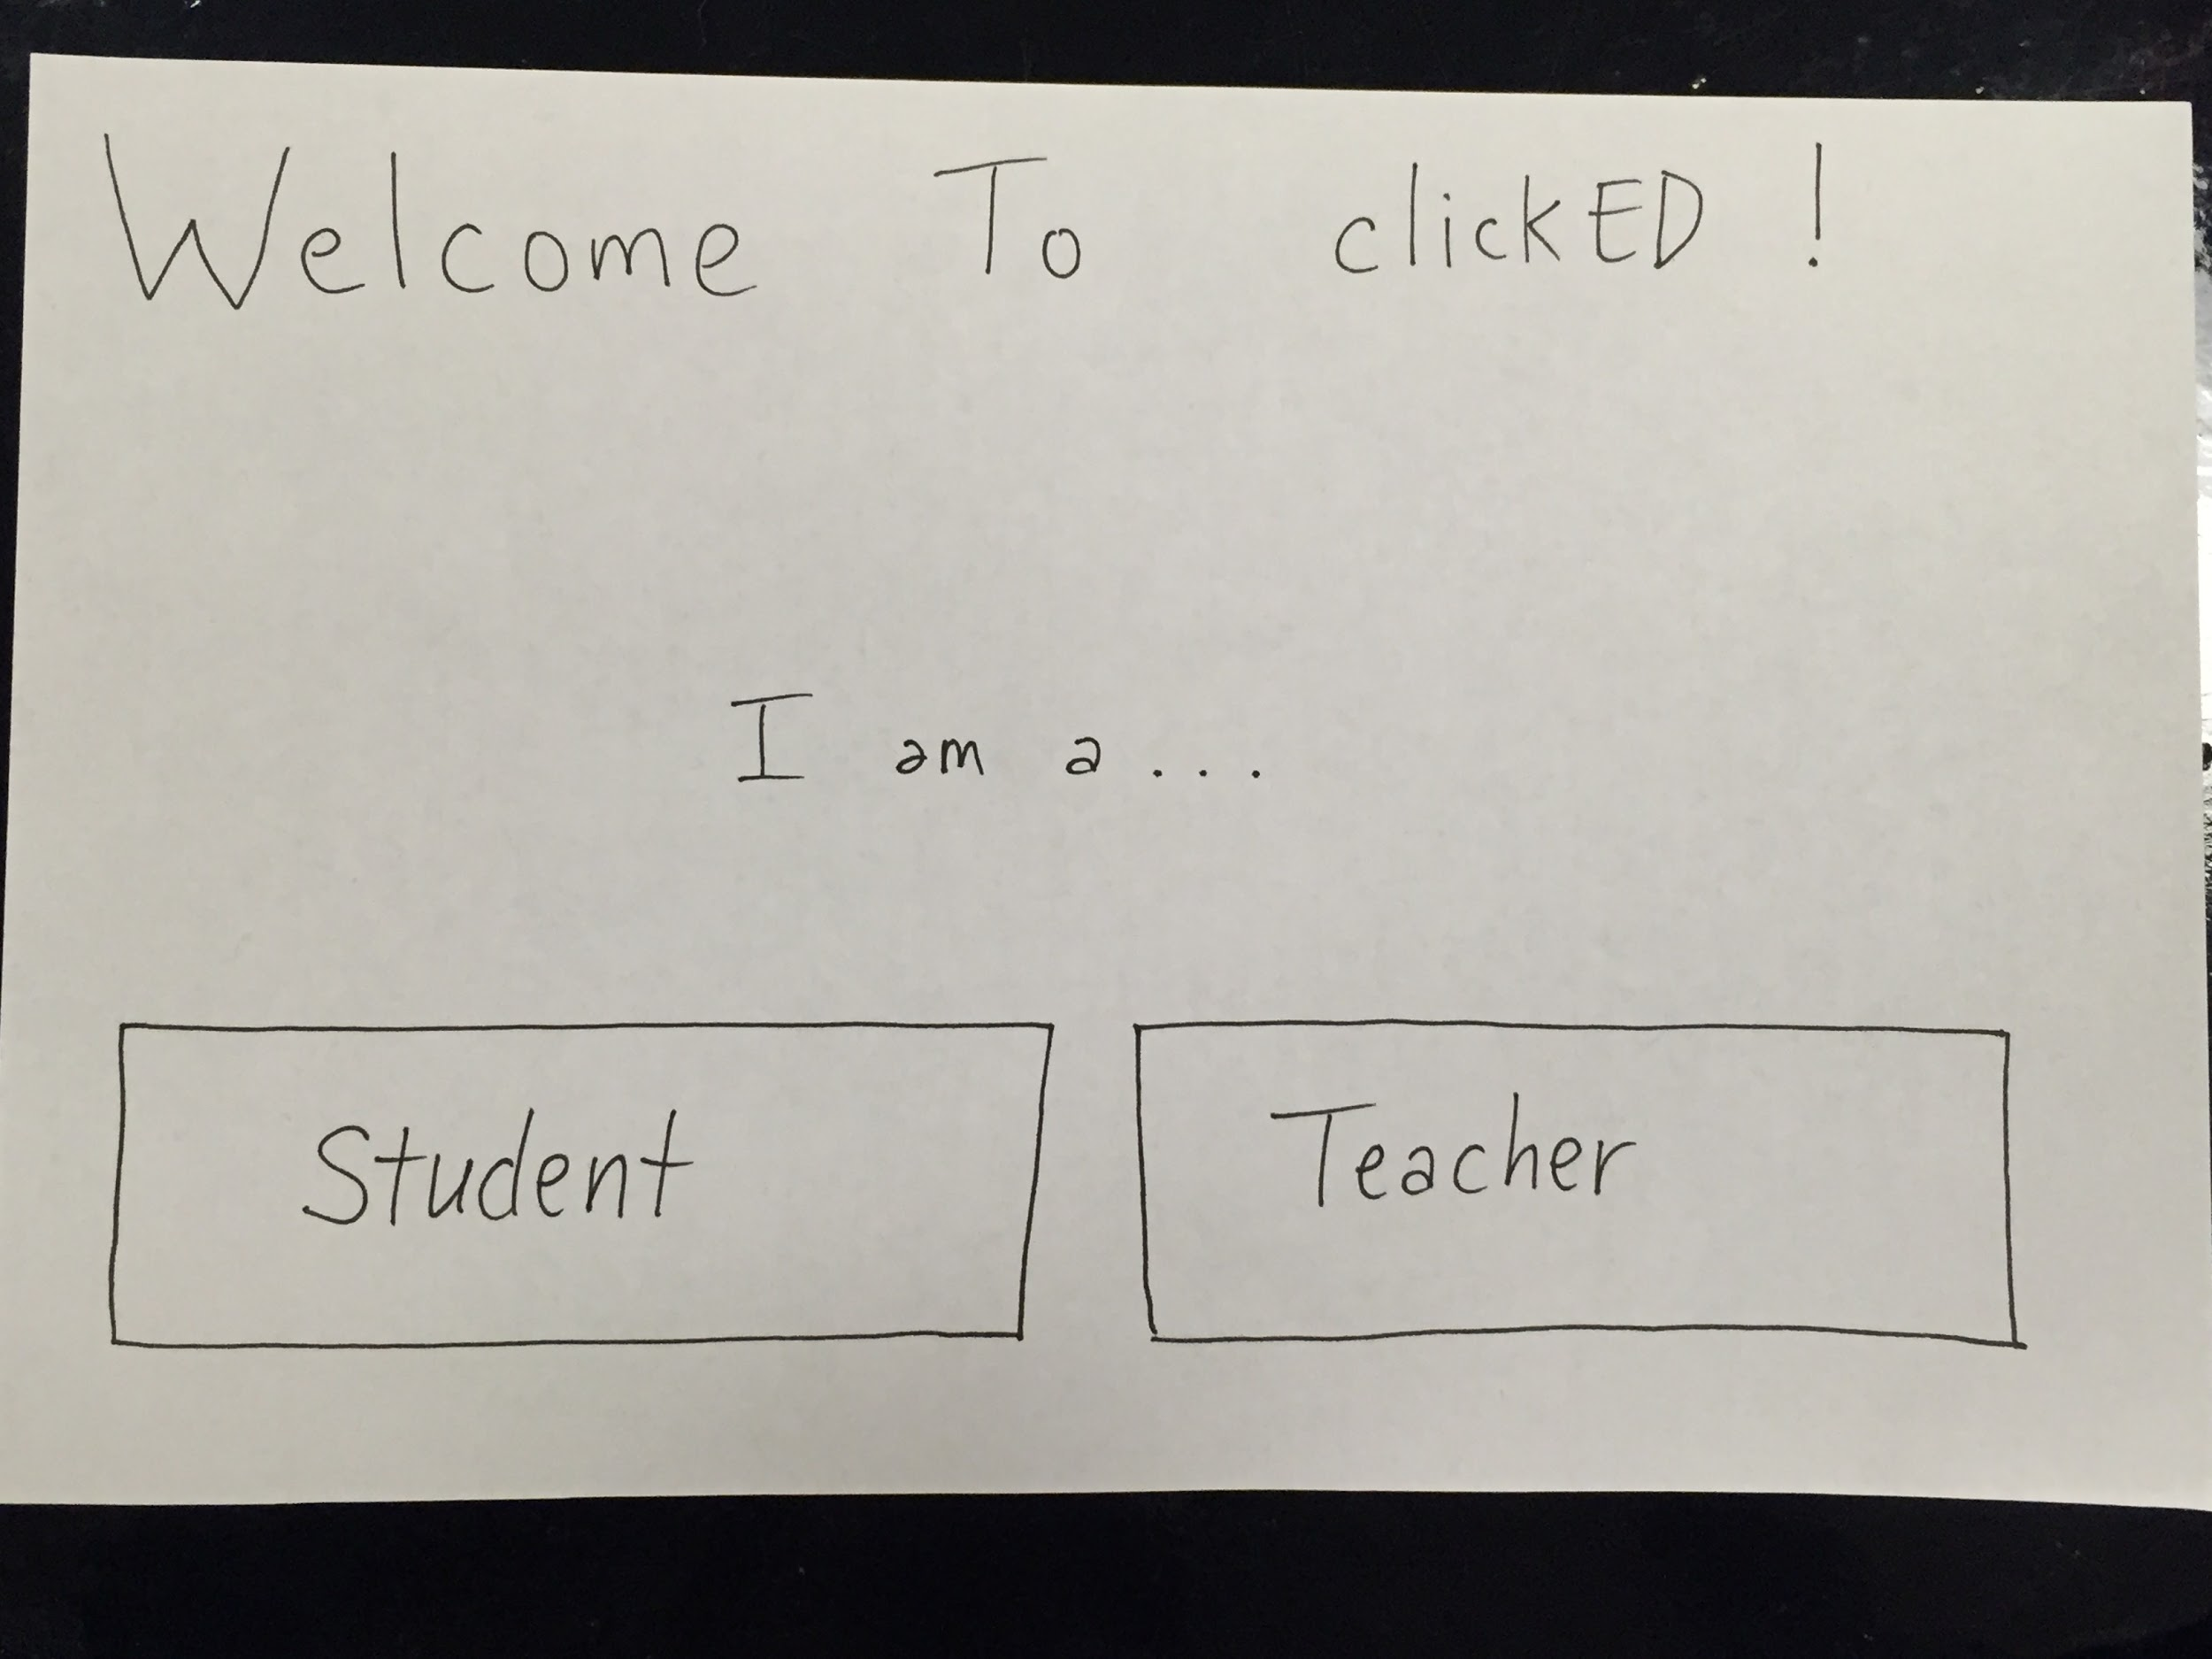

Slide 21
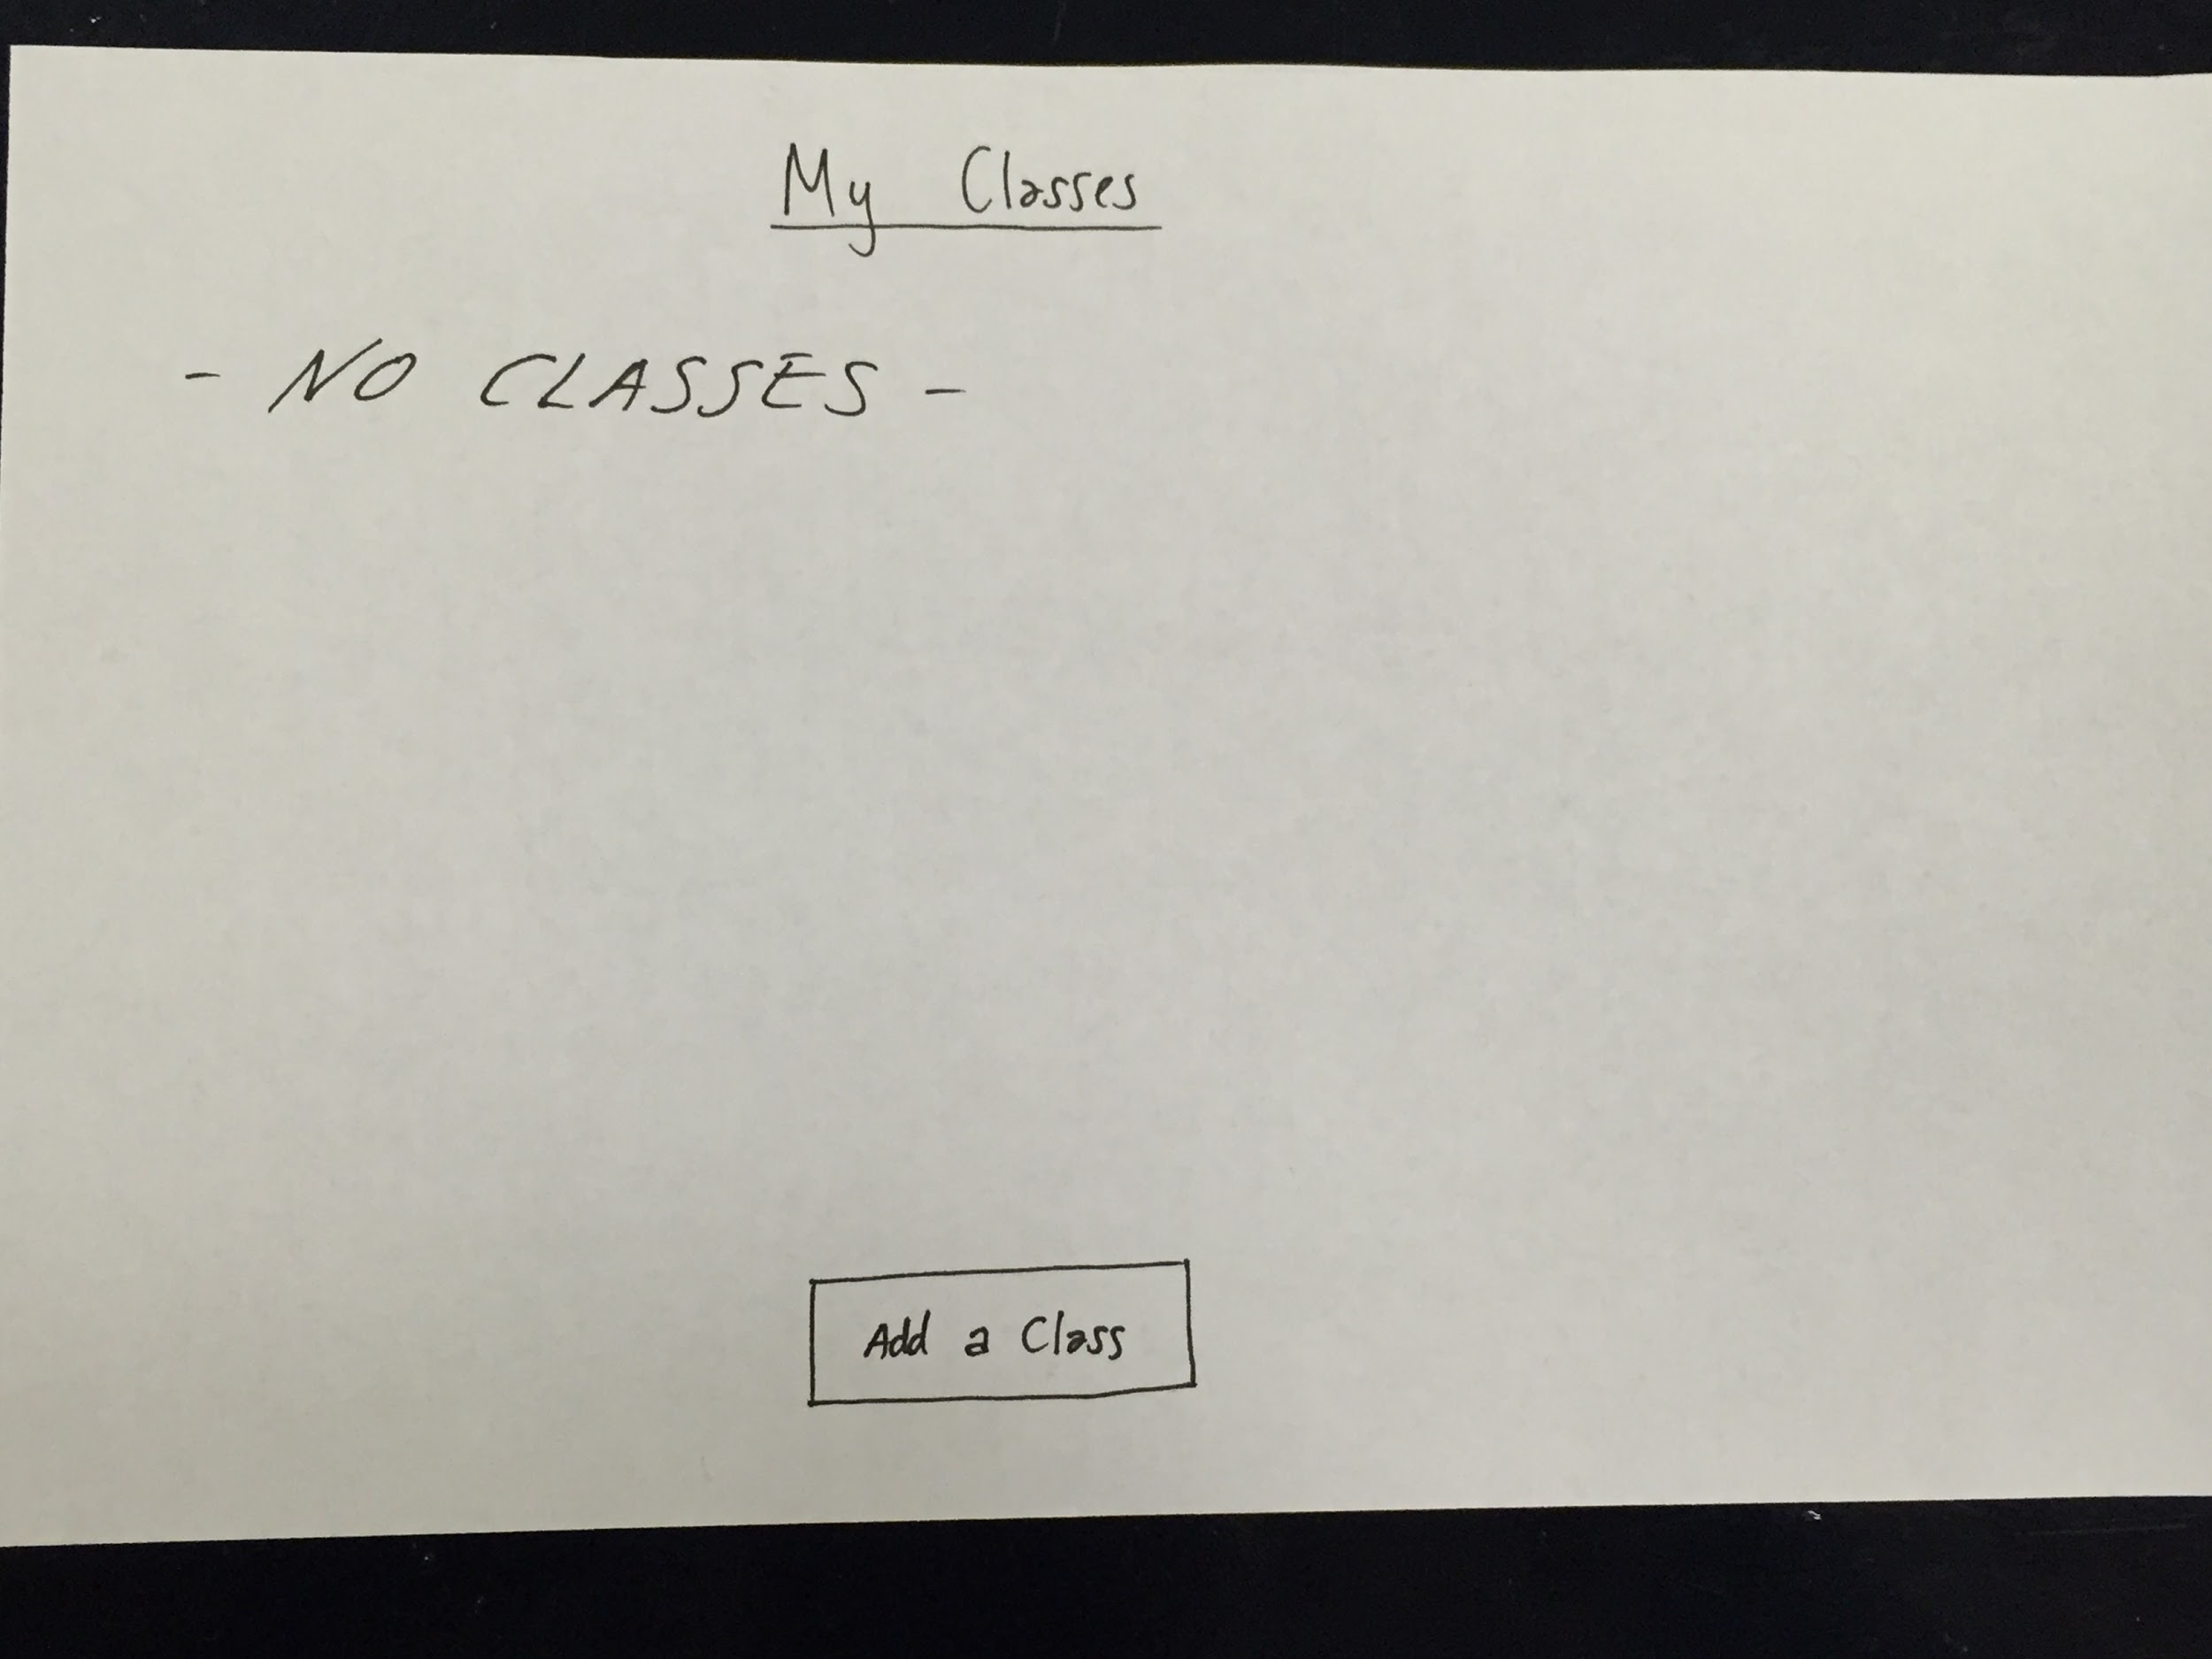

Slide 23
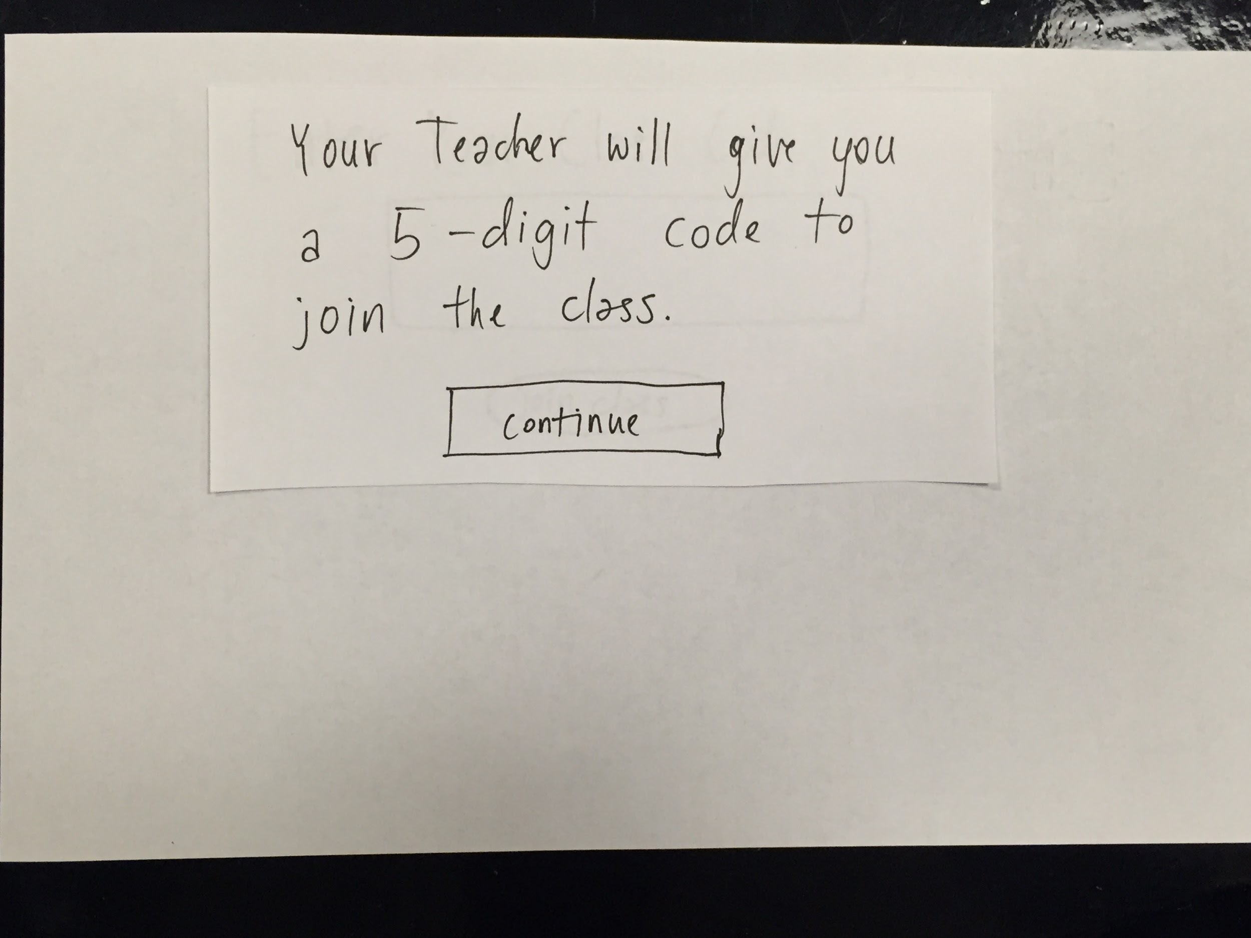

Slide 25
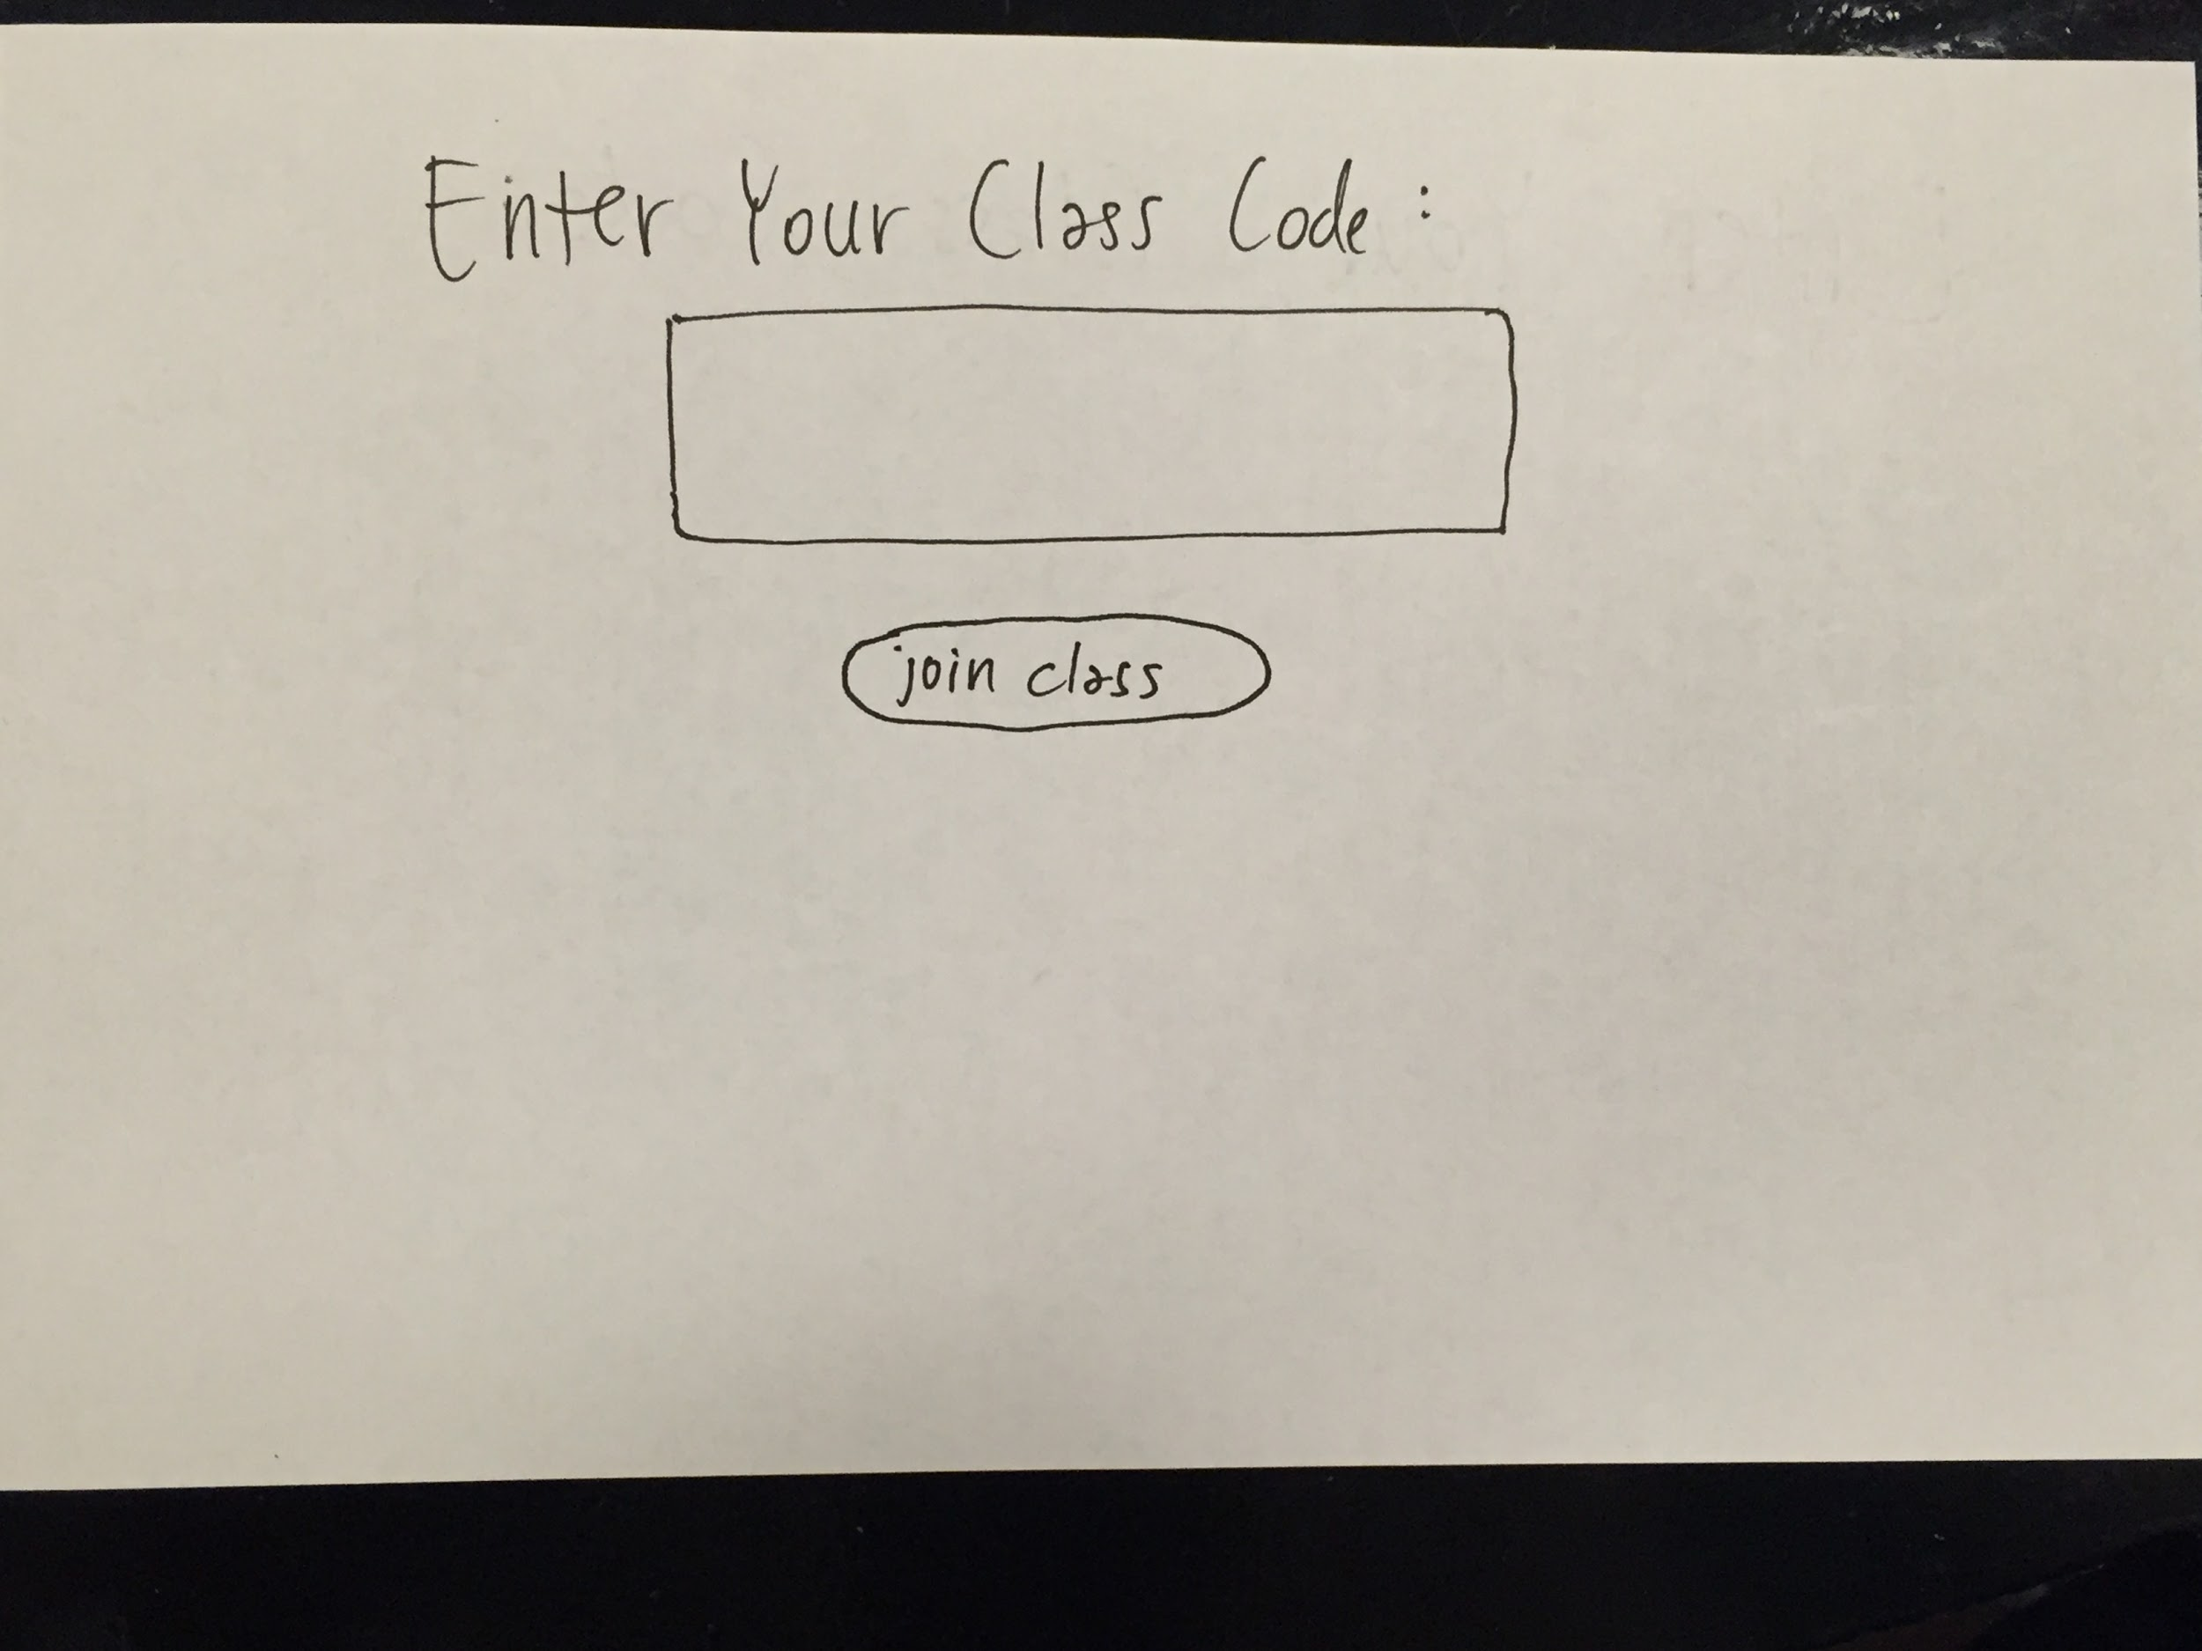

Slide 27
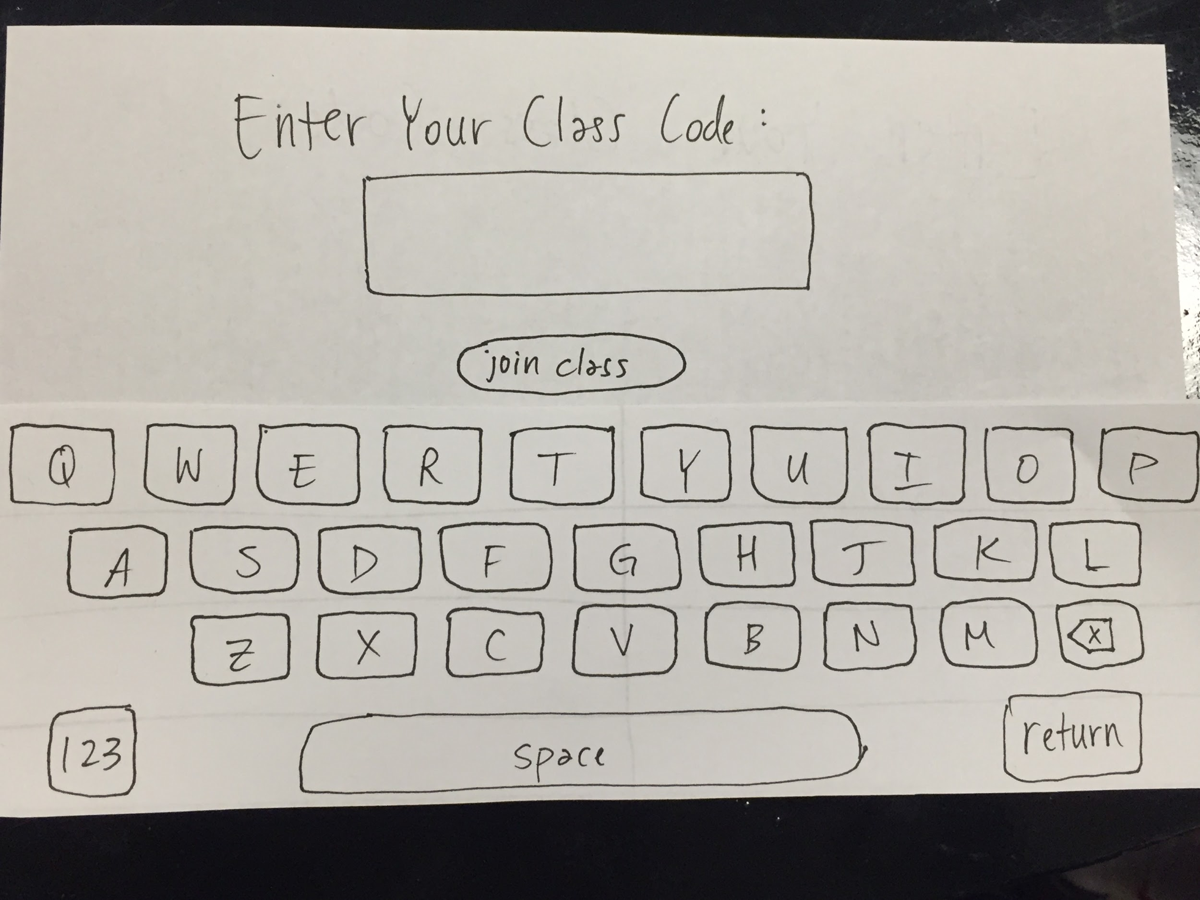

Slide 29
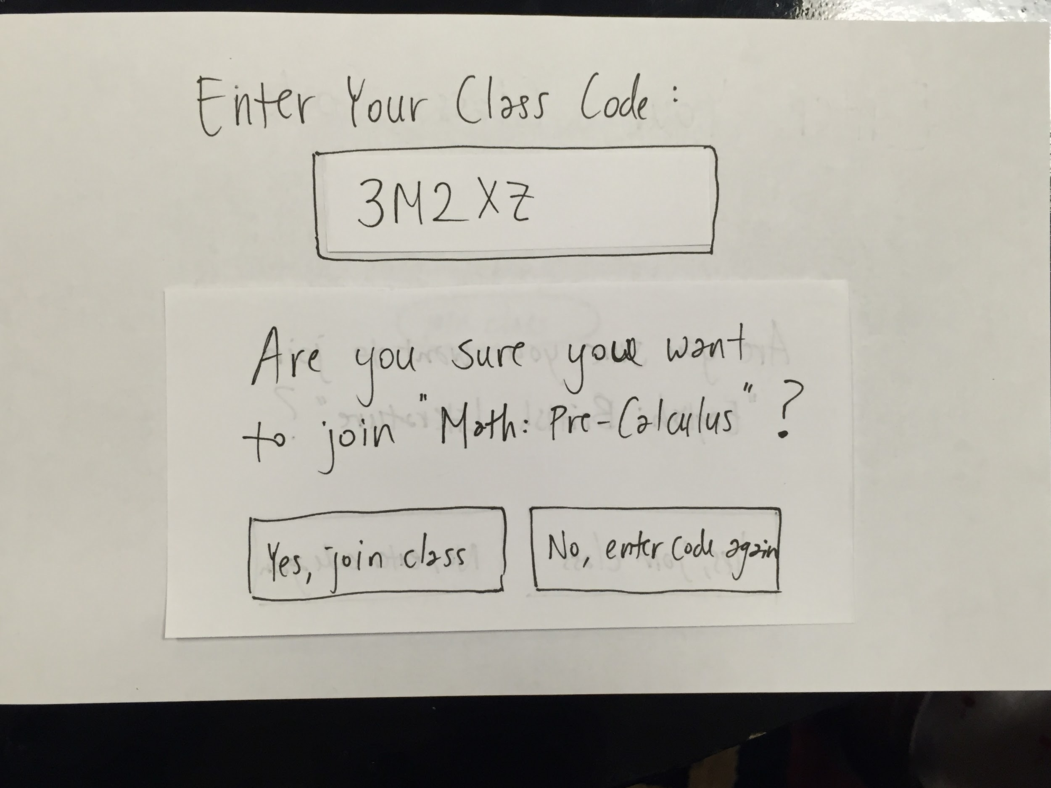

Slide 33
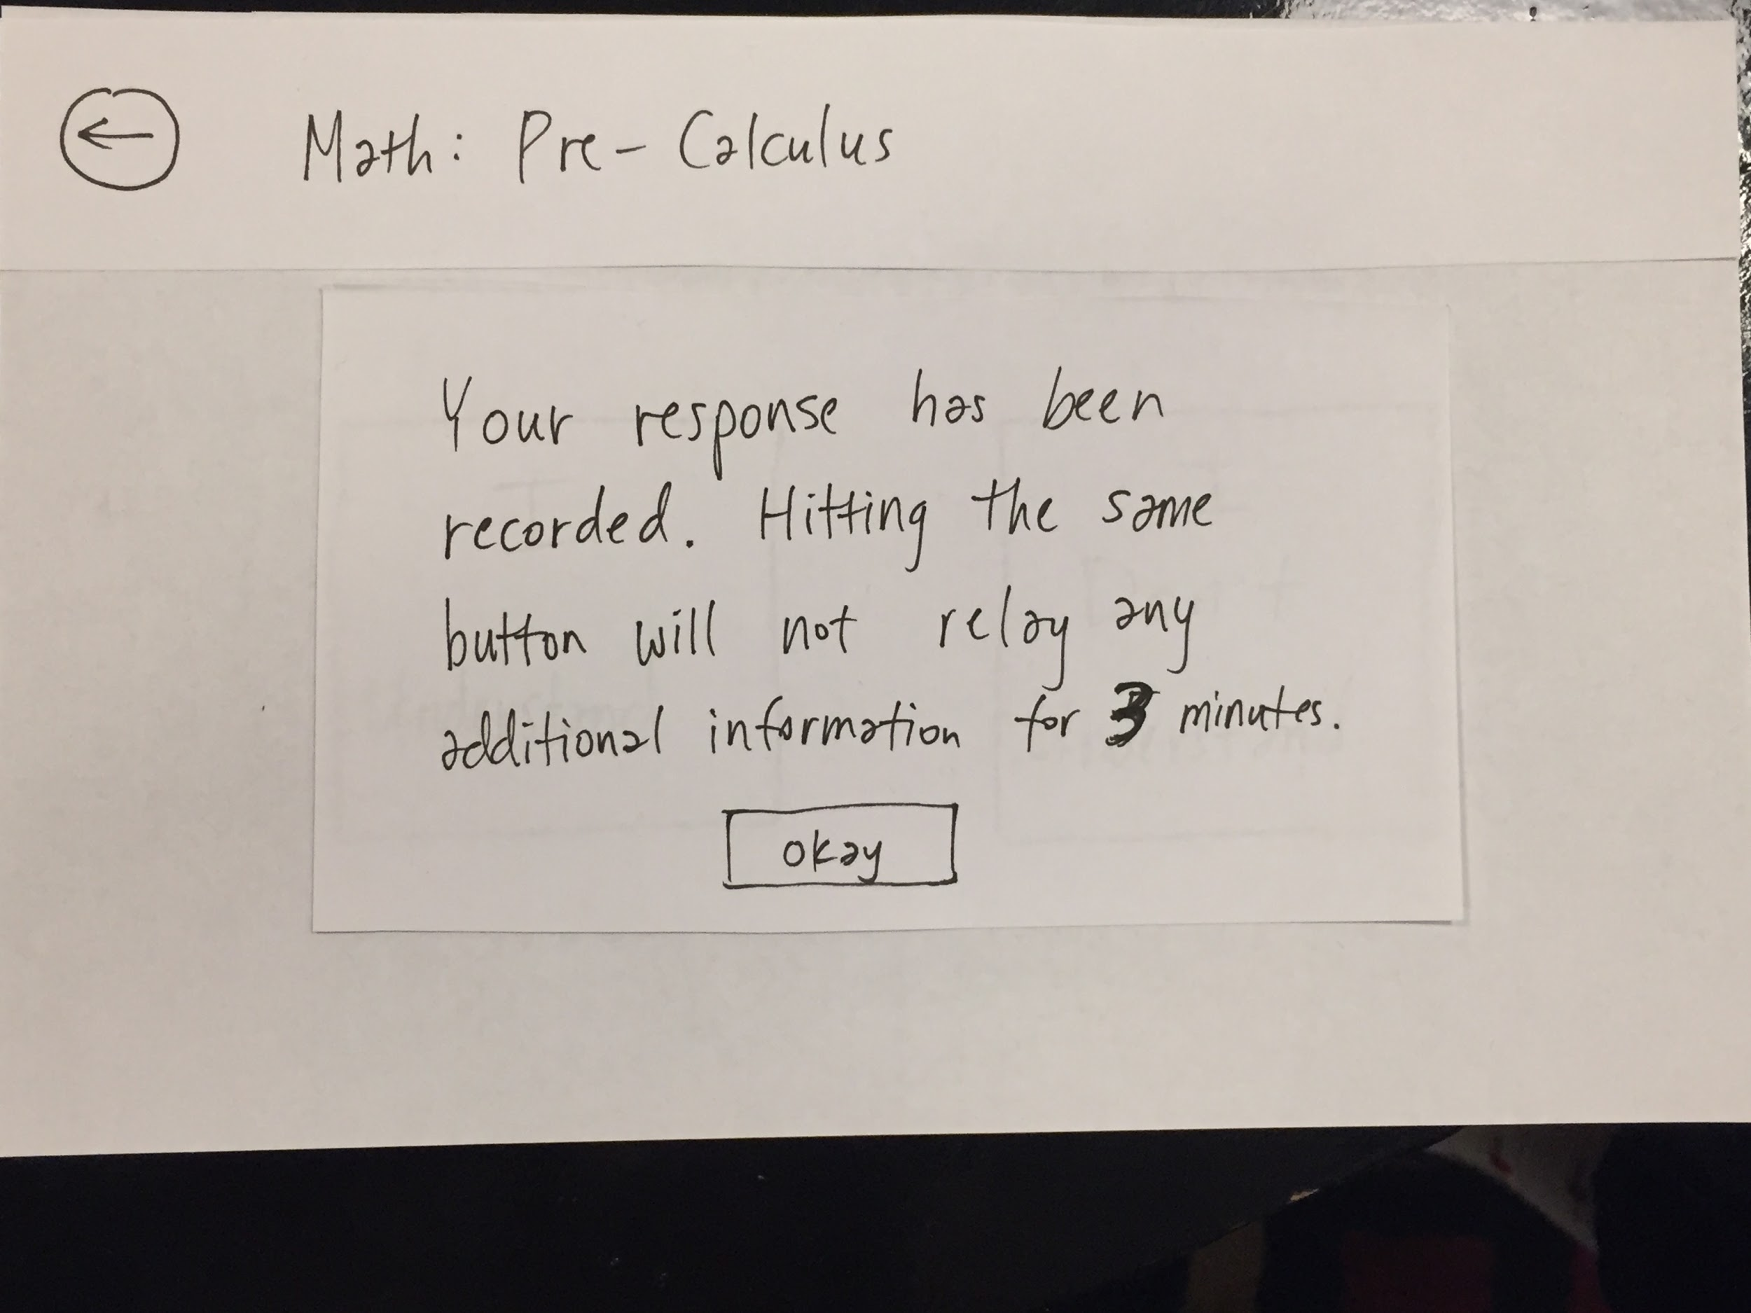

Slide 37
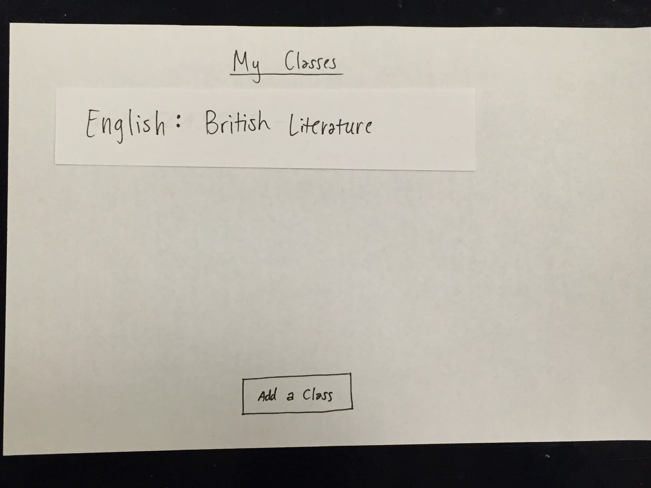

Slide 38
Task 2: Teacher “Reads the Room”

Slide 39
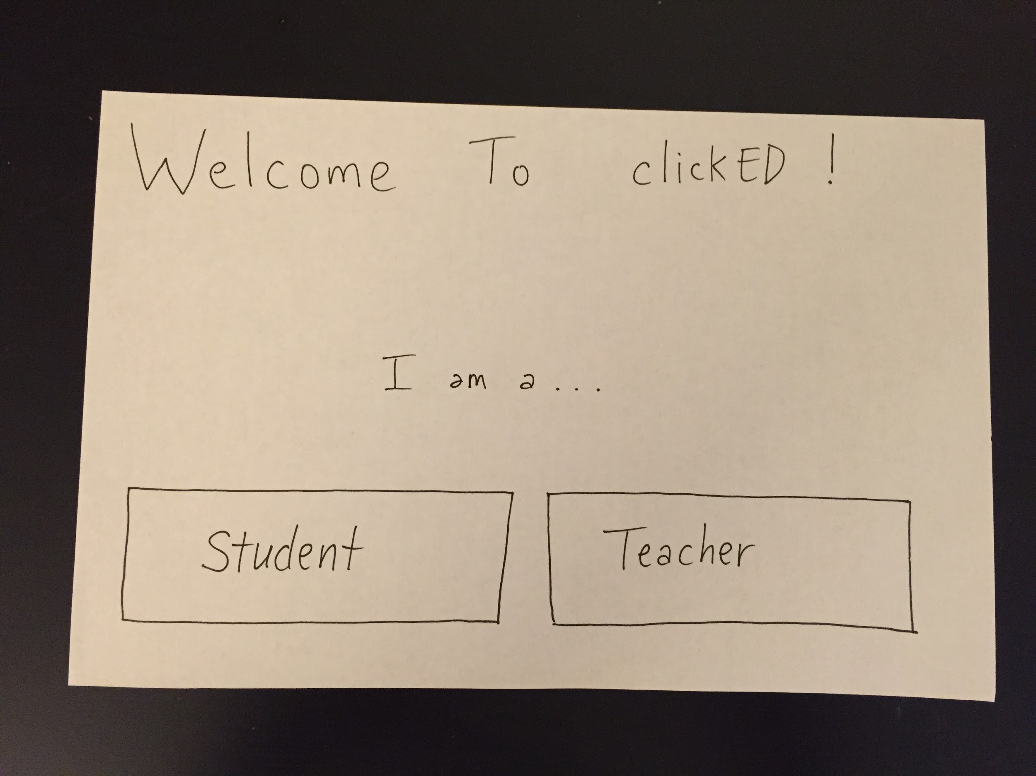

Slide 43
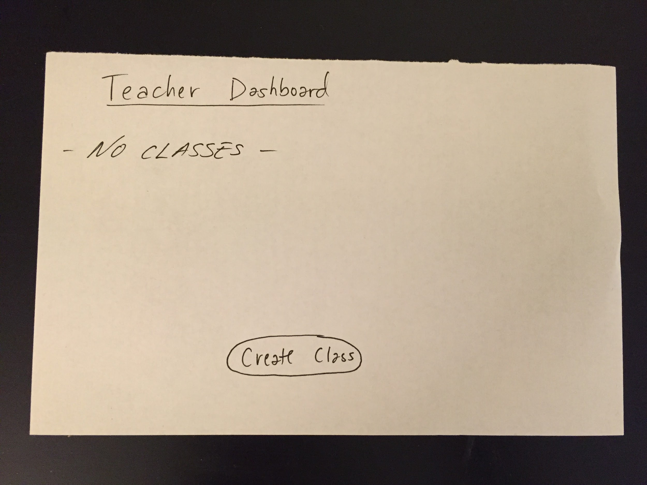

Slide 45
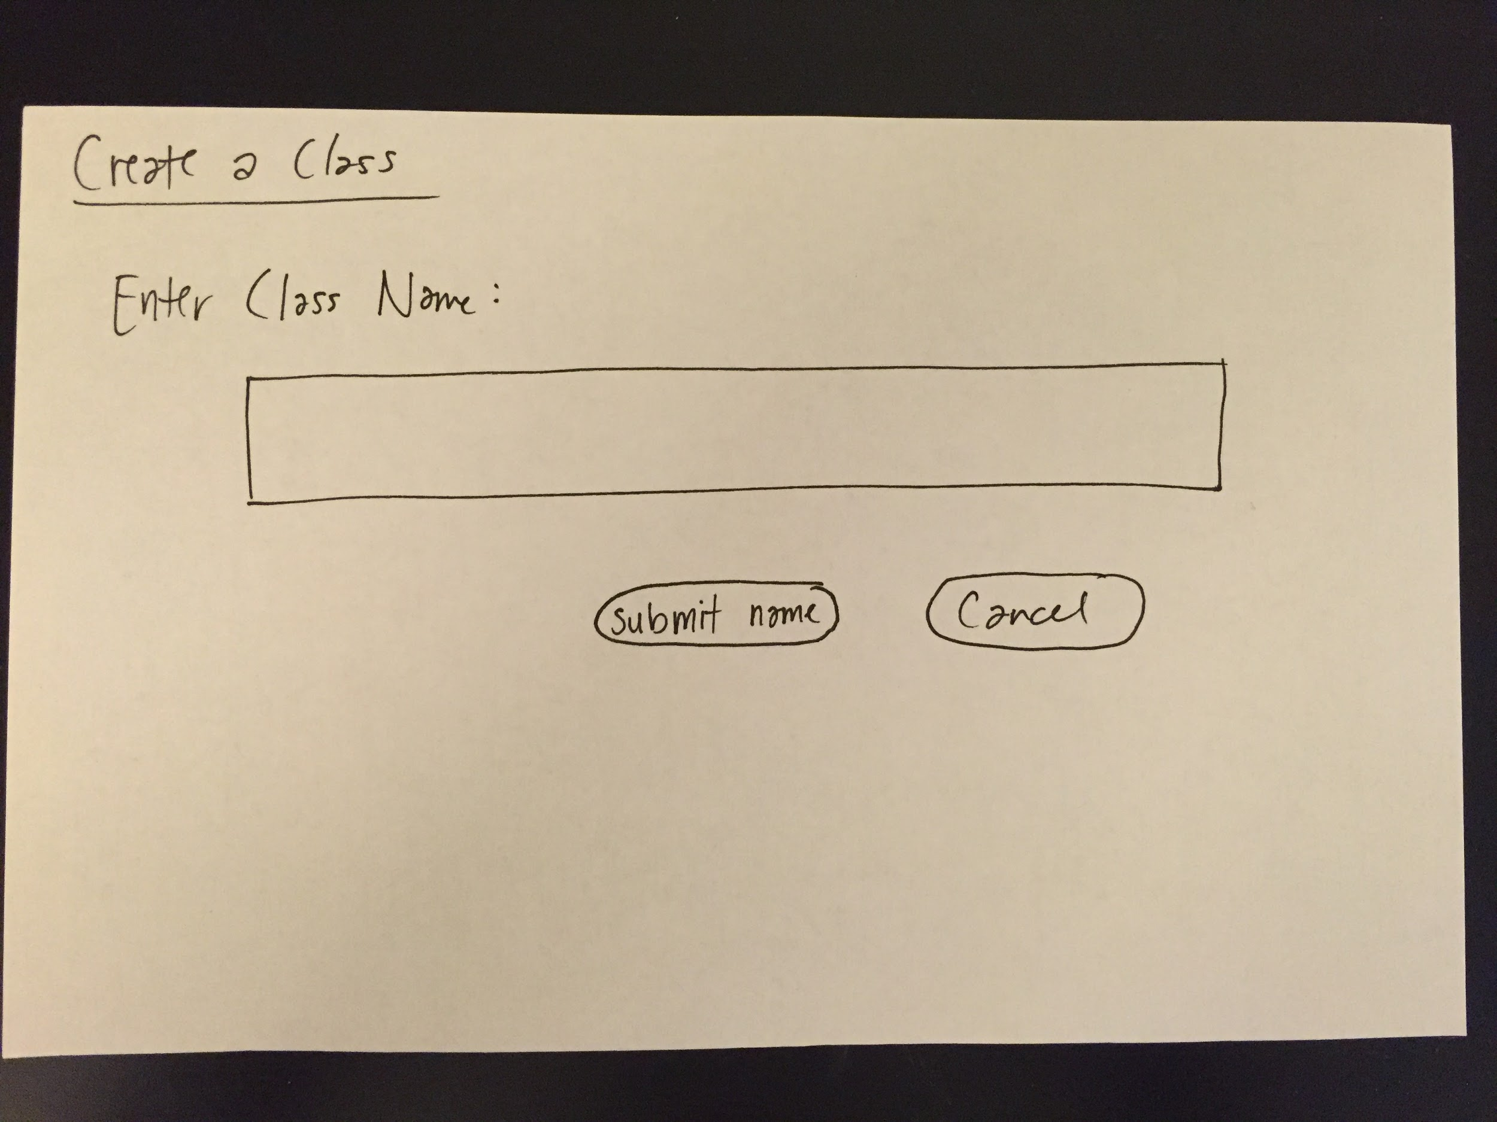

Slide 47
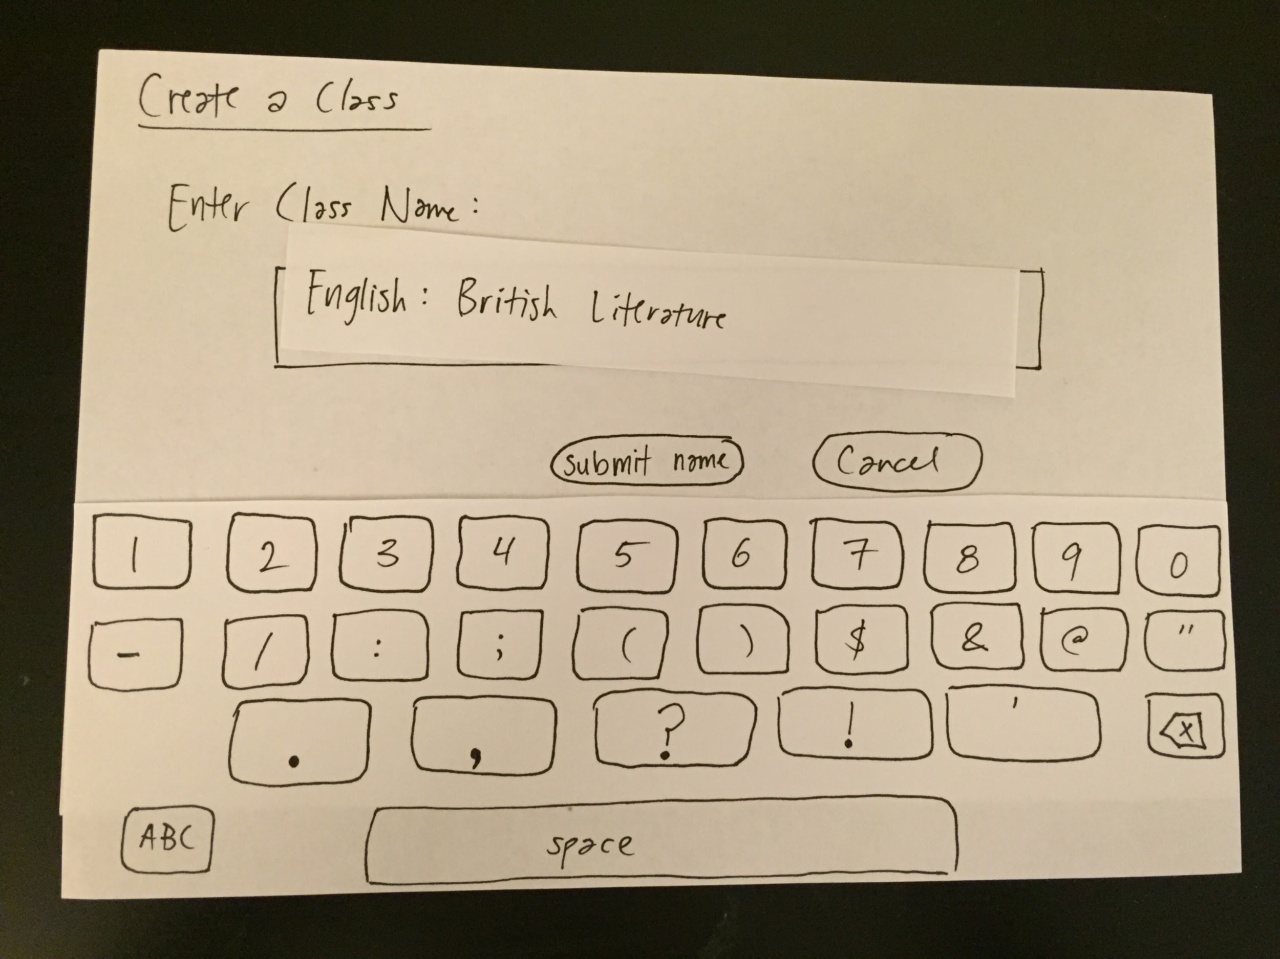

Slide 49
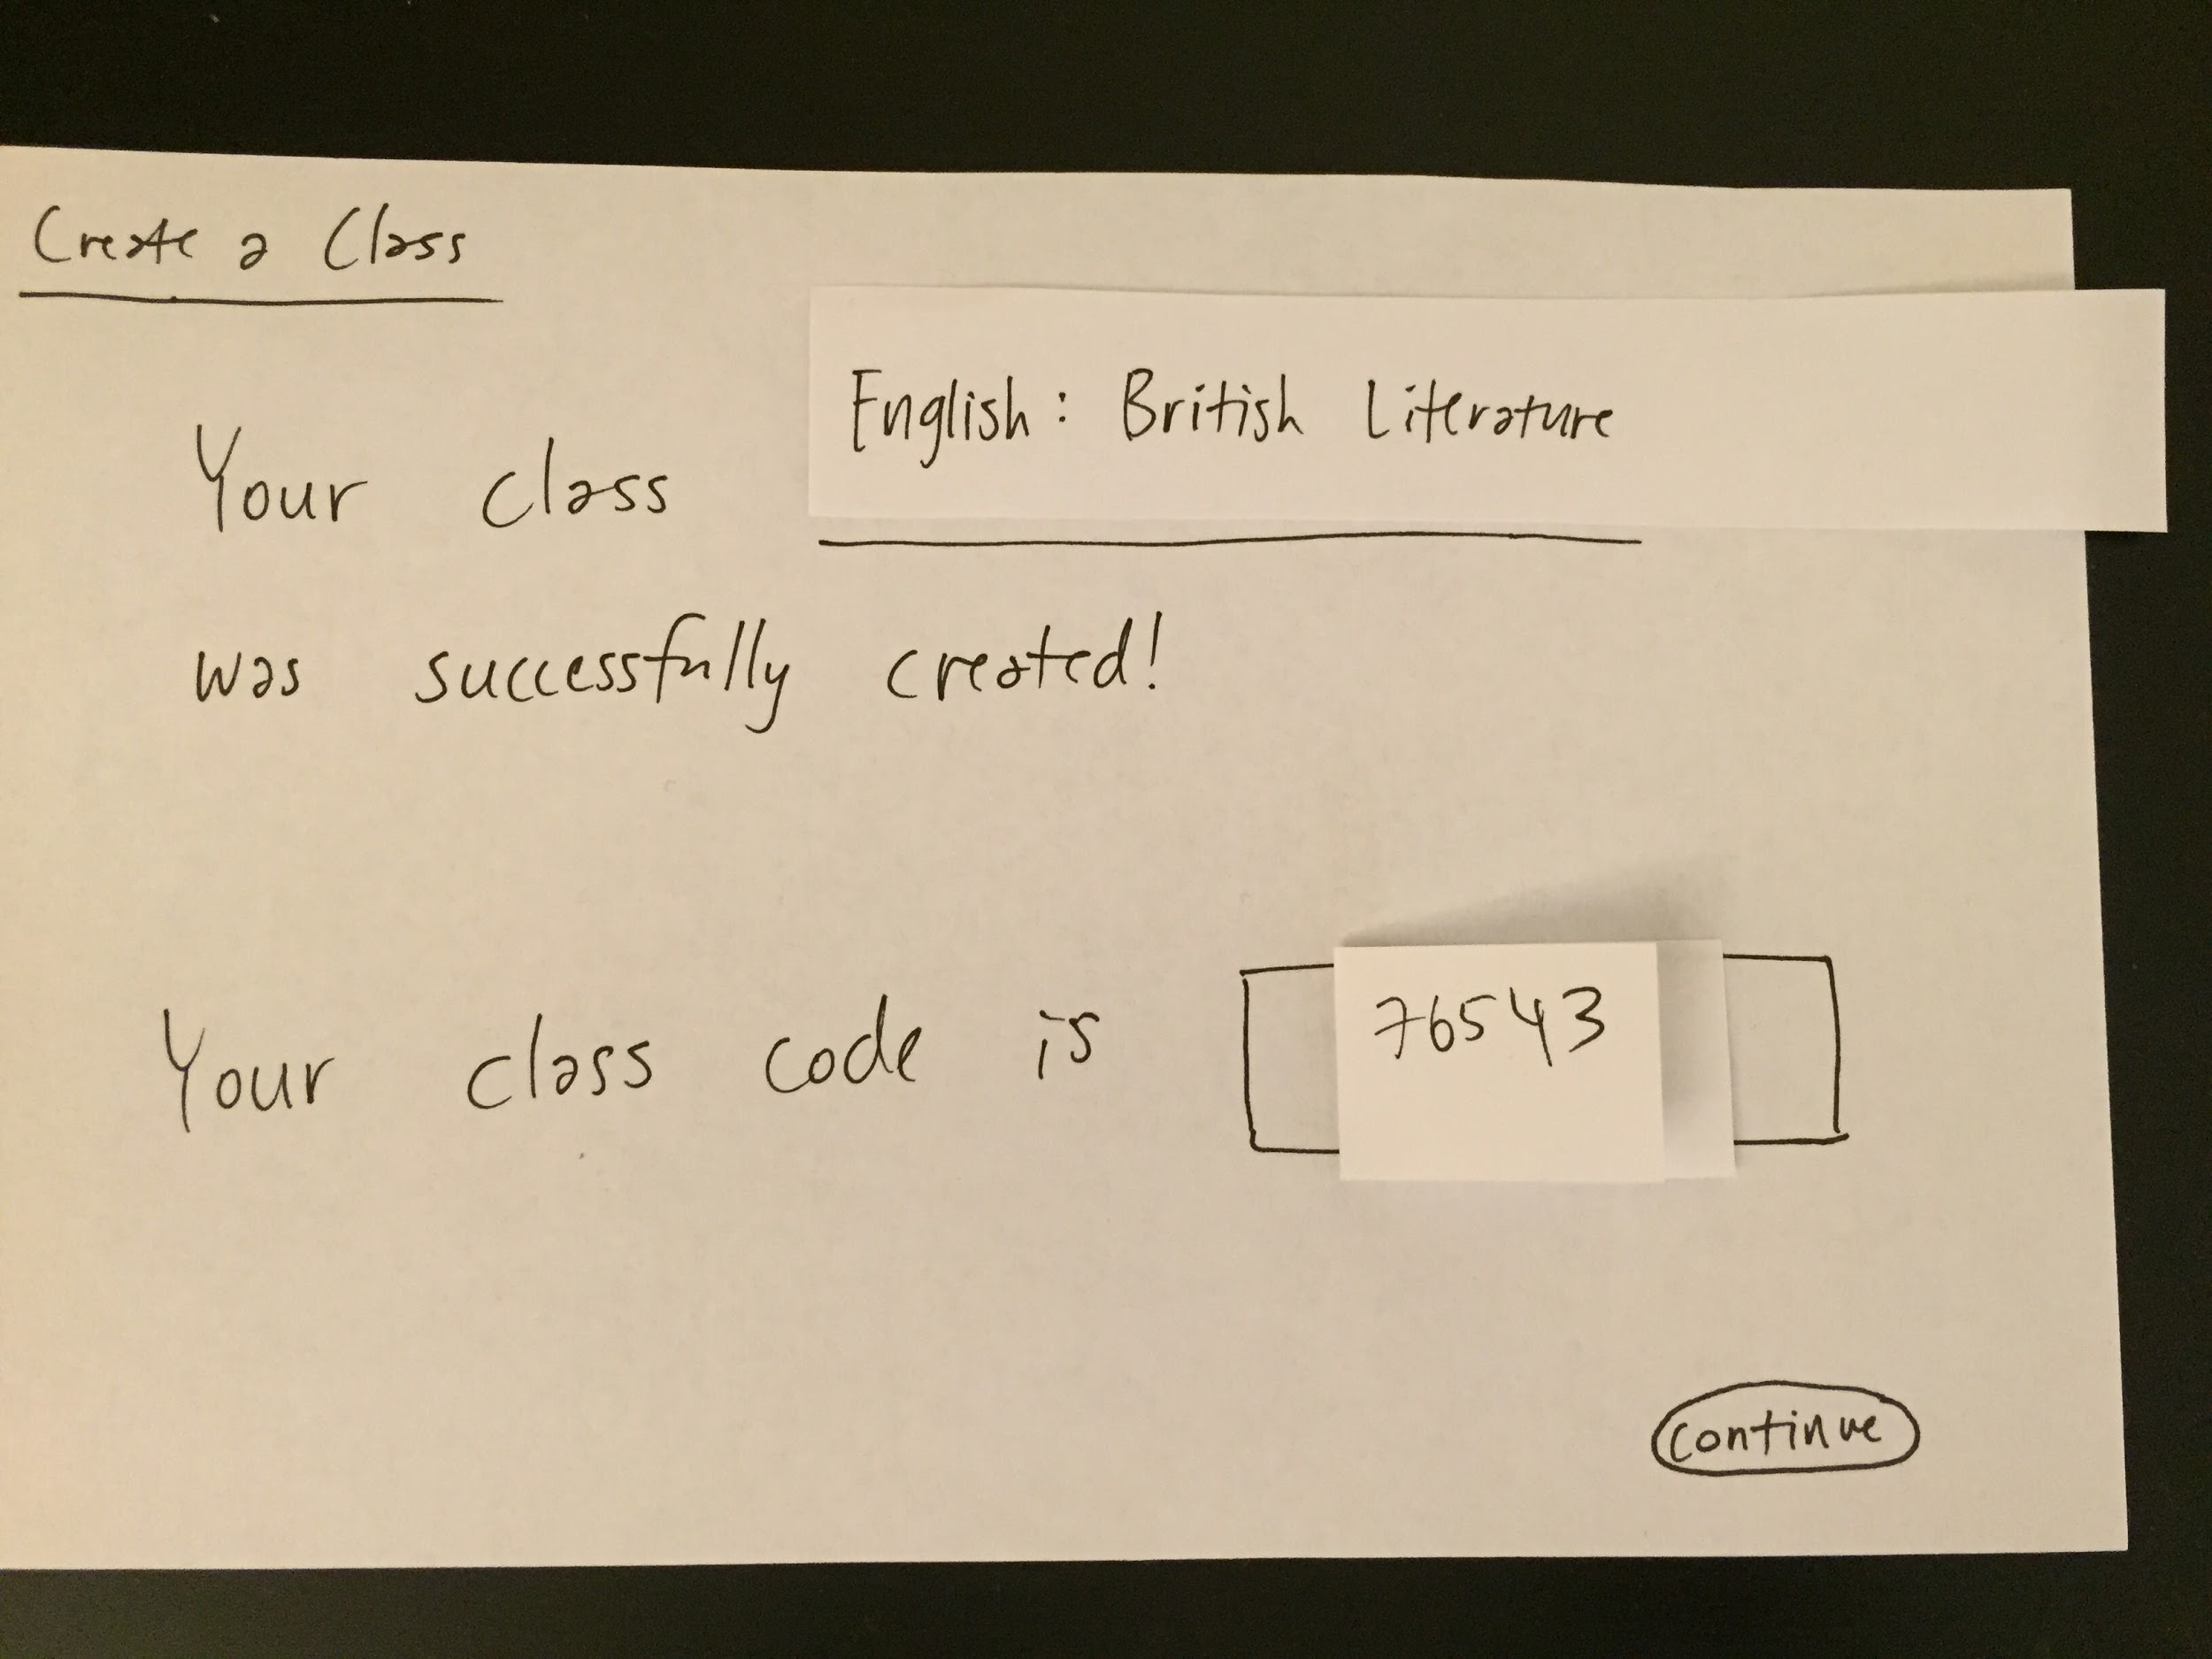

Slide 51
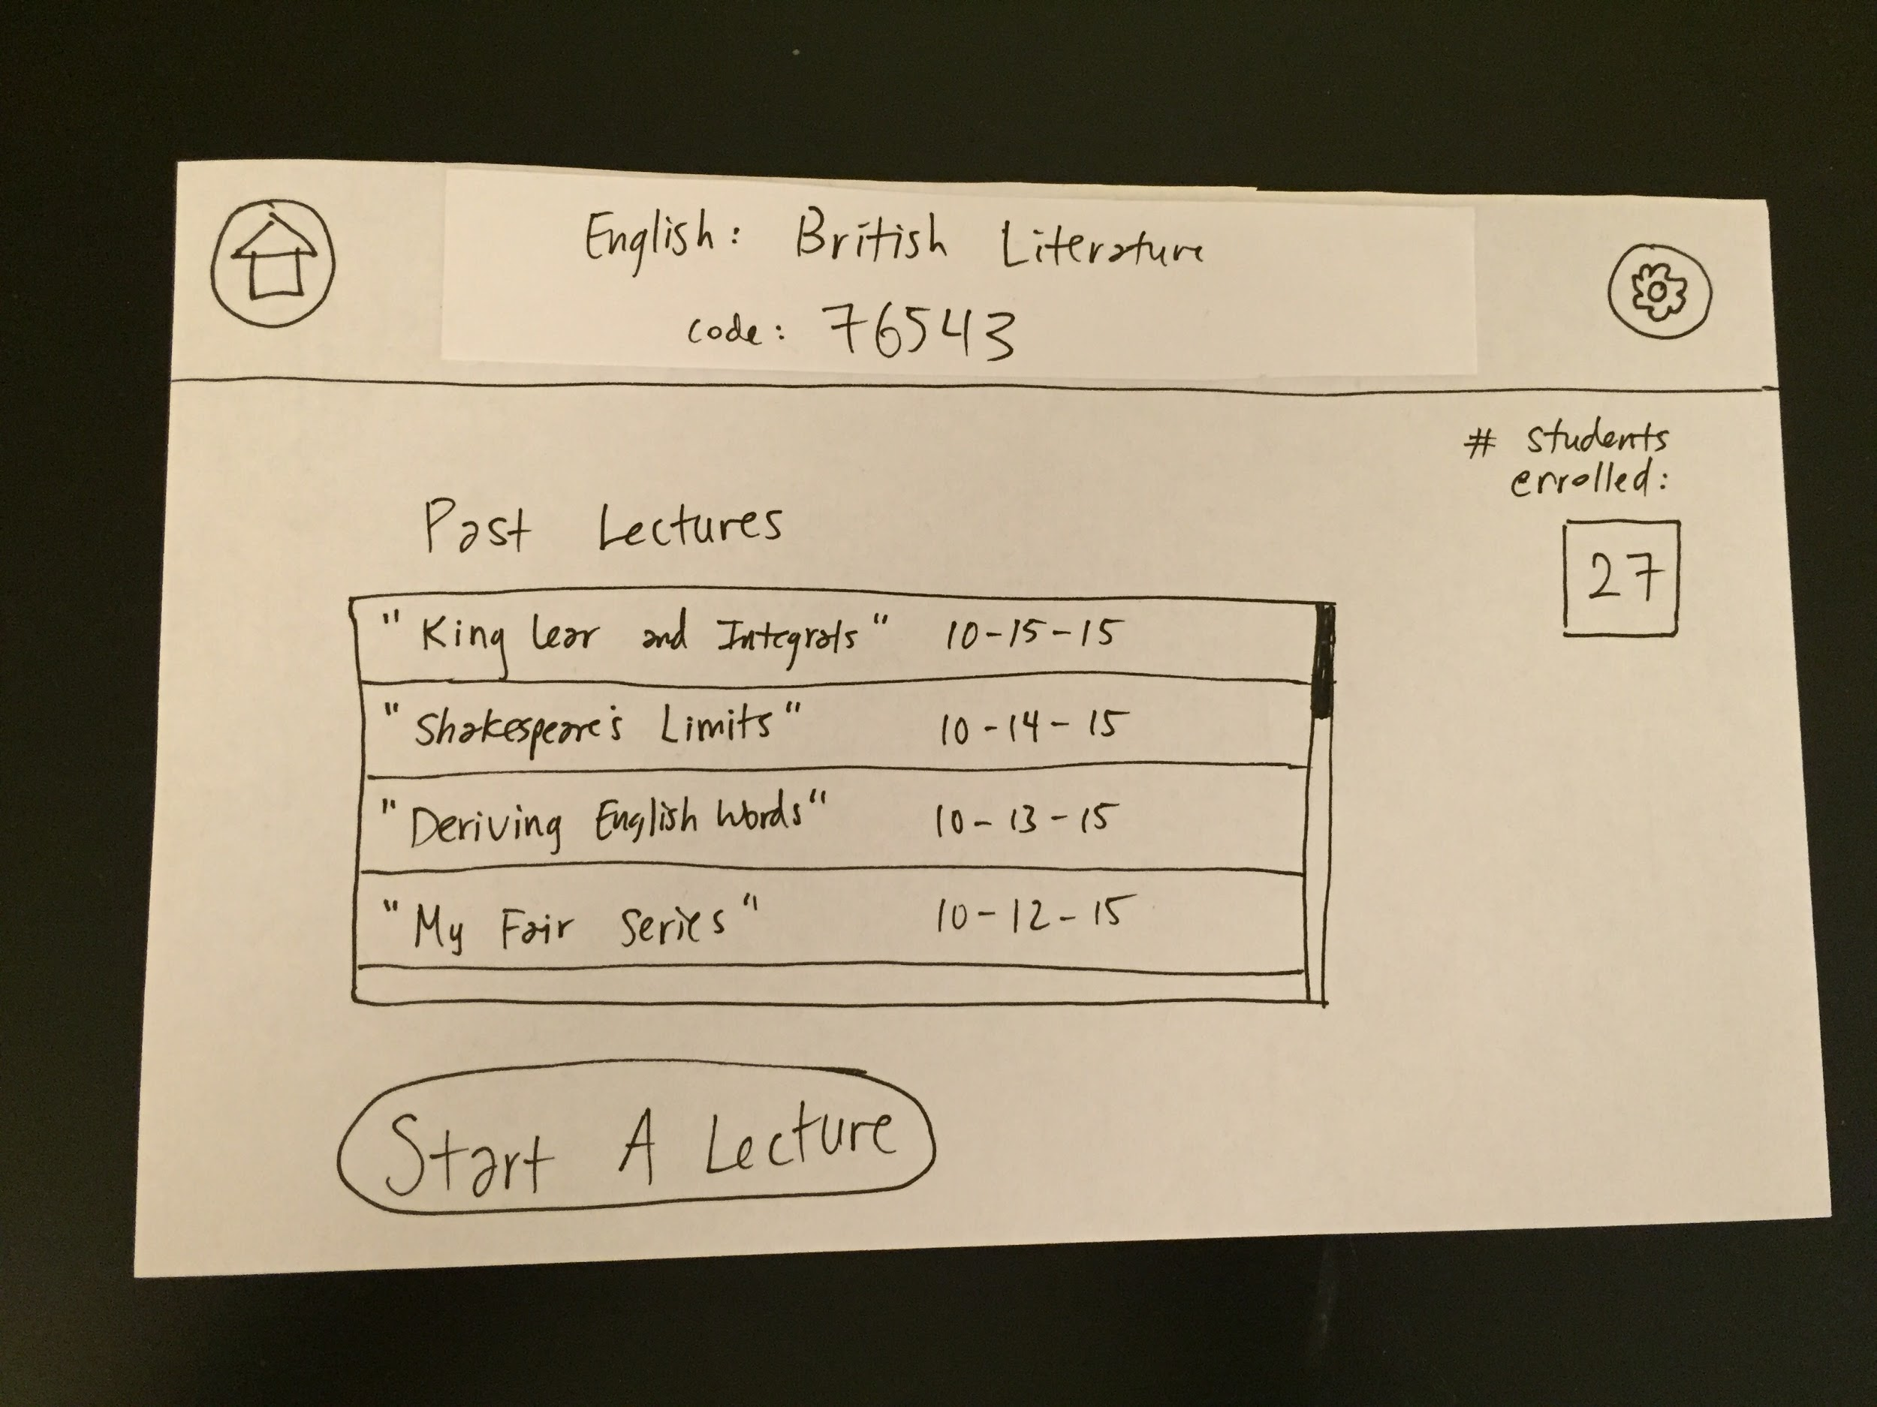

Slide 55
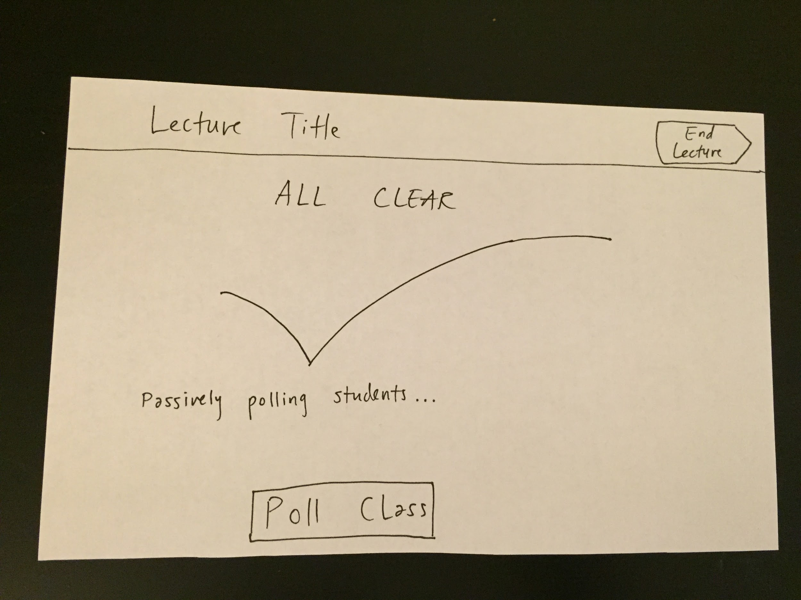

Slide 56
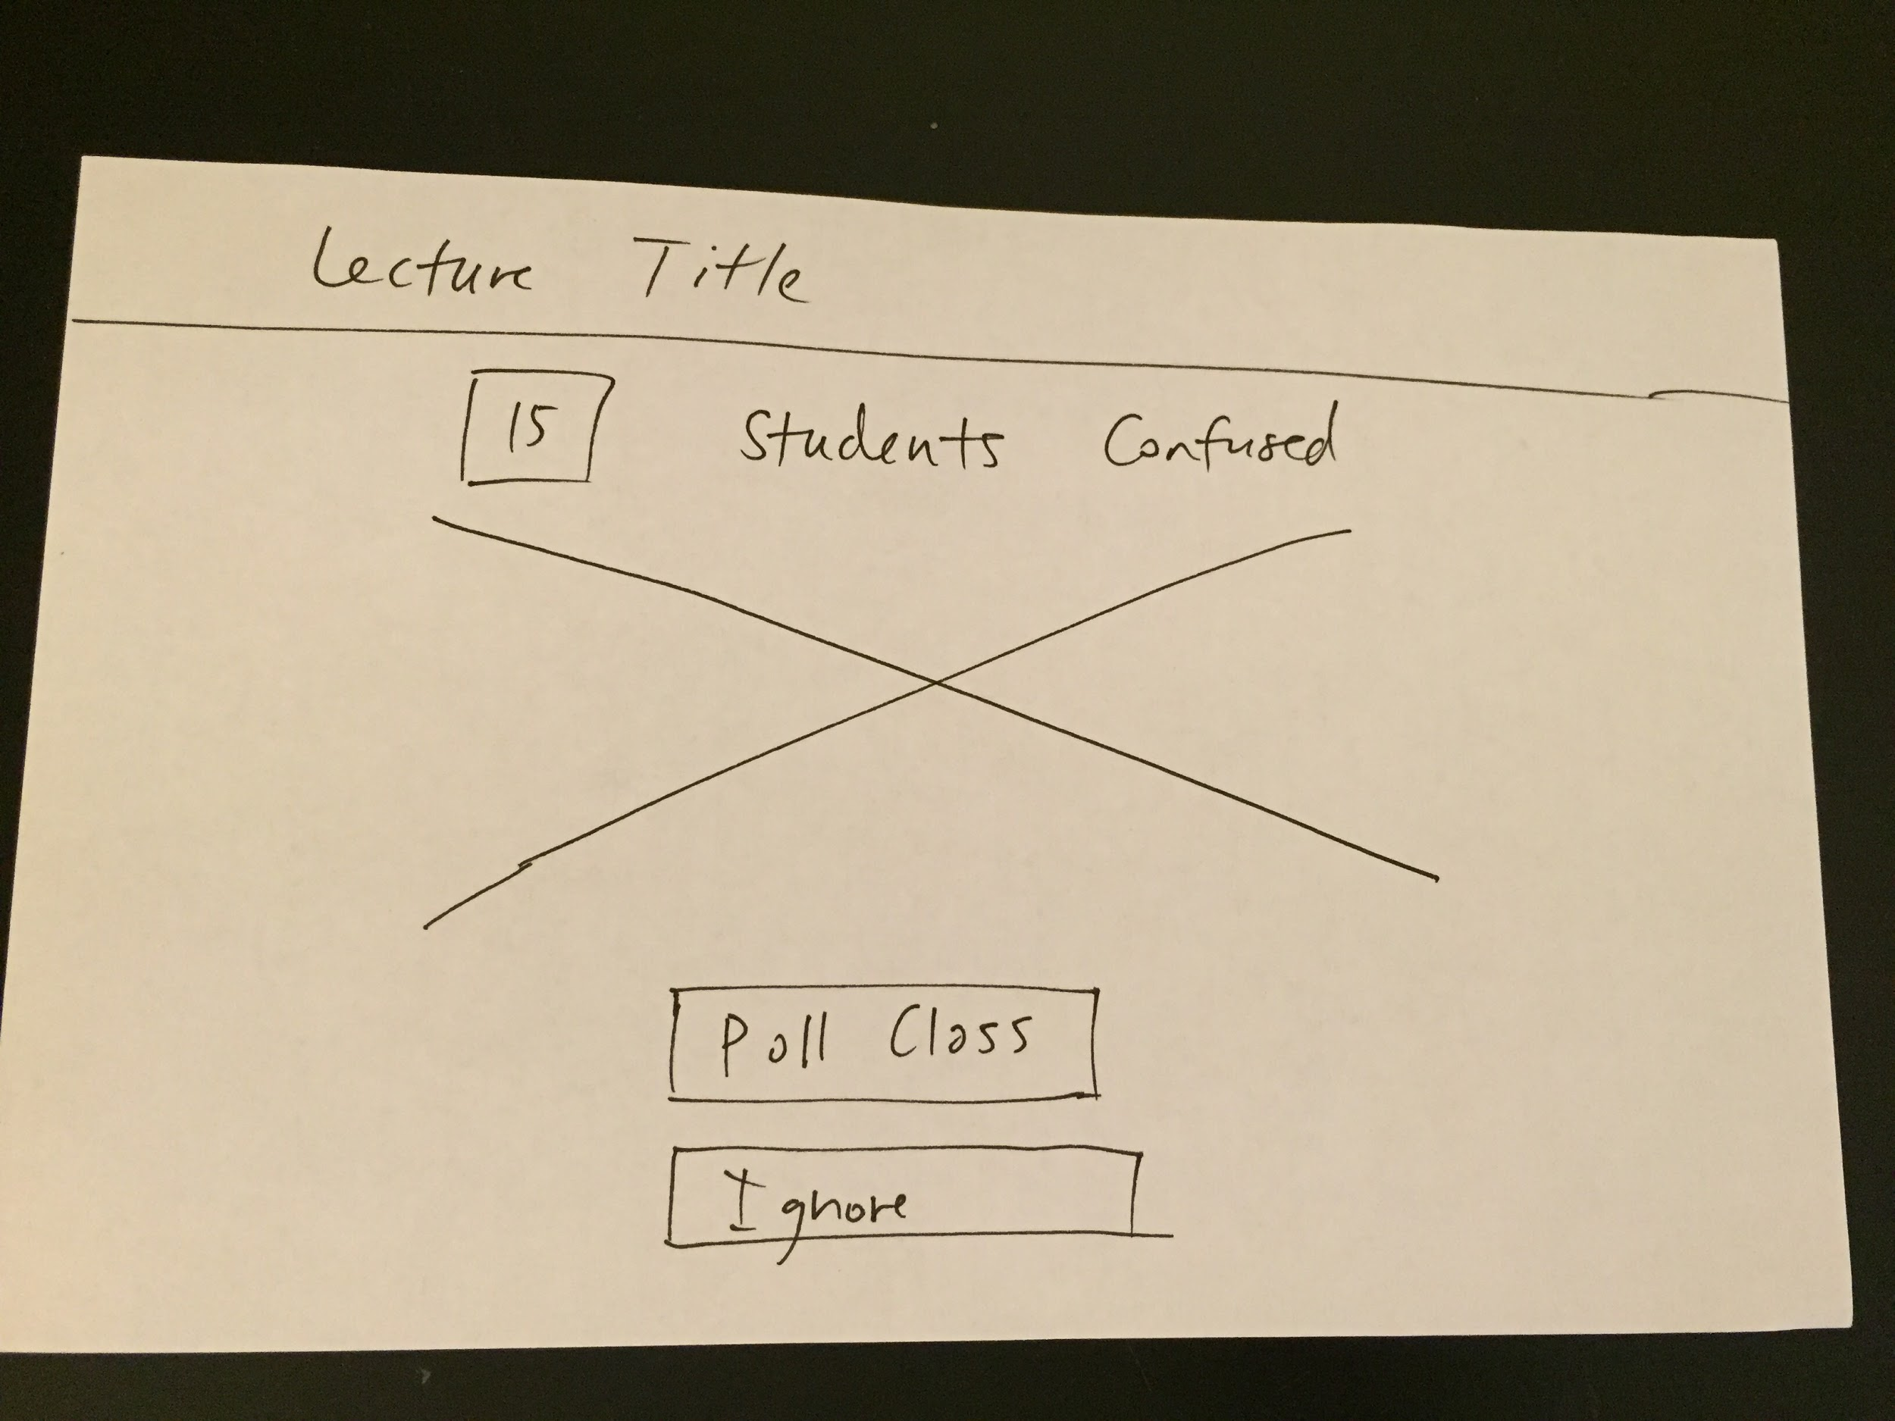

Slide 57
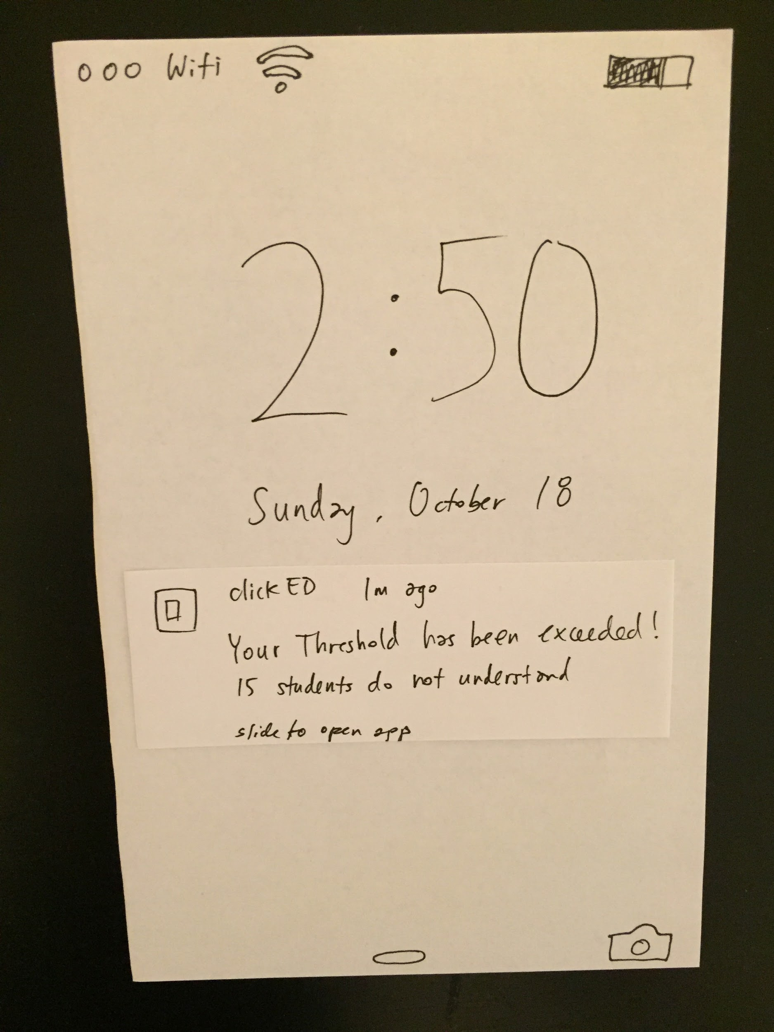

Slide 61
Task 3: Teacher Reviews Lecture

Slide 64
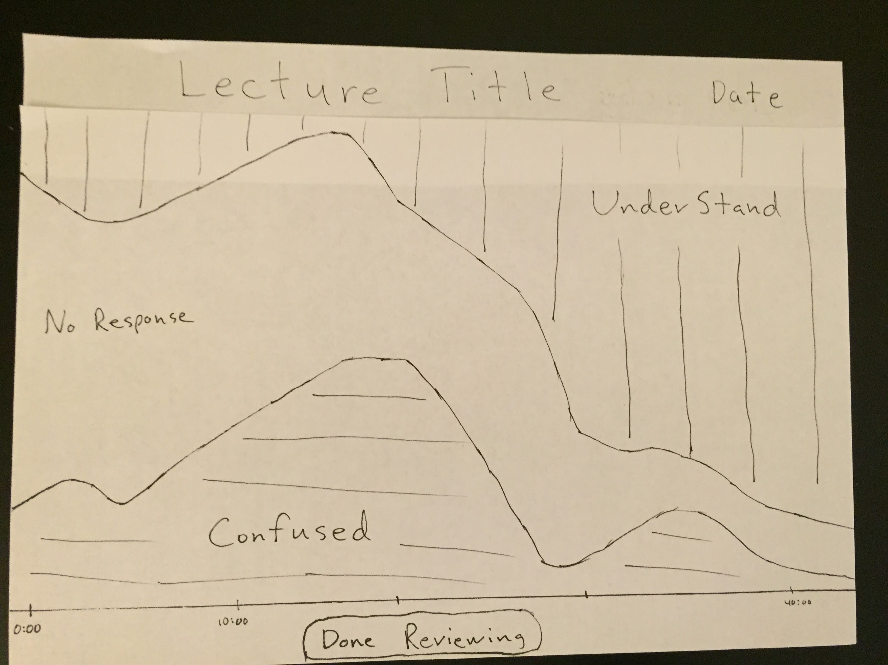

Slide 71
Overview of Talk
Brainstorming and picking between possible devices and UIs
Narrowing UI flow for each task
Constructing prototype for tasks and necessary functionality
User experimentation and feedback

Slide 72
Experimental Method
Participants:
Teachers who used iPads Frequently
Teachers who didn’t
Students who didn’t mind speaking up in class
Students who did
Environment: Teacher’s Office, Teachers’ Lounge, Library

Slide 73
Experimental Method Continued...
Procedure:
Gordon facilitated, but said little during tasks
Michael acted as the computer
Jake took notes
Test Measurements:
Number and severity of errors
Time to complete
Demonstrated interest and usefulness [subjective]

Slide 74
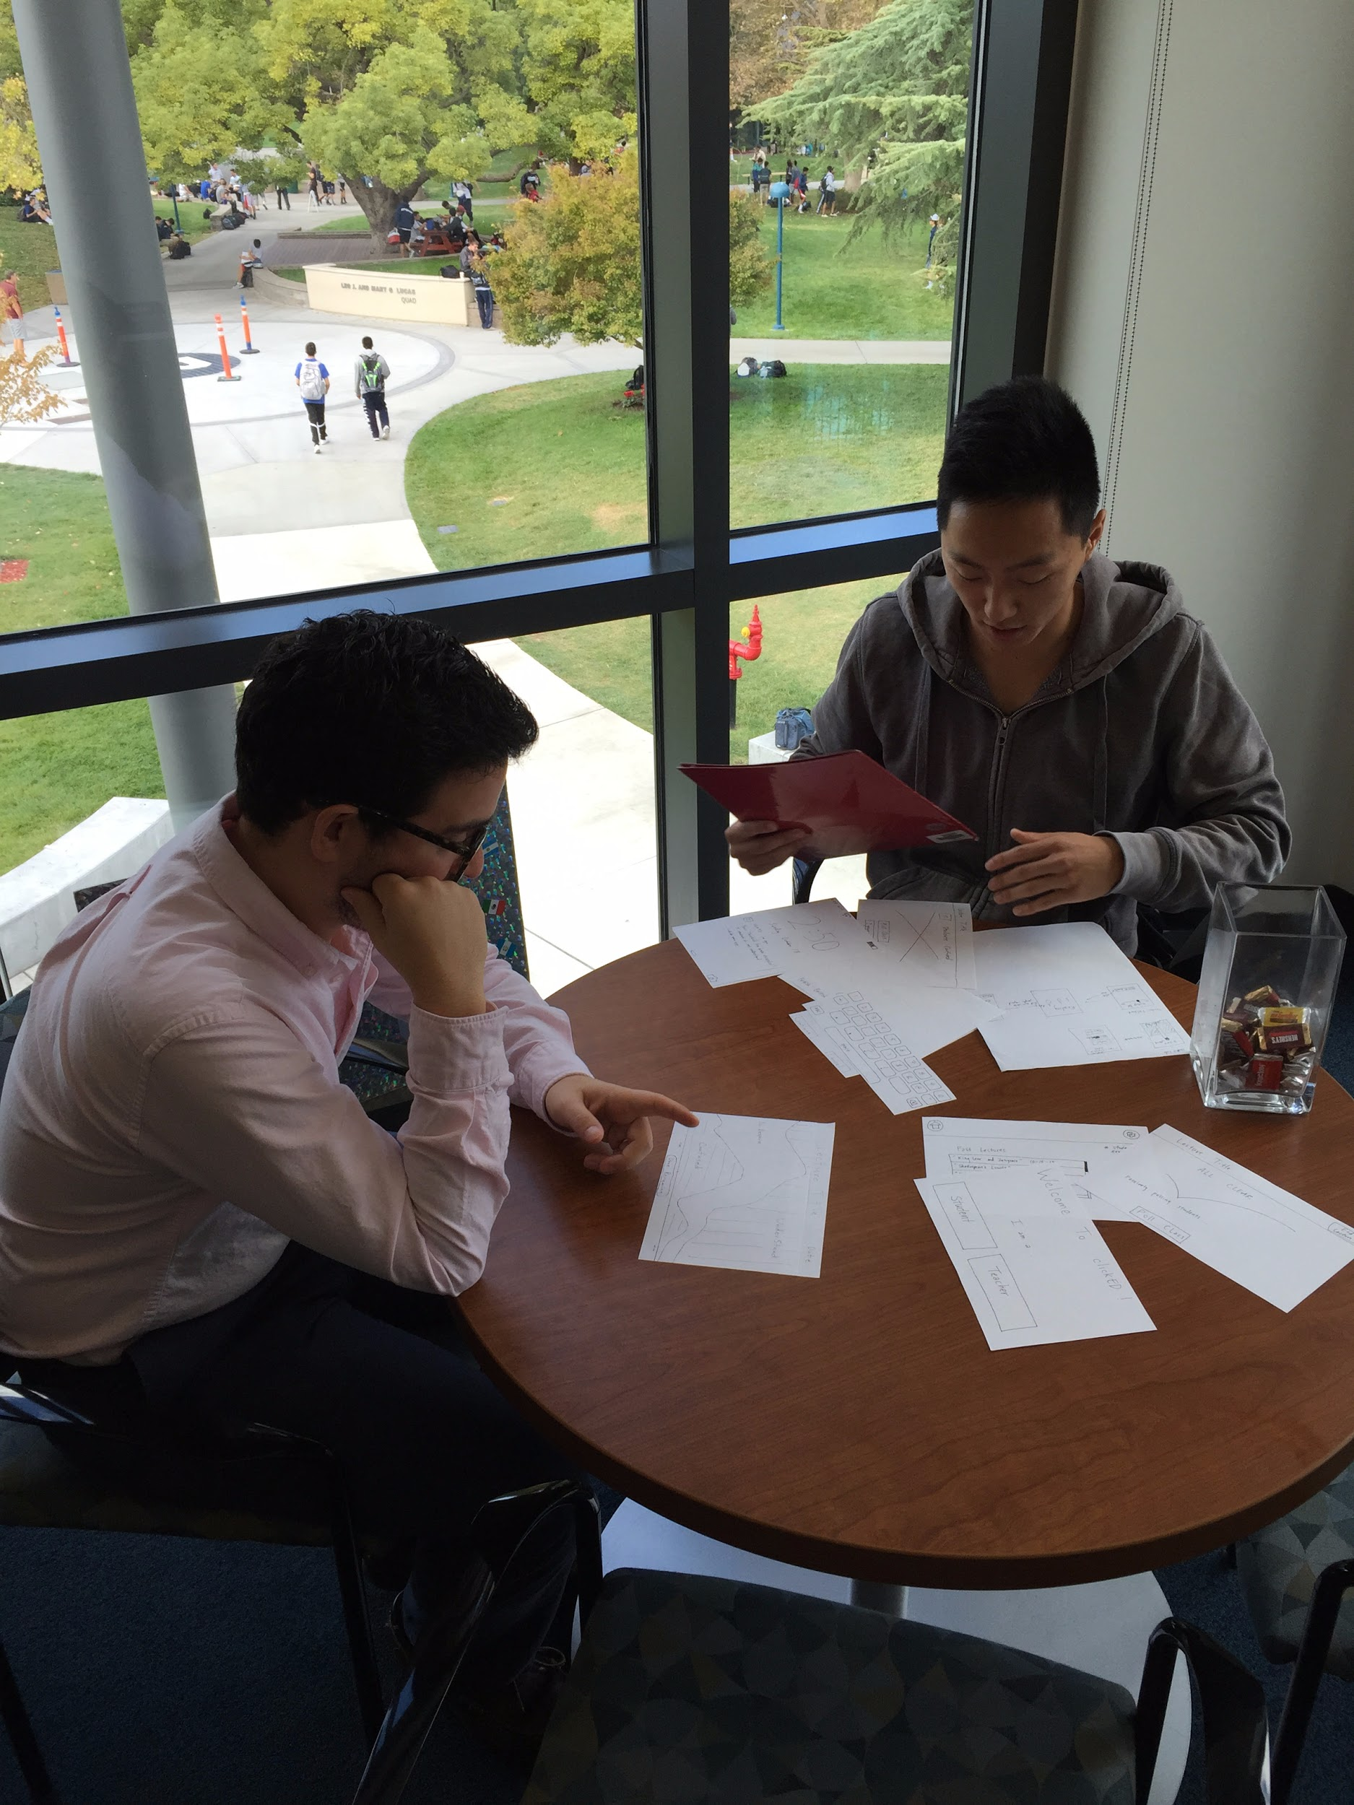
Interview 1 - Teacher
Subject 3 - Spanish Teacher
Slow with navigation
Confused on lecture-running slide (“All Clear” slide)
Couldn’t get much useful information out of graph

Slide 75
Suggested UI Changes
“All Clear” Screen is confusing - Clarify purpose in app
e.g. give a tutorial with explanations
“Don’t understand” button insufficient - specific feedback.
e.g. let students input what topic they are confused about
Remove “Class Code” Screen - unnecessarily confuses teacher

Slide 76
Interview 2 and 3 - Teachers
Subject 1 - Religious Studies Teacher
Navigated quickly with one error
Got minor information from graph
Subject 2 - History Teacher
No errors, modest speed
Wanted individual student info on the Graph

Slide 77
Suggested UI Changes
Single largest cause of confusion:
De-anonymize students so can get more info in graph
Don’t call it “lecture”
Allow flexible polling - e.g. allow teacher to create a “one question quiz”

Slide 78
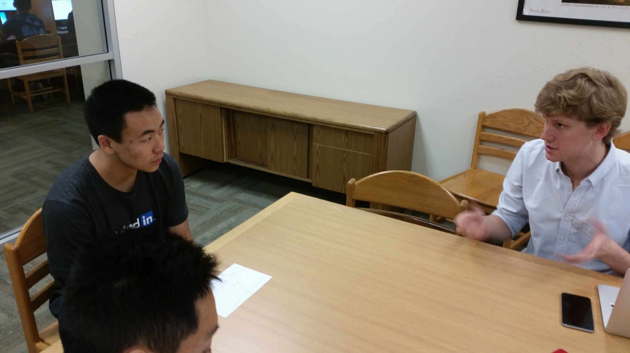
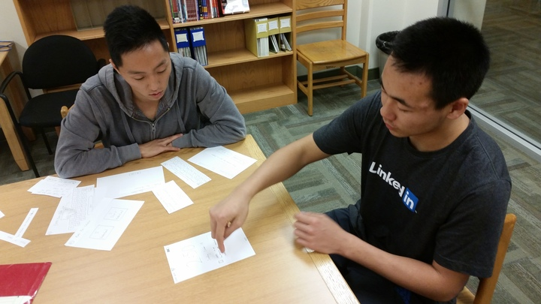
Interview 4 and 5 - Students
Subject 4 - active student
Fast, no errors
Said useful for others
Subject 5 - passive student
Fast, no errors
Hesitate to give feedback

Slide 79
Suggested UI Changes
Anonymous during class - students didn’t want to get “checked on” during class
De-Anonymize after class - both students agreed this would be fine with students, and useful for teachers
Let students be specific - let students say specifically where they got lost

Slide 80
Overview of Talk
Brainstorming and picking between possible devices and UIs
Narrowing UI flow for each task
Constructing prototype for tasks and necessary functionality
User experimentation and feedback
Notes:
Remember to summarize UI Changes - lots of similarities in feedback

Slide 81
Overview of Talk - End
5. Feedback or Questions?

