Slide 1
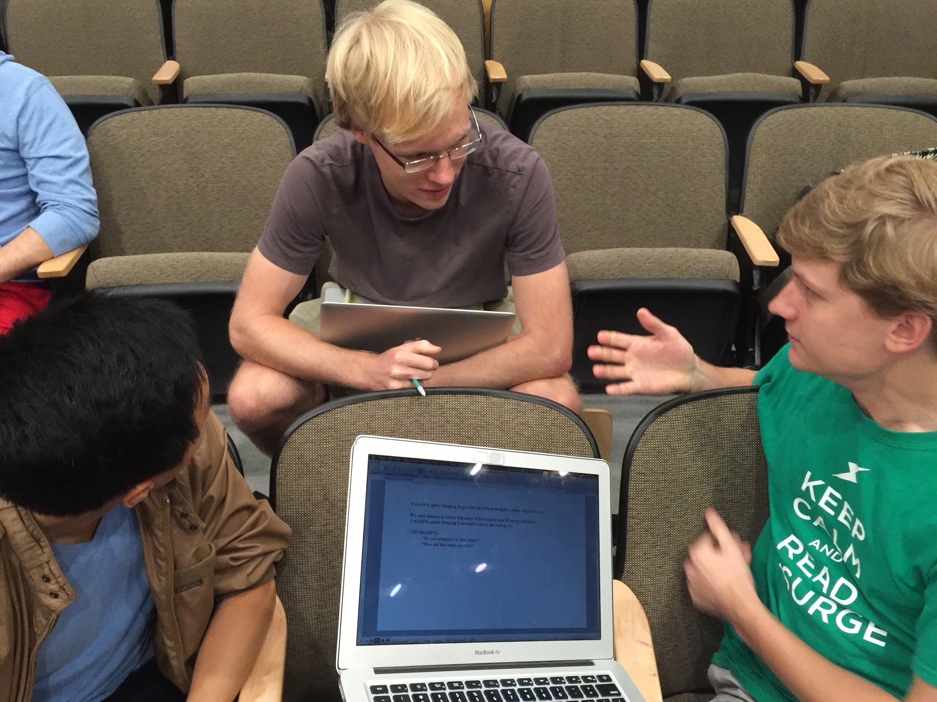
Concept Video
click Education

Slide 2
clickED
Never Leave Class Confused.

Slide 3
Problem/Solution Overview
Problem:
Students don’t want to publicly admit that they don’t understand class material, so teachers don’t have a reliable means by which to determine their students’ comprehension until it’s too late.
Solution:
Anonymous student feedback removes the participation barrier, enabling teachers to both revisit what was misunderstood in real-time and to update their lesson plans based on this information.

Slide 4
Tasks
Simple: Students need to alert their teacher when they are confused in class.
Moderate: Teachers need to effectively read the classroom to determine student understanding during a lecture.
Complex: Teachers need to update their next lesson after class based on what happened during class that day.

Slide 5
Storyboard

Slide 6
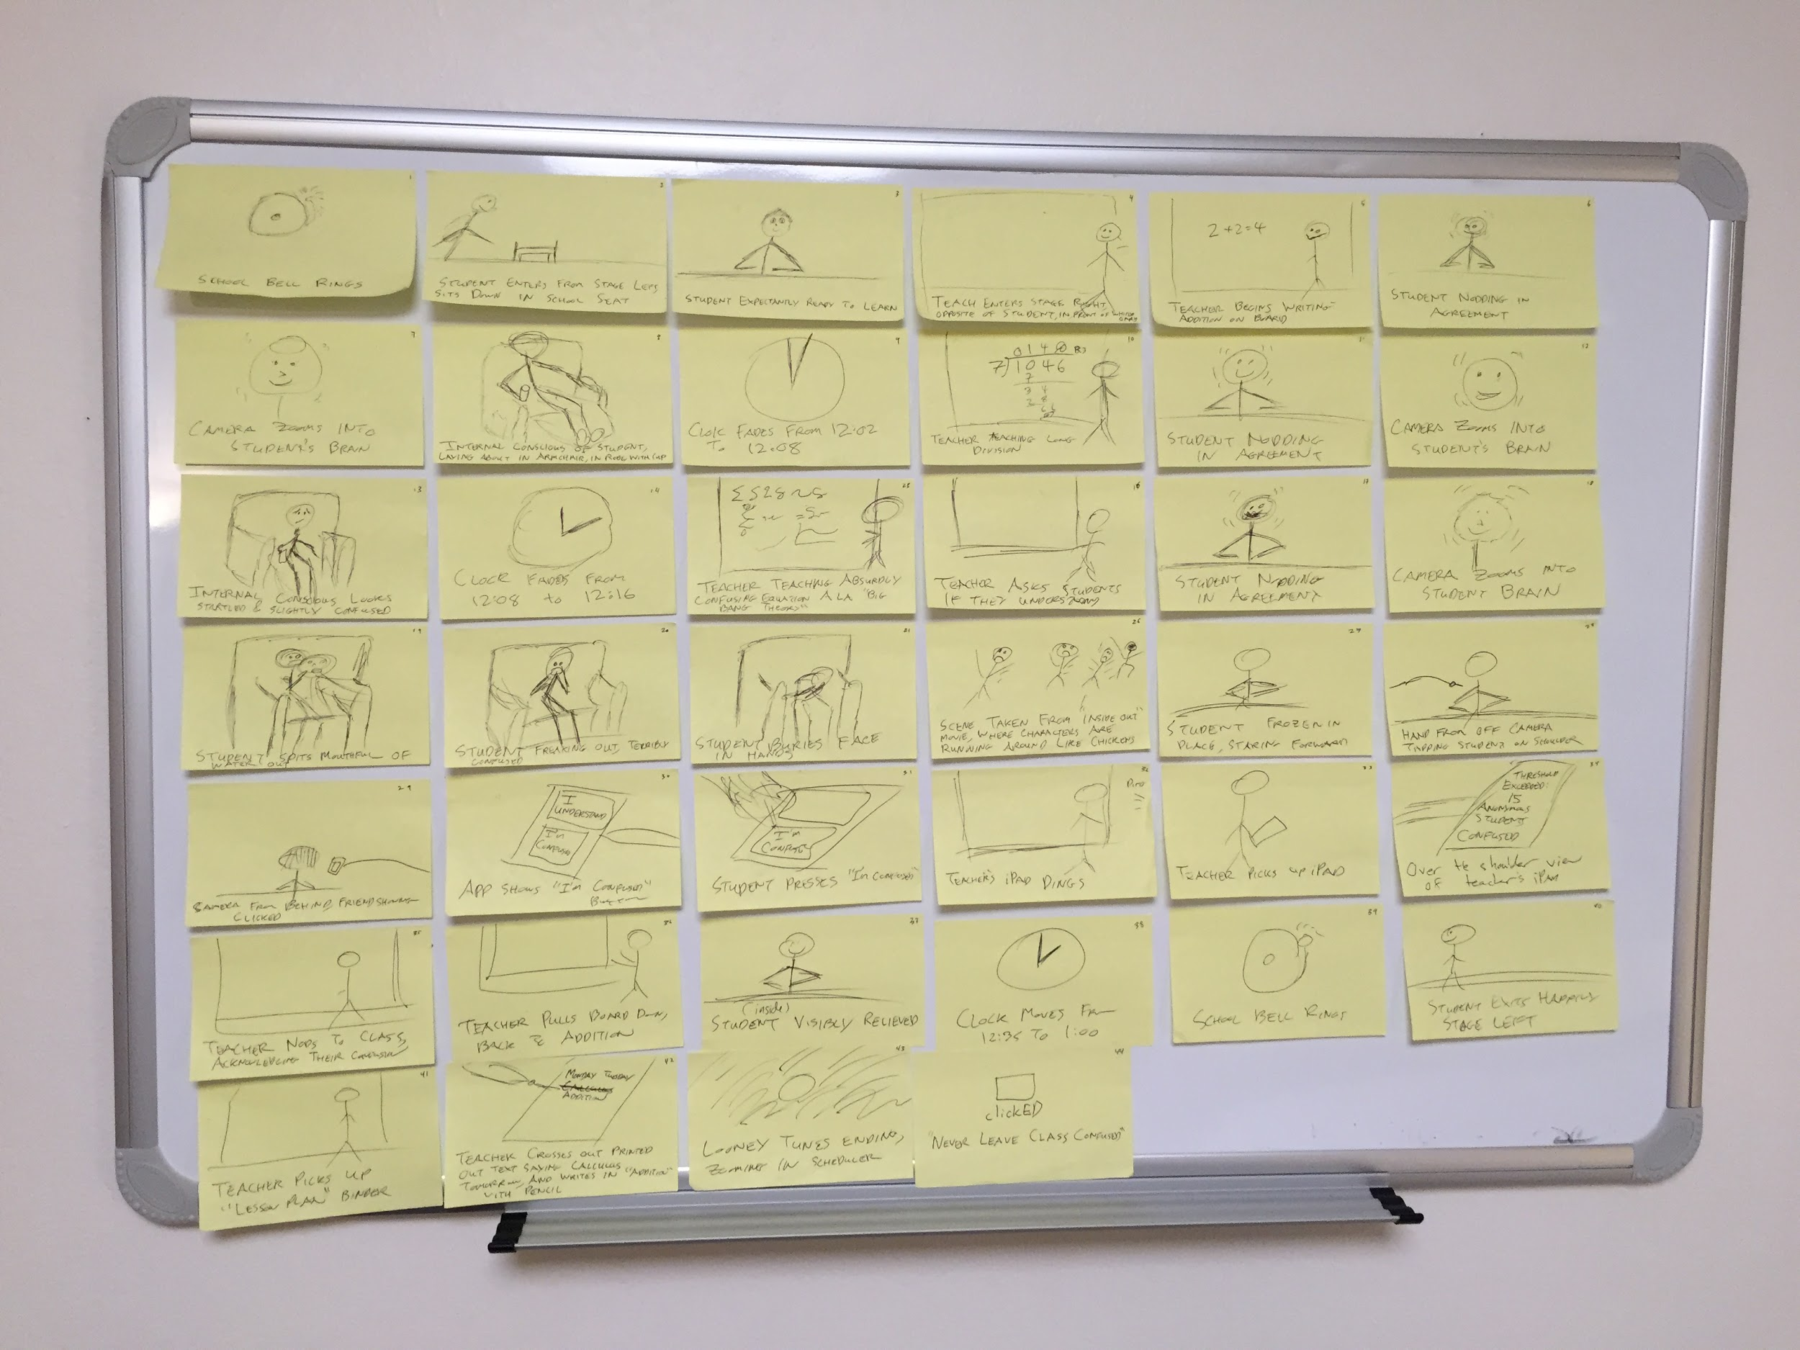

Slide 7
Scene: Set-up

Slide 8
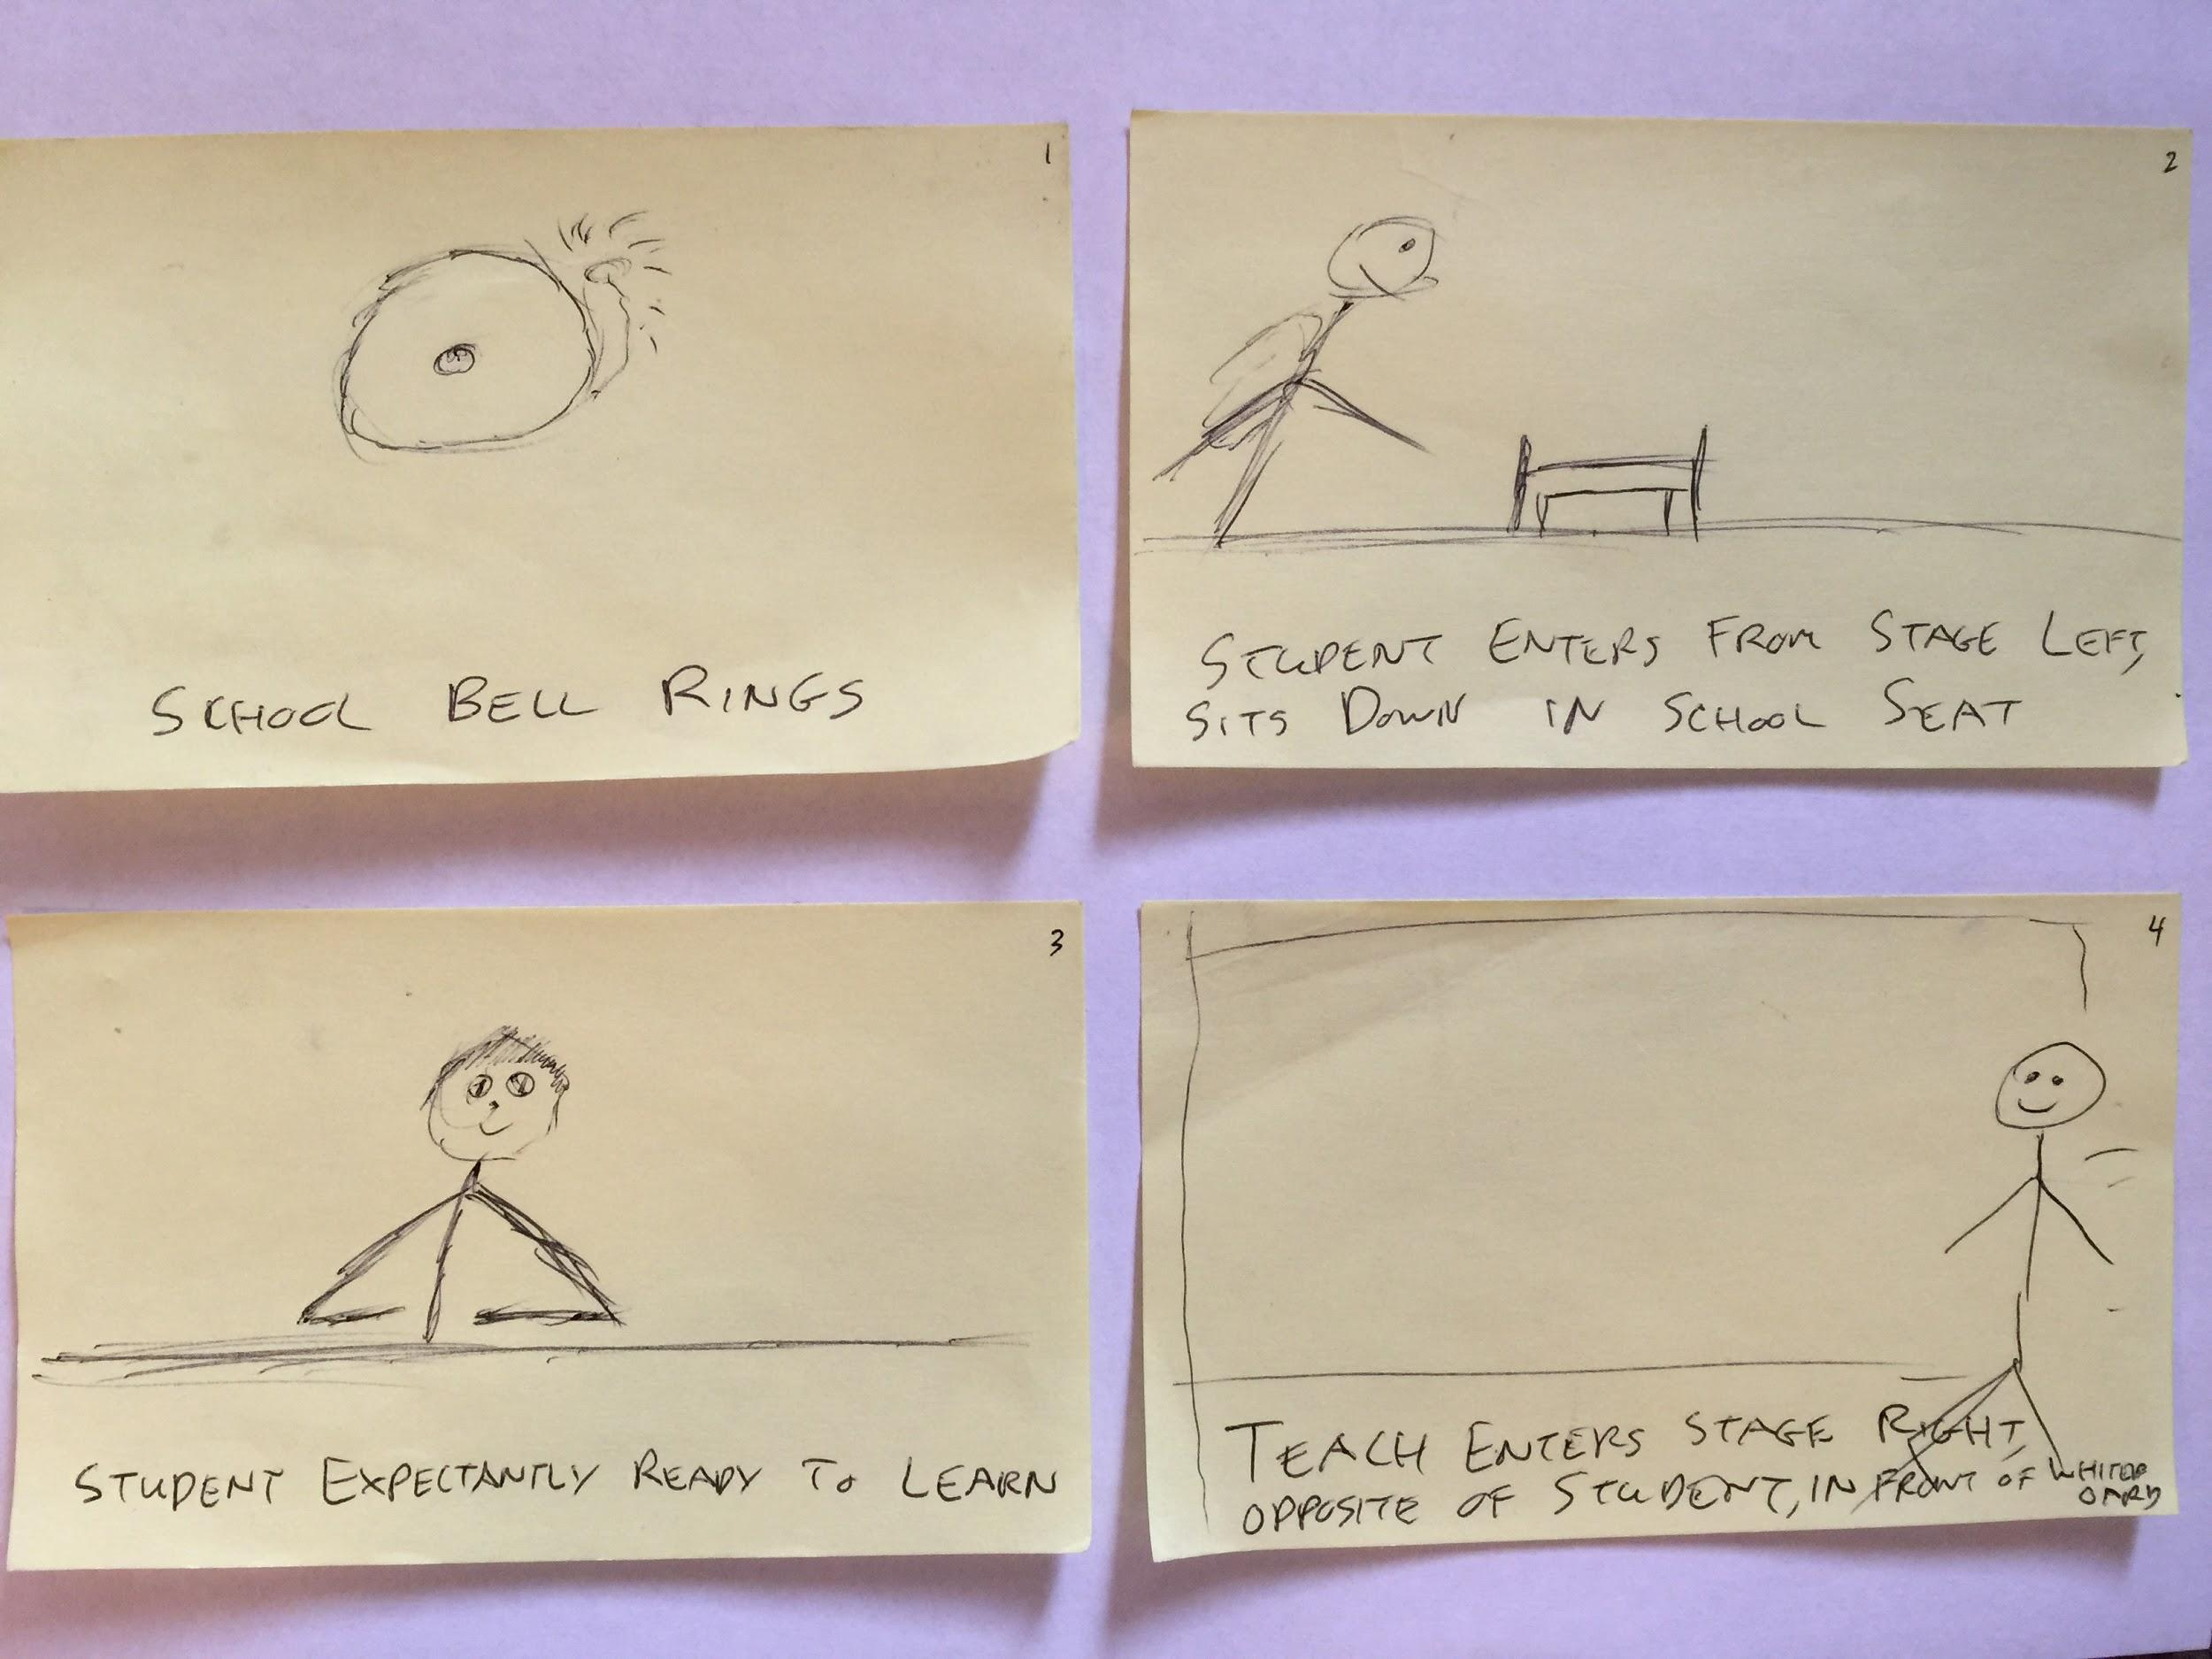

Slide 9
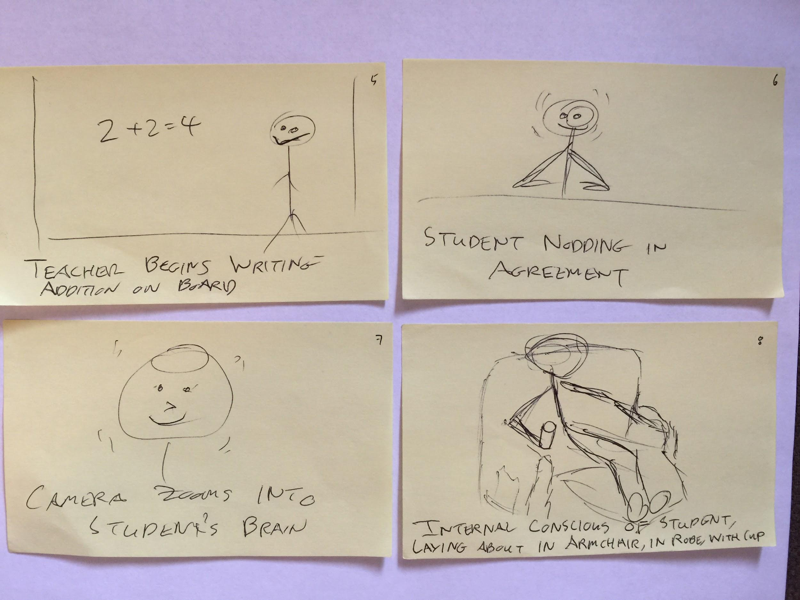

Slide 10
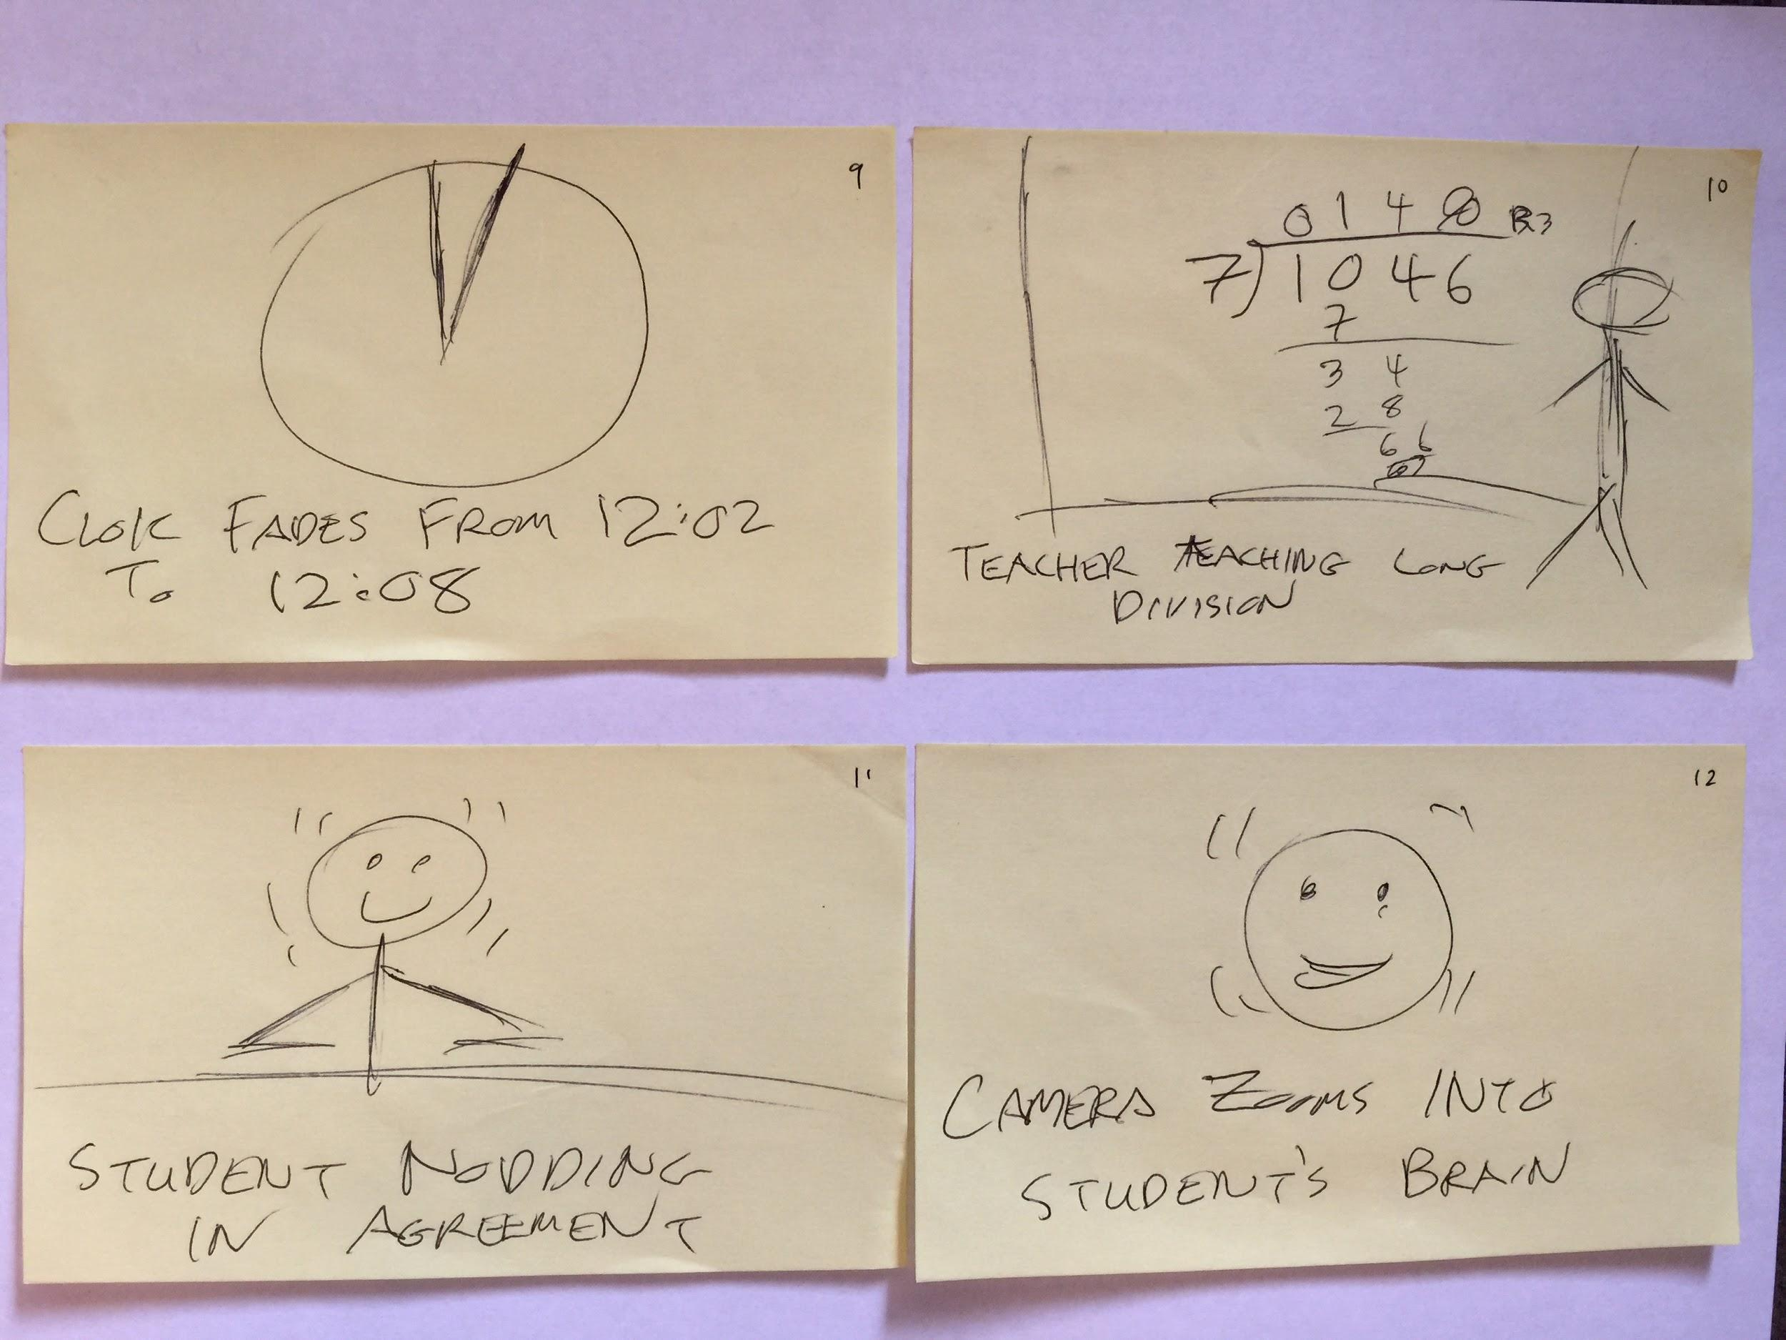

Slide 11
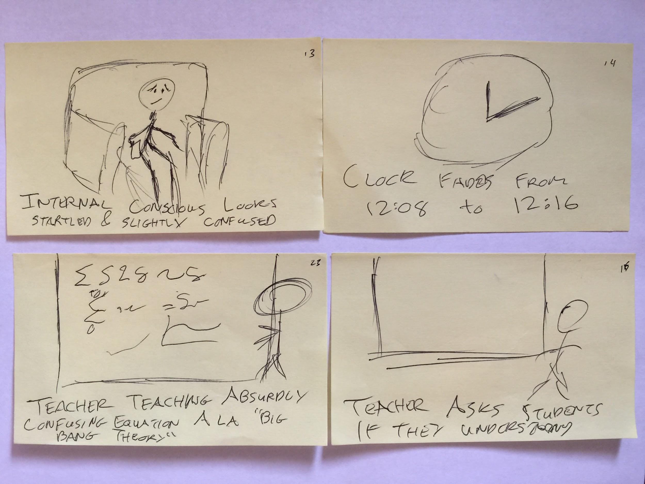

Slide 12
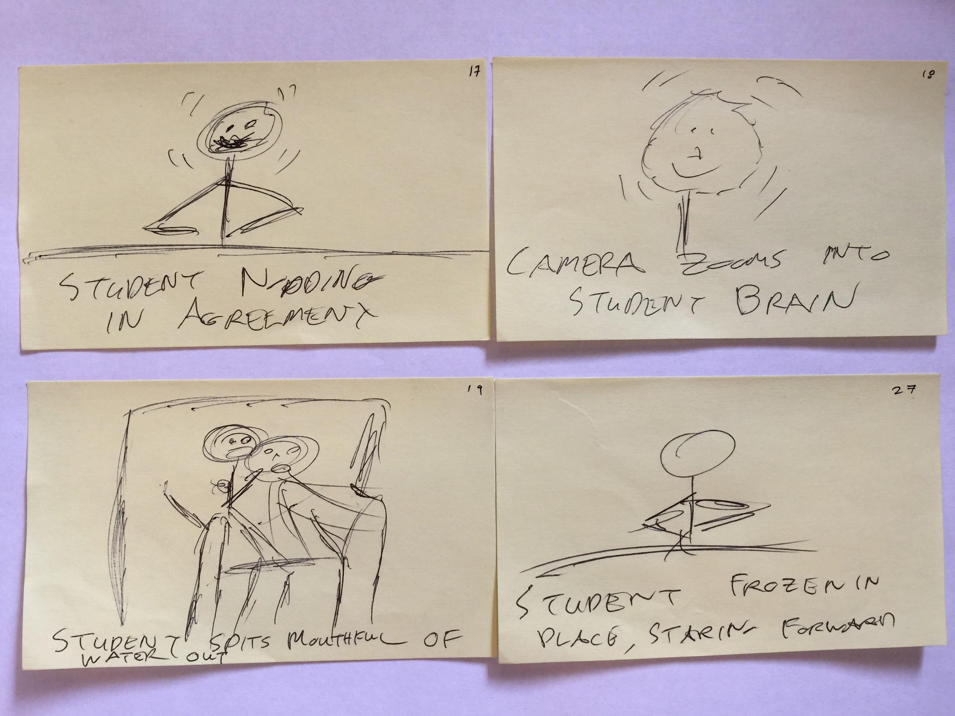

Slide 13
Scene: Task #1

Slide 14
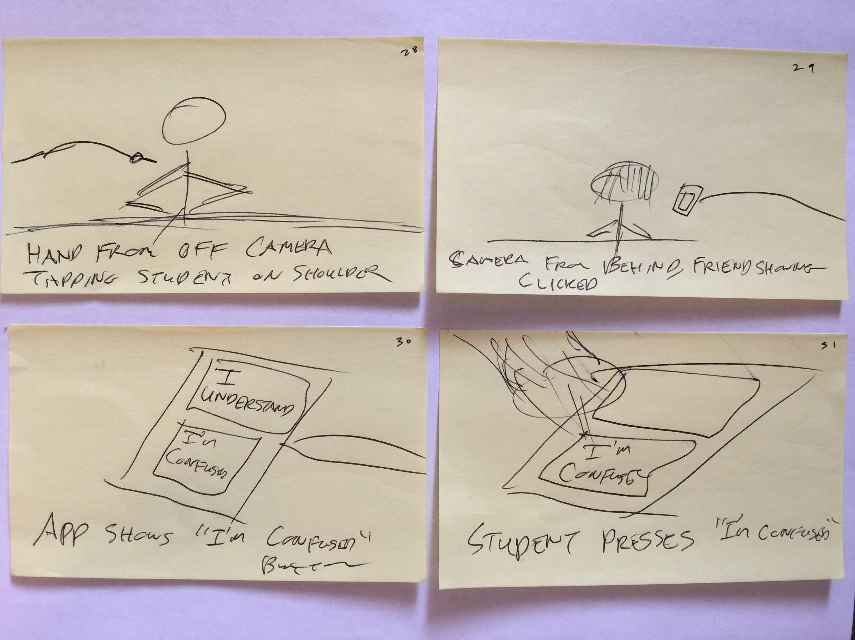

Slide 15
Scene: Task #2

Slide 16
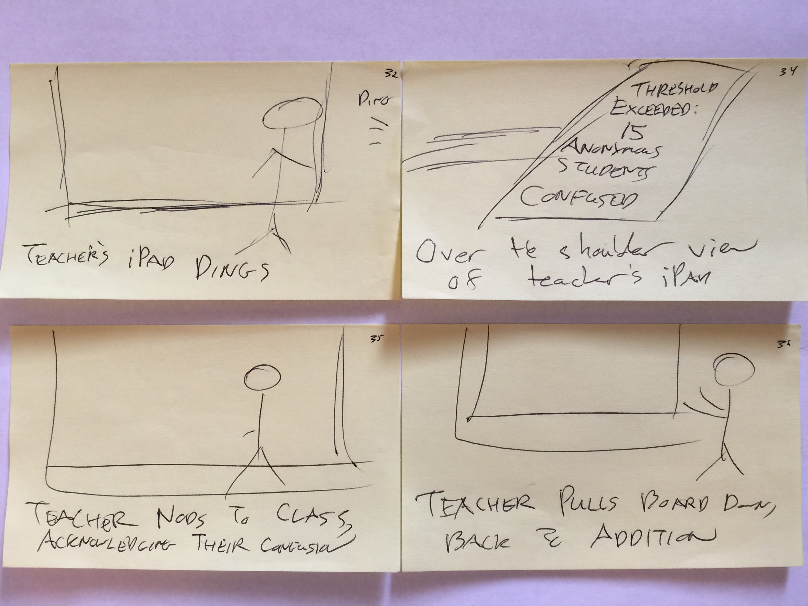

Slide 17
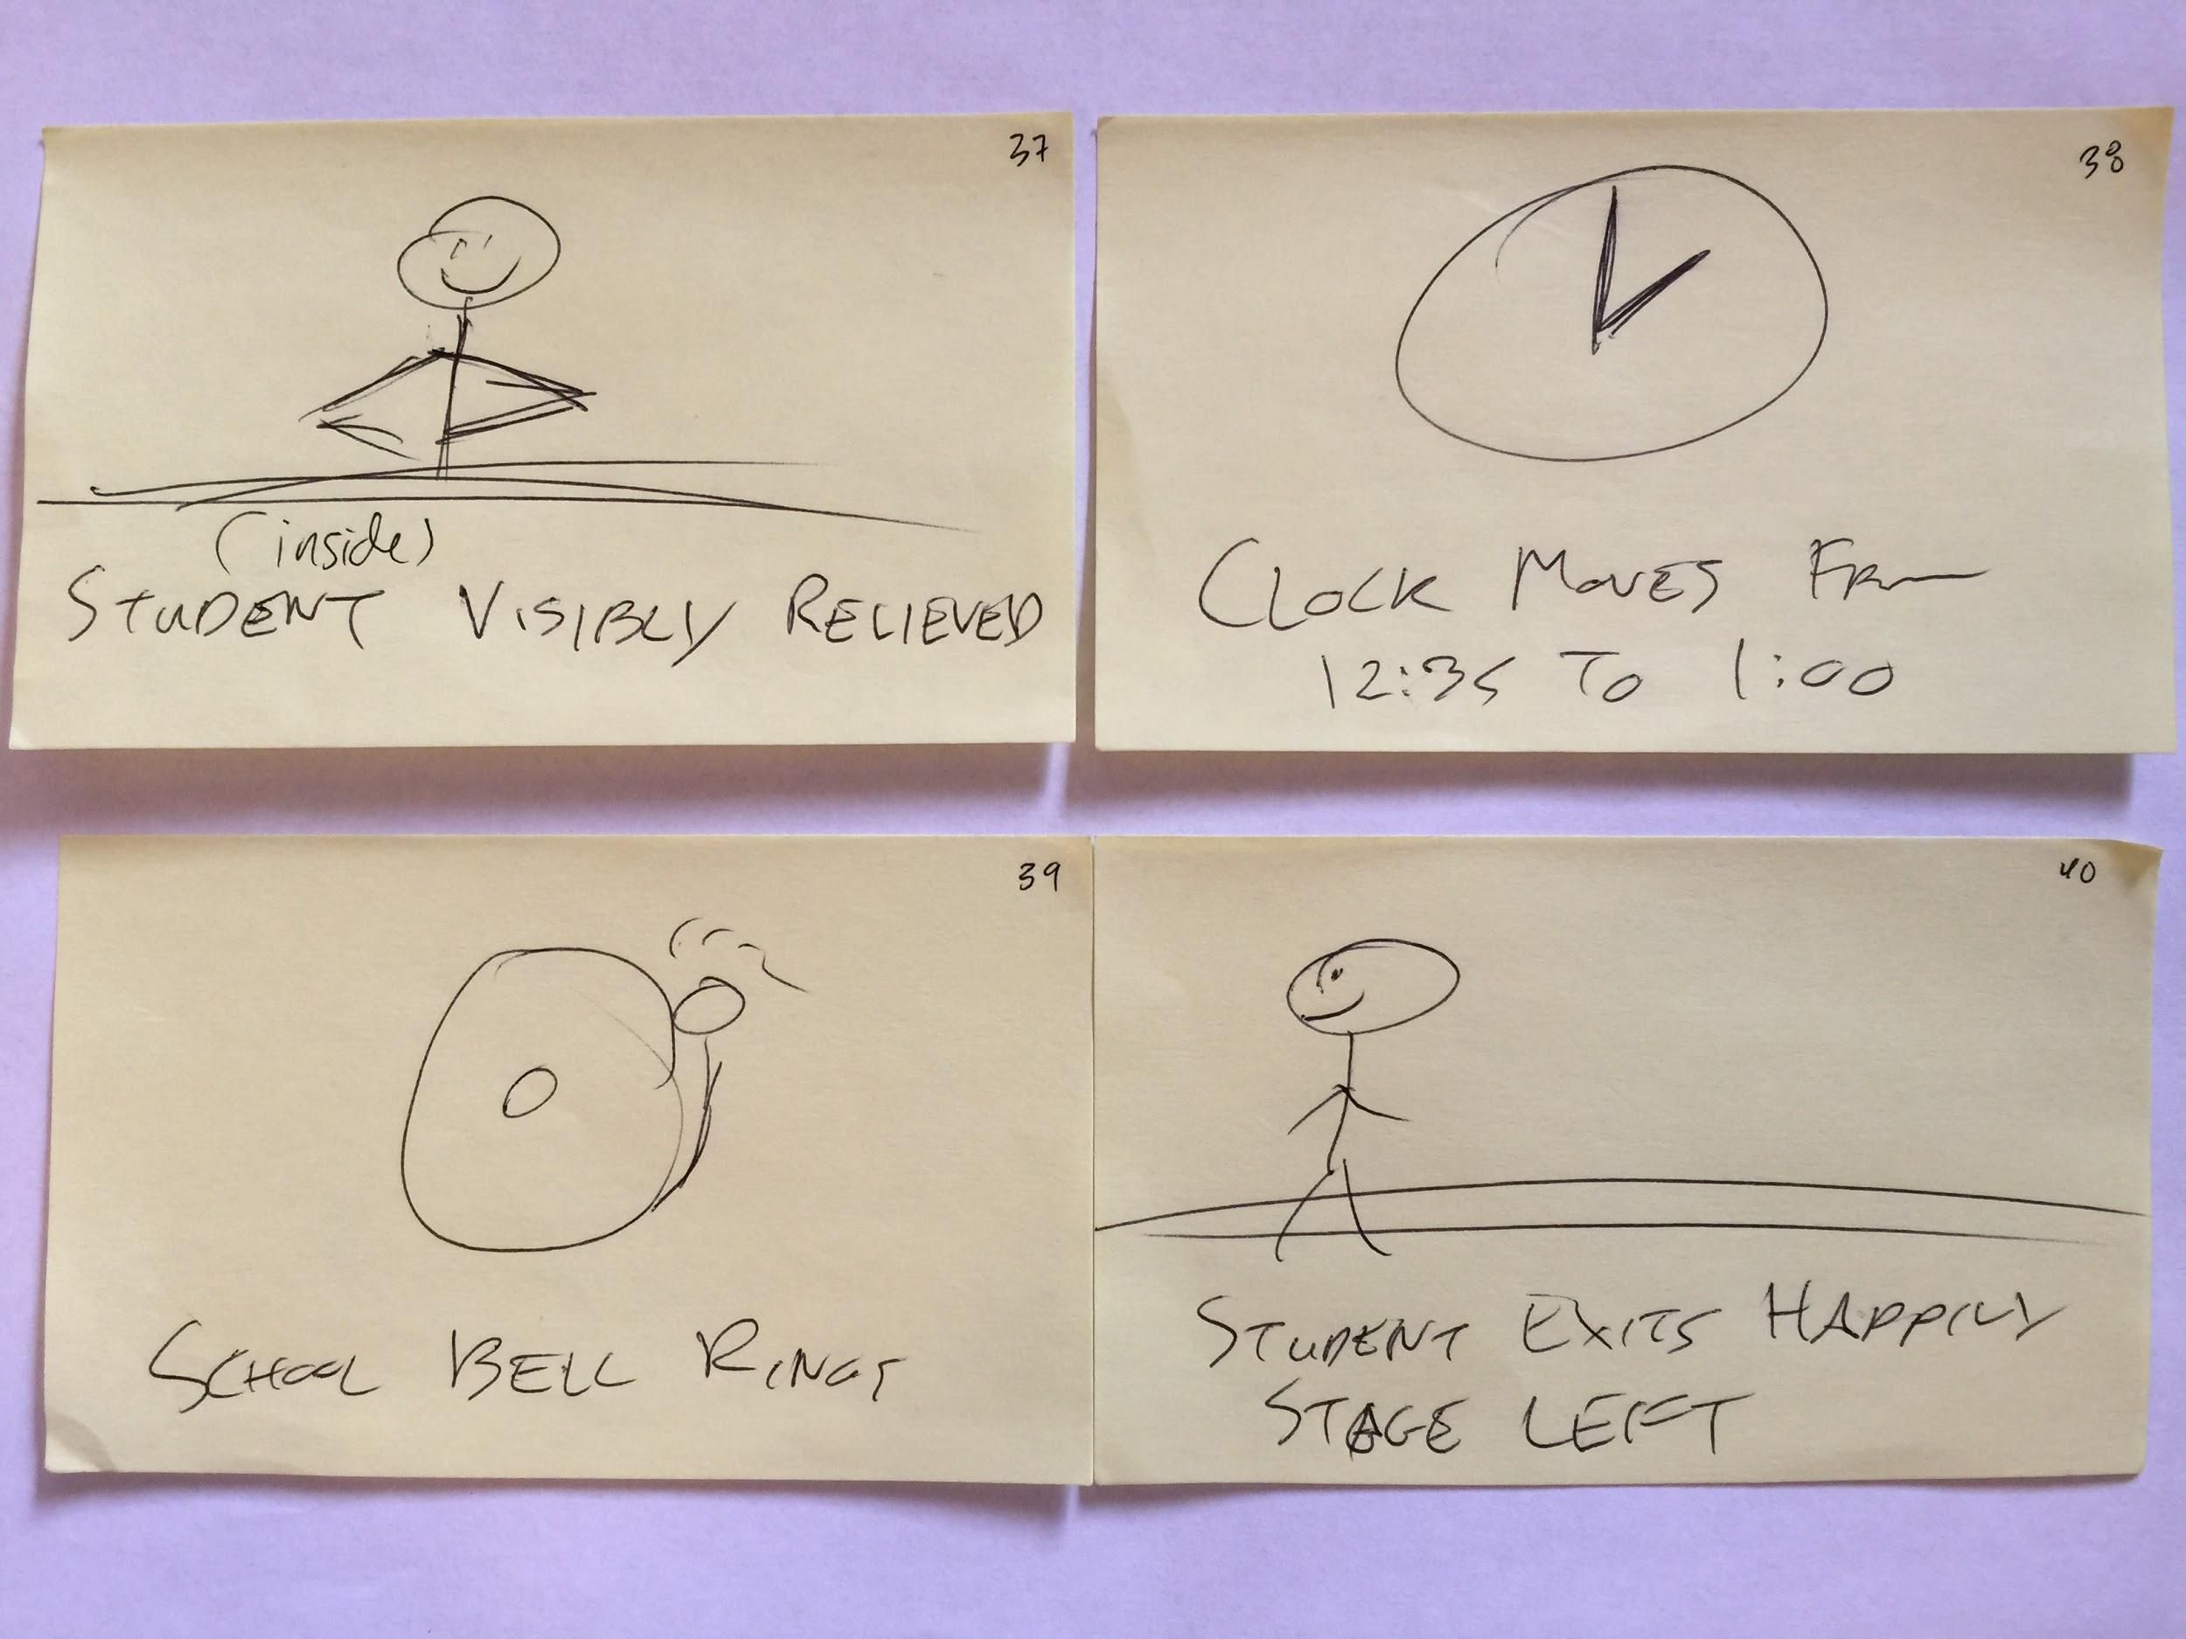

Slide 18
Scene: Task #3

Slide 19
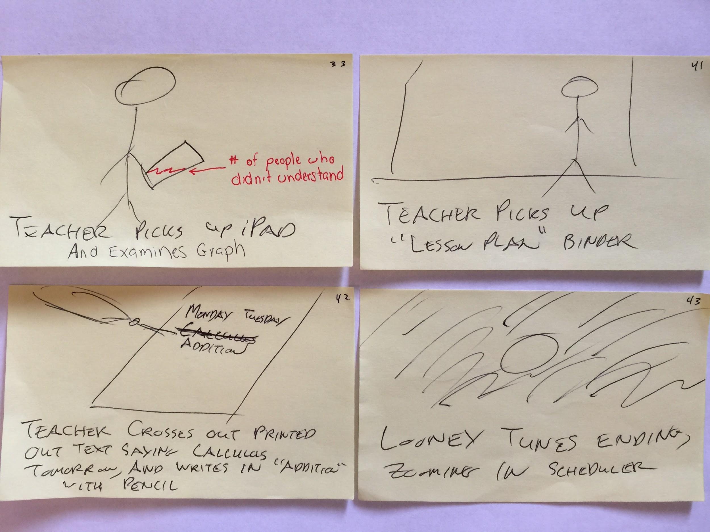

Slide 20
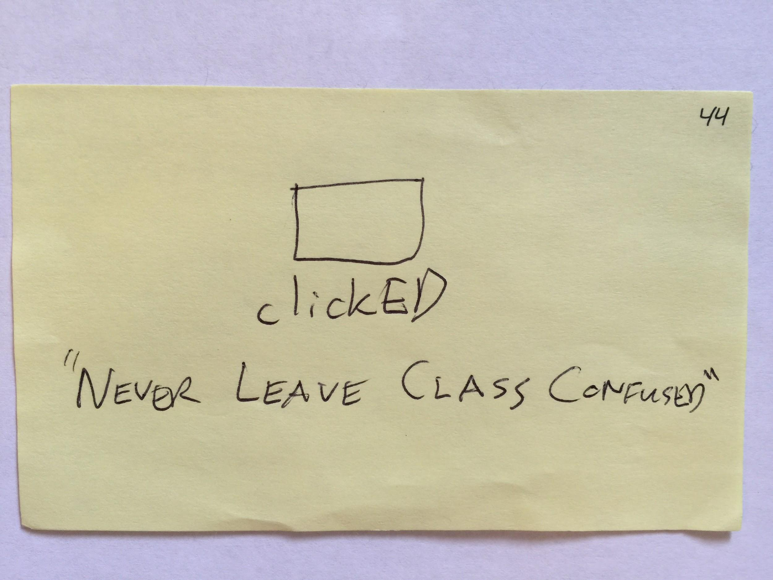

Slide 21
clickED Concept Video:
https://www.youtube.com/watch?v=05dbkMW-Y6k
Notes:
https://www.youtube.com/watch?v=05dbkMW-Y6k

