Slide 1



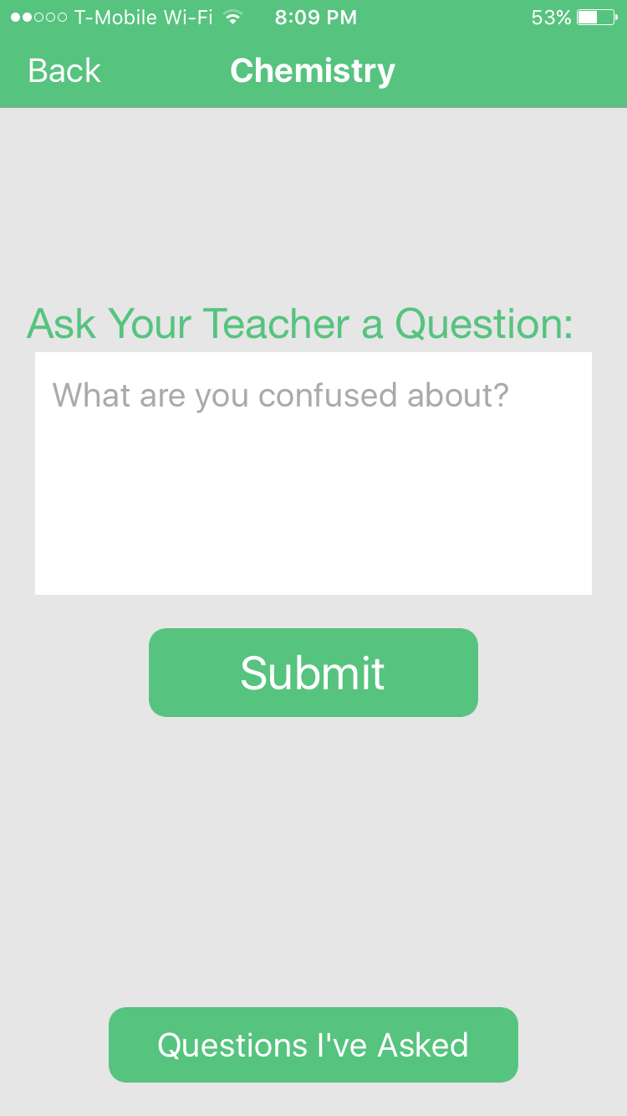
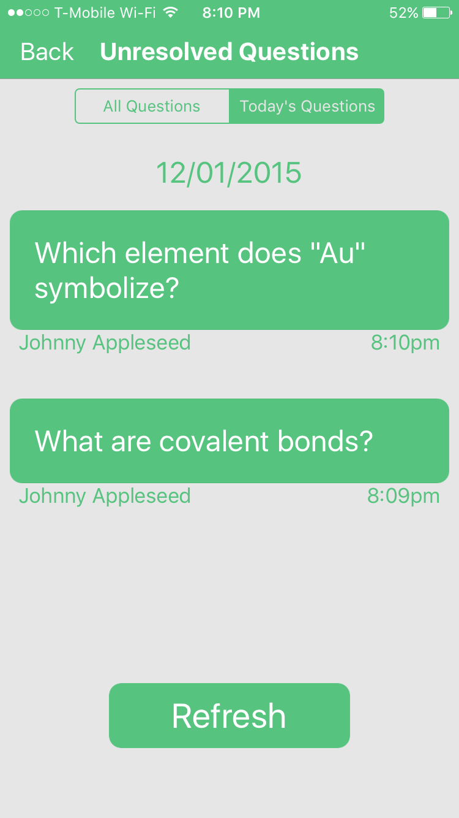
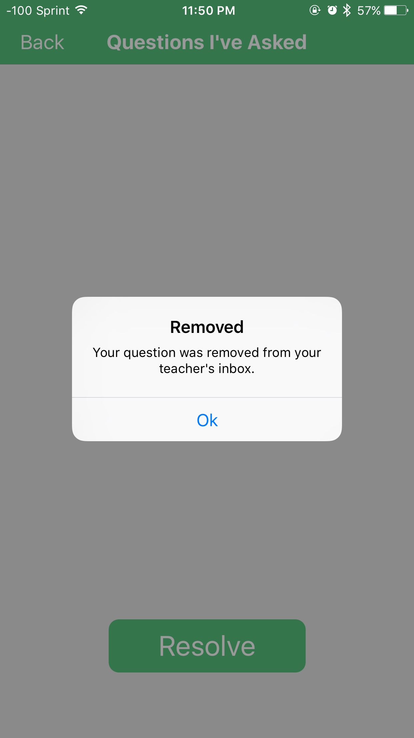
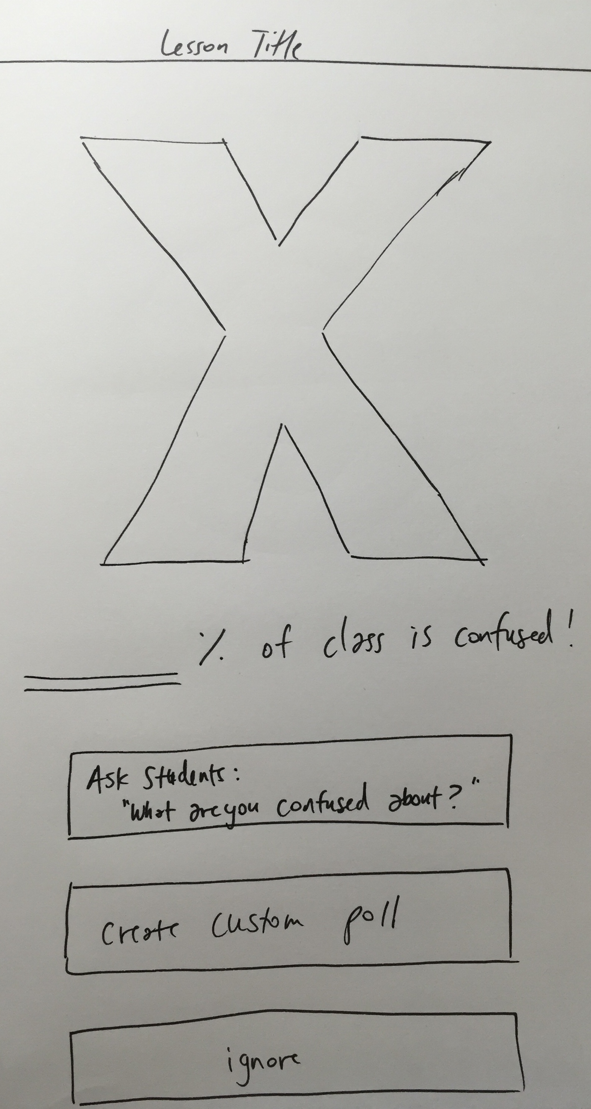
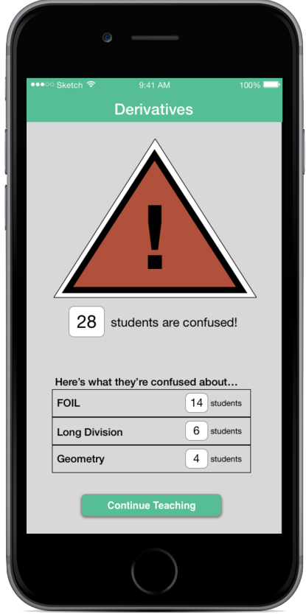
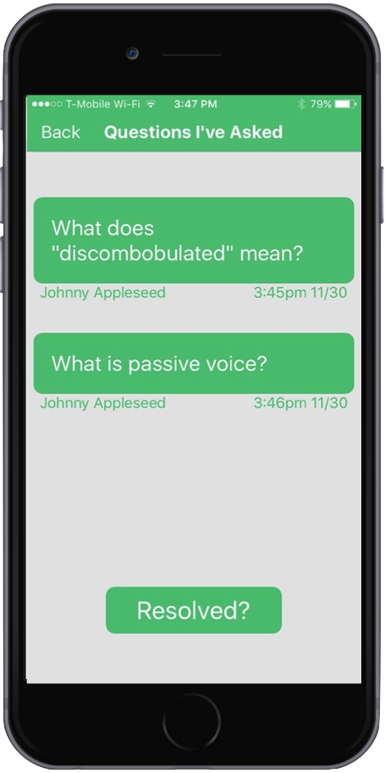
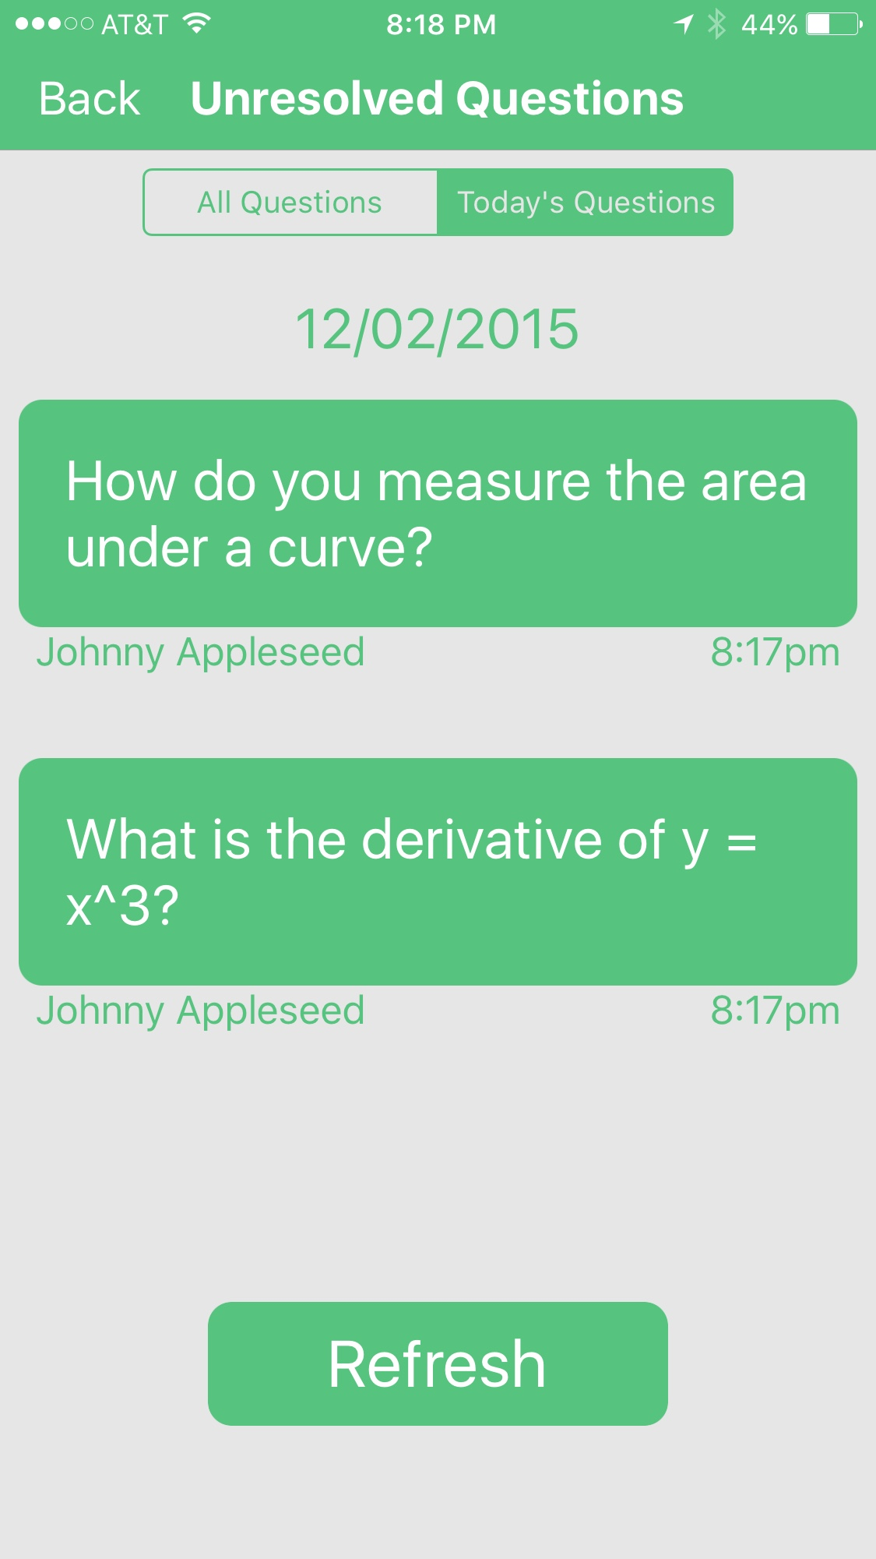
clicked See the Questions Behind their Masks
Problem
Students are embarrassed to ask questions in front of their classmates.
Teachers can’t read their students’ minds during class.
Teachers can’t effectively target their struggling students.
I don’t want my friends
to think I’m stupid.
I’m too shy to ask
my question.
Does my class
understand?
Solution
Students ask private questions
Teachers review questions in real-time
Students resolve clarified questions
Design Process
User Test Findings:
Binary data wasn’t helpful for teachers
In-class polling was too time consuming
Solutions:
Teachers add pre-defined topics for students to select
Heuristic Evaluation:
Inputting topics adds work for teachers
“Threshold exceeded” alert is disruptive
Solutions:
Students submit questions privately to teacher’s dashboard
Low-Fi Prototype
Medium-Fi Prototype
High-Fi Prototype
Krister Johnson . Gordon Dean . Jake McKinnon . Michael Kim CS 147
http://hci.stanford.edu/courses/cs147/2015/au/projects/learning/clicked Fall 2015

