Slide 1
CanTour
PERSONALIZE YOUR CANTOR EXPERIENCE

Slide 2
Problem & Solution
Visitors experience museum fatigue and overwhelming options
CanTour proposes to personalize and curate your museum experience at the Cantor Arts Center

Slide 3
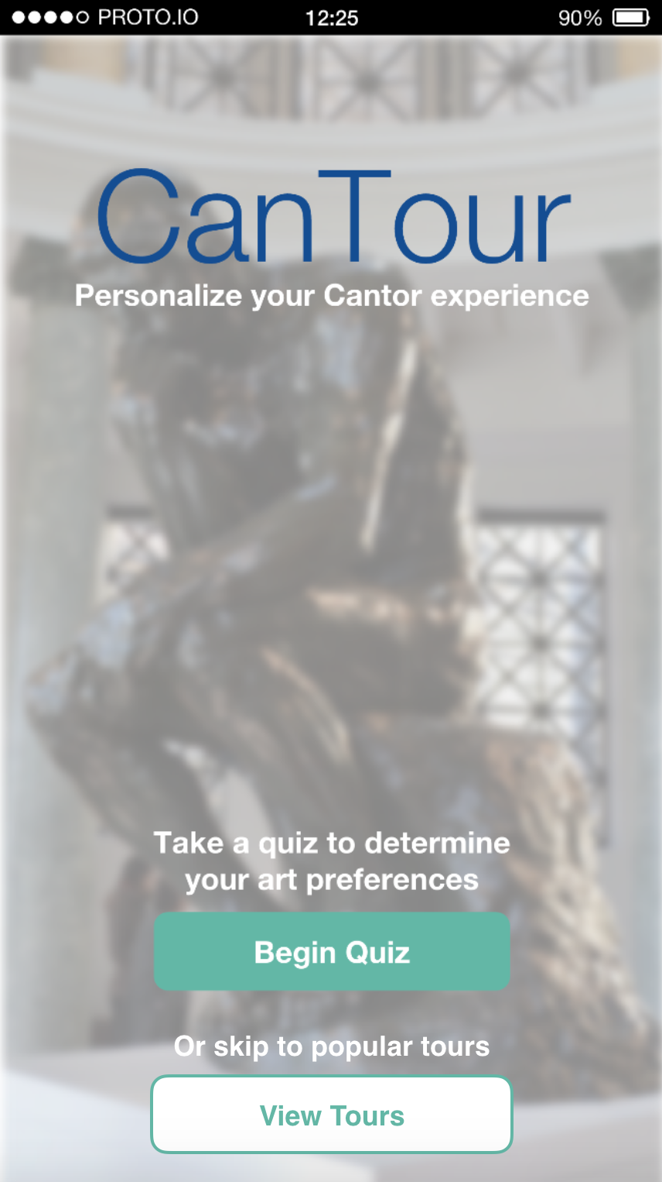
Heuristic Evaluation Results & Revisions | Severity 3
Violation
H2-7 Flexibility and efficiency of use: Users who are not interested in discovering preferences
Revisions
“View tours” button
Skips quiz
Notes:
Flexibility and efficiency of use
Use cases: “Expert” users
Already know what genre they are interested
Previously used app, want different experience
Solution
View tours button on homepage that skips task 1 (quiz)

Slide 4
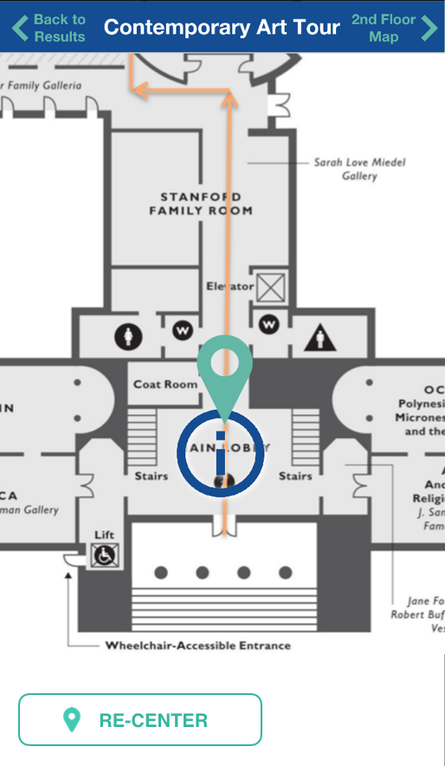
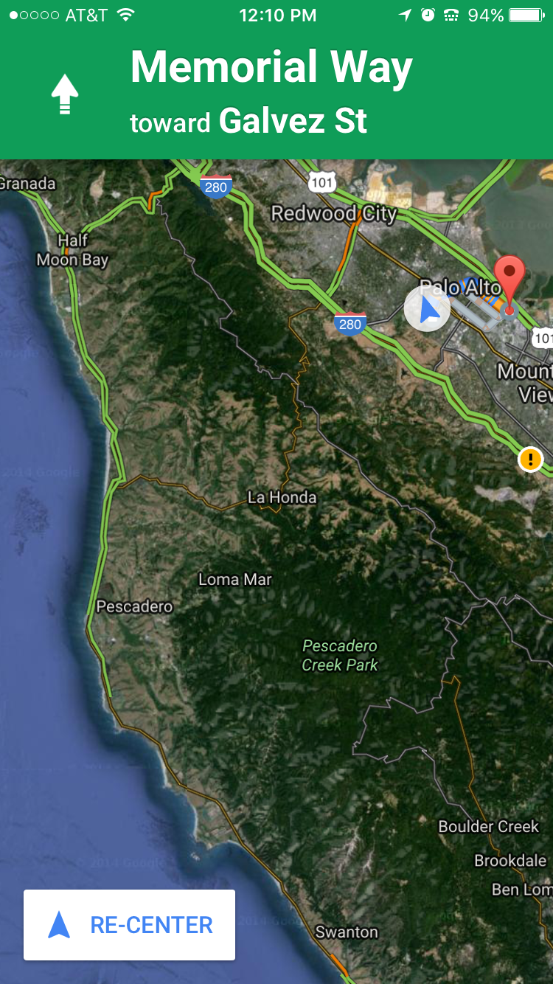
Heuristic Evaluation Results & Revisions | Severity 3
Violation
H2-3 User control and freedom: Map’s predefined scope
Revisions
Pinch interaction
Re-center button
Notes:
User control and freedom
Map has single, predefined scope around current location
Solution
Pinch interaction, allows user to zoom in for more precise location or zoom out for overview of tour
“Re-center” button ala Google Maps

Slide 5
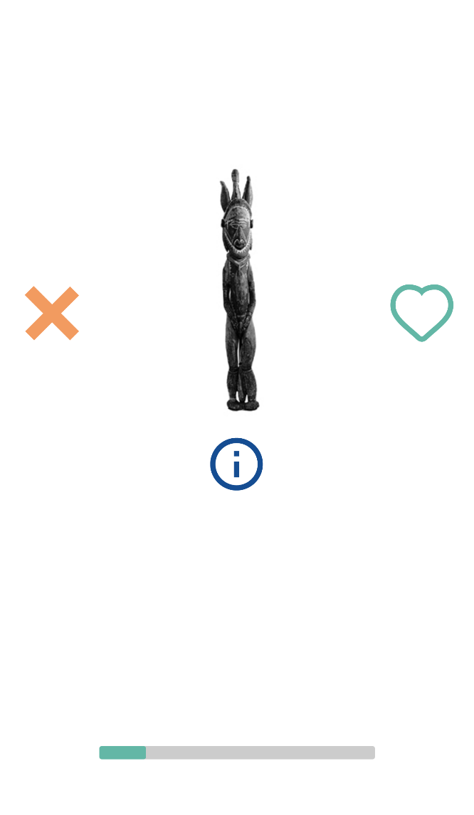
Heuristic Evaluation Results & Revisions | Severity 3
Violation
H2-3 User control and freedom: Lack of “undo”
Revisions
Maintain current design
Quiz task: quick
Minimalist design
Low impact on results
Notes:
User control and freedom
No “undo” option
Revision? Deciding to maintain current design
Quiz task is meant to be quick and dirty - get user through many questions as quickly as possible
Undo option emphasizes accuracy too much
Undo option would detract from minimalist design
One mistake in quiz will not drastically change results

Slide 6
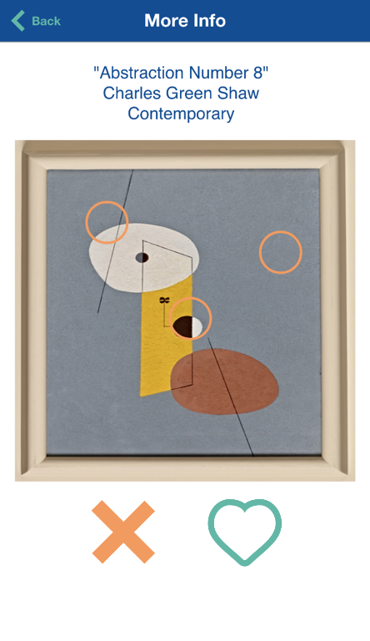
Heuristic Evaluation Results & Revisions | Severity 3
Violation
H2-7 Flexibility and efficiency of use: No option to respond to painting
Revisions
Maintain current design
Tours curated via quiz results
Detracts from task 3 (learning more about art)
Significant backend, not MVP
Notes:
Flexibility and efficiency of use
No way to respond to painting
Source of data to judge success of quiz task
Further personalize tour
Revisions? Deciding to maintain current design
To us, more of a feature request
Tours are specifically curated via quiz results...we’ve made our decision on how to generate and evaluate preferences
Might detract from task 3 (getting more information on piece of art), cross-polenation with task 1 (discover preferences)
Actually decreases efficiency of use
Great idea, but would require significantly more back-end work...not part of a MVP

Slide 7
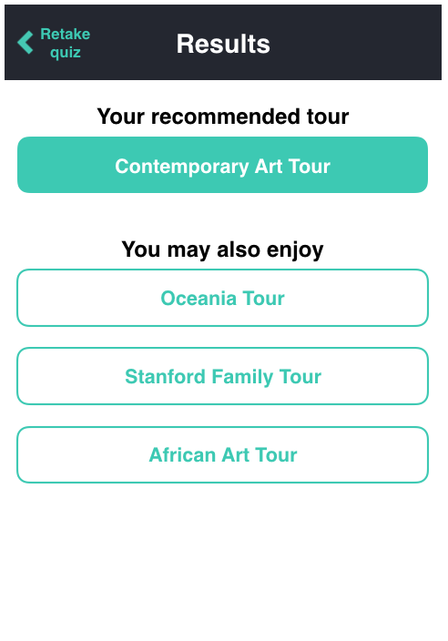
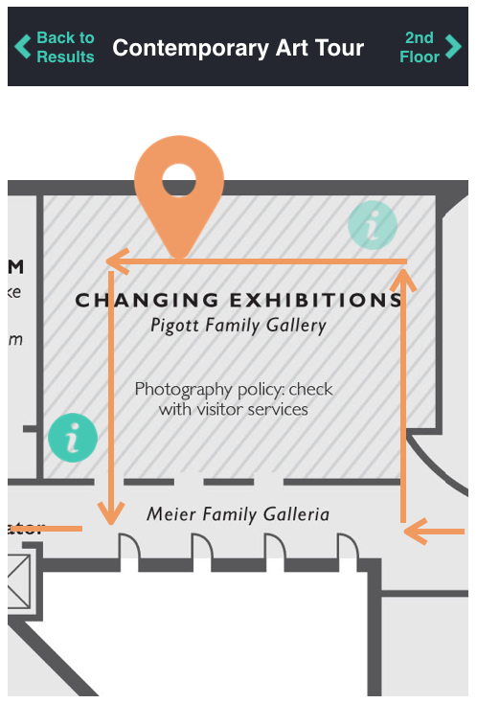
Heuristic Evaluation Revisions | Severity 1 & 2
Notes:
H2-4: on results page, tour title is a button
Changes to map:
H2-2: After visiting painting, “i” icon gets lighter...user knows how much of tour is remaining
H2-4: You are here icon = orange...consistent w/ color scheme + more closely match known apps/conventions
H2-4: 2nd floor button top right, 1st floor button top left, back to results top left of 1st floor map
H2-5: default zoom is closer so that info bubbles are more precise
H2-8: color scheme change...dark dark gray instead of navy = fewer hues

Slide 8
Current Prototype Implementation Status
Tools
Native iOS app using XCode and Swift
Implementation Features
Task 1 - Preferences quiz with swiping interface (medium)

Slide 9
Unimplemented Features & Plan
To be implemented:
Task 1
Finalize progress bar/mechanism
Task 2 and 3
Allow users to select a tour
Animate tour through museum
Highlight points of interest in museum tour
Display art with additional information

Slide 10
Unimplemented Features & Plan
Plan to finish
16 | 17 | 18 | 19 | 20 All night code-a-thon
30 | 1 Finish Task 2 | 2 | 3 Finish Task 3 | 4 Poster session

Slide 11
Hard-coded Data
1st Task - The Quiz
Fixed Database of Pictures
No Machine Learning
2nd Task - The Tours
Limited Tour Options
3rd Task - Additional Information
Small Database of Facts
Notes:
Instead of using the results of the quiz and machine learning to figure out the perfect quiz for the user, we will look at a few indicator pictures to choose the recommended tours for the user
Instead of building out every single tour we will probably just build a couple of them out entirely and then link the other tours to go to the ones we have built out

Slide 12
Wizard of Oz Techniques
2nd Task - The Map
No GPS tracking of user location
Animated map to simulate the user progress through the tour

Slide 13
Issues & Questions
Main issue - time!
No iOS development experience - learn as we go!
No design experience

Slide 14
Demonstration of Prototype

Slide 15
Summary

