Slide 1
CanTour
Week 5: Lo-fi Prototyping

Slide 2
Overview
Value Proposition
Selected Interface & Rationale
Lo-fi Prototype Structure
Experimental Method
Results
UI Changes

Slide 3
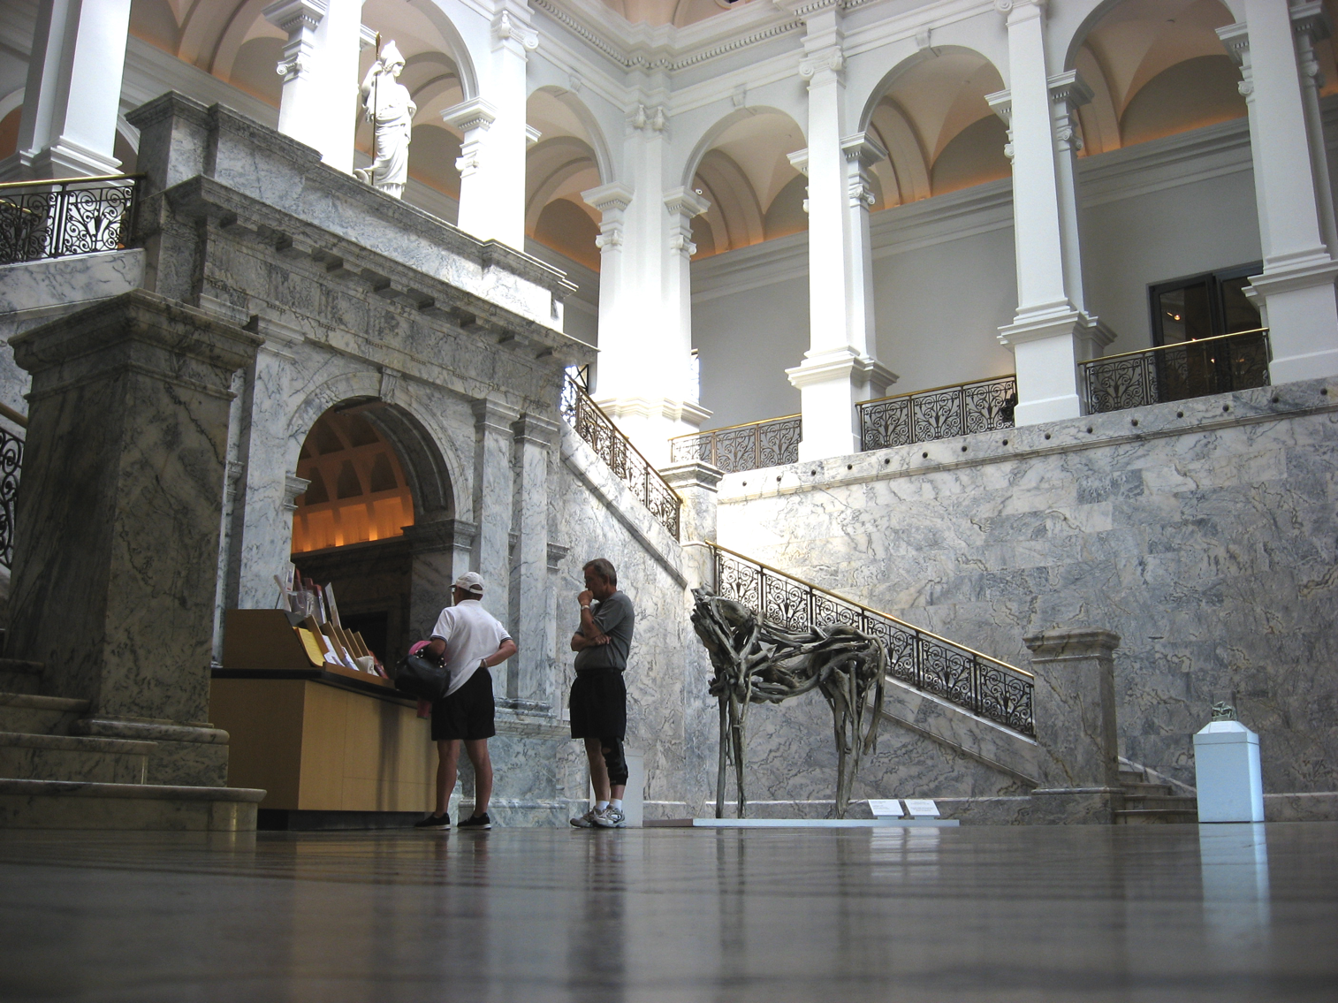
Value Proposition
Personalize your Cantor experience.
Notes:
Image from San Joaquin Magazine.

Slide 4
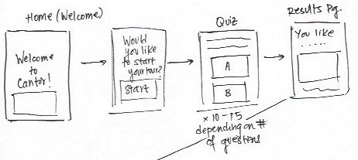
Selected Interface & Rationale
Rationale:
Demographics
Interface
Device Capabilities
Native Mobile App UI Flow

Slide 5
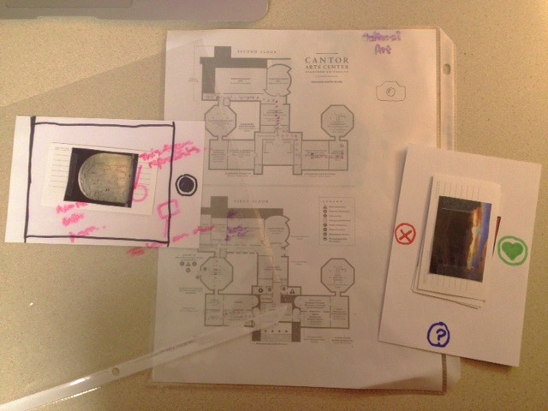
Lo-fi Prototype Structure

Slide 6
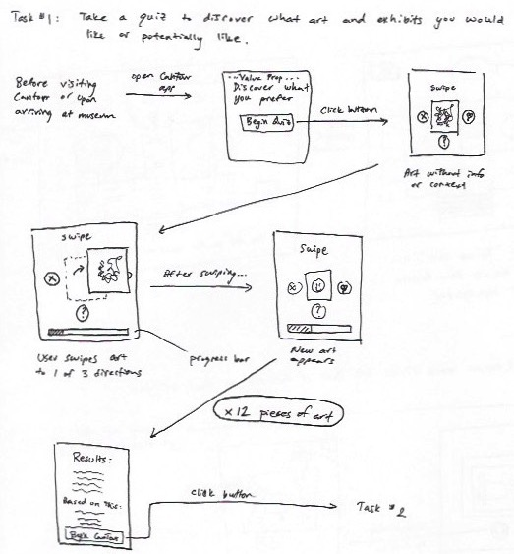
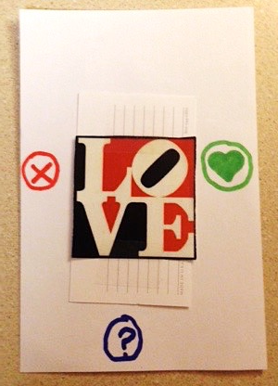
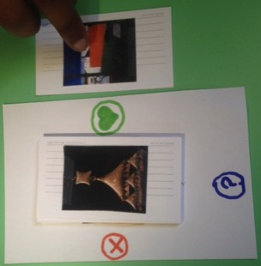
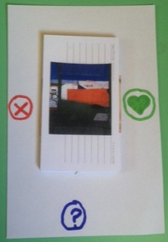
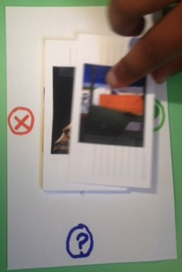
Task 1: Art Preferences Quiz

Slide 7
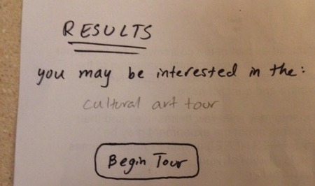
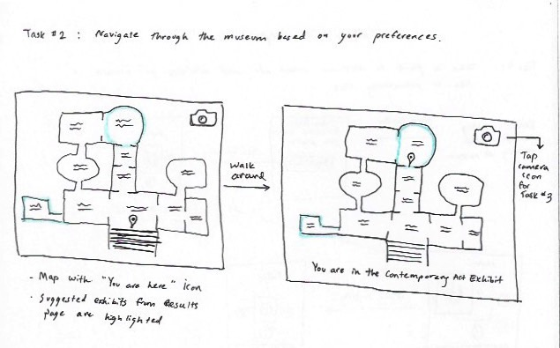
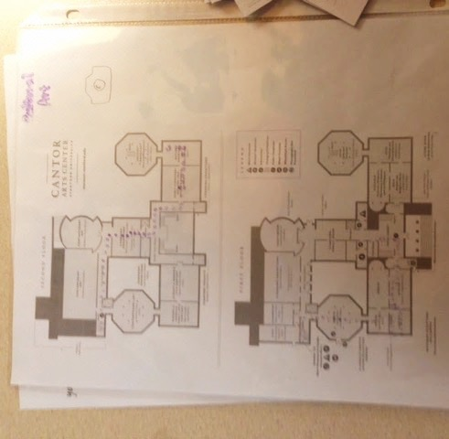
Task 2: Museum Navigation

Slide 8
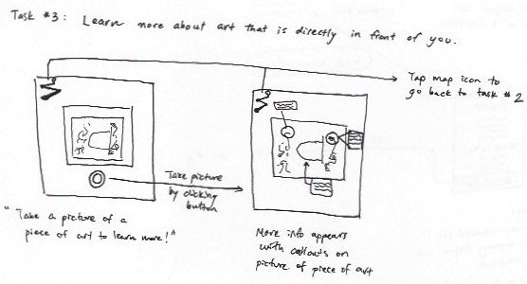
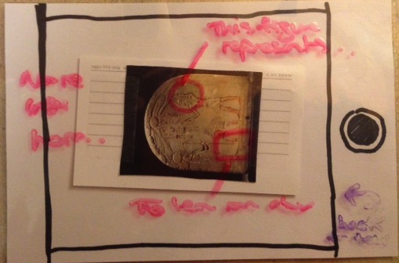
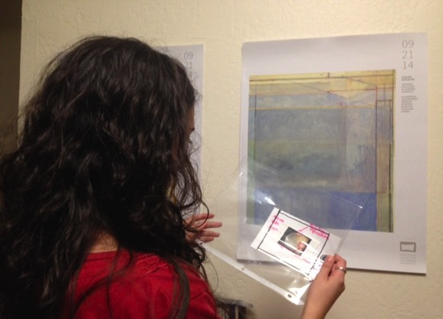
Task 3: Seek Further Information

Slide 9
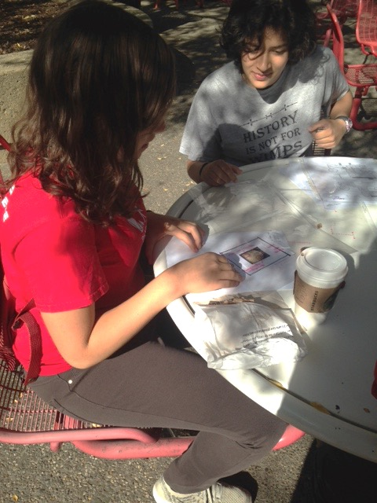
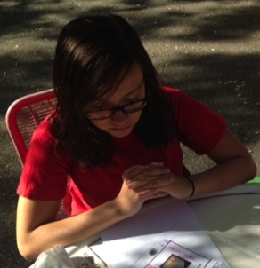
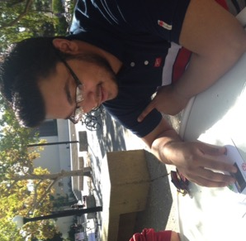
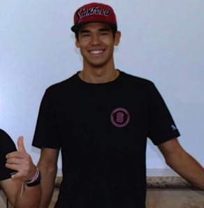
Experimental Method
Participants

Slide 10
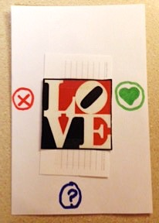
Experimental Results
Task 1
Participants initially mistook icons for buttons (3/4)
Many enjoyed “mindless” swiping (4/4)
Most were confused by the ? icon (help button?)(3/4)

Slide 11
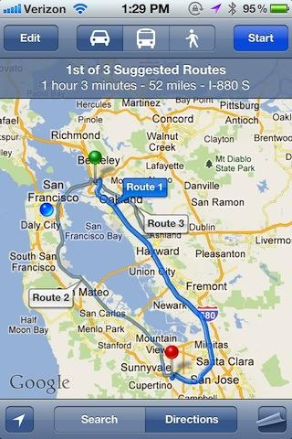
Experimental Results
Task 2
Results page was clean; next step was clicking “Begin Tour” (3/4)
Entire Cantor map overwhelming – too much information (3/4)
Desired location tracking (4/4)
Some expressed desire for multiple tour options (2/4)

Slide 12
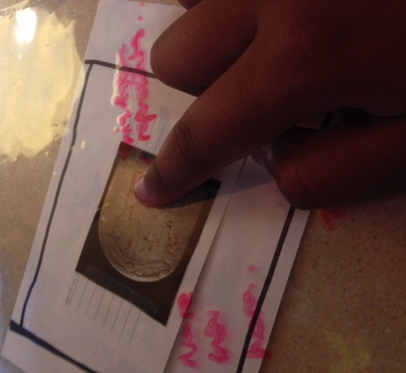
Experimental Results
Task 3
Was not obvious when user was at a point of interest (3/4)
Several people tried to tap parts of art to learn more (2/4)
“Back to Tour” button was clear to all participants (4/4)
No “Exit Tour” button! (4/4)

Slide 13
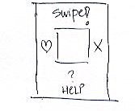
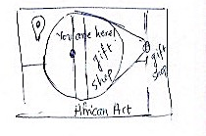
Suggested UI Changes
Task 1
Task 2
Suggest swiping more clearly – instructions, blinking icon
Clicking should have equivalent function
Clarify ? Icon
Multiple options for tour
Smaller floor plan presented – whole map was overwhelming
Tracking feature should be emphasized

Slide 14
Suggested UI Changes
Task 3
Make clearer which pieces of art a user may want to learn more about
Do users have to take a picture of the art in question?
Instead of displaying all info at once, allow art to be clickable and let users identify areas of interest
Way to end current tour

Slide 15
Summary
We need a landing “splash” page, exit page
Swiping interface non-intuitive
Map “chunks” need to be manageable
Should users have to take pictures?
Many possible tours?
Can’T wait to build CanTour!

