Slide 1
Slaptitude
by Focus Pocus
Ashley Mills, Jocelyn Hickcox, and Daniel Melendez

Slide 2
Value Proposition
To empower people to improve their focus, and to make focusing fun!

Slide 3
Introduction to Problem & Solution
We are unable to condition ourselves to stay focused in a world that is constantly competing for our attention.

Slide 4
Introduction to Problem & Solution
Slaptitude seeks to train our ability to block out distractions and focus on what’s meaningful.

Slide 5
Overview
Heuristic Evaluation
Revised Design
Prototype Implementation Status
Demo
Summary

Slide 6
4. Heuristic Evaluation Results
Problem 1: When you start a focus session, you cannot go back and change parameters without quitting.
Fix 1: Add “back” button to the focus session that appears for the first few minutes.
Problem 2: Can’t extend a focus session if you’re on a roll!
Fix 2: Add a button that allows users to extend a session by five minutes.

Slide 7
4. Heuristic Evaluation Results
Problem 3: Don’t know what it means to keep the alarm going after you quit a session.
Fix 3: Eliminate this option
Problem 4: Unclear that the “ouch” button the Slap Screen is a button.
Fix 4: Standardize location of buttons on all screens to make this consistent and clear.

Slide 8
4. Heuristic Evaluation Results
Problem 5: Locations aren’t grouped in a logical manner in progress page.
Fix 5: We integrated GPS and show locations with map as well as a list ordered by proximity. GPS also fixed many low-priority issues.
Problem 6: Unclear what options in Settings mean.
Fix 6: Simplify Settings to apply only to main task, rather than to additional features.

Slide 9
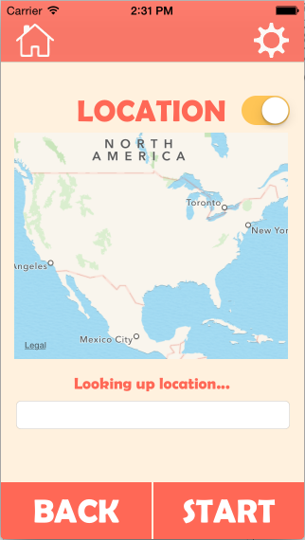
5. Overview of Revised Design
Incorporate GPS to resolve awkwardness of setting, getting, and viewing location

Slide 10
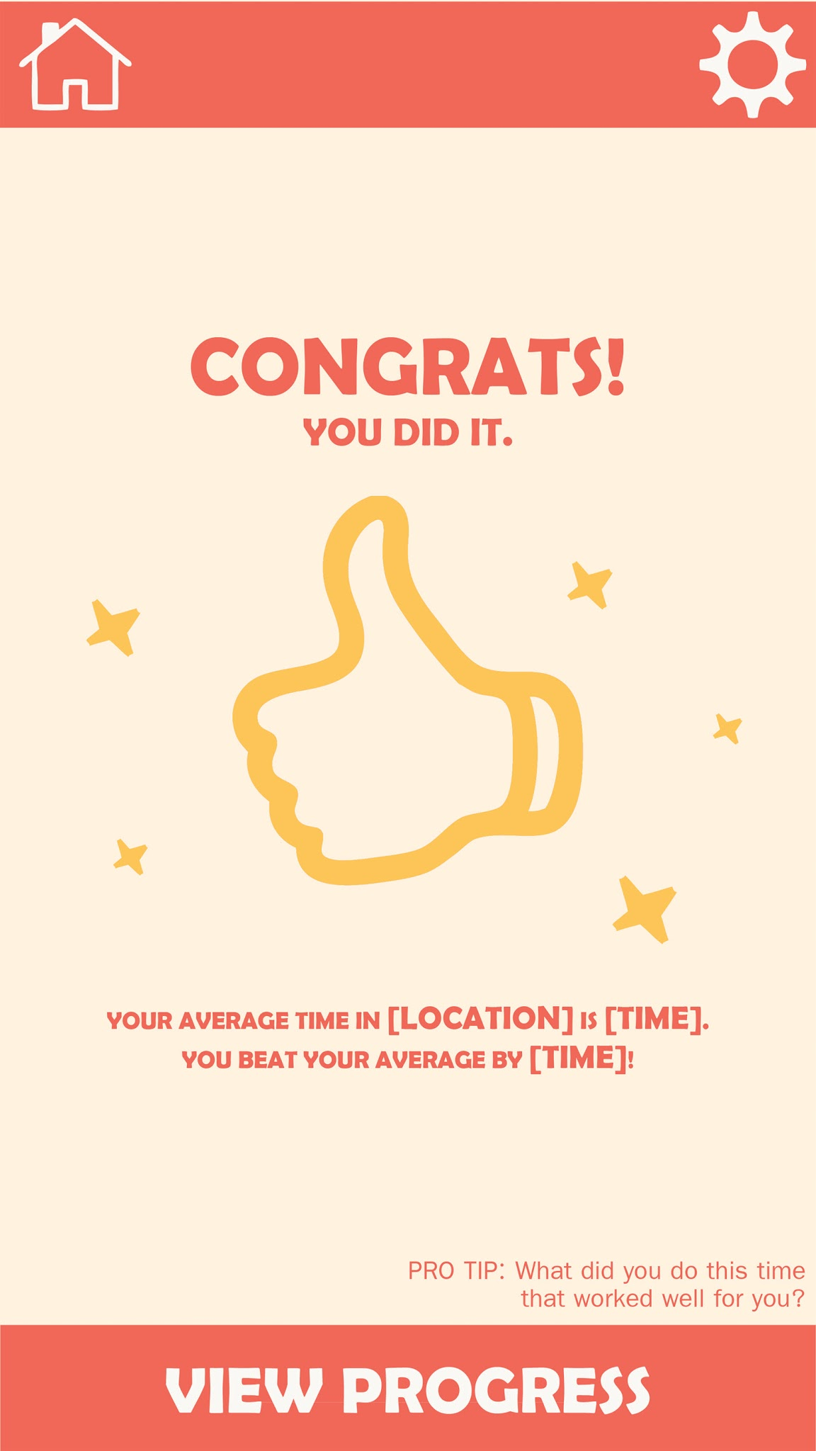
5. Overview of Revised Design
Fun and playful color scheme and design

Slide 11
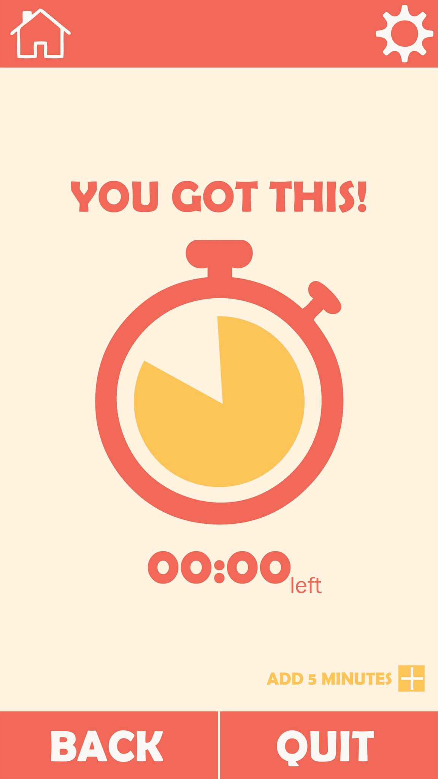
5. Overview of Revised Design
Simple design following iOS standards to reduce cognitive load

Slide 12
Prototype Implementation Status

Slide 13
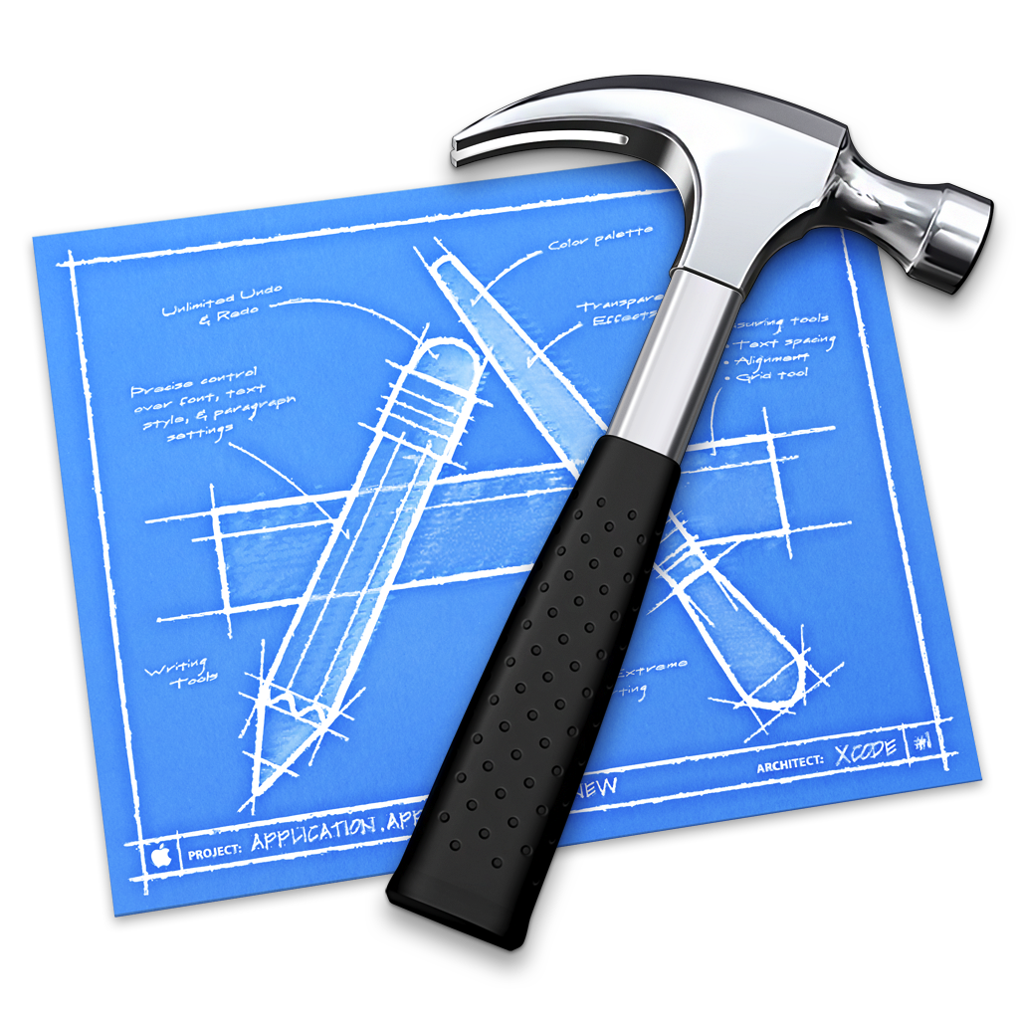
Tools Being Used
Illustrator
xCode

Slide 14
Implemented Features
TASK 1: Keep track of time remaining for staying focus
Set custom time to focus for
Recommends time based on last run
Location set by GPS (on-off feature)
Visual timer to indicate how much time left, supplemented with text
Ability to tell if user has ‘quit’ the focus session
Feedback on session

Slide 15
Unimplemented Features & Plan
Features:
Task 2: Keep track of progress over time
Task 3: Check out leaderboard
Settings
Plan:
Revisit design (heuristic evaluation)
Modify design
Implement it!

Slide 16
Wizard of Oz Techniques and Hard-coded Data
Wizard of Oz Techniques:
Hard-coded Data:
Leaderboard friends and stats?

Slide 17
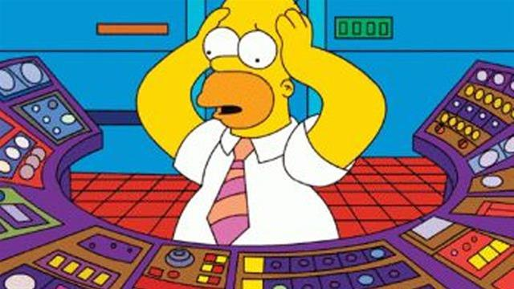
Issues/Questions
Facebook API
Location Heuristics

Slide 18
Demonstration

Slide 19
Summary

