Slide 1
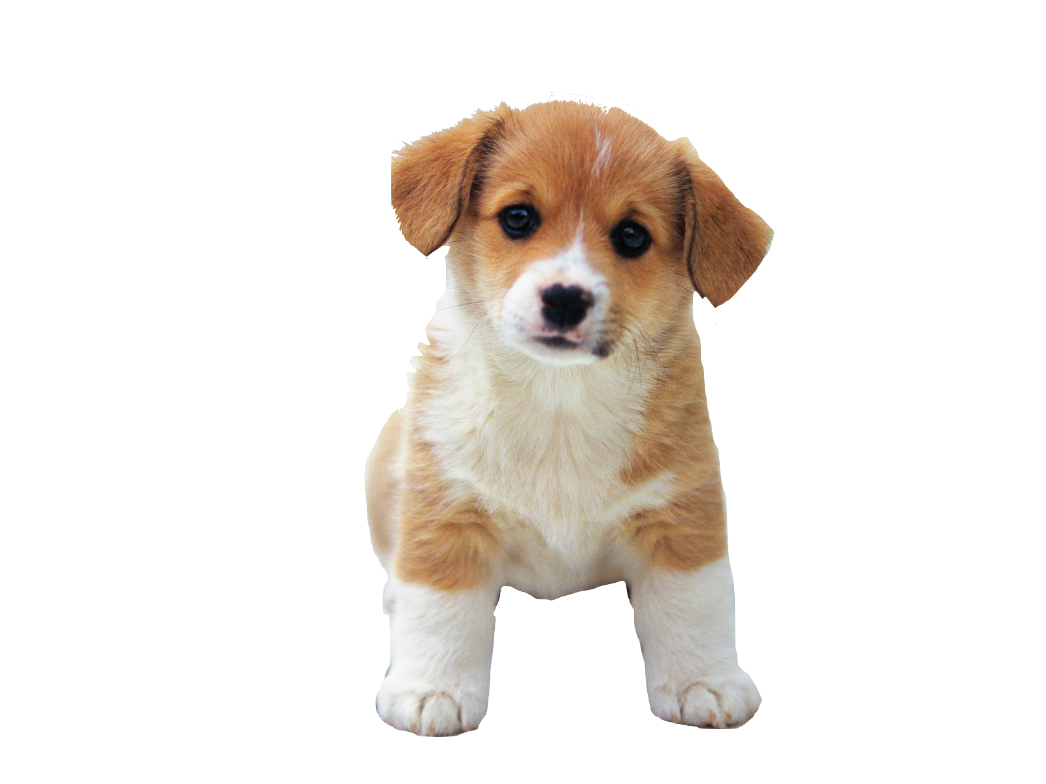
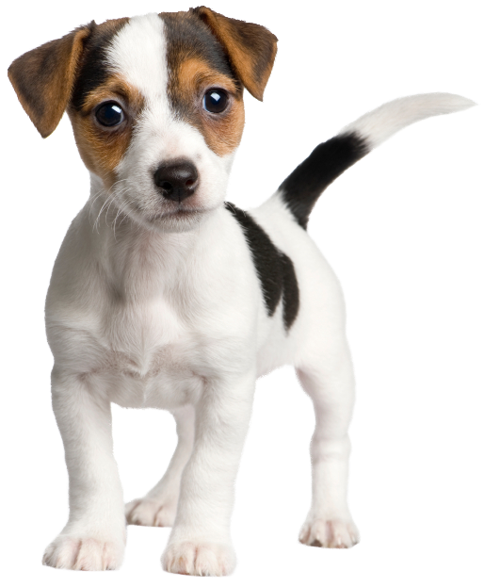
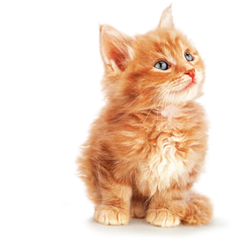
MED-FI PROTOTYPE
Ashley Mills
Jocelyn Hickcox
Daniel Melendez

Slide 2
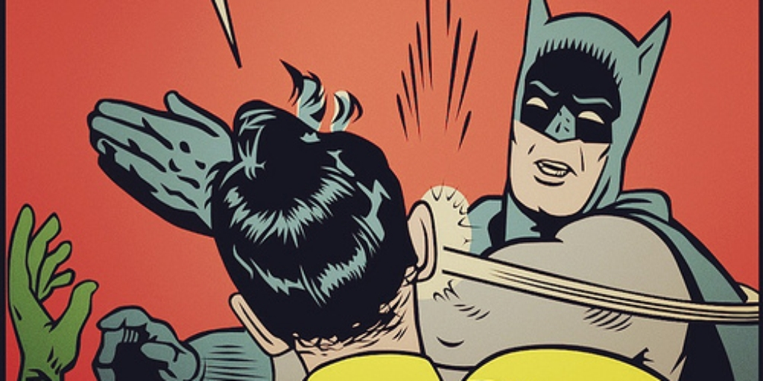
What is Slaptitude?
individual focus training

Slide 3
We are unable to condition ourselves to stay focused in a world that is constantly competing for our attention.
Slaptitude seeks to train our ability to block out distractions and focus on what’s meaningful.

Slide 4
Mission Statement
Our goal is to empower people to improve their focus by making focus training fun!

Slide 5
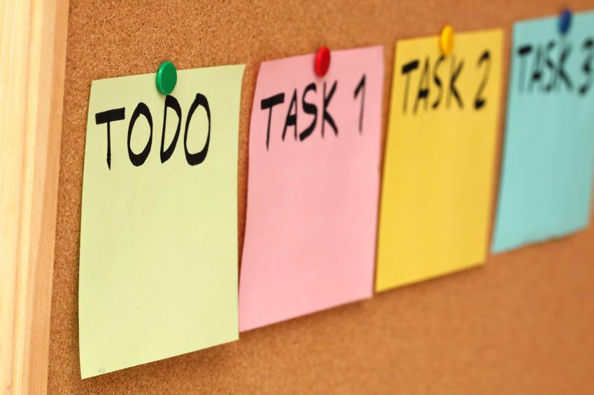
Revised Tasks

Slide 6
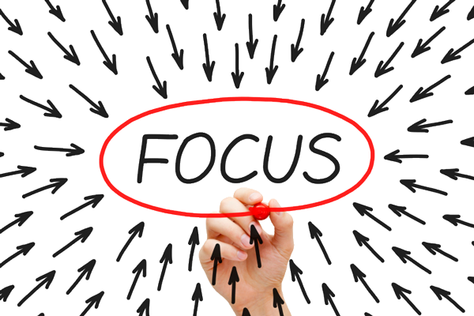
TASK 1: Keep track of time remaining for staying focus
Allows you to set custom time for focus
Suggests time based on last run
Visual timer indicates how much time left, supplemented with text

Slide 7
TASK 2: Keep track of progress over time
Presents you with stats regarding last run i.e. how long, where, time, and date
Graphs time focused over date, month, and time of day
Prompts you to add location, helps you see where you focus best

Slide 8
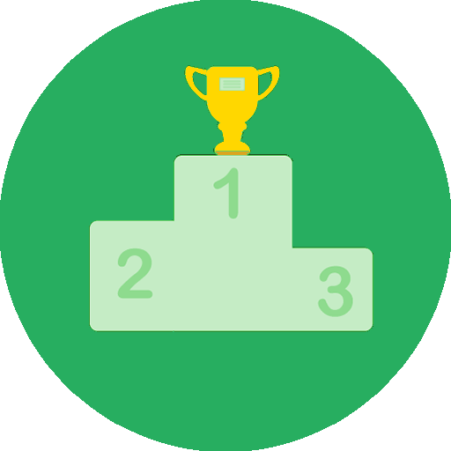
TASK 3: Check out leaderboard
See where your friends are in relation to you
Based on overall “focus time” average

Slide 9
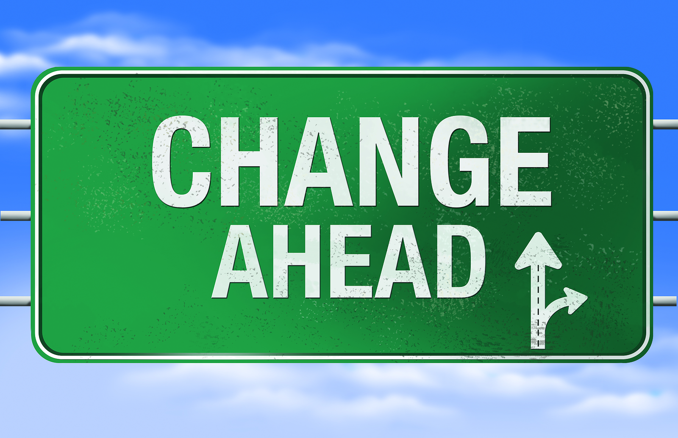
Revised Interface Design
Major Design Changes

Slide 10
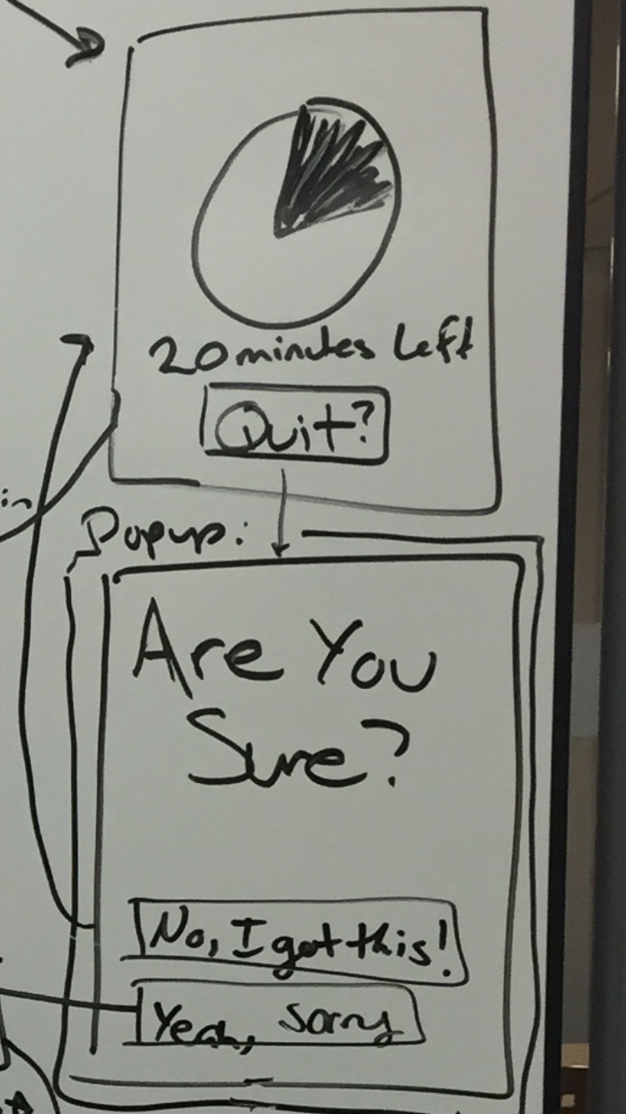
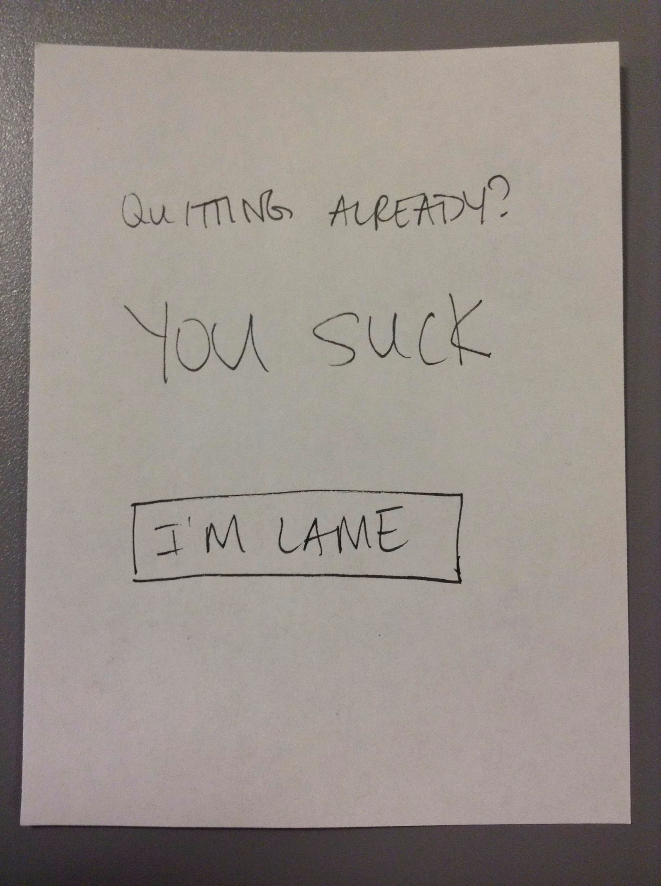
Made our language more positive and encouraging
Before
After

Slide 11
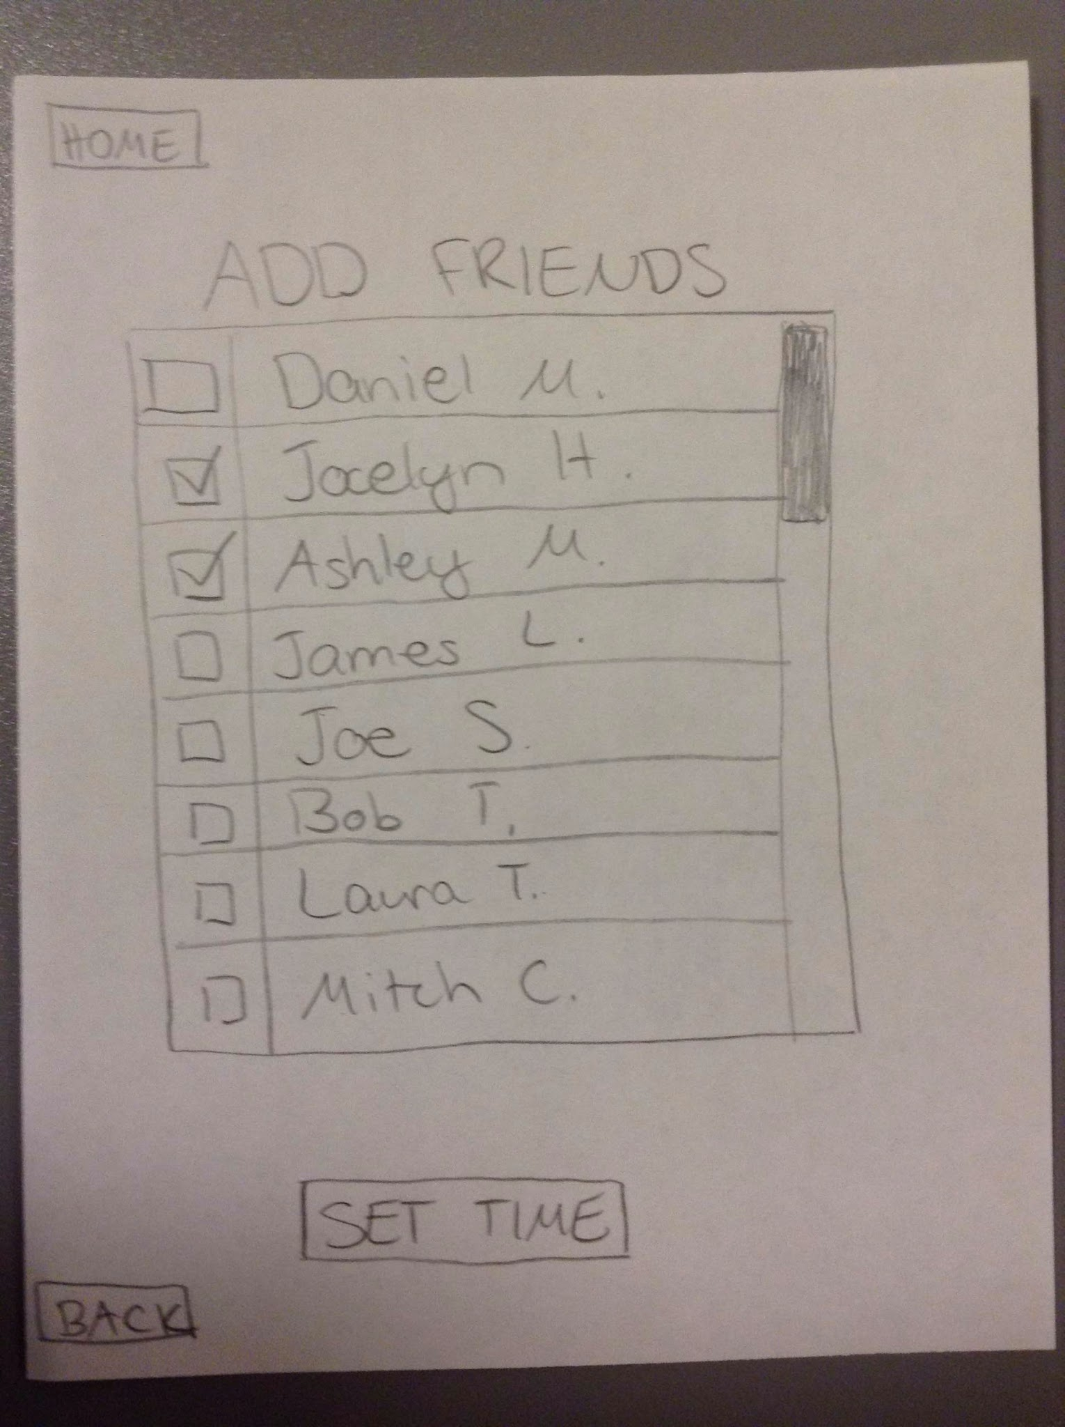
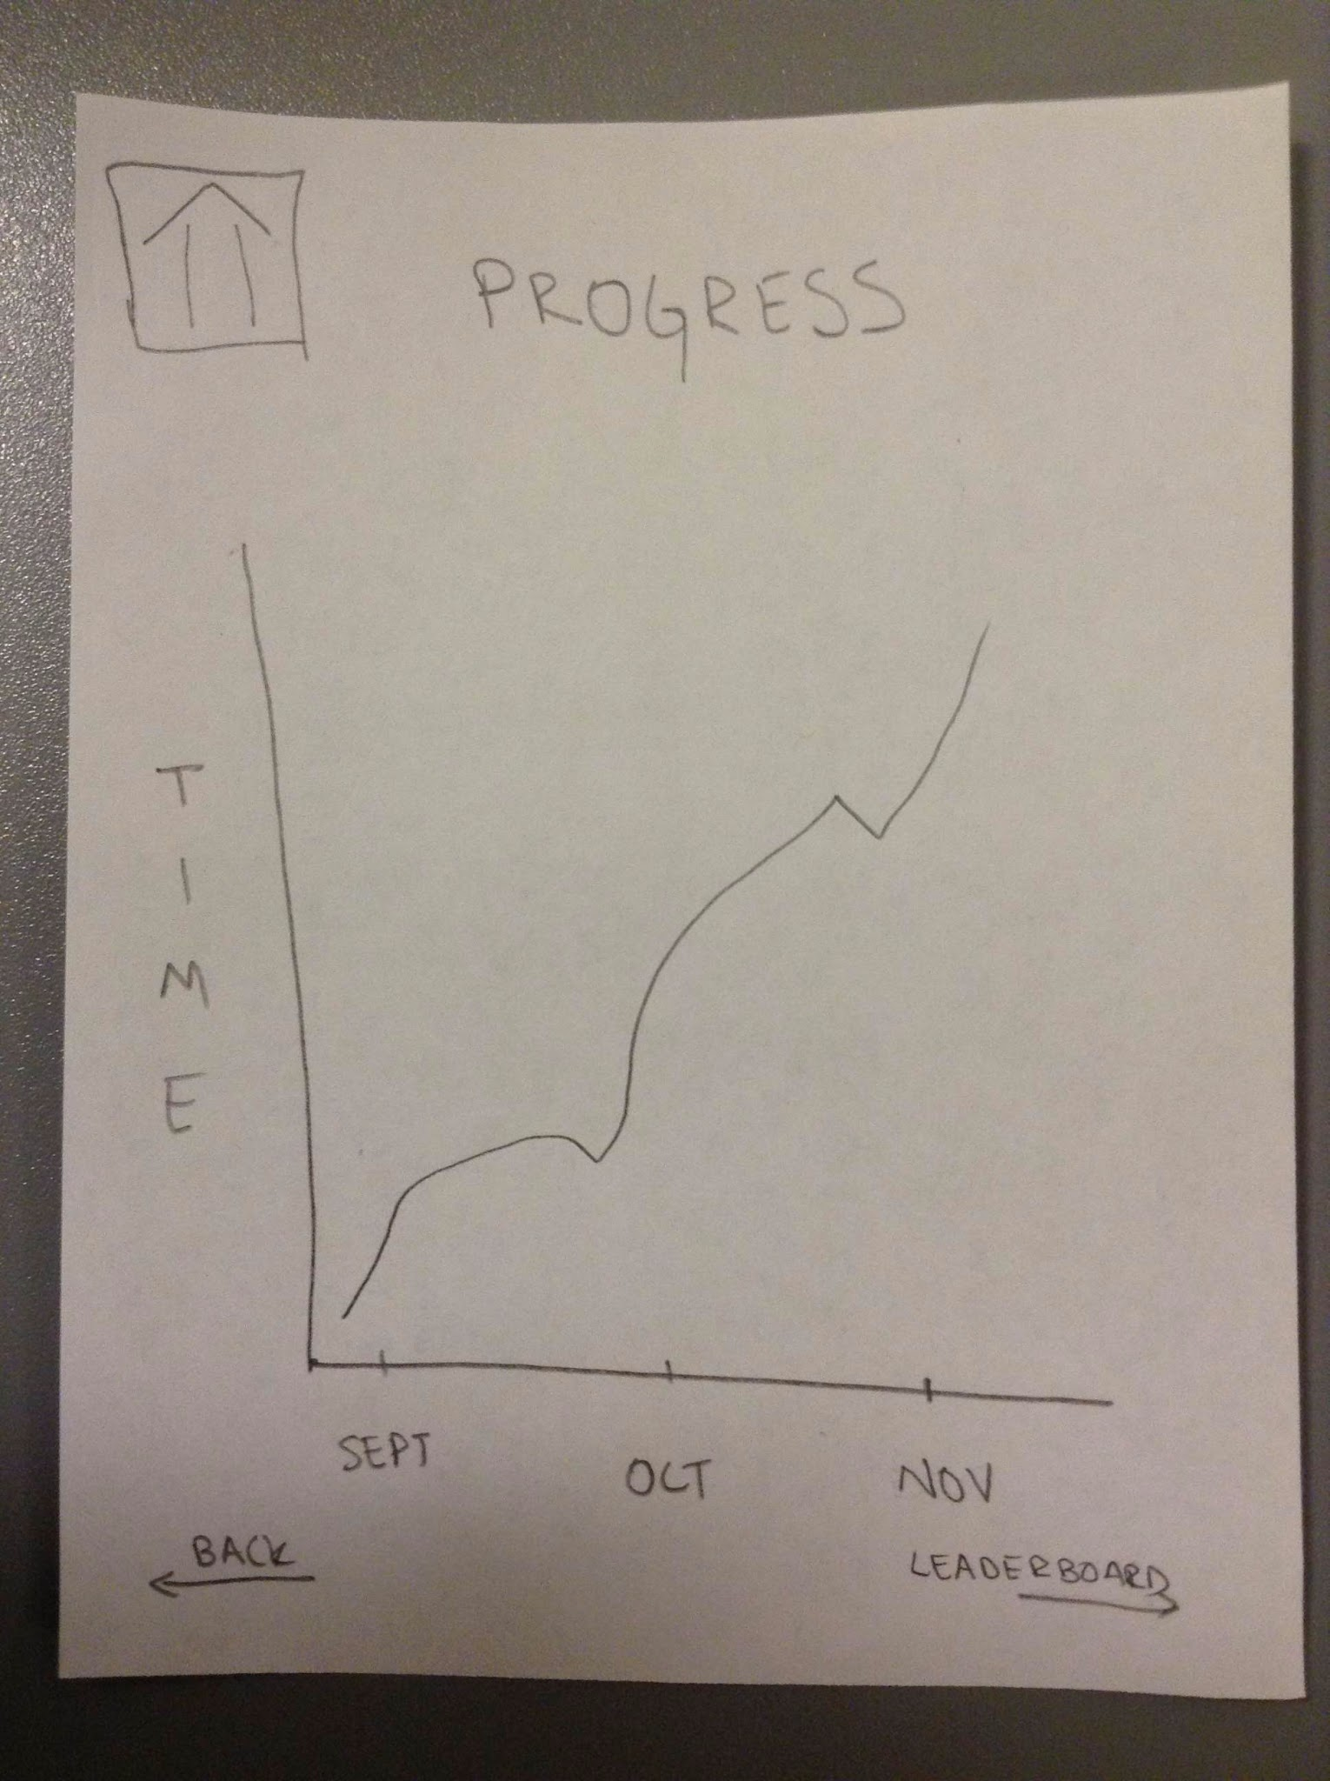
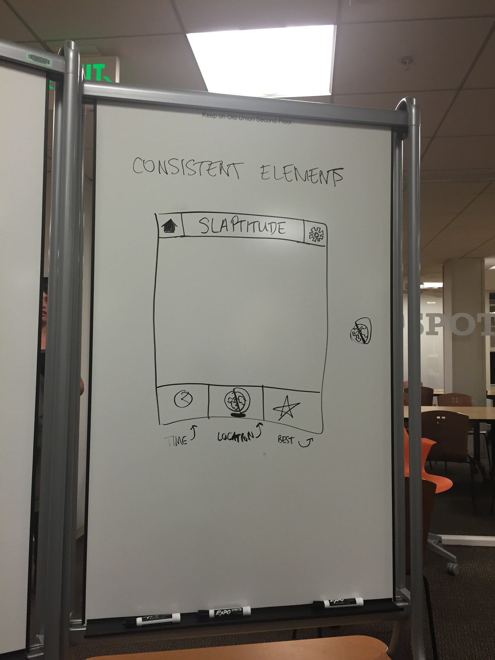
Standardized ‘Top-Bar’
Before
After

Slide 12
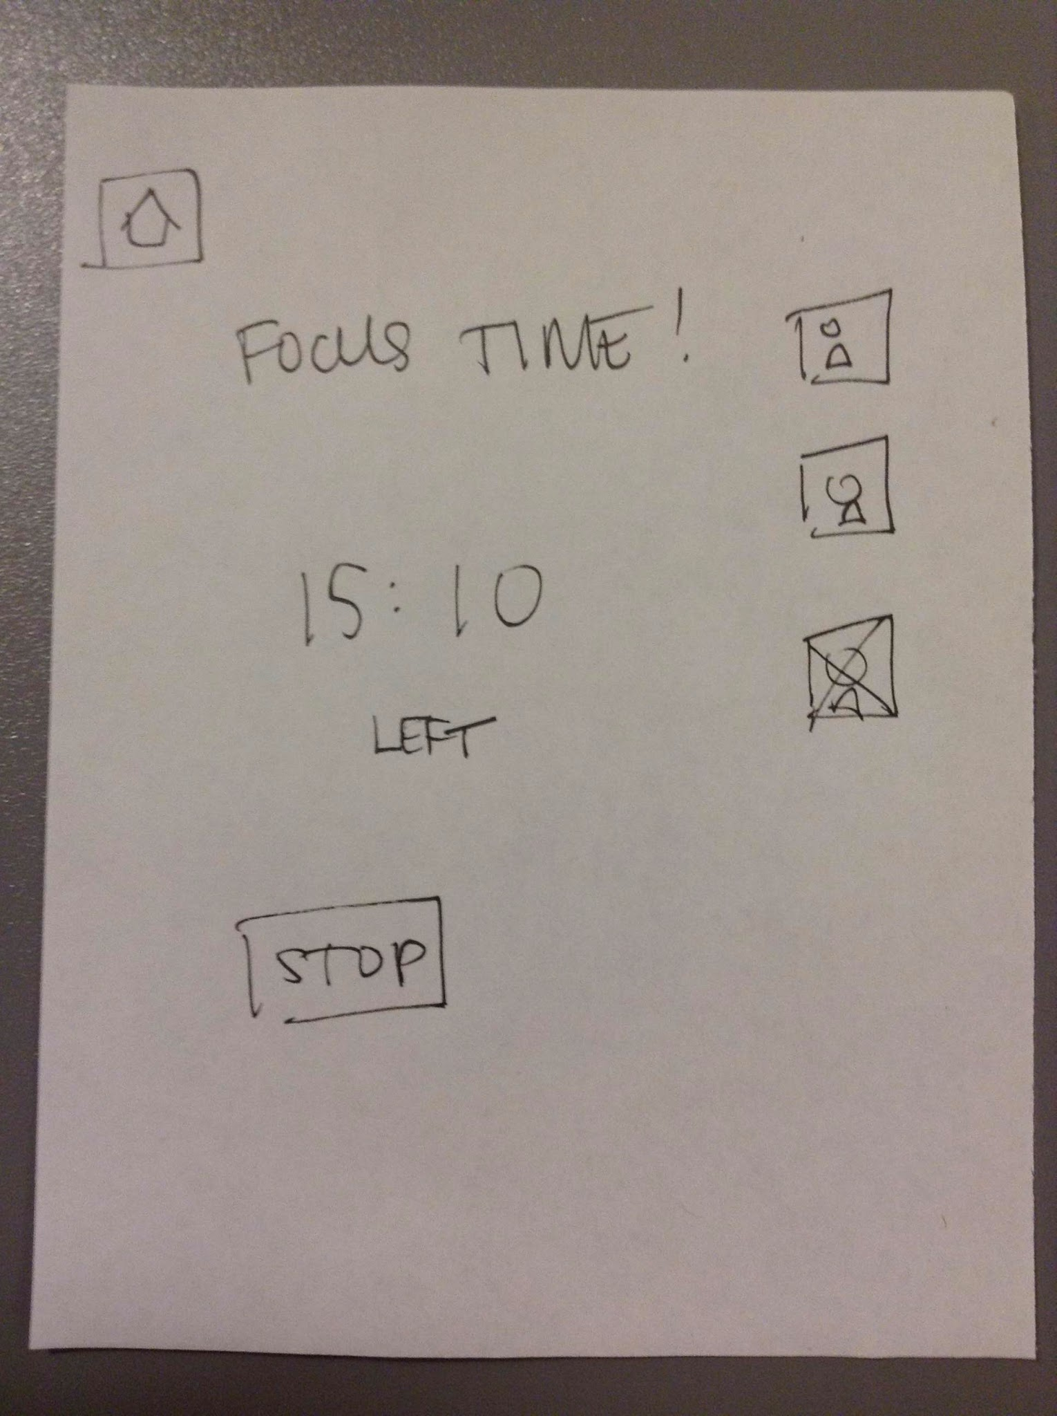
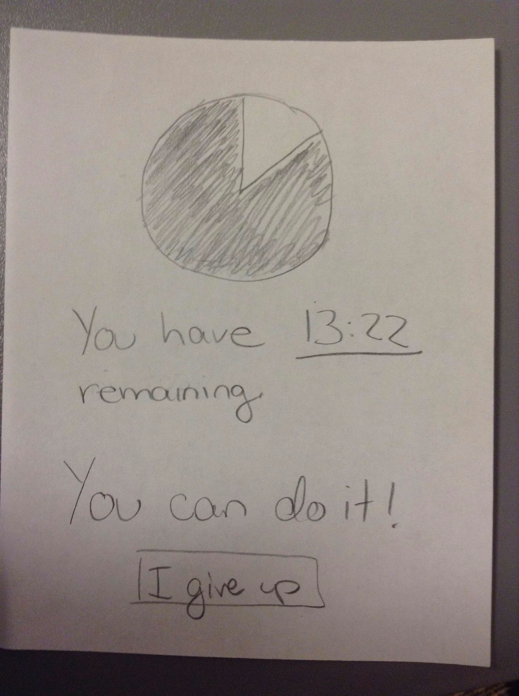
Uniform Timer
Before
After

Slide 13
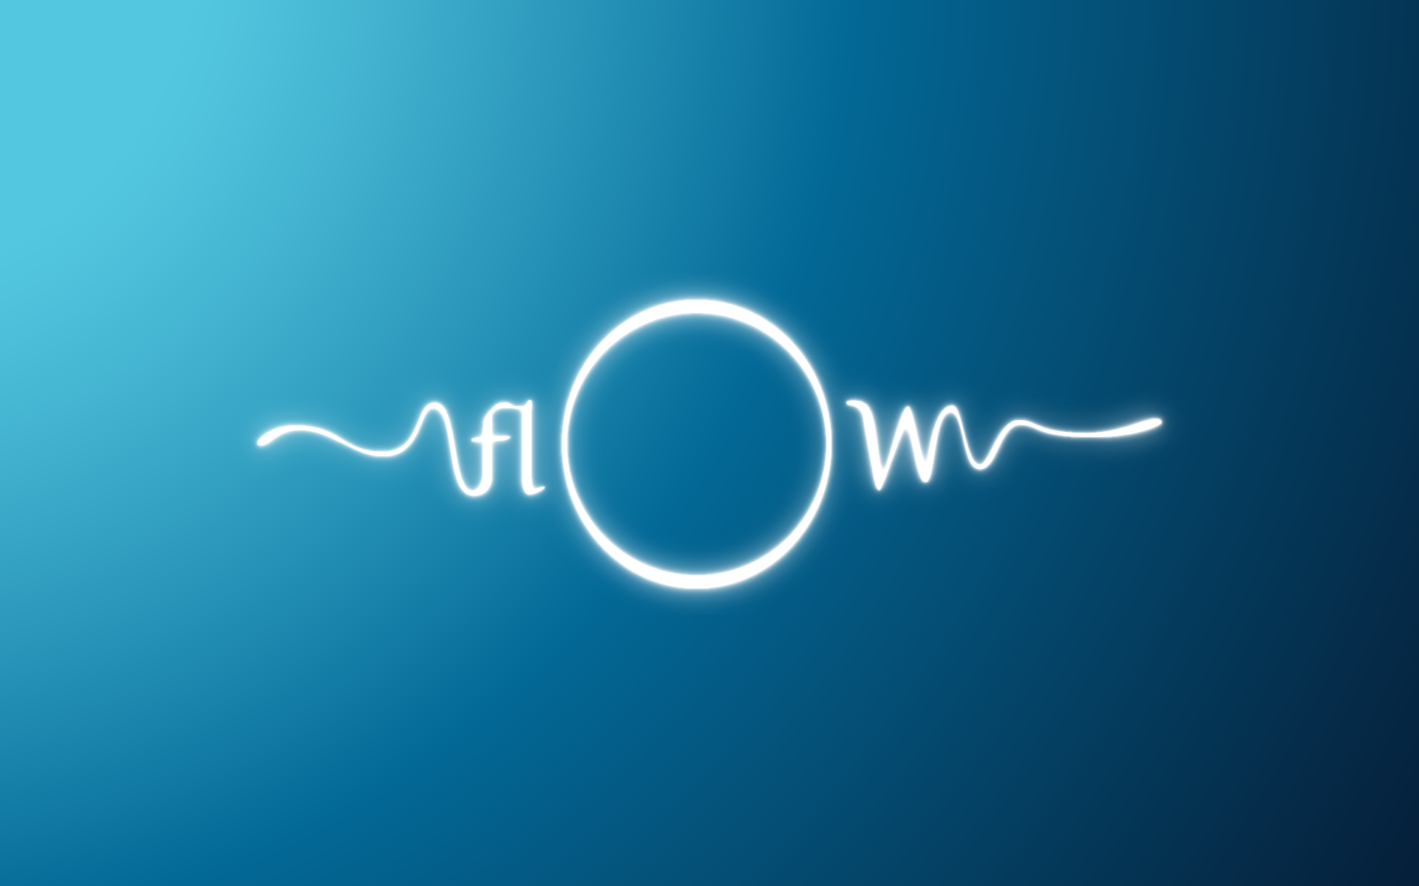
Task Flows

Slide 14
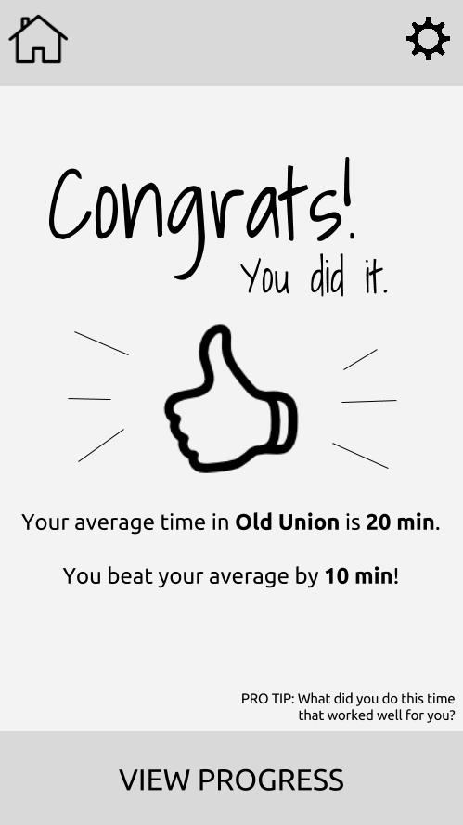
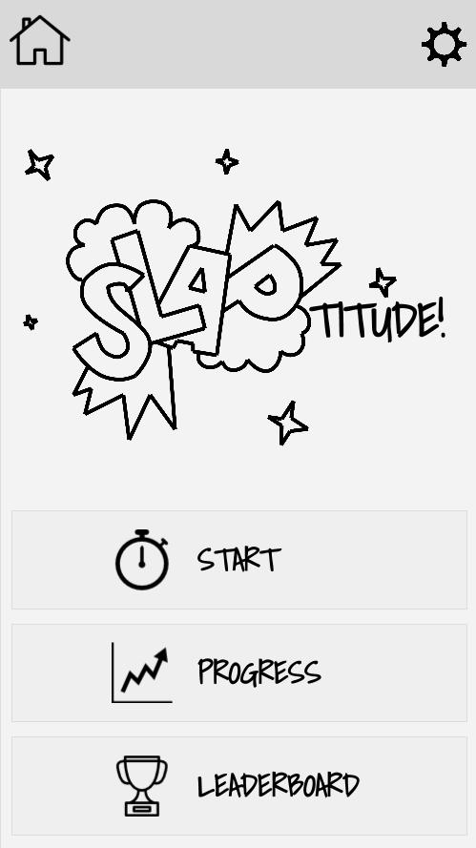
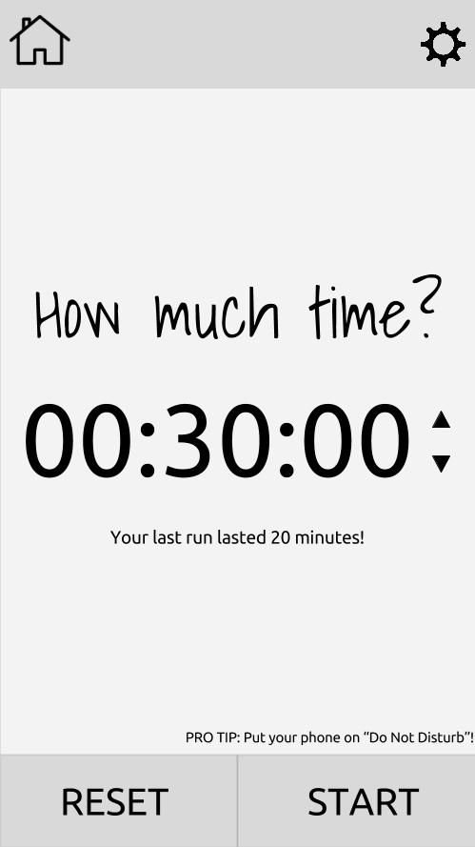
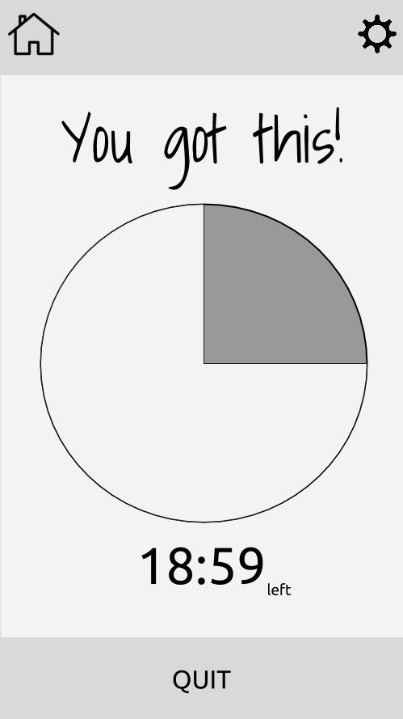
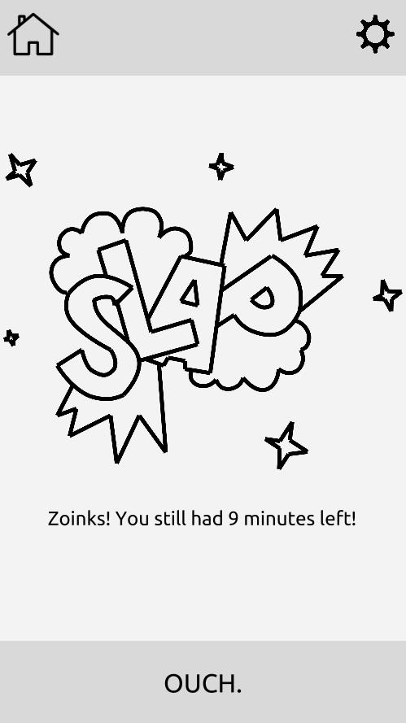
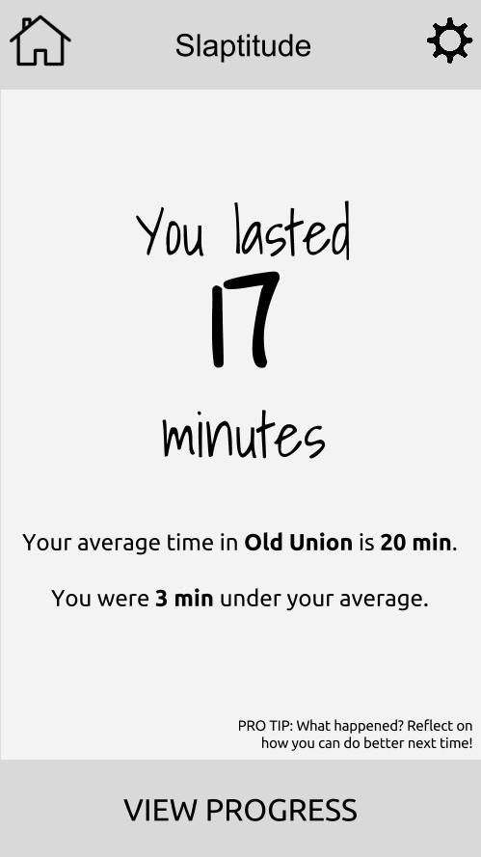
Task 1 Flow: Staying focused yo!

Slide 15
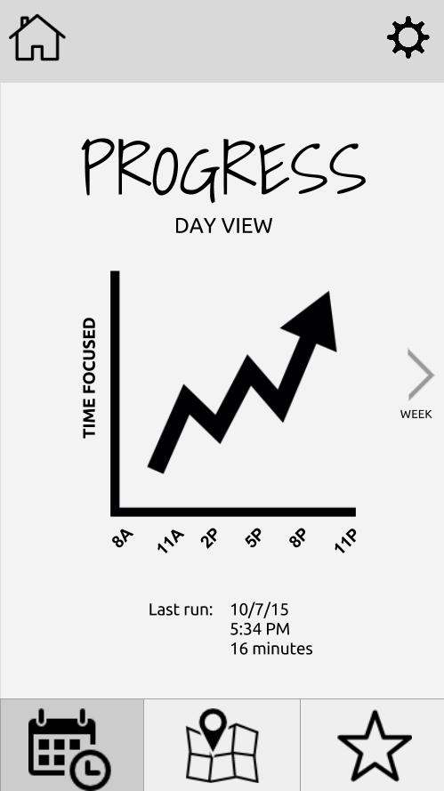
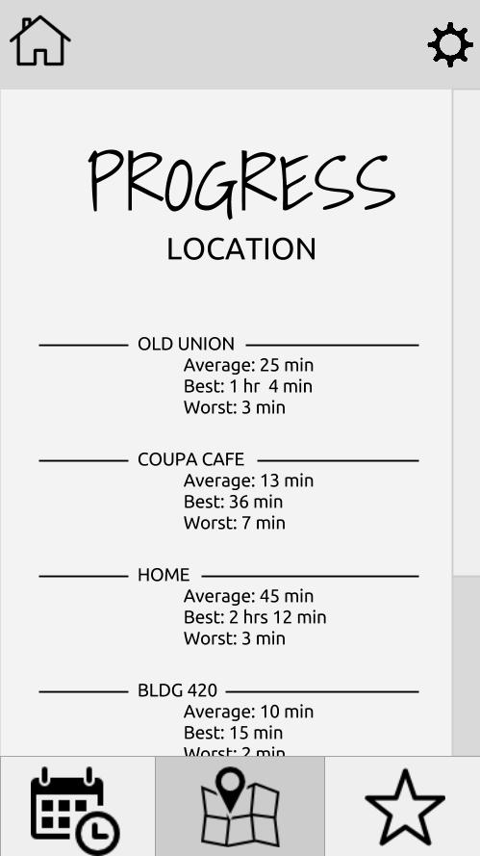
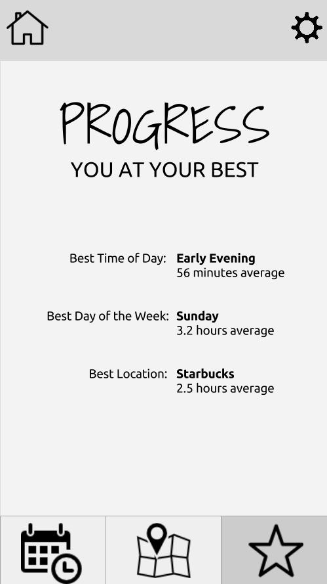
Task 2 Flow: How you doin’?

Slide 16
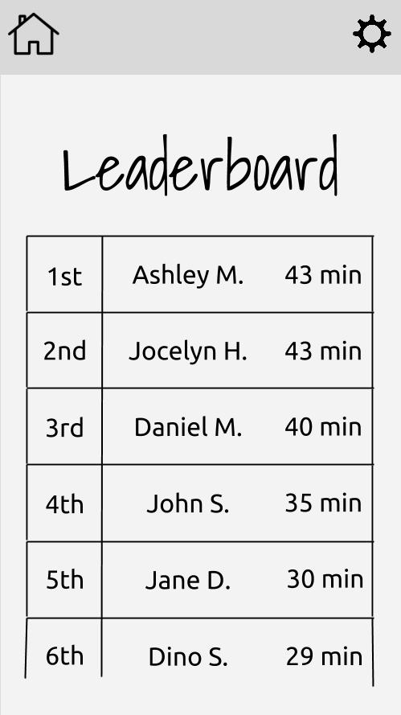
Task 3 Flow: How yo friends doin’?

Slide 17
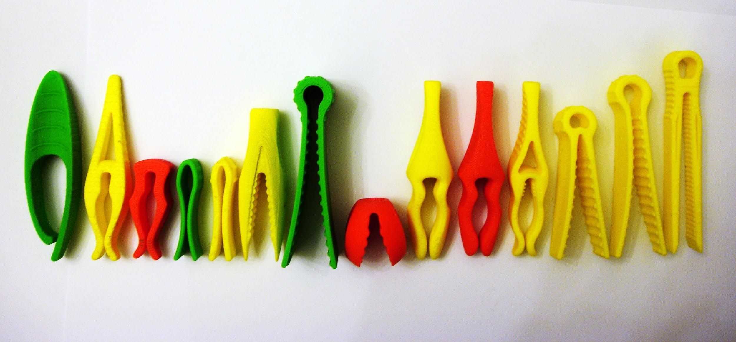
Prototype Overview
Tools, Limitations and Techniques

Slide 18
Prototype Tools: Google Drawings and Marvel
Google Drawings
Pro: Very low learning curve -- good for us!
Con: Doesn’t look as iOS-y
Marvel
Pro: Easy to add interactions between screens
Con: Couldn’t simulate timer countdown functionality

Slide 19
Prototype Limitations and Tradeoffs
Didn’t incorporate some features we were considering
Group challenges - too hard to coordinate
Taking a picture when they get “slapped” - don’t have access to the camera

Slide 20
Wizard of Oz and Hand-coded Techniques
Couldn’t simulate the timer functionality, so had to fake a progression of time. Have to click the progress circle to advance or wait a few seconds.
Leaderboard is filled with fake friends
Hand-coded the optional focus times and locations so we didn’t have to include many different screens

Slide 21
Questions?

