Slide 1
docket Assignment 6: Medium-fi Prototyping
Irene Hsu, Ke Xu, Jessica Zhang

Slide 2
docket: “Bringing ideas to life”
For people of all demographics and career paths, the bustle of everyday life leaves little time and energy for personal side projects.
docket is a public platform that tracks the progress of projects and allows users to support one another’s projects for inspiration and motivation. Through documentation and social interaction, docket aims to keep users accountable for the success of their own and of others’ projects.

Slide 3
Task 1: Follow inspiring projects (medium)
Originally
Users come to look for inspiration.
Notes:
We originally had subtasks within our tasks
For medium fidelity prototyping: simplified tasks

Slide 4
Task 2: Add a public quicknote (complex)
Originally
Users document their projects.
Notes:
For task 2: same task, but renamed

Slide 5
Task 3: Look over project page (simple)
Originally
Users motivate themselves
Notes:
Again, same concept but more specific task

Slide 6
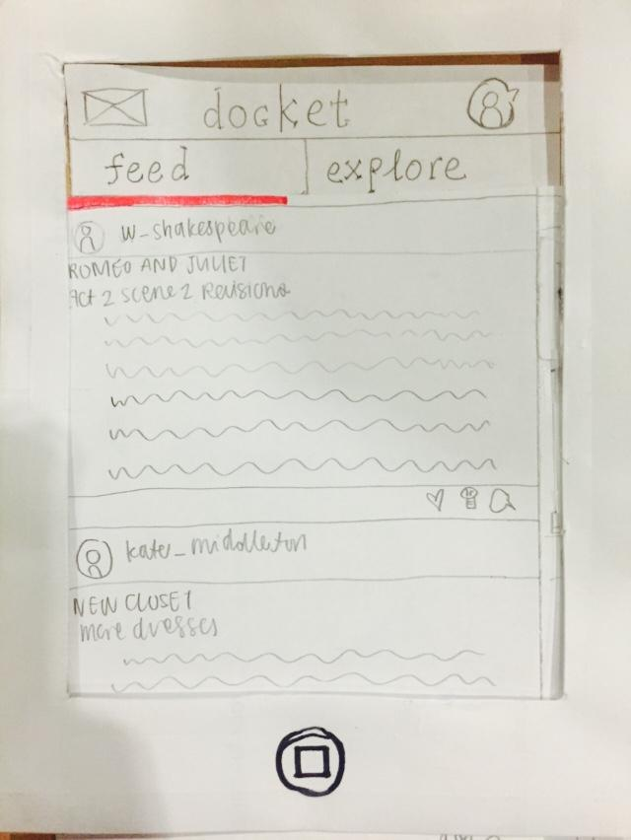
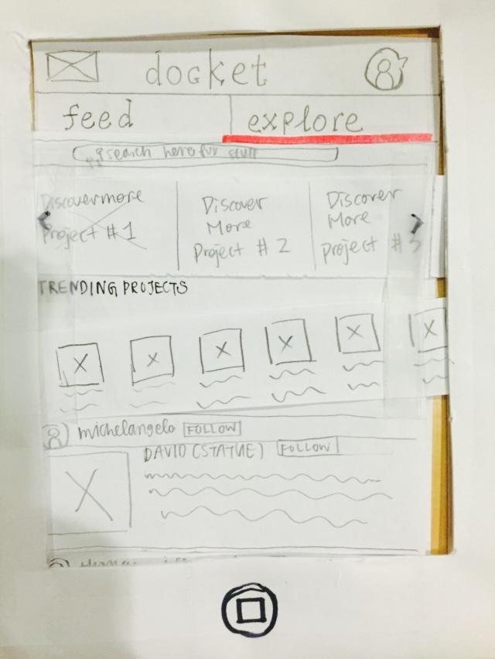
Major Design Change 1:
Simplified feed
(before)
(after)
One “explore” page with a mix of followed & suggested projects
-Smart algorithm will compile feed based on onboarding preferences
-Make the inspiration stage less confusing
Notes:
Many design changes to streamline our concept.
One: Simplify feed
Old: two tabs for inspiration: feed and explore
Within explore: several sections
Ultimately: overwhelming, potentially confusing (took into account feedback for…)
New: One “explore” page with a mix of followed & suggested projects
Rationale:
-able to do this via a Smart algorithm, which will compile feed based on preferences selected during onboarding
-Make the inspiration stage less confusing

Slide 7
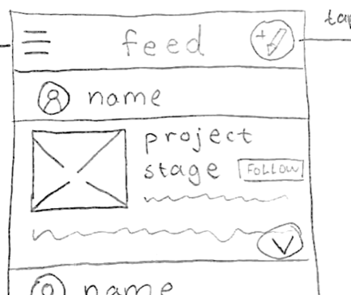
Major Design Change 2:
Simplified social interactions
(before)
(after)
One action for social interaction: FOLLOW PROJECT
-Decrease the focus on stats
-Make social interaction less confusing
Notes:
Next: Simplified designs of our social interactions
Old: Like, inspired by, comment button → eventually tracked into a stats page (could be accessed for motivation)
could also follow user, follow project
(again, feedback about how this could be complicated, too nuanced)
New: ONE MODE OF INTERACTION: Follow project (shows up as one number on project page)
Rationale:
-decrease the focus on stats
some users said stats could become too external or unhealthy of motivation
-make social interaction more straightforward

Slide 8
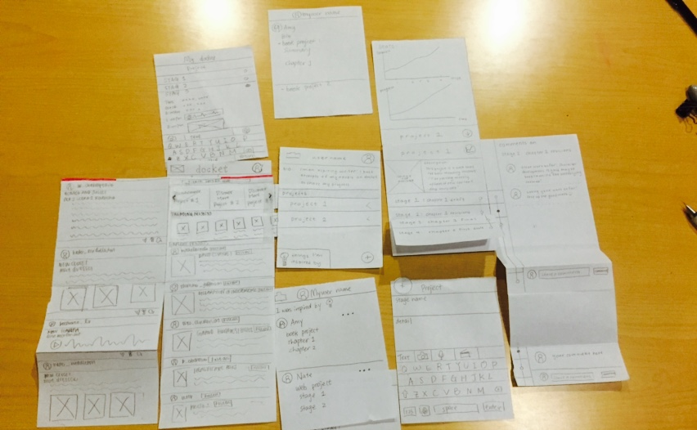
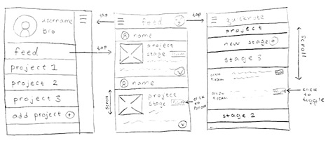
Major Design Change 3:
Simplified navigation
(before)
(after)
Sidebar
-reduces amount of swiping
-makes all pages more accessible
Notes:
Finally: Simplified navigation between pages
Old: Lots of swiping in all directions to navigate; center screen here is the user’s profile page
(again, feedback about how this could be complicated, non-intuitive for vertical swiping
New: sidebar that shows navigation options (simplifies navigation w/o sacrificing screen space)
Rationale:
-reduces amount of swiping to get from page to page
-makes all pages more accessible via sidebar icon on top left

Slide 9
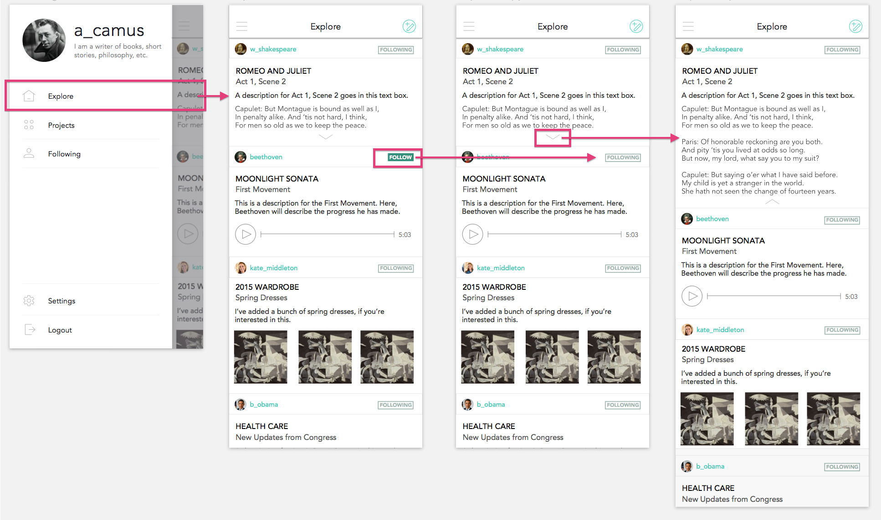
Task Flow 1:
Follow inspiring projects
explore page
(expanded)
explore page
(with follow)
navigation bar
explore page
Notes:
Follow inspiring projects: start from navigation bar and to access explore page
Scroll through explore page
Smart algorithm theoretically chooses suggested projects, distributes throughout feed with projects the user is following
Can follow these, or unfollow by clicking
Can expand projects on feed
Return via sidebar button on top left

Slide 10
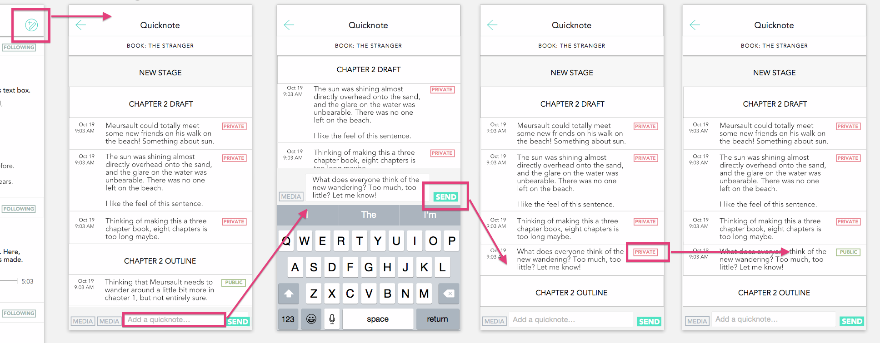
Task Flow 2:
Add public quicknote
private (default)
note added
icon
quicknote page
compose
note made public
Notes:
any screen: quicknote icon
scroll through quicknote page
compose a quicknote
posted as a private post by default (won’t show up on project page
can set to public/private by clicking
once public, will show up on others’ feeds & on project page
return button to go back to previous page

Slide 11
Task Flow 3:
Look over project page
project page
(expanded ch3)
project page
(expanded ch2)
navigation bar
project page
Notes:
navigate to project page from navigation bar
can expand stages by clicking and scroll through them to see public quicknotes and media
collapse stages by clicking again on stage header
return to navigation via sidebar icon

Slide 12
Prototype: Tools
Sketch
-lay out pages
-templates and icons
-finnicky ordering and layer group collapsing
-no page transition
InVision
-order task flow
-clarify user gestures
-buggy upload
-screens disappear

Slide 13
Prototype: Limitations/Tradeoffs
-some gestures simplified (InVision limitations)
-animations simplified/left out (InVision limitations)
-users’ profile pages left out (simplify taskflow)
-single project (simplify taskflow)
-adding media functionality left out (simplify taskflow)
Notes:
-InVision limitations: some gestures & animations simplified
want users navigate with either swipe or click, couldn’t show in invision
pages should have parallax scrolling with stackable headers (useful for project stages, users on the feed, anything with larger amount of content within sections headers)
toggling between buttons (following/follow; public/private) made smoother for better experience
-simplify taskflow: left out some pages because weren’t crucial (including users’ profile pages, add media feature on quicknotes page, etc.
-single project page for our user for ease of prototype use

Slide 14
Prototype: Wizard-of-Oz and Hard-code
Wizard-of-Oz
-none
Hard-Coded Features
-mock users
-mock projects
-mock project stages
-mock descriptions
Notes:
No Wizard-of-Oz techniques
Hardcoded features to simulate full user experience
created mock users, projects, project stages, descriptions, etc.

Slide 15
Prototype: Link
https://invis.io/3H4QV7S4N

