Slide 1
docket Assignment 4: Concept Video
Irene Hsu, Ke Xu, Jessica Zhang
Focus: Productivity in transitioning stages of education

Slide 2
Value Proposition: “Ideas coming to life”
Problem:
The bustle of everyday life leaves little time and energy for personal side projects.
Solution:
docket is a public platform that helps document the progress of projects. By updating a project docket, looking through others’ projects and interacting with users, anyone can keep track of his/her progress and stay motivated.

Slide 3
Tasks
Users come to look for inspiration. (simple)
(e.g., browsing through other projects)
Users come to look for/give motivation. (moderate) (e.g., interacting with community through comments)
Users come to document their project. (complex) (e.g., uploading to/updating their project page)

Slide 4
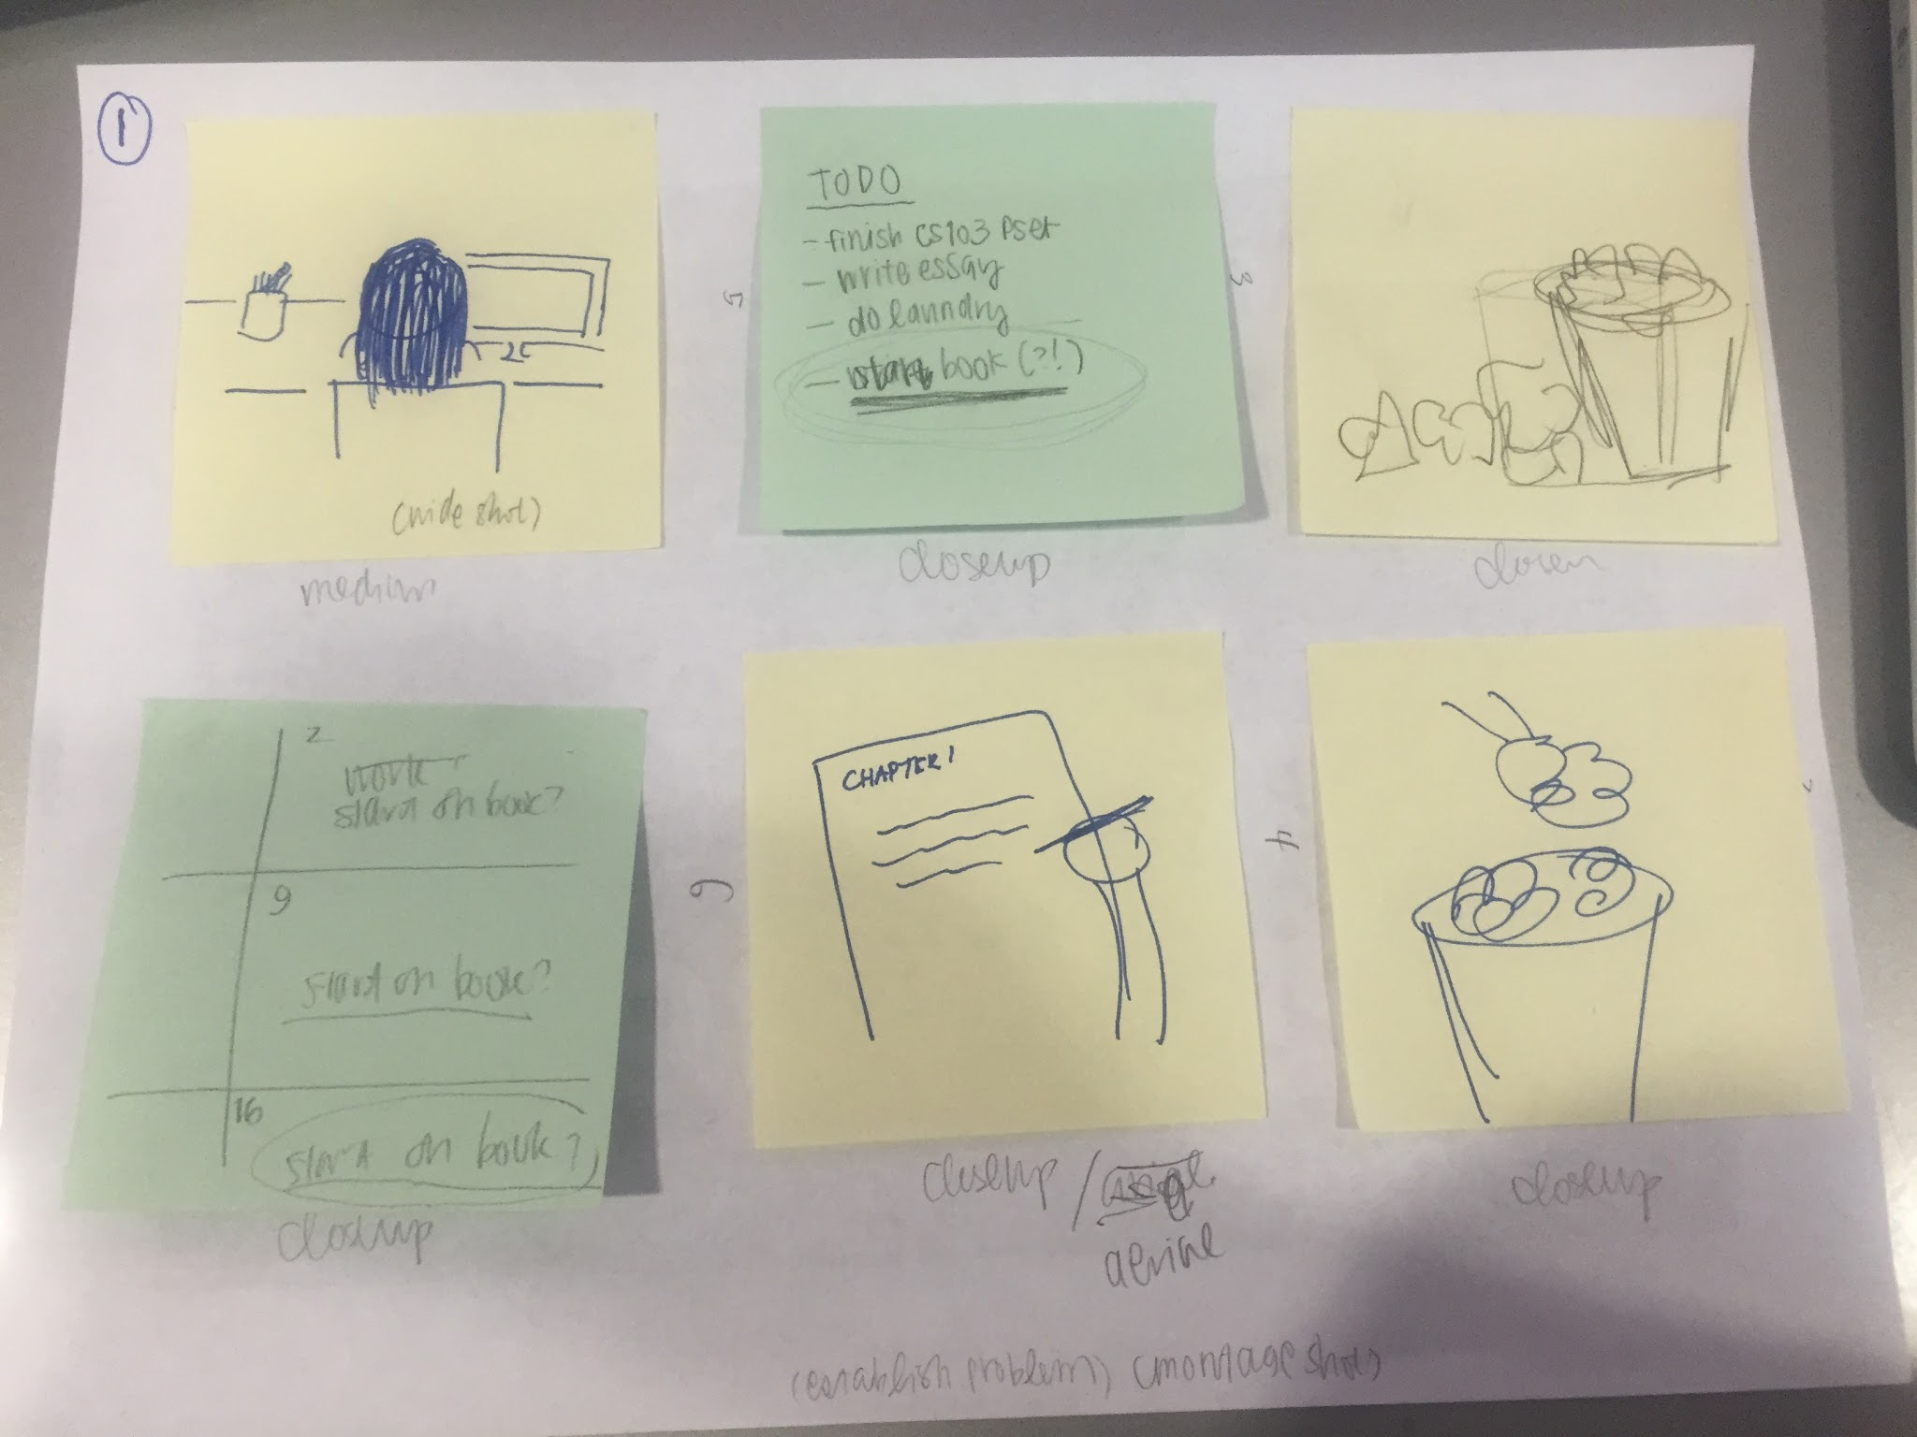
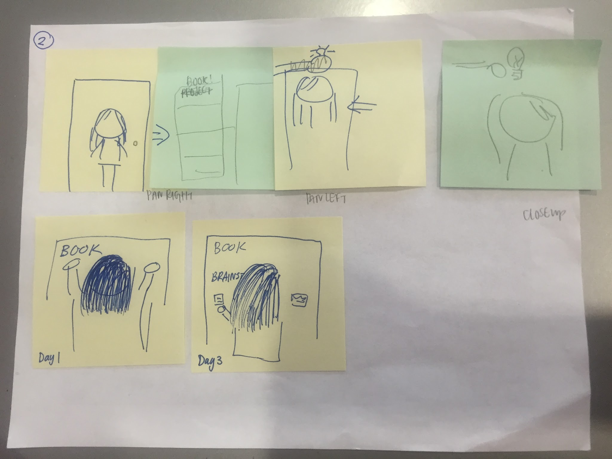
Story Board

Slide 5
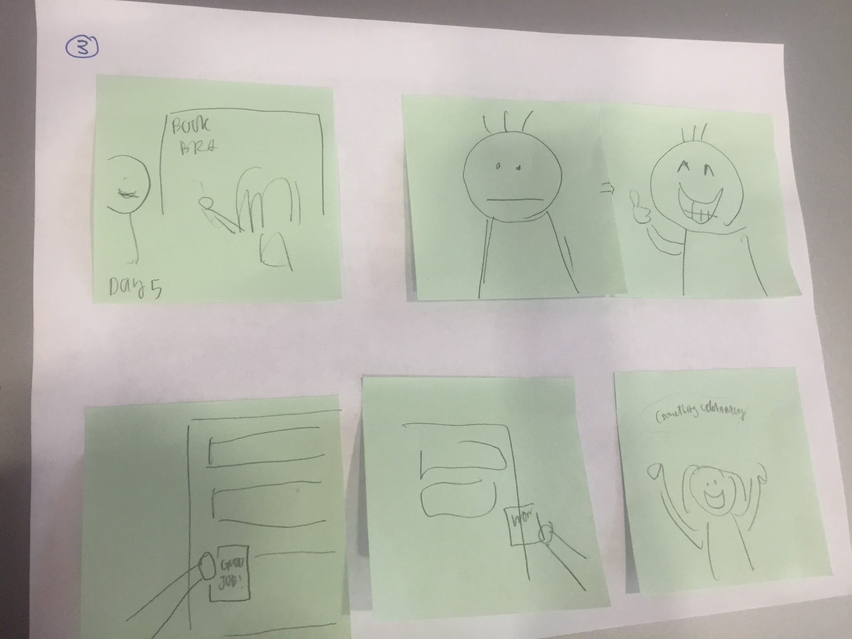
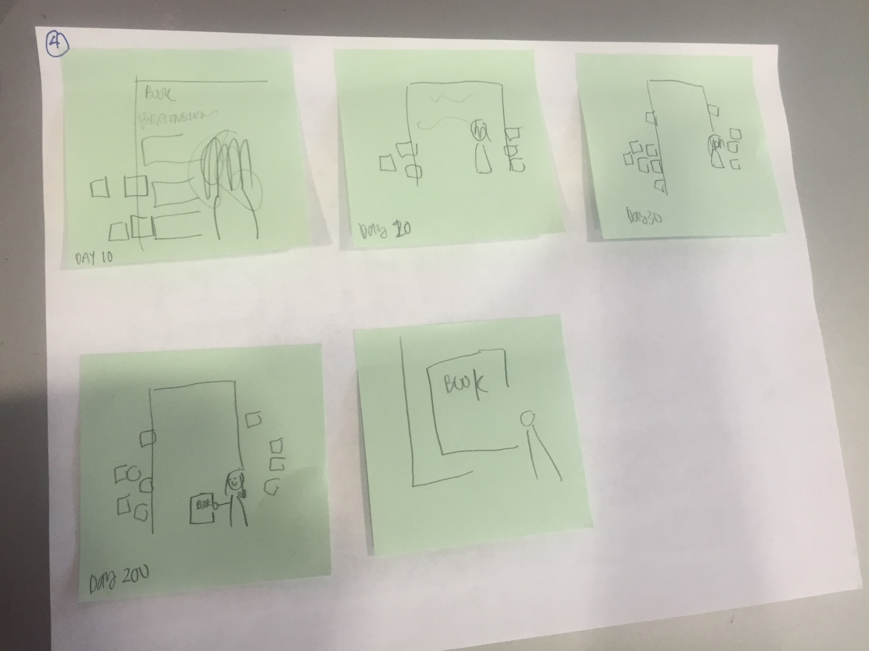
Story Board

Slide 6
Story Board

Slide 7
Video
Watch here!

