Slide 1
B-Sharp:
Medium Fidelity Prototype
Nathalia S., Marilyn H., Thu N., Jamison S.

Slide 2
Overview & Mission
Integrate mindfulness practices into rehearsal routines to help musicians stress less and focus more
“Get in tune with yourself”
Notes:
In a career path that demands perfection, a musician can sometimes be her worst inner critic, letting perfection impede her growth. Mindfulness practices are known to increase self-awareness and help individuals develop a sense of perspective to life’s challenges, allowing them to weather the ups and downs more easily. The goal of “B-Sharp” is to integrate such practices into a musician’s regular rehearsal routine, helping musicians stress less about perceived failure and allowing them focus on learning about themselves and their craft.

Slide 3
Tasks
Log Emotions
Track Progress
Engage with Community
Notes:
Log Emotions: Medium
Track Progrss: Simple
Engage with Community: Complex
Tasks virtually the same, changed community task to be simpler and clearer (Post and upvote only)
Our project focuses on three key tasks :
#1: Logging emotions at the start of rehearsals to build a practice of self check-ins and self-awareness
#2: Reviewing longitudinal data on these emotions through a dashboard to understand broader patterns about how inner state and mindset relates to musical development
#3: Sharing about musical successes and struggles anonymously through a Community Feed, meant to increase a sense of connectedness and shared experience in a profession that can be isolating.

Slide 4
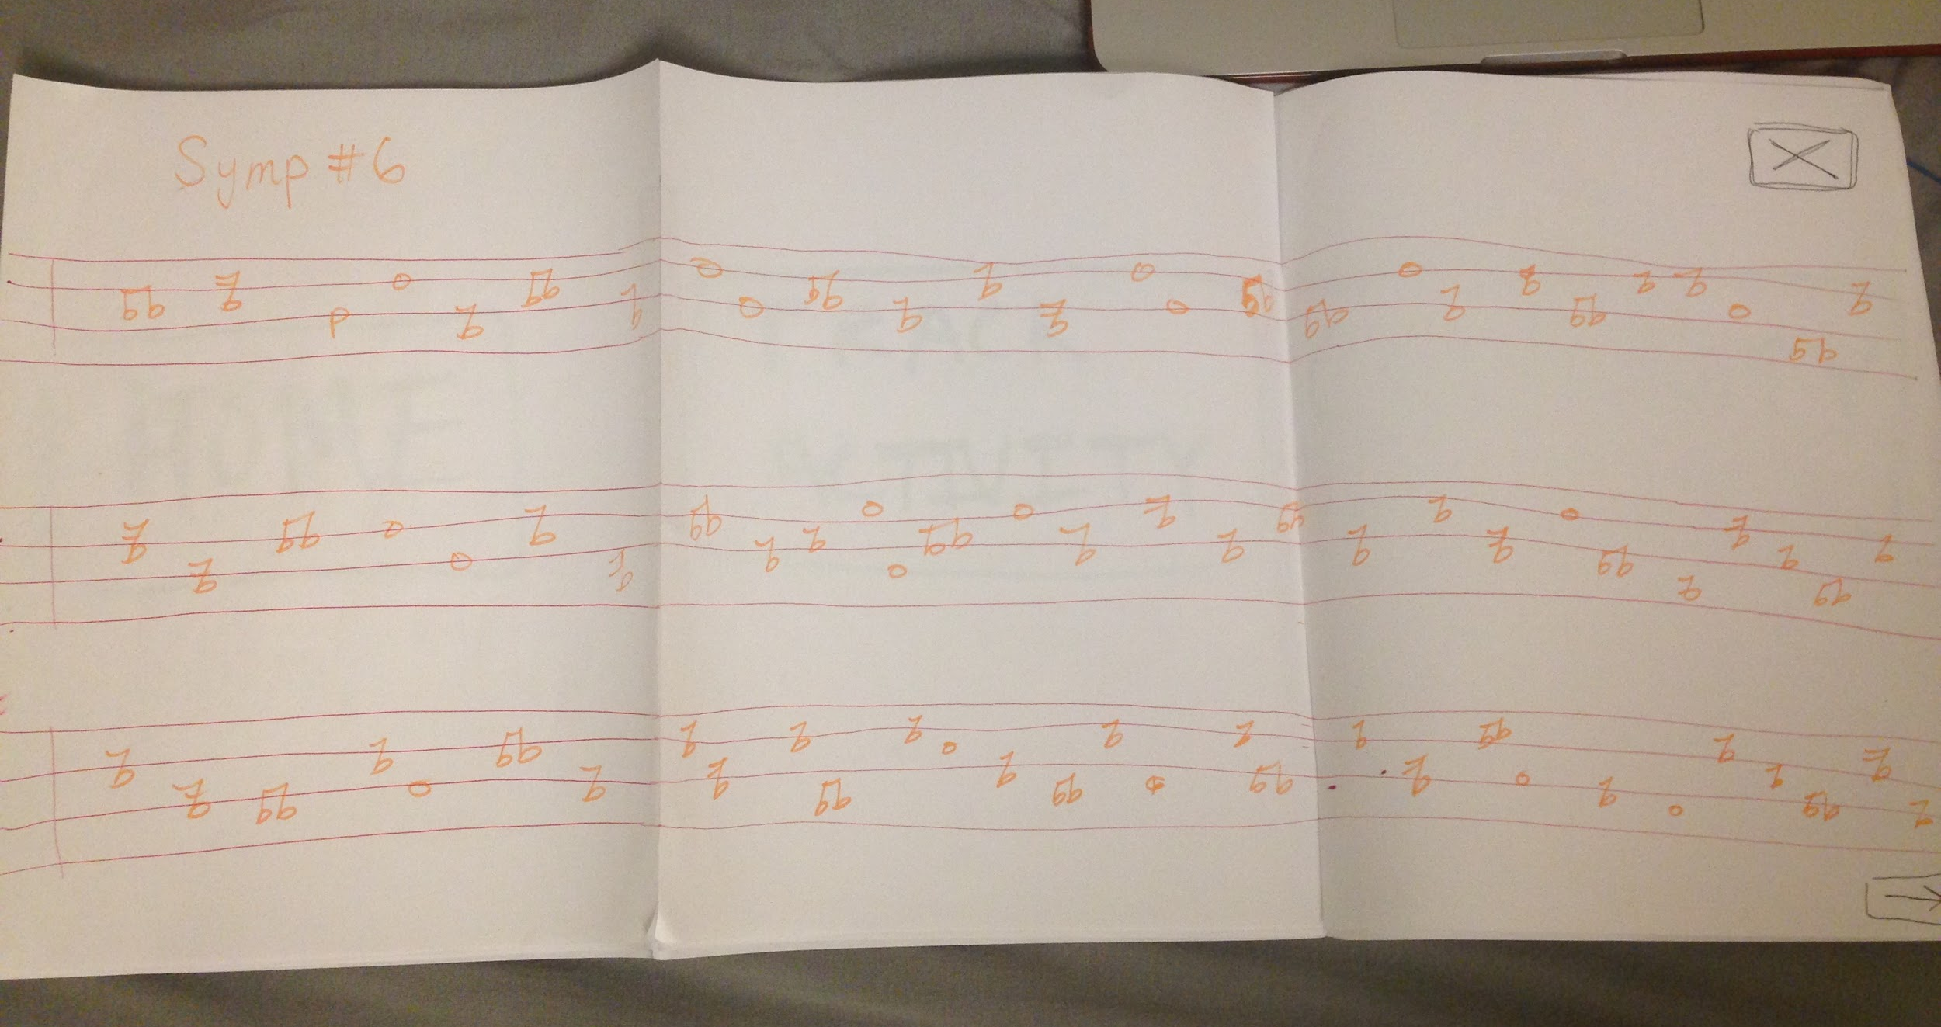
Design Changes
Digital Sheet Music --> iPad
Notes:
iPad switch: More realistic, easier to develop for. Translated pretty well (swipe instead of multiple screens)

Slide 5
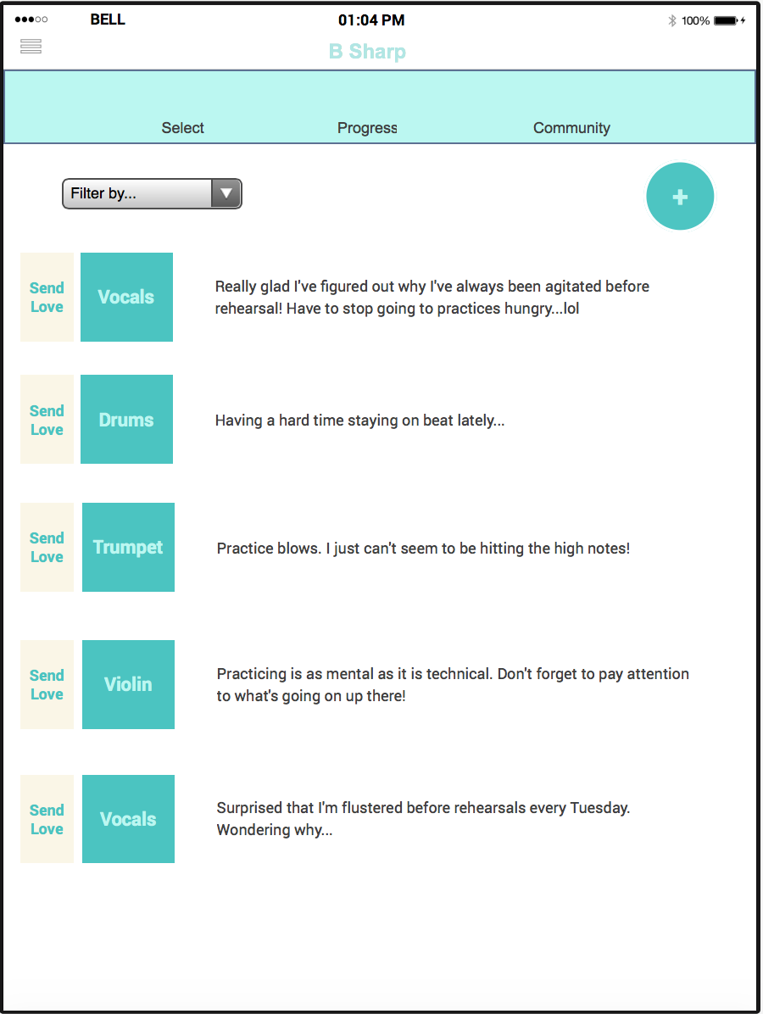
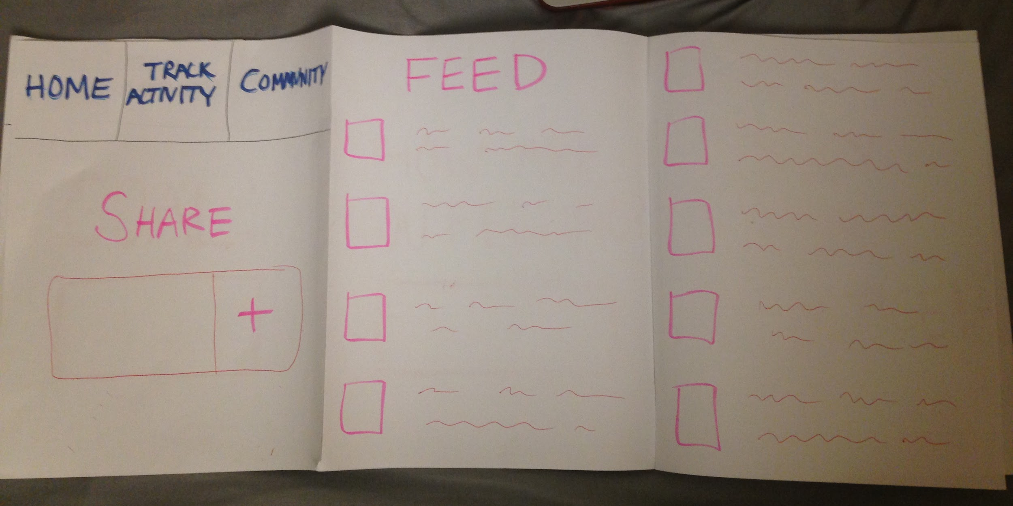
Design Changes
2. Community
Notes:
Community: Based on feedback, we changed this to be a simpler task that focused on empathy: simple posts with the ability to upvote (only) and to provide a filter by musician type

Slide 6
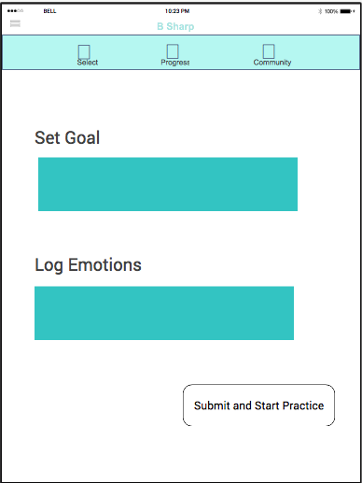
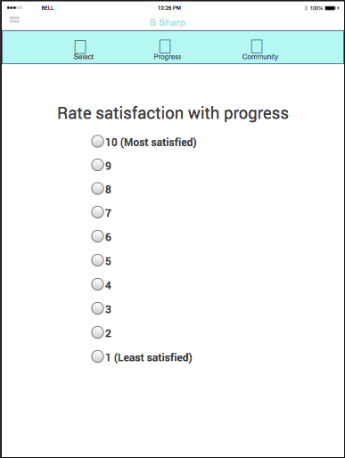
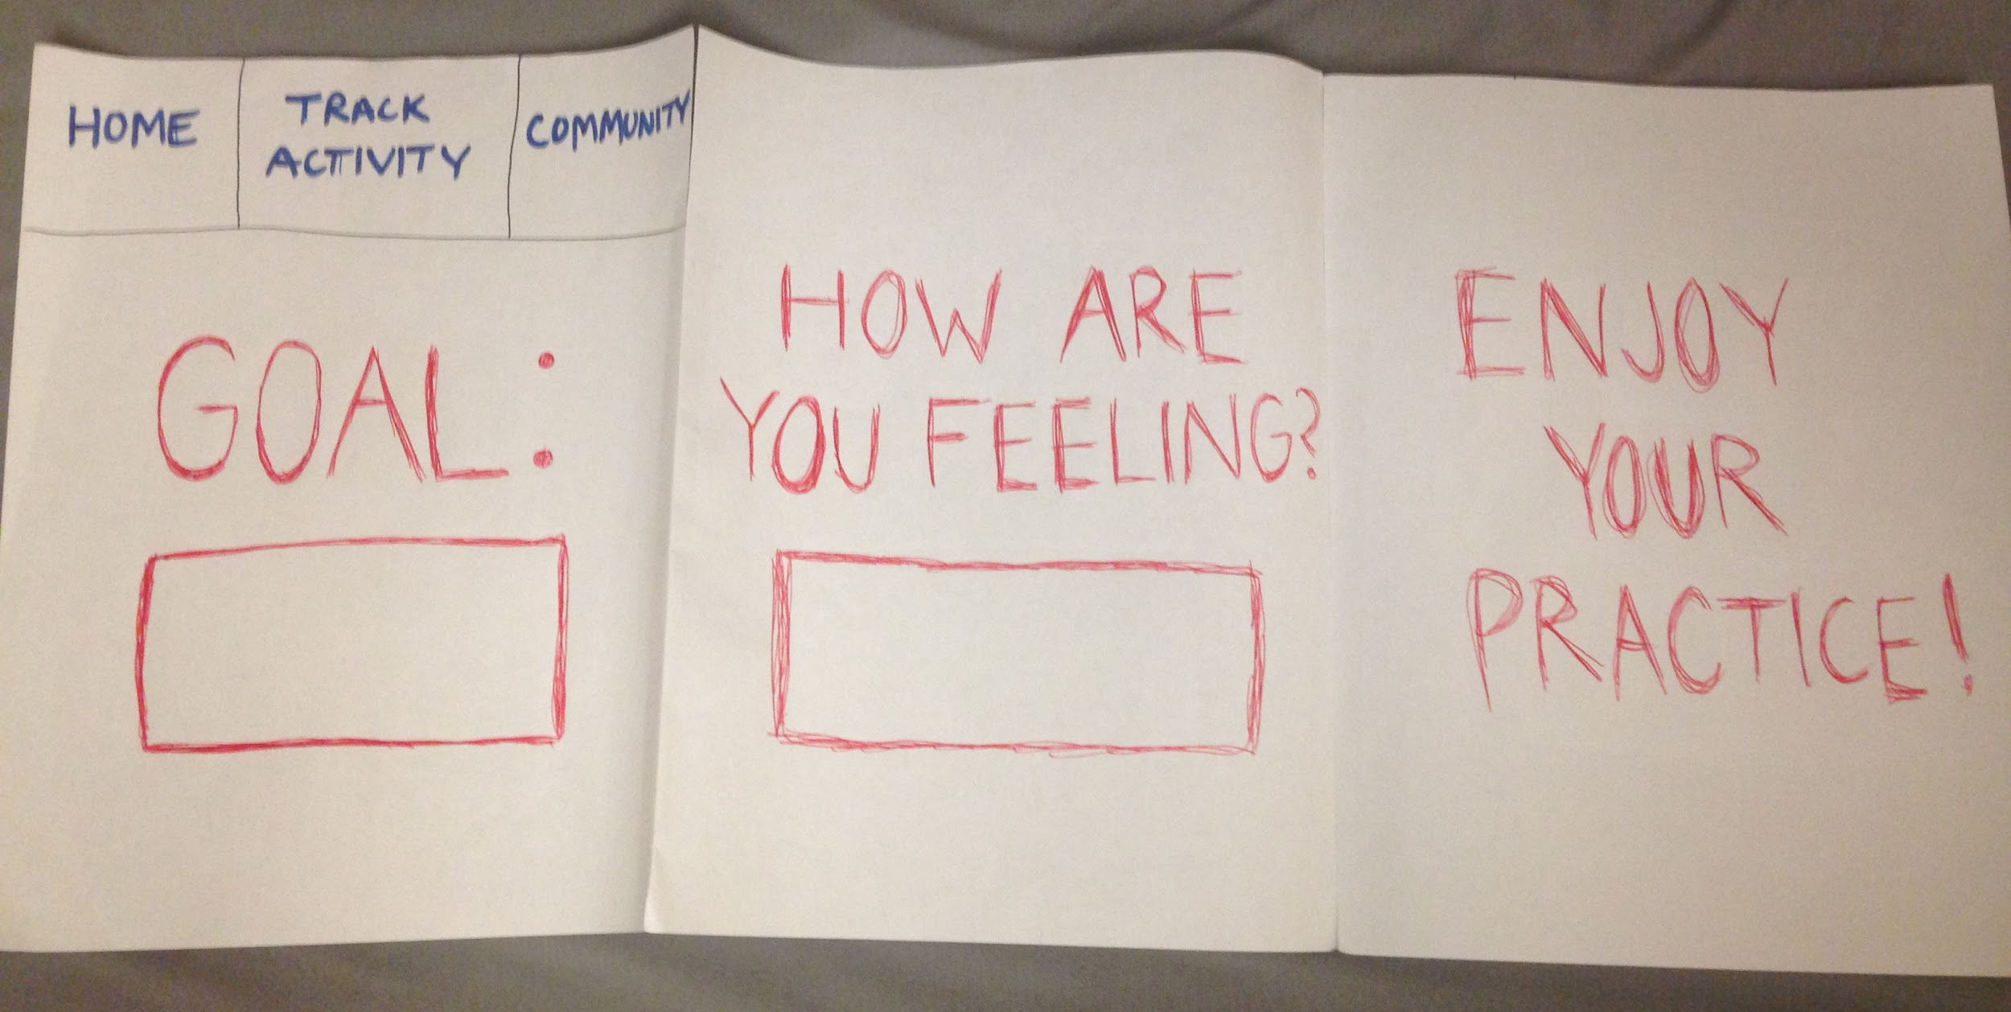
Revised Interface
3. Goal Setting
Notes:
Changed so it doesn’t pop up every single time → option to rehearse without goals
Option to log both emotions and goals - not pigeonholed into selecting one
More evaluative: Given option to rate satisfaction with rehearsal post practice

Slide 7
Task Flows

Slide 8
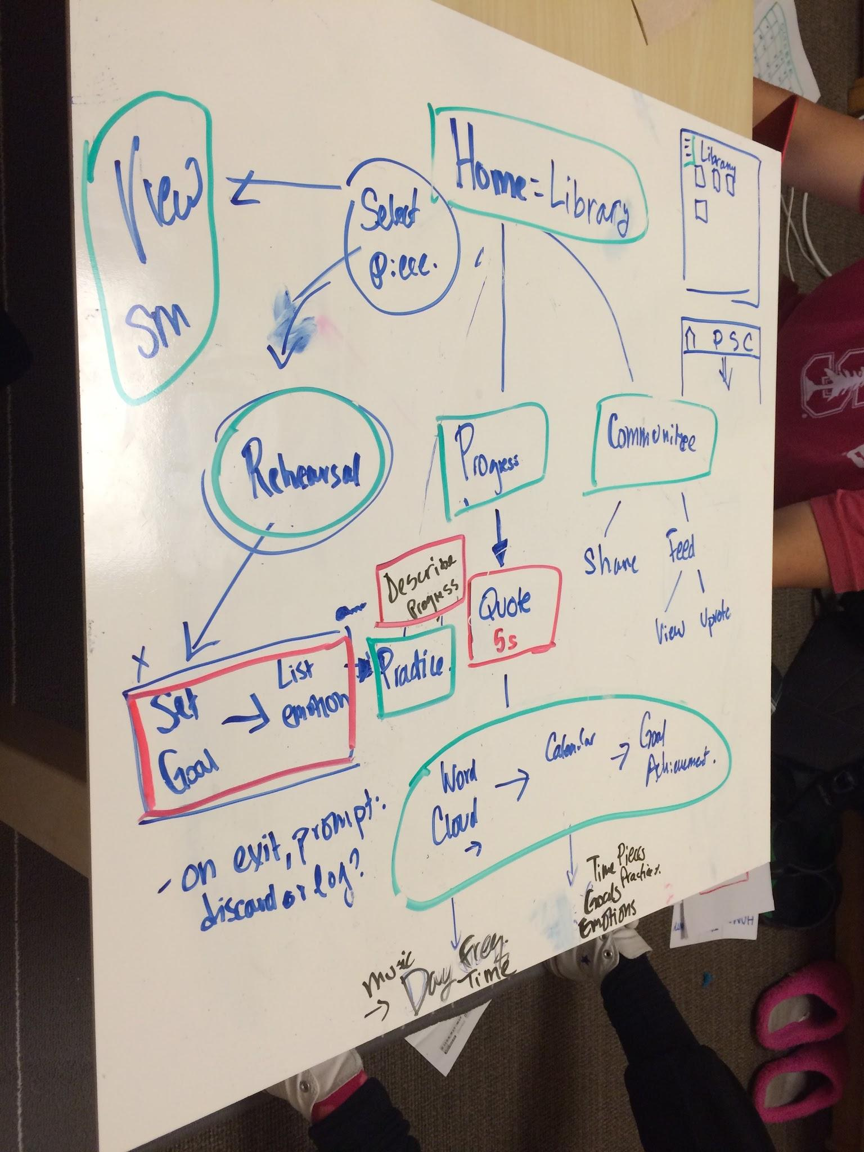
Overview

Slide 9
Task 1: Logging Emotions
Input Goal
Input Emotions
Submit and Start Practice
Finish Practice
Rate Satisfaction with Progress

Slide 10
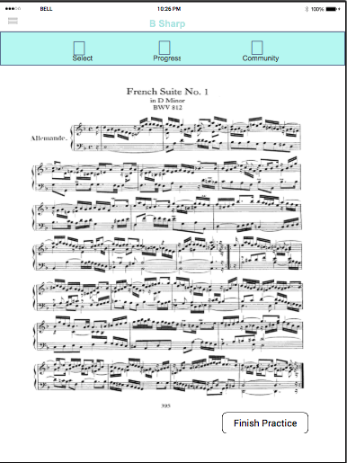
Task 1: Logging Emotions

Slide 11
Task 2: Tracking Progress
View Chart of Emotions
Motivational Quotes
Word Cloud of Emotions
Detailed breakdown
Calendar View

Slide 12
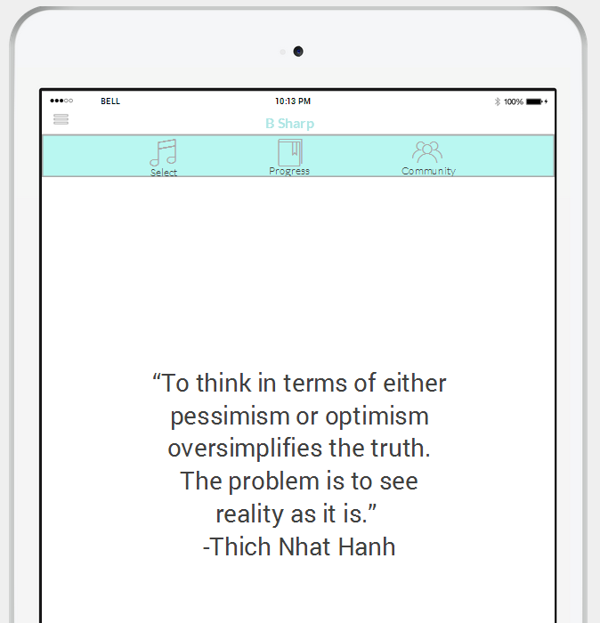
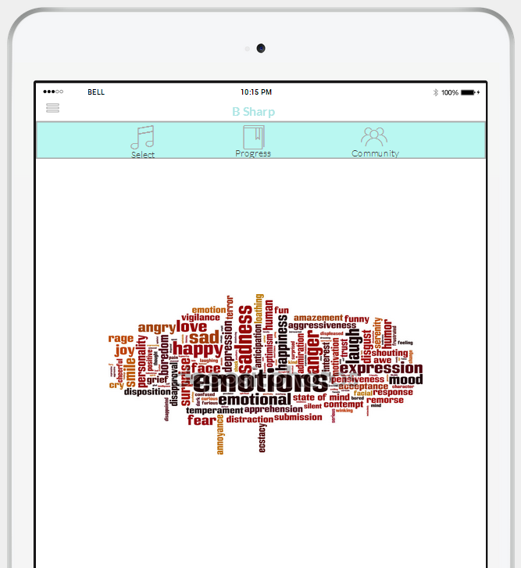
Task 2: Tracking Progress

Slide 13
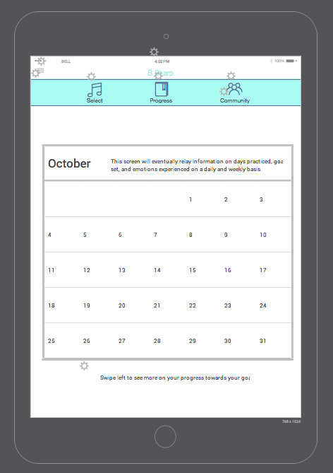
Task 2: Tracking Progress

Slide 14
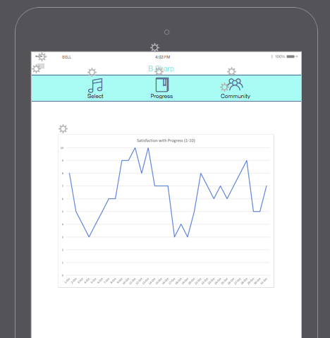
Task 2: Tracking Progress

Slide 15
Task 3: Engaging with Community
“Send Love” to another poster
Filter Posts
Add Post

Slide 16
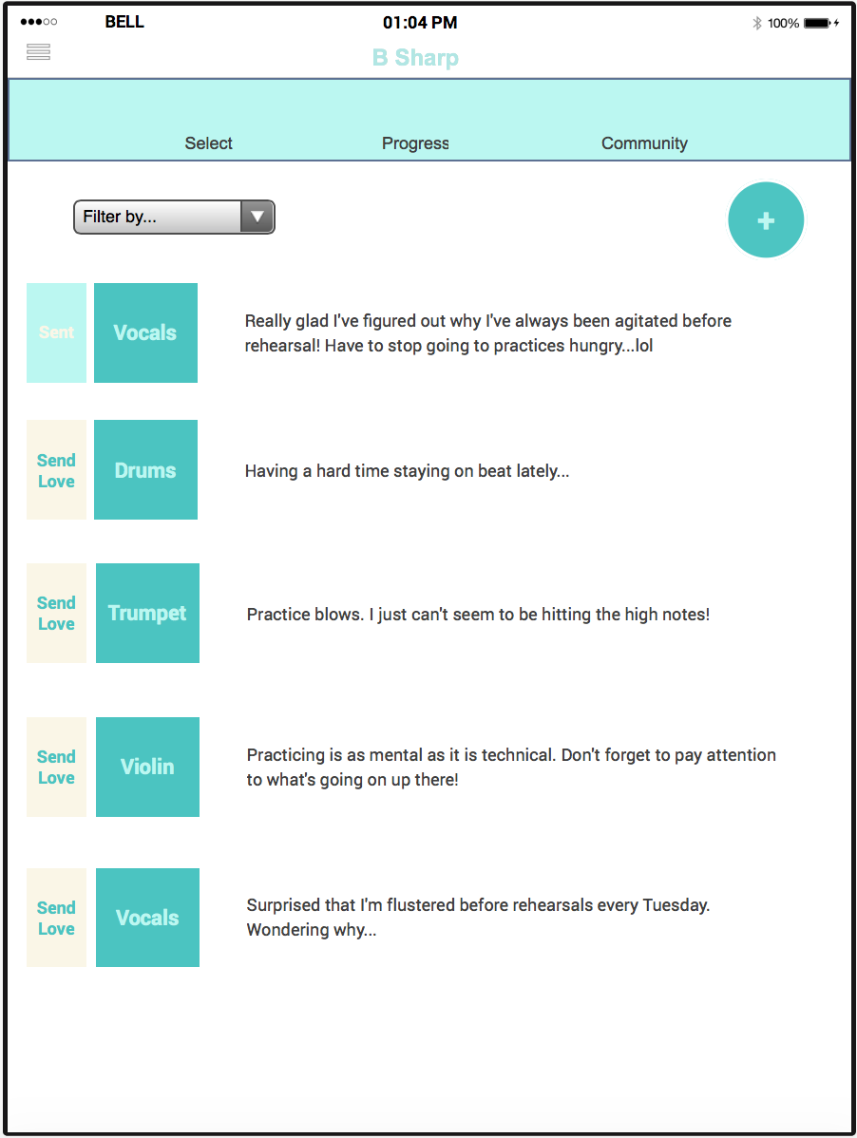
Task 3: Engaging with Community - “Send Love”

Slide 17
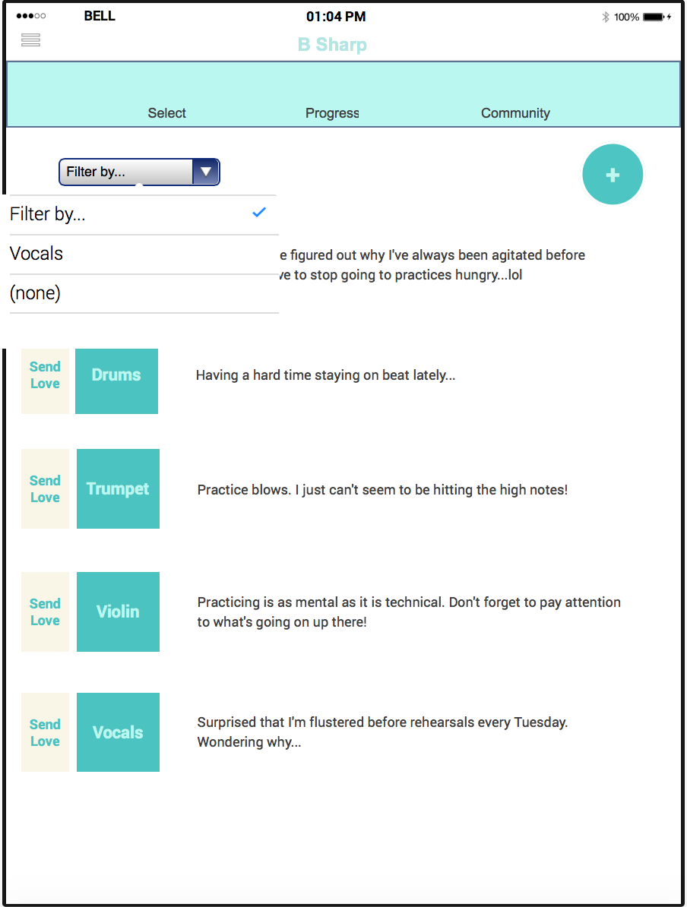
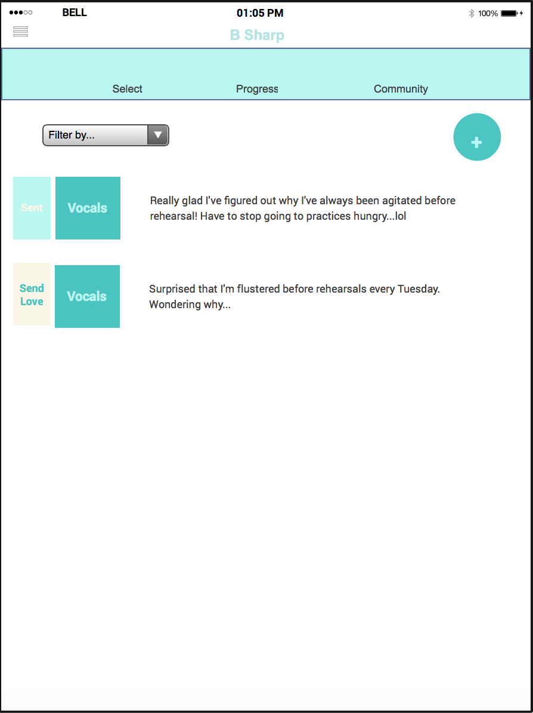
Task 3: Engaging with Community - Filter Posts

Slide 18
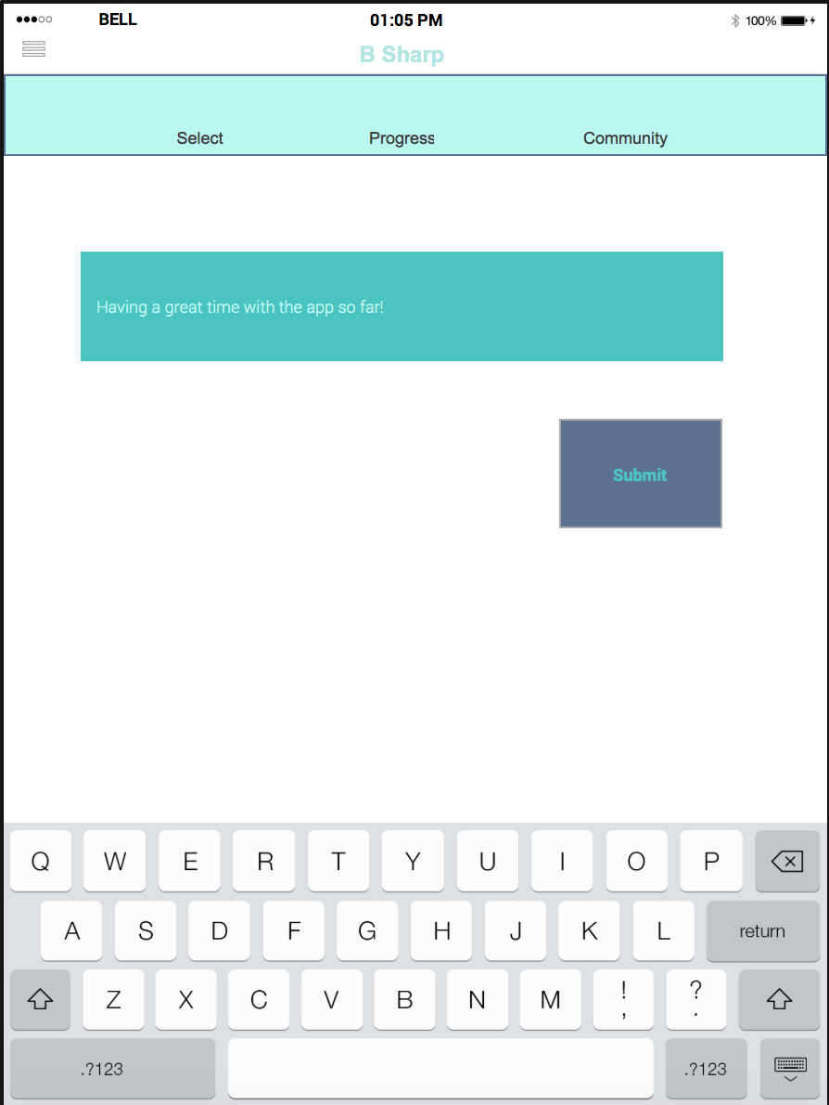
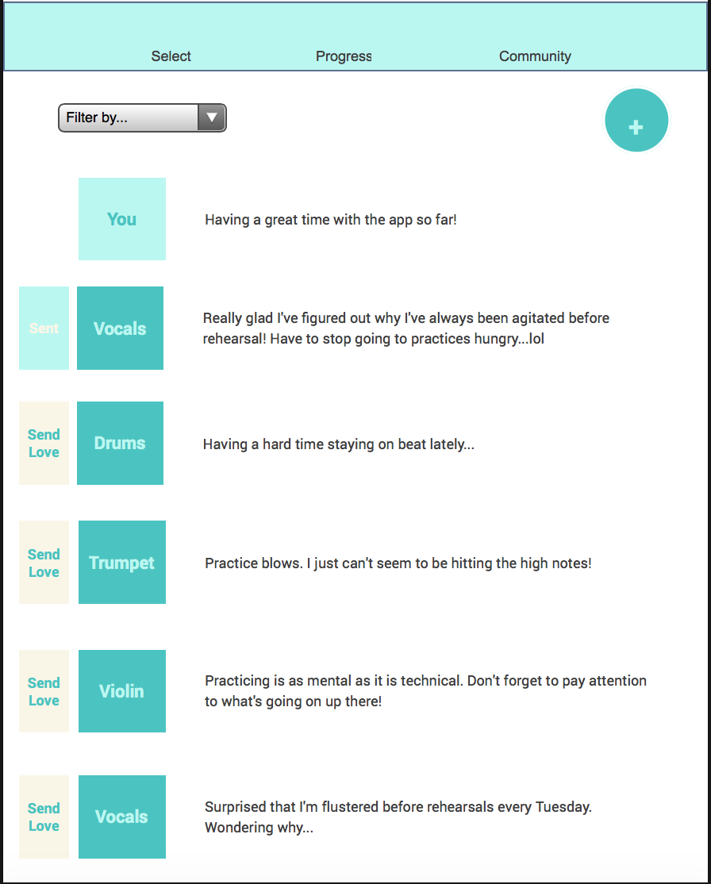
Task 3: Engaging with Community - Add Post

Slide 19
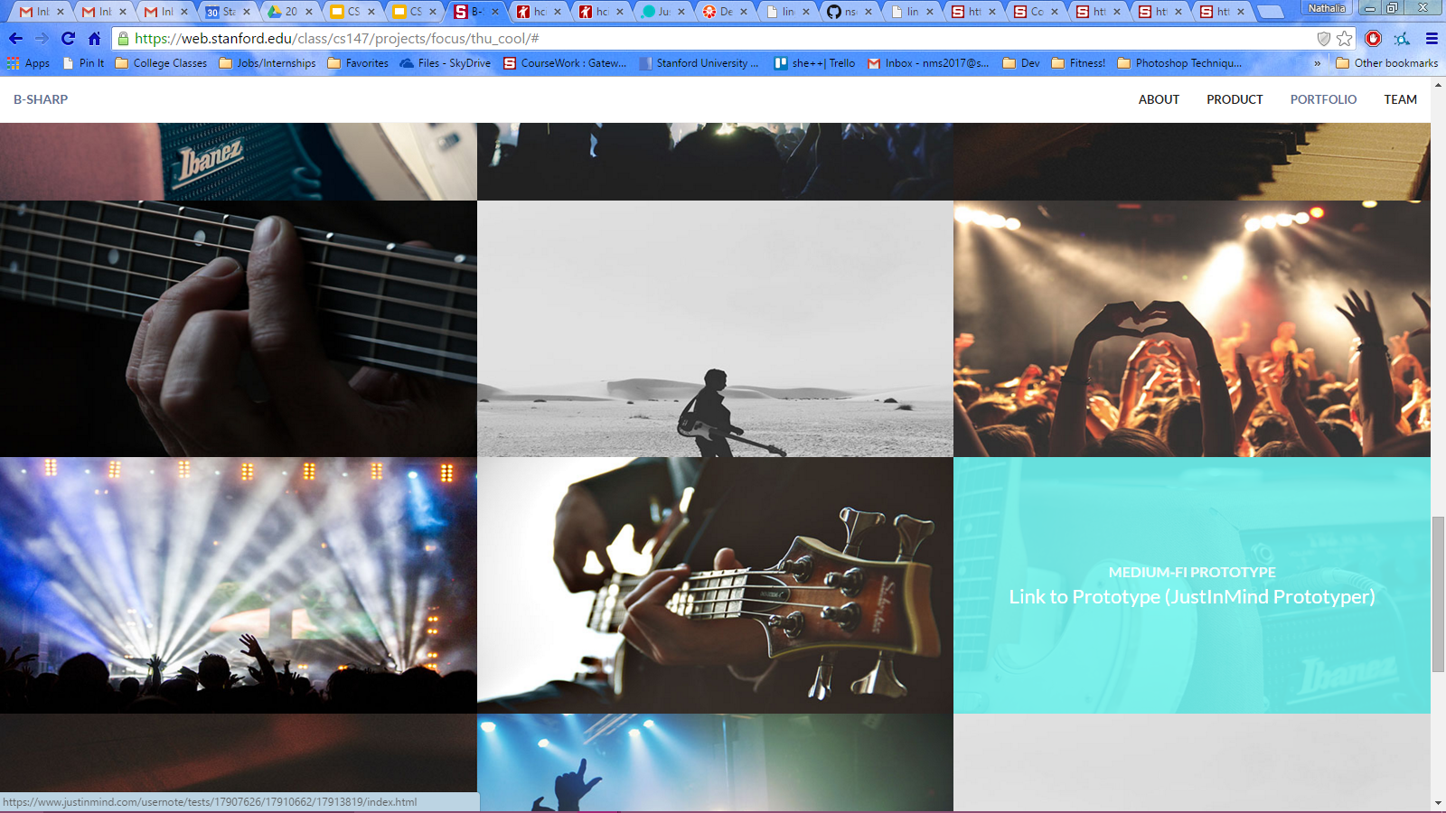
Prototype Overview
Tool Usefulness:
More realized interface
Reconsidered screen flow
Easily shareable
Highlight interactive areas
Tool Shortcomings
Team committing + publishing
Icons disappearing
Notes:
a. Prototyping Tools
■ What did you use? JustInMind Prototyper
■ How the tool helped: Helped us see what our interface would look like. Reconsidered flow when having to link each screen
■ How the tool did not help: Team members had to ‘unlock screens’ to work on them. Had to commit separately from publish → wish these processes were hooked up together

Slide 20
Prototype Overview
Limitations/Tradeoffs:
Community (too dynamic)
Select sheet music
Notes:
b. Limitations/tradeoffs of the current prototype (What was left out and why): Left out more of a robust community (currently only post/upvote) → time constraints, not something you can really prototype well with hard coded data (too dynamic)
Select sheet music - don’t want to worry about a feature that isn’t integral to our actual product (pretending it’s built in)

Slide 21
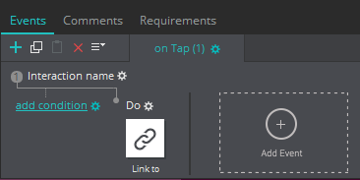
Prototype Overview
Wizard of Oz:
Action animations
Screen links via hotspots
“Post” in community
“Hard Coded"
Feed data
Progress Data
Notes:
c. Any Wizard of Oz techniques required to make it work: Action animations and link screens. Also option to “post” in community feed with dynamic text input and variable saving/presentation
d. Hand-coded features and why required: Hard coded social messages (to give feel of feed), progress data (to show what it could be like to use the app)

