Slide 1
POV & Experience Prototyping
Nathalia Scrimshaw, Thu Ngo, Marilyn Harris, Jamison Searles

Slide 2
Problem Domain: Musicians + Focus

Slide 3
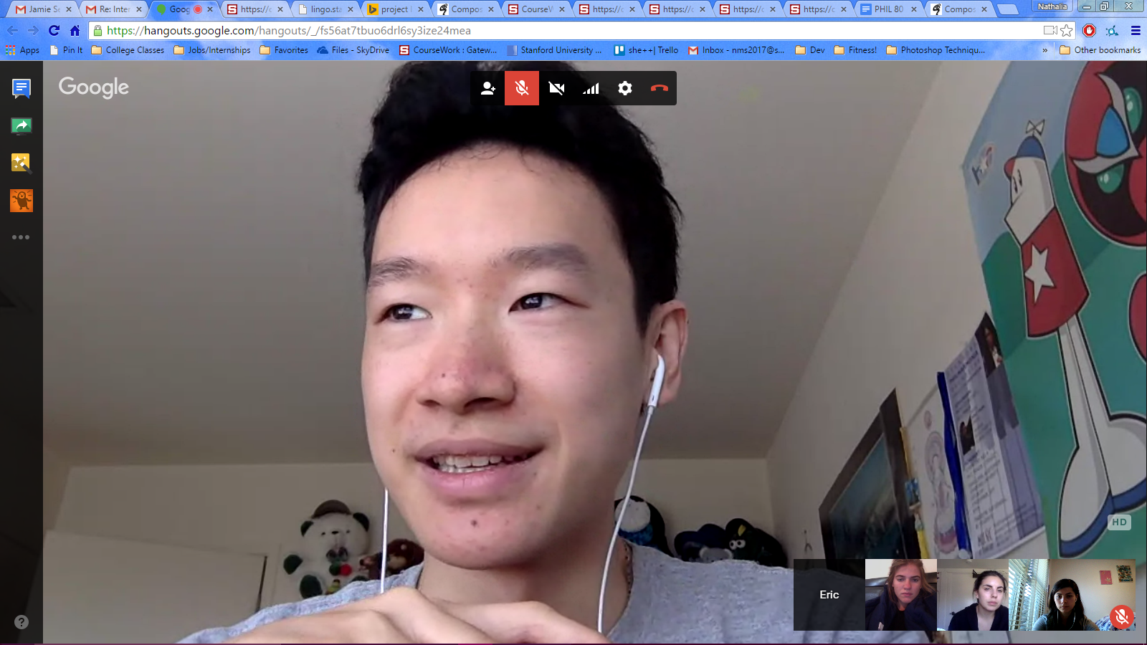
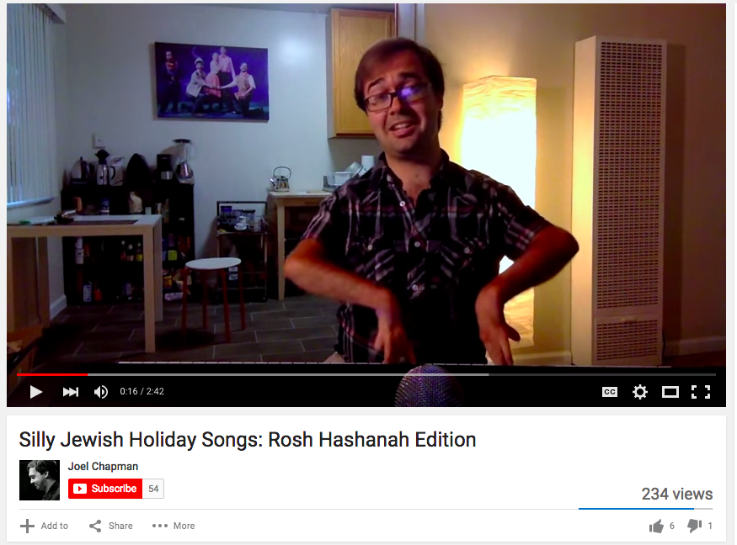
Needfinding Cont.
Eric Tran: Classical Pianist and Composer
Joel Chapman: Conductor, Singer, Composer

Slide 4
What we learned
Eric:
Mindset and validation from your community help you be emotionally resilient as an artist.
Joel:
When your body is your instrument, failure feels more personal and emotions have a greater impact on your performance.

Slide 5
Initial POV
We met Brian
who needs more gigs
because he wants to establish his career
It would be game changing if...
he could easily connect with other aspiring musicians

Slide 6
Revised POV
We met Brian
who needs exposure
because he wants to build his network
It would be game changing if…
he had access to marketing resources for musicians

Slide 7
How Might We…
Optimize a musician’s most limited resources, time and money?

Slide 8
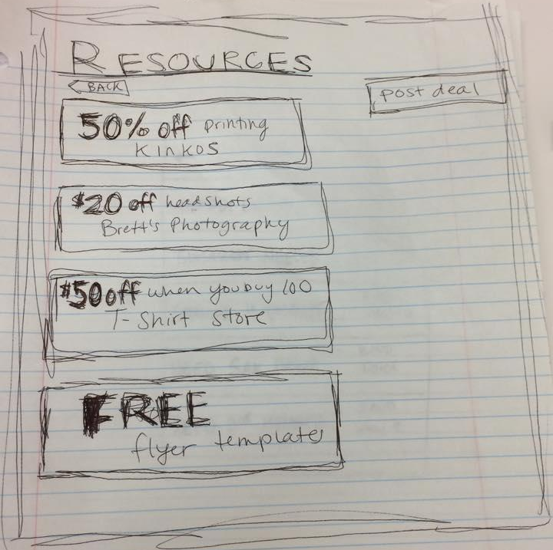
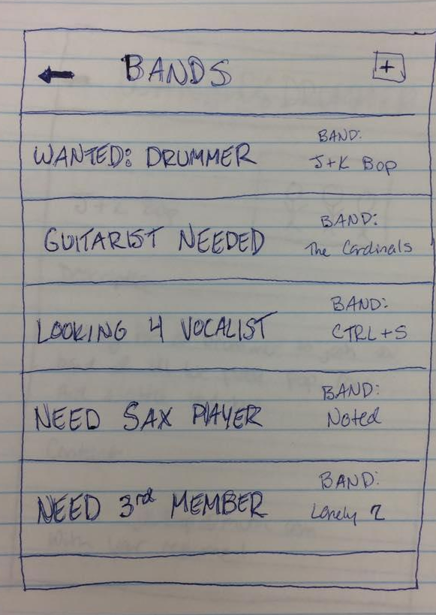
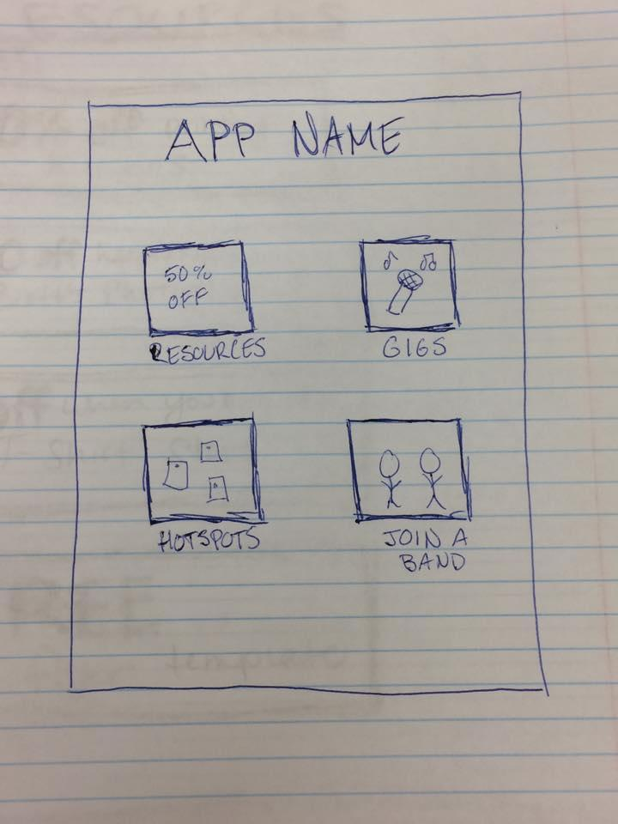
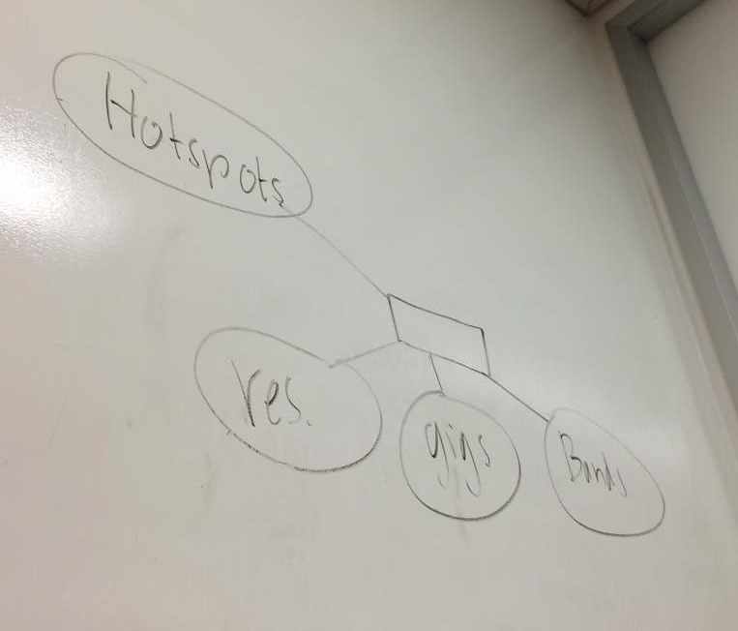
Prototype:
Exposure
Notes:
Tested with Jamie, aspiring guitarist, singer, and songwriter (pictured in slide)
Liked:
how it would help musicians build network
“Craigslist feel” of “Resources” feature
Possible Issues:
“Resources” page might look too much like ads
Many musicians don’t have trouble finding gigs
There aren’t many gigs (supply/demand issue)
Suggestions:
Feature to connect musicians with students in need of lessons
Feature to share music

Slide 9
Exposure: Jamie’s Feedback
What worked:
Need for network building
Craigslist feel
What didn’t:
“Resources” feature might look like ads
Many musicians prefer brand building by word of mouth
Suggestions:
Music sharing
Feature to connect with students with instructors

Slide 10
Revised POV
We met Amanda
who needs places to rehearse
because she practices in her car
It would be game changing if…
proprietors opened their spaces to her

Slide 11
How Might We…
Help aspiring musicians connect to people in similar situations?

Slide 12
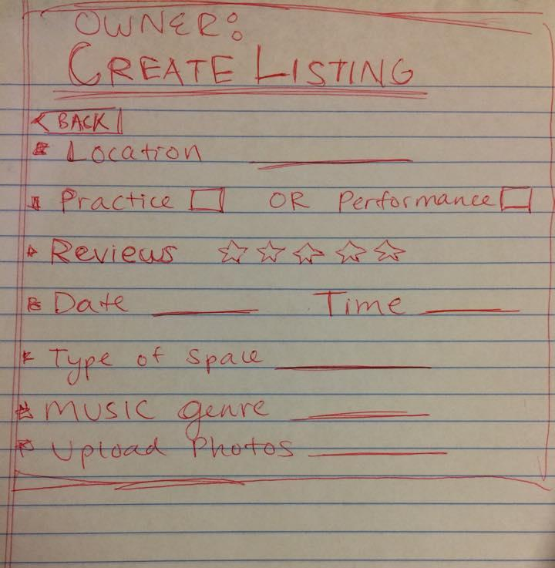
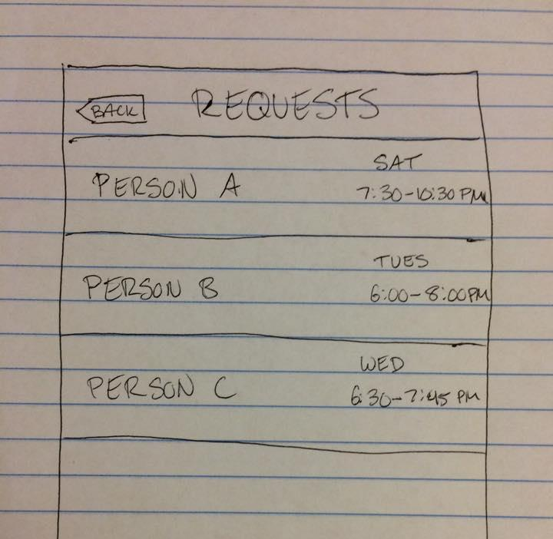
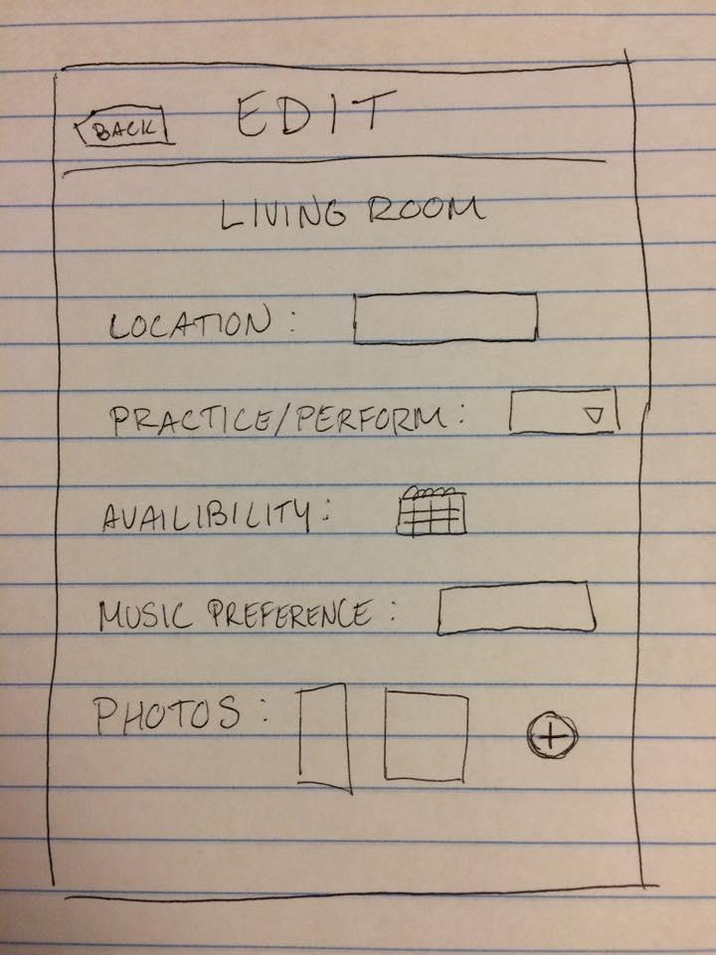
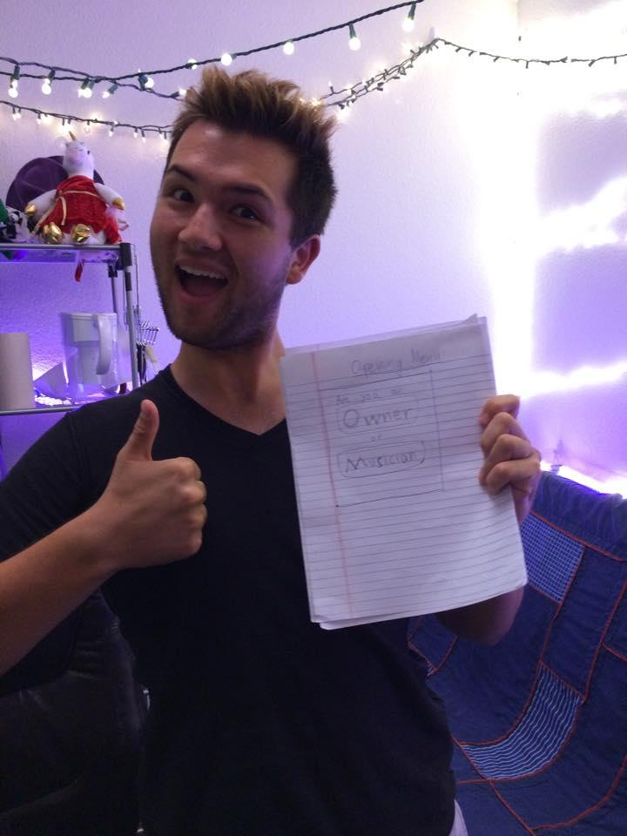
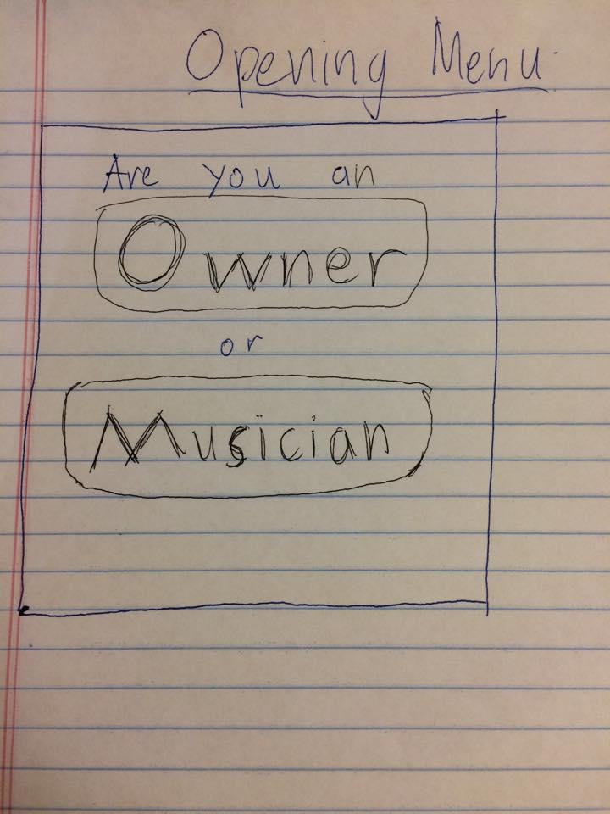
Prototype: Practice Space
Main Menu
Musician
Owner
Search
Create Listing
Manage Listings
View Requests
Listings
Leave Review
Apply
Approved
Rejected
Leave Review
Contact Owner
Notified
Notes:
value proposition?
airbnb for perf. spaces. musician/renter
list space, criteria, charge/free?
Kevin’s reaction: meet ppl in local area who appreciate musicians.
potential networking value → super cool to meet chill people.
general UI comments, overall concept good. little weird with review system
bad reviews could hurt you?
Really liked the concept, wanted to know if it was being made.
Identified with the struggle of having to find practice spaces for his band on campus.

Slide 13
Practice Space: Kevin’s Feedback
What worked:
Loved the concept + validated a need
“What stage is this in?!”
Potential networking tool
What didn’t:
Negative reviews may impact musicians
Some unclear UI

Slide 14
Revised POV
We met Eric
who has strong mindfulness skills
because he’s learned how to face failure
It would be game changing if…
we could help build this mindset in the many other musicians who struggle in this area

Slide 15
How Might We…
Help musicians build resilience?

Slide 16
The Mindful Musician
Goal: Tailor existing mindfulness practices to help musicians develop and embrace an awareness of change and connect them to a community that can remind you on an off-day, you’re not alone.

Slide 17
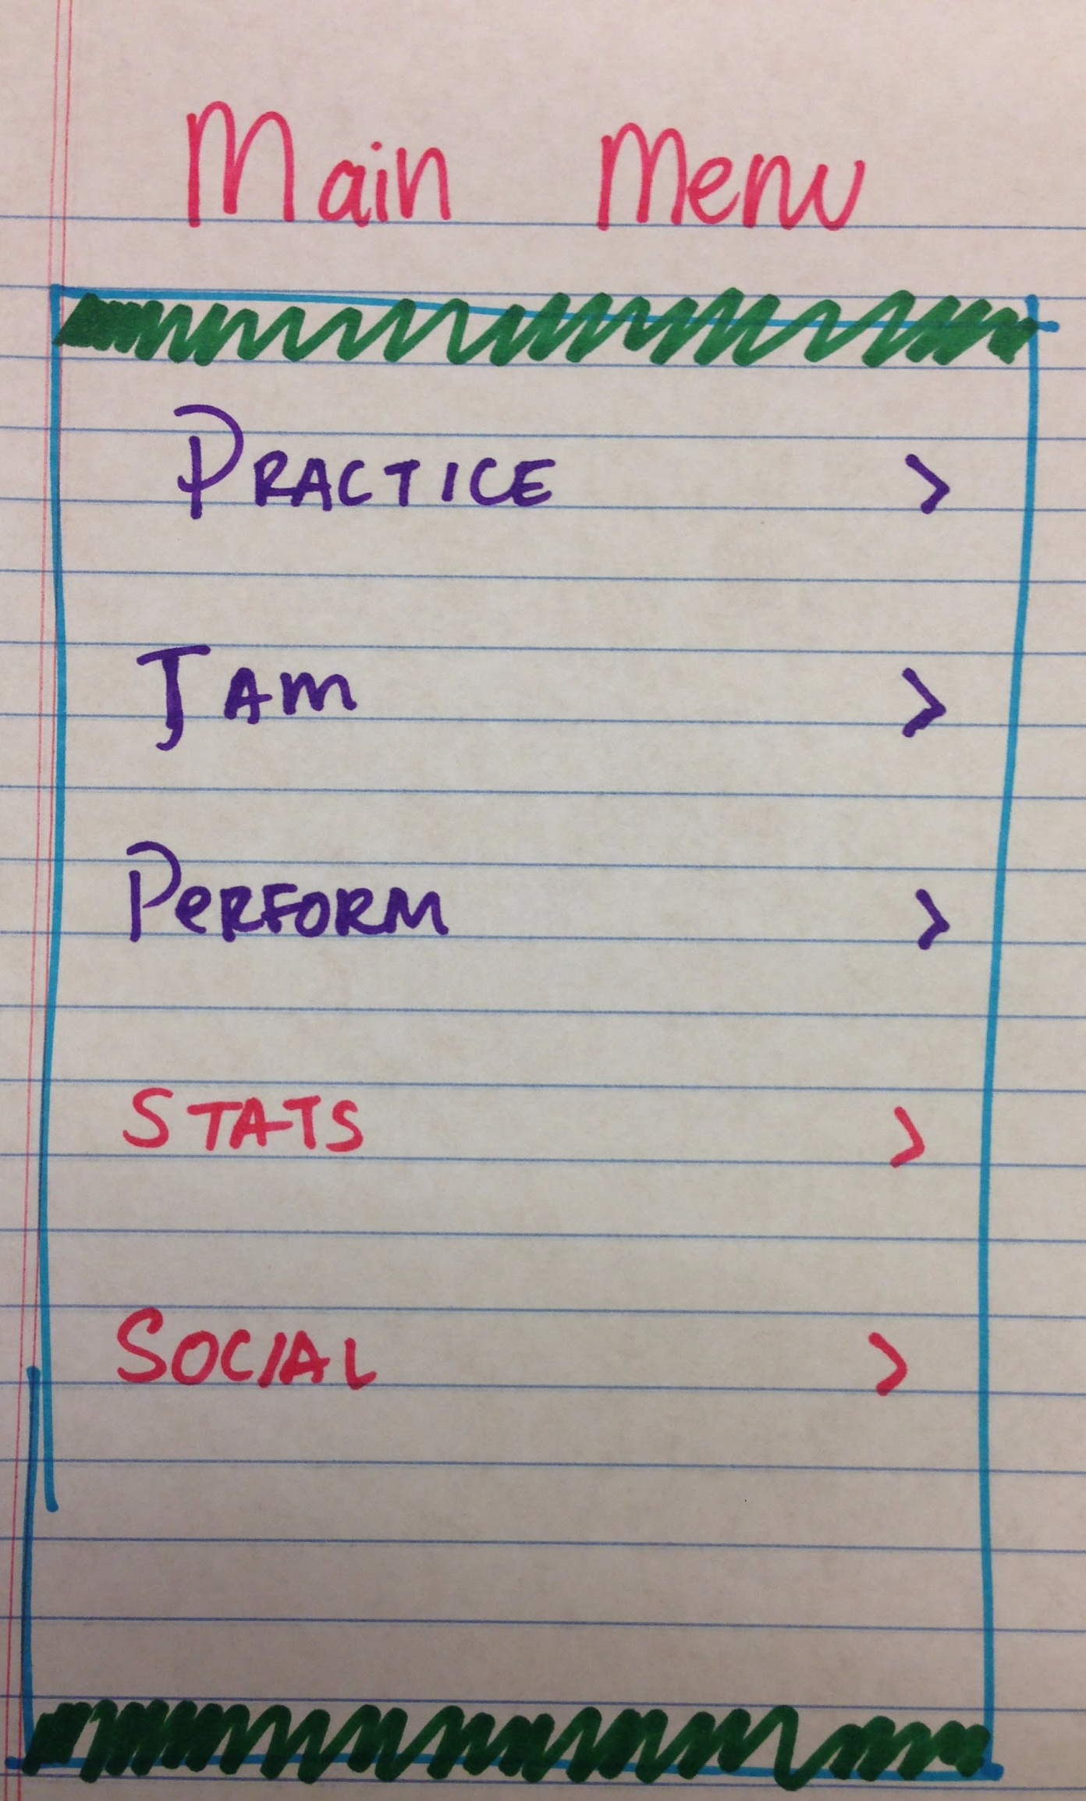
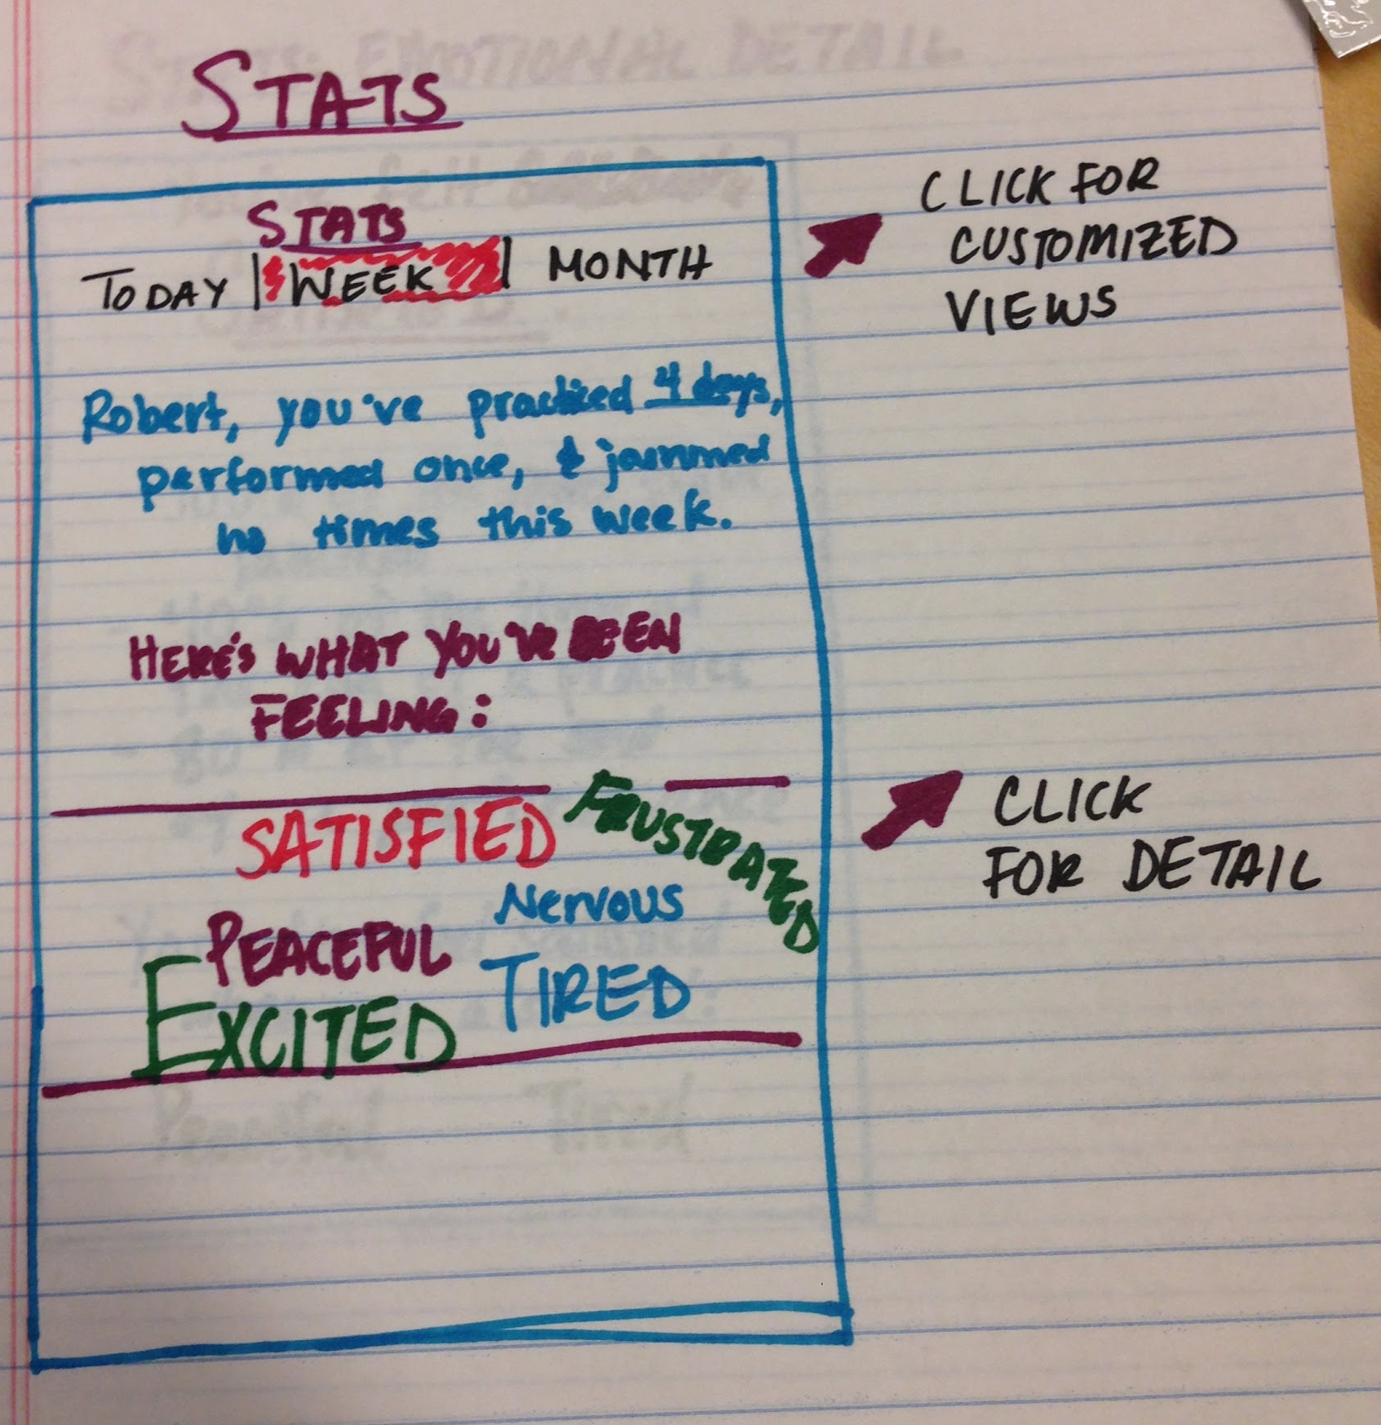
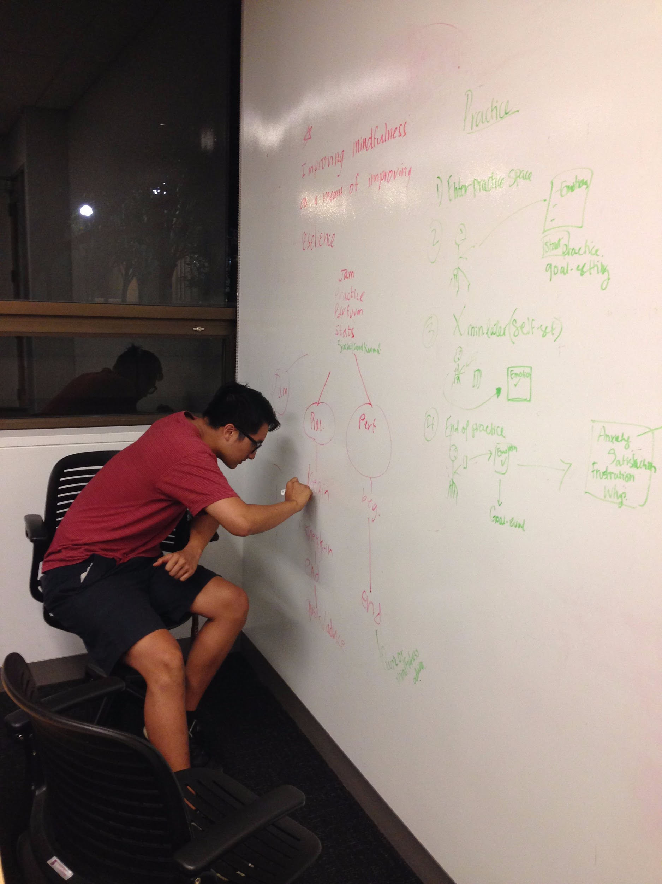
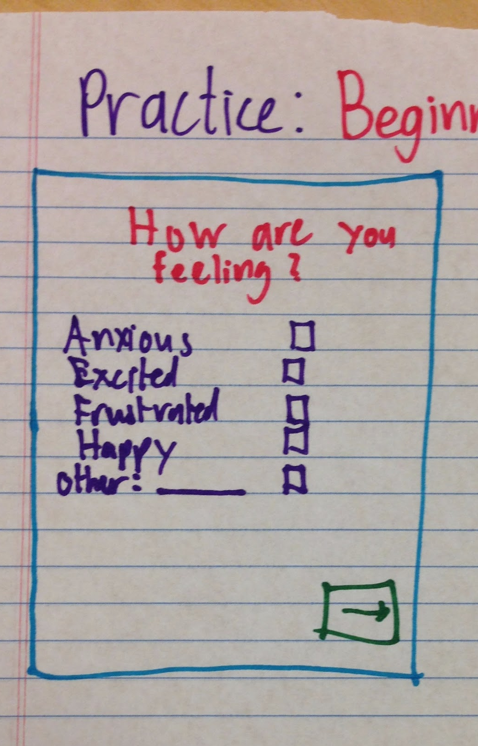
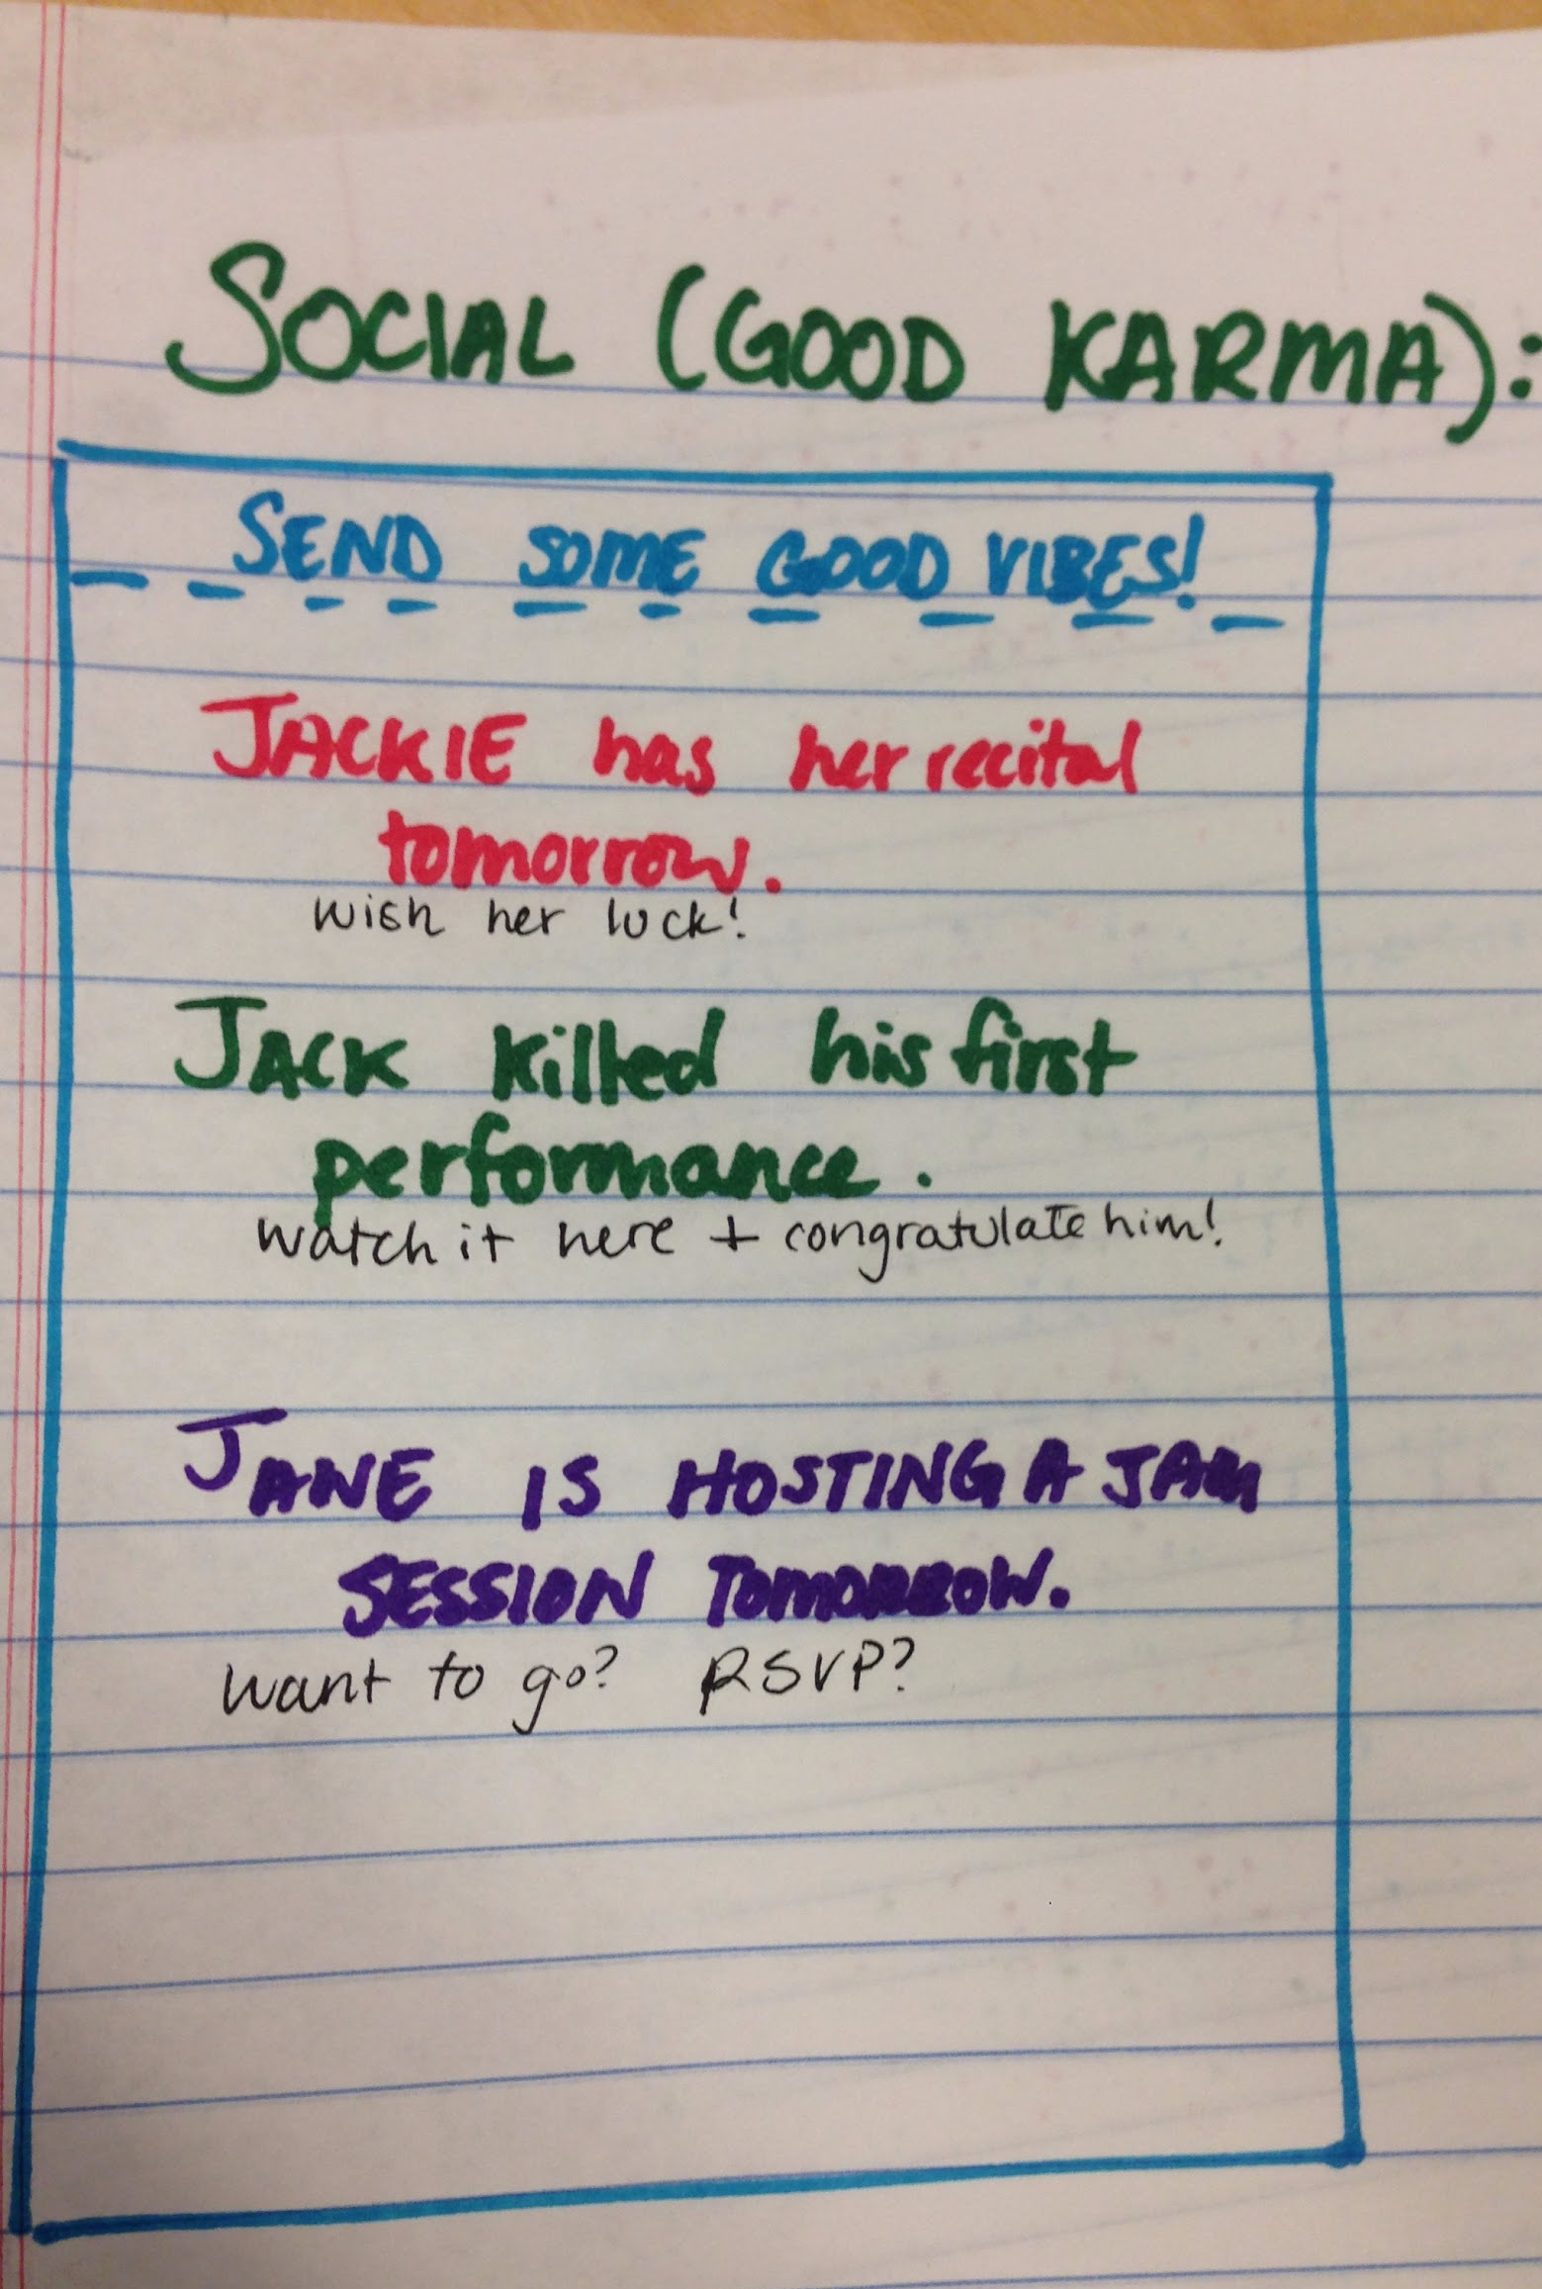
Prototype: The Mindful Musician

Slide 18
Mindful Musician: Joel’s Feedback
What Worked
Need
Form
Social: Yikyak for musicians?
What Didn’t
Jam/Performance Functions
Bring more humor into app
Suggestions
Target users: Highly technical, intermediate to advanced musicians, young musicians
Clarify purpose and content of summaries/statistics
Value from not just monitoring emotions, but all non-practice activities
Notes:
Need: Mindfulness important for a musician, get musicians to think about daily actions outside of practicing
Form: iphone is natural during rehearsal

Slide 19
Questions?

